Slide 1
LSI-VC-15
2024
Agency Updates: ESA
Ferran Gascon, ESA
Agenda Item 2.6
LSI-VC-15 2024, Tokyo
3rd - 5th April 2024

Slide 2
Overview
Overview of ESA Missions
Update on CEOS-ARD at ESA
Update on ESA Collections
Publications
Copernicus Data Access

Slide 3
Reprocessing on-going
Reprocessing completed
ESA UNCLASSIFIED – For Official Use
European Space Agency
Notes:
D/EOP has three main lines of activities: Earth Science, Copernicus and Meteorology

Slide 4
Status of ESA CEOS-ARD Products
Mission | Product | PFS | Status | Availability Date
Sentinel-2 | L2A | SR | ✅ | January 2022
PROBA-V | Collection 2 | SR | ✅ | March 2023
Sentinel-2 | L2H | SR | Under Development | 2023 (pilot product), TBD (operational product)
Sentinel-2 | L2F | SR | Under Development | 2023 (pilot product), TBD (operational product)
Sentinel-2 | L2A | AR | Under Development | TBD
Sentinel-1 | NRB / ORB | NRB / ORB | Under Development | TBD
Sentinel-3 | SYN | SR | Under Development | TBD
ERS SAR | TBC | NRB | Under Development | TBD
ERS ATSR | TBC | LST | Under Development | 2024
Envisat ASAR | TBC | NRB | Under Development | TBD
Envisat MERIS | TBC | SR | Under Development | 2024
CHIME | L2A | SR | Under Development | 2029
CHIME | L2H/L2F | SR | Under Development | 2029 (pilot product), TBD (operational product)
LSTM | L2A | ST, SR | Under Development | 2029
LSTM | L2H/L2F | ST, SR | Under Development | TBD
ROSE-L | TBD | NRB…TBC | Under Development | TBD

Slide 5
ESA Collections
ERS: https://earth.esa.int/eogateway/missions/ers/data
Envisat: https://earth.esa.int/eogateway/missions/envisat/data
Proba-1: https://earth.esa.int/eogateway/missions/proba-1/data
GOCE: https://earth.esa.int/eogateway/missions/goce/data
SMOS: https://earth.esa.int/eogateway/missions/smos/data
CryoSat: https://earth.esa.int/eogateway/missions/cryosat/data
Proba-V: https://earth.esa.int/eogateway/missions/proba-v/data
Aeolus: https://earth.esa.int/eogateway/missions/aeolus/data
Copernicus Sentinel-2: https://sentinels.copernicus.eu/web/sentinel/technical-guides/sentinel-2-msi/copernicus-sentinel-2-collection-1-availability-status
Copernicus Sentinel-5P: https://sentinels.copernicus.eu/web/sentinel/-/copernicus-sentinel-5-precursor-full-mission-reprocessed-datasets-further-products-release

Slide 6
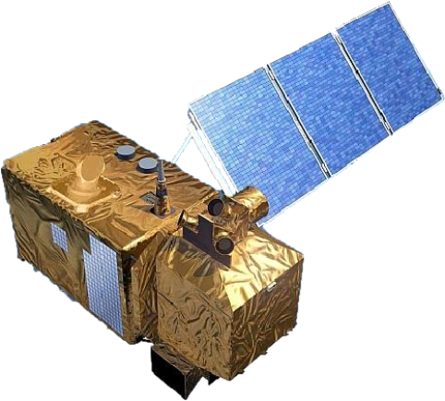
Copernicus Sentinel-2
https://dataspace.copernicus.eu
https://sentinels.copernicus.eu/web/sentinel/technical-guides/sentinel-2-msi/copernicus-sentinel-2-collection-1-availability-status

Slide 7
Conclusions and Outlook
ESA is providing collections for most of its past and present missions.
Additional collections are being prepared, e.g. Proba-1
Scientific applications, such as for climate change, have underlined the importance of collections management.
The development of new “down-stream” applications and services using space-borne data have increased the need for collections management.
Heterogeneous approaches for collections management (within ESA and across Agencies).
Need of further coordination between space agencies for defining harmonized and improved collection management practices ?

Slide 8
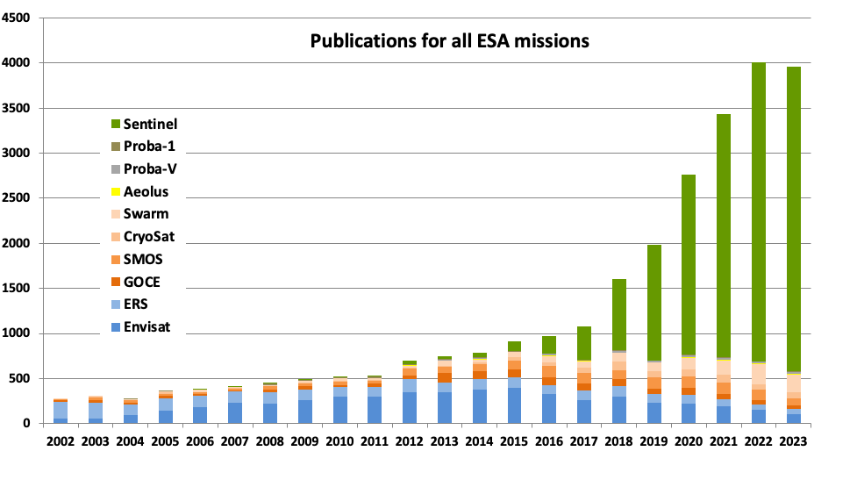
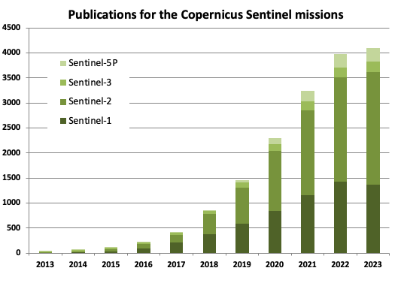
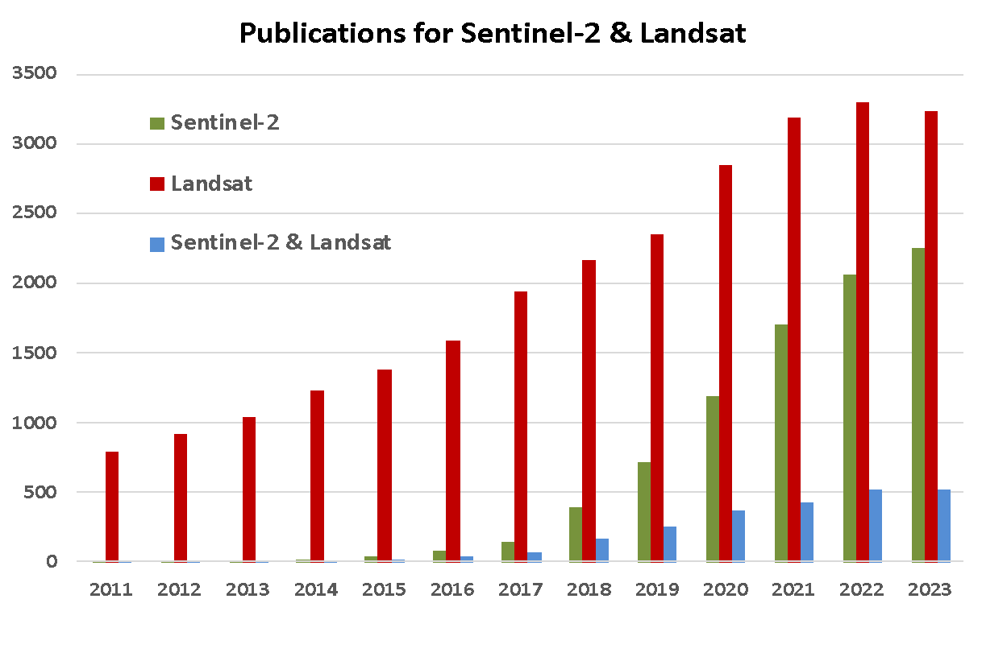
Peer-Reviewed Publications*
2251 publications in 2023
*Method: Based on Elsevier SCOPUS database, exact number of peer reviewed publications searching for mission/instrument name within papers title, abstract and keywords, and excluding conference papers.

Slide 9
Data Access

Slide 10
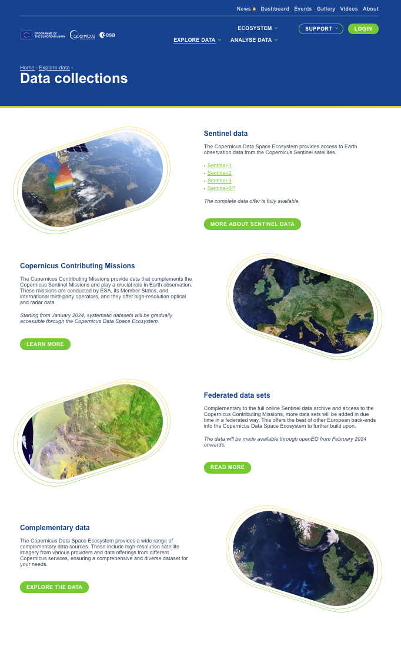

Slide 12
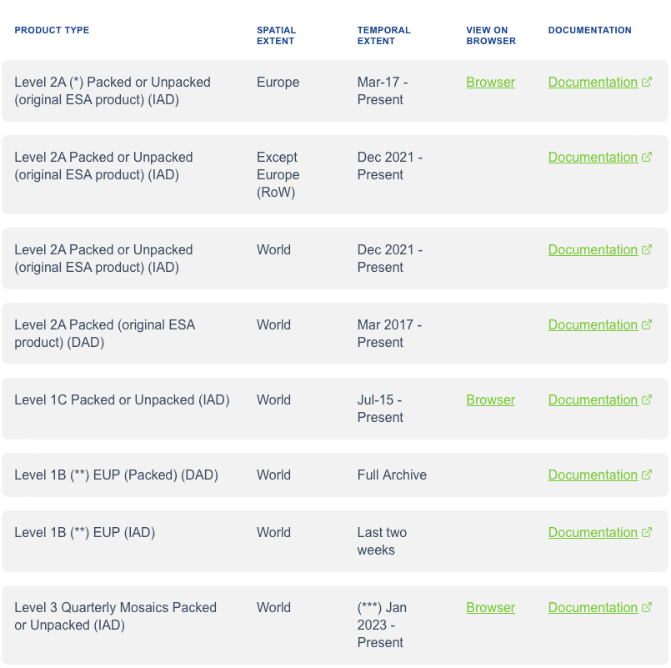
Data Access
(*) For period 07/2015 - 11/2021 the data repository holds original ESA products and products generated using Sentinel-2 Toolbox (sen2cor). (**) Access restrictions may apply. (***) Quarter 1, 2, and 3 of 2023 (more will be added)

Slide 13
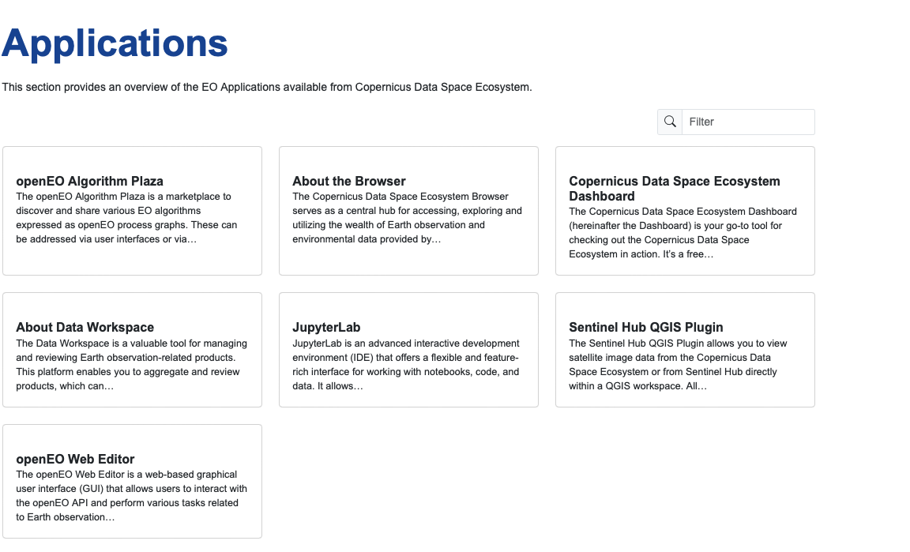
Copernicus Data Space Environment / APIs and Apps

Slide 14
Thank you!

Slide 15
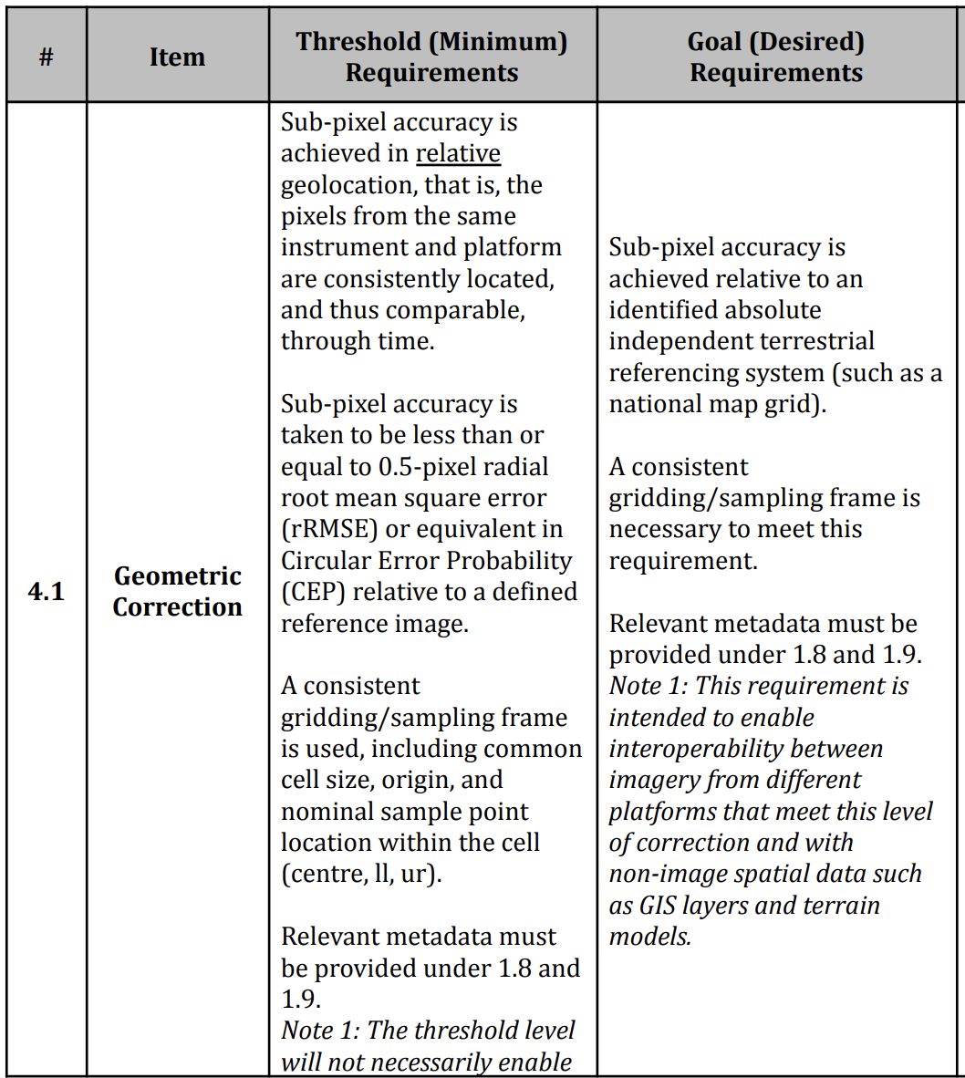
CHIME feed-back on CEOS-ARD
With respect to CEOS-ARD PFS Surface Reflectance v5.0.1 document.
CHIME team wonders if bottom-of-atmosphere reflectance products on sensor geometry that have been appended a per-pixel lat./long./altitude refined geometry information information are CEOS-ARD compliant.
PFS SR chapter 1.6 “Map Projection” indicate that non-projected products are still compliant.
However, in chapter 4.1 “Geometric Correction” Threshold requirements, the description is considered as not clear in particular regarding what can be considered as “consistent”.

Slide 16
CHIME feed-back on CEOS-ARD
“Sub-pixel accuracy is achieved in relative geolocation, that is, the pixels from the same instrument and platform are consistently located, and thus comparable, through time.”
In sensor geometry a near-coincident ground location will appear on a different image locations within the products and the actual pixel footprint will be slightly different.
“A consistent gridding/sampling frame is used, including common cell size, origin, and nominal sample point location within the cell (centre, ll, ur).”
In sensor-geometry each image element corresponds to a given focal-plane element, but this does not translate to a fixed ground sampling distance (it will depend on the local DEM). Does this qualifiy as consistent sampling?
What does constitute a consistent gridding? Can a consistent gridding be achieved without a map projection?
Page 19: “These products would be resampled onto a common geometric grid (for a given product) and would provide baseline data for further interoperability both through time and with other datasets.”
This would not be satisfied by CHIME sensor geometry products.

