Slide 1
2.5: Combined Optical PFS Discussion
Agenda Item #2.5
LSI-VC-15 2024, Tokyo
3rd - 5th April 2024

Slide 2
Combined Optical PFS
A combined PFS for Optical sensors (comparable to the Radar/SAR PFS) is suggested
This could include a matching metadata specification (as done for the Combined SAR PFS)
Need to establish a clear understanding of level of commonality between different optical PFS and opportunities for combination/harmonisation
We should also consider common elements between optical and SAR PFS, with a view to further harmonisation

Slide 3
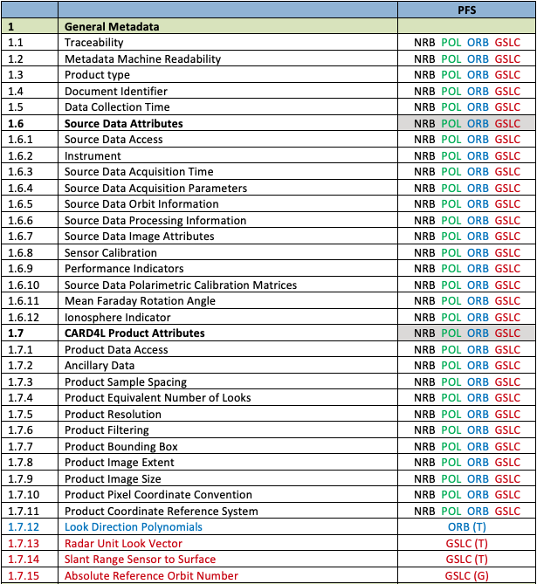
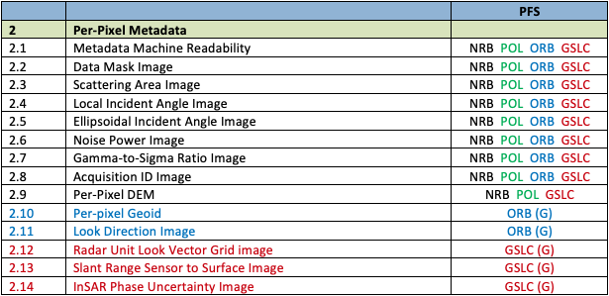
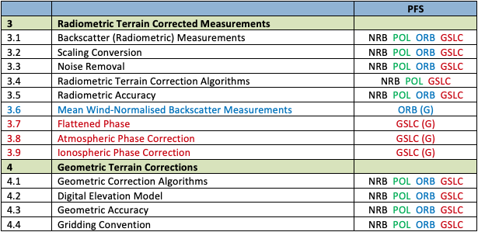
CEOS-ARD for Synthetic Aperture Radar
Large number of SAR PFSs (NRB, POL, ORB, GSLC) – and more to come
Challenge for users and data providers
70% commonality of parameters
Common parameters must match
Revisions to one PFS may affect several or all
Challenge to keep track & risk for inadvertent inconsistencies
42 of 60 parameters common across the SAR PFSs

Slide 4
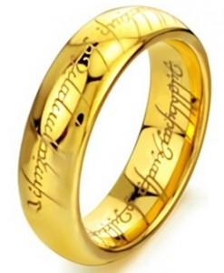
CARD4SAR – One PFS to Rule Them All
Single PFS for all CEOS-ARD SAR products:
NRB, POL, ORB, GLSC
Benefits:
Ensure consistent parameter names and specifications across all SAR PFSs
Simplify PFS revisions and change tracking
Simplifying interface with ongoing external standarisation frameworks (OGC/ISO, STAC)
Elegance:
CARD4SAR PFS facilitates the generation of one, several or all of the CARD SAR products – a true combined SAR ARD product
Reduces duplication of per-pixel metadata
CEOS-ARD for SAR

Slide 5
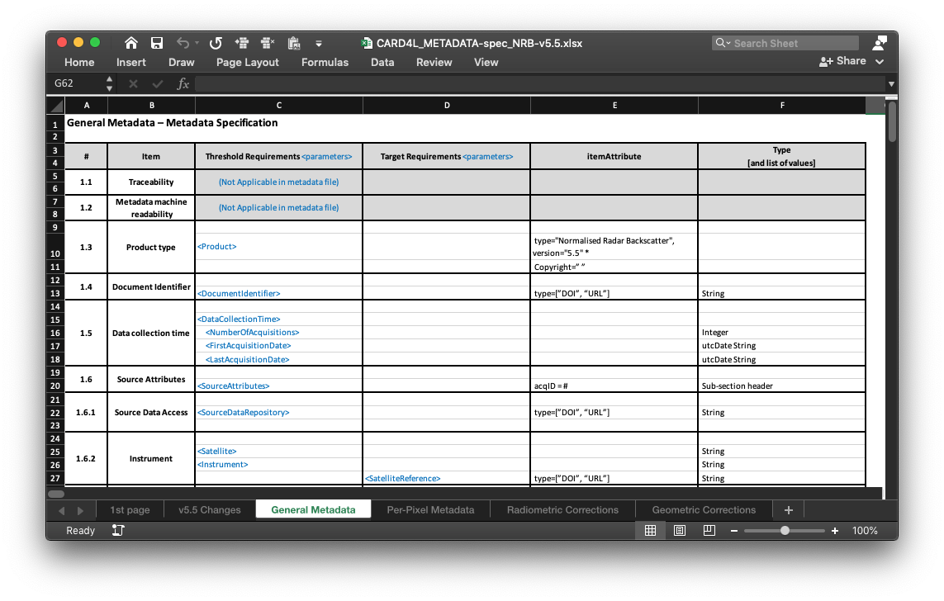
CARD4SAR – One PFS to Rule Them All
CARD4SAR Metadata
Accompanying single metadata specification
Consistent mapping of parameter names between PFS and metadata
Specs for XML format but data provider may select other metadata formats
(For discussion – need for additional GeoJson spec (for selected parameter) to support STAC)
Non-mandatory (Target req.)

Slide 6
Discussion Points
CEOS-ARD PFS Mapping from Ake:
https://docs.google.com/spreadsheets/d/1WyTfxrsz-x4H_FJvKg8OBg3w6YrcaYSfTtbqU3HPLM4/edit#gid=1122310695
Already clearly significant consistency
Issues from earlier today with inconsistency and out of sync updates
Also aid STAC Extension work – Proposal from Matthias Mohr:
Switch to a grouping of similar requirements (“profiles”) as e.g. in STAC with their Extensions, and then combine them in the actual PFS. Means it only needs to be maintained once and are consistent.
Could run into issues with desire for sensor agnostic PFS?
Should be looking less at the sensor, more at the measurements?
Ocean Reflectance PFS – An issue or opportunity regarding this combined PFS?
SAR PFS accommodated the possibility that the ARD product may not be generated from a single data source.
Indicated by source data attributes (1.6) and CEOS-ARD product attributes (1.7) being separated.
This could be something brought across to the optical side as well.
Increased alignment with SAR side also?
Peter Strobl recognised we need to talk about the overall structure. This is where ISO/OGC is starting now. Will need to find a scheme that is robust across the value chain. Ensure the same logic at different product levels.
LSI-VC-15 Decision Point: Do we proceed in this direction? Who will take the lead? Timeframe for development?

