Slide 1
2.4: Discussion on Sub-Pixel Accuracy Requirement (4.1 Geometric Correction)
Agenda Item #2.4
LSI-VC-15, Tokyo
3rd - 5th April 2024

Slide 2
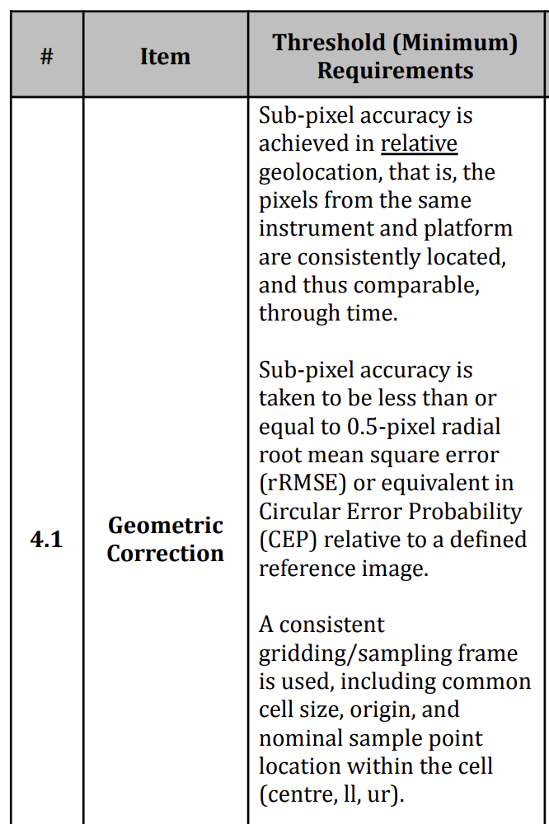
Background
A long standing issue. KARI (LSI-VC-8, 2019):
Leads took an action from LSI-VC-14:
LSI-VC-14-08 | LSI-VC Leads to summarise options for addressing the issue related to high resolution datasets and the 0.5 pixel rRMSE sub-pixel accuracy requirement of the SR PFS, for debate and decision at LSI-VC-15. Discussions should consider the: ● Impact of this requirement on the applicability of CEOS-ARD to ‘New Space’ and industry generally; ● Core motivations for CEOS-ARD (stackable, time series analyses) ● Stopgap downsampling approach used by KARI and whether this is something that would be officially recommended to other VHR satellite operators ● Scientific rigour vs. inclusivity discussions and approach used by the SAR CEOS-ARD team (i.e., requiring documentation and leaving it up to users to decide dataset applicability for their applications). | Decision on way forward at LSI-VC-15

Slide 3
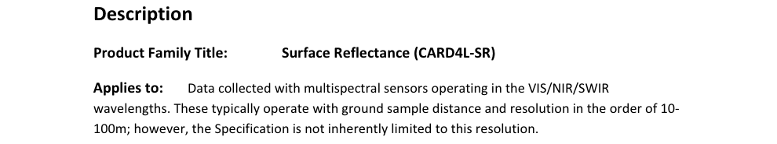
KARI’s Works on ARD (3/18)
Surface Reflectance (3/8)
  The CARD4L-SR (Surface Reflectance) specification
KARI’s EO missions provide high resolution imagery. Considering our experiences, we feel that it is very difficult to
        Assess physical properties (e.g. surface reflectance) for every pixel properly even with coarse accuracy
        Achieve the sub-pixel accuracy of PFS, i.e. 0.5 pixel rRMSE
We have focused on checking if the ARD product based on high resolution EO imagery, especially using KOMPSAT-3/3A imagery, can meet the threshold requirement for the CARD4L-SR.

Slide 4
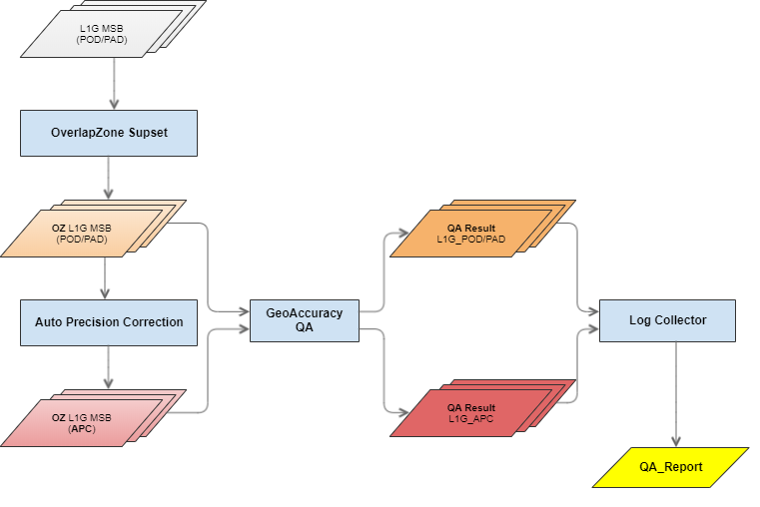
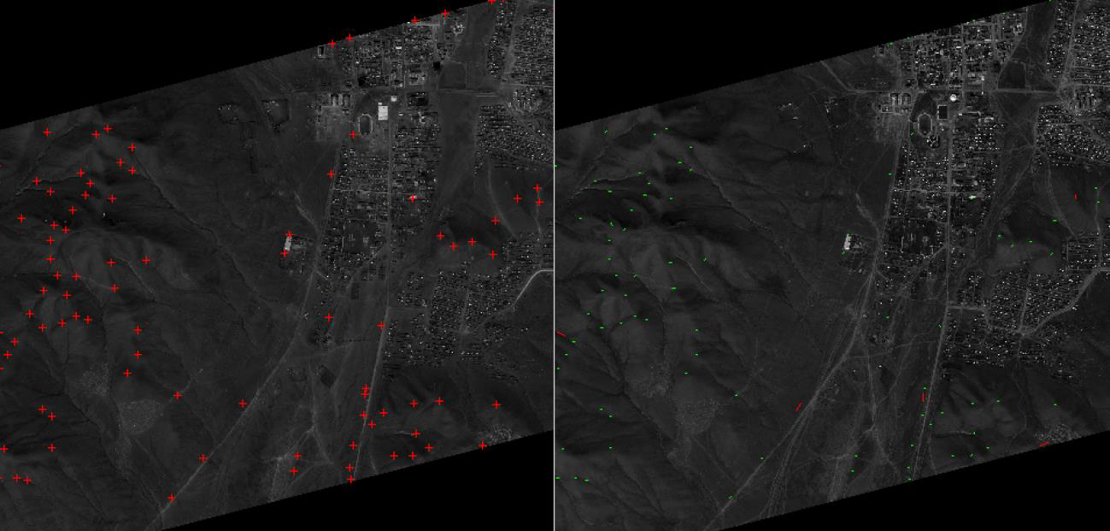
KARI’s Works on ARD (5/18)
Surface Reflectance (5/8)
  Feasibility Study: Assessment of registration accuracy (1/2)
Methods
  rRMSE/CEP
    For matched points
Image matching
Procedure for Qualifying Geolocation Accuracy

Slide 5
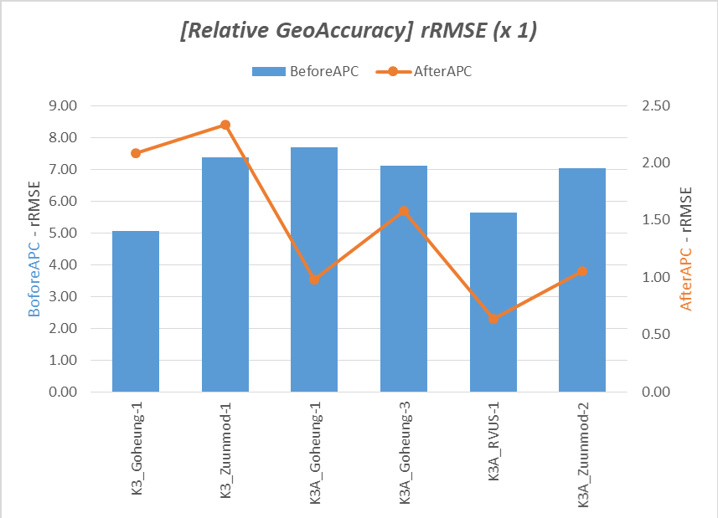
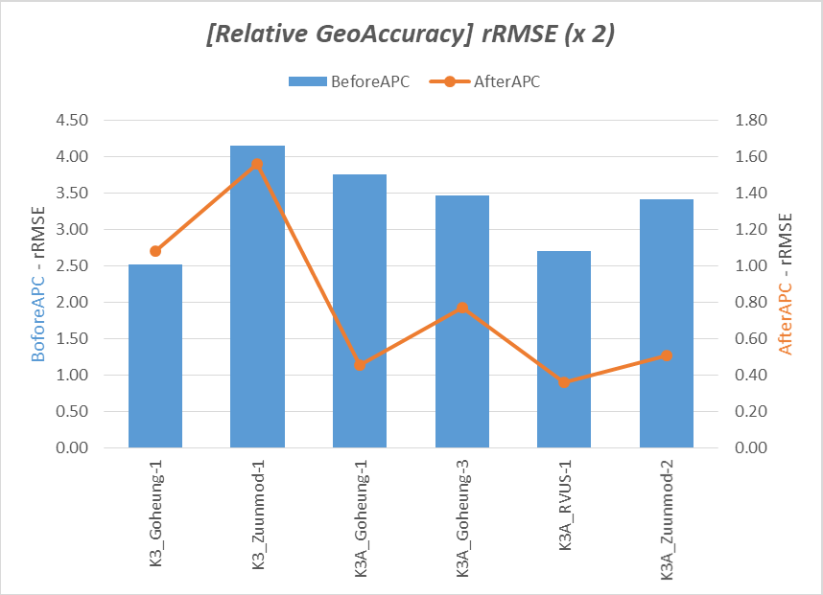
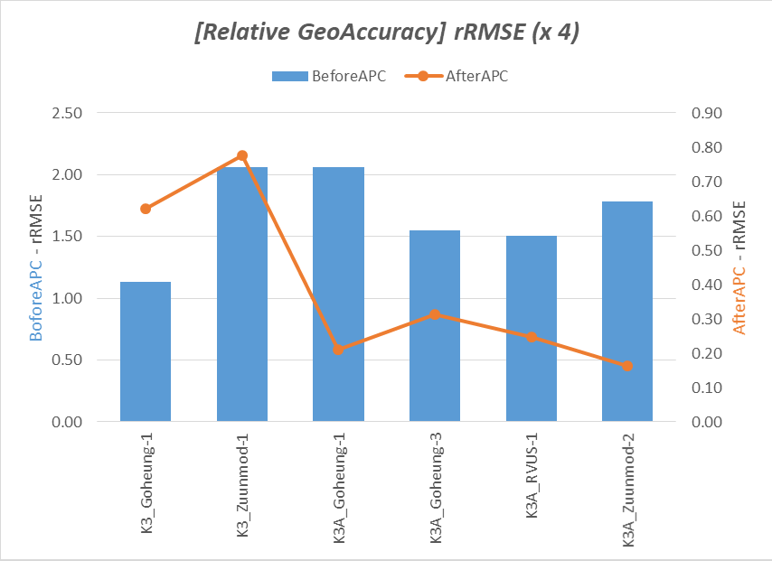
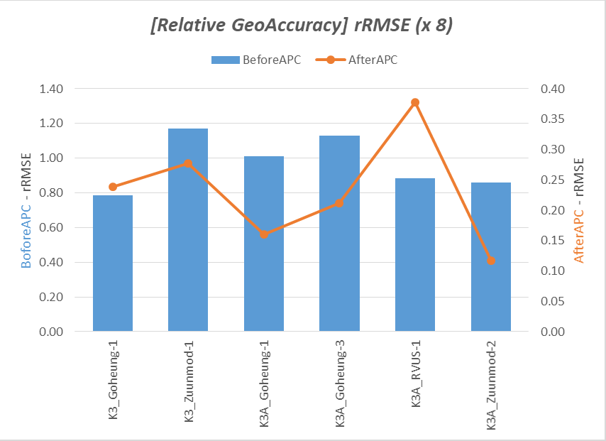
KARI’s Works on ARD (6/18)
Surface Reflectance (6/8)
  Feasibility Study: Assessment of registration accuracy (2/2)
Test data
  Down-scaled datasets
    1/2/4/8
Result
  8-Down-scaled datasets meet the threshold of “4.1 Geometric Correction” in CARD4L-SR.
    ~16m spatial resolution
8-Down-scaled datasets meet the threshold of “4.1 Geometric Correction” in CEOS-ARD SR requirements (~16m spatial resolution). KARI suspects that if they had a better DEM they could meet the requirements at a higher resolution, but this requires testing. Also, global high resolution DEMs are not readily available
Spatial Resolution Vs. Registration Accuracy

Slide 6
LSI-VC-14 Discussion Summary
Issue will become more frequent as resolutions improve and we look to engage the commercial sector.
Downsampling is not an appropriate solution.
On the SAR side, it was decided to not have a per pixel requirement.
  Geometric accuracy is for the data provider to specify – then it is up to the user to decide whether the accuracy is good enough for their application (scientific rigour versus inclusivity)
  Counter argument: this defeats the fundamental purpose of being CEOS-ARD (i.e. stackable data through time)
    Counter-counter argument: There are many other hurdles to stacking data, such as projection. Slippery slope to be defining CEOS-ARD purely around this strict temporal stacking requirement
Have to be careful with absolute quality, especially for <10m data as there are no good global references.

Slide 7
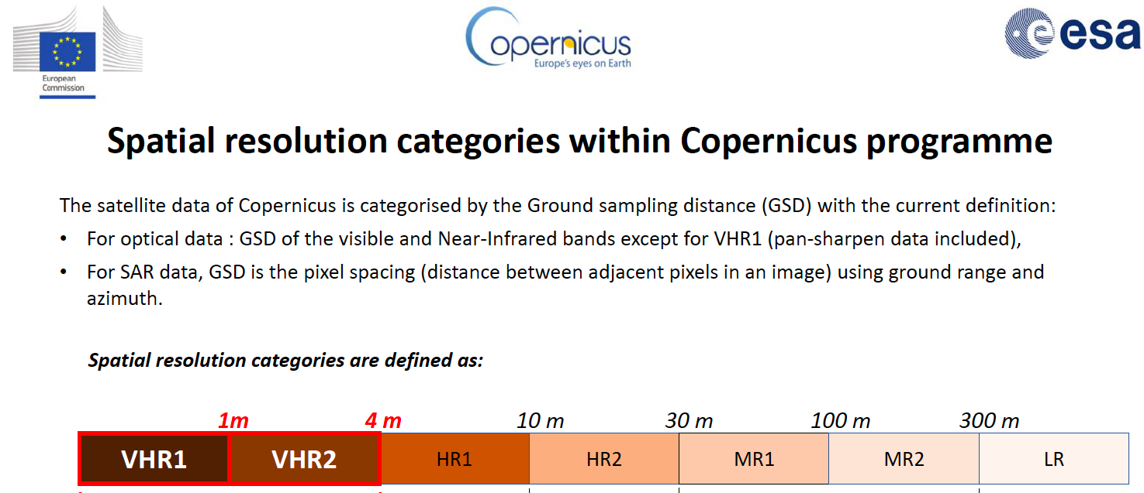
Peter’s inputs:
We first need to agree within CEOS what 'high' resolution means. There are as many schemes as there are interpretations of processing levels ;) Here is the one we use in Copernicus:

Slide 8
Peter’s inputs:
Furthermore we need to distinguish geolocation uncertainty (absolute) from geometric co-registration (relative - in theory divided into intraband, intrapath [difference in viewing geometry <3(?)deg], and crosspath [different viewing geometry]).
As a benchmark 'pixel' should be replaced, as it is rather random, by 'GSD' (ground sampling distance - usually at sea level), which is a sensor characteristic.
In the range of HR2 and coarser it is reasonable to expect (less than) 0.5 GSD (absolute) geolocation uncertainty (CE95) and same or better in co-registration terms.
For HR1 or finer I would recommend to fix the requirement at 5m absolute and 0.5-1.0 GSD relative, as threshold for intraband and intrapath.

Slide 9
Map projection (1.6) inconsistencies
Peter’s suggestion is distinguishing between two geometric requirements:
a) Geolocating: Determines the geographic location of an observation/pixel.
b) Georectification: Corrects sample locations to achieve a regular 2D geographic grid. Sharing the grid enhances interoperability.
In most cases this step requires resampling of original observations. It will only foster interoperability ('analysis readiness') if respective grid is shared with other datasets with which interoperability is desired. In this case the specific (harmonised) grid should become part of a threshold requirement. A rectification to a grid, arbitrarily chosen by the provider, is generally not desirable. In this case requirement a) is sufficient and should ideally be accompanied by:
c) Resampling method: Derives values for locations other than observed ones. This remains a goal due to various applicable methods.

Slide 10
Other inputs / options from the LSI Leads…

Slide 11
Background
Discussion!
Decision!

