Slide 1
LSI-VC-15
2024
CONAE Updates
Laura Frulla, CONAE
Agenda Item 2.6
LSI-VC-15 2024, Tokyo
3rd - 5th April 2024

Slide 2
SAOCOM 1 Constellation and Data Access
SAOCOM-1A SAOCOM-1B | October 7th 2018 August 30th 2020
satellites lifetime | 5 years (each satellite)
repetition cycle | 16 days (1 satellite)/8 days (constellation)
acquisition modes | real time/stored
access | 3 possibilities
(both operational)
AO for SAOCOM ESA/CONAE
Promotion of Utilization and Mission Applications and Science (PUMAS)
Initiative under Earthnet's Third Party Missions Programme
For science and application developments (EO)
Data available: ESA (EO), Copernicus and SAOCOM
(still open)
https://www.argentina.gob.ar/ciencia/conae/misiones-satelitales/ao-iniciativa-puma-esa-conae
https://earth.esa.int/eogateway/announcement-of-opportunity/saocom

Slide 3
SAOCOM Data Access(1/2)
2. Catalog
    inside ASI exclusivity area (ASI-CONAE cooperation): https://www.asi.it/en/earth-science/saocom/
    outside ASI exclusivity area: u_inter@conae.gov.ar
SAOCOM Catalog can be navigated freely to identify already existing data. Upon registration, quicklooks can be seen: https://catalogos.conae.gov.ar/catalogo/catalogoSat.html
agreement
project
Licence to Use

Slide 4
SAOCOM Data Access(2/2)
3. One click possibility
https://www.argentina.gob.ar/ciencia/conae/productos-saocom/acceso-productos-saocom-1

Slide 5
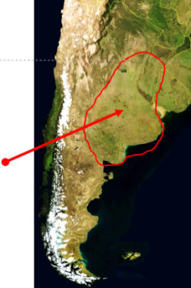
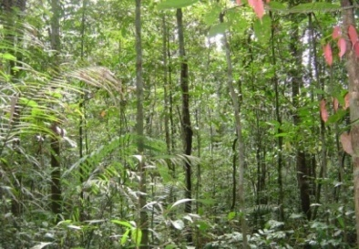
SAOCOM Mission Acquisition Strategy
Baseline Mission
  (fixed acquisitions)
Foreground Mission (variable acquisitions)
Background Mission (useful data base)
  soil moisture
  (Pampas)
(changes without jeopardizing the initial data base)
  users
  Argentina: new user needs
  biomass
  polar zones
  rest of the world
  regions of WG on Disasters interest with dedicated acquisitions
SAR calibration:
  rain forest
  specific point targets
  doldrums
StripMap DP (biomass)
TOPSAR Narrow QP (rest)
https://www.argentina.gob.ar/misiones-satelitales/planes-de-adquisiciones-saocom-1

Slide 6
Planned Missions (SAR and and other lines)
Better geometric resolution
Operative TOPSAR interferometric products
Improved knowledge of the orbit
Better orbital tube/improve interferometric capabilities
SAO2 IMPROVEMENTS
Interferometric wide swath modes
Better duty cycle
Intensify Antarctica monitoring
Digital beam forming
SAOCOM 1A
SABIA-Mar
(ocean)
SAOCOM 2
SAOCOM 3
SAOCOM 1B
Companion
Patagonia Beta
(ship detection)
Geostationary
(single pass interferometric acquisitions with SAO2)
SARE II
  polar regions
  glaciers/biomass
  change detection (height in snow, ice and glaciers)
operational
SARE Beta
(environmental monitoring)
under development
SARE I
(fishing monitoring)
SARE III
(climate laboratory)

Slide 7
Thank you for your attention

