Slide 1
LSI-VC-15
2024
CEOS-ARD: RADARSAT Missions
François Charbonneau,
W. Mackinnon, H. Drouin
CCMEO/NRCan
Agenda Item 2.1
LSI-VC-15 2024, Tokyo
3rd - 5th April 2024

Slide 2
Overview
Earth Observation Data Management System (EODMS)
  EODMS is the catalog which holds Radarsat-1, Radarsat-2 (federal allocation) and Radarsat Constellation Mission (RCM) archives
CEOS-ARD implementation was on the back burner for a while due to EULA restrictions
Since April 2023, public access to RCM 16m and up, over land (ocean 100m), under SLC and MLC formats (GRD was already accessible)
Increased motivation in converting the RCM National Land Standard Coverage (RCM-LSC) to CEOS-ARD:
              ScanSAR 30 m Compact Polarimetric

Slide 3
Status and Roadmap
Systematic processing of RCM-LSC to CEOS-ARD
  Ongoing finalization of the production chain and product validation (metadata and per-pixel)
  Peer-review submission to CEOS-ARD team: late spring 2024
  Systematic production
    Summer 2024
    Based on Combined SAR PFS, sub-category Polarimetric which includes also NRB
    Data access through AWS; will include STAC metadata
Mid-terms
  Archive processing of all RCM 30m CP over Canada to CEOS-ARD
  For vetted users, on demand service for converting mostly all RCM products to CEOS-ARD, not limited to Canada land
Longer terms
  RADARSAT-1: Reprocess from L0 to L1 first. ARD performance limitation due to geolocation inaccuracy
  RADARSAT-2: Commercial restriction; Ongoing discussion with the data provider for CEOS-ARD public access

Slide 4
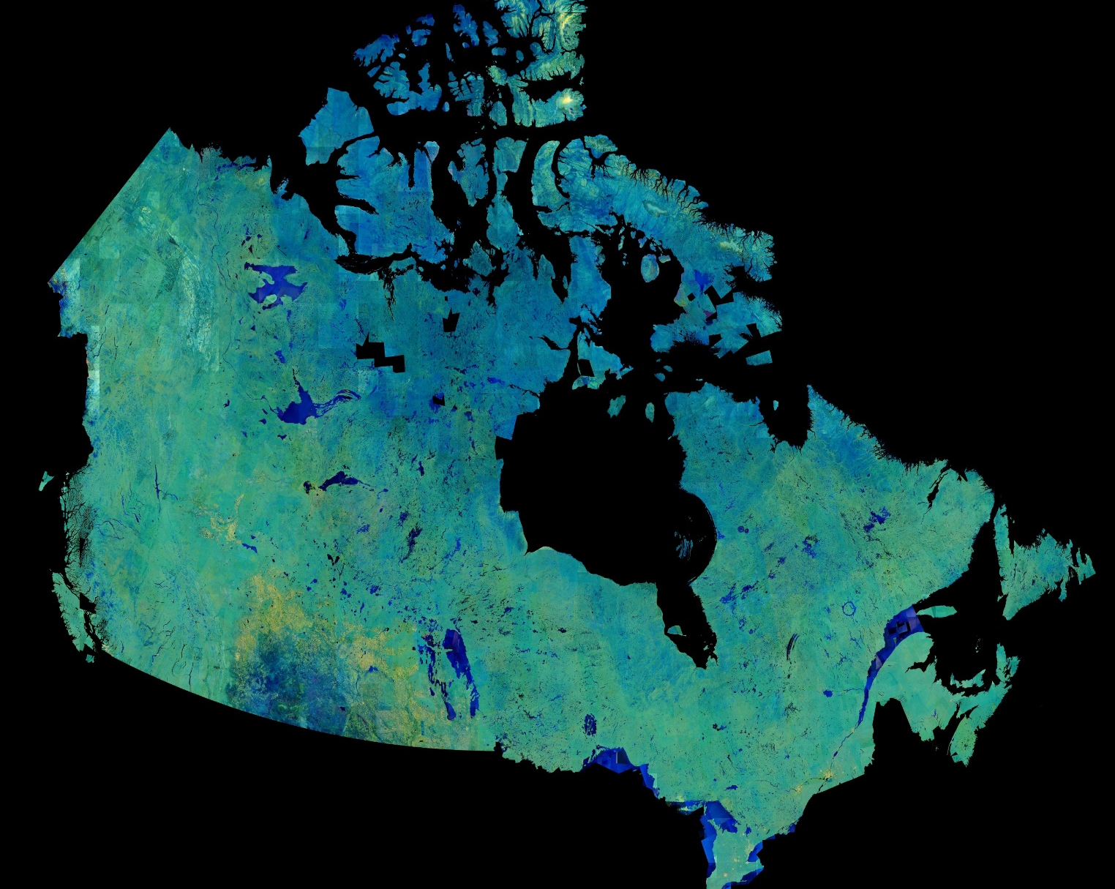
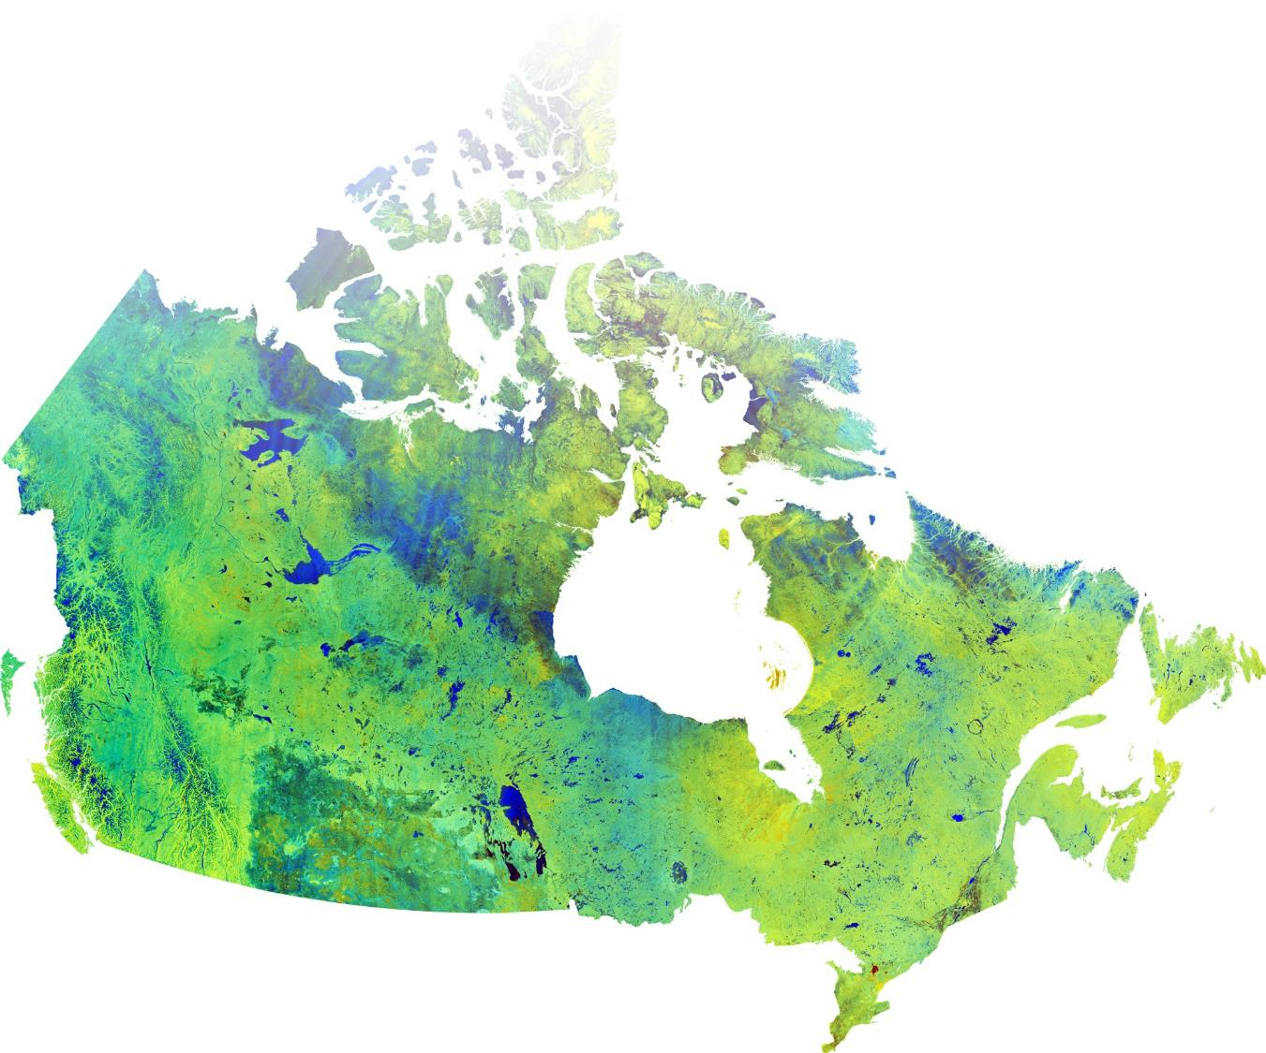
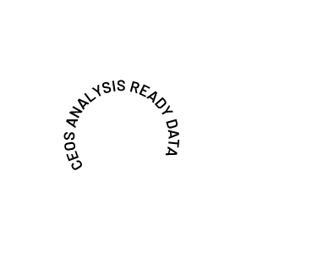
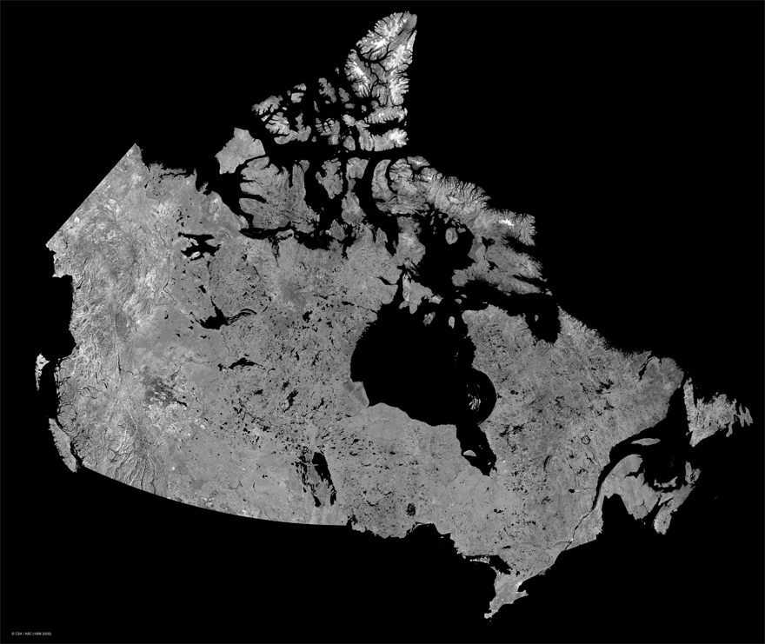
Optimal Goal
28 years of RADARSAT ARD
2018-2024 RCM
2008-2024 R-2
1996-2013 R-1

