Slide 1
LSI-VC-15 Item 2.1
JAXA CEOS-ARD update
and self-assessment report
Takeo Tadono, JAXA EORC
Osamu Isoguchi, Kazufumi Kobayashi, RESTEC
Ake Rosenqvist, soloEO

Slide 2
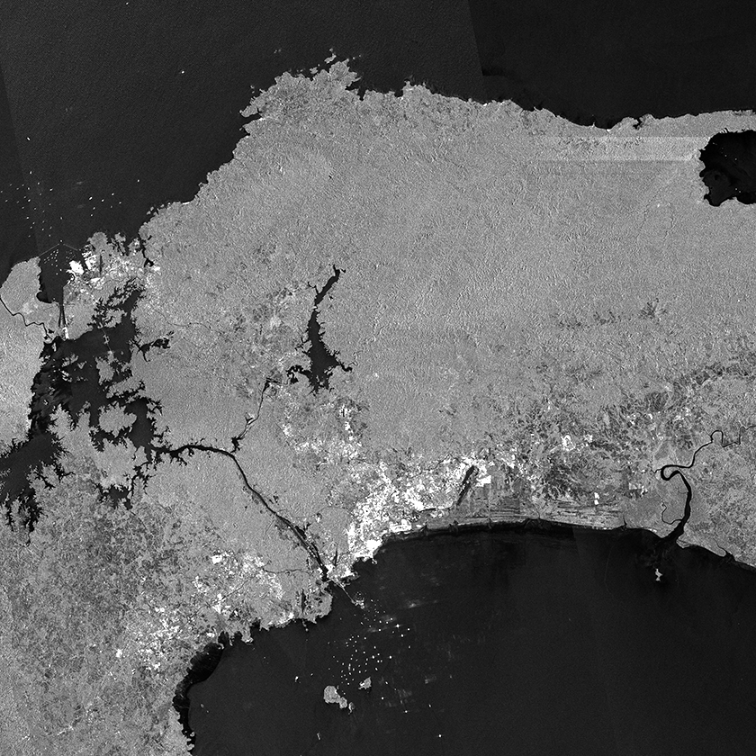
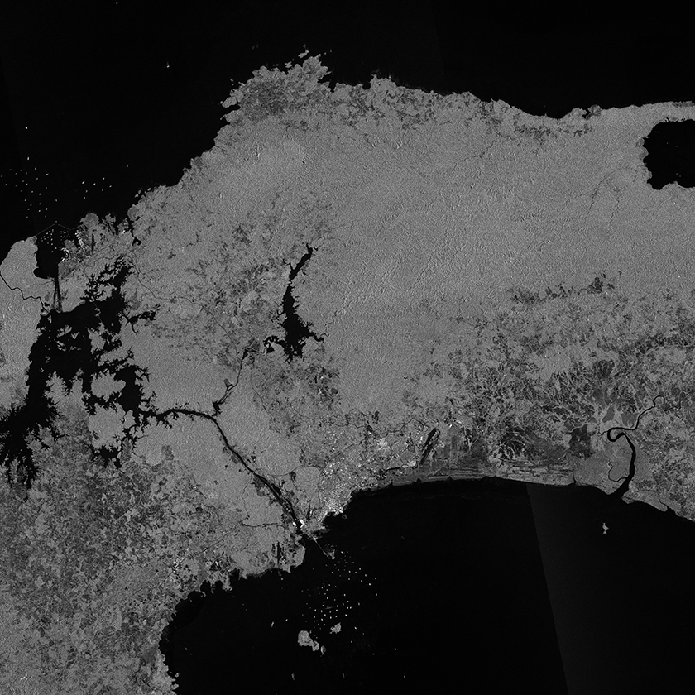
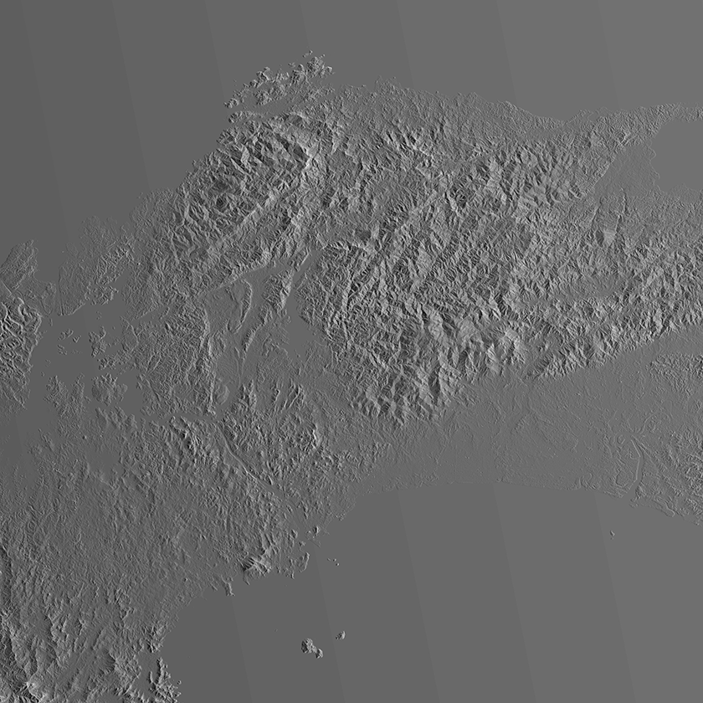
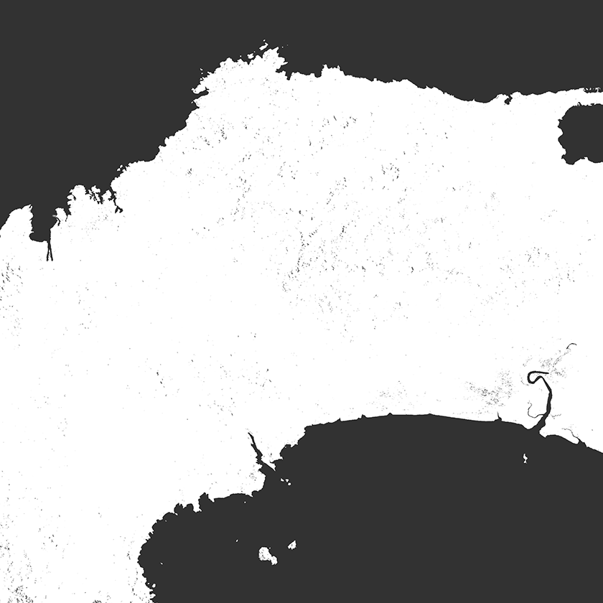
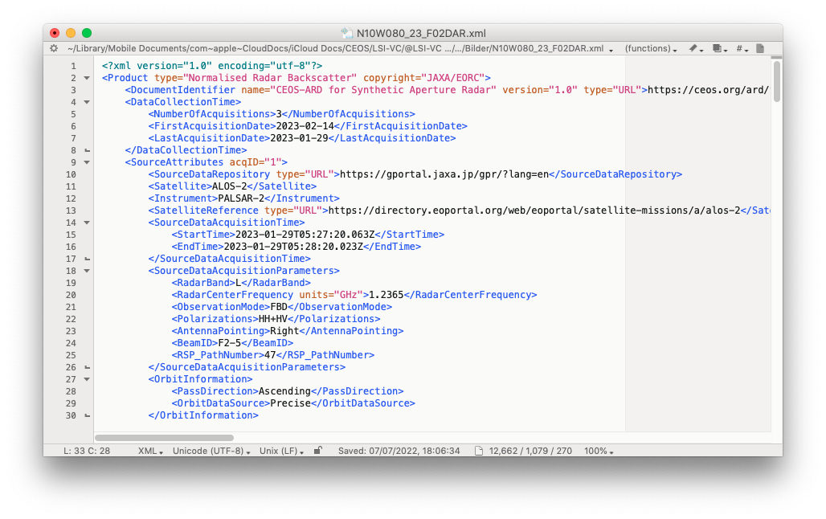
Updates to CEOS-ARD for SAR v1.0
ALOS-2 PALSAR-2
Global Fine Beam Mosaics
[25 m; 1x1 deg tiles; multi-date composite]
Measurement data:
Updated for compliance with new CEOS-ARD SAR PFS: (CEOS-ARD for Synthetic Aperture Radar v1.0 [NRB product])
Self-assessment submitted 2 April 2024
Revisions required to (XML) metadata only
Measurement data and Per-pixel metadata unchanged
Valid for mosaic products from 2023. Mosaic products for 2022 and earlier remain compliant with CARD4L NRB v.5.5
γ⁰ Backscatter (HH)
γ⁰ Backscatter (HV)
Per-pixel metadata:
General metadata:
Local Inc. Angle
Acquisition ID
Data Mask

Slide 3
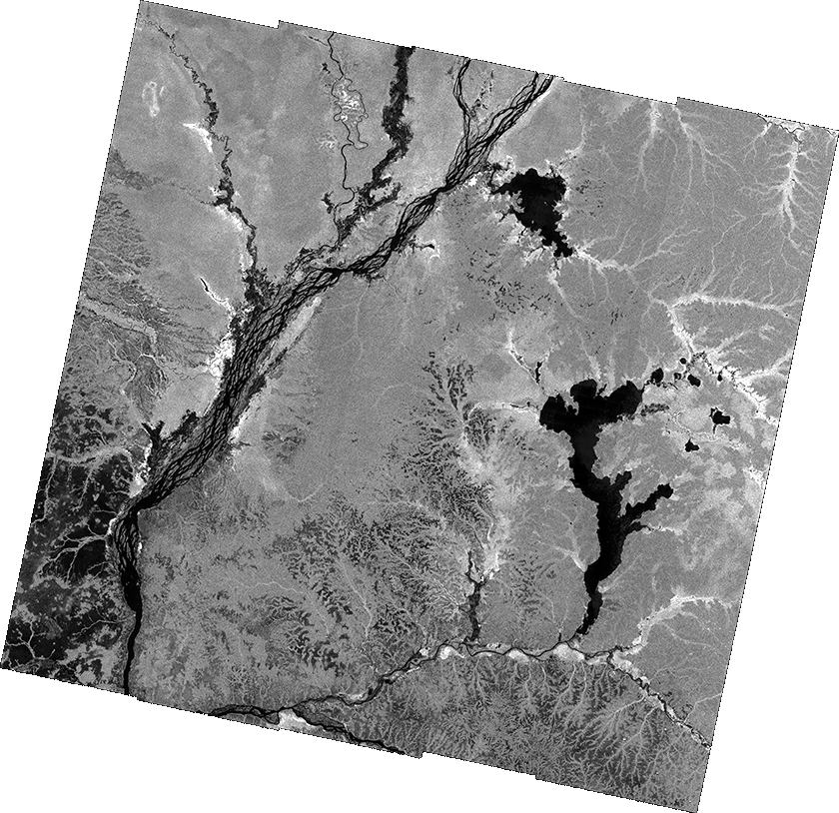
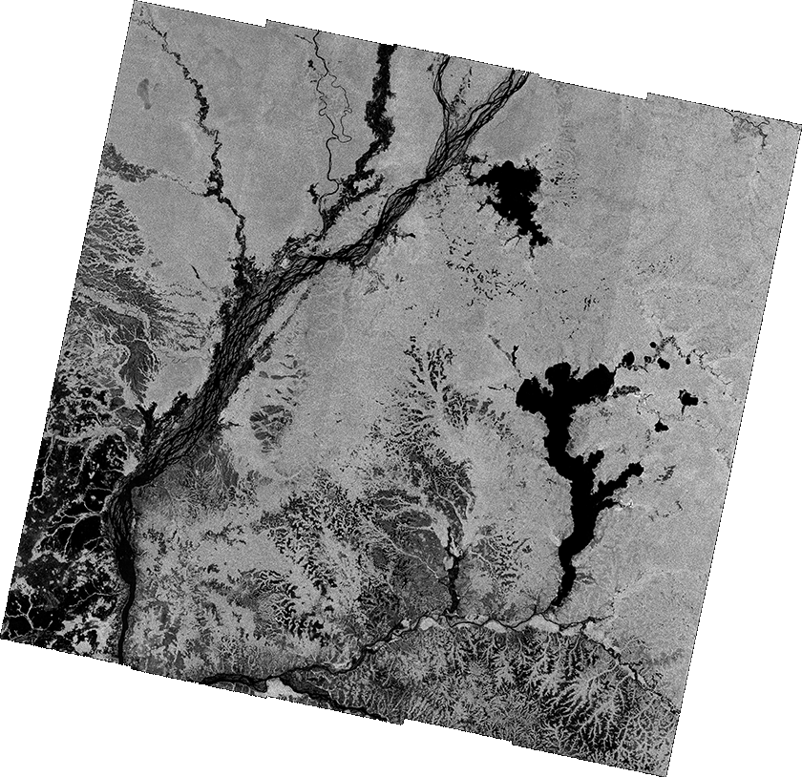
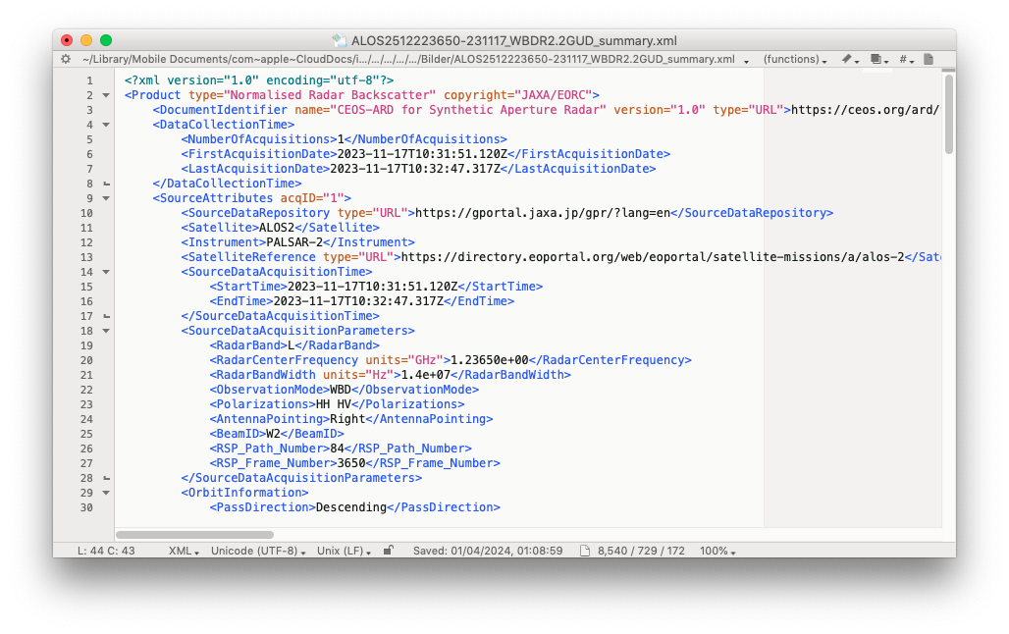
Updates to CEOS-ARD for SAR v1.0
ALOS-2 PALSAR-2
ScanSAR Level 2.2
[25 m; scene-based; single-date]
Measurement data:
Updated for compliance with new CEOS-ARD SAR PFS: (CEOS-ARD for Synthetic Aperture Radar v1.0 [NRB product])
Self-assessment submitted 2 April 2024
Revisions required to (XML) metadata only
Measurement data and Per-pixel metadata unchanged
Re-processing of all products ongoing. Replacement of products on G-Portal, GWW, AWS during 2024
γ⁰ Backscatter (HH)
γ⁰ Backscatter (HV)
Per-pixel metadata:
General metadata:
Local Incidence Angle
Data Mask

Slide 4
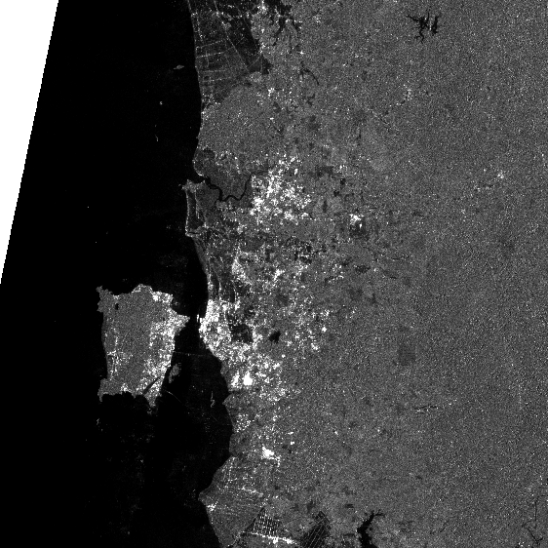
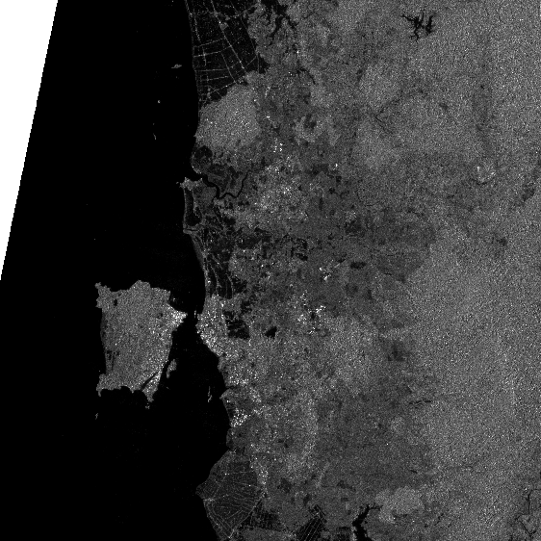
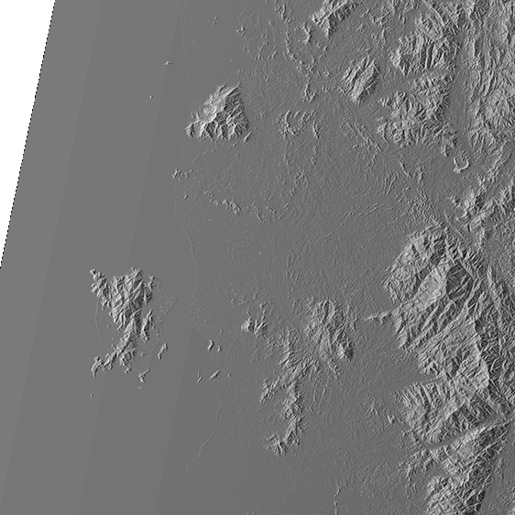
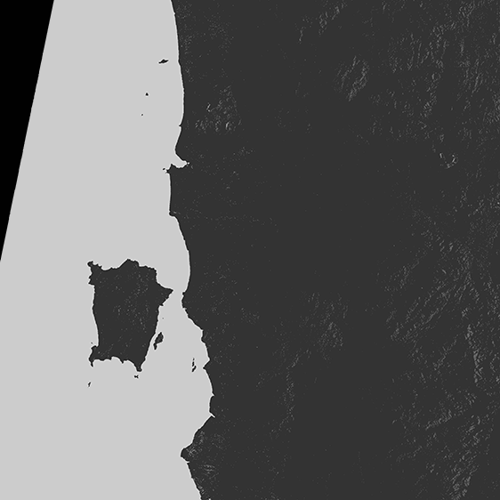
Updates to CEOS-ARD for SAR v1.0
ALOS-2 PALSAR-2
ScanSAR K&C tile data
[50 m; 1x1 deg tiles; single-date]
Measurement data:
Updated for compliance with new CEOS-ARD SAR PFS: (CEOS-ARD for Synthetic Aperture Radar v1.0 [NRB product])
Self-assessment submitted 2 April 2024
Revisions required to (XML) metadata only
Measurement data and Per-pixel metadata unchanged
Valid for products from 2024. Mosaic products for 2023 and earlier remain compliant with CARD4L NRB v.5.5
γ⁰ Backscatter (HH)
γ⁰ Backscatter (HV)
Per-pixel metadata:
General metadata:
Local Incidence Angle
Data Mask

Slide 5
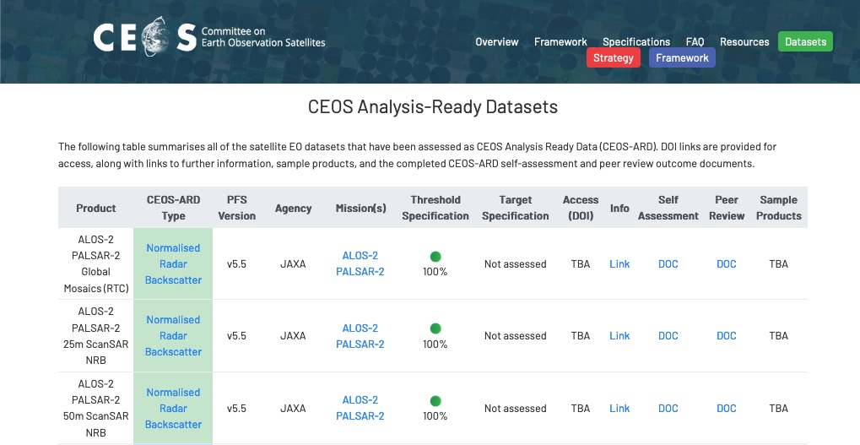
Updates to CEOS-ARD for SAR v1.0
Public access @JAXA EORC www
Public access @ G-Portal, GEE, AWS, [DE-Africa]
Re-processing ongoing
Access via JAXA RA (K&C) programme

Slide 6
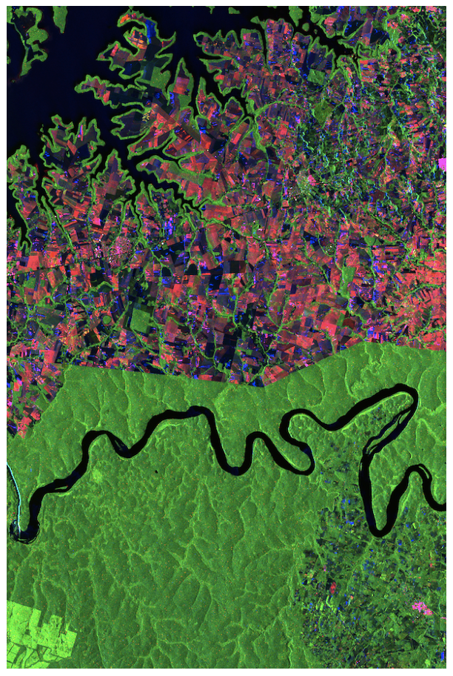
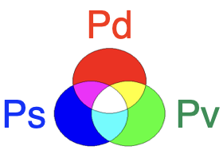
JAXA EORC plans for CEOS-ARD
Plans for 2024
ALOS-2 polarimetric decomposition
JERS-1 SAR mosaics
Self-assessment for CEOS-ARD for SAR v1.0
Submission foreseen Q2/2024
ALOS-4 PALSAR-3
CEOS-ARD products currently not included in JAXA’s standard processing (AUIG3) system for ALOS-4.
Special CEOS-ARD processing foreseen at JAXA EORC (CEOS-ARD for SAR v1.0).
ALOS-4 global observations at full polarisation → Global mosaic generation to continue.
In addition to NRB products, also CEOS-ARD POL and GSLC under consideration on a R&D basis.
Courtesy of Y. Yamaguchi © JAXA

