Slide 1


SAR CEOS-ARD
ISRO Status Updates
Committee on Earth Observation Satellites
Hari Priya S, Raghav Mehra , Manavalan Ramanujam V , Manju Sarma M
Indian Space Research Organization
LSI-VC-15, April 3-5, 2024 – Session 2.1 (CEOS-ARD)
Notes:
So Good morning, good day and good evening again
My name is Ake Rosenqvist and I represent JAXA and the Committee on EO satellites – CEOS
On behalf of the SAR expert colleagues listed here, I will provide an overview of CEOS Analysis-Ready Data for Land (CARD4L) Product Specifications for Synthetic Aperture Radar (SAR)

Slide 2
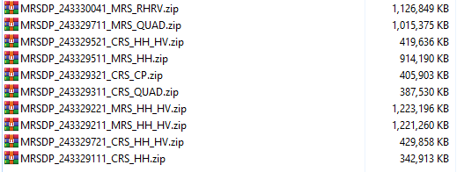
EOS04–NRB (Normalized Radar Backscatter ) for CEOS ARD
EOS-04 RISAT -1A CEOS –ARD NRB has been designed for the ScanSAR Imaging mode .
Medium Resolution ScanSAR (MRS) -:18 meters spacing, scene-based (Level-2B ARD) Single, Dual, Circular and Full -polarization single-date products.
Coarse Resolution ScanSAR (CRS) - :36 meters spacing, scene-based (Level-2B ARD) Single, Dual, Circular and Full -polarization single-date products.
10 datasets pertaining to MRS ,CRS with various Tx/Rx Polarization Combinations were uploaded for SAR CEOS ARD Focal Points for Assessments
( We did take 4 Iterations for corrections and updations ..)
The datasets provided are generated through the operational chain -IMGEOS(Integrated Multi-Mission Ground Segment for EO satellites), which is the data dissemination setup at NRSC .
*EOS-04 NRB datasets can be downloaded from
www.bhoonidhi.nrsc.gov.in.

Slide 3
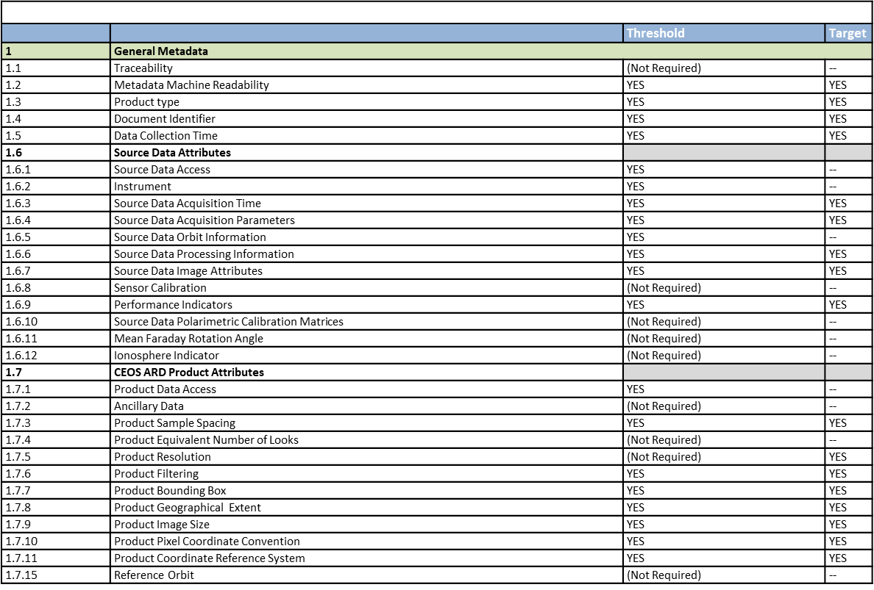
EOS-04-NRB- Self-Assessment Table -Summary

Slide 4
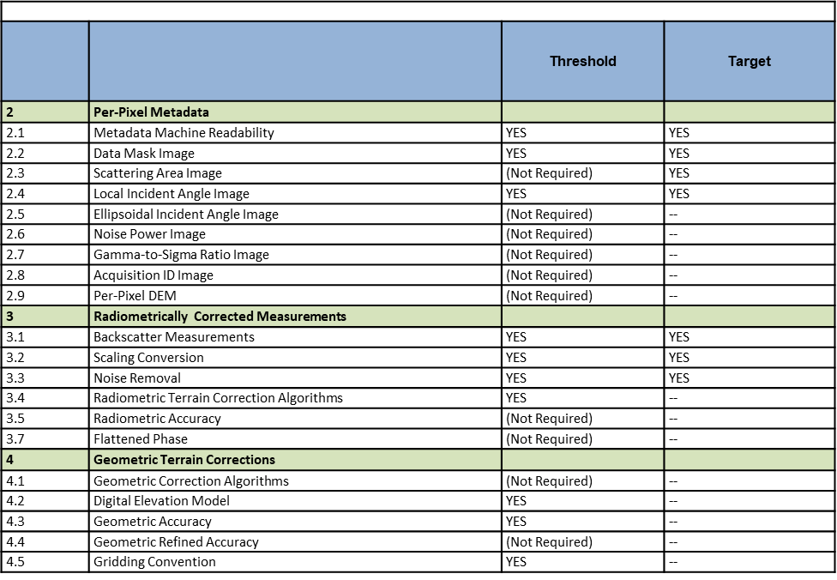
Summary Self-Assessment Table-EOS-04-NRB

Slide 5
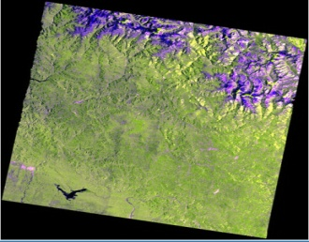
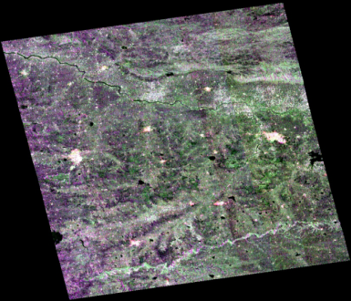
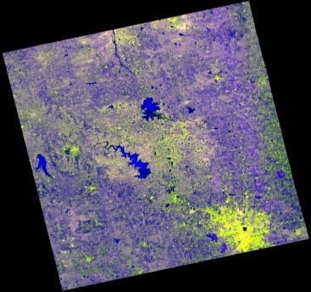
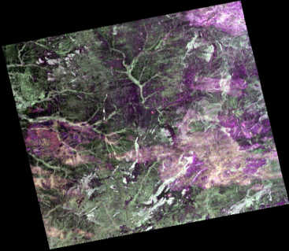
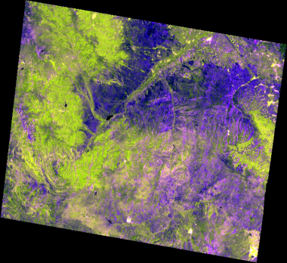
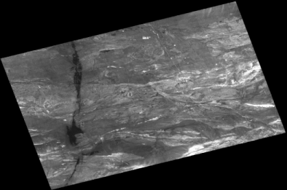
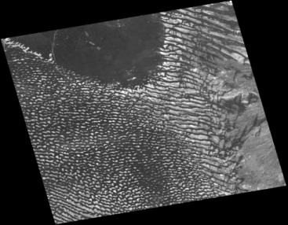
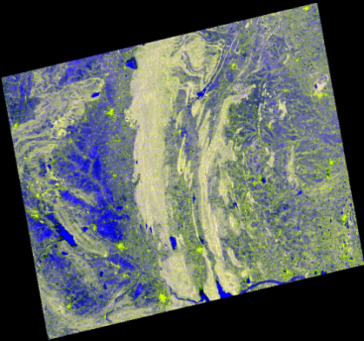
CEOS ARD NRB Datasets
MRS _HH_HV
MRS_Full Pol
MRS_RH_RV
CRS_HH_HV
CRS_FullPol
MRS_HH
CRS_HH
CRS_RH_RV

Slide 6
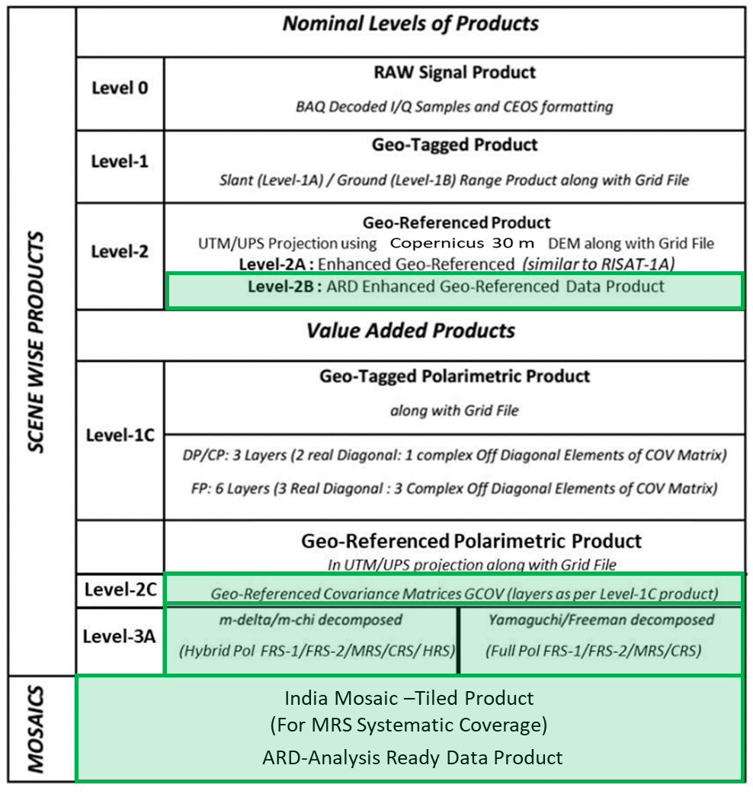
  EOS-09 (RISAT-1B) Data Products Definitions

Slide 7
ISRO CEOS-Compliant ARD Product Generation
SNO | ARD Product | Sensor | Product Type | Timeline
1 | Normalised Radar Backscatter | EOS-04 /EOS-09 | Level2B | 2023 (CEOS Endorsed) 2024
 |  | EOS04(RISAT1A)/ EOS-09 | India Mosaic (Tiled Product) | May-2024 2024
2 | Polarimetric Radar | EOS04(RISAT1A)/1B | Geocoded Polarimetric Decomposition Products (Level-3A) | 2024
 |  | EOS04(RISAT1A)/1B | GCOV (Geocoded Covariance Product) | 2024
 |  | NISAR | GCOV (Level-2) | 2024
3 | Geocoded Single Look Complex | NISAR | GSLC (Level-2) | 2024
4 | Interferometric Products | NISAR | GUNW (Geocoded – Unwrapped Interferogram) | 2024/25

Slide 8
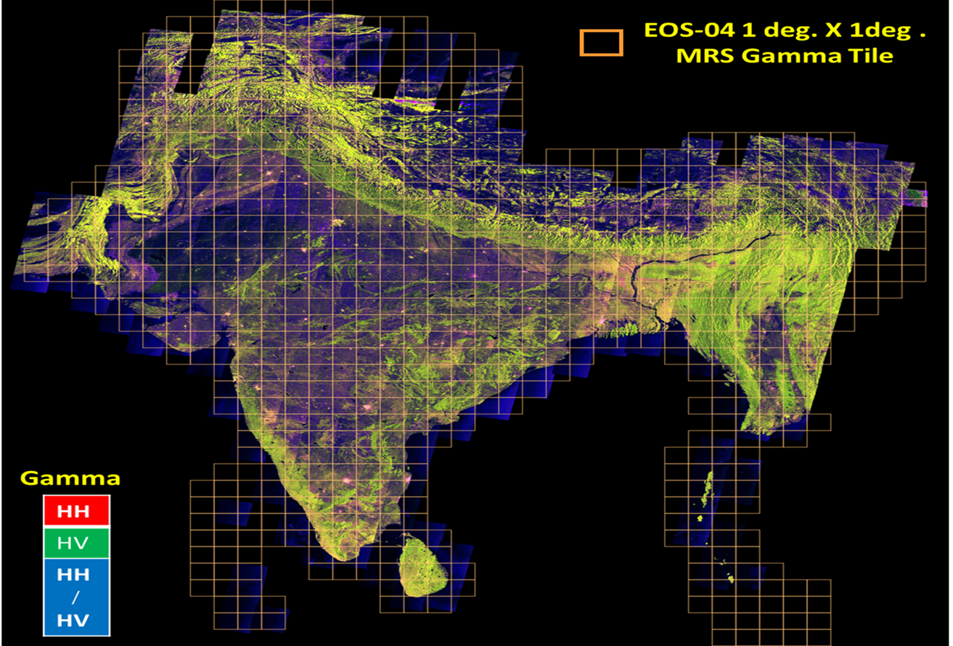
Summary
CEOS ARD SAR WGCV has endorsed the EOS04 NRB products for MRS and CRS ScanSAR imaging modes .
We shall be submitting the Mosaic Products of EOS04 NRB to CEOS soon.
NISAR & EOS-09 –RISAT1B data products are also designed for CEOS ARD compliance.
Technical Papers
1.Towards EOS-04 ARD –Normalized Radar Backscatter(NRB) Product –Raghav Mehra et al-IEEE InGARSS 2023
2.CEOS-Analysis Ready Data For Land (CARD4L) for SAR –Prospects and Roadmap to Realisation –Hari Priya et al -ESA Living Planet Symposium 2022
3.CEOS Analysis Ready Data using EOS-04 SAR –Hari Priya et al-CEOS SAR WGCV 2023 ; LSI-VC-14 2023
Thank You ….

