Slide 1
CEOS ARD updates and self assessment report: OPERA and NISAR products
Bruce Chapman

Slide 2
OPERA and NISAR RTC products
The OPERA project is already archiving S1 RTC products at the ASF DAAC.
The Self Assessment of the OPERA S1 RTC product was completed by Tom Logan (ASF) but has not yet been submitted.
There are two issues that came up, but the RTC products were found to be otherwise compliant
Under “Source Data Image Attributes” section 1.6.7, one of the attributes, the ”Azimuth Spacing in meters” was omitted in the original OPERA RTC metadata hdf5 file.
It has now been added to future iterations of the product (~Feb 2024 onward).
This was specifically changed so as to meet CEOS ARD threshold requirements.
The “azimuth spacing in meters” was omitted because the algorithm team recorded the “azimuth time interval” (that is, the PRI) (which is a constant) and ground velocity from the source SLC, while the azimuth spacing in meters (which is slightly varying i.e., due to the changing ground velocity with time) was not recorded.
This value is a threshold requirement by the CEOS ARD specifications so that users can estimate the number of looks in the RTC multilooked product.
The OPERA RTC product actually has an image layer providing the exact number of looks per pixel
Based on this experience, I have proposed for consideration a minor change to the specification:
the threshold requirement would be the azimuth spacing (in meters) or the PRI (in seconds) of the source data product (as well as the other attributes)
a target requirement that supersedes the baseline requirement would be a pixel-for-pixel image layer providing the number of looks.

Slide 3
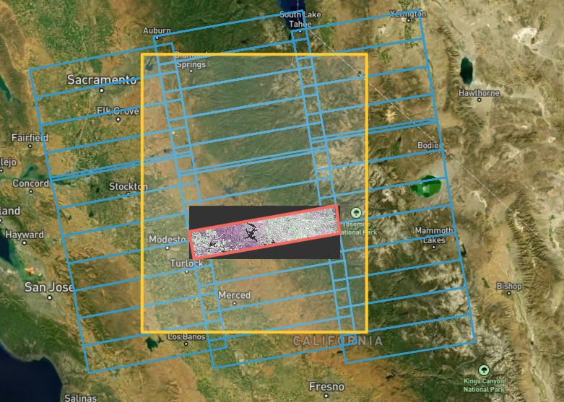
OPERA and NISAR RTC products
Second issue:
Under section 2.4 “local incidence angle image”, the threshold requirement is for this image layer to be provided.
This was not initially provided at full resolution
OPERA (and NISAR) now plans to provide separate full resolution static image layers for each image frame.
For layers related to image geometry
Exact same spatial definition
This is to avoid duplicating this same image layer in every product.
Cost and CPU savings
This concept of storing static files like this in the archive separate from the RTC product has been discussed with the CEOS ARD team and was provisionally agreed to.
When finding the desired product at ASF, the static layers can also be downloaded, or a link might be provided in the metadata.
It is now believed that the OPERA RTC product is compliant with the CEOS ARD specifications based on Tom Logan Self Assessment
The software and metadata of NISAR “GCOV” product is being developed by the same team that produced the OPERA RTC product, and it is therefore expected to be compliant as well.
The OPERA S1 products will be produced for every burst
Potentially reduces data download volumes to only those areas of interest.
Can be seamlessly mosaicked
NISAR products will be 240 km x 240 km
ASF DAAC vertex search page
OPERA RTC S1 product

Slide 4
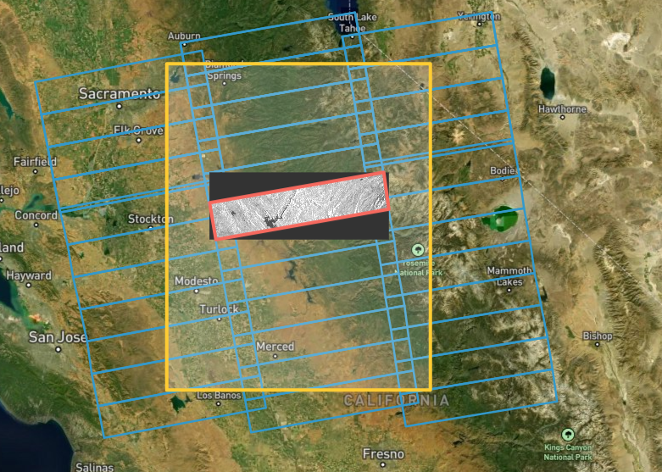
NISAR and OPERA GSLC products
The OPERA project is already producing ”CSLC” products from S1 data and archiving them at ASF.
Only the S1 VV data is distributed
The CSLC S1 product has a different name than “GSLC”, but it is a GLSC product.
Each S1 burst is archived in a separate file that can be easily mosaicked with the others to cover the standard S1 frames.
Much of the metadata is the same as provided for the RTC product
The OPERA project has not yet begun a self-assessment.
NISAR will also produce an image-frame GSLC product that will be similar to the OPERA S1 CSLC product ( but all acquired polarizations will be provided)
ASF DAAC vertex search page
OPERA CSLC S1 product

Slide 5
Data formats for OPERA and NISAR products
The OPERA S1 RTC product has the VV and VH in a Geotiff cloud-optimized format, metadata in hdf5 and xml, and a separate static layer for the incidence angle and the layover/shadow masks in Geotiff format.
The OPERA S1 CLSC product is in hdf5 format.
This format is being adopted by many NASA missions (GEDI, SWOT, etc.)
All the NISAR products will be archived in hdf5 format.
It is possible that the ASF DAAC will support on-demand conversion to other formats for distribution to users
NISAR has recently resolved a cloud optimization issue of the hdf5 format, and all NISAR products will be in an efficient cloud optimized hdf5 format.
While software support for hdf5 is present to some extent with most software (such as gdal), it is currently not as user-friendly as Geotiff.

Slide 6
Other ARD factors
While the data format is not specified for CEOS ARD, it can be an important factor in whether a data product is analysis ready.
For example, is it a data format that can be fully understood by gdal, arcgis, qgis, google earth, etc?
This is one reason geotiff is a popular format, as it is widely supported by software.
Another consideration, especially for large data sets, is whether the file is “cloud optimized”.
Data archive facilities are often now utilizing cloud computing infrastructures for data distribution that permit, for example, post-processing and analysis without first moving the data file out of storage.
The cloud optimization is best completed when initially making the product
The suitability for cloud processing may soon become another factor in whether a product is analysis ready.
The most analysis-ready platform may be Google Earth Engine, and yet many of the products there are not CEOS ARD compliant.
As part of CEOS ARD activities, it may be worthwhile for this group to ensure that widely used remote sensing formats and features continue to be supported by the various useful software packages.

