Slide 1
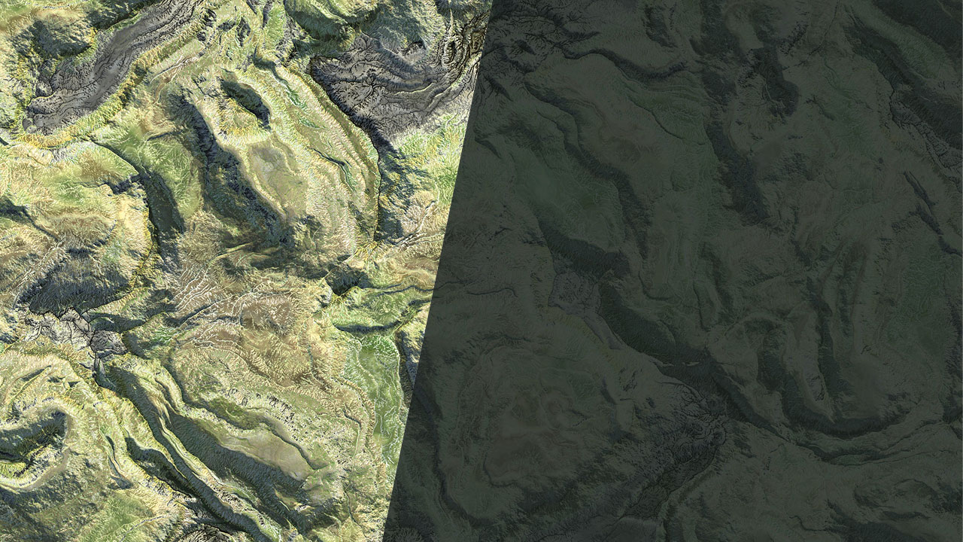
GEOGLAM Requirements Analysis Example USGS National Land Imaging Program 5 October 2023

Slide 2
Comparison of RCA User Needs Data to GEOGLAM Requirements Data
RCA User Needs
GEOGLAM Requirements
Attributes
Geophysical parameter
GCMD Hierarchy
Horizontal resolution (Min/Fully Satisfied)
Sampling interval (Min/Fully Satisfied)
Acquisition strategy
Geographic Coverage
Attributes
Agriculture Variable
Spatial resolution
Update frequency
Acquisition strategy
Assumed Global Agricultural Lands
Need to ensure these are apples-to-apples
Needed for analysis
Specific technologies are not explicitly part of RCA user needs
Sensors match to user needs based on the geophysical parameters they can provide
Assume field size is inherent in the needed spatial resolution

Slide 3
GEOGLAM User Need Development
Used 2019 GEOGLAM data collection
Selected two GEOGLAM requirements to use as test cases
Within season crop mask
Soil moisture
x
X
X
X
X
X
X
X
X
X
X
X
X
X
X
X
X
X
Spatial resolution needed for specific variable
Grouped each variable by spatial resolution resulting in 10 unique requirements

Slide 4
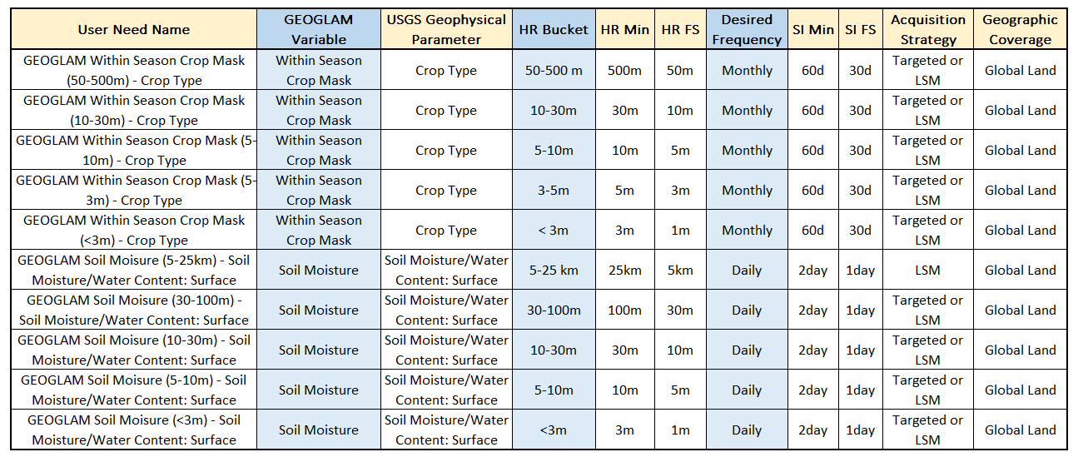
GEOGLAM User Needs Attributes
Geophysical parameter
Aligned GEOGLAM variable to GCMD Heirarchy
Horizontal Resolution
Used spatial resolution bucket
Sampling Interval
Used desired frequency as fully satisfied, 2x as minimum
Acquisition strategy
Assumed wall-to-wall was land survey mission only and crop extent could use tasking
Geographic coverage
Assumed all global land

Slide 5
Analysis Capabilities
International Components
U.S. Components
USGS
Landsat (8/9)
LandsatNext
NASA
SMAP
SWOT
ICESat 2
PACE
SBG
NOAA
GOES
JPSS
EC/ESA
Sentinel 1
Sentinel 2
Sentinel 3 OLCI
Sentinel 3 SRAL
Sentinel 3 SLSTR
Sentinel 6
SMOS
FLEX
BIOMASS
LSTM
CHIME
ISRO
ResourceSat
Core Architecture
Set of capabilities run in the analysis included US and international components
Systems included if data freely and routinely available to user community
Joint Components
NISAR
Note: Analysis was conducted with potentially out of date capability data
- Launch/end of life dates may be incorrect
- LNext system specifications were based on 2021 assumptions
- No high-resolution commercial data buys included
- Collection strategy/coverage may not be complete

Slide 6
Analysis Scoring
Analytical tool ingests user needs/capabilities and calculates a utility based on the output from 4 attribute scoring modules
Spatial Resolution Score
weight
User Need
Temporal Resolution Score
Geophysical Parameter Match
weight
Overall Score
Geographic Coverage Score
Capability
weight
Rating Score
weight

Slide 7
Performance Evaluation
Organized the tool’s quantitative score output into four qualitative categories defining the performance

Slide 8
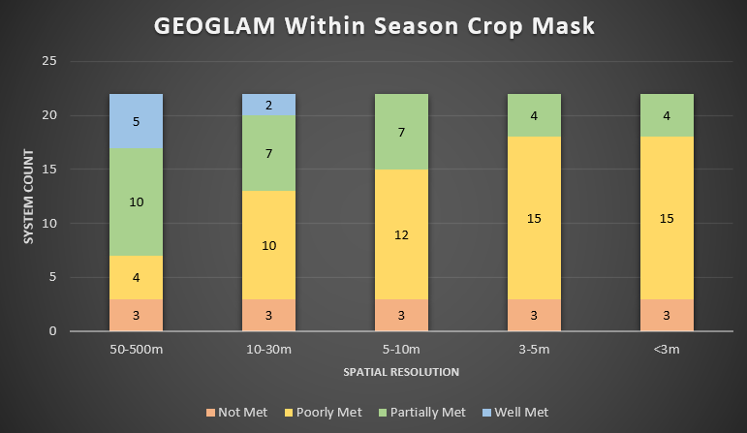
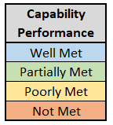
GEOGLAM Within Season Crop Mask
As the spatial resolution gets finer, the Core Architecture’s performance decreases
The Core Architecture has a better capability for within season crop mask with a 10-500m spatial resolution.
Note: Landsat (8-9), Sentinel 1 (A-D), Sentinel-2 (A-D), Sentinel 6 (A-B), ResourceSat-3/3A, VIIRS systems were treated as groups instead of per satellite

Slide 9
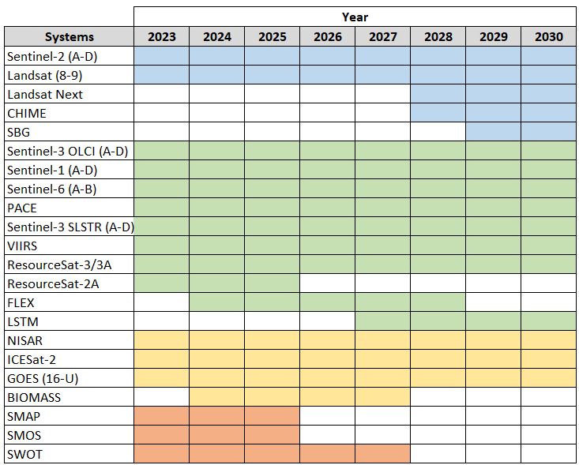
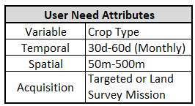
Within Seasonal Crop Mask 50-500m Analysis
Seasonal Crop Mask with a 50-500m requirement was Well Met by 5 systems

Slide 10
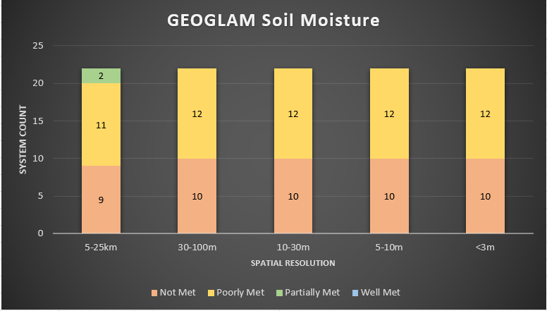
GEOGLAM Soil Moisture
Regardless of spatial resolution the core architecture system’s abilities are consistently poorly met from 100-3m
Core Architecture has better capability for soil moisture with a 5-25km spatial resolution.
Note: Landsat (8-9), Sentinel 1 (A-D), Sentinel-2 (A-D), Sentinel 6 (A-B), ResourceSat-3/3A, VIIRS systems were treated as groups instead of per satellite

Slide 11
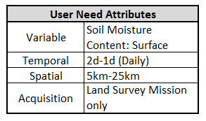
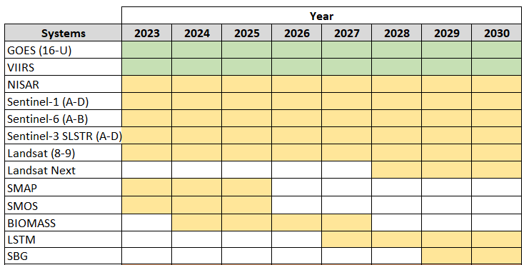
Soil Moisture 5-25km Analysis
Soil Moisture from 5-25km is Partially Met by GOES and VIIRS

Slide 12
Conclusion
This is one of a variety of views we can analyze/visualize this kind of data
Data collected by GEOGLAM is similar enough to RCA data at this point for analysis, but a few small changes would make it more valuable
Identifying a “Minimum” and “Fully Satisfied” value for horizontal resolution and sampling interval
Aligning GEOGLAM variables with GCMD Hierarchy
Collecting requirements in a technology-agnostic fashion as to not unintentionally exclude applicable solutions (ex: hyperspectral not an option in the 2019 chart)
What’s next?
Option to expand analysis to additional requirements from 2019
Option to do analysis for 2023 data once collected
Option to expand current analysis with additional views
Option to update capability data for a more up to date view of systems

Slide 13
Back up

Slide 14
GEOGLAM User Needs
GEOGLAM Within Season Crop Mask (50-500m) - Crop Type
GEOGLAM Within Season Crop Mask (10-30m) - Crop Type
GEOGLAM Within Season Crop Mask (5-10m) - Crop Type
GEOGLAM Within Season Crop Mask (3-5m) - Crop Type
GEOGLAM Within Season Crop Mask (<3m) - Crop Type
GEOGLAM Soil Moisture (5-25km) - Soil Moisture/Water Content: Surface
GEOGLAM Soil Moisture (30-100m) - Soil Moisture/Water Content: Surface
GEOGLAM Soil Moisture (10-30m) - Soil Moisture/Water Content: Surface
GEOGLAM Soil Moisture (5-10m) - Soil Moisture/Water Content: Surface
GEOGLAM Soil Moisture (<3m) - Soil Moisture/Water Content: Surface

