Slide 1
ARD Interoperability
Surface Reflectance Quality, Equivalency and Consistency
Simon Oliver
Geoscience Australia
LSI-VC 14
Frascati, 10-12 October 2023

Slide 2
Overview
What is this?
Why are we so invested in this?
Steps to get there (in broad terms)
The best way to progress (which forum?)
Potential pitfalls / things to avoid
Discussion on options and way forward

Slide 3
What is this?
Concept briefed at ARD23 Workshop and WGCV June 23 and paper circulated for comment.
Direct-source consistent, equivalent, high quality surface reflectance from space agencies, commercial space companies and value-adders.
Avoid reprocessing currently required to achieve measurand (physical quantity being measured) interoperability.
Evolution / next step and builds upon CEOS-ARD.

Slide 4
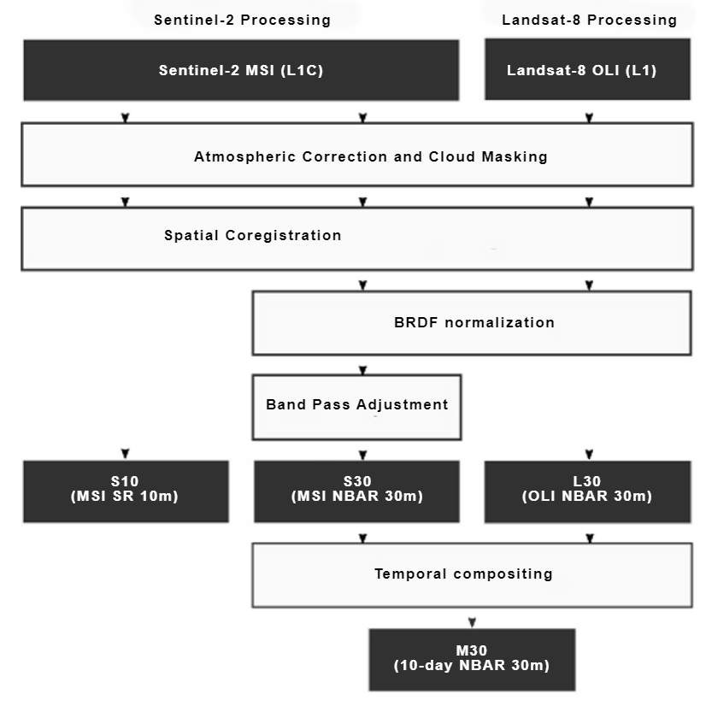
What is this?
"Quality Goal"
for the community
Proprietary value-add
Harmonization
Homogenization
NASA HLS https://hls.gsfc.nasa.gov/algorithms/

Slide 5
Why are we so invested in this?
Several organisations currently maintain pipelines for production of Surface Reflectance from Landsat and Sentinel-2 mission data. ​
NASA HLS, ESA Sen2Like, others..
Direct-source of ARD allows for:​
Reduced duplication of effort.​
Cost savings.​
Increased global applicability of algorithms -> rather than having them tuned to particular flavours of surface reflectance.​
Consistent time-series across sensors and providers.​
Steps towards harmonisation/homogenisation​
Focuses efforts on supporting space agencies to optimise their products​
Focuses efforts on value-adding with a common baseline measurand.​
Other benefits...​
​

Slide 6
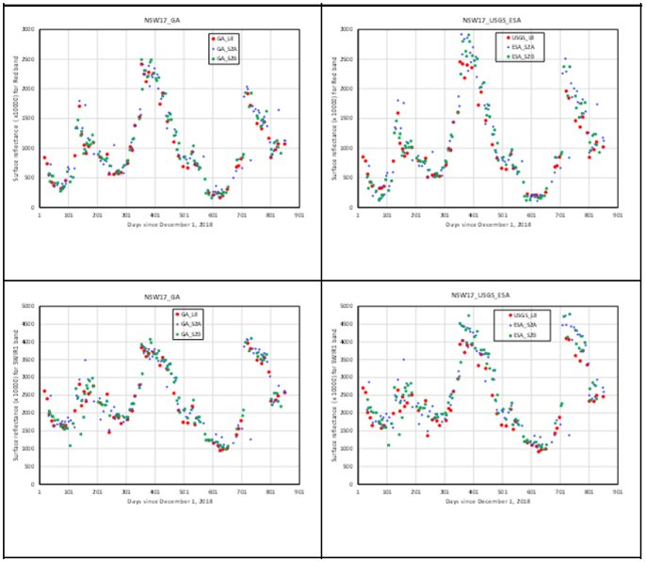
Why are we so invested in this?
Consistent approaches leads to equivalent surface reflectance measurands and yields better results from multi-sensor analyses.​
Time-series consistency with common methods and inputs
Common methods
Agency-specific approaches

Slide 7
Steps to get there
Engage the expert community
Define the target measurand
Explicit definition of surface reflectance in this context
Confirm the range of required inputs and methods
Determine tolerance of required inputs and methods
Publish through appropriate channels as a key reference for practitioners
CEOS-ARD Framework
Standalone guidance document
Surface Reflectance metadata specifications
Journal paper

Slide 8
What's the best way to progress this?
CEOS LSI VC Pilot?
Pros: Existing community of practice and the originators of CEOS ARD.
Cons: Expertise for pilot would likely need to come from outside LSI VC.
ARD Standard Working Group / ISO / OGC?
Pros: Contributes to current movement to solidify ARD as a specification.
Cons: Slow, much more work ahead of this specific aspect of ARD.
Journal article
Pros: Creates a seminal reference for future work on this topic.
Cons: Slow uptake / incomplete guidance from scientific focus.
CEOS-ARD Framework Expansion / Advisory Note?

Slide 9
Potential pitfalls / things to avoid
Divided expert opinion ("Do it my way.")​
Avoid this by being non-specific in terms of what brand of tool or input to use, and instead focus on requirements.​
Focus on specifics at the cost of the bigger picture in the short-term.​
Avoid this through focus on tangible outputs vs technical minutia .

Slide 10
Discussion on next steps
Document expressions of interest received so far
Expressions of Interest | Organisation
Eric Vermote | NASA
Martin Bachmann | DLR
Peter Strobl | EC

Slide 11
Thank you

