Slide 1
LSI-VC-14
2023
LST CDRs
Darren Ghent
NCEO University of Leicester
LSI-VC-14 2023, ESA/ESRIN
10th - 12th October 2023

Slide 2
Background
CDRs are robust, sustainable, and scientifically sound climate records that provide trustworthy information on how, where, and to what extent the land, oceans, atmosphere and ice sheets are changing. These datasets are thoroughly vetted time series measurements with the longevity, consistency, and continuity to assess and measure climate variability and change (NOAA, 2004).
ECV Inventory contains ~40 LST CDRS (existing + planned)
A CDR is not the same as a consistently reprocessed dataset

Slide 3
Requirements
Item | Type | Value | Notes
Horizontal resolution | G | <1 K | Only polar orbiting satellites can currently provide data at these resolutions
 | B | <1 K
 | T | 1 K
Temporal resolution | G | <1 hour | Only Geostationary data can provide data at these resolutions but these are regional datasets.
 | B | 1 hour
 | T | 6 hours | Very nearly met by day/night temporal resolution from polar orbiting satellite
Timeliness | B | 2 days
 | T | 30 days
Required Measurement Uncertainty | G | <1 K | Total uncertainty per pixel combining four components: random, locally correlated atmospheric, locally correlated surface, and large scale systematic. Requirement for correlation length scale knowledge
 | B | <1 K
 | T | <1 K
Stability | G | 0.1 K per decade | For climate modeling community long-term product stability is noted as high priority. Temporal stability of the LST products need to be sufficient for global and regional trends in LST anomalies
 | B | 0.2 K per decade
 | T | 0.3 K per decade

Slide 4
Building a CDR
For a CDR, LST data records from multiple sensors need to be consistently processed and harmonized
Level-1 input data should itself constitute a Fundamental Climate Data Record (FCDR)
Consistent calibration (brightness temperatures)
Corrections for orbital drift, stray light, …
Traceable uncertainty budget from the measurement equation
Harmonisation across missions
Consistency in processing includes retrieval algorithm, auxiliary data, cloud masking, uncertainty model

Slide 5
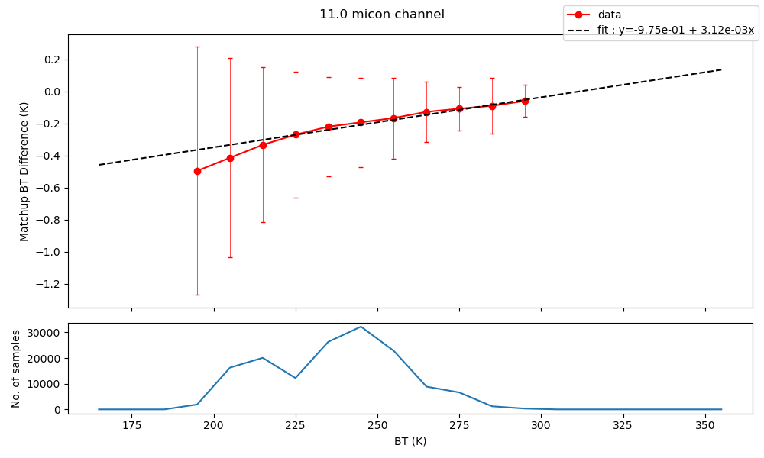
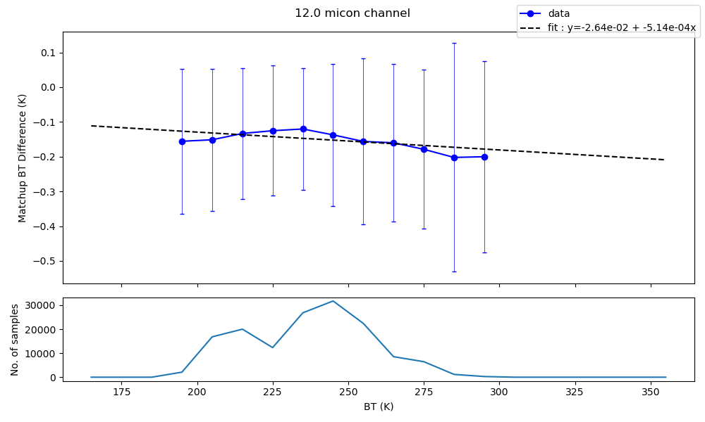
Intercalibration
Where no FCDR exists LST CDR data providers need to build a FCDR
Intercalibration in BT space against a reference sensor, such as IASI, with BTs processed from reference sensor spectra using SRFs.
Method of GSICS heritage

Slide 6
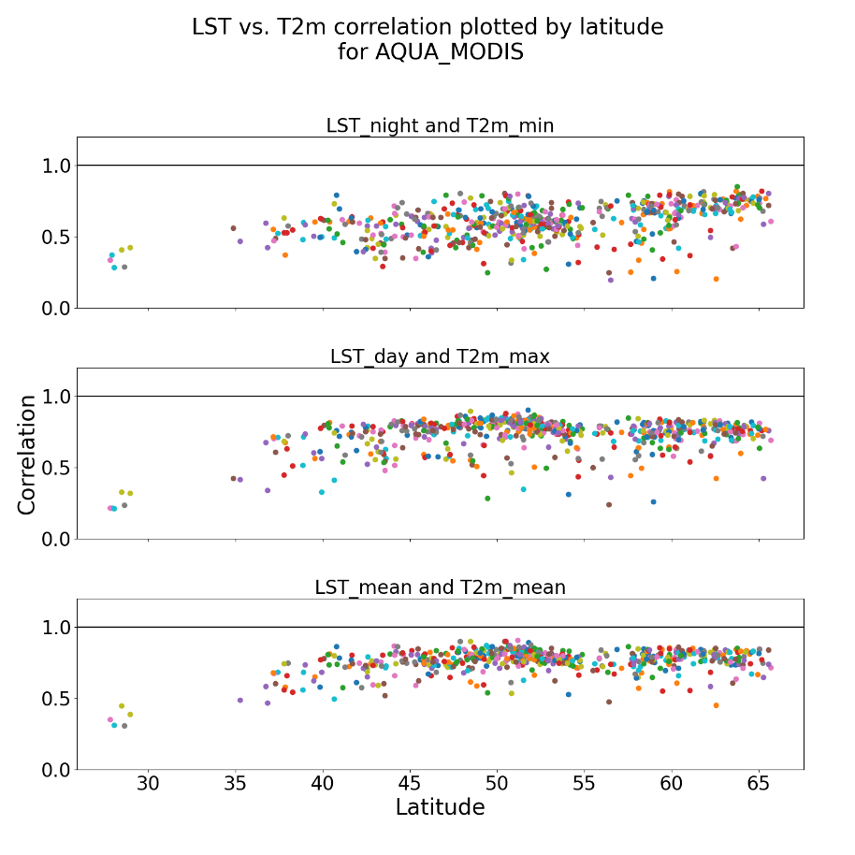
Assessment
Compared LST_cci anomalies with homogenised near-surface air temperature anomalies from EUSTACE dataset.
LST vs T2m correlations are significantly improved in in the datasets recently released to the CCI Open Data Portal.
Conclusion is datasets, such as LST_cci Aqua-MODIS, are considered homogeneous and thus suitable for use for robust climate trend analysis.
Good et al., 2022, An Analysis of the Stability and Trends in the LST_cci Land Surface Temperature 1 Datasets over Europe, ESS

Slide 7
CDRs and Long time-series
Example Thematic CDRs:
ESA LST_cci CDRs (MODIS, SLSTR, Merged IR, ATSRs, SSM/I, GOES)
CM SAF TCDR (MVIRI + SEVIRI)
NASA MEaSUREs (GEO LST [GOES], LEO LST [MODIS + VIIRS])
Interim CDRs to address the GCOS timeliness requirement
NRT data underpinned by a consistent historical data record
Currently no ICDRs for LST (planned SLSTR one coming soon)

Slide 8
Summary
ECV Inventory reports the current and planned LST CDRs
No independent assessment of the quality of these CDRs
Most satellite level-1 data from agencies used for LST are not processed as FCDRs
LST data providers should develop an FCDR if one doesn’t exist
GCOS requirements for a CDR are very demanding particularly on stability
LST data products are usually validated but not assessed for long-term stability

