Slide 1
Drone Mapping for ARD Validation Testing
Brian Killough
CEOS Systems Engineering Office (SEO)
LSI-VC Meeting – Frascati, Italy
October 12, 2023

Slide 2
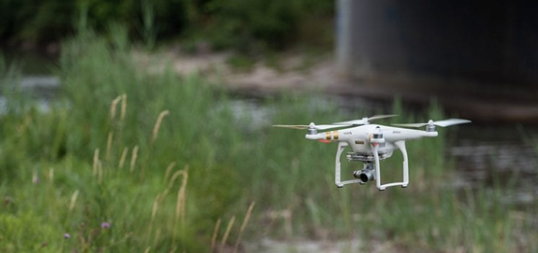
What is the state of drone imaging?
Text
Text
Text
Drones are becoming more popular as they are now “cheap” and available to anyone. The market is growing at a 30% annual rate.
Drones are becoming more capable due to technology advancements
Improved cameras … spatial resolution of a few centimeters!
Improved stability and control
Improved flight planning software and data processing software
Ability to carry small and complex payloads (e.g., hyperspectral imagers)
Their contribution to Earth Science is growing!
Their connection to CEOS satellite data is real. Did you know ESA is funding a drone-based Cal-Val campaign called SRIX4VEG with CEOS endorsement?

Slide 3
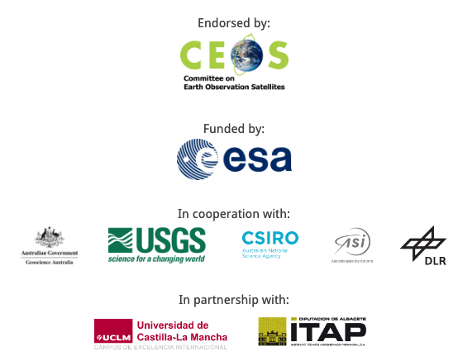
What is SRIX4VEG?
Text
Text
Text
SRIX4VEG = Surface Reflectance Intercomparison Exercise for Vegetation
The initiative is developing guidelines for UAV-based surface reflectance product validation
No good practice protocol exists for data collection from UAVs to support Earth Observation validation.
SRIX4VEG has been initiated in the frame of the CEOS Working Group on Calibration and Validation (WGCV), in order to put forward a good practice protocol that is jointly determined by the participants through a dedicated campaign and a series of workshops.

Slide 4
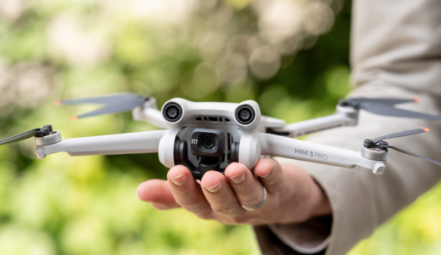
My experience with drone imaging
I own a DJI Mini-3 Pro … about $1000 USD with controller, 249 grams
Altitude = 120 meters (max allowed due to aircraft regulations)
Image size = 12 MP (4000 x 3000) = (179 x 135 meters at 120-m altitude)
Spatial Resolution = ~ 4-cm GSD (ground sample distance)
Orthorectification … Each JPG image (7 MB) contains a GPS coordinate at the center. Multiple overlapping images can be combined to yield an orthorectified larger image. The key requirement is that you use lots of overlap >70% for images to get good “triangulation”. You can also add a Ground Control Point (GCP) file for precise locations or use QGIS plugins for manual georectification. I have tried them all …
Software … Open Drone Map (ODM) is a great open source software solution. I have also used their web-based “Lightning” version with 150 free credits. It takes about 2 minutes to create an orthorectified image based on 20 base overlapping images.
Mapping … Manual or using flight planning software (e.g., Dronelink). It is a VERY time consuming process to set up mapping schemes.
Text
Text
Text

Slide 5
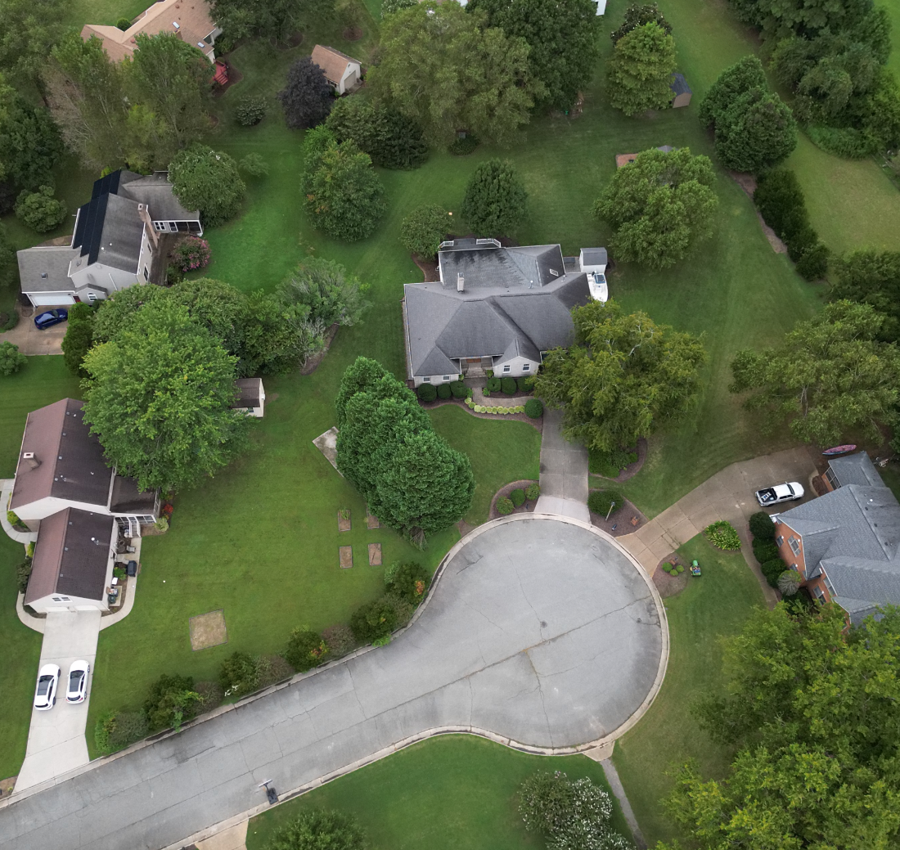
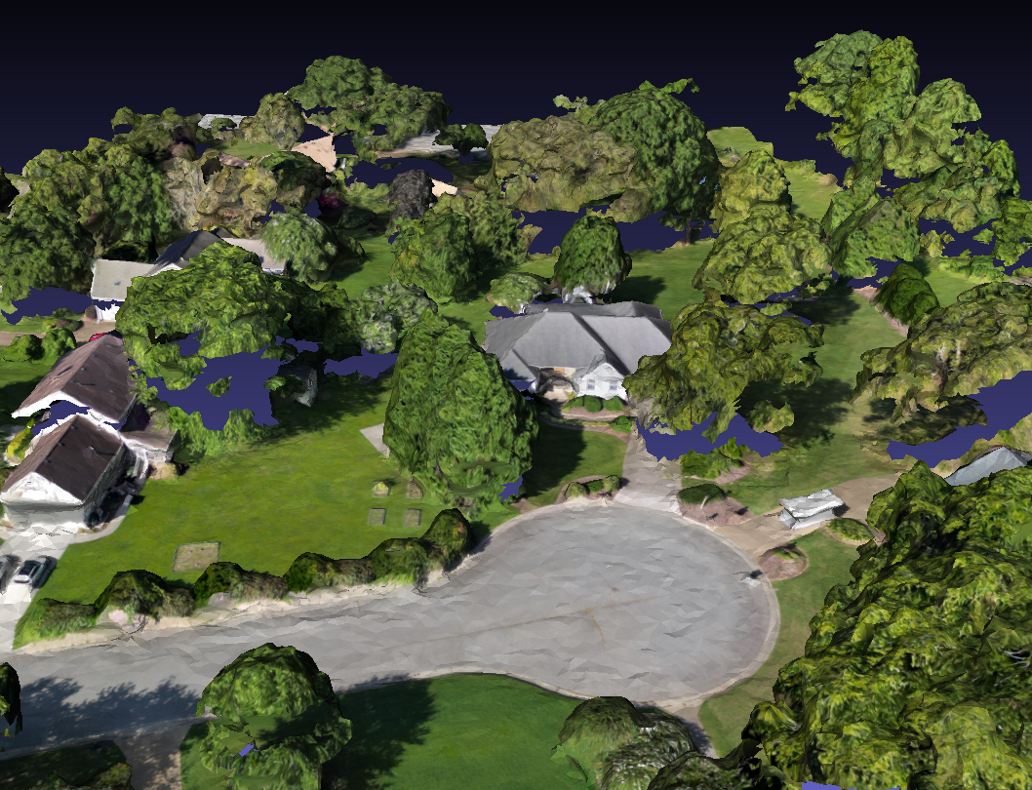
Drone Product Examples
Text
Text
Text
Common drone JPG image
DJI Mini-3 Pro – 12MP
3D Mesh Image
Open Drone Map processing + MeshLab Viewer
Possible to measure heights of objects

Slide 6
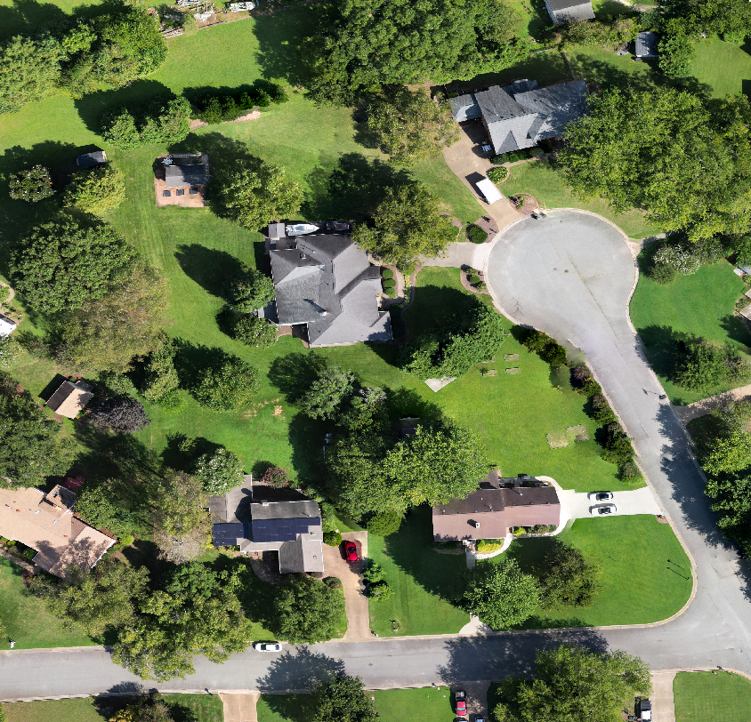
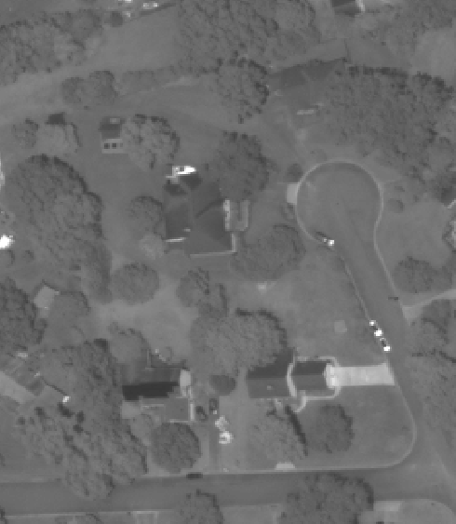
Image Comparisons
DJI Mini-3 Pro Drone: 3.8-cm resolution September 12, 2023
Maxar Worldview-3: Panchromatic Band
50-cm resolution June 17, 2023

Slide 7
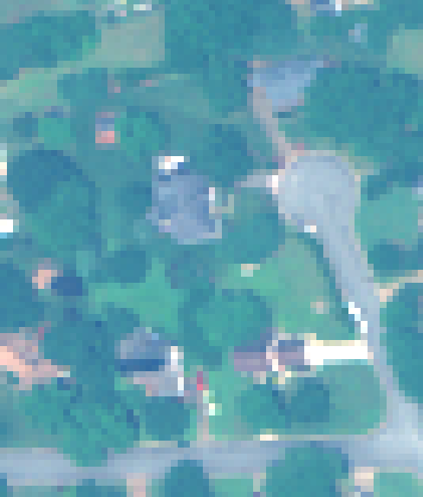
Image Comparisons
Maxar Worldview-3: Panchromatic Band
50-cm resolution June 17, 2023
Maxar Worldview-3: Multispectral Band
2-meter resolution June 17, 2023

Slide 8
Image Comparisons
Maxar Worldview-3: Multispectral Band
2-meter resolution June 17, 2023
Planet Lab: 3-meter resolution June 17, 2023

Slide 9
Image Comparisons
Planet Lab: 3-meter resolution June 17, 2023
Sentinel-2: 10-meter resolution June 14, 2023

Slide 10
Image Comparisons
Sentinel-2: 10-meter resolution June 14, 2023
Landsat-8: 30-meter resolution June 13, 2023

Slide 11
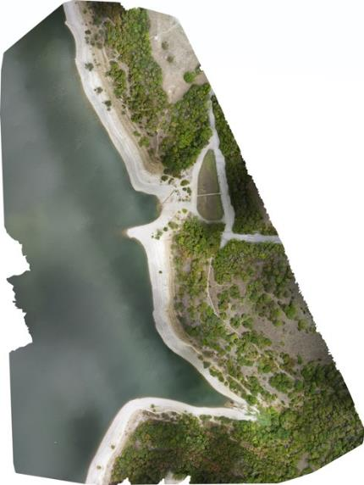
Drone Product Examples
From Brian Terry – Analytical Mechanics Associates (AMA)
Benbrook Lake - Fort Worth, Texas
Imagery acquired with DJI Mavic Mini 2
Orthomosaic processed using Open Drone Map
* Funded by GEO-Microsoft Program
Landsat-8 image

Slide 12
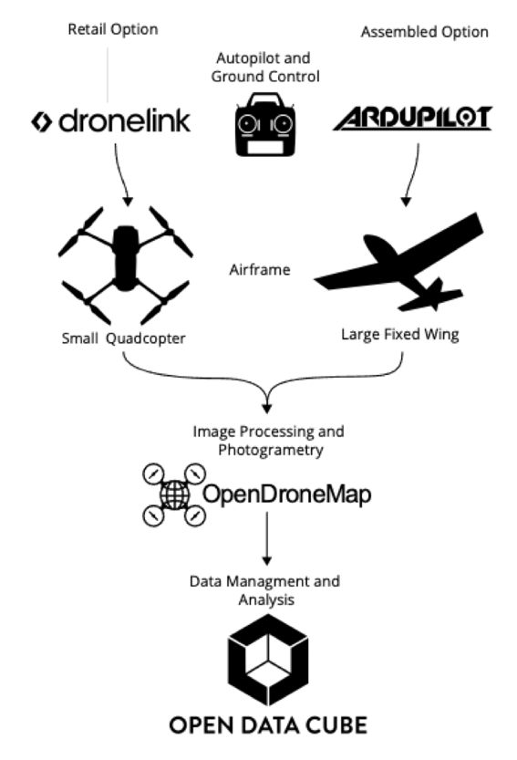
Drone Flight Pipeline (from AMA)
Text
Text
Text
Determine Region of Interest
Use CEOS COVE tool to predict Landsat 8 or Sentinel-2 flyover dates and times – Use the Acquisition Forecaster
Generate flight path (DroneDeploy or Dronelink) and perform flight
Process flight data with OpenDroneMap and obtain GEOTIFFs
Use AMA (Analytical Mechanics Associates) developed drone data import scripts to import the data into the ODC (Open Data Cube)

Slide 13
Thoughts for the Future
Text
Text
Text
Advantages for Basic Education about different EO sources … what can we see from space and how does it compare to what we know on the ground?
Advantages for Capacity Building and Training … collecting and processing drone data can be a great hands-on experience. Further correlation with CEOS satellite data enhances the training.
Support for UN-SDGs by providing data equity and independence for remote regions. Cost-efficient and drones can fill the gap between commercial and public datasets and promote the impact of EO data.
Advantages of ODC Integration … AMA has made some good progress integrating drone data into data cubes. Making this process faster and more efficient could be quite valuable.
What other ideas might LSI-VC have to take advantage of this growing technology?

