Slide 1
CEOS SEO Plans for an ARD Interoperability Test Using the CEOS Analytics Lab (CAL) as a ‘New Space’ Demonstration
Brian Killough
CEOS Systems Engineering Office (SEO)
LSI-VC Meeting – Frascati, Italy
October 12, 2023

Slide 2
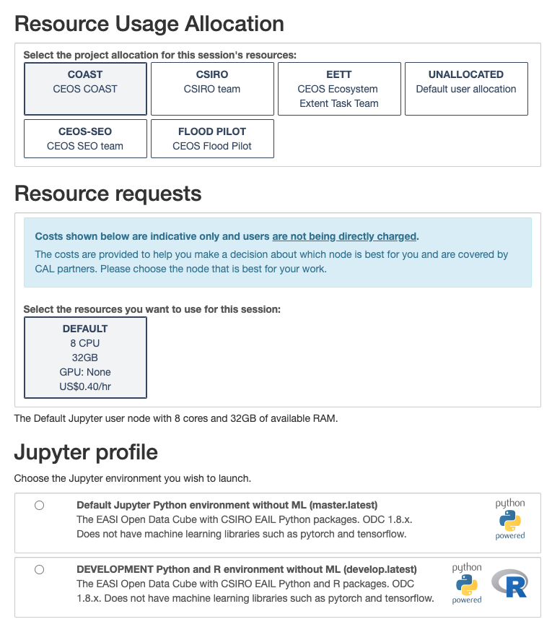
The overall plan
Goal: Conduct an ARD interoperability test using the CEOS Analytics Lab (CAL) as a contribution to the CEOS “New Space” initiative
ARD Interoperability: Evaluate how ARD datasets from CEOS can be used interoperably with datasets from the commercial space providers.
What are the issues using these datasets together?
Can CEOS provide any tools or utilities that would improve the interoperability?
Can CEOS make any recommendations to the commercial space providers that would improve the use of their data and its marketability?
CEOS Analytics Lab (CAL): Use the cloud-based CAL tool to conduct the test. This will enable participation across SEO-funded partners and take advantage of the CSIRO Jupyter Python environment and Open Data Cube (ODC) utilities.
CEOS New Space initiative: The CEOS organization is searching for tangible tasks that can demonstrate improved connections between CEOS data and commercial data.
https://hub.cal.ceos.org

Slide 3
The proposed analysis plan
Test Case #1: Optical Data Comparison
Area of Interest: Hampton, Virginia and the Chesapeake Bay
CEOS Datasets: Landsat 8/9, Sentinel-2A/2B, Sentinel-1A
Commercial Datasets: Planet Lab, Maxar (from NASA CSDA contract)
Test Case #2: Radar Data Comparison
Area of Interest: Southeast Asia (small rice fields – Mekong or Malaysia ???)
CEOS Datasets: Sentinel-1A, ALOS-2 ScanSAR, SAOCOM-1A/1B
Commercial Datasets: Umbra ???, ICEYE and Capella (from NASA CSDA contract)
Interoperability questions
CEOS ARD compliance? Dataset formats and metadata parameters.
Georectification consistency .. What are alignment errors?
Spectral/Radiometric consistency … What are the differences?
WGCV and WGISS collaboration … Can we work with other CEOS groups define the tasks?

Slide 4
Feedback from LSI-VC
Should we include collaboration with WGCV or WGISS?
Should we share the results with the commercial space data providers and how?
How do we see this benefiting the CEOS New Space effort?
Do you have any other ideas to consider for addition to this effort?

