Slide 1
CEOS-ARD for Synthetic Aperture Radar [CARD4SAR] Geocoded Single-Look Complex [GSLC]
Ake Rosenqvist^{1,2,} Takeo Tadono², Francois Charbonneau^{3,}, Clément Albinet⁴, Bruce Chapman⁵, Danilo Dadamia⁶; Guillaume Hajdush⁷, Josef Kellndorfer⁸, Marco Lavalle⁵,
Thomas Logan⁹, Franz Meyer⁹, Nuno Miranda⁴, Paolo Pasquali¹⁰; Marko Repse^{11,}
HariPriya Sakethapuram¹², Andreia Siqueira^{13;} David Small¹⁴, Medhavy Thankappan^{13,}
John Truckenbrodt¹⁵, Fang Yuan¹⁶, Howard Zebker¹⁷, Zheng-Shu Zhou¹⁸
1 – soloEO; 2 – JAXA; 3 – NRCan; 4 – ESA; 5 – NASA JPL;
6 – CONAE; 7 – CLS group; 8 – EBD; 9 – ASF; 10 – sarmap;
11 – Sinergise; 12 – ISRO; 13 – Geoscience Australia;
14 – Univ. Zürich; 15 – DLR; 16 – Digital Earth Africa;
17 – Stanford Univ; 18 – CSIRO
LSI-VC-14
Agenda Item 5.2
Frascati, Italy
October 10-12, 2023

Slide 2
LSI-VC-14 – Agenda Item 5.2
SAR & Lidar PFS status
PFSs for consideration @ LSI-VC-14
Geocoded SLC
Combined “CEOS-ARD for SAR”
Implications on the existing portfolio of CEOS-ARD SAR products
Discussion and potential endorsement.

Slide 3
LSI-VC-14 – Agenda Item 5.2
SAR and Lidar PFS status

Slide 4
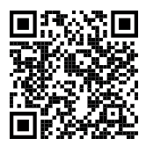
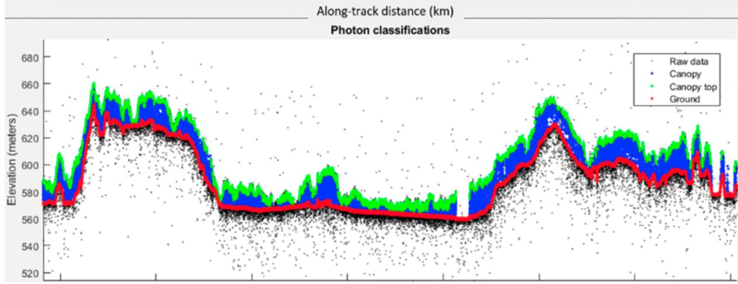
CEOS-ARD for (Spaceborne) Lidar
PFS: Lidar Terrain & Canopy Height
Footprint (1D single-source) product
Gridded (2D multi-source) product – under discussion
Prime focus on spaceborne Lidar
Accommodating full waveform and photon counting systems
Current ARD-Lidar team members
Lidar mission teams:
GEDI, MOLI, ICESat-2
Data Providers:
NASA LP-DAAC; NSIDC; USGS (TBC),
Science community
Schedule (easy does it...)
First PSF draft: Q1/2024
Lidar Terrain & Canopy Top Height PFS draft (based on new CEOS-ARD PFS template)
Terrain & canopy top height from ICESat-2
(Neuenschwander et al, 2019)

Slide 5
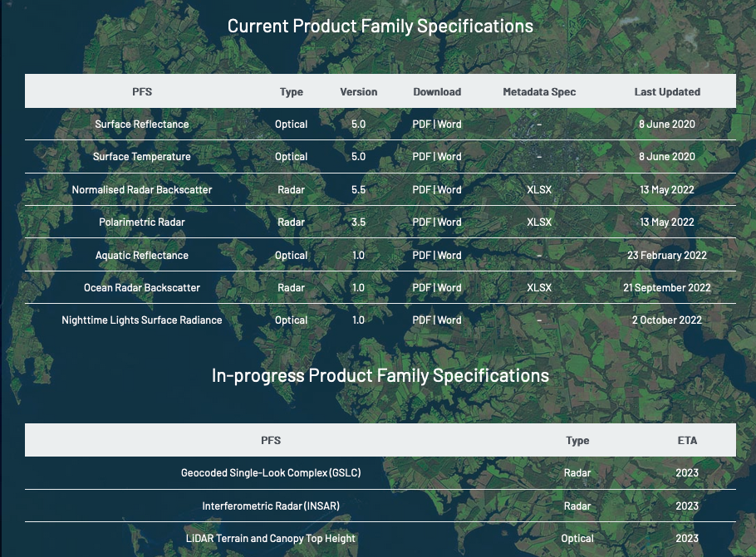
CEOS-ARD for Synthetic Aperture Radar
Endorsed:
Normalised Radar Backscatter (NRB v5.5)
Polarimetric Radar (POL v3.5)
Ocean Radar Backscatter (ORB v1.0)
For endorsement @ LSI-VC-14:
Geocoded SLC (GSLC)
Next in line:
Interferometric Radar (INSAR)
Community uptake:
Approved NRB compliant:
DE-Africa/Sinergise (Sentinel-1)
JAXA (ALOS-2 PALSAR-2)
CSIRO (NovaSAR-1) [NEW]
Ongoing NRB self-assessments or preps
ESA (all SAR), DLR (S1), NASA (OPERA), CONAE (SAOCOM), ISRO (RISAT-1A), KARI (KOMPSAT-5), …

Slide 6
LSI-VC-14 – Agenda Item 5.2
Geocoded Single-Look Complex
[GSLC]

Slide 7
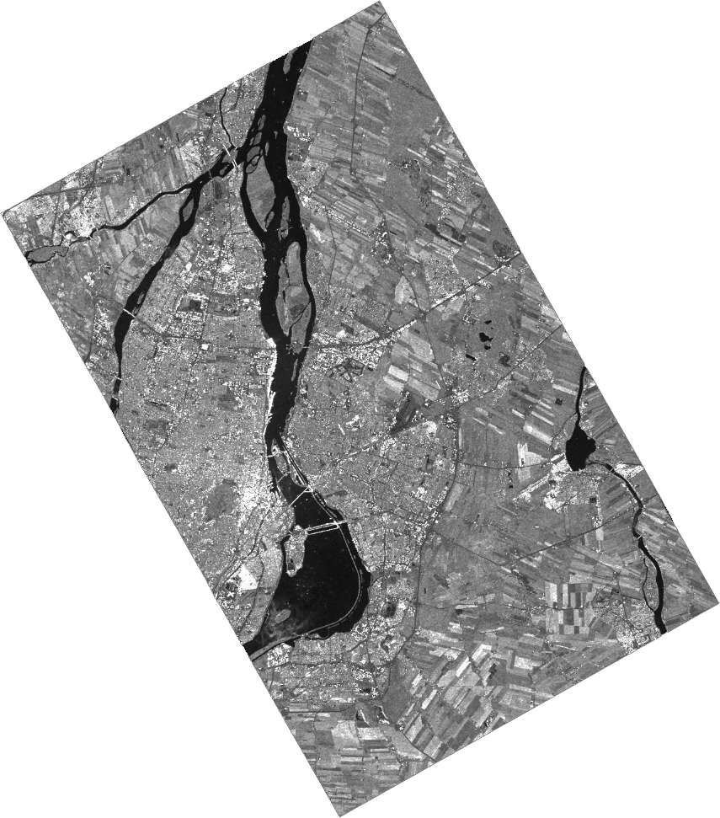
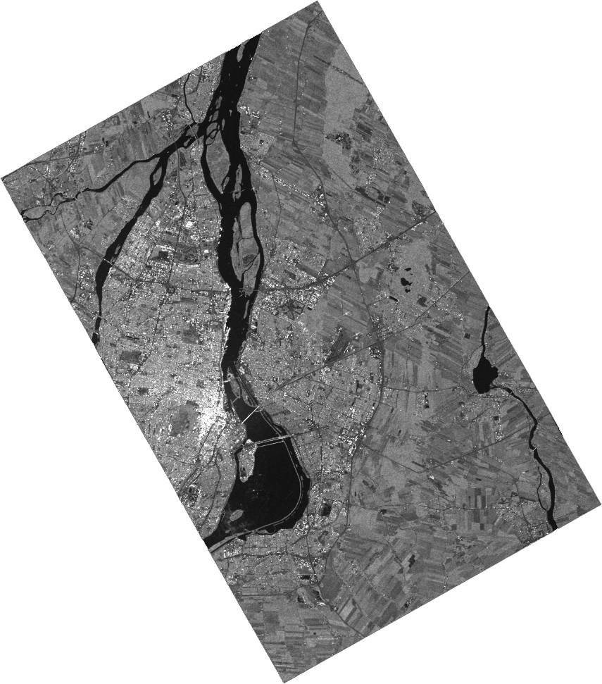
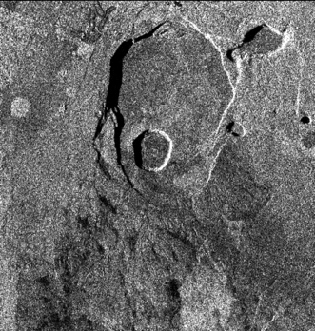
Geocoded Single-Look Complex [GSLC]
RCM1 ©CSA Proc. F. Charbonneau, NRCan
GSLC Measurement data:
Geometric Terrain Correction (map proj) relative to a common reference orbit
Radiometric Slope Correction (RTC)
Backscatter expressed as gamma-nought, γ0
Measurement data provided in complex (float64) format from which backscatter amplitude/power and phase can be derived.
Co-registered GSLC images in a stack have same geometry 🡪 interferometric applications feasible by simple image math.
HH HV
PALSAR GSLC stack. Proc. H. Zebker

Slide 8
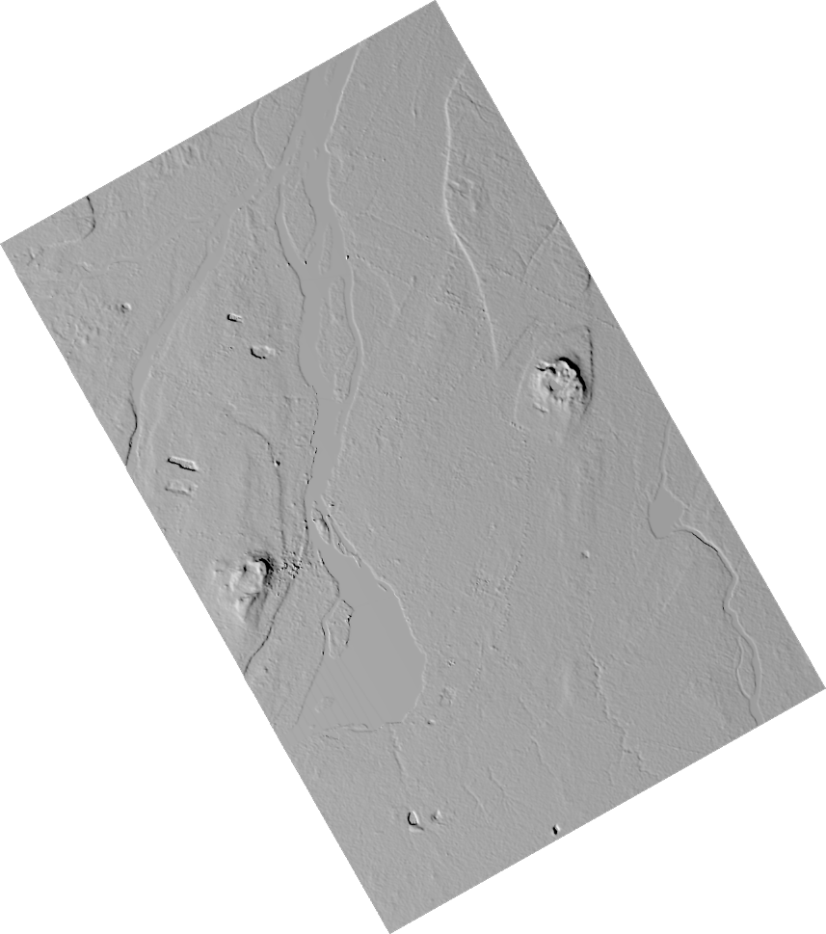
Geocoded Single-Look Complex [GSLC]
Per-Pixel Metadata (Common for all SAR PFSs)
Data Mask Image (Thresh.)
Scattering Area Image (Goal)
Local Incident Angle Image (T)
Ellipsoidal Incident Angle Image (G)
Noise Power Image (G)
Gamma-to- Sigma Ratio Image (G)
Acquisition ID Image (T)
Per-pixel DEM (G)
Per-Pixel Metadata (GSLC specific)
Radar Unit Look Vector Grid Image (G)
Slant Range Sensor to Surface Image (G)
InSAR Phase Uncertainty Image (G)
Atmospheric Phase Correction Image (G)
Ionospheric Phase Correction Image (G)
Complex backscatter
InSAR Phase
Radar Unit Look Vector
Gamma-to- Sigma Ratio
RCM1 ©CSA Proc. F. Charbonneau, NRCan

Slide 9
LSI-VC-14 – Agenda Item 5.2
CEOS-ARD for Synthetic Aperture Radar
[CARD4SAR]

Slide 10
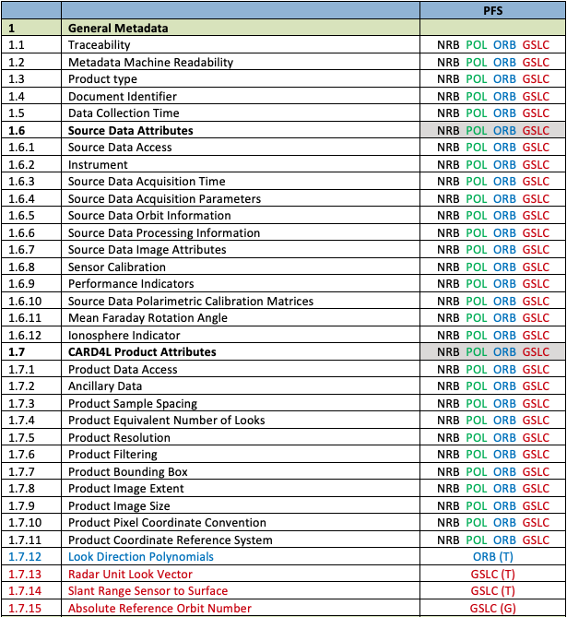
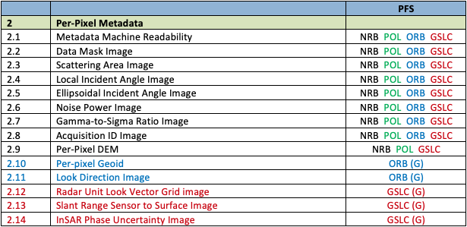
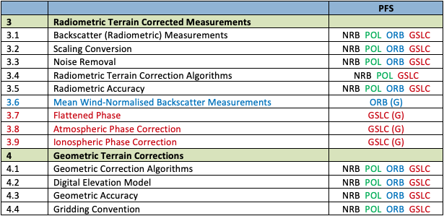
CEOS-ARD for Synthetic Aperture Radar
Large number of SAR PFSs (NRB, POL, ORB, GSLC) – and more to come
Challenge for users and data providers
70% commonality of parameters
Common parameters must match
Revisions to one PFS may affect several or all
Challenge to keep track & risk for inadvertent inconsistencies
42 of 60 parameters common across the SAR PFSs

Slide 11
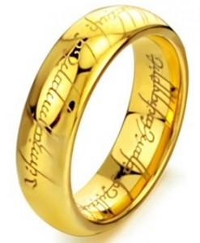
CARD4SAR – One PFS to Rule Them All
Single PFS for all CEOS-ARD SAR products:
NRB, POL, ORB, GLSC
Benefits:
Ensure consistent parameter names and specifications across all SAR PFSs
Simplify PFS revisions and change tracking
Simplifying interface with ongoing external standarisation frameworks (OGC/ISO, STAC)
Elegance:
CARD4SAR PFS facilitates the generation of one, several or all of the CARD SAR products – a true combined SAR ARD product
Reduces duplication of per-pixel metadata
CEOS-ARD for SAR

Slide 12
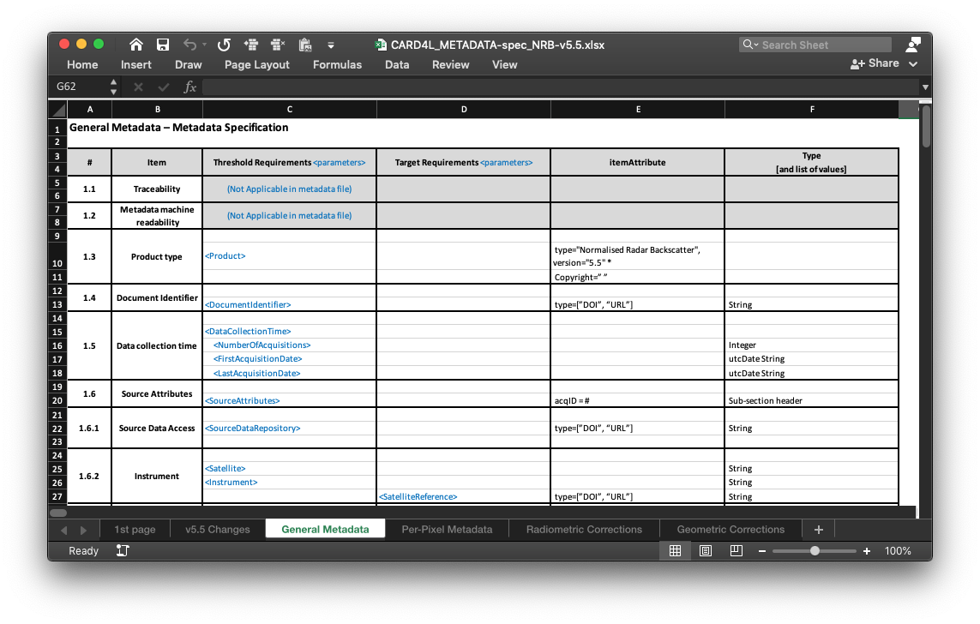
CARD4SAR – One PFS to Rule Them All
CARD4SAR Metadata
Accompanying single metadata specification
Consistent mapping of parameter names between PFS and metadata
Specs for XML format but data provider may select other metadata formats
(For discussion – need for additional GeoJson spec (for selected parameter) to support STAC)
Non-mandatory (Target req.)

Slide 13
LSI-VC-14 – Agenda Item 5.2
Implications on the existing portfolio
of CEOS-ARD SAR products

Slide 14
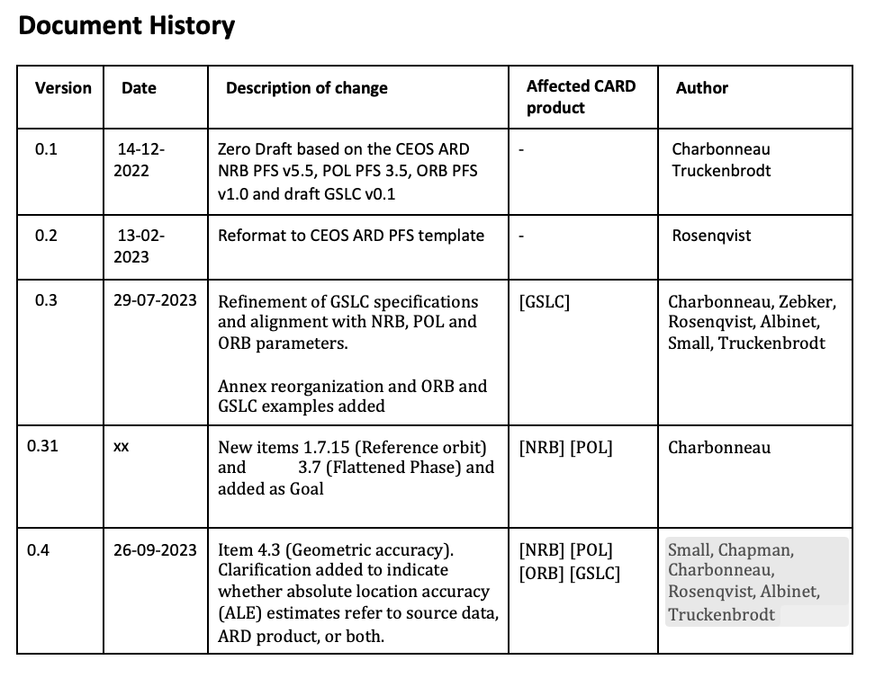
LSI-VC-14 – Agenda Item 5.2
Traceability – PFS
PFS Document History tracks revisions to each original SAR PFS (NRB, POL, ORB, GSLC)
No changes to THRESHOLD requirements of endorsed PFSs (NRB v5.5, POL v3.5, ORB v1.0) in CARD4SAR v1.0

Slide 15
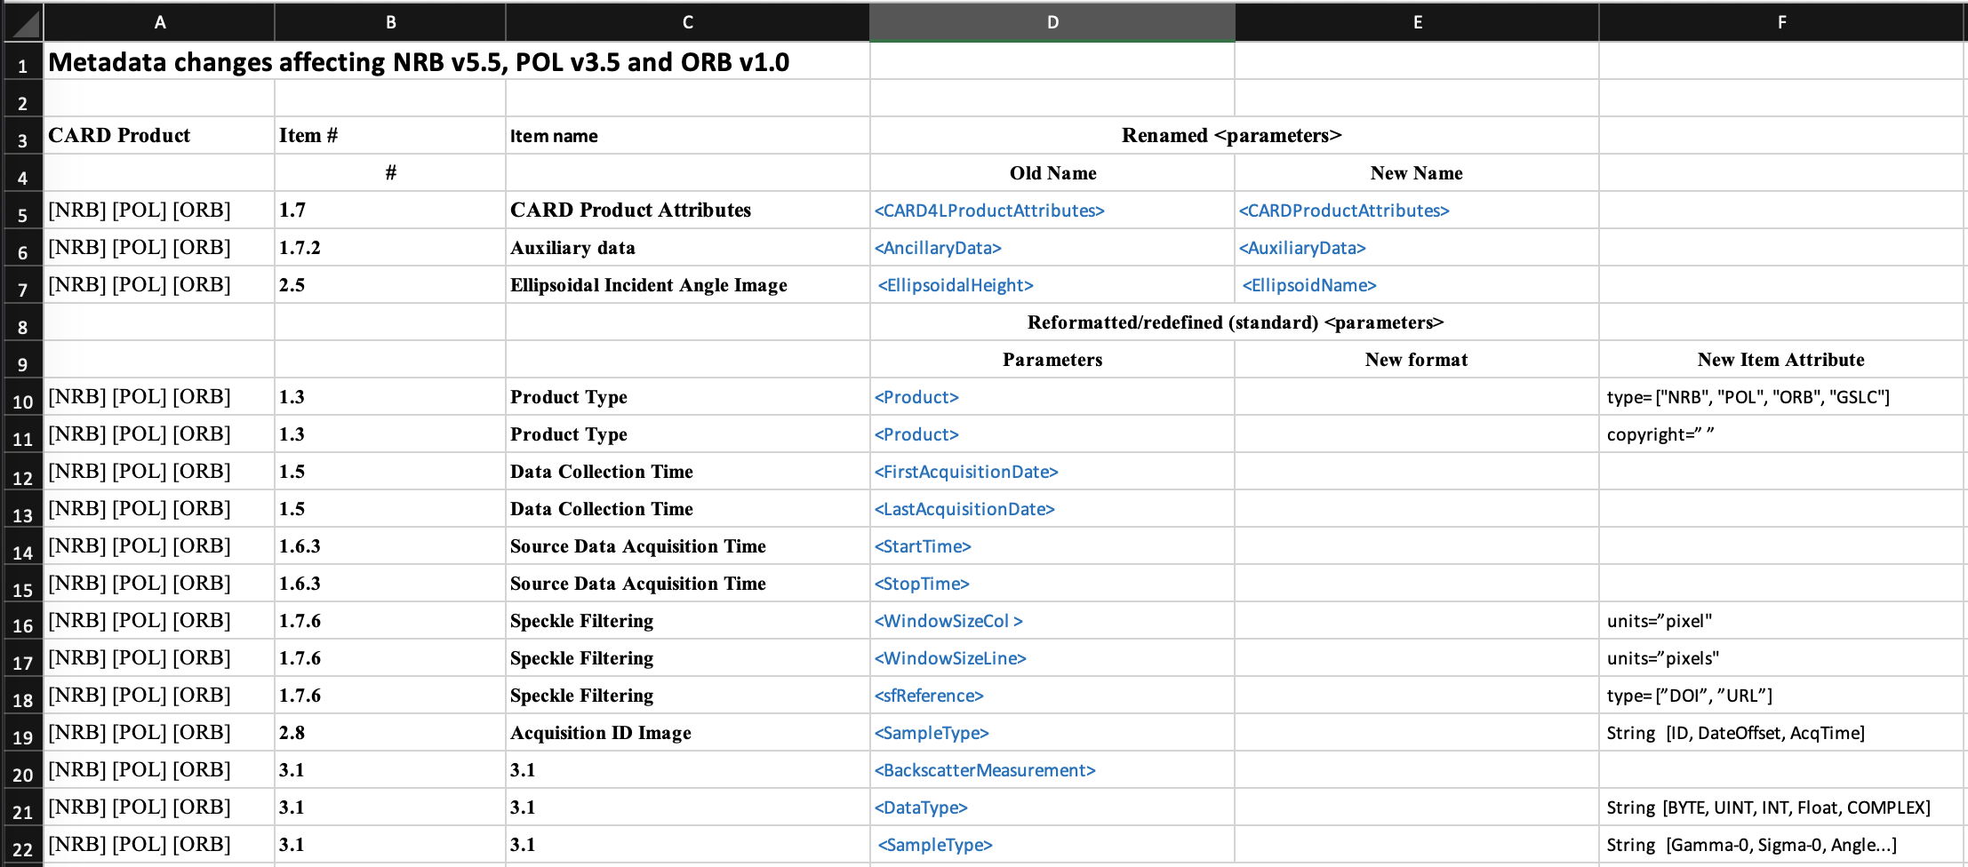
LSI-VC-14 – Agenda Item 5.2
Traceability – Metadata

Slide 16
LSI-VC-14 – Agenda Item 5.2
Discussion and potential endorsement

