Slide 1
CEOS-ARD Product Evaluation
Medhavy Thankappan and Peter Harrison
Geoscience Australia
LSI-VC 14
Frascati, 10-12 October 2023

Slide 2
CEOS-ARD Review Process
ORIGINAL PROCESS

Slide 3
CEOS-ARD Review Process
MODIFIED PROCESS
ONLY FOR TARGET LEVEL EVALUATIONS
LSI-VC Secretariat: Matt Steventon, Symbios
WGCV PoC: Medhavy Thankappan, GA
WGCV Alternate PoC: Clement Albinet, ESA
Supported by Peter Harrison, GA

Slide 4
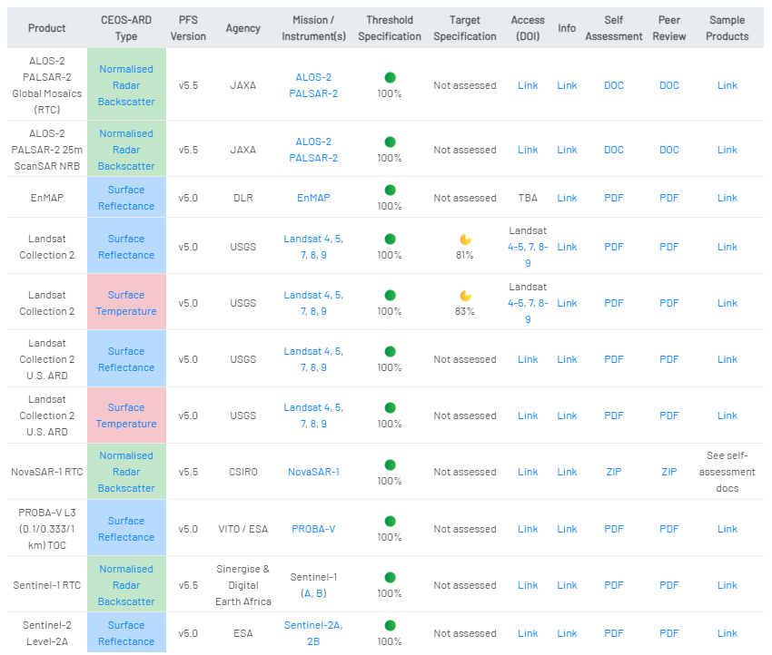
CEOS-ARD Evaluation (complete)

Slide 5
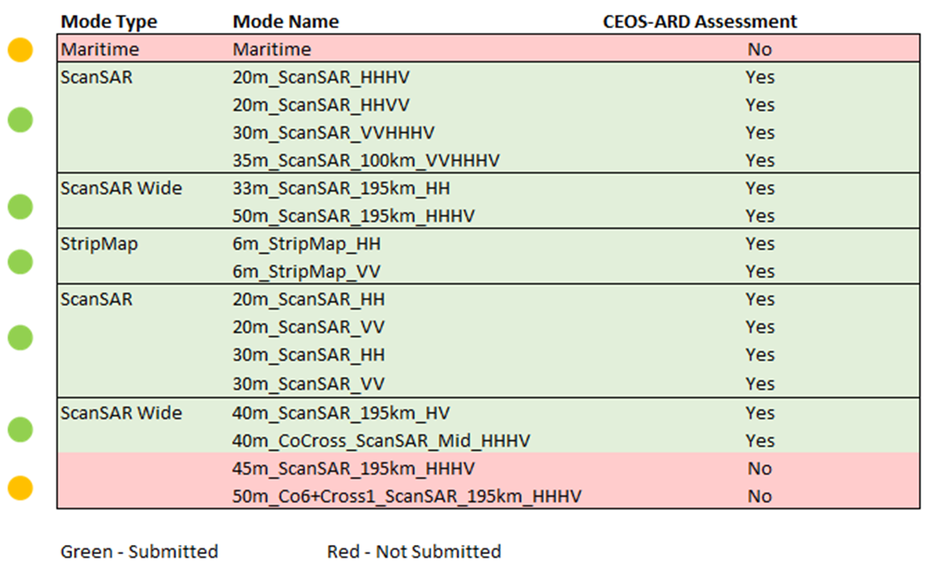
NovaSAR Product Evaluation

Slide 6
CEOS-ARD Evaluation (in progress)
Review pending clarification from data provider

Slide 7
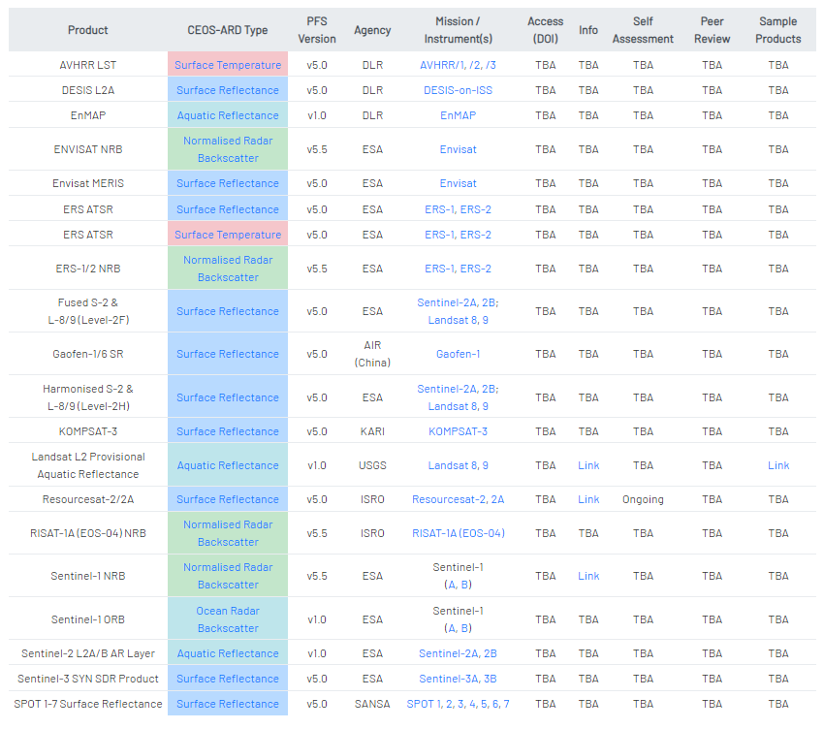
CEOS-ARD Evaluation (outlook)
https://ceos.org/ard

Slide 8
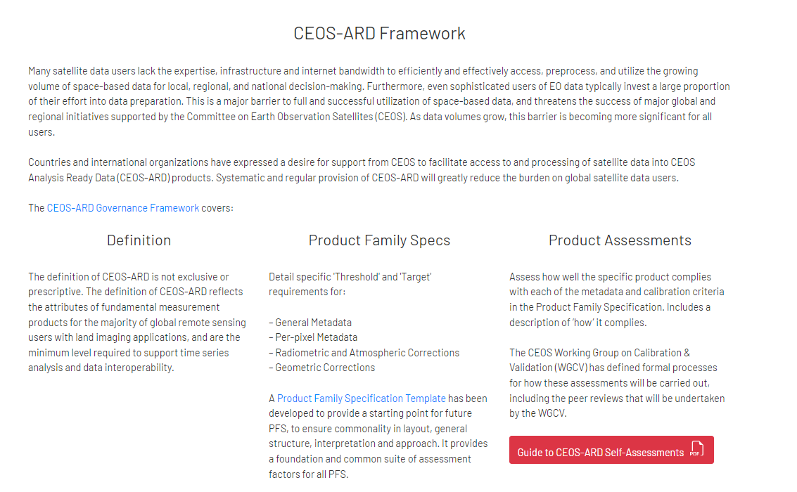
CEOS-ARD Self-Assessment Guide
Guide for CEOS-ARD Self-Assessment available
USGS helped with final edits to the Guide
Completed self-assessment PFS to be submitted for review via email
Email for submission of self-assessments ard-contact@lists.ceos.org
https://ceos.org/ard/files/User%20Guide/CEOS_ARD%20User%20Guide%20v1_3_Final_06152023.pdf

Slide 9
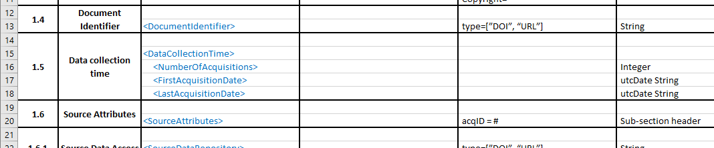
PFS Feedback
Minor discrepancy with Normalised Radar Backscatter PFS v5.5
General Metadata Section 1.5
The Excel spreadsheet requires just a date, while the pdf document specifies need for an additional time stamp
For single date products, only the date is required in Section 1.5 as time is provided in Section 1.6.3

Slide 10
Thank you
medhavy.thankappan@ga.gov.au
peter.harrison@ga.gov.au

