Slide 1
ESA S-1 ARD implementation
LSI-VC-14 meeting
Clément Albinet (ESA)
SAR Data Quality and Cal/Val Manager
11th October 2023

Slide 2
Overview
What is an ARD product?
ESA general approach
CEOS ARD Normalised Radar Backscatter
Sentinel-1 NRB prototype
CEOS Ocean Radar Backscatter
S1 ORB prototype product and processor development
Status and way forward

Slide 3
What is an ARD product?
Definition CEOS Analysis Ready Data (ARD): “[…] data that have been processed to a minimum set of requirements and organized into a form that allows immediate analysis with a minimum of additional user effort and interoperability both through time and with other datasets. (http://ceos.org/ard )
Main benefits of an ARD product:
No need for larger data preprocessing by users
No SAR knowledge needed to calibrate or project the data
Align gridding and projections of different datasets
Considering requirements of users
Compliant with modern data access approaches

Slide 4
ESA approach: Family of SAR ARD products
Landsat
Sentinel-2
ERS-1/2
ENVISAT
Sentinel-1
Sentinel-1 NG
BIOMASS
ROSE-L

Slide 5
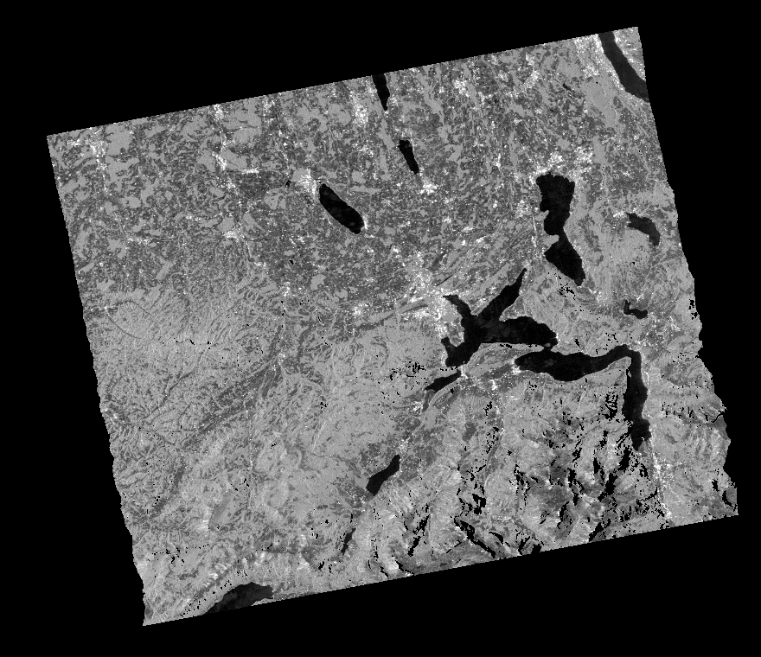
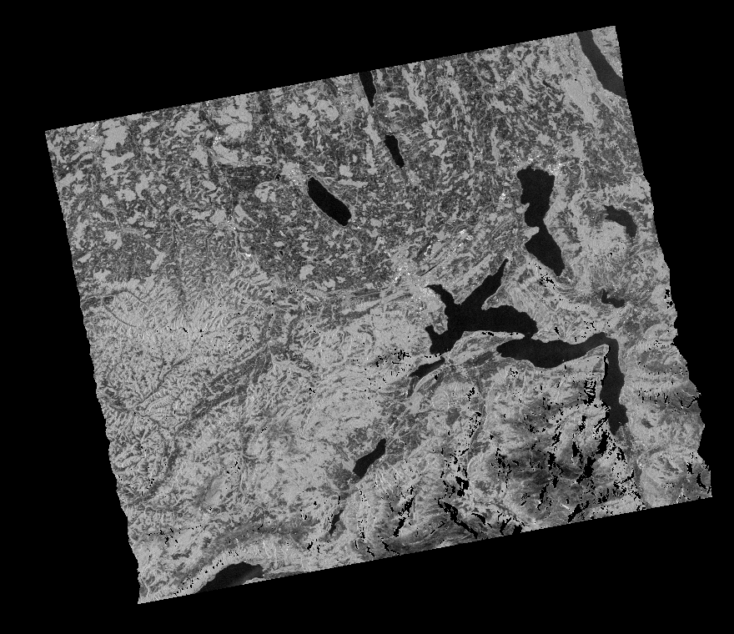
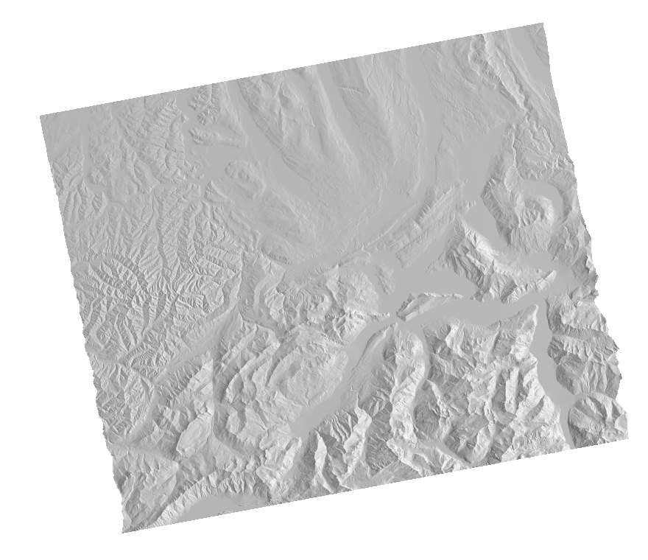
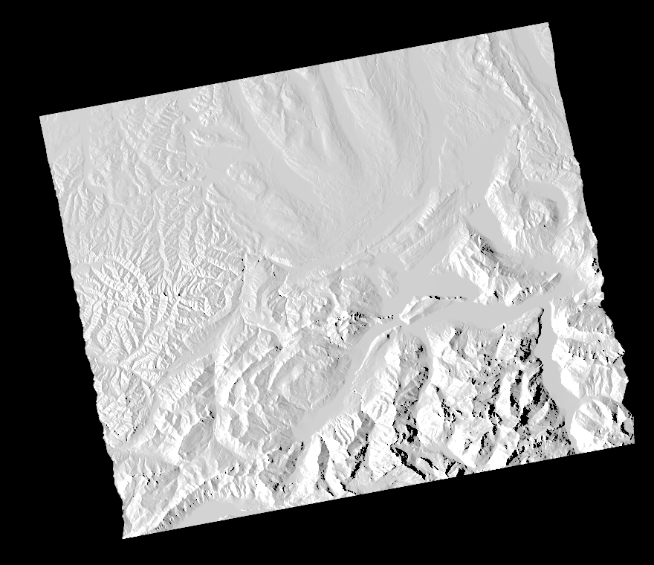
Context: CEOS ARD Normalised Radar Backscatter
Radar Measurement data:
Geometric Terrain Correction (ortho)
Radiometric Terrain Correction
Backscatter expressed as gamma-nought, $γ_{T}^{0}$
Per-pixel metadata:
Threshold (required):
Local Incidence Angle image
Mask image
Acquisition ID image (for mosaic products)
Target (desired):
Scattering Area image
Gamma-to-Sigma ratio image
Ellipsoid Inc. Angle image
Noise power image (if applied)
Per-pixel DEM
General metadata:
Detailed specs about source data and product (44 entries).
Metadata XML format spec provided (Target)
PALSAR1 FBD Processing: UZH
$γ_{T}^{0}$ Backscatter (HH)
$γ_{T}^{0}$ Backscatter (HV)
Local Inc. Angle
Local Scattering Area

Slide 6
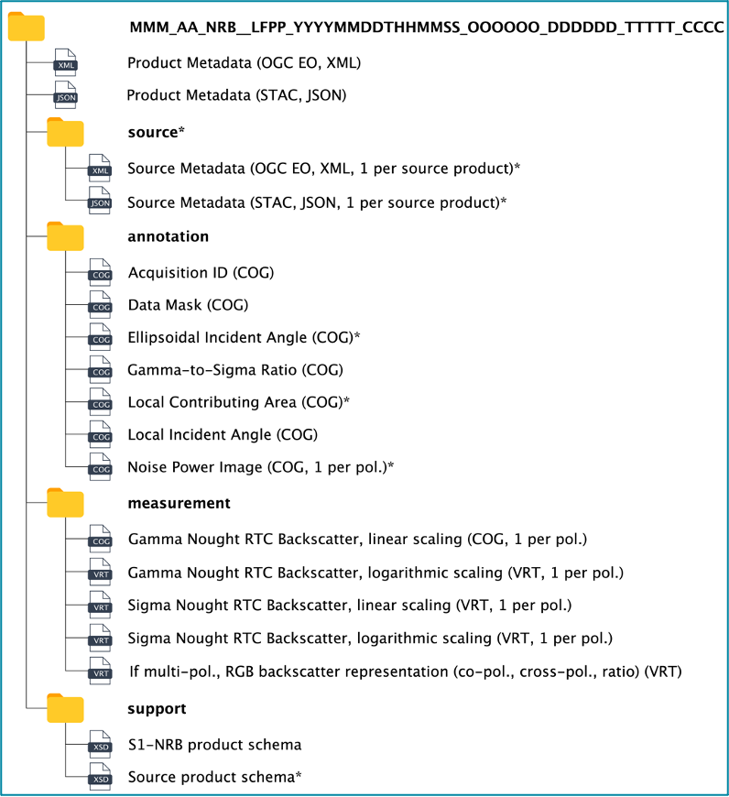
Sentinel-1 NRB prototype
To be confirmed in operational product
Based on the CEOS CARD4L Normalised Radar Backscatter product
CEOS: « Analysis Ready Data are satellite data that have been processed to a minimum set of requirements and organized into a form that allows immediate analysis with a minimum of additional user effort and interoperability both through time and with other datasets. »
Calibrated with RTC, denoised, projected over Copernicus DEM, geolocated ➔ Immediate analysis!
Same griding / tiling system, and DEM than Sentinel-2 (based on MGRS) ➔ Interoperability!
Cloud-Optimised GeoTIFF, VRT, XML and STAC ➔ Cloud-computing compliant!
Open-source processor (based on PyroSAR, GDAL, SNAP) ➔ Open science compliant!
Could be dropped in the operational product

Slide 7
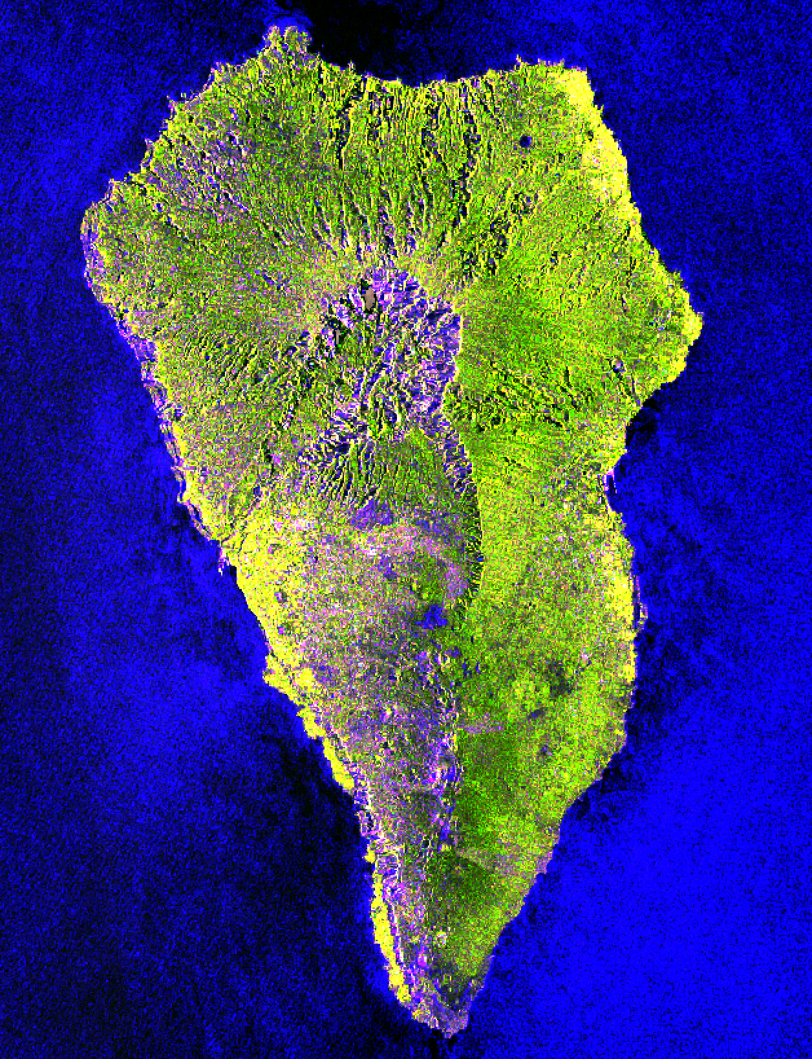
CEOS Ocean Radar Backscatter
Following the CARD4L: CEOS Analysis Ready Data for Land NRB product.
Definition of an NRB product for Sentinel-1 with the objective of having it becoming a core product (TBC).
What about Ocean?
RTC and DEMs not relevant for ocean.
CEOS Analysis Ready Data (ARD) Ocean Radar Backscatter (ORB) Product Family Specifications (PFS)

Slide 8
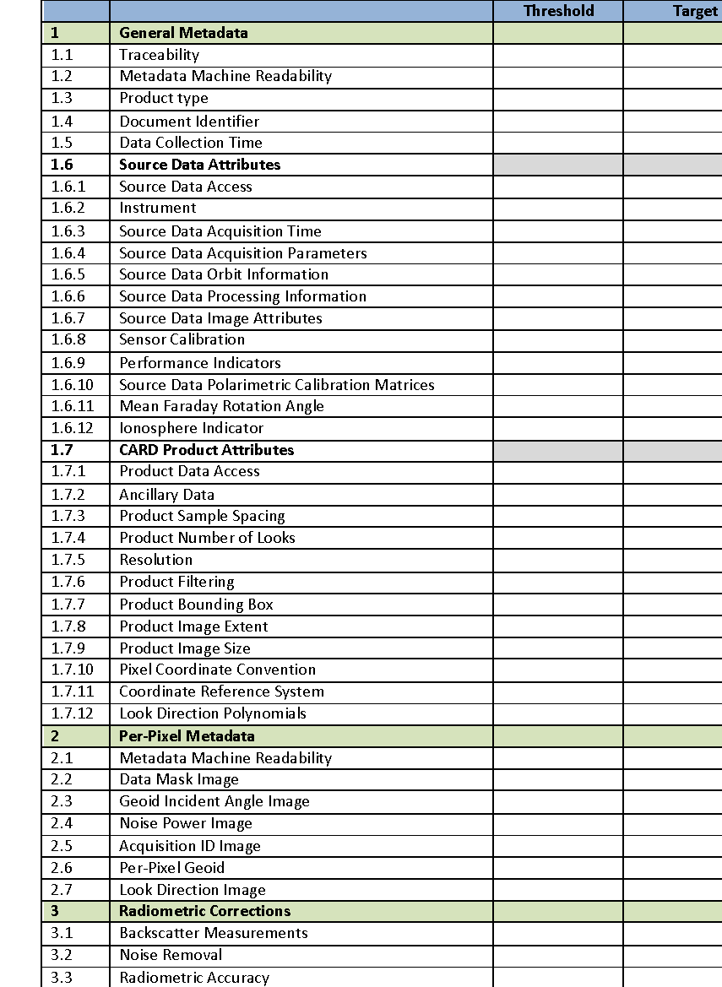
CEOS Ocean Radar Backscatter
ORB is dedicated to represent radar backscatter over oceanic surfaces.
ORB PFS structure based on NRB to assure consistency:
Terminology similar to NRB but requirements adapted to ocean products
Dedicated ORB Metadata Specifications developed
CARD ORB is a simplified version of the CARD NRB product for ocean applications.

Slide 9
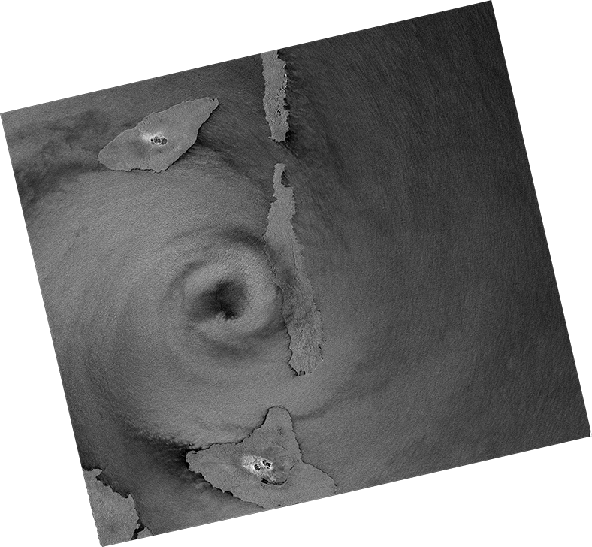
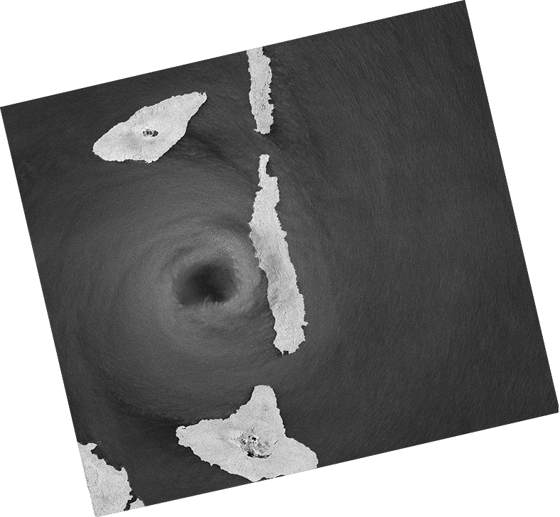
CEOS Ocean Radar Backscatter
Radar measurement data:
Geoid-Corrected backscatter
Expressed as σ⁰ for each polarisation
Per-pixel metadata:
Threshold (required)
Geoid Incidence Angle image
Data mask image (including land mask)
Acquisition ID image (for composite products)
Target (desired)
Noise power image (if applied)
Per-pixel geoid
Look Direction image (representing the planar angle between north and each range direction. It is not constant in range, especially close to the poles.)
σ⁰ backscatter (VV)
σ⁰ backscatter (VH)
Data mask image
Geoid Inc. angle image
Sentinel-1 (ESA / Copernicus / EC) Processing: A. Rosenqvist (soloEO)

Slide 10
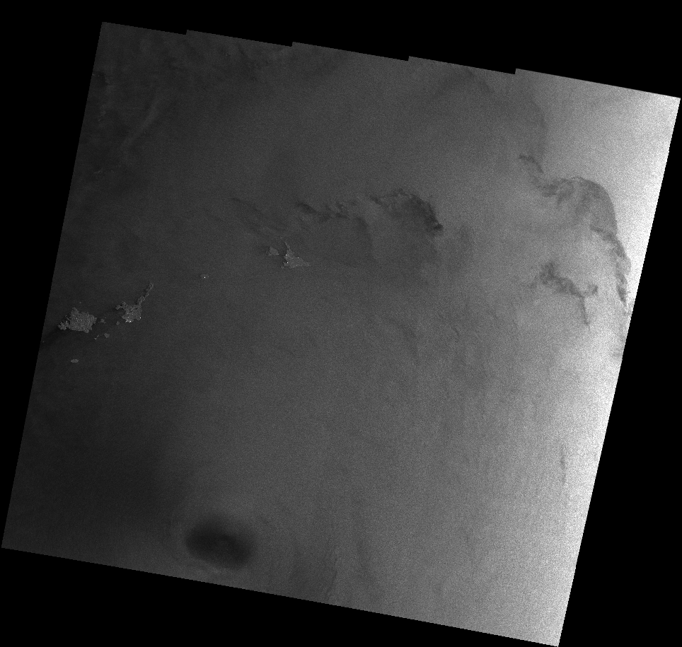
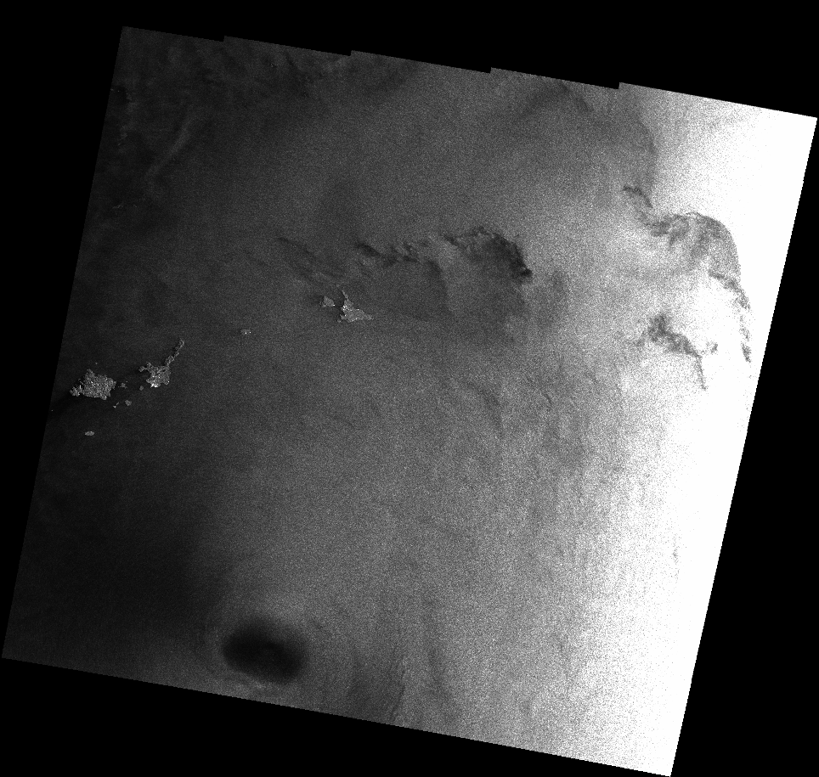
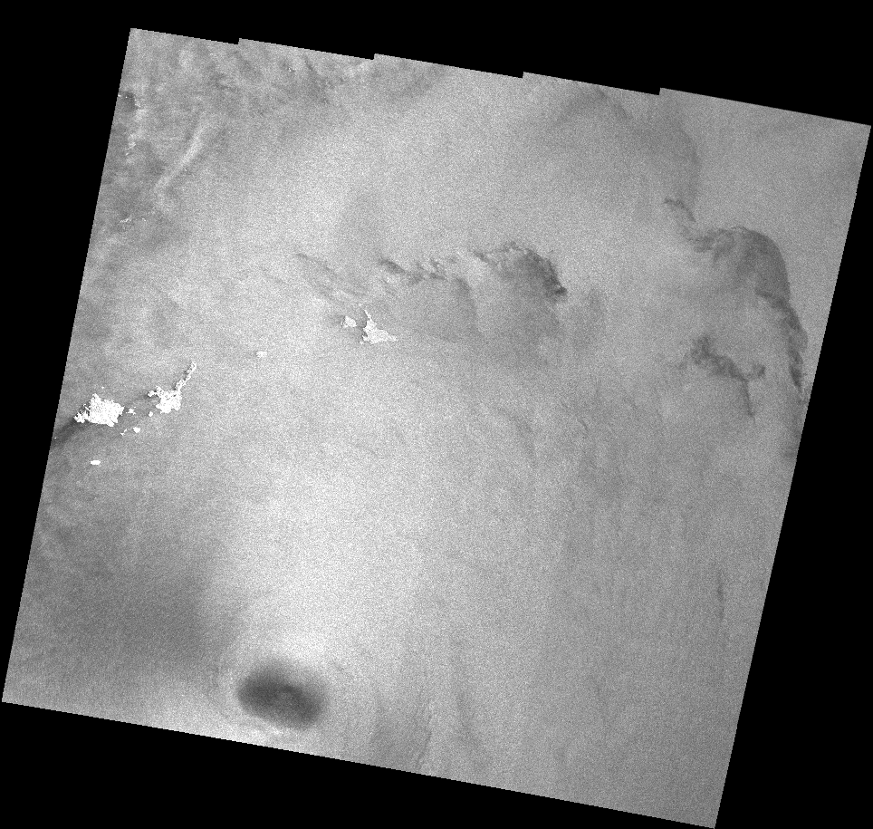
CEOS Ocean Radar Backscatter
Example of ORB product: Sentinel-1 EW
σ⁰ product geocoded
Original product (with DN) geocoded
σ⁰ compensated with the "Mean Wind-Normalised Backscatter Measurements" (it is not σ⁰ anymore) and geocoded
Sentinel-1 (ESA / Copernicus / EC) Processing: G. Hajduch (CLS)

Slide 11
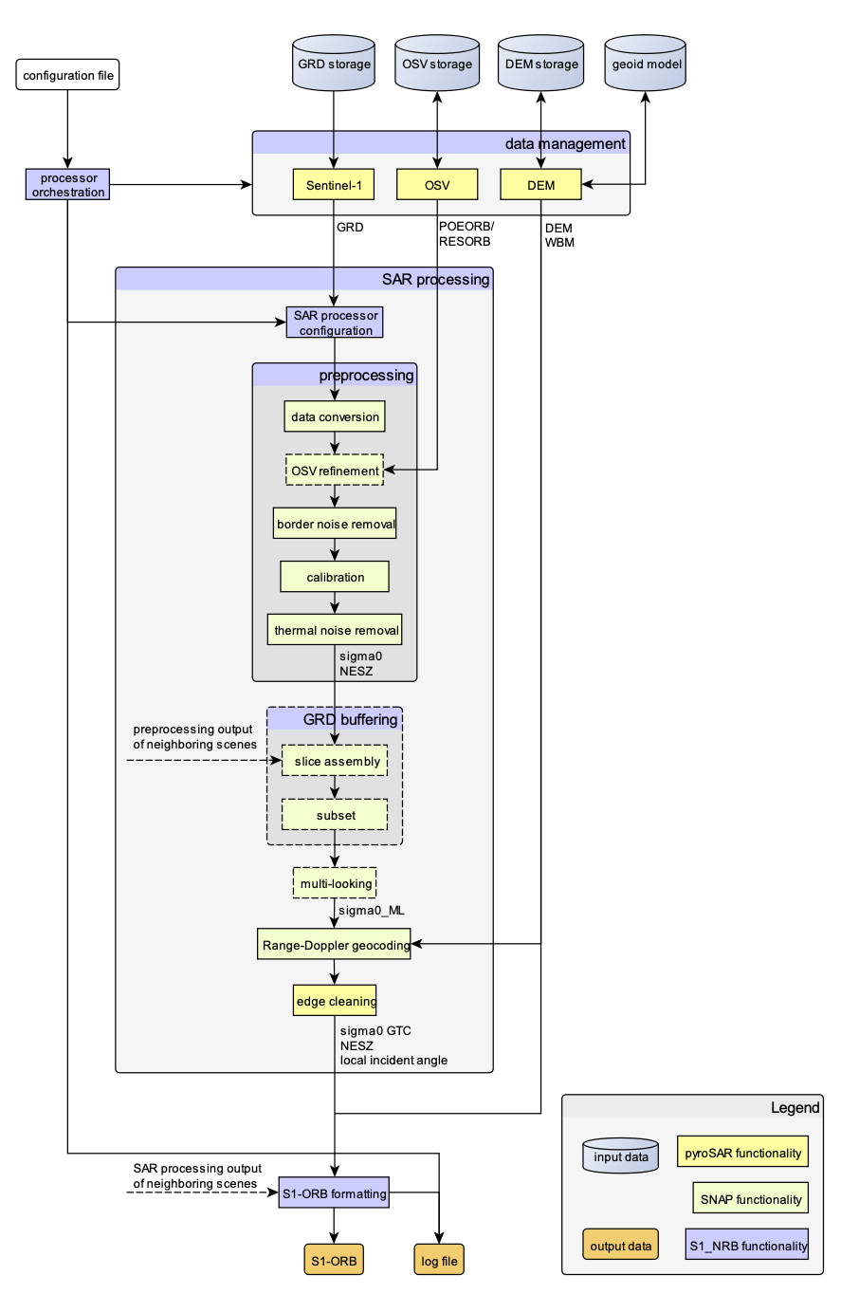
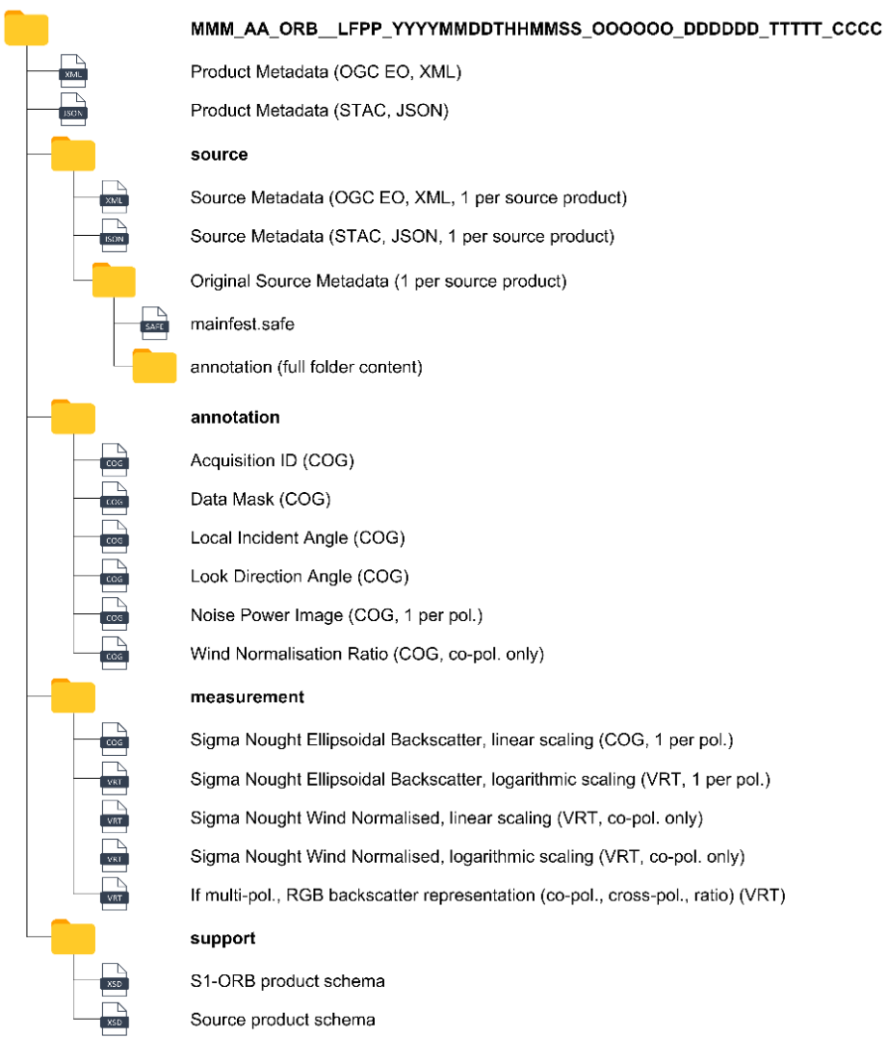
S1 ORB prototype product and processor development
Started in April 2023
First version of product specification and Architecture Design Documents.
Operational product format and corrections applied could diverge from the prototype.
ORB Working Group meeting to advise ESA on the development of the prototype product and potential further operationalisation.

Slide 12
Sentinel-1 ARD over Ocean: Working Group
S. Santos-A. Rocha, EMSA
CMEMS, A. Repucci
Working group
Cop. Services
EO Experts
CEOS
Other missions
EC
T. Nagler, C3S
Object Detection, B. Tings
A. Gambardella,
L. Fasano, DG
Sea/Ice, A. Moiseev,
A. Frost,
J. Karvonen
Sea State, A. Pleskachevsky
Peter Strobl, JRC
Wind, G. Hajduch,
S. Jacobsen
ROSE-L
LSI/VC, H.P. Sakethapuram
ESA, N. Longepe
N. Miranda
S1-NG
SAR WGCV, A. Rosenqvist,
F. Charbonneau

Slide 13
Status and Way Forward
Today
NRB prototype processor development achieved and available on-the-fly (C-TEP).
Implementation as option in the Sentinel-1 IPF re-engineering activity.
Future
End of 2023: ORB prototype processor development achieved and available on-the-fly (C-TEP).
To be further consolidated (non-exhaustive list):
Benefit of this product for the Ocean Community (is there some tailoring needed?)
Operationalisation of NRB and ORB product?
Integration of the ORB and NRB products?

