Slide 1
ESA Update on CEOS-ARD
Ferran Gascon
as ESA representative at CEOS LSI-VC
CEOS LSI-VC#13
10 October 2023

Slide 2
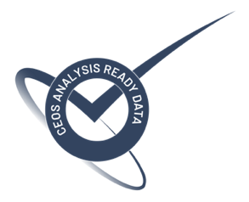
Status of ESA CEOS-ARD Products
Mission | Product | PFS | Status | Availability Date
Sentinel-2 | L2A | SR | ✅ | January 2022
PROBA-V | Collection 2 | SR | ✅ | March 2023
Sentinel-2 | L2H | SR | Under Development | 2023 (pilot product), TBD (operational product)
Sentinel-2 | L2F | SR | Under Development | 2023 (pilot product), TBD (operational product)
Sentinel-2 | L2A | AR | Under Development | TBD
Sentinel-1 | NRB / ORB | NRB / ORB | Under Development | TBD
Sentinel-3 | SYN | SR | Under Development | TBD
ERS SAR | TBC | NRB | Under Development | TBD
ERS ATSR | TBC | LST | Under Development | 2024
Envisat ASAR | TBC | NRB | Under Development | TBD
Envisat MERIS | TBC | SR | Under Development | 2024
CHIME | L2A | SR | Under Development | 2029
CHIME | L2H/L2F | SR | Under Development | 2029 (pilot product), TBD (operational product)
LSTM | L2A | ST, SR | Under Development | 2029
LSTM | L2H/L2F | ST, SR | Under Development | TBD
ROSE-L | TBD | NRB…TBC | Under Development | TBD

Slide 3
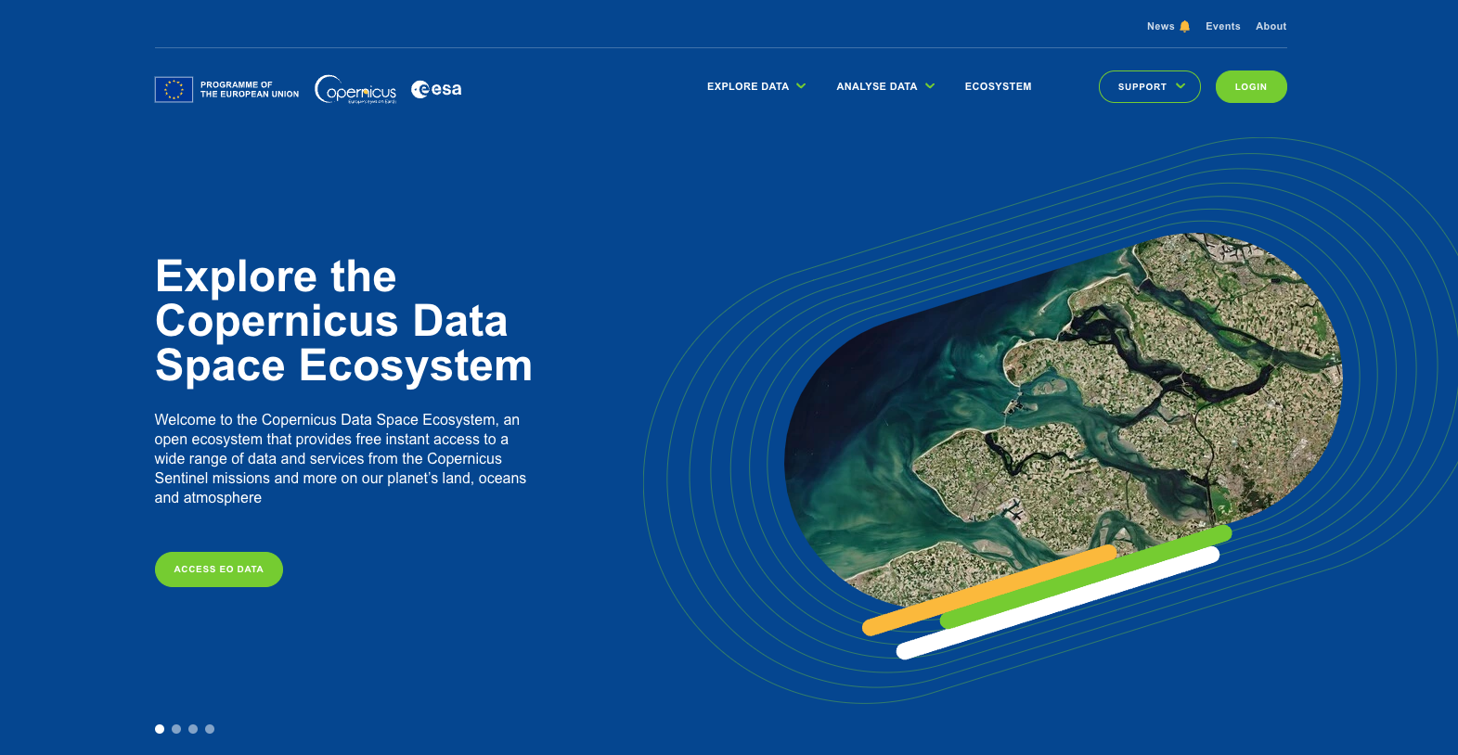
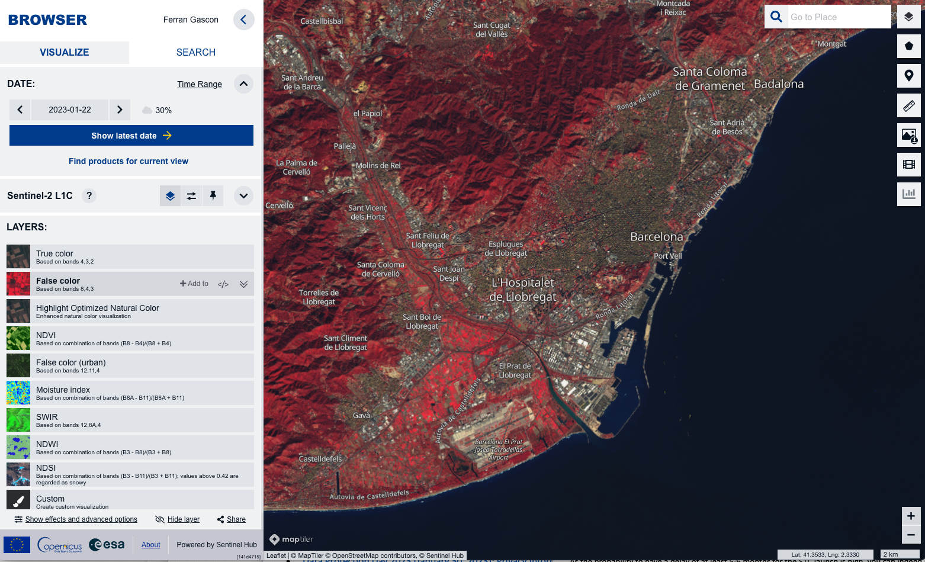
Copernicus Data Space Ecosystem
The Copernicus Data Space Ecosystem Service offer has been significantly upgraded in July 2023 as per public service roadmap (including new data, APIs and Apps): https://documentation.dataspace.copernicus.eu/Roadmap.html
Additional services and data offer are planned before end 2023.
The ramp-down of the Copernicus Data Hub Services is on-going (up to end-of-October 2023) to support final users in smoothly migrating to the new service.
https://dataspace.copernicus.eu/

Slide 4
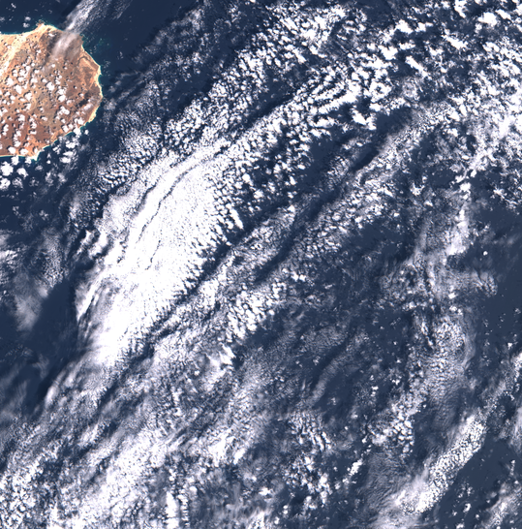
Sentinel-2 Collection-1
Collection 1 being generated by reprocessing full S2 archive for all user products (Level-1B, Level-1C and Level-2A).
Products will use the latest Processing Baseline (05.xx) which includes Copernicus DEM 30m, geometric refinement with S2 GRI, etc.
Reprocessing campaign on-going, first products published on 24 January 2023 the Copernicus Data Space Ecosystem and on the DIAS platforms (CREODIAS, MUNDI and ONDA).
Planned production completion within Q4 2023 and planned distribution completion within first half 2024.
More information at: https://sentinels.copernicus.eu/ca/web/sentinel/technical-guides/sentinel-2-msi/copernicus-sentinel-2-collection-1-availability-status
Cabo Verde 04 April 2019

Slide 5
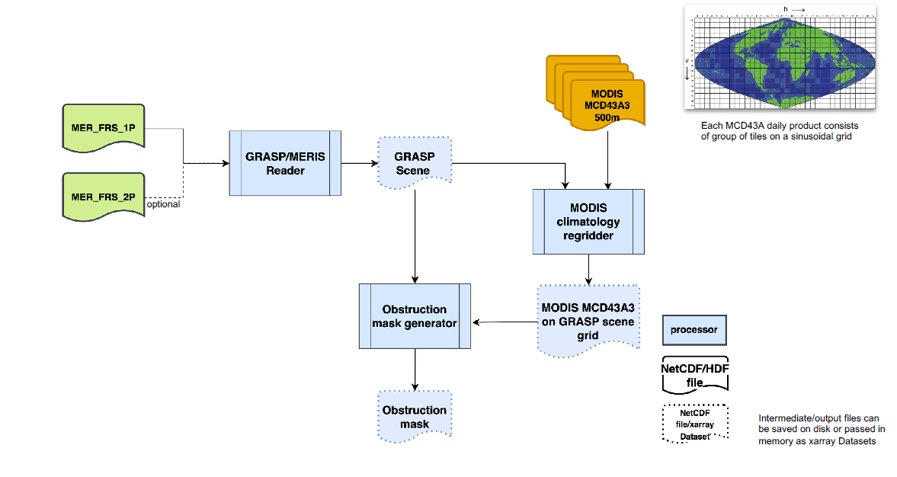
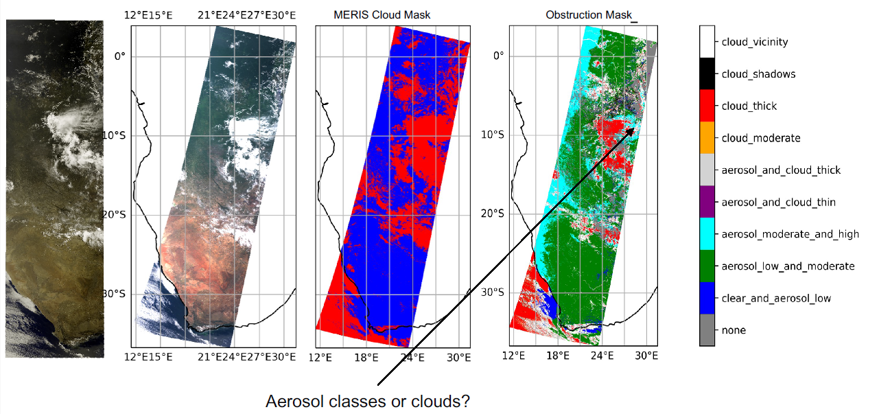
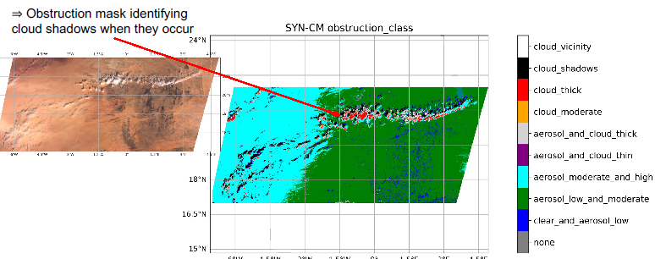
CEOS-ARD SR for Envisat - MERIS
The GRASP (Generalized Retrieval of Atmosphere and Surface Properties) atmospheric correction algorithm was successfully tested on MERIS Full Resolution data.
First version of MERIS cloud mask and obstruction mask (with cloud shadow mask) is implemented.
Still some refinements are needed due to some pixel misclassification or missing data in MODIS cloud classification and cloud properties.
Next steps:
Cloud mask and cloud obstruction mask will be correctly tuned, then a diagnostic MERIS ARD dataset will be generated (MERIS 2008 data over selected sites) by end of 2023.
If ARD quality will be compliant with CEOS specifications, then in 2024 full MERIS data will be processed to generate Surface Reflectance ARD products.

Slide 6
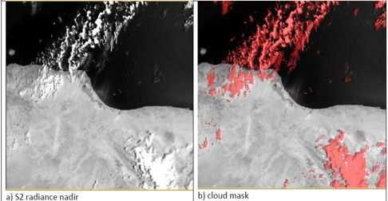
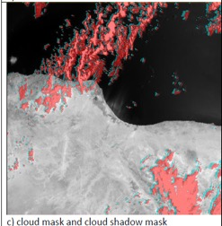
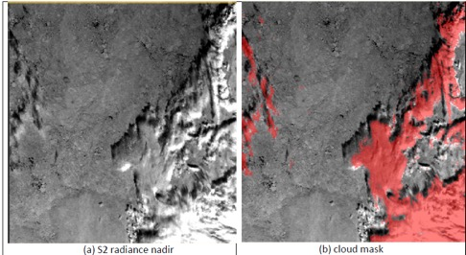
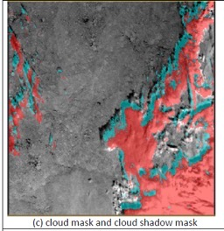
CEOS-ARD ST for ERS/Envisat - (A)ATSR
Activities ongoing for the definition of the best cloud shadow algorithm to be applied to (A)ATSR data.
Mediterranean Sea (31°N, 15°E) – 20020810T083508
The retrieval of Cloud Top Height is not completely solved yet: fixed at 6km.
The conversion of brightness temperature into cloud top height is a complex task.
Cloud shadow is computed only over land.
Far North (81°N, 122°E) – 20020810T083508

Slide 7
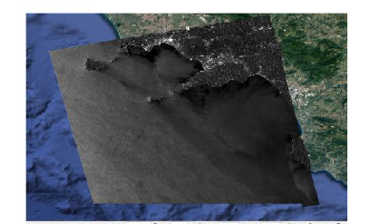
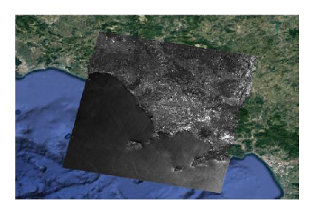
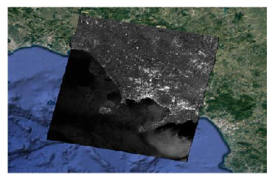
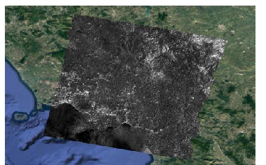
CEOS-ARD NRB for ERS/Envisat for SAR/ASAR
ERS-1 Feb 1993
Project to align CEOS-ARD specs for ERS/Envisat (A)SAR data to those of an enhanced Sentinel-1 product has been concluded.
The first subset of ERS and Envisat SAR NRB (Normalized Radar Backscatter) ARD products were generated to be aligned at best to Sentinel-1 corresponding products (including the usage of the Copernicus 30m DEM and the Cloud Optimized GeoTIFF format to facilitate compliance between the two products).
ERS-2 Dec 1995
Next steps:
Development of operational ARD post processor starting from SLC or GRD (IMP, APP, WSM) and open source, mainly in Python.
Compatible with the current ERS/ENVISAT processor algorithm, the future GPU processor, and with On-The-Fly (OTF) capabilities.
Procurement approach: ITT (Open call) with KO planned on April 2024.
Envisat Jul 2003
Envisat Jun 2007
ASAR Ottawa transponder – 29 October 2006

Slide 8
DGGS R&D Activity
Context:
Increasing number of open remote sensing data,
Heterogeneity of the sensors, resolution, georeferencing and data format, ...
Benefits for having a common multi-mission/dataset geometry
Objectives:​
Study to identify a multi-mission DGGS framework
Development of a DGGS pilot platform for demonstration purposes

Slide 9
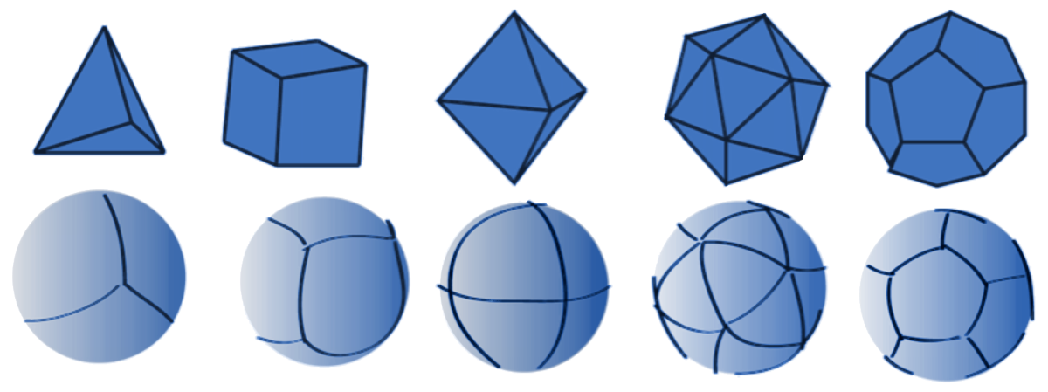
What Is a DGGS?
Open Geospatial Consortium – OGC:
"A DGGS is a spatial reference system that uses a hierarchical tessellation of cells to partition and address the globe. DGGS are characterized by the properties of their cell structure, geo-encoding, quantization strategy and associated mathematical functions."
Base polyhedron
Orientation
Projection
Cell geometry
Aperture
Indexing Strategy
Regular polyhedron (top) and their corresponding initial tessellation (bottom)

Slide 10
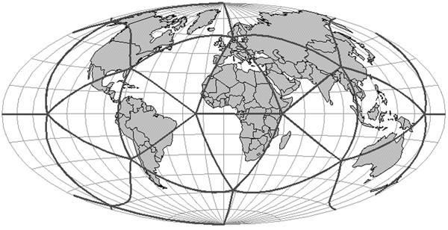
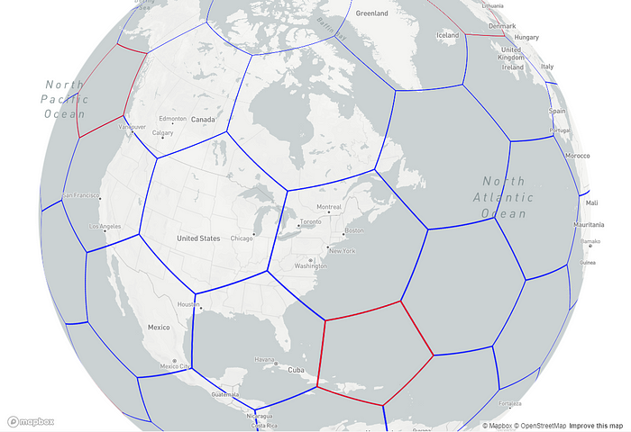
What Is a DGGS?
Open Geospatial Consortium – OGC:
"A DGGS is a spatial reference system that uses a hierarchical tessellation of cells to partition and address the globe. DGGS are characterized by the properties of their cell structure, geo-encoding, quantization strategy and associated mathematical functions."
Base polyhedron
Orientation
Projection
Cell geometry
Aperture
Indexing Strategy
Spherical icosahedron oriented using Fuller’s Dymaxion orientation.
All vertices fall in the ocean. Credit: Sahr and al., 2003
Uber H3 —On a globe projection

Slide 11
What Is a DGGS?
Open Geospatial Consortium – OGC:
"A DGGS is a spatial reference system that uses a hierarchical tessellation of cells to partition and address the globe. DGGS are characterized by the properties of their cell structure, geo-encoding, quantization strategy and associated mathematical functions."
Base polyhedron
Orientation
Projection
Cell geometry
Aperture
Indexing Strategy
Different grids implementation cell neighbors

Slide 12
What Is a DGGS?
Open Geospatial Consortium – OGC:
"A DGGS is a spatial reference system that uses a hierarchical tessellation of cells to partition and address the globe. DGGS are characterized by the properties of their cell structure, geo-encoding, quantization strategy and associated mathematical functions."
Base polyhedron
Orientation
Projection
Cell geometry
Aperture
Indexing Strategy
H3 grid cell aperture (size and shape) at different levels

Slide 13
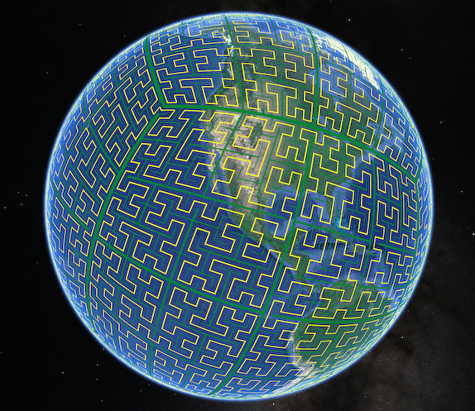
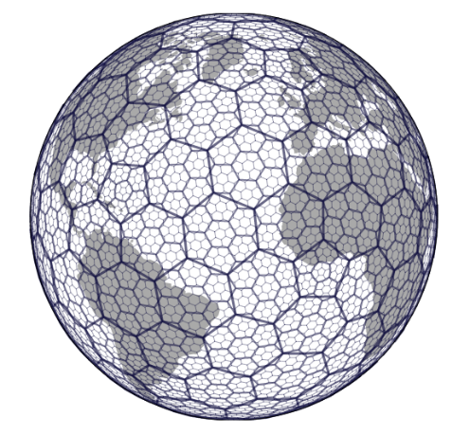
What Is a DGGS?
Open Geospatial Consortium – OGC:
"A DGGS is a spatial reference system that uses a hierarchical tessellation of cells to partition and address the globe. DGGS are characterized by the properties of their cell structure, geo-encoding, quantization strategy and associated mathematical functions."
Base polyhedron
Orientation
Projection
Cell geometry
Aperture
Indexing Strategy
Classic Hierarchical index
Space-filling curve
(Google S2)
H3
Coordinates examples:
Level 0: 0
Level 1: 2
Level 2: 23
Level 3: 231
Level 4: 2312
Level 5: 23120
Coordinates examples:
fff1000...000000000 # Level 0 cell ID
fffpp10...000000000 # Level 1 cell ID
[...]
fffpppp...pppp10000 # Level 28 cell ID
fffpppp...pppppp100 # Level 29 cell ID
fffpppp...pppppppp1 # Level 30 cell ID
Coordinates examples (ESRIN)
Level 0: 8053fffffffffff
Level 1: 8152bffffffffff
Level 2: 82528ffffffffff
Level 3: 83528dfffffffff
[...]
Level 12: 8c528d0e1cb1dff
Level 13: 8d528d0e1cb1d3f

Slide 14
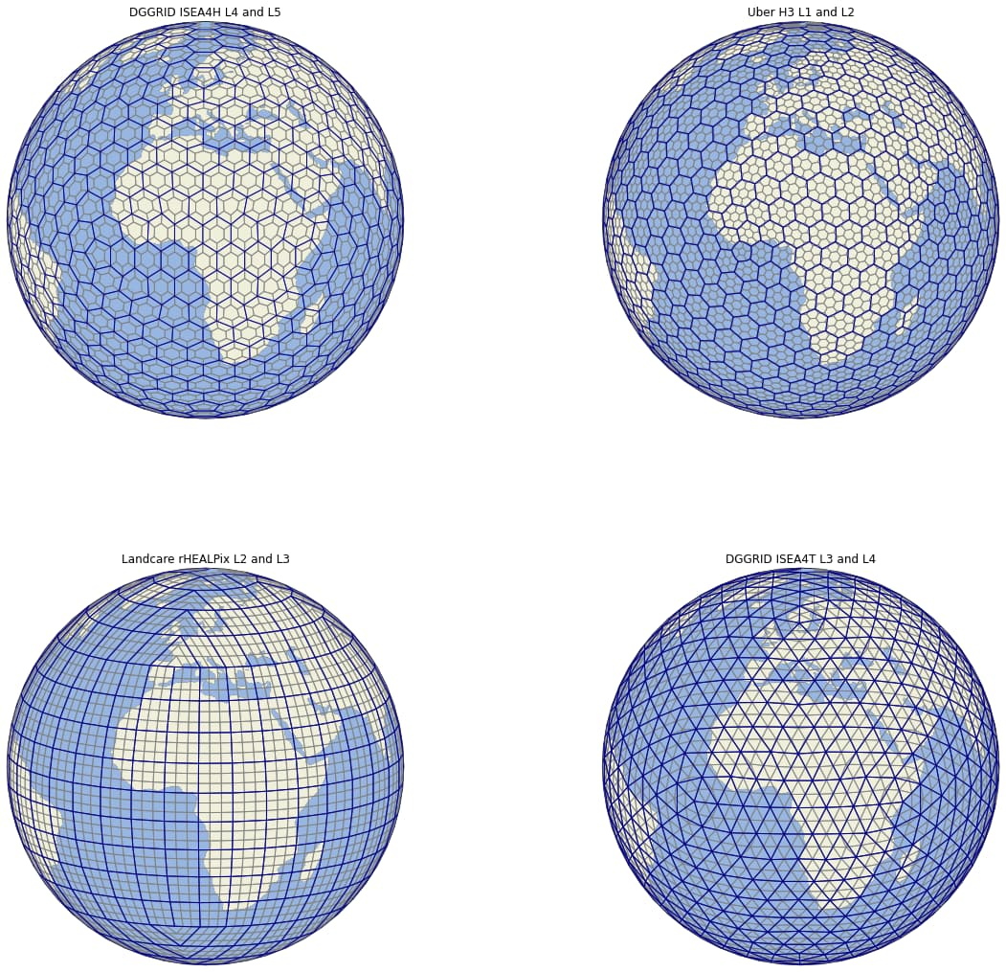
DGGS implementations comparison
ISEA7H (Hexagons)
Icosahedral Snyder Equal Area
H3 (Hexagons)
rHealPix (Multiple-Quadrilater)
ISEA4T/D (Tringles/Diamonds)

Slide 15
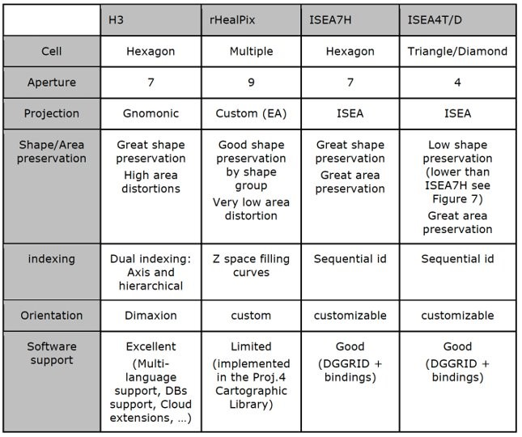
DGGS comparison
ISEA7H and rHealPix are good candidates regarding shape and area preservation.​
ISEA7H brings the benefits of an equal area projection, high compactness and great neighbours' relation.​
rHealPix is by design suitable for raster processing specially in the mid latitudes (square faces) and provides some unique features useful for multiresolution handling.​
H3 is subject to high area distortion but also the most used DGGS and by far the most supported. A good support and user experience are key to the adoption of DGGS. ​ This makes H3 the go-to grid for practical application.

Slide 16
Conclusions
A perfect DGGS does not exist and not able to match each single mission requirements;
Almost no current EO application relies on DGGS. Mainly actively used in some commercial projects (e.g. Uber and PokemonGo);
Beside Uber H3, almost no well-maintained open-source tools are available, while based on the selection criteria ISAE7H and rHEALPix are better options for Sentinel-2 ARD data;
Promising capabilities considering data indexing;
Large scale application is conditioned by performant conversion (Raster to DGGS grid) and storage tools (Clickhouse/ElasticSearch/PostgresSQL) offering a good compression ratio.

Slide 17
Sentinel-3 Synergy Surface Reflectance
CARD4L-SR Status and prospective
Steffen Dransfeld¹, Silvia Scifoni²
ESA ESRIN ESA S3 Optical Data Quality Manager
Serco Italia Spa, S3 Data quality management support

Slide 18
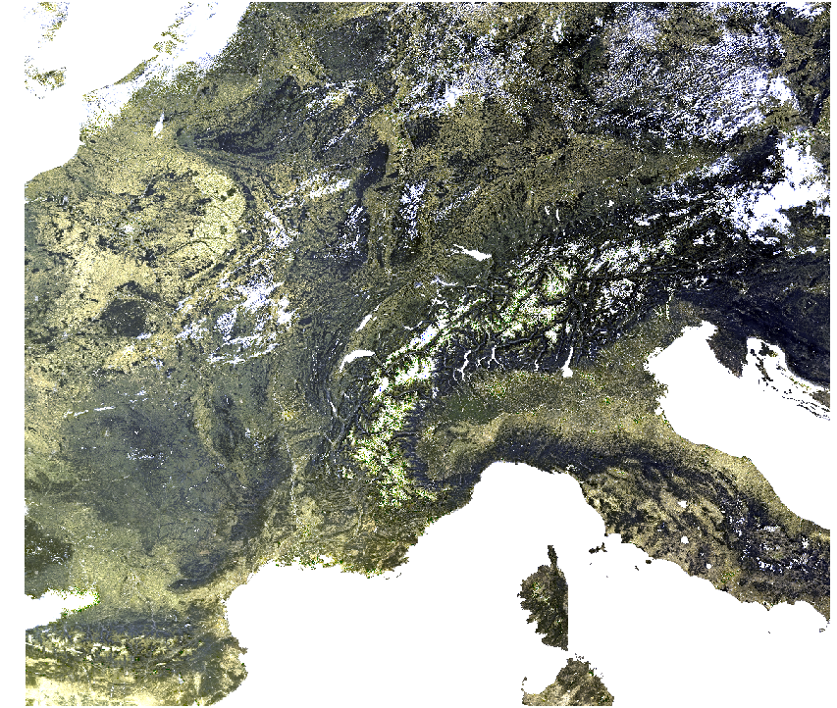
Sentinel-3 SY_2_SYN product overview
SYN Level-2 processing aims to combine information from the OLCI and SLSTR instruments to provide improved data for land surface analysis.
SY_2_SYN: atmospherically corrected surface directional reflectance (SDR) from 16 OLCI and 5 Nadir and Oblique SLSTR bands, and aerosol parameters over land.
Coverage: corresponds to the common part of the OLCI and SLSTR nadir view swaths for the daylight part of the SENTINEL-3 orbit.
Revisit time: it is based on the longest revisit time of the two instruments, OLCI and SLSTR. It is less than 2 days at the equator with two operational satellites.
Spatial resolution: ~300 m on the OLCI L1B image grid.
Data access: https://scihub.copernicus.eu/dhus/#/home
Data availability: since October 2018.
S3A_SY_2_SYN____20210814T094700_20210814T095000_20210816T134840_0179_075_136_2160_LN2_O_NT_002.SEN3

Slide 19
SY_2_SYN CARD4L SR Self-Assessment Status overview
CARD4L-SR Threshold requirements
CARD4L-SR Target requirements

Slide 20
SY_2_SYN CARD4L SR Threshold requirements self-assessment
General Metadata
Traceability
Metadata Machine Readability
Data Collection time
Geographical Area
Coordinate Reference System
Map Projection
Geometric Correction methods
Geometric Accuracy of the data
Compliant
Instrument
Spectral bands
Sensor calibration
Radiometric accuracy
Algorithms
Auxiliary data
Processing Chain provenance
Data Access
Overall data quality
General Metadata
(2/2)
Not compliant
Not applicable
Coordinate reference system and Map projection: the SYN product is georeferenced but not projected on a regular tiling grid or map projection. The metadata do not specify a CRS or map projection accordingly.
Recent evolution: the DOI landing page has now been included in the product (from 25/07/2023 for S3A and 18/07/2023 for S3B). The page contains information on Algorithms, Instrument, Data Access, etc:
https://sentinels.copernicus.eu/web/sentinel/user-guides/sentinel-3-synergy/processing-levels/level-2

Slide 21
SY_2_SYN CARD4L SR Threshold requirements self-assessment
Per-pixel metadata
Metadata Machine Readability
No data
Incomplete testing
Saturation
Cloud
Land/water mask
Cloud shadow
Snow/Ice mask
Terrain shadow mask
Terrain Occlusion
Solar and Viewing Geometry
Terrain Illumination Correction
Aerosol Optical Depth Parameter
General Metadata
(2/2)
Compliant
Not compliant
Not applicable
Incomplete testing and cloud shadow: SYN product is not compliant because cloud shadow test is still missing, but it is under development.

Slide 22
SY_2_SYN CARD4L SR Threshold requirements self-assessment
Compliant
Not compliant
Radiometric – Atmospheric- Geometric corrections
Measurement
Measurement Uncertainty
Measurement Normalisation
Directional Atmospheric Scattering
Water Vapour Corrections
Ozone corrections
Geometric corrections
Not applicable
Geometric corrections: the sub-pixel accuracy has been accessed for OLCI and SLSTR individually, but not for SYN.

Slide 23
SY_2_SYN CARD4L SR Target requirements self-assessment
General Metadata
Traceability
Metadata Machine Readability
Data Collection time
Geographical Area
Coordinate Reference System
Map Projection
Geometric Correction methods
Geometric Accuracy of the data
Compliant
Not compliant
Coordinate reference system and Map projection: same comment of threshold.
Geometric correction methods: it is part of the OLCI and SLSTR L0 to L1 processing. However, there is no information in the SYN metadata.

Slide 24
SY_2_SYN CARD4L SR Target requirements self-assessment
General Metadata
Instrument
Spectral bands
Sensor calibration
Radiometric accuracy
Algorithms
Auxiliary data
Processing chain provenance
Data Access
Overall data quality
Compliant
Not compliant
Radiometric accuracy: we have an empty parameter for radiometric uncertainty.
Algorithms: ATBD are not all published in peer-review journals.
Auxiliary data: information on auxiliary data are available in the metadata as a single DOI landing page, but these are not publicly available for downloading.

Slide 25
SY_2_SYN CARD4L SR Target requirements self-assessment
Per-pixel metadata
Metadata Machine Readability
No data
Incomplete testing
Saturation
Cloud
Cloud shadow
Land/water mask
Compliant
Snow/Ice mask
Terrain shadow mask
Terrain Occlusion
Solar and Viewing Geometry
Terrain Illumination Correction
Aerosol Optical Depth Parameter
General Metadata
(2/2)
Not compliant
Incomplete testing: same comment of threshold
Saturation: there is a summary saturation flag but it is not for each spectral band.
Cloud shadow: cloud shadow is under development.
Terrain shadow mask: it is available for OLCI in IdePix. This could be adapted to SLSTR and then for SYN.
Terrain occlusion: not available.
Terrain illumination correction: terrain correction is not included in SYN processing.

Slide 26
SY_2_SYN CARD4L SR Target requirements self-assessment
Compliant
Radiometric – Atmospheric- Geometric corrections
Measurement
Measurement Uncertainty
Measurement Normalisation
Directional Atmospheric Scattering
Water Vapour Corrections
Ozone corrections
Geometric corrections
Not compliant
Measurement normalisation: values are not normalised. It could however be useful for users to have a BRDF correction as for e.g. MODIS does it.
Geometric corrections: as already mentioned in Threshold requirement, the sub-pixel accuracy has been accessed for OLCI and SLSTR individually, but not for SYN.

Slide 27
Conclusion
The recent SYN_SDR product evolution (DOI inclusion) allows to reach the threshold requirements for Instrument, data access, Algorithms. Cloud shadow is under development.
Few steps are still necessary to reach the ARD compliance at Threshold level:
Coordinate System – Map Projection (Requirement 1.5/1.6): In the previous CEOS LSI-VC meeting two questions were raised about these requirements:
If Lat/Lon could be sufficient at threshold level or Tiling grid is strictly necessary (Action LSI-VC-13-07). Are there any updates about this action?
The inclusion of DGGS as an option for grid tiling system in the CEOS ARD Requirement. Did you have further discussions about this topic?
Geometric correction: ongoing discussion on how to fulfil this requirement. SYN SDR are provided as georeferenced pixels based on two separate geometrically calibrated and then co-registered instruments.

Slide 28
Thank You

