Slide 1

Status Report on the Black Marble Nightlight Occlusion Analysis and Thoughts on Additional ARD Testing
Brian Killough
CEOS Systems Engineering Office (SEO)
LSI-VC Meeting – Frascati, Italy
October 10, 2023

Slide 2
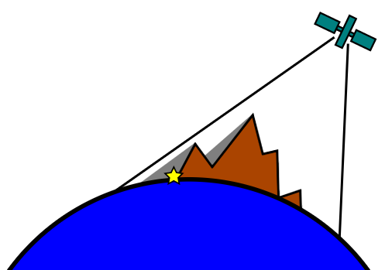
Overview and Key Points
  Goal: Global occlusion analysis of the NASA's "Black Marble" Night Lights Dataset
  Short-term Objective: Identify in the Area of Interest (AOI) pixels (full or partial) where light sources are blocked or obscured by topographic features such as hills, mountains, or buildings.
  Datasets: NASA's "Black Marble" Night Lights data with Copernicus Digital Elevation Model (DEM) data and orbital position data
    Both the datasets need to be in the same spatial resolution, coordinate system, and extent. Involves resampling, reprojecting, or clipping the datasets.
  Method: Perform a line-of-sight analysis to determine the visibility of each point(s) on the terrain.

Slide 3
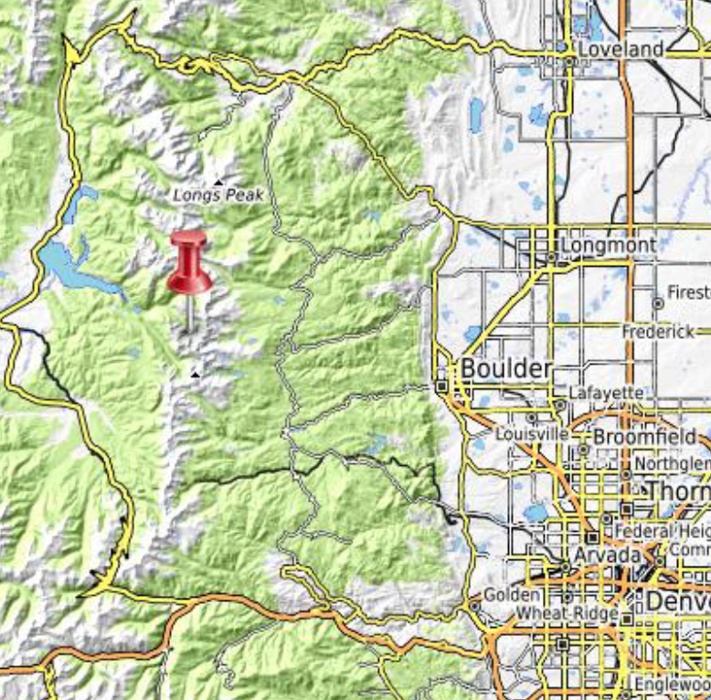
Analysis Approach
Areas of Interest: Boulder, Colorado
Time: June 2022 (32-day period, 2 revisit cycles)
Analysis Method:
  Employ Vallado's SGP4 orbital propagation model and Two Line Element Sets (TLEs) to estimate the orbital parameters of the Suomi NPP satellite.
  Use Digital Elevation Model (DEM) data from OpenTopography's SRTM15+ to execute visibility analyses.
  Apply a Visibility Analysis Viewshed to identify, classify, and map potential occlusion events that may compromise the VIIRS data's reliability.
  Consolidate the data into a time series binary dataset that indicates the likelihood of potential terrain occlusions at designated points over time.

Slide 4
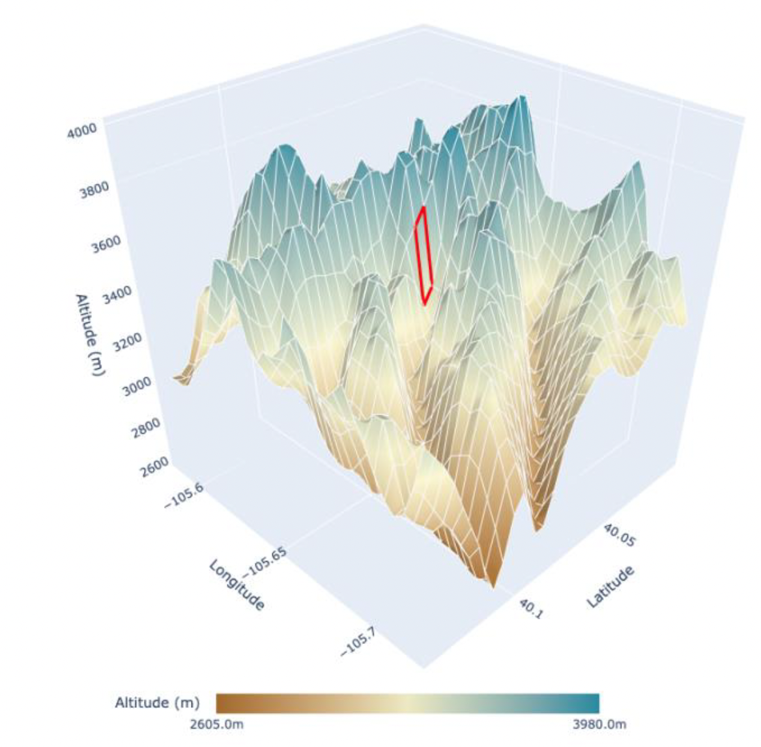
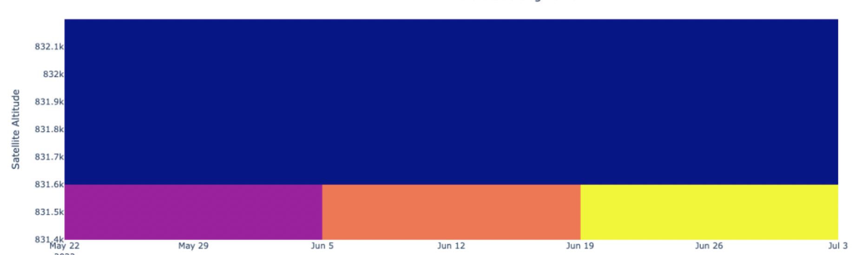
Sample Results
A target point was selected for the analysis (RED region)
Altitude Analysis: The distribution of potential occlusion events varies with satellite altitude. Lower altitudes have been identified as more susceptible to occlusions.
Temporal Patterns: The data suggests a periodic nature to the occurrence of potential occlusions, aligning closely with the satellite's 16-day revisit cycle.
Density Heatmap: High concentrations of potential occlusion events were consistently found to occur during specific time windows, as evidenced by the heatmap.
0
1
2
3
Target point and 3D DEM model

Slide 5
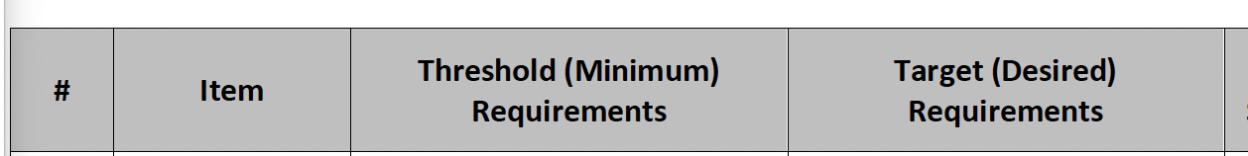
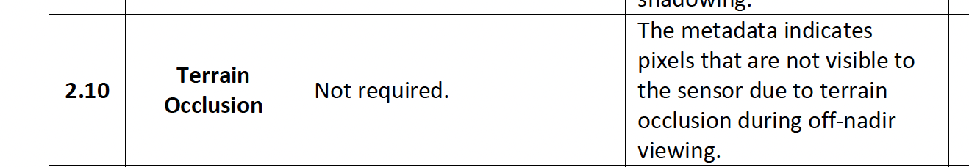
Conclusions
These analysis results suggest it is possible to calculate potential occlusion events at any location around the world using terrain (DEM) data and orbit position data
Future studies should scale these pixel-level findings to an entire region and then compare potential occlusion results with actual Black Marble nightlight data.
In addition, it would be good to coordination these findings with the Black Marble team as they may desire to include these potential terrain occlusion locations in their ARD product as a metadata parameter (see below).

