Slide 1
LSI-VC-14
2023
KARI’s works on ARD
Chiho KANG, KARI
Agenda Item 2.3
LSI-VC-14 2023, ESA/ESRIN
10th - 12th October 2023

Slide 2
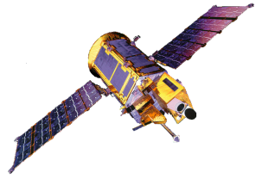
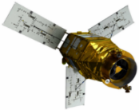
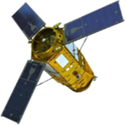
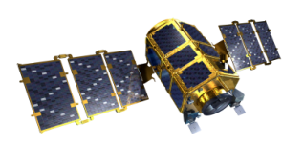
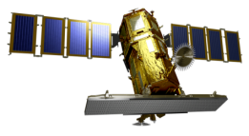
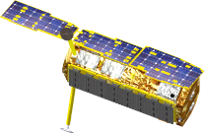
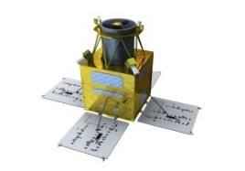
KARI’s LEO Missions
LEO
KOMPSAT-1
KOMPSAT-2
KOMPSAT-3
KOMPSAT-3A
KOMPSAT-7
KOMPSAT-7A
1999
EO 6.6m
2006
EO 1m
2012
EO 0.7m
2015
EO 0.55m
2024
EO 0.3m
2025
EO 0.3m
Not Working
KOMPSAT-5
KOMPSAT-6
"Development of over 170 satellites, launch of more that 40 domestic launch vehicles (~2031)”
National Space Committee (2021)
2013
SAR 1m
2024
SAR 0.5m
CAS500-1
CAS500-2
2019
EO 0.5m
2025
EO 0.5m
Working
Under Development

Slide 3
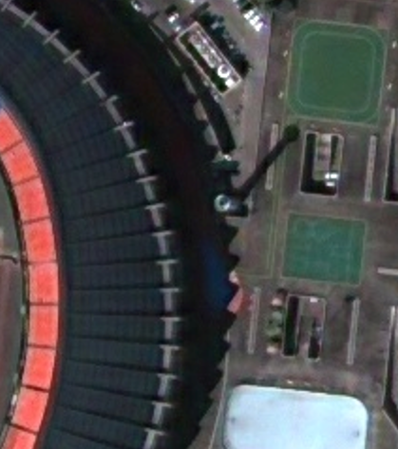
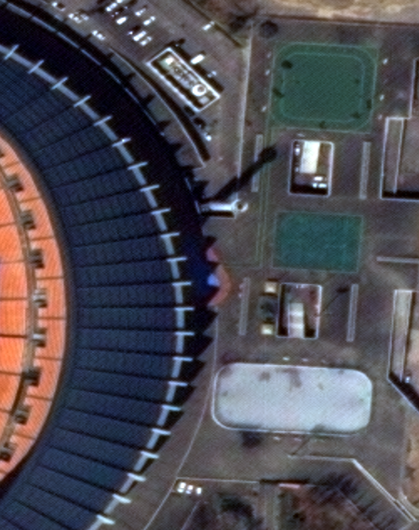
KARI’s Works on ARD (1/18)
Surface Reflectance (1/8)
Major characteristics of KOMPSAT-3 & KOMPSAT-3A systems
KOMPSAT-3
Property | KOMPSAT-3 | KOMPSAT-3A
Orbit | Sun-Synchronous | Sun-Synchronous
Altitude (km) | 685.13 | 528
Inclination (°) | 98.14 | 97.5
MLTAN | 13:30 | 13:30
Bandwidth (nm) | PAN: 450 – 900 MS1 (B): 450 – 520 MS2 (G): 520 – 600 MS3 (R): 630 – 690 MS4 (NIR): 760 – 900 | PAN: 450 – 900 MS1 (B): 450 – 520 MS2 (G): 520 – 600 MS3 (R): 630 – 690 MS4 (NIR): 760 – 900
GSD (m, @nadir) | 0.5 (PAN) / 2.0 (MS) | 0.4 (PAN) / 1.6 (MS)
Data Quantization (bit/pixel) | 14 | 14
Swath (km, @nadir) | 16 | 13
Geolocation Accuracy (m) | 19.96 (RMSE), < 30.3 (CE90) | 7.86 (RMSE), < 11.2 (CE90)
Map Projection / Datum | UTM / WGS84 | UTM / WGS84
Product Format | GeoTIFF | GeoTIFF
KOMPSAT-3A

Slide 4
KARI’s Works on ARD (2/18)
Surface Reflectance (2/8)
KOMPSAT-3 & KOMPSAT-3A product level
Level | Description
1R | Corrected for radiometric and sensor distortions Difference of relative radiometric response between detectors is corrected. Internal detector geometry and mis-registrations between detectors are corrected.
1O | Ortho-ready Corrected for radiometric and sensor distortions Corrected for geometric distortions and projected to UTM. Optical distortions and terrain effects are corrected using average height over the region. The final product is projected to UTM coordinate.
1G | Corrected for radiometric and sensor distortions Corrected for geometric distortions and projected to UTM. Optical distortions and terrain effects are corrected a coarse digital elevation model (DEM), SRTM DEM The final product is projected to UTM coordinate.

Slide 5
KARI’s Works on ARD (3/18)
Surface Reflectance (3/8)
The CARD4L-SR (Surface Reflectance) specification
KARI’s EO missions provide high resolution imagery. Considering our experiences, we feel that it is very difficult to
Assess physical properties (e.g. surface reflectance) for every pixel properly even with coarse accuracy
Achieve the sub-pixel accuracy of PFS, i.e. 0.5 pixel rRMSE
We have focused on checking if the ARD product based on high resolution EO imagery, especially using KOMPSAT-3/3A imagery, can meet the threshold requirement for the CARD4L-SR.

Slide 6
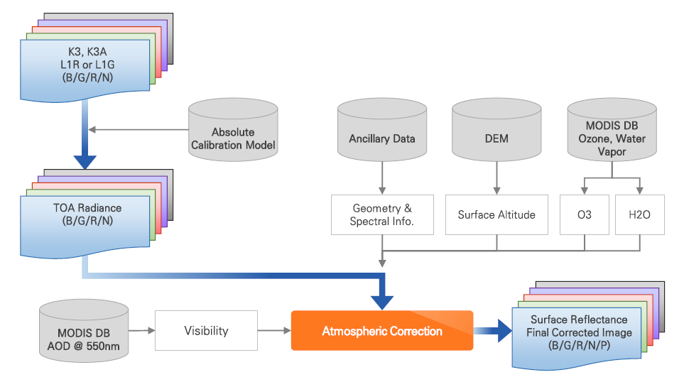
KARI’s Works on ARD (4/18)
Surface Reflectance (4/8)
Feasibility Study: Atmospheric correction
Atmosphere
MODIS DB
AOD/O3/WV
Radiation Transfer Model
MODTRAN
Result
Reflectance close to the reference value
RadCalNet
Procedure for Atmospheric correction

Slide 7
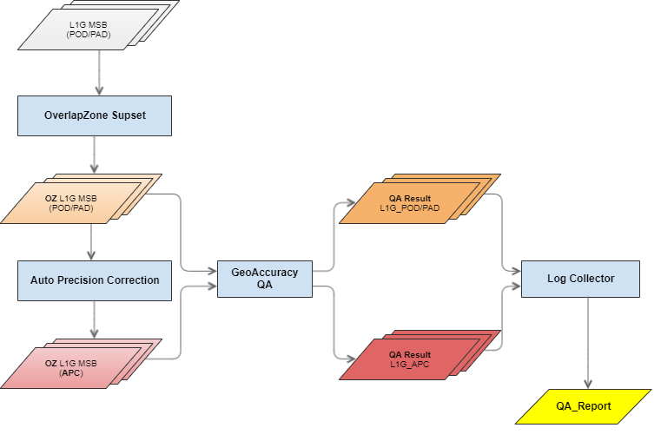
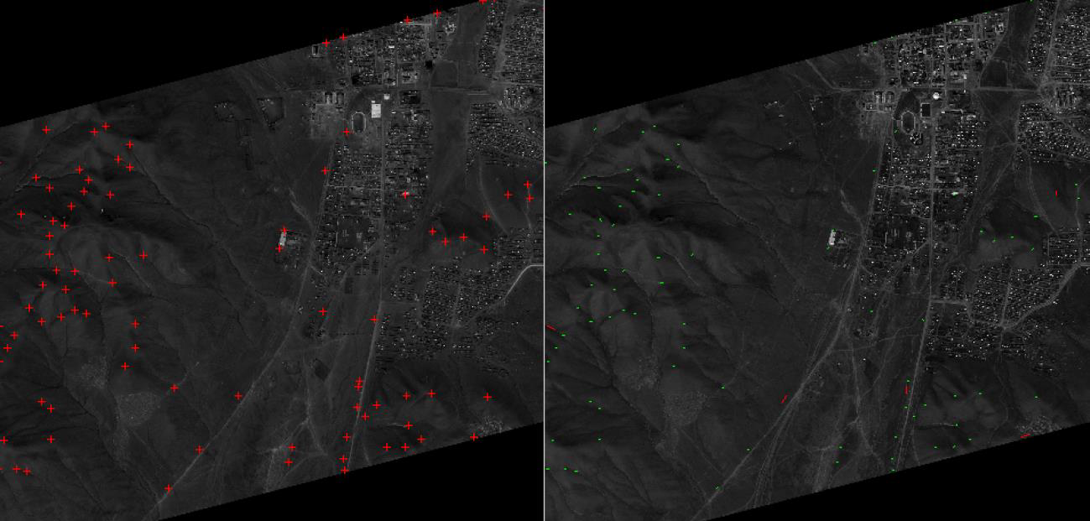
KARI’s Works on ARD (5/18)
Surface Reflectance (5/8)
Feasibility Study: Assessment of registration accuracy (1/2)
Methods
rRMSE/CEP
For matched points
Image matching
Procedure for Qualifying Geolocation Accuracy

Slide 8
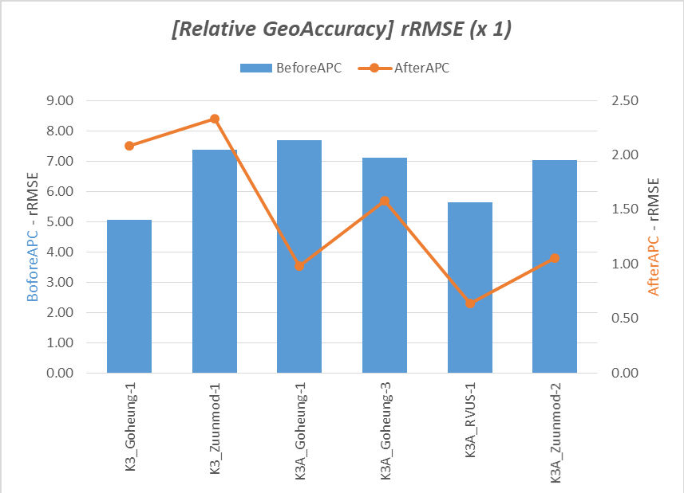
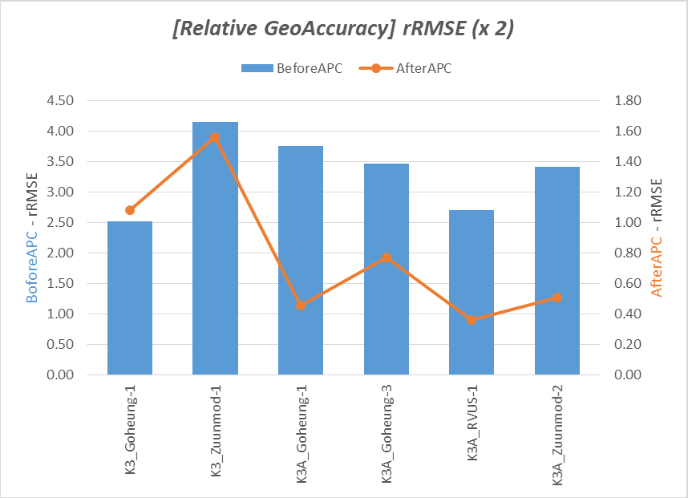
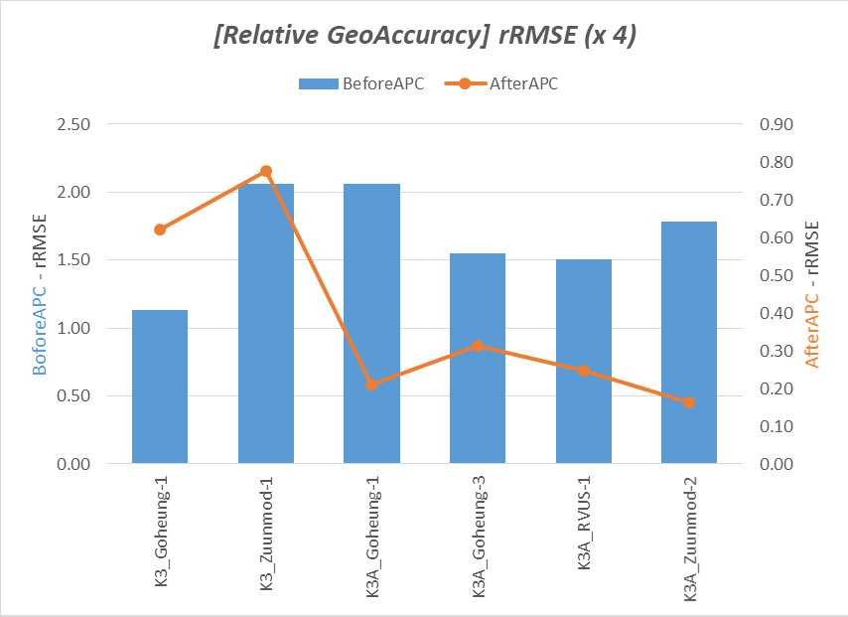
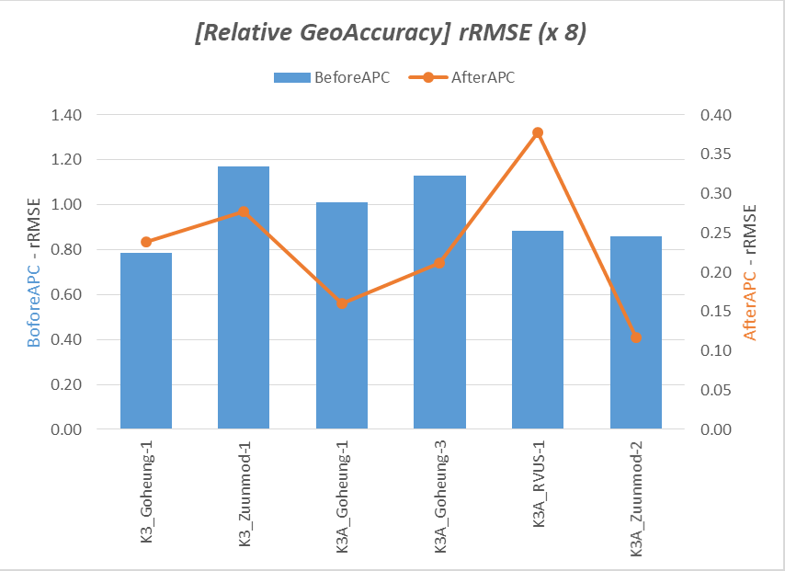
KARI’s Works on ARD (6/18)
Surface Reflectance (6/8)
Feasibility Study: Assessment of registration accuracy (2/2)
Test data
Down-scaled datasets
1/2/4/8
Result
8-Down-scaled datasets meet the threshold of “4.1 Geometric Correction” in CARD4L-SR.
~16m spatial resolution
Spatial Resolution Vs. Registration Accuracy

Slide 9
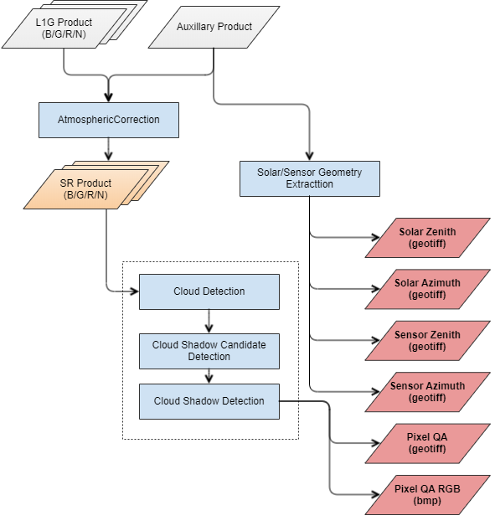
KARI’s Works on ARD (7/18)
Surface Reflectance (7/8)
Feasibility Study: Cloud detection for “Per-Pixel Metadata” generation (1/2)
Characteristics of cloudy pixels
Mass of pixels
Brighter than neighborhood pixels
Lower saturation/hue in HSI space
Lower texture details
Classification
No data
Cloud
Cloud Shadow
Earth’s Surface
Procedure for Cloud Detection

Slide 10
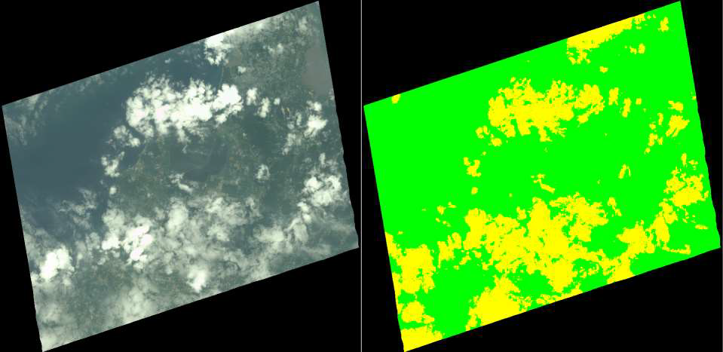
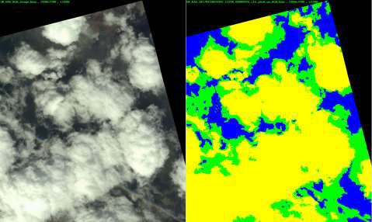
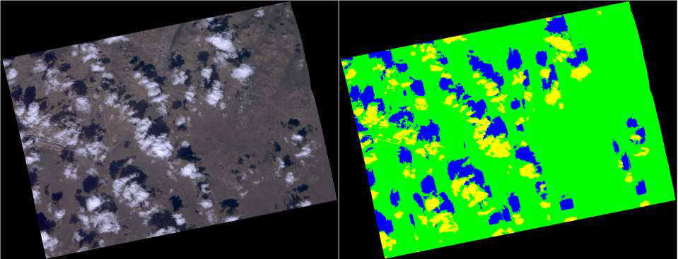
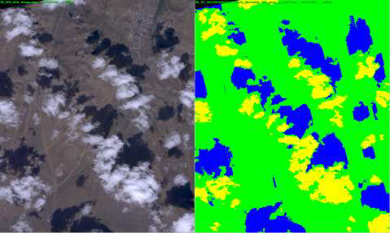
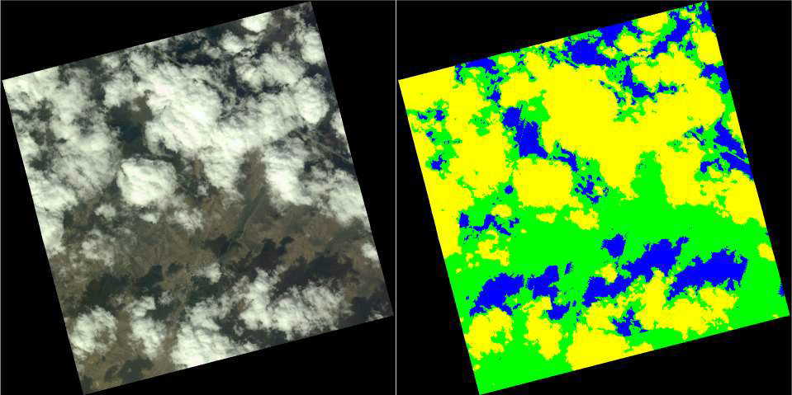
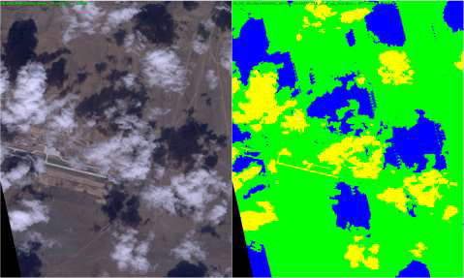
KARI’s Works on ARD (8/18)
Surface Reflectance (8/8)
Feasibility Study: Cloud detection for “Per-Pixel Metadata” generation (2/2)
 | No data (DN: 1)
 | Cloud (DN: 4)
 | Cloud Shadow (DN: 8)
 | Earth’s Surface (DN: 8)
Results
Detection accuracy
Cloud: ~80%
Cloud shadow: ~ 70%
Cloud Detection & Classification

Slide 11
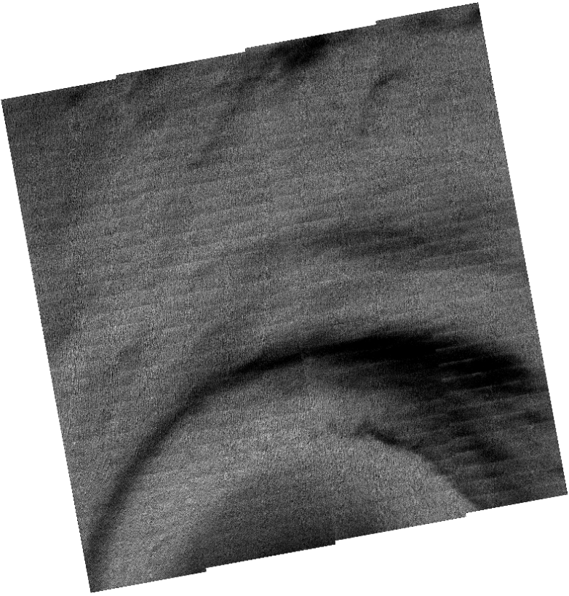
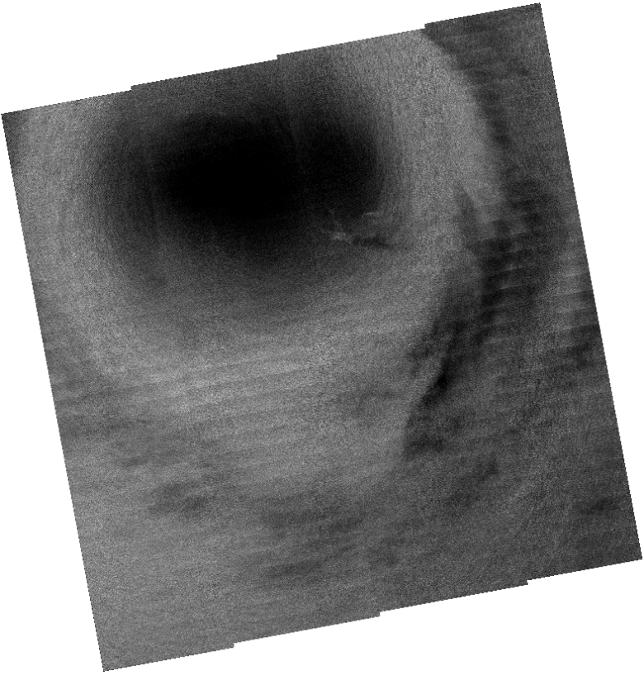
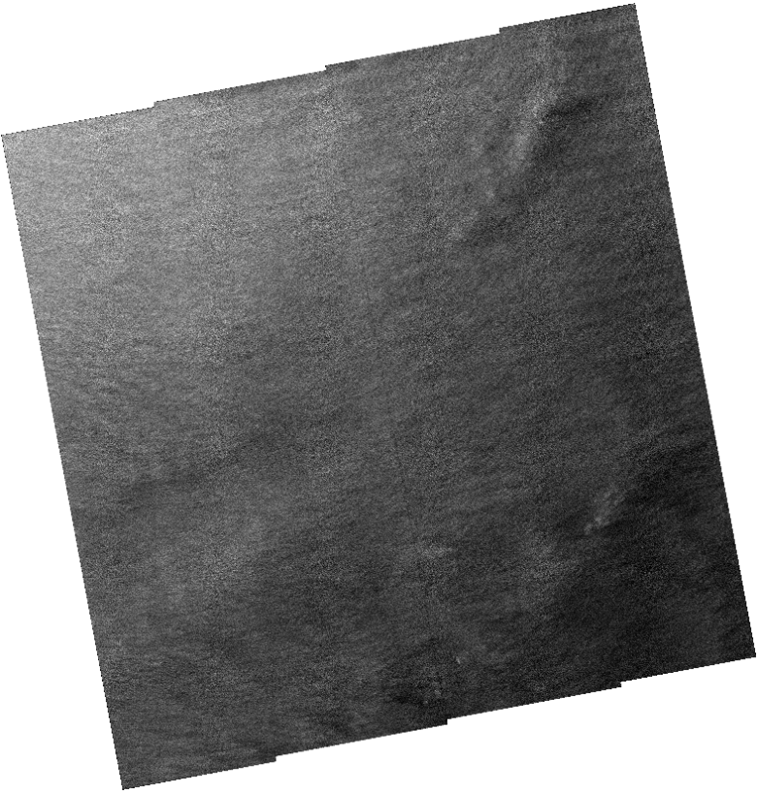
KARI’s Works on ARD (9/18)
Normalized Radar Backscatter (1/5)
Major characteristics of KOMPSAT-5 system
Property | KOMPSAT-5
Orbit | Sun-Synchronous
Altitude (km) | 550
Inclination (°) | 97.06
MLTAN | 6:00
Repeat Cycle (days) | 28
Operation Mode (Resolution (m), Swath (km)) | Stripmap (3, 30) Spotlight (1, 5) ScanSAR (20, 100)
Center Frequency (GHz) | 9.66
Incidence Angle (°) | 20 – 55
Polarization | HH / HV / VH / VV
Geolocation Accuracy (m) | 4.82 (RMSE), 7.32 (CE90)
Map Projection / Datum | UTM / WGS84
Product Format | HDF5 / GeoTIFF

Slide 12
KARI’s Works on ARD (10/18)
Normalized Radar Backscatter (2/5)
KOMPSAT-5 product level
Level | Description
1A | Single Look Complex Slant Range / Azimuth (Zero-Doppler)
1C | Geocoded Ellipsoid Corrected UTM / GEOG, EGM96 EQPOT Surface
1D | Geocoded Terrain Corrected UTM / GEOG, DEM + EGM96 EQPOT Surface

Slide 13
KARI’s Works on ARD (11/18)
Normalized Radar Backscatter (3/5)
Radiometric Terrain Correction (RTC)
CARD4L-NRB
We have focused on implementing and applying RTC function to SAR imagery, especially using KOMPSAT-5 imagery, to meet the threshold requirement for the CARD4L-NRB.

Slide 14
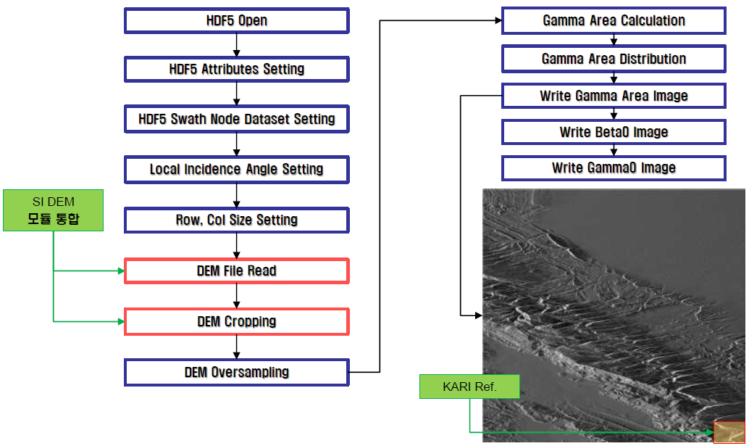
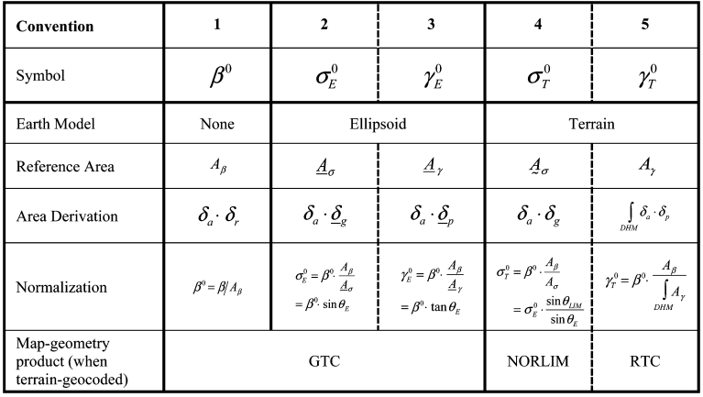
KARI’s Works on ARD (12/18)
Normalized Radar Backscatter (4/5)
Radiometric Terrain Correction Test (1/2)
DEM
SAR Backscatter Normalization Conventions
(D. Small, “Flattening Gamma: Radiometric Terrain Correction for SAR Imagery”, IEEE Transactions on Geoscience and Remote Sensing, Vol. 49, No.8, Aug. 2011)
Procedure for Radiometric Terrain Correction

Slide 15
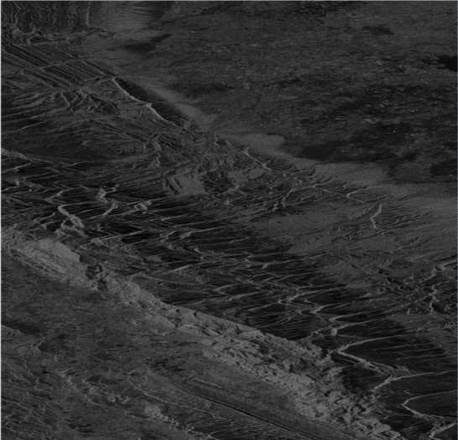
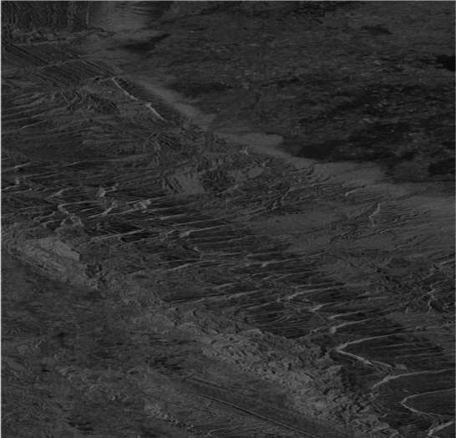
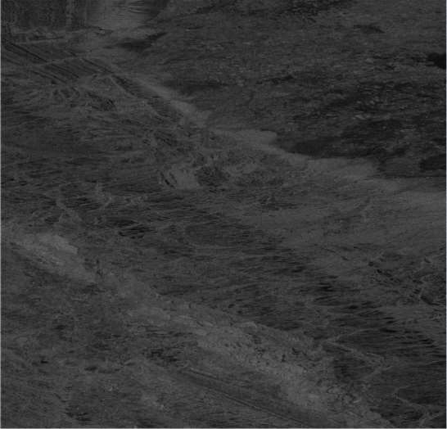
KARI’s Works on ARD (13/18)
Normalized Radar Backscatter (5/5)
Radiometric Terrain Correction Test (2/2)
$$γ_{E}^{0}$$
$$σ_{E}^{0}$$
$$γ_{T}^{0}$$
Result of Radiometric Terrain Correction Test

Slide 16
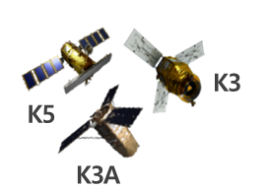
KARI’s Works on ARD (14/18)
System Preliminary Design (1/4)
ARD processing system
KOMPSAT Product
ARD Processing
ARD Product
K3/3A
Level
Processor
ARD SR Processing
K3/3A 1R/1G
L0 Data
Image
Pixel-Metadata
Metadata
K5
Level
Processor
K5 L1A
ARD NRB Processing
Image (SR, NRB)
Per-pixel Metadata
Optical · SAR
Image
ARD
Processing
ARD Metadata

Slide 17
KARI’s Works on ARD (15/18)
System Preliminary Design (2/4)
ARD product
Sensors
Product Families
K-ARD Products
General ARD Metadata
CARD4L PRODUCT FAMILY
Surface Reflectance
General Metadata
Quality Metadata
Measurement Calibration
Geometric Calibration
Surface reflectance - Image
KOMPSAT Optical
Pixel Metadata – Cloud Mask
KOMPSAT SAR
Pixel Metadata – QR(Quality Assessment)
TCI(True Color Image)
Thumbnail

Slide 18
KARI’s Works on ARD (16/18)
System Preliminary Design (3/4)
ARD processing software: SR

Slide 19
KARI’s Works on ARD (17/18)
System Preliminary Design (4/4)
ARD processing software: NRB

Slide 20
KARI’s Works on ARD (18/18)
Near Term Activities
Preliminary Design for ARD processing Software: ~’23/12
Detailed Design for ARD processing Software: ~’24/12

Slide 21
Thank You!
LSI-VC-14 2023, ESA/ESRIN
10th - 12th October 2023

