Slide 1

EOS-04-
TOWARDS CEOS ARD
Data Products
& NRB Self Assessment
HariPriya S,
V.M.Ramanujam, Raghav Mehra
H.S.V.Usha Sundari Ryali, ManjuSarma S
Indian Space Research Organisation
Agenda Item 2.1
LSI-VC-14 2023, ESA/ESRIN
10th - 12th October 2023

Slide 2
Contents
ISRO –EO Data Processing
EOS-04 –Introduction ,Imaging Modes & Data Product Specifications
EOS-04 – TOWARDS CARD-SAR
NRB Product Contents and Attributes
NRB Gamma Naught & Geometric Analysis of Level-2B
Systematic Coverage Cycles and Time Series Observations ,ARD-Mosaic
PFS -Self Assessment –Summary
CARDSAR -ISRO’s RoadMap
Summary
Novasar-S -Automated Data Production and Terrain Correction in IMGEOS

Slide 3



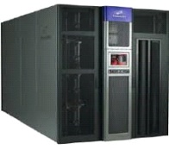
ISRO EO DATA PROCESSING
Integrated Multi-Mission Ground Segment for EO Satellites (IMGEOS)
Salient Features:
Enhanced user services with online data ordering & dissemination.
Data availability with minimum latency for processing (24 x 7 Operations).
World class state-of-the-art data centre with three-tier Storage Area Network (SAN)
Efficient data/file transfers over the secured & scalable network.
Automated Workflow Chains.
Algorithm Developments & Analysis
Data
Dissemination
Product
Archival
Users Community:
Government.
Industries
Academic
International
Disaster Support
Data Quality Evaluation
Product Quality
Check
Level-1/Level-2
Data Product Generation
Value Added Products
Open and Priced Data Products:
- 0.28 m to 360 m resolution
- Optical & Microwave
Payload
Planning
Level – 0
Data Processing
Acquisition/Processing
IRS & Non-IRS satellites
> 95 Passes / Day
>2 TB / Day
Shadnagar
Antarctica
Data Ingest
At IMGEOS, data is being acquired
processed, archived and disseminated for
both Indian Remote Sensing (IRS) and
Non-IRS category of Satellites.
Jodhpur
IGS
Data Archival
Notes:
-

Slide 4
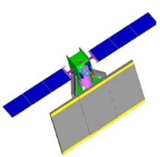
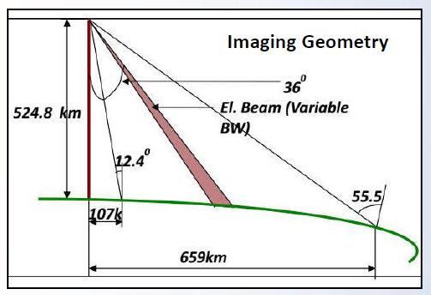
Introduction to EOS-04
EOS-04 (RISAT-1A) is Follow -on Mission of RISAT-1
Launched on 14-February 2022
Frequency: C-band (5.4 GHz).
Imaging Modes: Stripmap, ScanSAR and Sliding- Spotlight -(FRS-1, FRS-2, MRS, CRS and HRS)
Polarizations: Single, Dual, Compact (CP) & Full (FP)
Swath Coverage: 10 Km to 223 Km
Spatial Resolutions: 1m to 50m
Data availability: 23rd March 2022 onwards

Slide 5
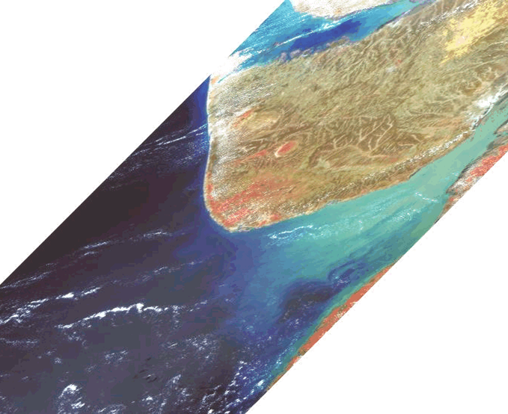

Operational Imaging Modes
524.87 km
FRS1/ FRS2 MODE
107 km
HRS MODE
CRS MODE
550 km
MRS MODE

Slide 6
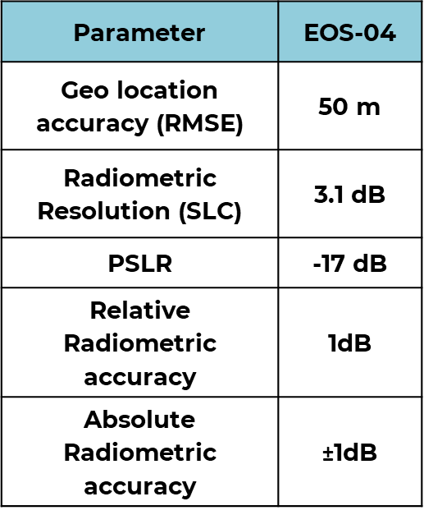
Product Specifications
MODES | FRS-1 (Fine Resolution Stripmap-1) | FRS-2 (Fine Resolution Stripmap-2) | MRS (Medium Resolution ScanSAR) | CRS (Coarse Resolution ScanSAR)
Swath (km) | 25 #20 | 25 #20 | 160 #115 | 223 #168
Azimuth Resolution(m) | 3 | 3 | 33 | 50
Slant range resolution(m) | 2 | 4 | 8 | 8
Ground range resolution(m) | 11-2.8 | 22-5.6 | 45-22 | 135-45
Worst Sigma Naught (dB) | ≤- 18 | ≤-19 | ≤- 18 | ≤-18
Off-Nadir (km) | 100 – 650 #100-400 | 100-650 #100-400 | 100 - 650 #100-400 | 100 - 650 #100-400
Look Angle (deg) | 11-49 #11-37 | 11-49 #11-37 | 11-49 #11-37 | 11-49 #11-37
Polarization | Single, Dual, Hybrid, Full | Single, Dual, Hybrid, Full | Single, Dual, Hybrid, Full | Single, Dual, Hybrid, Full
# represents specifications for Full Polarimetric mode.

Slide 7
EOS-04 Data Products
Levels of Data Products
Level -0 | Raw Signal Product (Generic Binary)
Level-1 | Geo-Tagged Products- Single Look Complex & Ground Range Products (CEOS/GeoTiff)
Level-2A Georef | Enhanced Terrain corrected Geo Referenced Product (GeoTiff)
Level-2B | Terrain Normalized Analysis Ready Data (ARD) product
Value Added Products
Level-1C | Geo-tagged Polarimetric products
Level-3A | Geo-referenced Polarimetric products
Mosaic | India Mosaic (for systematic coverage) (yet to be operationalised)
Projection: UTM (Level-2) Datum : WGS84 (Level-2) Resampling : CC (Level-2)
EOS-04 data is available at Bhoonidhi web portal for user ordering
https://bhoonidhi.nrsc.gov.in

Slide 8
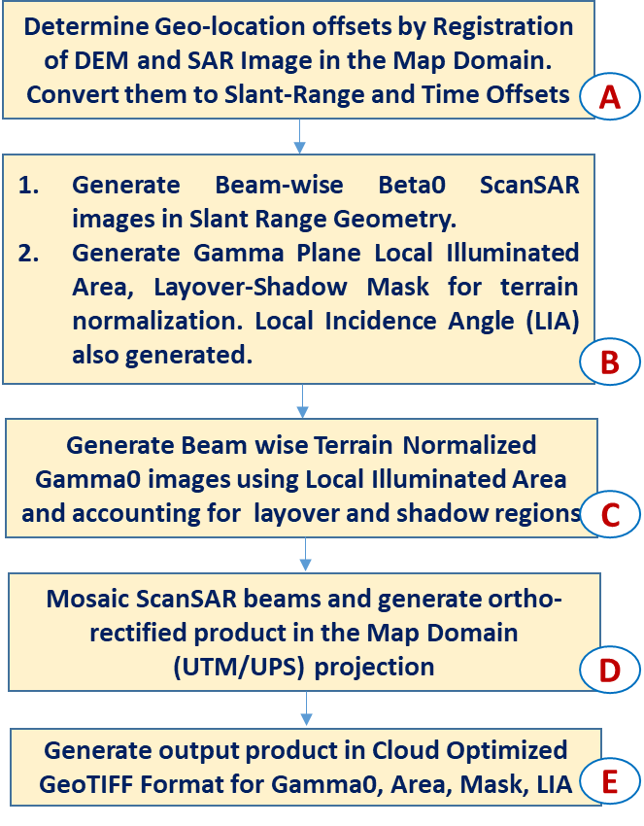
EOS-04 – Towards CARD-SAR
The EOS-04 NRB data is designed to be CEOS NRB v5.5 compliant . The NRB data pixels indicate the true backscatter of the land cover without any over-estimation, which allows for immediate analysis with minimum additional user effort. The product is designed to be in compliance with CEOS CARD4L-NRB product family specifications.
Level-2B data products are geo-coded incorporating the Copernicus 30m Digital Elevation Model DEM (2019 version) and comprise the Terrain-flattened Gamma-Naught backscatter coefficient for each polarization (e.g., HH, HV, VV, VH, RH, and RV) .
EOS-04 NRB is applicable to the MRS and CRS ScanSAR modes, in the current DP version (v 1.1.02)
The Per Pixel Meta data includes the Local Incidence Angle File ,Mask File , Scattering Area File and the product meta file in ASCII and xml formats .

Slide 9
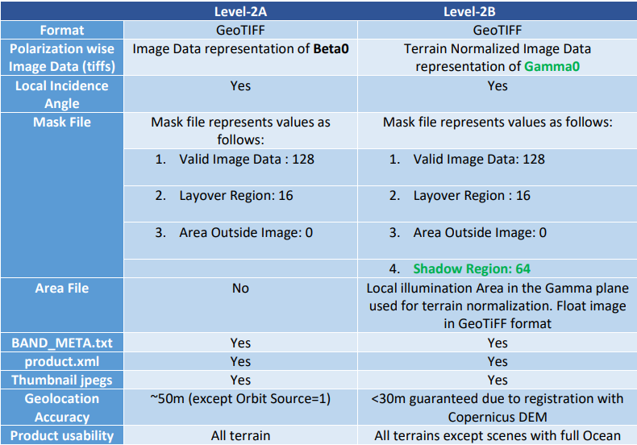

EOS-04 -NRB Product Contents and Attributes

Slide 10
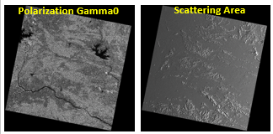
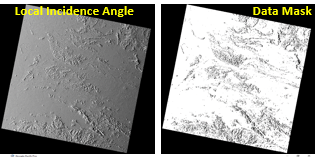
EOS-04 – NRB - MRS MODE
Gamma Naught HH, Scattering Area, Local Incidence Angle and Mask Imagery
DOP: 24-APR-2022 Scene Centre Coordinate: 21.15 deg N, 84.53 deg E

Slide 11
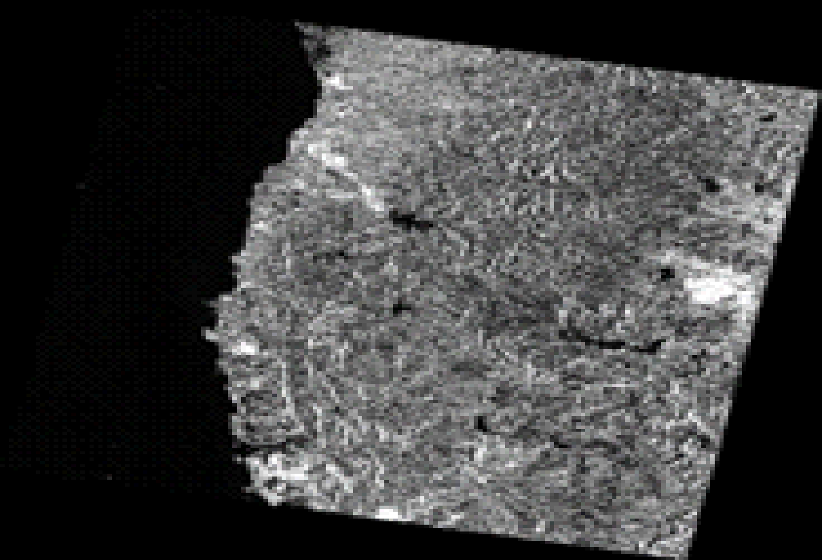
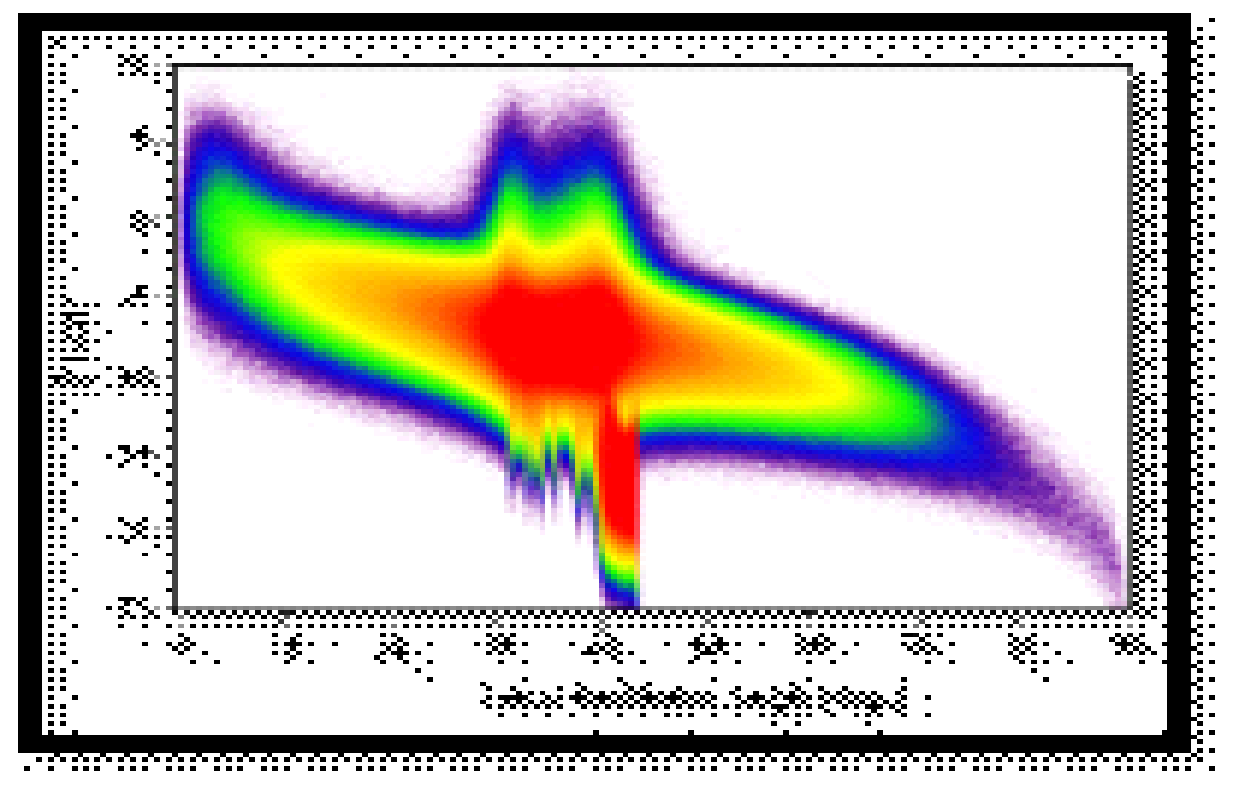
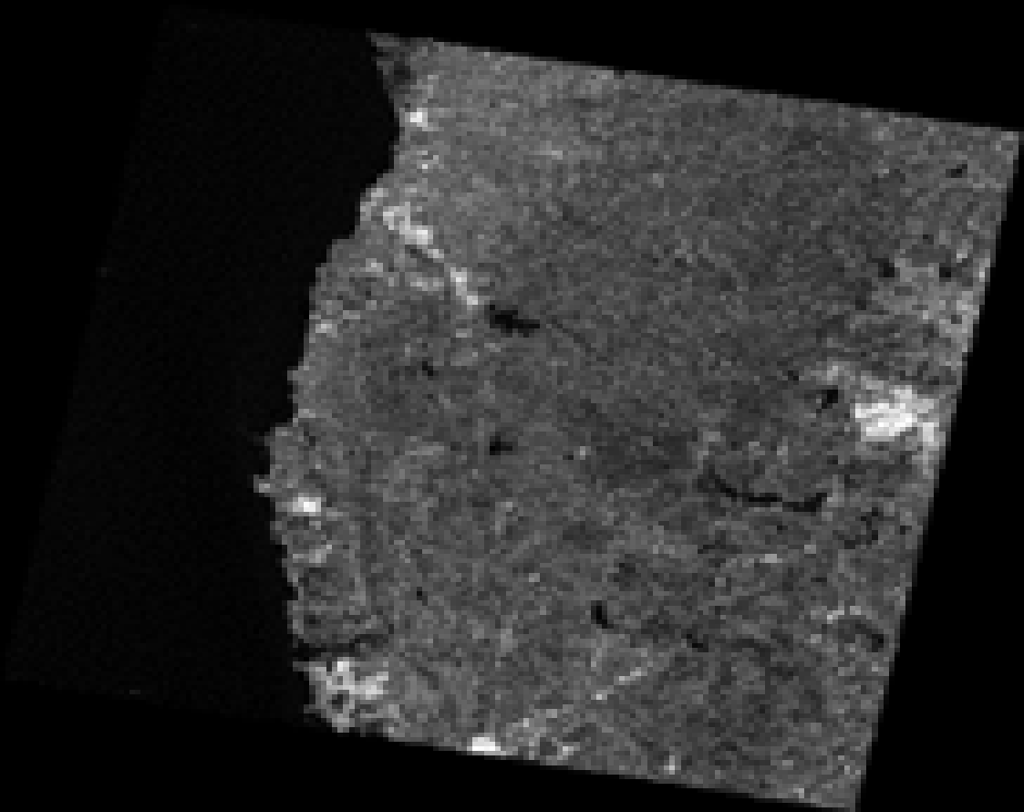
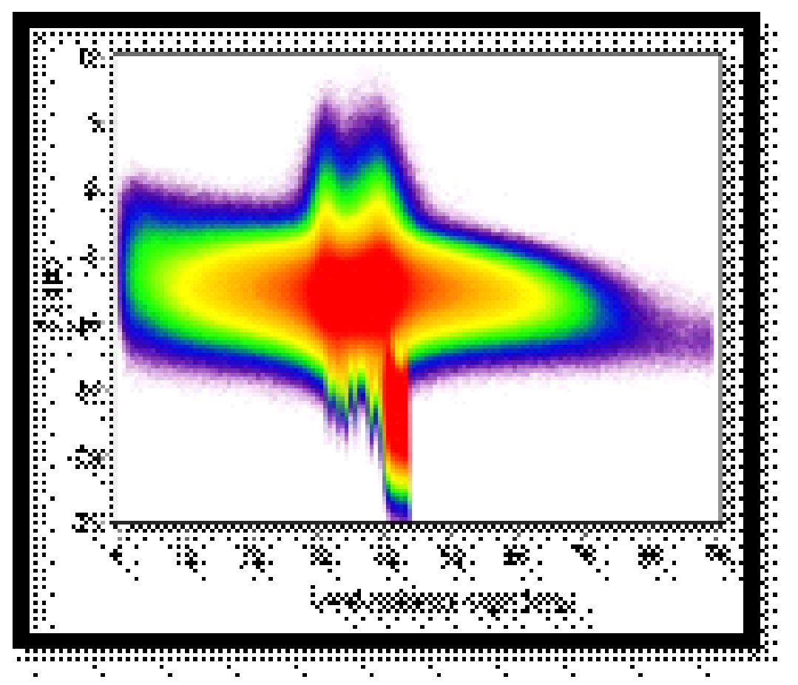
EOS-04 – Ellipsoid Based vs Terrain Based Normalization
Ellipsoid based Gamma Naught (γ_{E}⁰ ) and γ_{E}⁰ versus Local Incidence Angle
After applying terrain based normalization γ_{T}⁰ Radiometric Terrain corrected (RTC)
and γ_{T}⁰ versus Local Incidence Angle
Scene Coordinate: 19.646458 deg N, 73.534427deg E Area: Nashik, Maharashtra, India

Slide 12
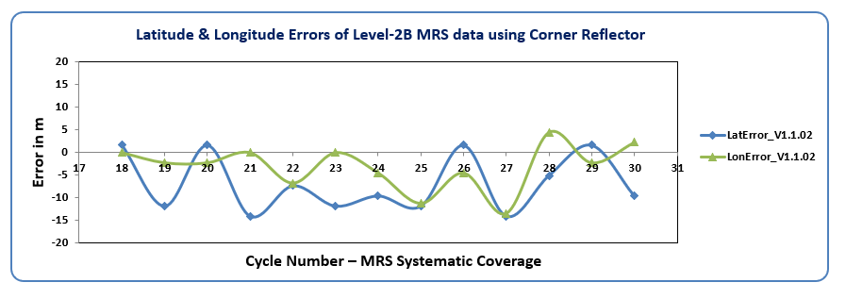
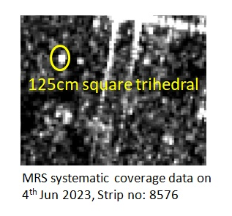
Geometric Analysis of Level-2B
The Data is analysed over Cycles of Systematic Coverage and the geometric and Radiometric Compliance of the data is investigated using known Ground targets and Land cover regions during different sensing periods and cycles of coverage.
Latitude & Longitude errors were computed for the peak location with respect to the DGPS coordinates of the corner reflector.
Absolute geometric accuracy and Relative accuracy across cycles for Level-2B product is observed to be within 1 pixel (<18m).
Region: IMGEOS –Cal Val Site ,
Hyderabad, India

Slide 13
EOS04 NRB Self Assessment- Summary
Summary Self-Assessment Table
 |  | Threshold | Target
1 | General Metadata
1.1 | Traceability | Not Required
1.2 | Metadata Machine Readability | YES
1.3 | Product type | YES
1.4 | Document Identifier | YES
1.5 | Data Collection Time | YES
1.6 | Source Data Attributes
1.6.1 | Source Data Access | YES
1.6.2 | Instrument | YES
1.6.3 | Source Data Acquisition Time | YES
1.6.4 | Source Data Acquisition Parameters | YES
1.6.5 | Source Data Orbit Information | YES
1.6.6 | Source Data Processing Information | YES
1.6.7 | Source Data Image Attributes | YES
1.6.8 | Sensor Calibration | Not Required
1.6.9 | Performance Indicators | YES
1.6.10 | Source Data Polarimetric Calibration Matrices | Not Required
1.6.11 | Mean Faraday Rotation Angle | Not Required
1.6.12 | Ionosphere Indicator | Not Required
1.7 | CARD4L Product Attributes
1.7.1 | Product Data Access | YES
1.7.2 | Ancillary Data | Not Required
1.7.3 | Product Sample Spacing | YES
1.7.4 | Product Filtering | YES
1.7.5 | Product Bounding Box | YES
1.7.6 | Product Image Extent | YES
1.7.7 | Product Image Size | YES
1.7.8 | Product Pixel Coordinate Convention | YES
1.7.9 | Product Coordinate Reference System | YES
2 | Per-Pixel Metadata
2.1 | Metadata Machine Readability | YES
2.2 | Data Mask Image | YES
2.3 | Scattering Area Image | YES
2.4 | Local Incident Angle Image | YES
2.5 | Ellipsoidal Incident Angle Image | Not Required
2.6 | Noise Power Image | Not Required
2.7 | Gamma-to-Sigma Ratio Image | Not Required
2.8 | Acquisition ID Image | Not Required
2.9 | Per-Pixel DEM | Not Required

Slide 14
EOS04 NRB Self Assessment- Summary
3 | Radiometric Terrain Corrected Measurements
3.1 | Backscatter Measurements | YES
3.2 | Scaling Conversion | YES
3.3 | Noise Removal | YES
3.4 | Radiometric Terrain Correction Algorithms | YES
3.5 | Radiometric Accuracy | Not Required
4 | Geometric Terrain Corrections
4.1 | Geometric Correction Algorithms | Not Required
4.2 | Digital Elevation Model | YES
4.3 | Geometric Accuracy | YES
4.4 | Gridding Convention | YES
44 Threshold and 9 target specifications have been met by the MRS /CRS data products
https://ceos.org/ard/files/PFS/NRB/v5.5/CARD4L-PFS_NRB-v5.5.pdf

Slide 15
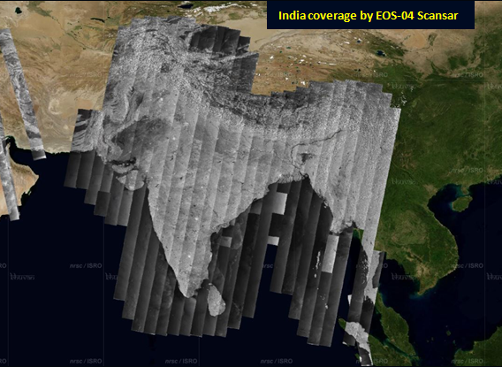
EOS-04 MRS Systematic Coverage
Indian Region is being covered in MRS Systematic Coverage with configuration.
  Resolution: 33m
  Swath: 160km
  Repeativity: 17 days
  Polarization: HH+HV
  Node, Look Direction: Descending, Right
  Incidence angle: 37 deg
33 Cycles completed till now.
EOS-04 MRS Systematic coverage data as displayed in Bhoonidhi vista

Slide 16
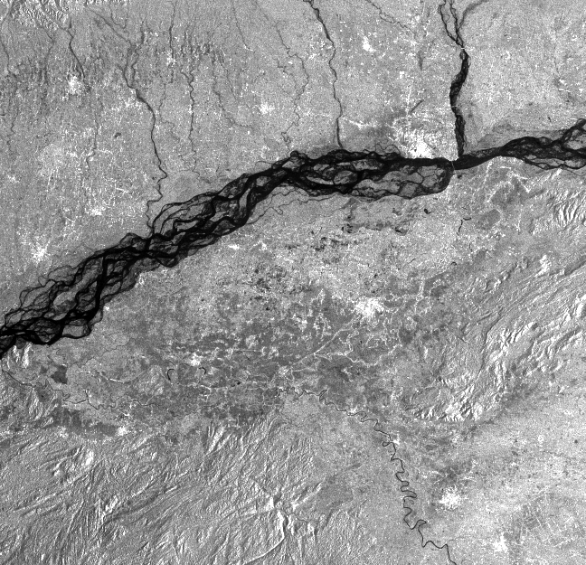
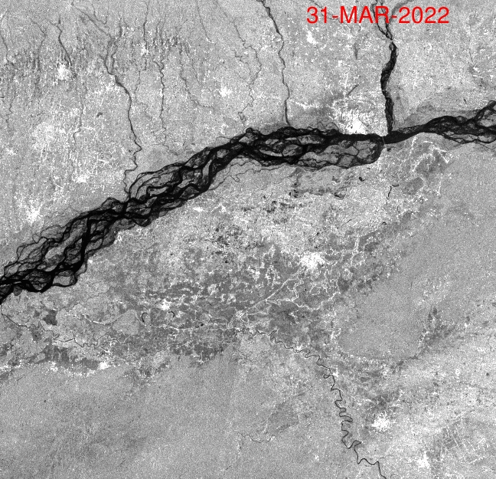
EOS-04 Radiometric Terrain Corrected (RTC) -Time Series -31 March 2022c to 30 May 2023
ScanSAR Mode
Region:Assam,India
EOS-04 L2A Product –Date of Imaging : 31 Mar 2022
EOS-04 L2B Product Time Series Date of Imaging:11 July 2022

Slide 17
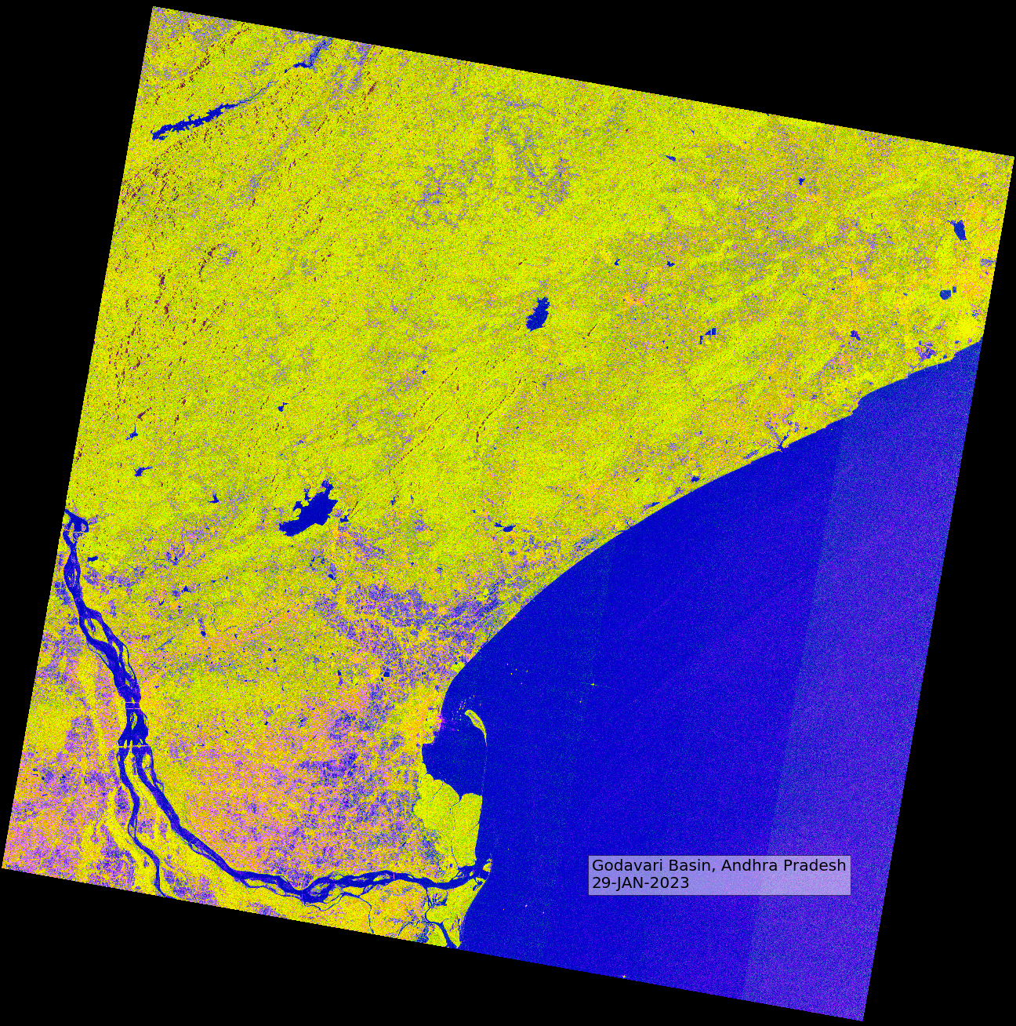
EOS-04 Radiometric Terrain Corrected (RTC) -Time Series- 29 Jan 2023 -21 Aug 2023 (FCC)

Slide 18
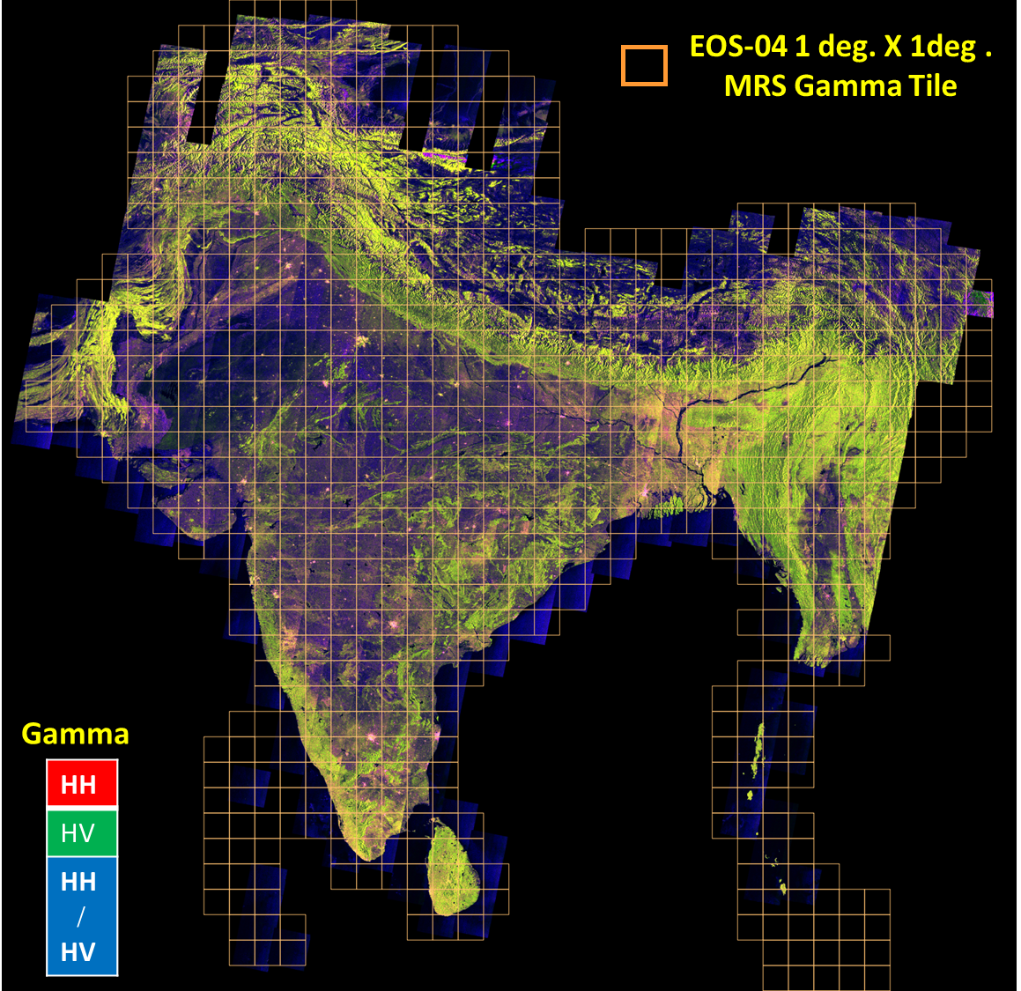
Analysis Ready Data (ARD) MRS India Mosaic Data Product
Indian Landmass systematically covered in EOS-04 Medium Resolution ScanSAR (MRS) mode every 17 days. India Mosaic ARD product to be available as 1⁰ X 1⁰ tiles corresponding to 18 meters sampling.
Software development completed. Work under progress for testing operationalization of India Mosaic ARD product generation at IMGEOS, NRSC by 25th October 2023
Cycle (17 days) to cycle registered product will aid in Time-Series analysis by application users.
Product content and composition as per CEOS NRB v 5.5 compliance
Mosaic ARD product will be applied for CEOS ARD certification.

Slide 19
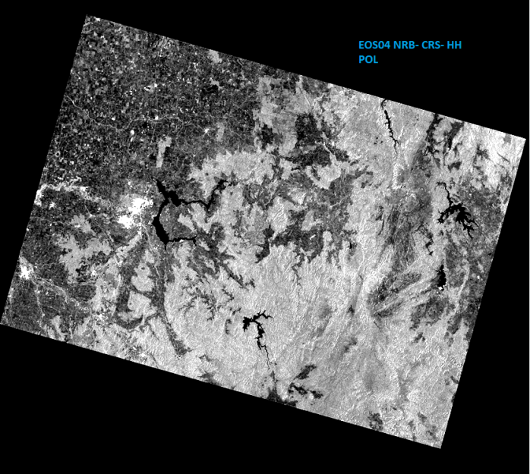
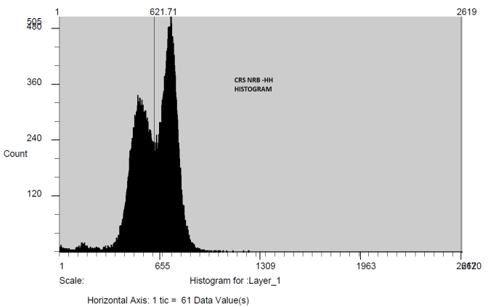
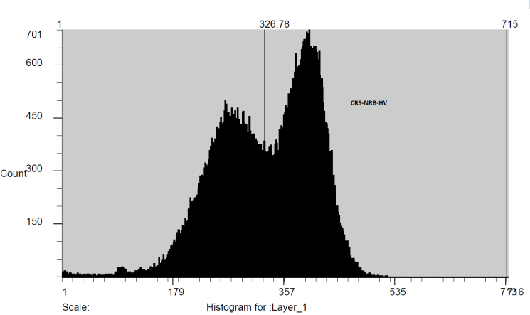
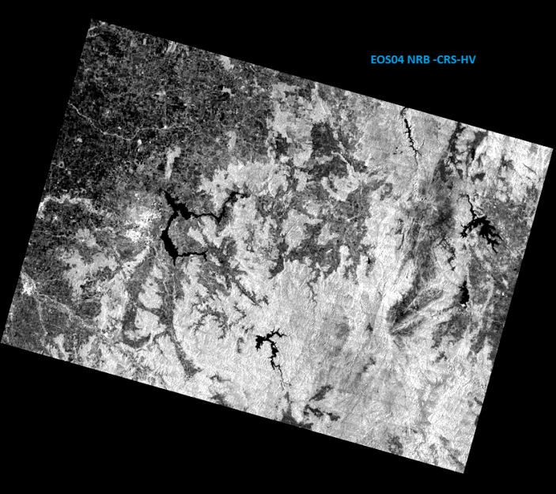
Level-2B NRB Mode: CRS -Dual
Geometric Analysis of Level-2B
EOS04 NRB Coarse Resolution ScanSAR CRS ;DOI:25 APR 2022 Orbit 1073; Region: Australia

Slide 20
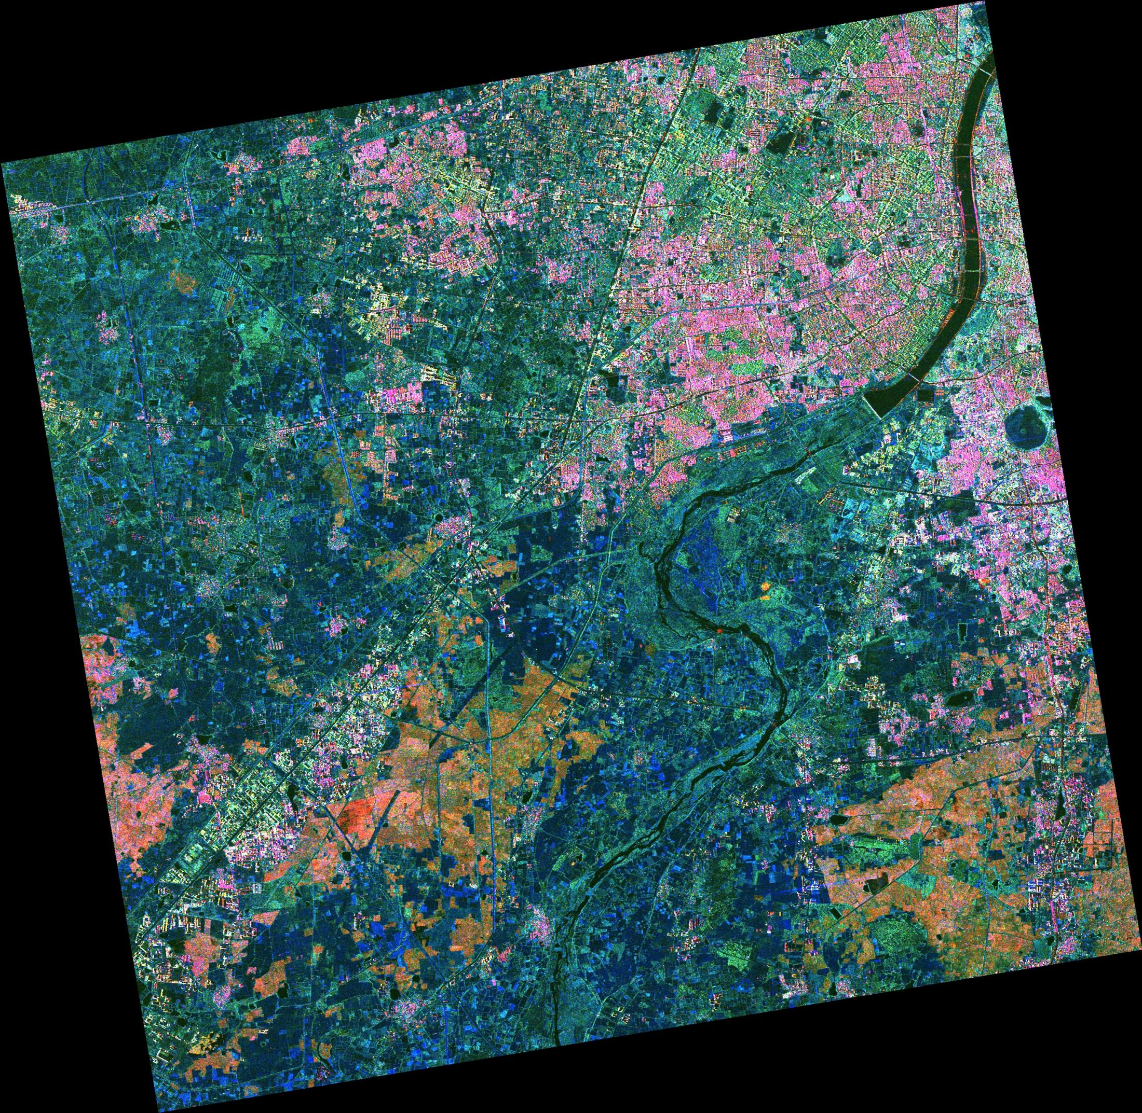
Polarimetric Decomposed Products-FP
Red- Even Bounce Scattering
Green – Volume Scattering
Blue – Odd Bounce Scattering
Date of Pass: 3rd April 2022, Full Polarimetry, Yamaguchi Decomposition, FRS-1, Level-3A
Ahmadabad, India

Slide 21
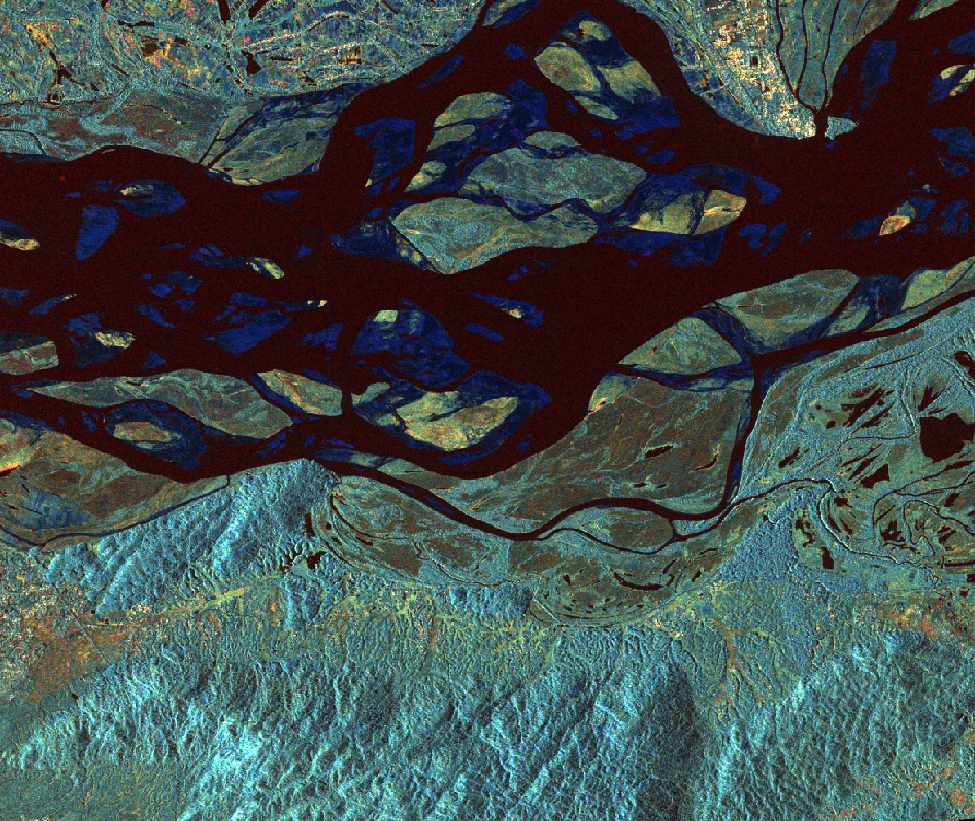
Polarimetric Decomposition – Hybrid Pol
Red- Even Bounce Scattering
Green – Volume Scattering
Blue – Odd Bounce Scattering
Brahmaputra River, Assam, Hybrid polarimetry, m-delta decomposition, FRS-1

Slide 22
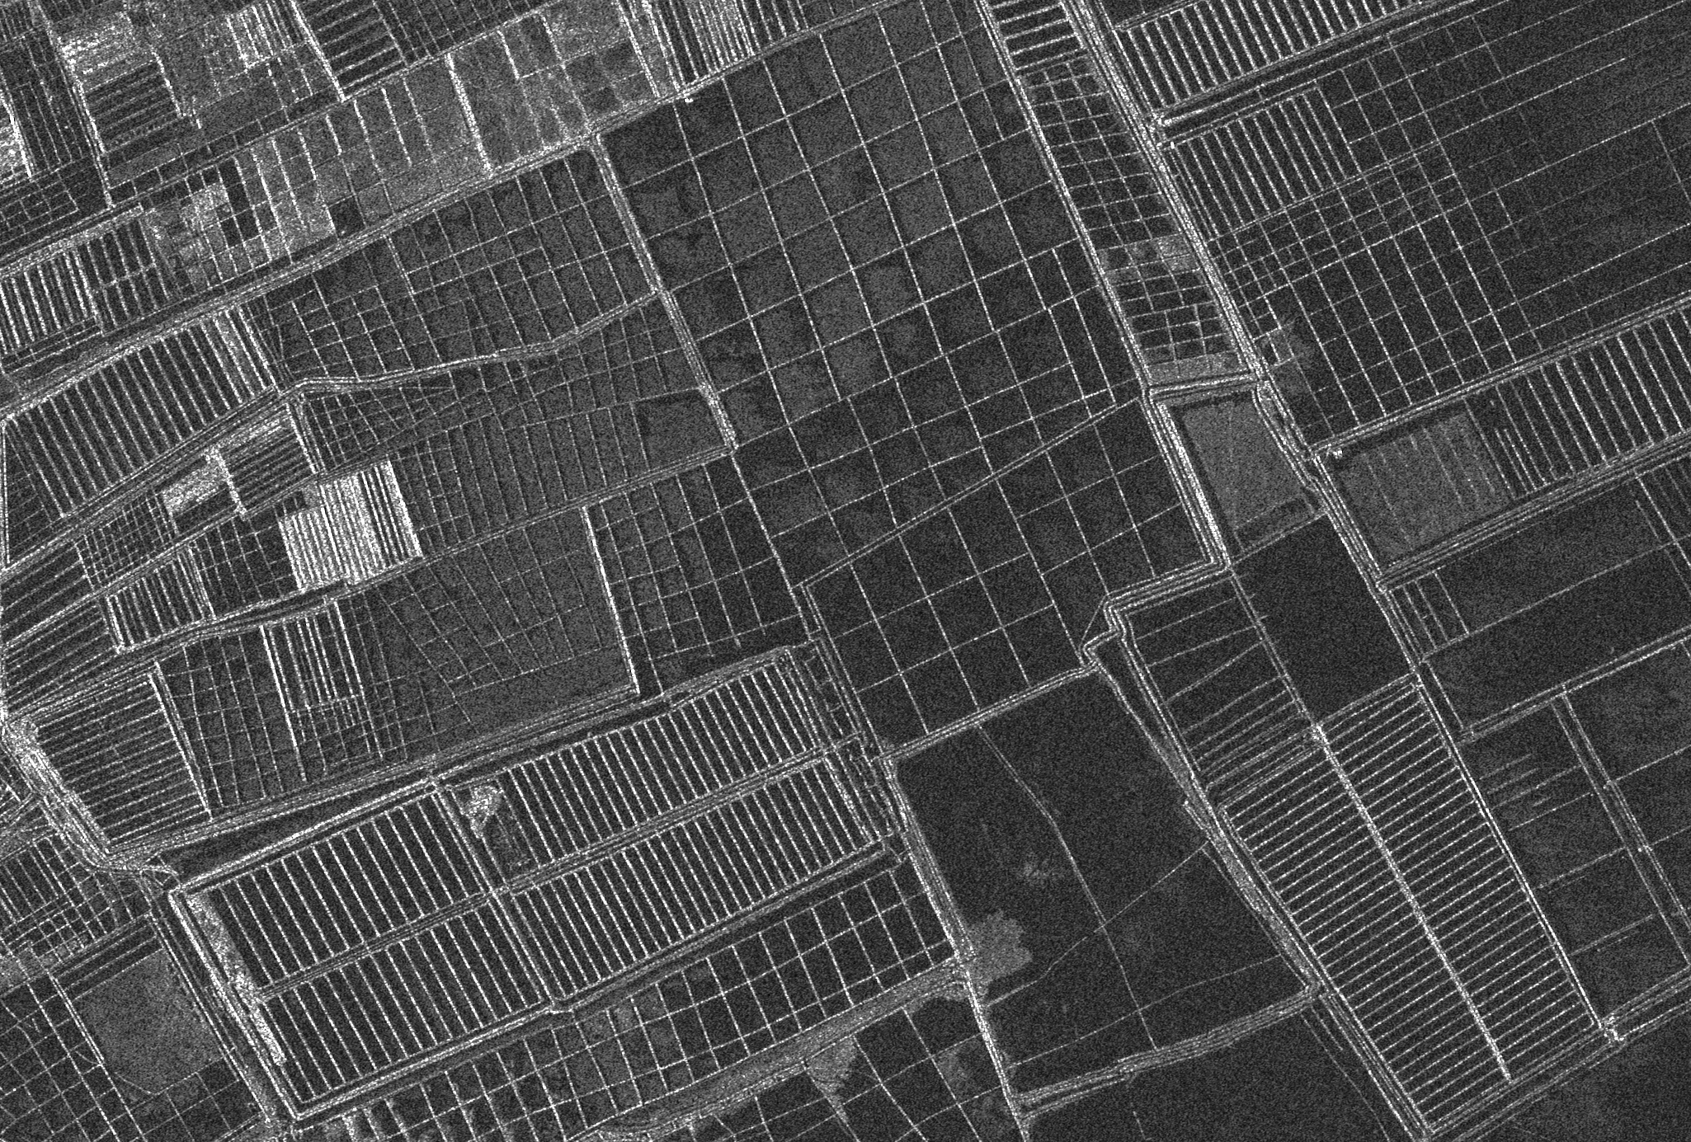
FRS-1 Stripmap Salt Panes- Kutch ,Gujarat
SALT PANS, KACHCHH, GUJARAT
Date of Pass :01-NOV-2022 ; Mode: FRS-1 , Salt Panes, Kutch , Gujarat, India

Slide 23
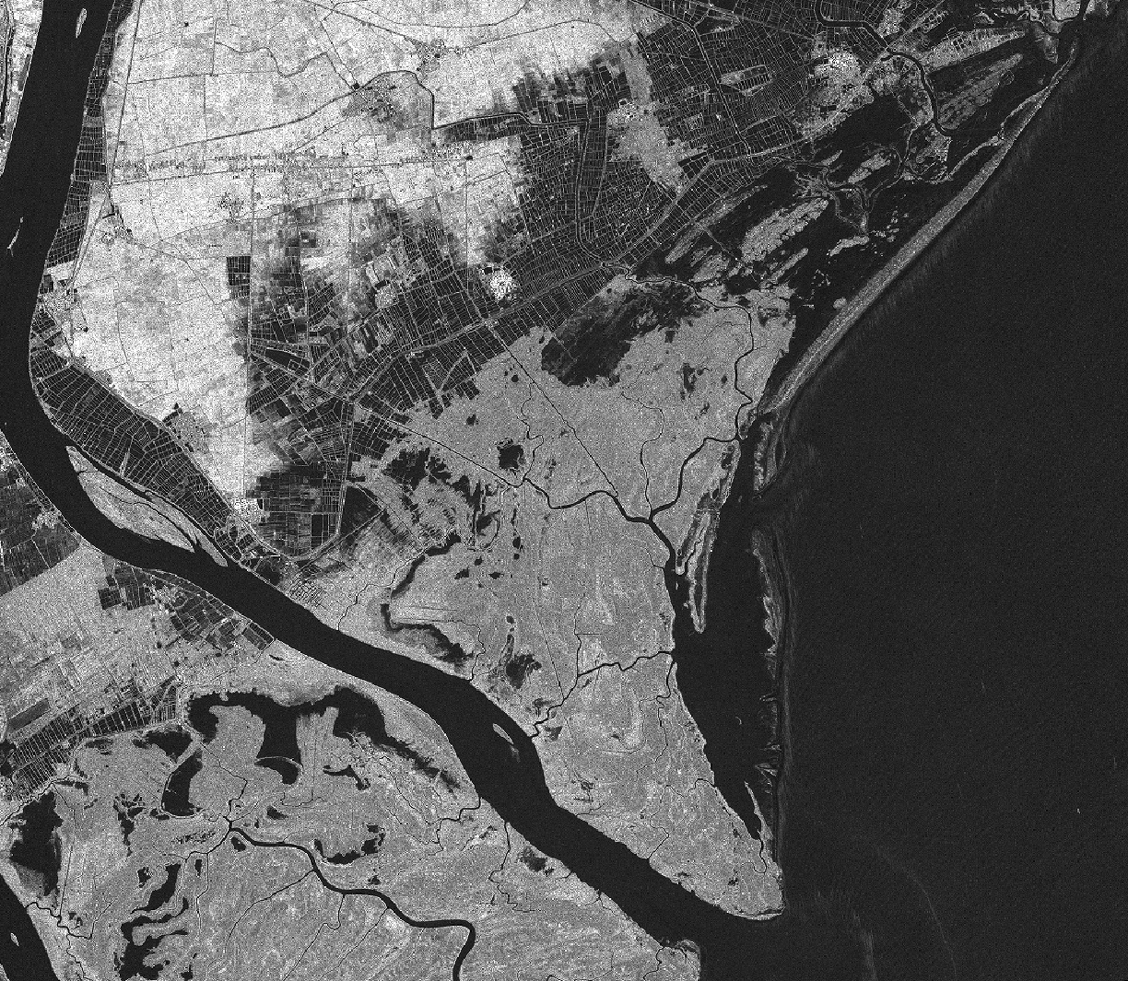
FRS-1 Stripmap –Krishna District
Date of Pass :29-OCT-2022 Mode: FRS-1 Polarization : HH , Nachugunta Reserve Forests Krishna Dist. AP

Slide 24
CARD SAR – ISRO’S Roadmap
SNO | ARD Product | Sensor | Product Type | Timeline
1 | Normalised Radar Backscatter | EOS04(RISAT1A)/1B | Level2B | 2023/24
 |  | EOS04(RISAT1A)/1B | India Mosaic (Tiled Product) | 2023/24
2 | Polarimetric Radar | EOS04(RISAT1A)/1B | Geocoded Polarimetric Decomposition Products (Level-3B) | 2023/24
 |  | EOS04(RISAT1A)/1B | GCOV (Geocoded Covariance Product) | 2024
 |  | NISAR | GCOV (Level-2) | 2024
3 | Geocoded Single Look Complex | NISAR | GSLC (Level-2) | 2024
4 | Interferometric Products | NISAR | GUNW (Geocoded – Unwrapped Interferogram) | 2024/25

Slide 25
Summary
EOS-04 Level-2B data is processed and designed to be in compliance with the CARD SAR -NRB Product Family Specifications.
The Normalized Radar Backscatter NRB product comprises the polarization-wise product gamma naught along with the Per -pixel Meta data files like Local Incidence Angle, Scattering Area , Mask File in GeoTiff Format .
The ancillary meta information is provided in ASCII format as BAND_META.txt and Product.xml which would help the data user to understand the acquisition and processing related information.
The EOS-04 NRB designated as Level-2B allows for immediate analysis with minimum additional user effort .
The self assessment Summary and the detailed Self Assessment has been submitted to CEOS SAR ARD Oversight Group and LSI –VC .
All the forty four Threshold requirements are met and nine of the target requirements are also met for the Medium Resolution and Coarse Resolution ScanSAR Imaging Modes.

Slide 26
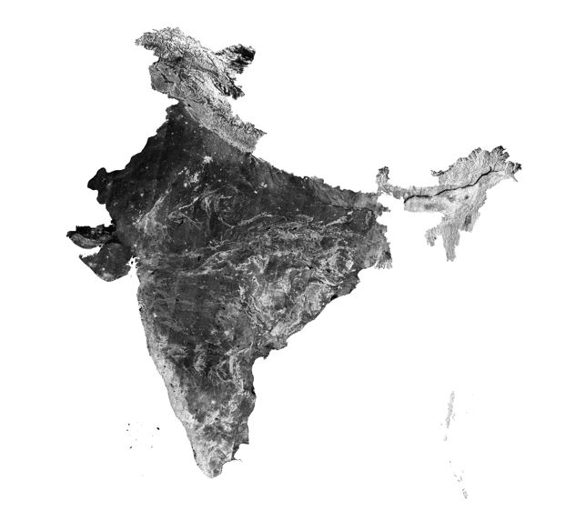
[1] https://ceos.org/ard/files/PFS/NRB/v5.5/CARD4L-PFS_NRB v5.5.pdf
[2] Synthetic Aperture Radar –Radiometric Calibration-David Small Erich Meler- Department of Geography-University of Zurich- www.geo.uzh.ch
References
[3] EOS-04 Sample Products https://bhoonidhi.nrsc.gov.in/bhoonidhi/help/sampleProducts.html
[4]Brochure https://bhoonidhi.nrsc.gov.in/bhoonidhi_resources/help/docs/E04_BROUCHURE.pdf
[5] Product Format Document
https://bhoonidhi.nrsc.gov.in/bhoonidhi_resources/help/docs/EOS_04_Data_Products_Format_Document.pdf
[6] Compact polarimetry based on symmetry properties of geophysical media: The π/4 mode,” J.-C. Souyris, P. Imbo, R. Fjørtoft, S. Mingot, and J.-S. Lee, IEEE Transactions. Geosciences Remote Sens., vol. 43, no. 3, pp. 634–646, Mar. 2005.

Slide 27
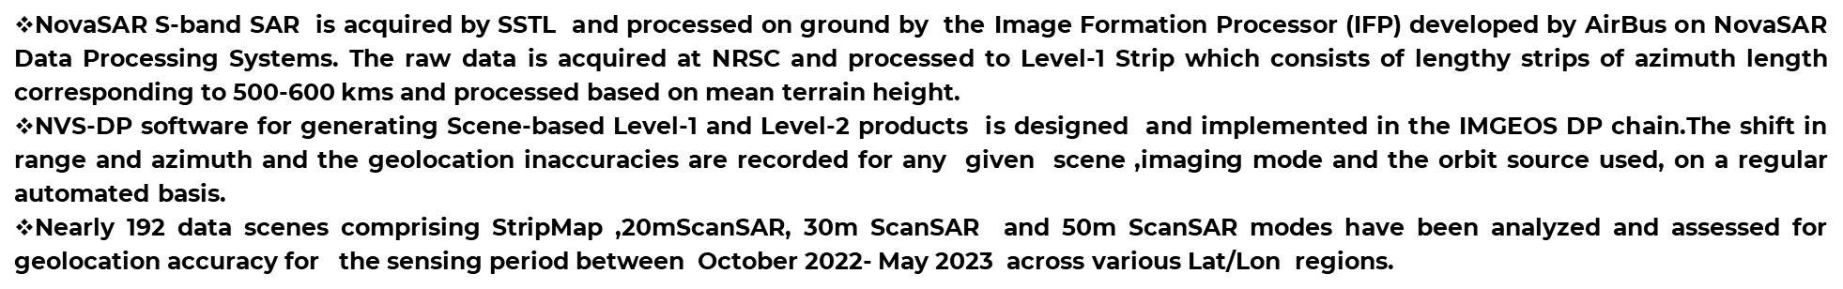
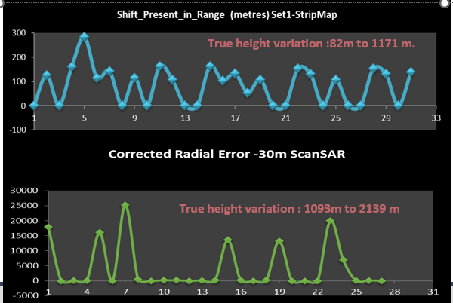
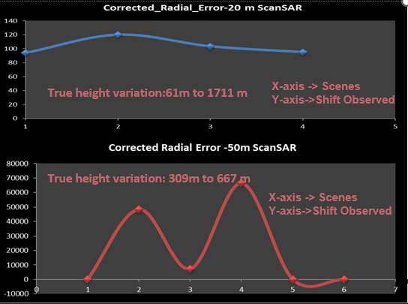
NovaSAR-S -Automated Data Production in IMGEOS

Slide 28
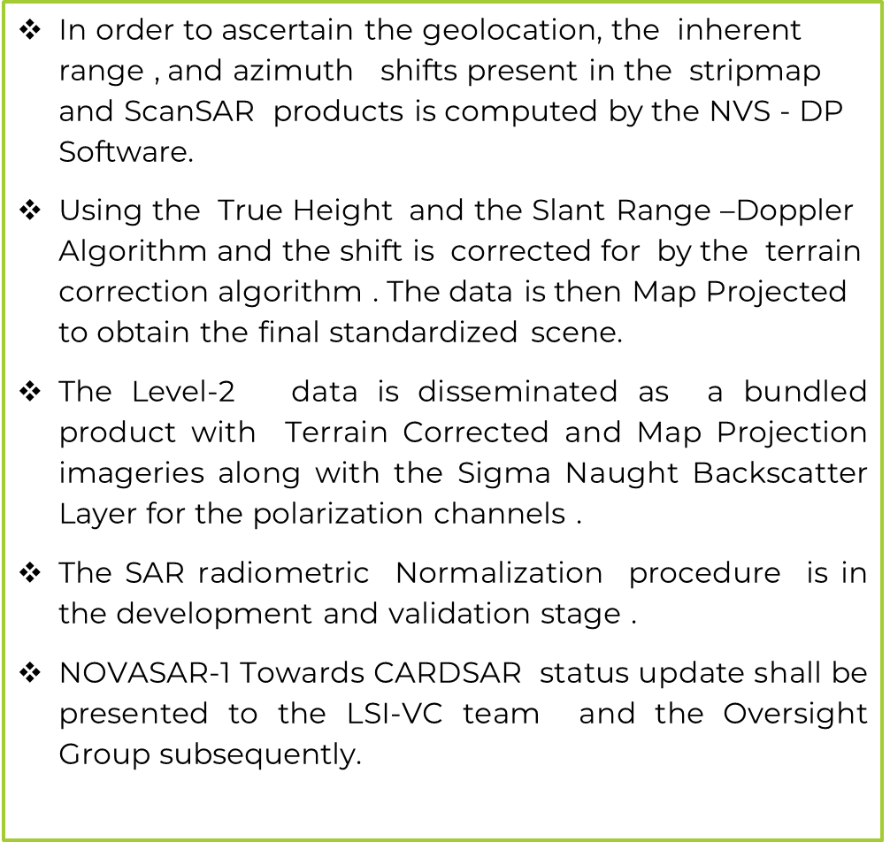
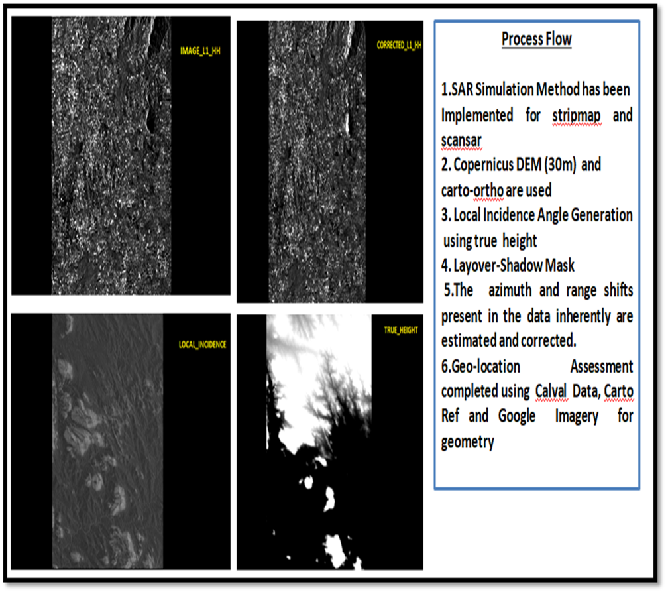
Thank You …

