Slide 1
LSI-VC-14
2023
ARD for SAOCOM and CONAE´s Updates
D. Dadamia, CONAE
L. Frulla, CONAE
Agenda Item 2.13
LSI-VC-14 2023, ESA/ESRIN
10th - 12th October 2023

Slide 2
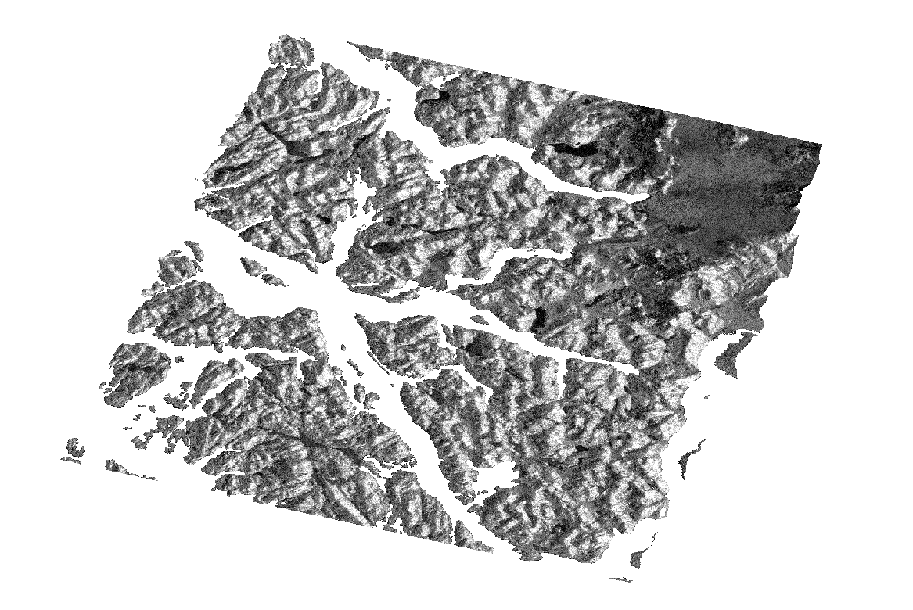
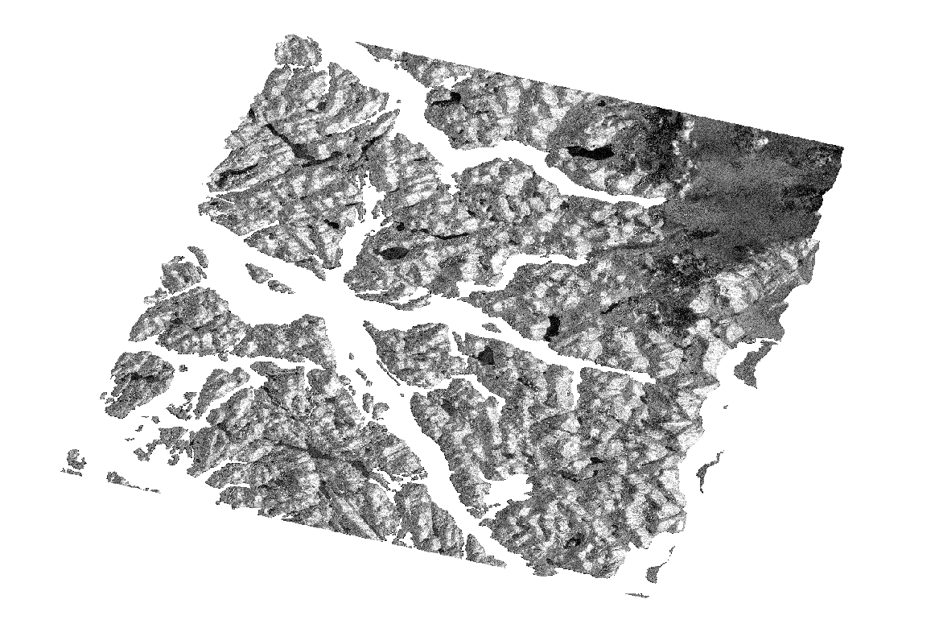



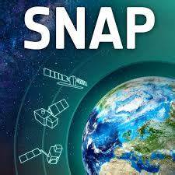
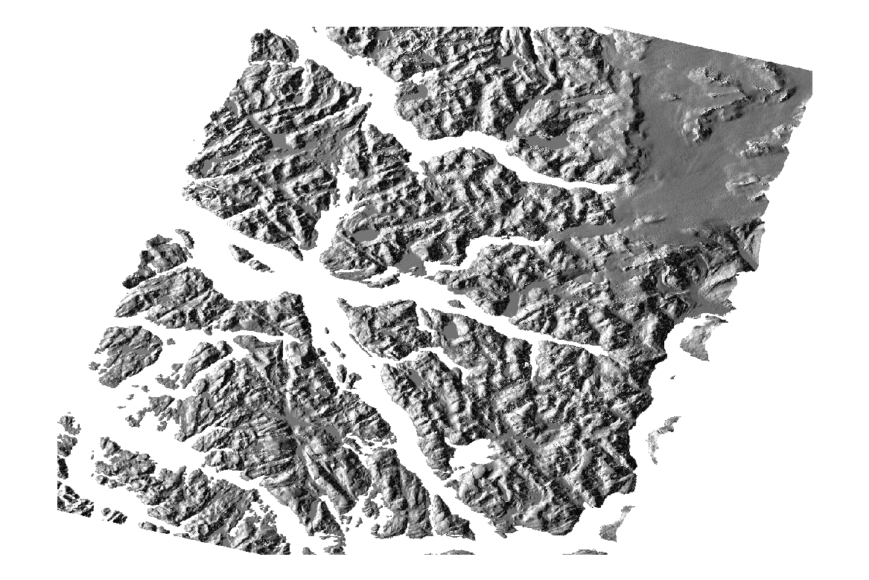
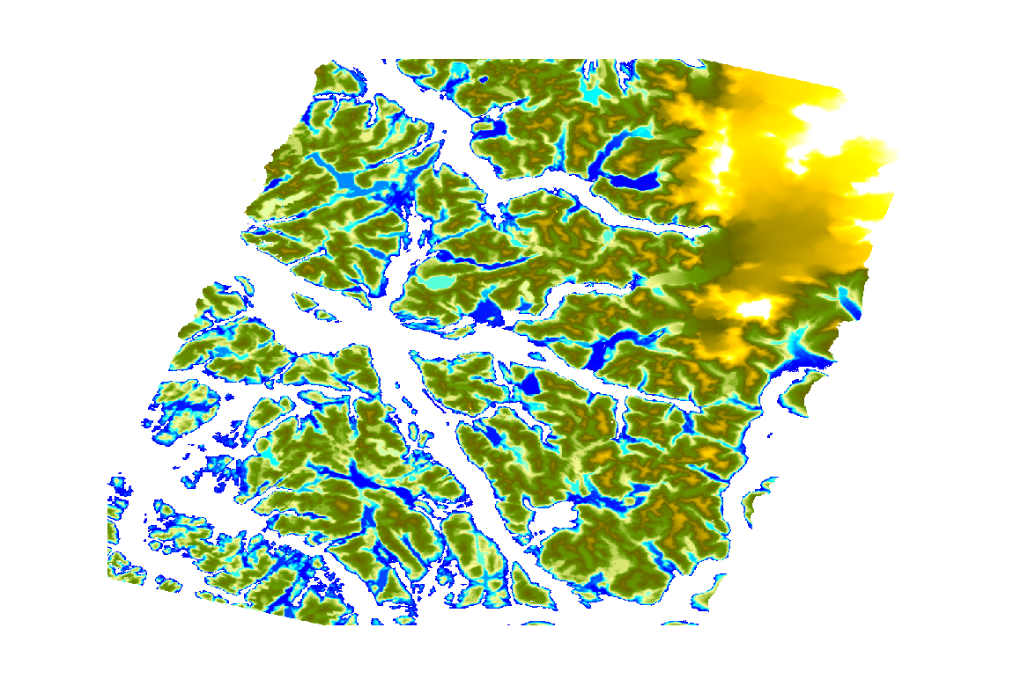
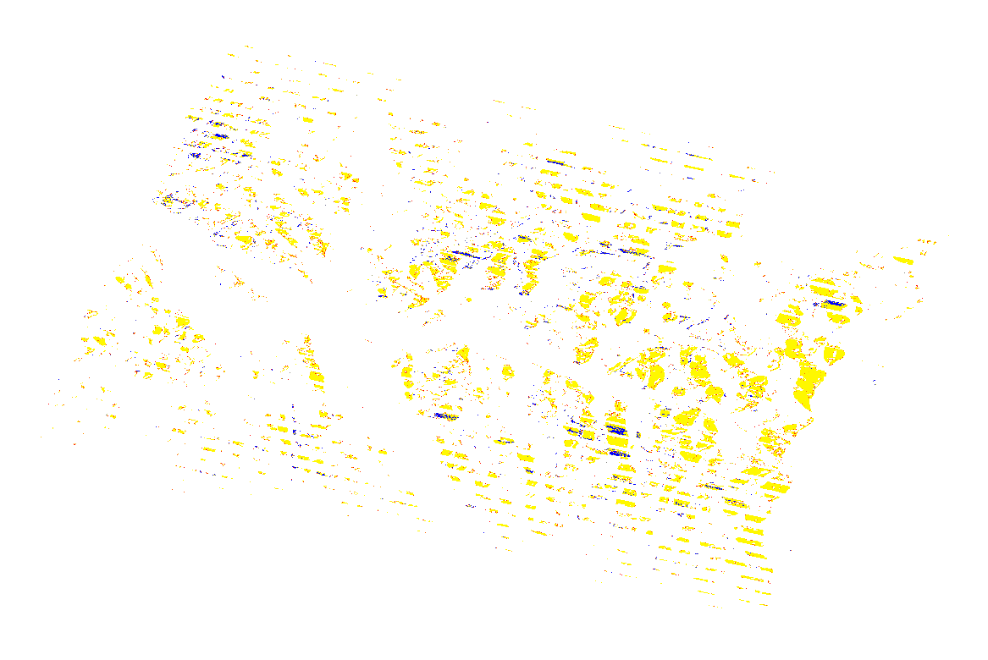
ARD SOFTWARE
Inputs
q
i
Outputs
Images
SIGMA0
Corrected by Local Incidence Angle
+
GAMMA0
StripMap SAOCOM
L1A: SLC
Outputs
Auxiliary
Data
Layover Shadow Mask
Projected Local Incidence Map
DEM

Slide 3
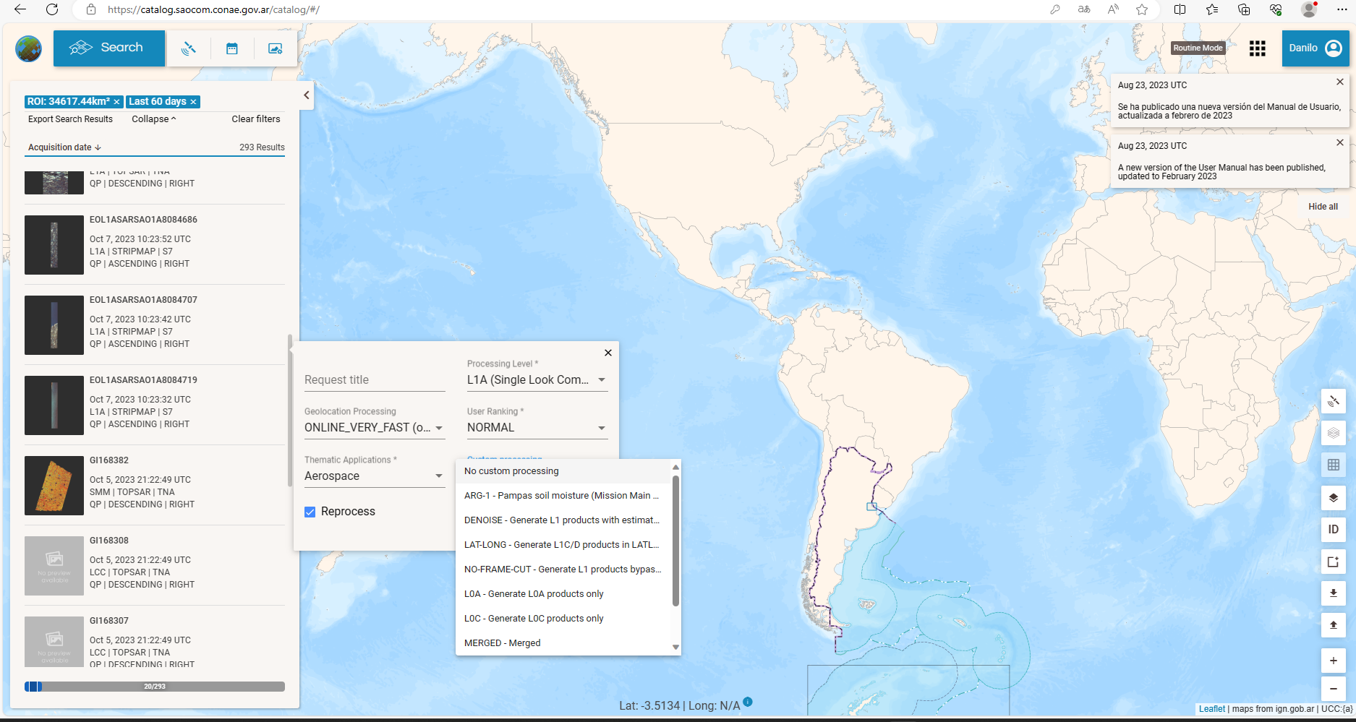
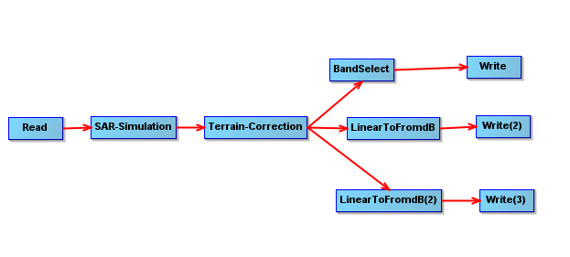
ARD SOFTWARE
We use Python to:
Create the software that run on bash SNAP
Process masks and build XML ARD format
SAOCOM CATALOG
+
We use SNAP to:
Process SAOCOM images using SNAP tools
ARD SIGMA0
ARD GAMMA0
ARD

Slide 4
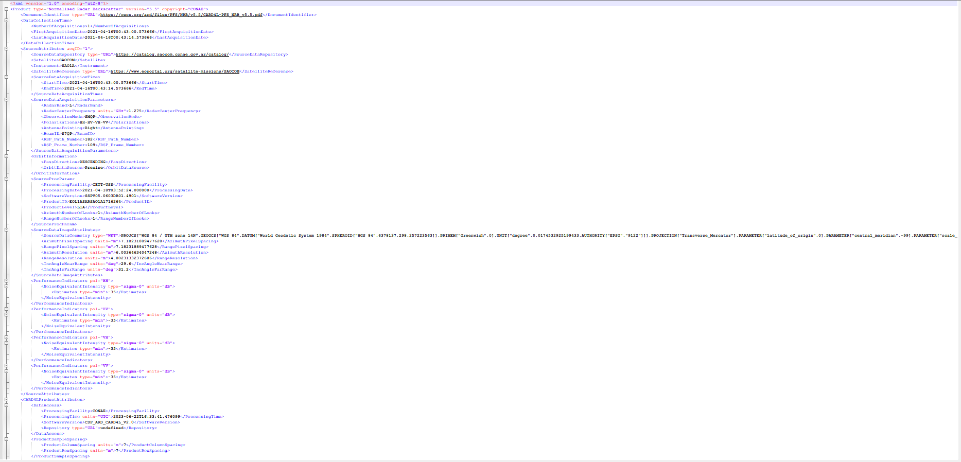
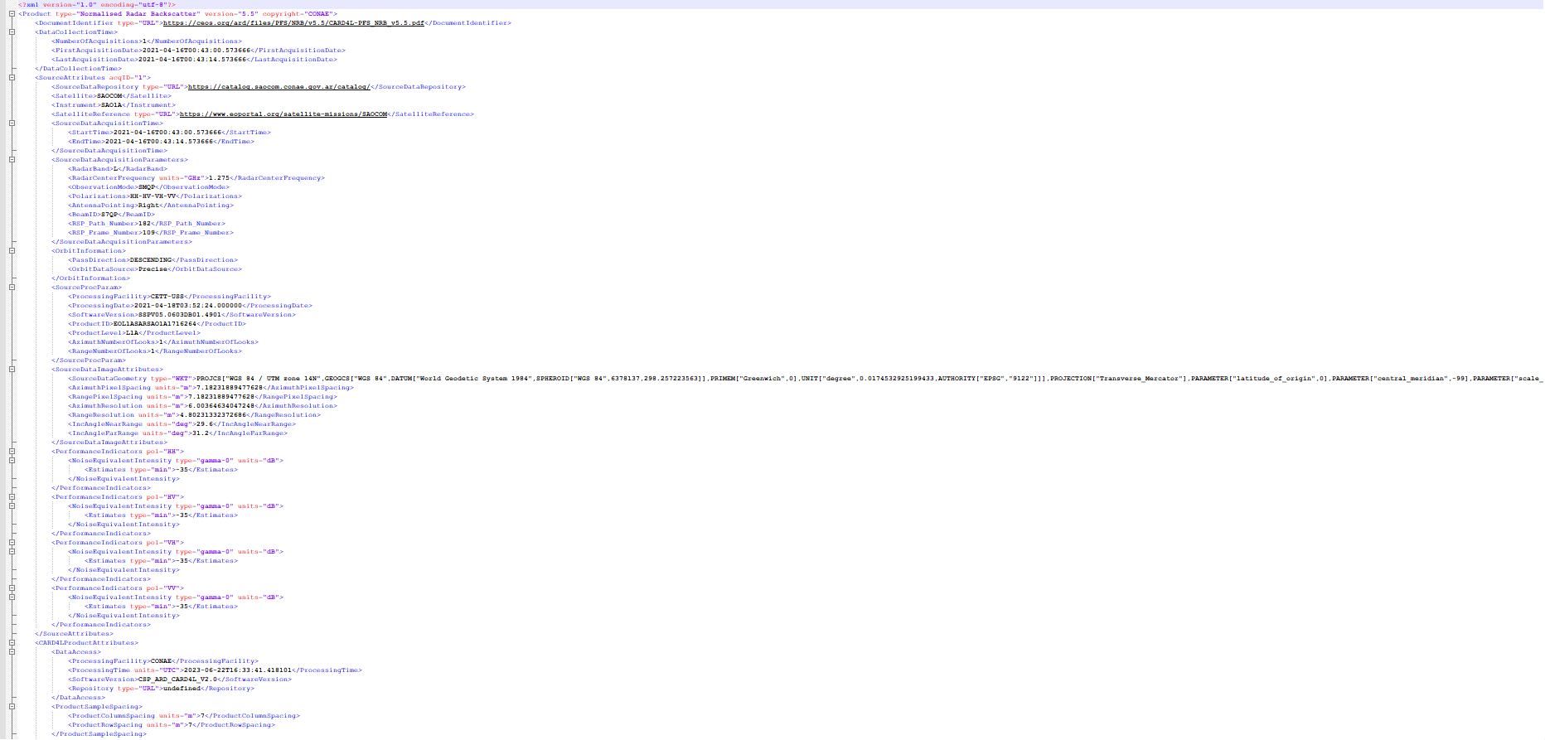
SAOCOM ARD Outputs Example
XML Files SIGMA0
XML Files Gamma0

Slide 5
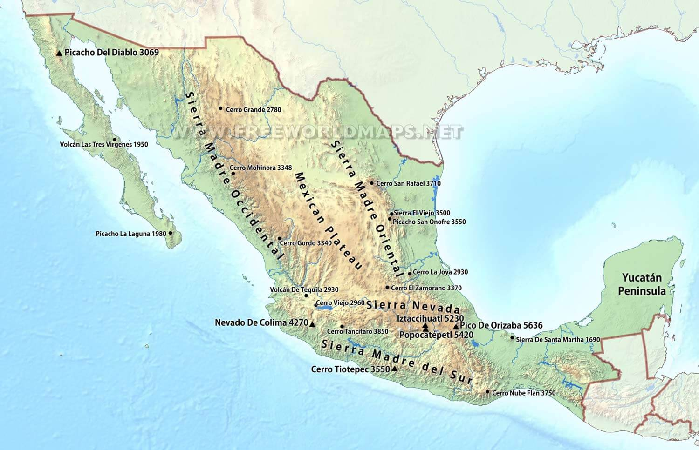
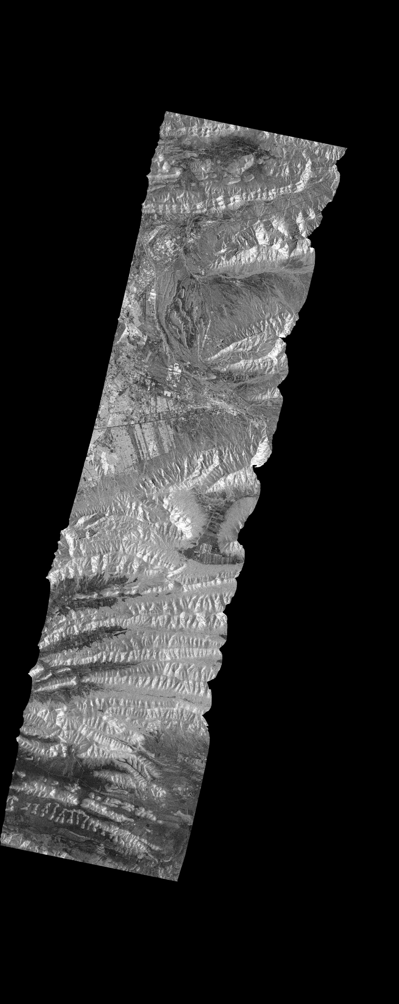
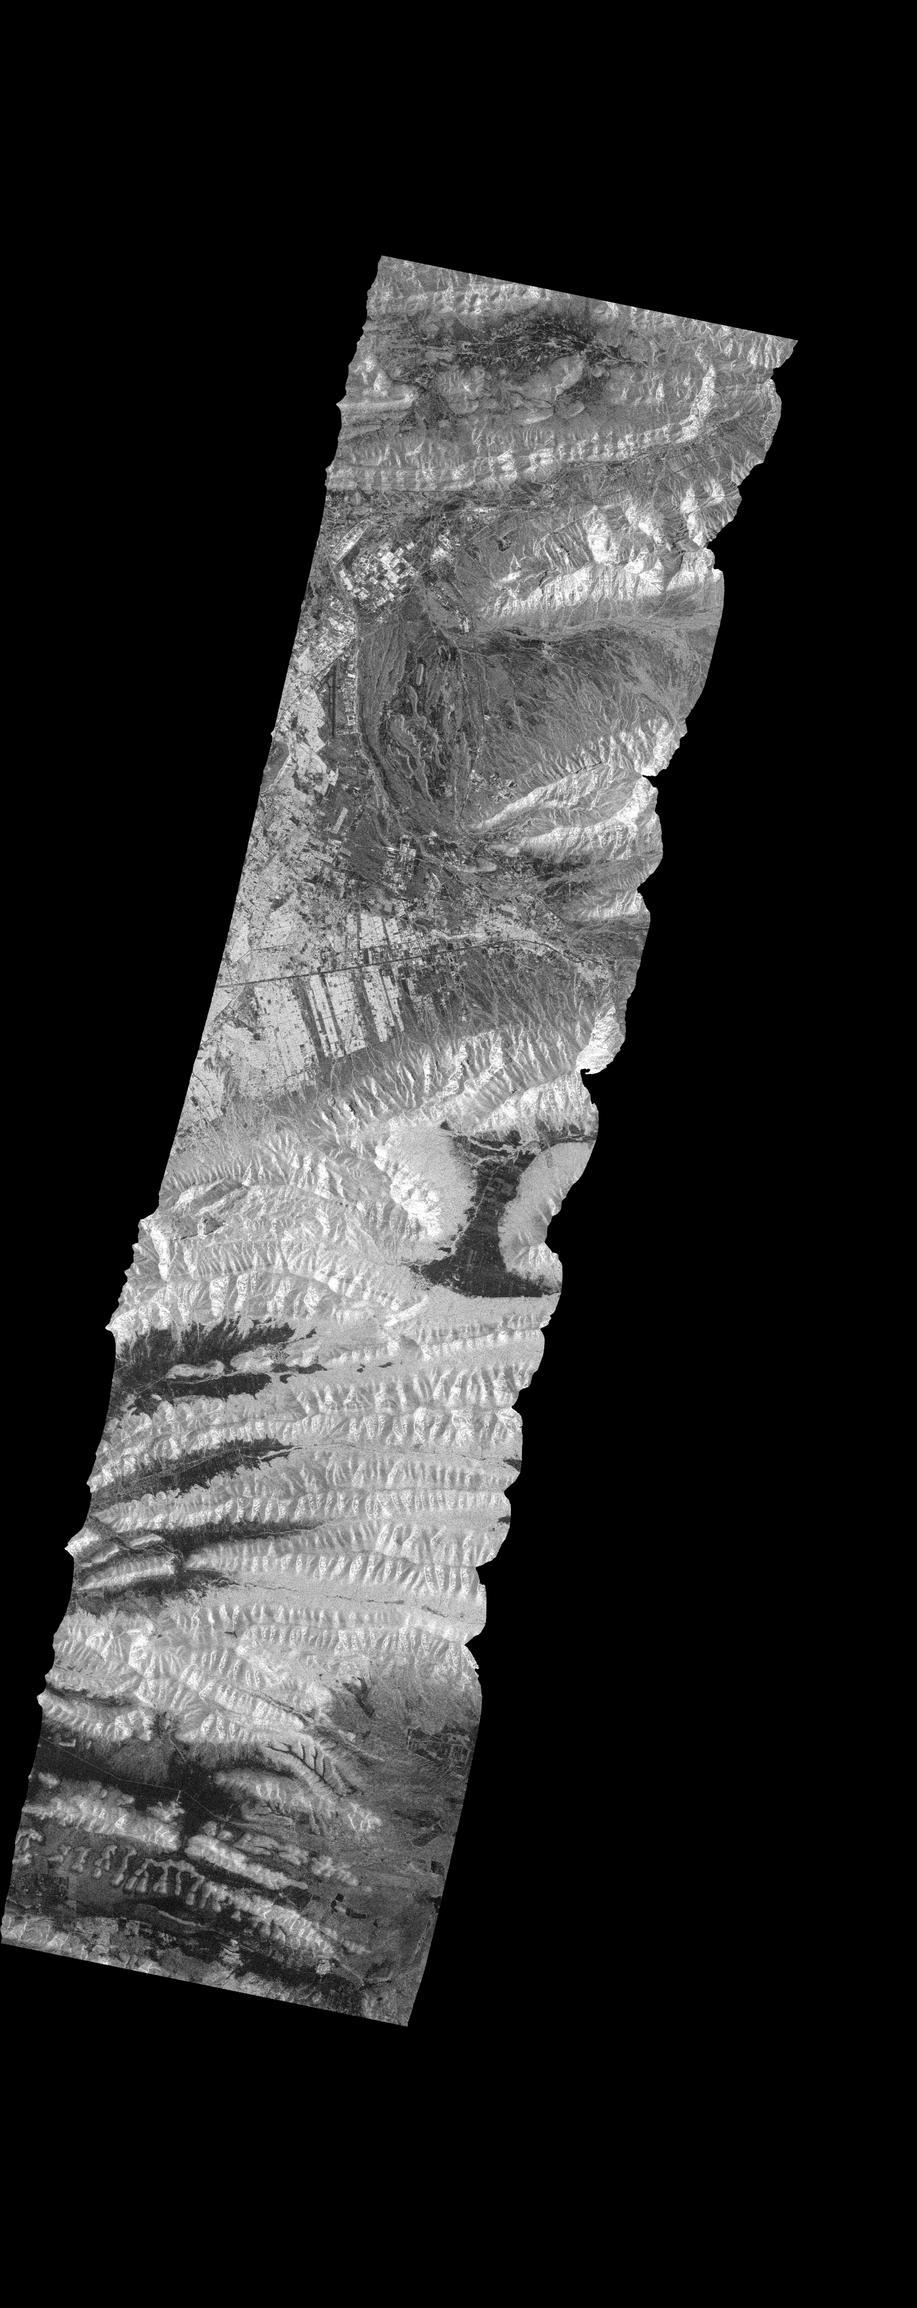
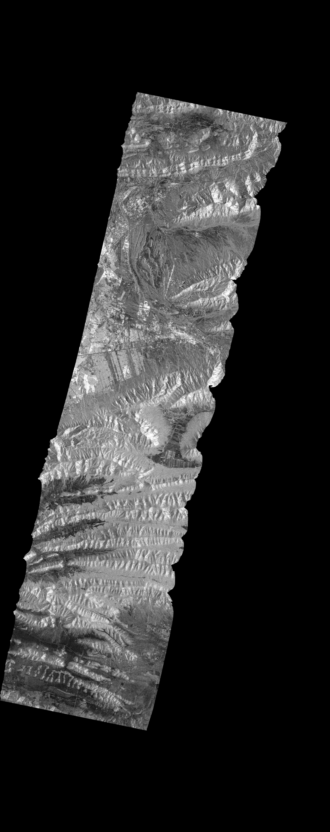
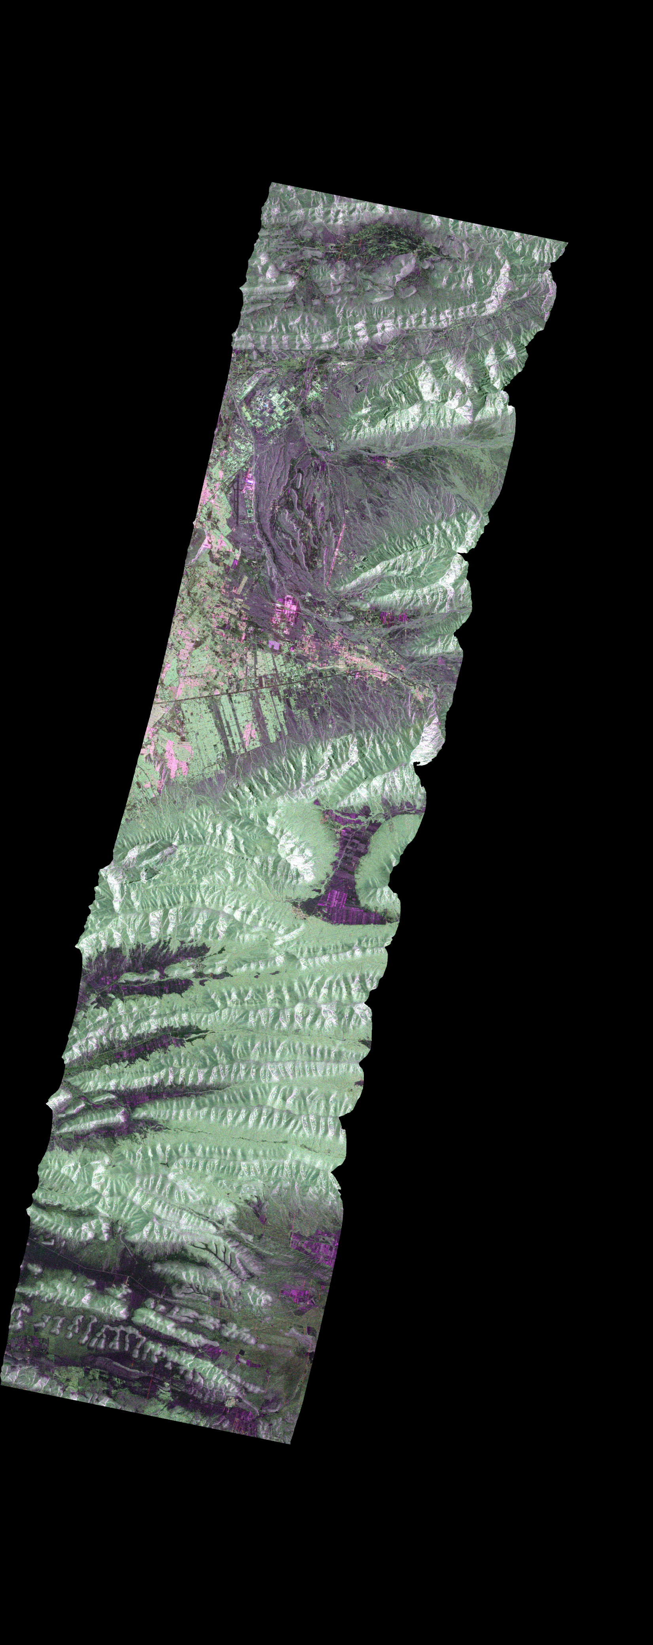
SAOCOM ARD Outputs Example
SAOCOM 1A CONAE.L-Band
StripMap
Mexico
April 18, 2021
R:SIGMA0_HH
B:SIGMA0_HV
G:SIGMA0_VV
SIGMA0_HH
SIGMA0_HV
SIGMA0_VH
SIGMA0_VV

Slide 6

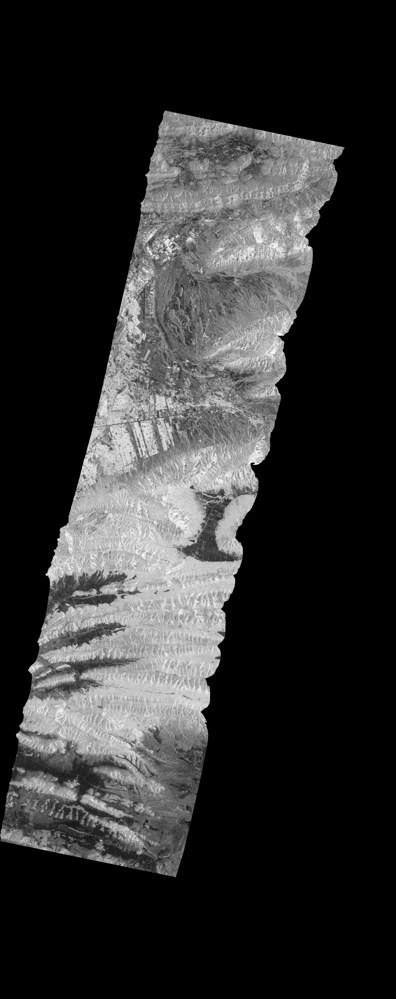

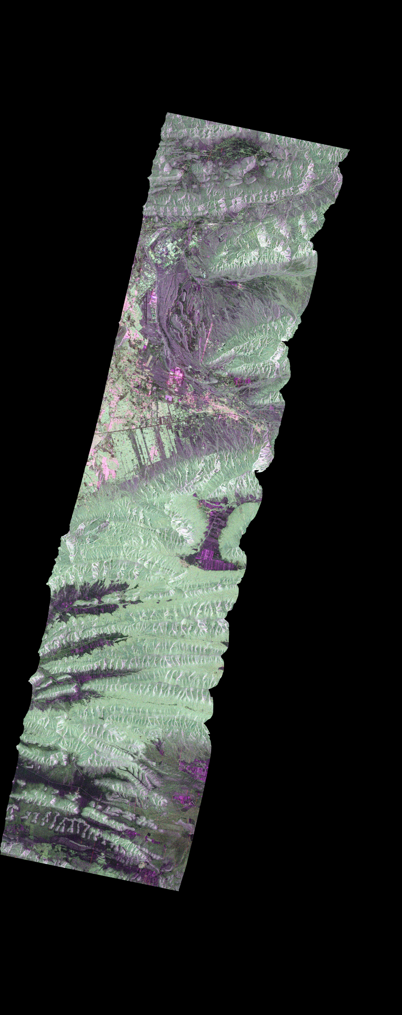
SAOCOM ARD Outputs Example
SAOCOM 1A CONAE.L-Band
StripMap
Mexico
April 18, 2021
R:GAMMA0_HH
B:GAMMA0_HV
G:GAMMA0_VV
GAMMA0_HH
GAMMA0_HV
GAMMA0_VH
GAMMA0_VV

Slide 7
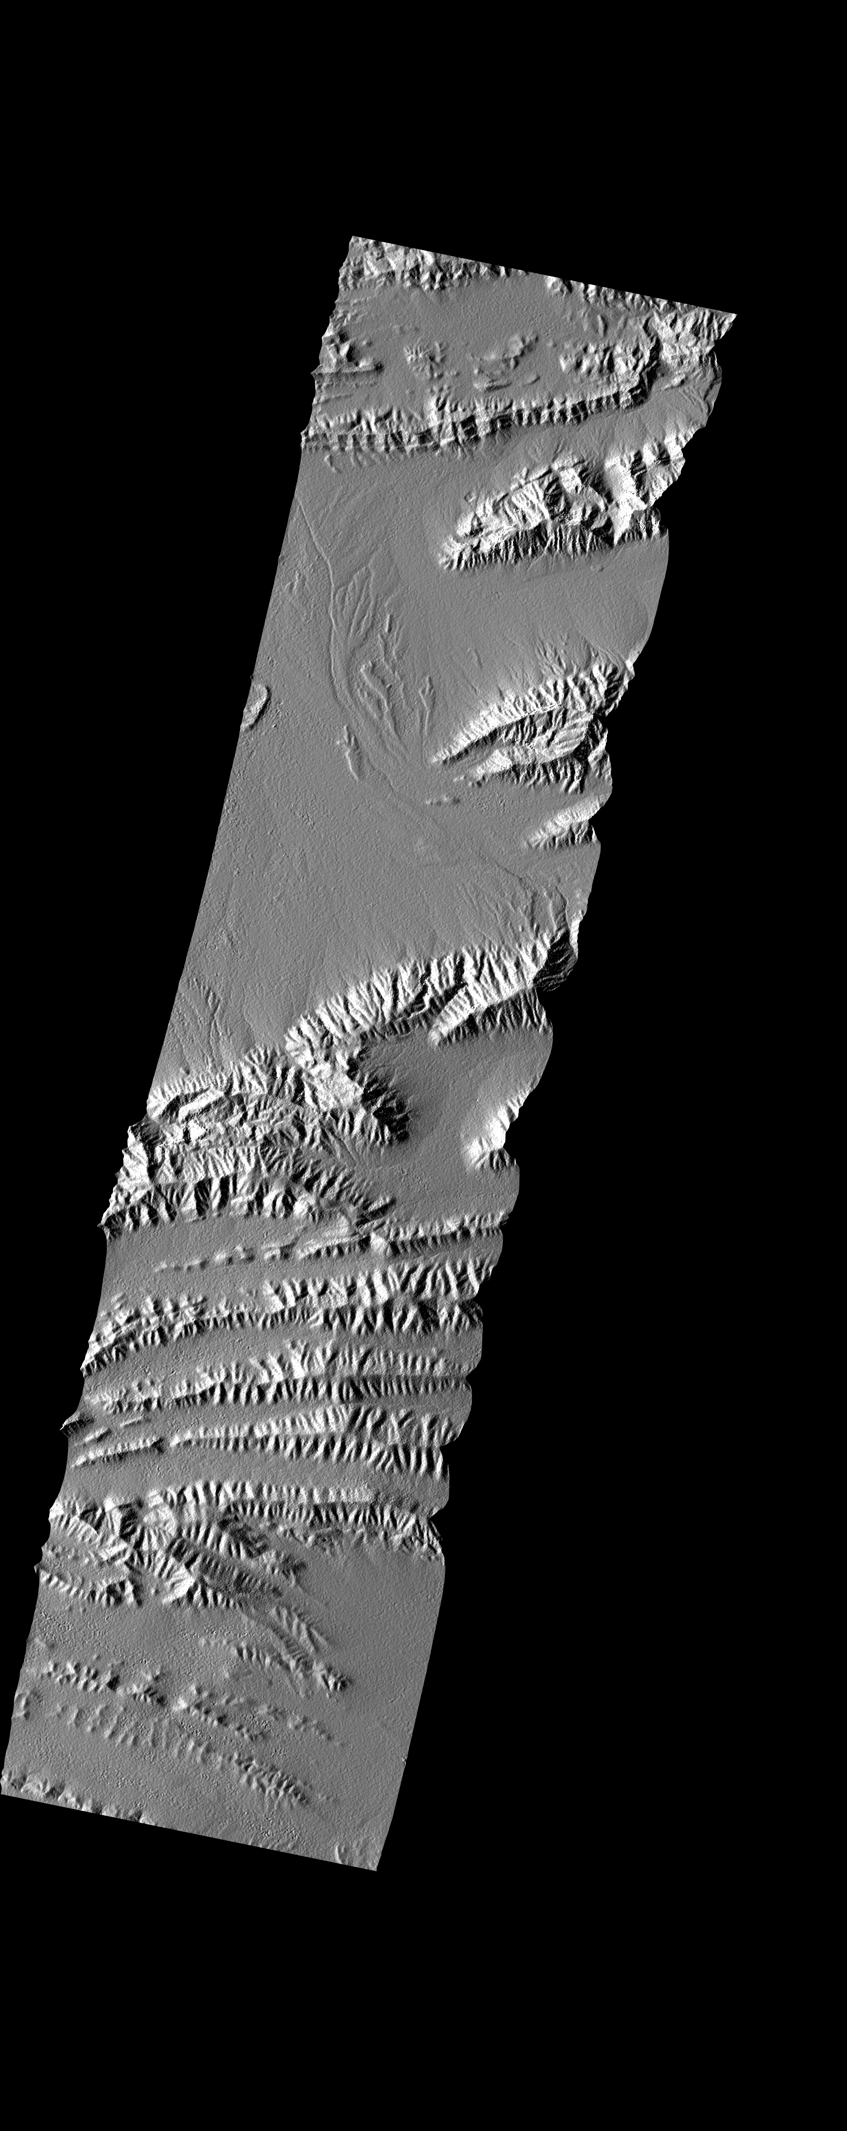
SAOCOM ARD Outputs Example
Auxiliary Data
SAOCOM 1A CONAE.L-Band
StripMap
Mexico
April 18, 2021
R:SIGMA0_HH
B:SIGMA0_HV
G:SIGMA0_VV
R:GAMMA0_HH
B:GAMMA0_HV
G:GAMMA0_VV
Layover
Shadow Mask
Projected Local
Incidence Map
DEM

Slide 8
SAOCOM Data Access and CONAE´s Updates

Slide 9
SAOCOM Data Access(1/3)
2 possibilities:
1. Catalogues
SAOCOM Catalogue can be navigated freely to identify already existing data. Upon registration, quicklooks can be seen:
  https://catalogos.conae.gov.ar/catalogo/catalogoSat.html
To access the data:
agreement
project
    u_inter@conae.gov.ar
    (outside ASI exclusivity area)
Licence to Use
project

Slide 10
SAOCOM Data Access(2/3)
Send letter to: u_inter@conae.gov.ar
Direct the letter to CONAE’s CEOS Principal (Eng. Raul Kulichevsky) describing the overall project, its objectives, duration, participants, the area of interest (including, if possible, files in KML or Shapefile formats).
Sign the License of Use by all project participants who will work with the images.
Require the images to u_inter@conae.gov.ar (archived/new).
Data will be transferred through FTP
project case

Slide 11
SAOCOM Data Access(3/3)
2. One click possibility
https://registro.conae.gov.ar/registracion/view/

Slide 12
National Space Plan/Updates
Better geometric resolution
Operative TOPSAR interferometric products
Improved knowledge of the orbit
Better orbital tube/improve interferometric capabilities
Interferometric wide swath modes
Better duty cycle
Digital beam forming
SAOCOM 2
SAOCOM 3
SAOCOM 1A
SABIA-Mar
(ocean)
SAOCOM 2
SAOCOM 3
SAOCOM 1B
Companion
Patagonia Beta
(ship detection)
SARE II
(single pass interferometric acquisitions with SAO2)
Geoestacionario
SARE Beta
(environmental monitoring)
SARE I
(fishing monitoring)
SARE III
(climate laboratory)
Notes:
SAO2:
Operative TOPSAR interferometric products allow an improved coverage and better revisit time
Improved knowledge of the orbit (precise orbit with accuracies better than 20 cm) to avoid orbital fringes artifacts
Orbital tube of 200 m rms around a nominal operational orbit for optimizing DInSAR applications

Slide 13
Thank you

