Slide 1
LSI-VC-14
2023
CONAE´s Plans for Quad-pol SAOCOM SAR Observations
Presenter, Organization
Agenda Item #
LSI-VC-14 2023, ESA/ESRIN
10th - 12th October 2023

Slide 2
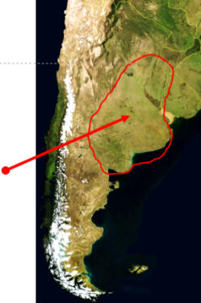
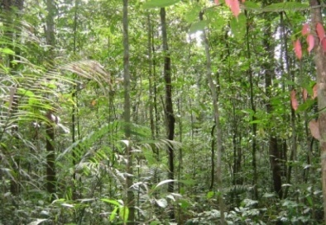
SAOCOM Acquisition Strategy
Baseline Mission
  (fixed acquisitions)
Foreground Mission (variable acquisitions)
Background Mission (useful data base)
  soil moisture
  (Pampas)
  Argentina:
  emergencies
  maritime control
  biomass
  Los Andes (tectonic plates and glaciers movement)
  users
acquired images
Total QP: 168833
SM QP: 4412
TN QP: 121005
TW QP: 3702
IMAS (Integrated Mission Acquisition Strategy)
SAR calibration:
  rain forest
  specific point targets
  Latinamerica and the rest of the world:
  biomass
  polar zones

Slide 3
IMAS-Cycle 16 (Aug 29 – Sep 13/2022)
https://www.argentina.gob.ar/misiones-satelitales/planes-de-adquisiciones-saocom-1
SAOCOM 1A, StripMap
SAOCOM 1A, TopSAR Narrow
SAOCOM 1A, TopSAR Wide
SAOCOM 1B, StripMap
SAOCOM 1B, TopSAR Narrow
SAOCOM 1B, TopSAR Wide
  https://catalogos.conae.gov.ar/catalogo/catalogoSat.html

Slide 4
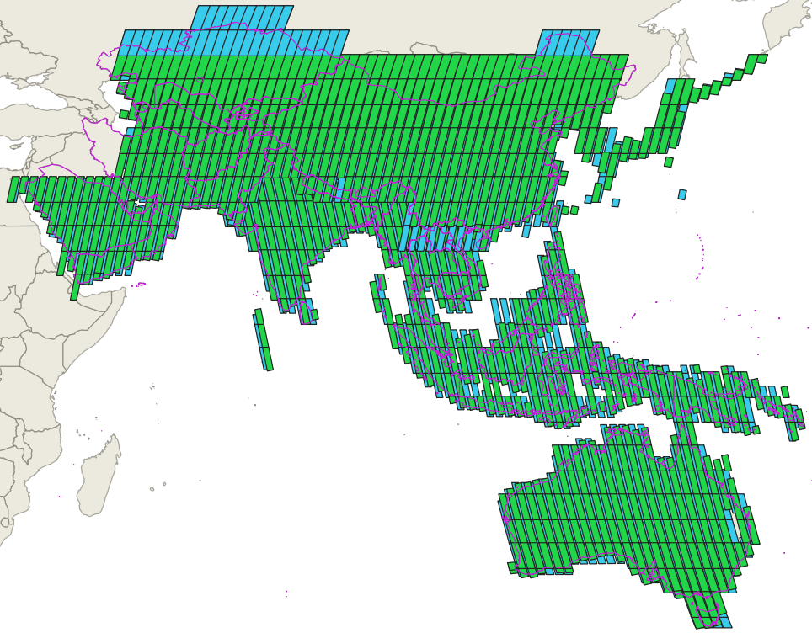
TOPSAR Narrow QP (Asia/Australia)
South Asia and Australia
SAOCOM 1A acquisitions in Desc. orbits (northern part)
SAOCOM 1B acquisitions in Asc orbits (southern part)
The region is covered systematically every four cycles
Example of Cycles 14 to 17
(Jul 28 to Sep 29/2023)
TNAQP
TNBQP

Slide 5
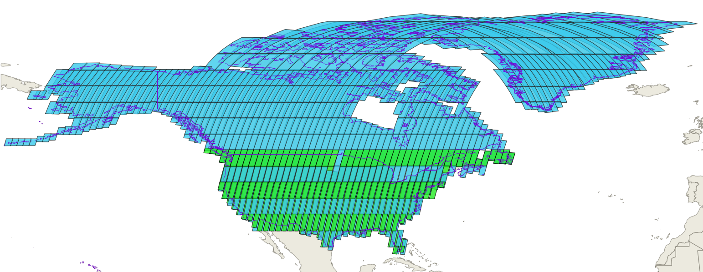
TOPSAR Narrow QP (America)2
North America and Greenland
The region is covered systematically from two cycles (Greenland and Alaska) to four cycles (Canada and U.S.A.)
TNAQP
TNBQP
Example of Cycles 15 to 18 of 2023 (Aug 13 to Oct 15)
SAOCOM 1B acquisitions
Asc. orbits: Greenland
Desc. orbits: Canada, Alaska
SAOCOM 1A in Desc orbits for USA

Slide 6
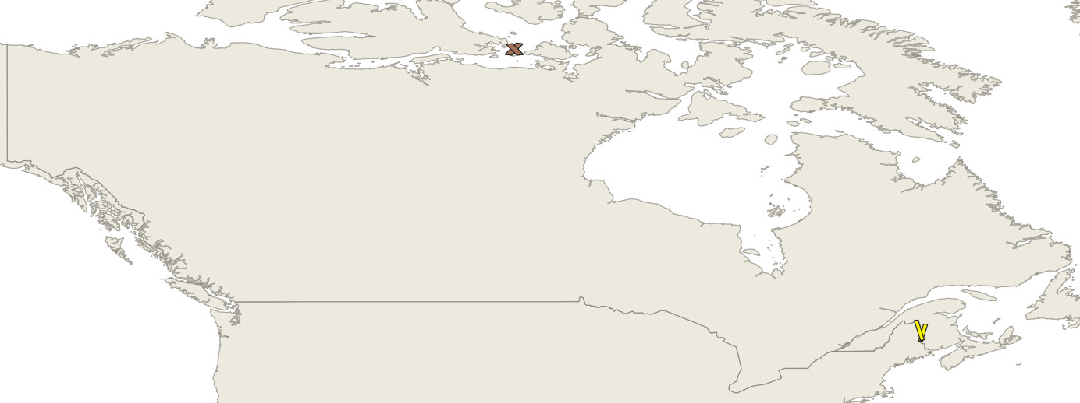
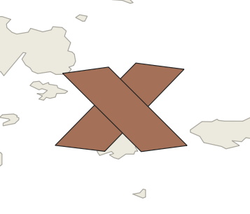
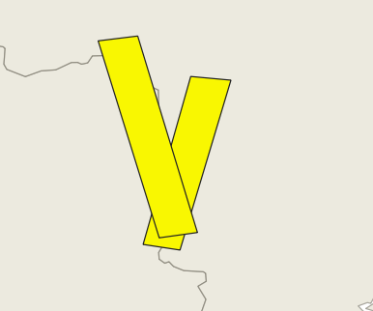
StripMap QP (Canada)
S1QP
S4QP
SAOCOM 1A acquisitions made every cycle, using Asc. and Desc. orbits
Example of Cycle 16
(Aug 29 to Sep 13/2023)

Slide 7
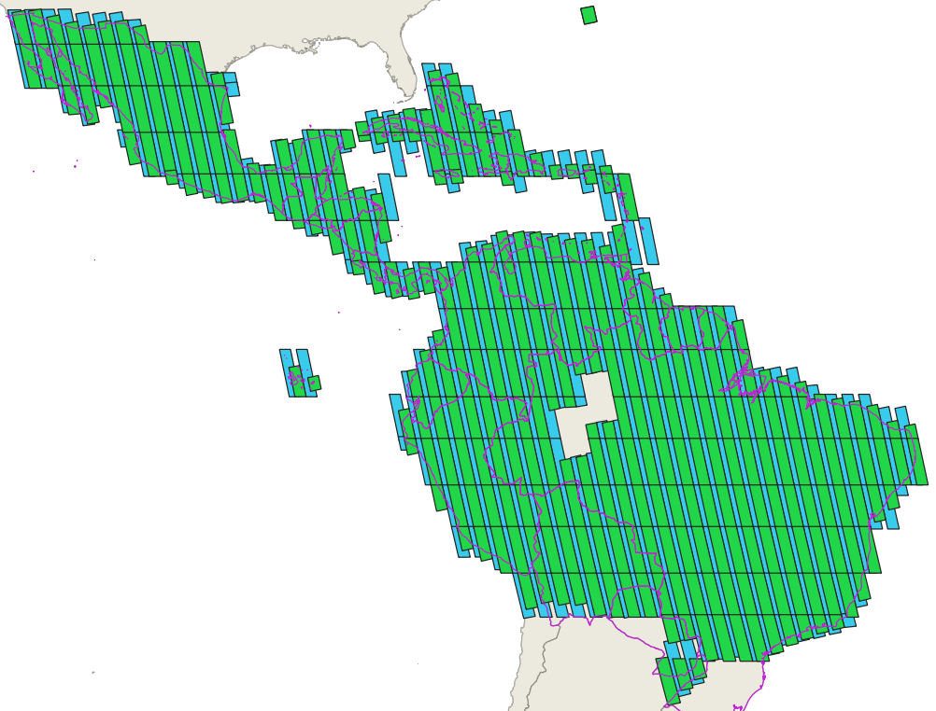
TOPSAR Narrow QP (America)
Central and South America
SAOCOM 1B acquisitions in Asc orbits
TNAQP
TNBQP
The region is covered systematically every four cycles
Example of Cycles 14 to 17 (Jul 28 to Sep 29/2023)

Slide 8
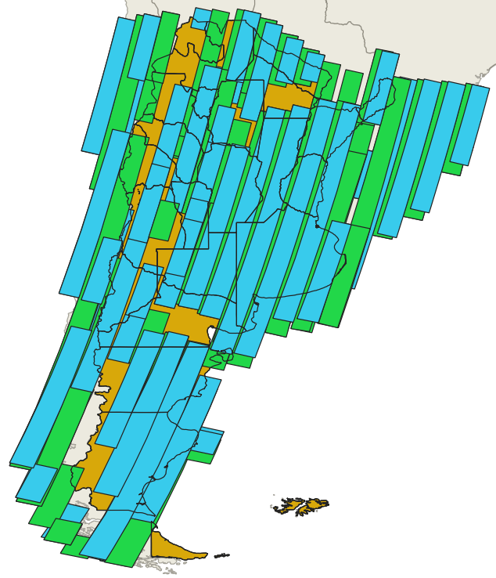
TOPSAR Narrow QP (Argentina)
SAOCOM 1A and SAOCOM 1B acquisitions in Desc. orbits
The region is covered systematically in two cycles for one satellite and in every cycle with both satellites.
Example of Cycles 6 and 7
(March 22 to Apr 22/2023)
TNAQP
TNBQP

Slide 9
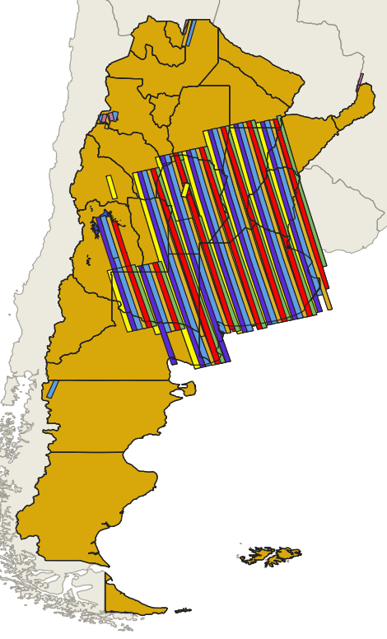
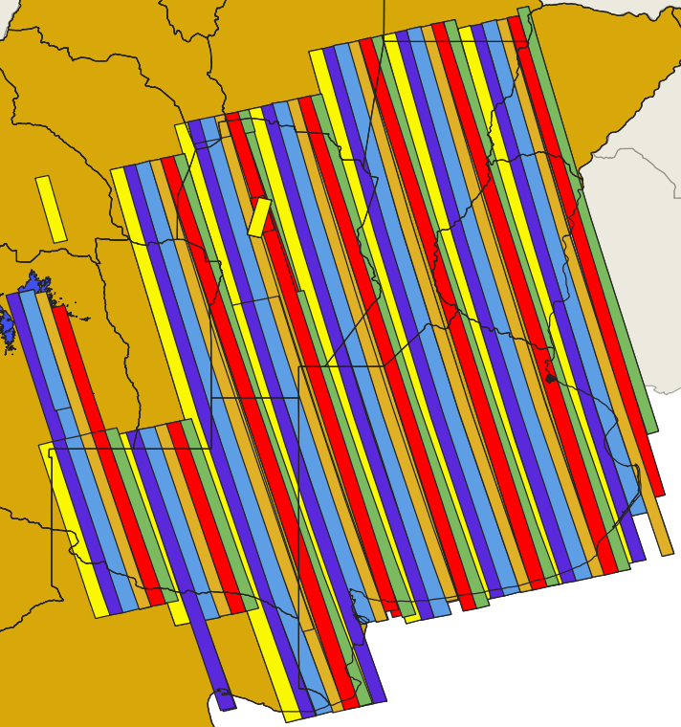
StripMap QP (Argentina)(1/2)
Pampa´s region
SAOCOM 1A and SAOCOM 1B acquisitions with 8 days repeat pass (Asc. Orbits, mainly)
S4QP
The region is covered systematically every 6 cycles (96 days)
S5QP
S6QP
Example of Cycles 6 to 11
(March 22 to June 25/2023)
S7QP
S8QP
S9QP

Slide 10
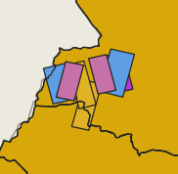
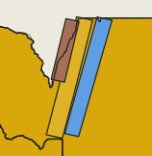
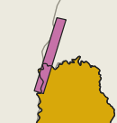
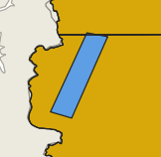
StripMap QP (Argentina)(2/2)
S1QP
S2QP
Pampa´s región and additional regions
S3QP
S6QP
S7QP
SAOCOM 1A and SAOCOM 1B acquisitions made on every cycle, Asc. and Desc. orbits
Example of Cycle 18
(Sep 30 to Oct 15/2023)

Slide 11
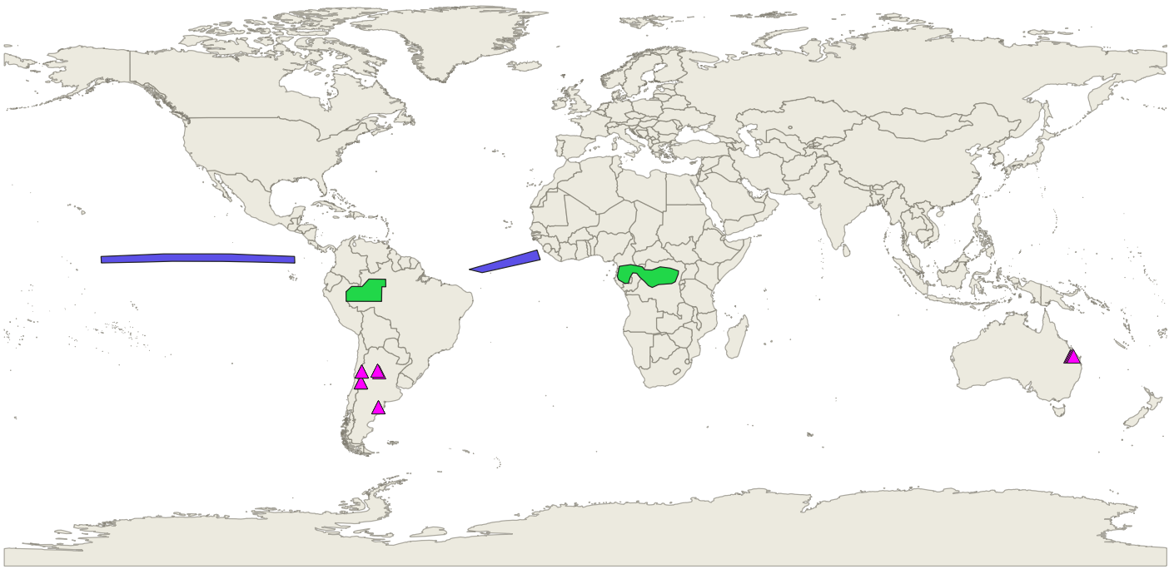
ST, TPN, TPW-QP (CalVal)
Sites of Point Targets
Rain Forests
Doldrums
A variable scheme of acquisitions in StripMap, TOPSAR Narrow and TOPSAR Wide QP modes for CalVal: SAOCOM 1A and SAOCOM 1B (point and distributed targets)

Slide 12
Thank you

