Slide 1
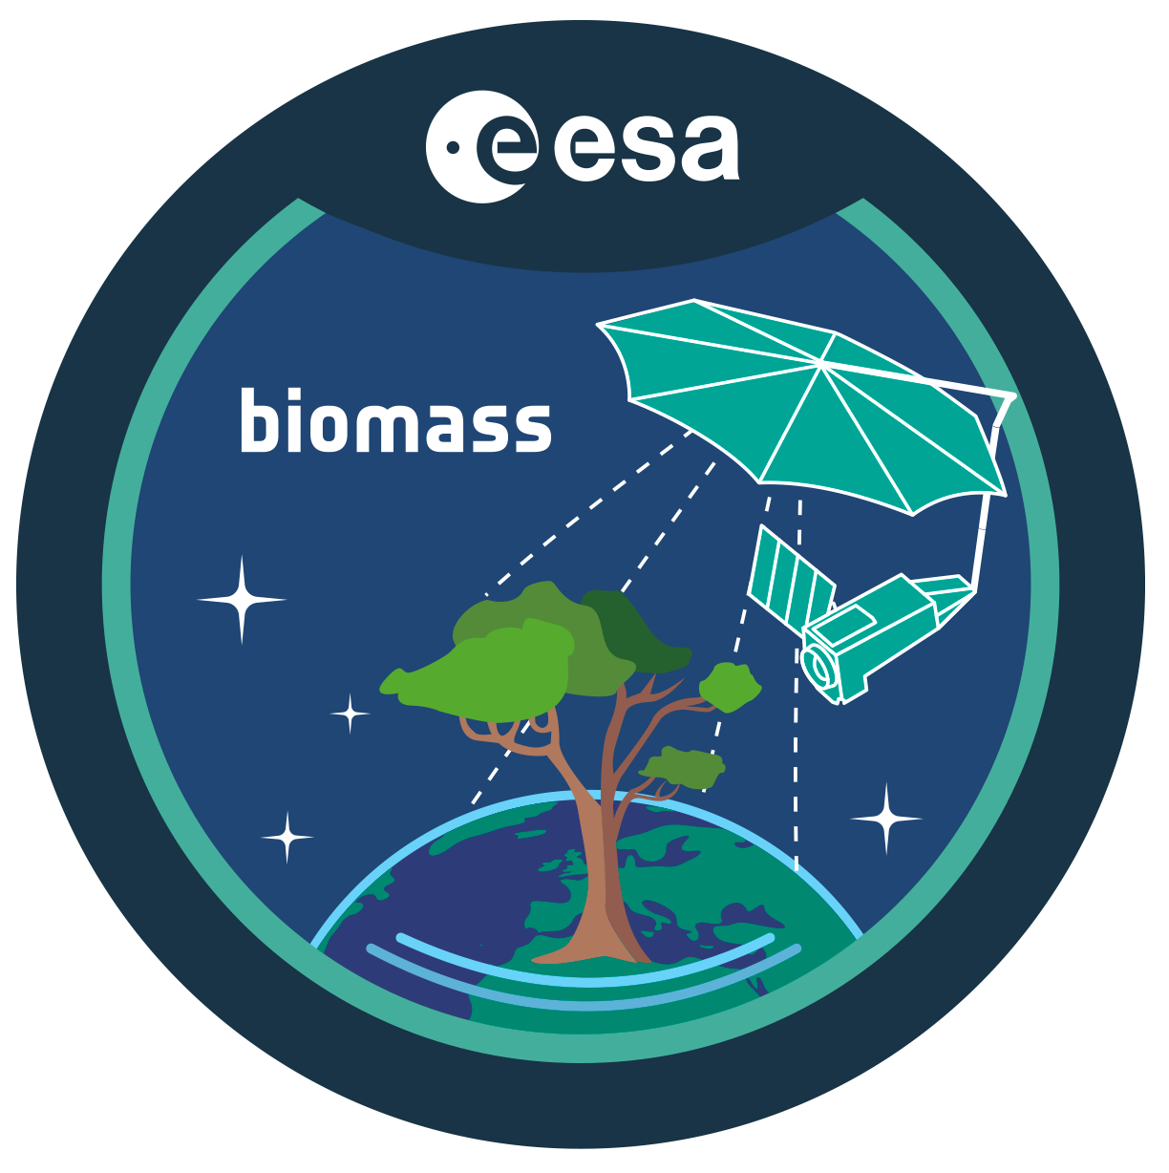
ESA’s Earth Explorer 7 Biomass
Primary objectives: determination of forest biomass, forest height, vegetation disturbances and re-growth
Secondary objectives: imaging of sub-surface geology in deserts, mapping the topography under dense vegetation, measurements of glacier and ice sheet velocities
Fully polarimetric SAR mission with high orbital active duty cycle
Launch readiness Q4-2024
First P-band SAR in space!
Nominal mission duration: 5.5 years
TOM
Global coverage
<17 months
INT
Global coverage
<9 months
INT
Global coverage
<9 months
INT
Global coverage
<9 months
INT
Global coverage
<9 months
INT
Global coverage
<9 months
INT
Global coverage
<9 months
Launch
Commissioning
<6 months

Slide 2
Copernicus Timeline – Current and Future SAR Missions
Copernicus Expansion missions
Provides new information not yet available (Gaps)
Provides enhanced information in combination with current Sentinel missions (Enhanced continuity)
Enhanced Continuity ensured by S1-NG
End Phase B1
Sentinel-1 NG
Gap Filling and Enhanced Continuity with ROSE-L
Phase C
ROSE-L
Sentinel-1 Mission Routine Operations
Sentinel-1 D
Sentinel-1 C
Sentinel-1 B
Sentinel-1 A
Note 1: same orbit configuration
Note 2: quad-pol capability for ROSE-L and S1NG
2014
2015
2016
2017
2018
2022
2023
2028
2032

