Slide 1

ISRO NISAR S-Band
Current or Near-future CEOS Agency plans for Quad-pol SAR Observations
LSI-VC-14 2023
V M Ramanujam, ISRO
Raghav Mehra, ISRO
Agenda Item 13.2
LSI-VC-14 2023, ESA/ESRIN
10th - 12th October 2023

Slide 2
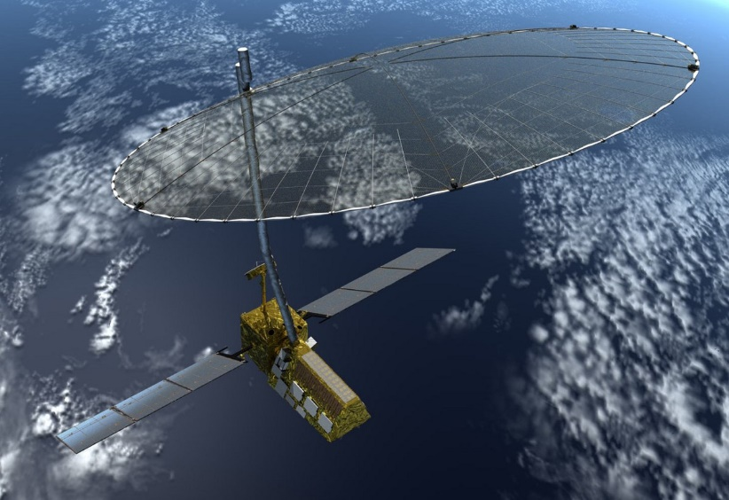


NISAR Mission/
Payload Specification
Orbit | 747 km with 98° inclination
Repeat Cycle | 12 days
Time of Nodal Crossing | 6 AM / 6 PM
Frequency | 3.2 GHz ± 37.5 MHz (S-Band) |  | 1.257 GHz ± 40 MHz (L-Band)
Available Polarimetric Modes | Single Pol (SP): HH or VV Dual Pol (DP): HH/HV or VV/VH,Compact Pol (CP): RH/RV,Quasi-Quad Pol (QQP): HH/HV and VH/VV , Quad Pol (Experimental Mode) |  | SP: HH or VVDP: HH/HV or VV/VHCP: RH/RV,Quad Pol (QP): HH/HV/VH/VV
Available Range Bandwidths | 10 MHz, 25 MHz, 37.5 MHz, 75 MHz |  | 5 MHz, 20 MHz, 40 MHz, 80 MHz (Additional 5 MHz iono band for 20 & 40 MHz modes at other end of pass-band)
Swath Width | > 240 Km |  | > 240 Km (except for 80MHz BW)
Spatial Resolution | 7m (Az); 3m-24m (Slant-Range) |  | 7m (Az); 3m-48m (Slant-Range)
Incidence Angle Range | 33 – 47 deg |  | 33 – 47 deg
Noise Equivalent σ° | -25 dB (baseline) -20 dB(Threshold) |  | -25 dB (for required full-swath modes)
Ambiguities | < -20dB for all modes except QQP |  | < -23dB swath average in SP or DP modes< - 17dB swath average in QP mode(exp)
Pointing control | < 273 arc seconds
Orbit control | < 350 meters
Data and Product Access | Free & Open

Slide 3
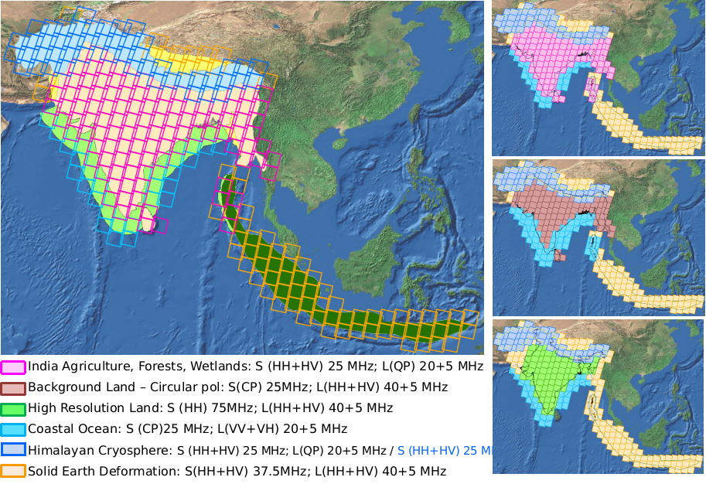

NISAR- ISRO Observation Plan
Descending Pass
SweepSAR QP mode
Swath :: 240 km
Fixed PRF of operation ~3000 Hz
Transmit gaps in 240 km Swath .
Alternating Fixed PRF’s of 3003 Hz and 3086 Hz to cover the Transmit Gaps
Daily Descending pass Left over Indian Region - LBand
S-SAR QP is an experimental Mode and exercised during initial phase of operation
ISRO will process the L and S Band data acquied as per ISRO Observation plan
Data Calibration using Point/Distributed Targets
Data will be hosted in Bhoonidhi portal

Slide 4
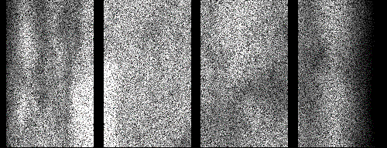
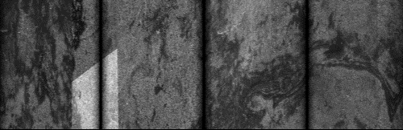
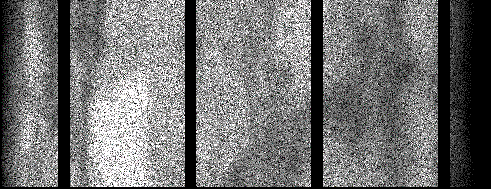
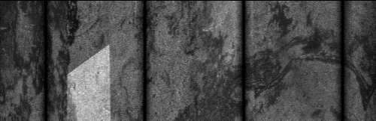
NISAR Mission/Payload Specification
Alternating Fixed PRF Scenarios/Examples
Because of changes in PRF location of
blind ranges has been changed across swath
Raw Data Level
Processed Image Level
Range
Range
Azimuth
Mode ID 199
PRF = 3086Hz
Azimuth
Range
Range
Azimuth
Azimuth
Mode ID 243
PRF = 3003Hz
Min Range
Max Range
Width of Partial Resolved Range Gaps = (Light Velocity)*Pulse Width
Slant Range Domain = 7.5 Km for 25 us pulse
Ground Range Domain = 12.5 Km for 25 us pulse
Width of Dead Range Gaps In Slant Range Domain
= (Light Velocity)* Pulse Width/2.0
Slant Range Domain = 3.75 Km for 25 us pulse
Ground Range Domain = 6.25 Km at 37° look angle
Black Strips Across Azimuth Represents Dead Range Gaps (where no echo data is available due to Transmit event)

Slide 5
NISAR Basic Data Product Definitions
Level-0
Level-1
Level-2
RAW Signal Product : Individual Channel or Digital Beam Formed
Products in Radar coordinates
Geo-Tagging using satellite Ephemeris data
Earth Geometry – Standard Ellipsoid
Dense grid of Geo-Locations with product
Geocoded Products
Horizontal datum : WGS 84
Map Projection : UTM, UPS for polar regions
DEM: COPERNICUS DEM(30m)
Radiometric Terrain Corrected Product
RSLC
RSLC product refers to the standard Range-Doppler geometry, Single Look Complex (SLC) image.
RIFG
RIFG product represents the ellipsoid height-corrected, wrapped Interferogram generated from two Range-Doppler SLC products in the Range-Doppler geometry of the earlier acquisition. Generated for Antarctica and Greenland only.
RUNW
RUNW product represents the unwrapped, multi-looked differential Interferogram generated from two Range-Doppler SLC products in the Range-Doppler geometry of the earlier acquisition. Generated for all regions other than Antarctica & Greenland
      ROFF
      Unfiltered and unculled layers of pixel offsets in range-Doppler coordinates with different resolutions obtained from coherent and incoherent speckle tracking. Generated for Antarctica, Greenland and pre-identified world mountain glaciers.
GSLC
Derived from Range-Doppler SLC product using a DEM and the MOE state vectors and output is in Map Projected system
GUNW
The GUNW product is derived from the Level-1 UNW product by using a DEM to project the data into the map-projected system.
GCOV
GCOV product is derived from slant domain Covariance matrix using a DEM to project the data into the map-projected system. The GCOV product contains the multilooked backscatter.
      GOFF
      Geocoded version of ROFF product using the MOE state vectors and a DEM. Generated for Antarctica, Greenland and pre-identified world mountain glaciers.
Level 0A
Data is ordered in time
Communication Artefacts , missing data and synchronization errors are not corrected
Intermediate product, Input to L0B processor
Level 0B
Aligned and raw radar signal data
BAQ samples from RAW products are decoded and packed into complete range lines
Available for dissemination

Slide 6
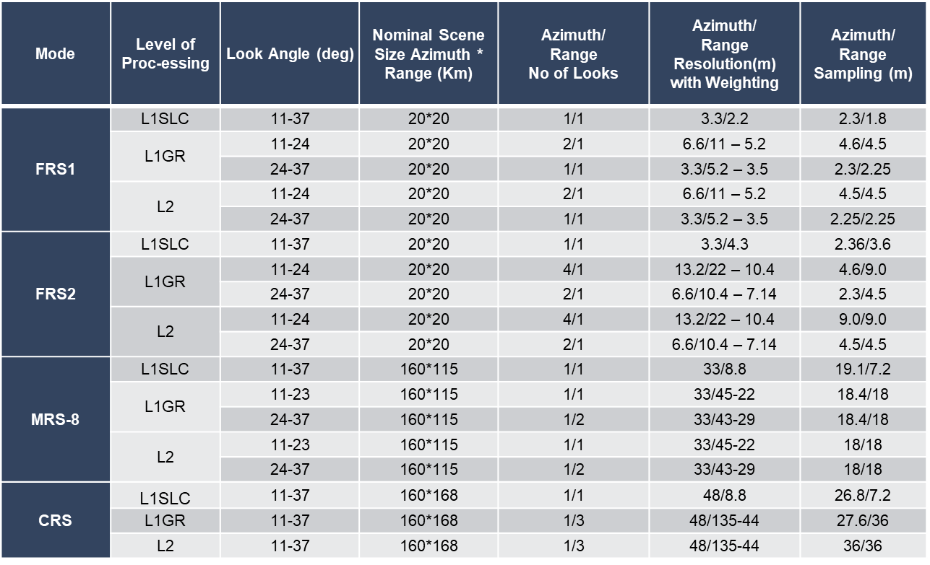
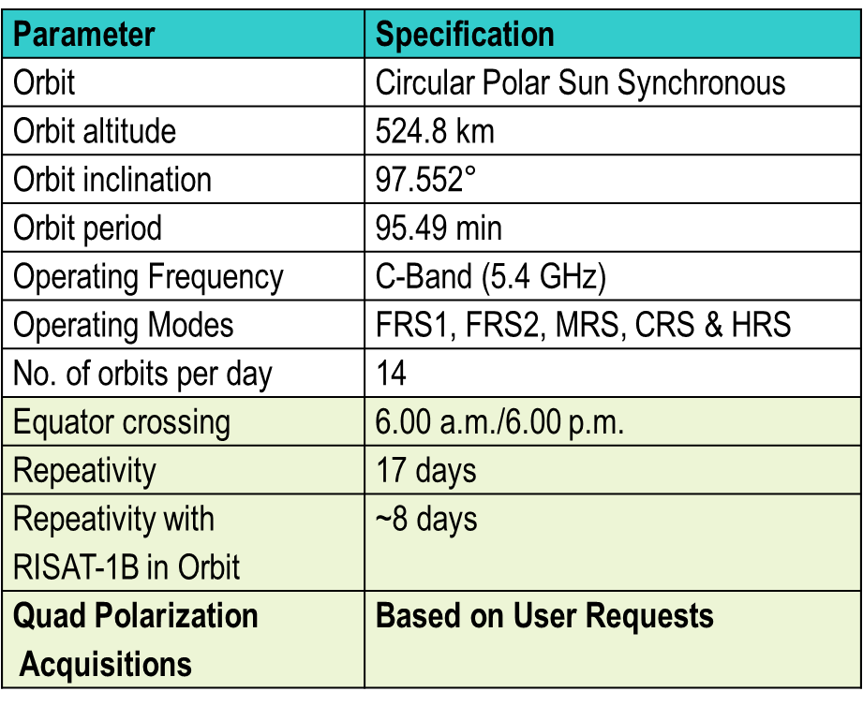
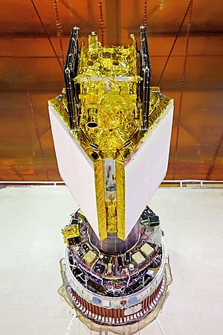
EOS-04 (RISAT-1A) / RISAT-1B
Specifications
EOS-04 (RISAT-1A) Specifications
EOS-04 Quad Polarization Product Specifications
EOS-04
Systematic Coverage of Indian Landmass in Medium Resolution ScanSAR (MRS) Mode every 17 days
# Value Added Level-1C (Covariance Matrix) and Level-3A (Georeferenced Polarimetric-
Decomposed Products also available

Slide 7

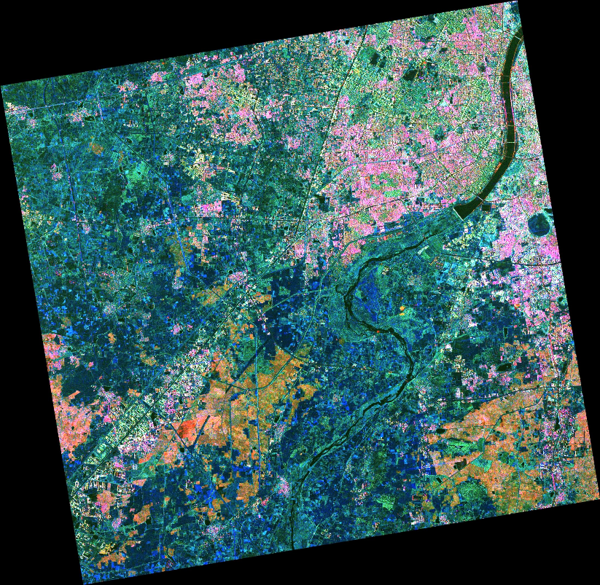
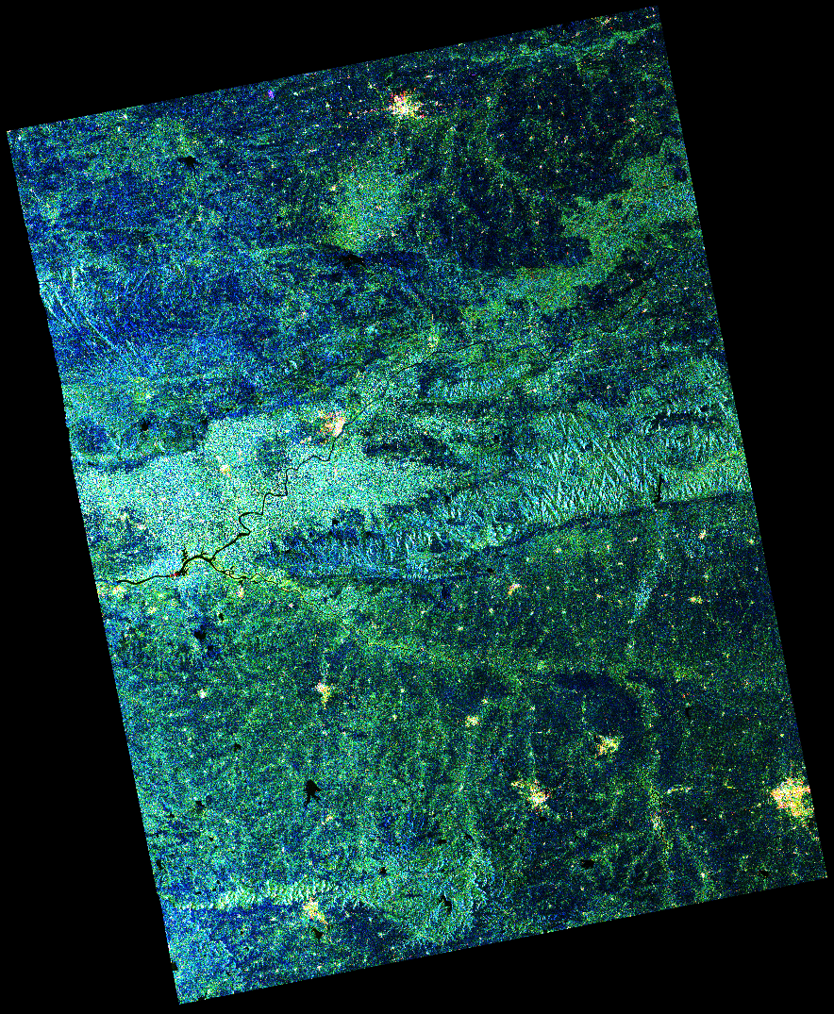
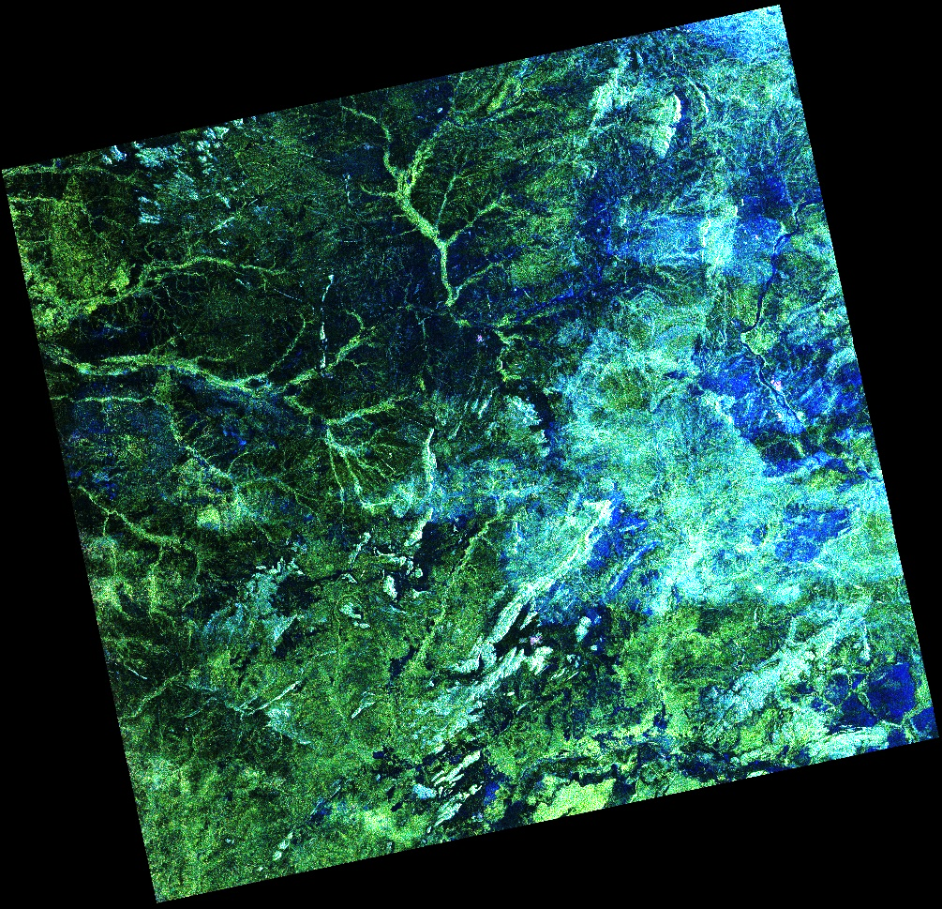
EOS-04 Quad Polarization Data Products
(Level-3A) Yamaguchi Decomposition
Fine Resolution Stripmap (FRS-1) Mode
Medium Resolution ScanSAR (MRS) Mode
Coarse Resolution ScanSAR (CRS) Mode
Image Size | 20 Km X 20 Km
Date of Pass : Region | 3rd Apr ’22 : Ahmedabad , India
Mode : Resolution | StripMap : 3 meters
Image Size | 160 Km X 115 Km
Date of Pass : Region | 10th March ’22 : Burhanpur, India
Mode : Resolution | ScanSAR (8 beams) : 33 meters
Image Size | 160 Km X 168 Km
Date of Pass : Region | 10th June ’22 : Chad, Central Africa
Mode : Resolution | ScanSAR (12 beams) : 48 meters

Slide 8
Thank You

