Slide 1
NISAR (L-band) Polarimetric observations
Dave Borges (NASA/LaRC)
LSI-VC-14 Item 13.2
‹#›

Slide 2
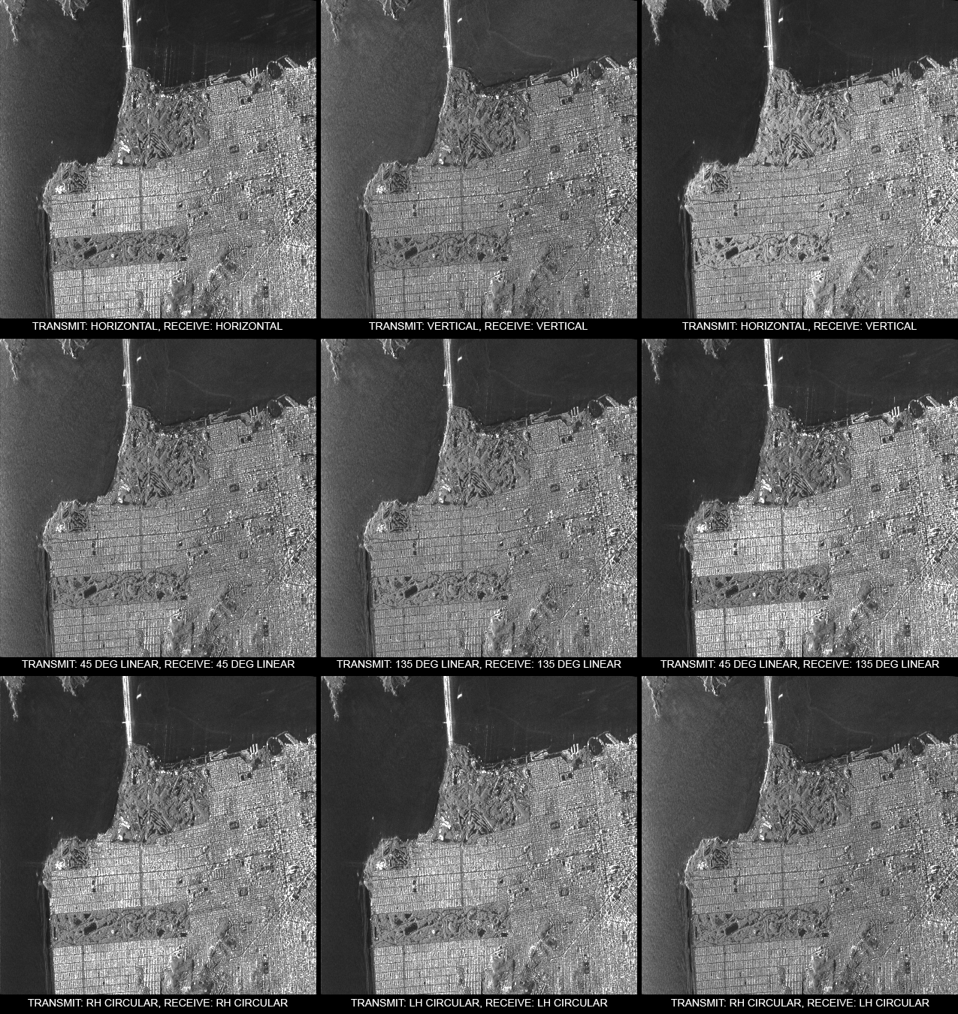
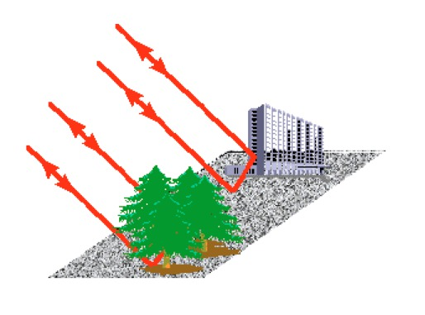
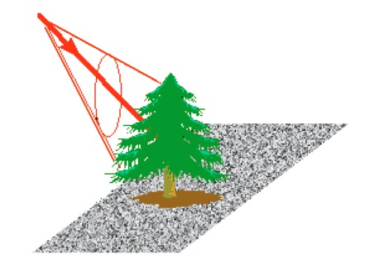
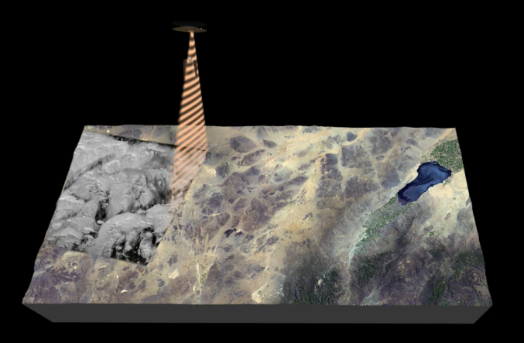
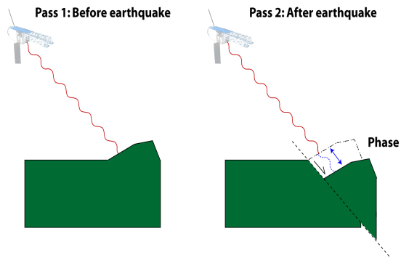
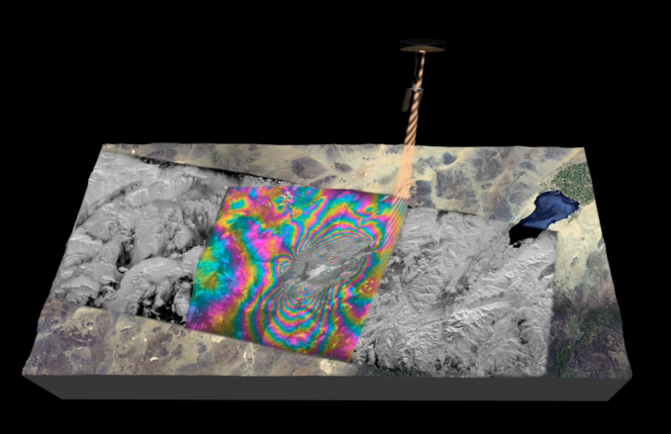
NASA-ISRO SAR (NISAR) Mission
Polarimetric Diversity
A joint SAR mission by NASA and ISRO
NISAR Characteristic: | Enables:
L-band (24 cm wavelength) | Low temporal decorrelation and foliage penetration
S-band (9 cm wavelength) | Sensitivity to lighter vegetation
SweepSAR technique with Imaging Swath > 240 km | Global data collection
Polarimetry (Single/Dual/Quad) | Surface characterization and biomass estimation
12-day exact repeat | Rapid Sampling/time series
3 – 10 meters mode-dependent SAR resolution | Small-scale observations
Pointing control < 273 arcseconds | Deformation interferometry
Orbit control < 500 meters | Deformation interferometry
L/S-band > 50/10% observation duty cycle | Complete land/ice coverage
Left looking | Almost complete coverage of Antarctica
L- and S-band Wavelength
L- longer S- shorter
24 cm 10 cm
Polarimetry
Repeat Pass Interferometry
Radar in space
First Pass, time t₁
Oriented Random
Structures Volumes
Repeat Pass InSAR
Second Pass, time t₂
Pass 1
Pass 2
‹#›

Slide 3
Current Observation Plan Revised every 6 months
Greenland
25MHz CP &
37.5MHz HH
SSAR
SP – Single Pol
DP – Dual Pol
QP – Quad Pol
Greenland
80MHz SP
LSAR
Sea Ice 5MHz
Background Land 20MHz DP
North America 40MHz DP & QP
Background Land 20MHz SP
Descending direction
Alternating each 12 days with Africa and South America
Global
Urban Areas 40MHz DP
Coverage of India Region with LSAR & SSAR
Sea Ice Quadrant with LSAR & SSAR
Antarctica 40&80MHz SP
LSAR
Antarctica
25MHz CP &
37.5MHz HH
SSAR
Sahara
5 MHz QD HH/VV

Slide 4
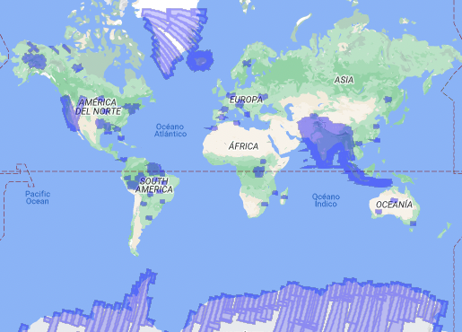
Location of planned joint L/S band observations in one 12-day orbit cycle
Many of the Cal/Val sites are jointly imaged by L-band and S-band

Slide 5
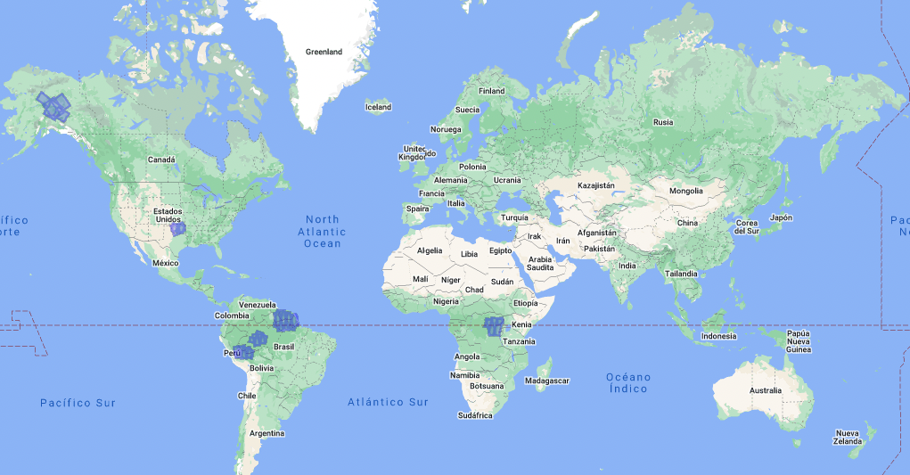
Image Calibration sites
(Observed in Quad-Pol mode at L-band, Compact-Pol mode at S-band)
Corner Reflectors
Corner Reflectors
Uniform and bright terrain
Uniform and bright terrain

