Slide 1
LSI-VC-14 Item 13.2
ALOS-2 / ALOS-4 polarimetric observations
Takeo Tadono, JAXA EORC
Ake Rosenqvist, soloEO/JAXA

Slide 2
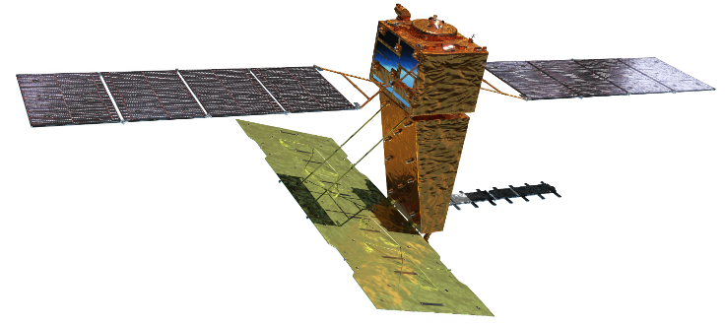
ALOS-4 PALSAR-3
Phase D
Launch | TBA by H3 Test Flight 2
Orbit | Same orbit as ALOS-2 Sun-synchronous sub-recurrent orbit Altitude: 628 km Inclination angle: 97.9 degree Local sun time at descending: 12:00 ± 15 min. Revisit time: 14 days (14+11/14 rev/day)
Lifetime | 7 years
Size | X 10.0 m x Y 20.0 m x Z 6.4 m
Satellite Mass | ~2,990 kg
Downlink | 1.8 / 3.6 Gbps (Ka-band)
Mission Instruments | PALSAR-3 (Phased Array type L-band Synthetic Aperture Radar-3) SPAISE3 (SPace based AIS Experiment 3)
Y
X
Z
SPAISE3 (AIS)
PALSAR-3
Ka-band DT antenna
In-orbit configuration

Slide 3
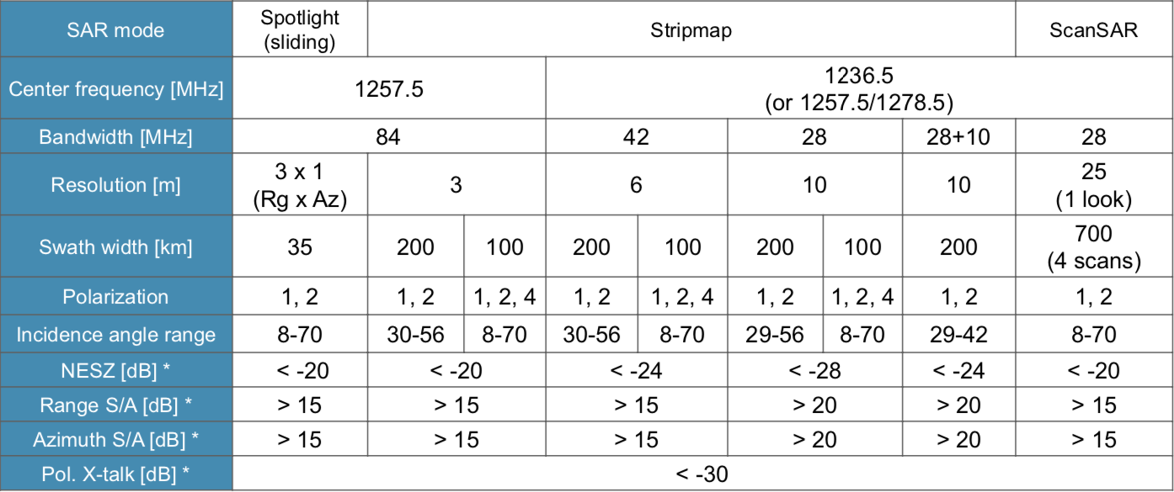
ALOS-4 PALSAR-3 observation modes
Full polarisation stripmap capacity with 100 km swath
3

Slide 4
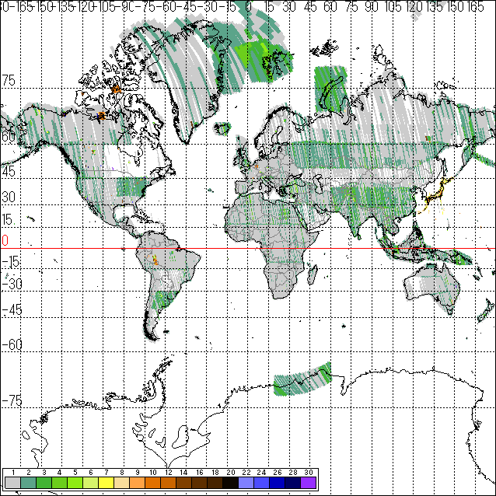
ALOS-2 / ALOS-4 polarimetric observations
PALSAR-3 swath width in Full-Pol mode is 100 km – major improvement from PALSAR (<30 km) and PALSAR-2 (<55 km)
Regional gap-free coverage (technically) feasible in only 2 cycles (28 days).
ALOS-2 and ALOS-4 joint operations planned → 6 day revisit foreseen during limited time.
Near-global FP coverage collected by ALOS-2 PALSAR-2
PALSAR-2 FP time-series data collected over a limited number of local sites - potential for multi-temporal Pol-SAR and Pol-InSAR research

Slide 5
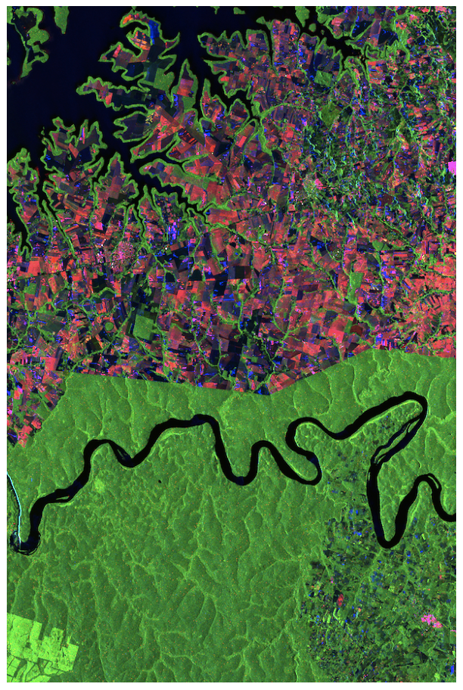
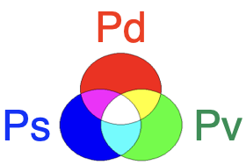
Tentative plans for ALOS-4 PALSAR-3 QP observations
Annual global coverage in 6 m Polarimetric (QP) mode (desc)
~ Bi-monthly QP national coverage over SE-Asia ( Thailand, Vietnam, Nepal, Laos, Cambodia)
~ Monthly QP time-series observations over R&D sites
Data access through JAXA Research Announcements. Next RA for ALOS-2/4 expected in 2024.
ALOS-2 © JAXA
Polarimetric processing:
Courtesy of Y. Yamaguchi

