Slide 1
LSI-VC-14
2023
Quad-pol and Multi-frequency acquisitions requests from the POLINSAR Workshop
Francesco Sarti, ESA
Magdalena Fitrzyk RSAC c/o ESA
Agenda Item 13.1
LSI-VC-14 2023, ESA/ESRIN
10th - 12th October 2023

Slide 2
Recommendations 2021-2023
Presenters should name their file using the following convention:
  AgendaItemNumber_LastName_Subject_Version (e.g., 1.1_Labhan_Welcome_v1)
Documents and presentations should be uploaded to the shared folder to allow for streamlined self service
  Shared Presentation Folder (default view only, ask for upload/edit permission as required)
  For support contact matthew@symbioscomms.com
  Presentations should be submitted by 3 October
Meeting website: https://ceos.org/meetings/lsi-vc-14/
Please explicitly highlight the decisions, outcomes, or actions you are seeking. The more explicit you are, the better. i.e., feel free to provide text for a proposed action – it may be revised later, but this approach will help with the efficient preparation of the actions record of the meeting.

Slide 3
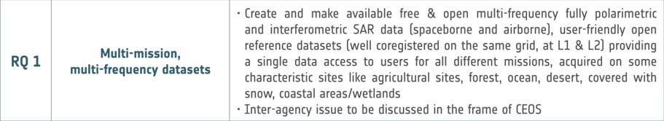
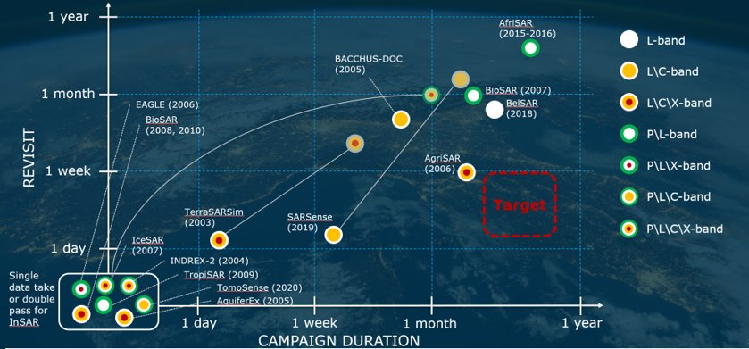
Recommendations POLINSAR
POLAR. SATELLITE MISSIONS
ALOS/PALSAR
RCM
COSMO SKYMED 2ND GEN.
SAOCOM (PUMAS)
EOS-04
FUTURE SATELLITE MISSIONS
BIOMASS
ROSE-L
S1 NG
NISAR
Contact point: Lorenzo Lanini
/ Malcolm Davidson
Airborne Campaigns

Slide 4
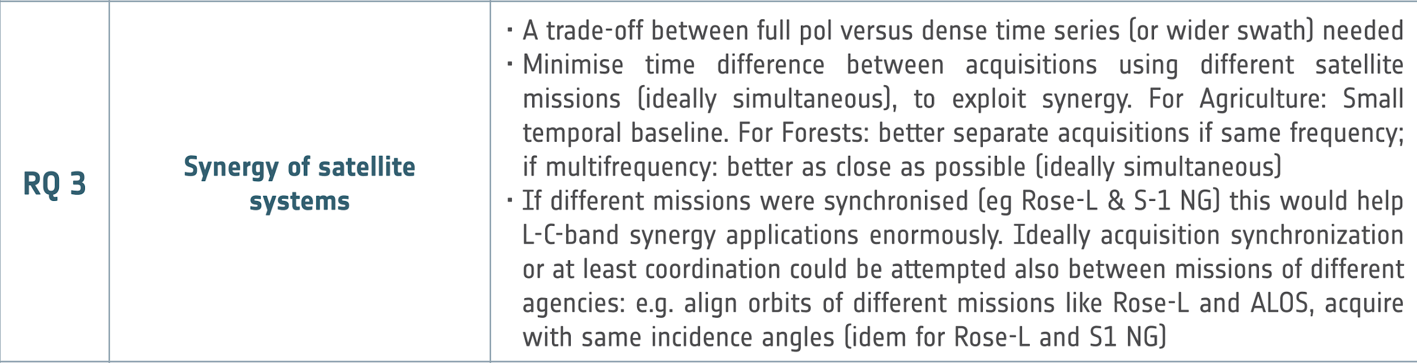
Recommendations POLINSAR
R.3
On-going joint research between JAXA and ESA on using SAR data products for selected areas and applications (see slide n.9)
  Improvement of observation frequency and coordination in Japan and Europe
  Explore synergies between C- and L-band
  Data exchange via dedicated ftp-site under ESA responsibility
  Project Implementation Plan (PIP) outlines specific Joint Research Activities to be conducted as part of the ESA-JAXA cooperation
PUMAS initiative ESA - CONAE (SAOCOM) for SAOCOM & Sentinel synergy and joint exploitation (in preparation for ROSE-L)
Acquisition coordination need between S1 NG and ROSE-L being taken into account
International Coordination Group for Spaceborne Synthetic Aperture Radar (SAR) Missions http://intl-sar-coord-group.space/ could be involved as well
  Example of Thematic groups: Polarimetric and Multi-frequency SAR, inSAR, Program and Mission coordination
Contact point: B. Rommen, K. Scipal

Slide 5
Recommendations POLINSAR
Some relevant mission managers (ESA, CONAE) have been informed. Adapting acquisition plans is a challenge, due to many different constraints
Action to be discussed also at CEOS level (LSI – VC?)

Slide 6
Possible actions: SUPERSITES
The scientific SAR polarimetry (POLINSAR) community is advocating since many years the creation of so-called supersites for polarimetry (and interferometry): a set of predefined sites, including various types of natural targets (forests, ice, snow, deserts, coastal areas, wetlands, agriculture etc.). Associated requirements:
In-situ data are regularly collected (plus lidar when relevant for the specific application)
Data from several different SAR missions (and airborne campaigns), at different frequencies, are acquired, including full-pol data, over appropriate time periods (multitemporal aspect)
Acquired datasets shall be harmonized and made available free & open for the scientific community
Airborne campaign data shall come in a standardized format
User-friendly open reference datasets (ideally coregistered on the same grid, at L1 & L2)
Providing a single data access to users for all data
Include characteristic sites like agricultural sites, forest, ocean, desert, covered with snow, coastal areas/wetlands

Slide 7
Possible actions: SUPERSITES
More specifically:​
For FOREST supersites:​
Acquired data shall allow analysis of vertical forest structure from PolInSAR, TomoSAR and LIDAR. Data shall be well calibrated polarimetrically and interferometrically. Provision of 3D data would be also beneficial.​
Study of forest change requires multitemporal data, possibly PolTomo, gathered at well-characterized supersites and coincident Lidar and in-situ collection.​
A global network of forest reference sites (forest inventory, airborne data and terrestrial lidar) is currently established under GEO-TREES. All data will be open and free. Systematic EO data acquisition of these sites would foster R&D.​ ESA Contact: Klaus Scipal
For AGRICULTURE supersites:​
quad-pol is essential, possibly at high resolution and with large baseline to gain sensitivity on crop height​
​

Slide 8
Possible actions: SUPERSITES
For SNOW supersites:​
campaigns/acquisitions shall allow to evaluate retrieval in various conditions (varying snow depth, dry/wet, temperature, topography).​
Acquired dataset shall have the right format/mode/level of processing in order to allow application of different methodologies (polarimetry, DEM differencing, DInSAR, Tomography)​
Data shall include SAR acquisitions in different bands, including high frequencies. Dedicated snow campaign should be launched for the investigation of higher frequencies, TomoSAR and mono/bistatic acquisitions.​
​
These requirements were gathered during the last two POLINSARs. In the same way we could gather requirements from the scientific community for the other types of supersites.​
​

Slide 9
ESA-JAXA Mutual SAR Cooperation
Mutual Cooperation using SAR Satellites in Earth Sciences and Applications (info from J.Kubanek, ESA)
Joint research between JAXA and ESA on using SAR data products for selected areas and applications
Improvement of observation frequency, coordination Japan-Europe; trade-off studies for acquisition strategies (quad pol vs. others)
Explore synergies between C- and L-band in preparation for S1 NG, ROSE-L and ALOS-4
Data exchange via dedicated ftp-site under ESA responsibility
Project Implementation Plan (PIP) outlines specific Joint Research Activities to be conducted as part of the ESA-JAXA cooperation
Themes and Applications
Polar area monitoring
  Sea Ice, MOSAiC
Forest monitoring
  Forests, Urban forests, Forest fires
  Deforestation in refugee camps
Ocean monitoring
  Ship detection, Oil spill, Wind speed and hurricanes
Ionosphere
  TEC gradients, Traveling ionospheric disturbances
  High latitude scintillations
Wetlands
  Flooding, Inundation,
Snow Water Equivalent
  2 sites with different characteristics
Soil moisture
  2 sites in Europe
Agriculture and GHH
Volcano Monitoring
Deformation
  Urban areas
About 25 sites (mostly in Europe, apart from Sea Ice in the Arctic, wetlands in the US, hurricanes...), with about 3000 ALOS-2 acquisitions (a minor part thereof in quad-pol). Data can be requested, for research & support to this analysis, contacting Julia Kubanek, ESA)

Slide 10
Datasets/database generated from ESA study
Reporting on recently finalised ESA study “Information content of multi-spectral Pol-InSAR data”
ESA contract (with DLR) no: 4000133590/20/NL/AS (info from B. Rommen, ESA). Final results & data will be made available soon (possibly on a dedicated ESA Airborne Campaigns web page).
Covering a number of test sites for different applications. Datasets cover:
  Forestry
  Agriculture
  Wetlands
  Land ice
  Snow-covered areas
Consistent datasets mostly arriving from airborne campaigns (E-SAR, F-SAR) together with in-situ measurements.
Datasets allow user community to test hypotheses and investigate the need for fully polarimetric SAR data.
Examples provided in following slides.
Note: the results of the activity (datasets and software) are currently only open to the ESA community (i.e. entities within ESA member and cooperating states). Further dissemination of results may be possible (but not automatic)

Slide 11
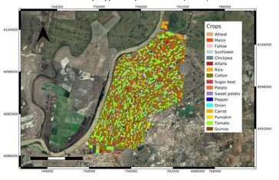
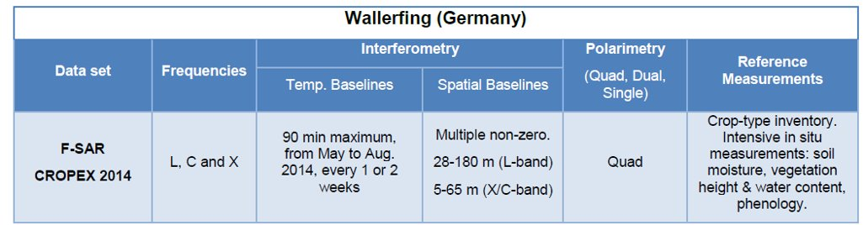
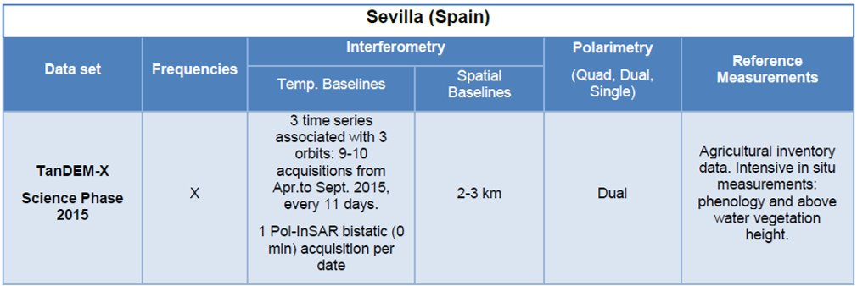
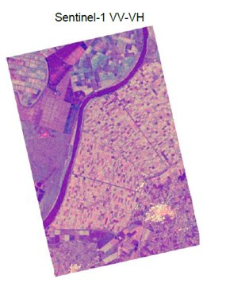
Datasets/database generated from ESA study – Agriculture
EXAMPLES
Sevilla test site: crop map (2017)

Slide 12
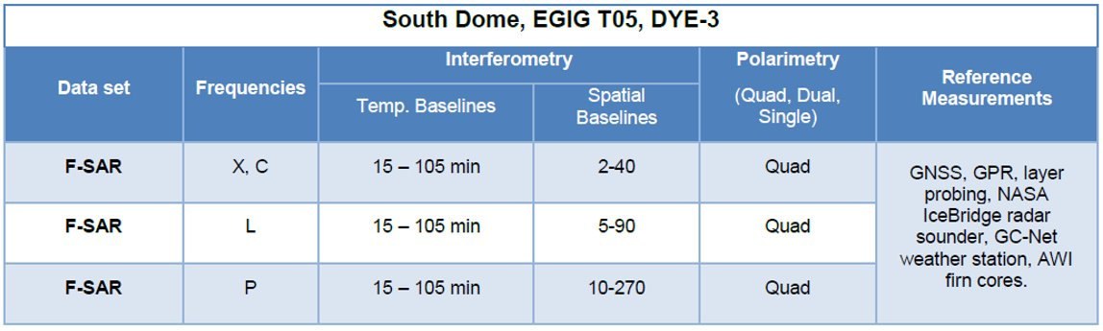
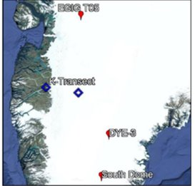
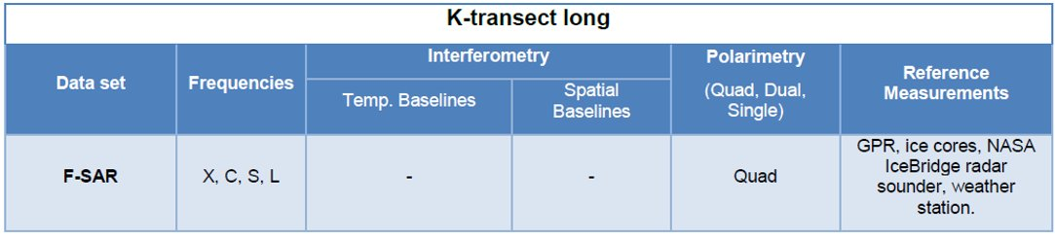
Datasets/database generated from ESA study – Land ice
EXAMPLES

Slide 13
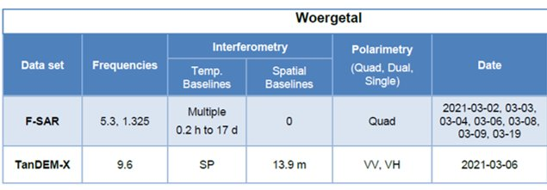
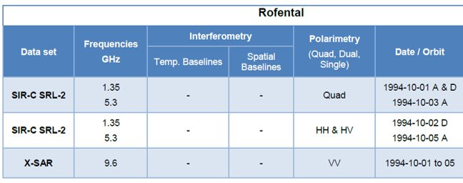
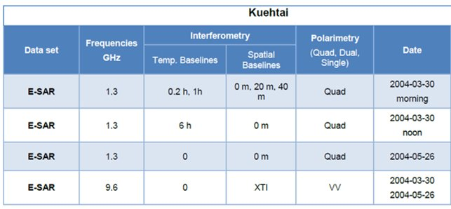
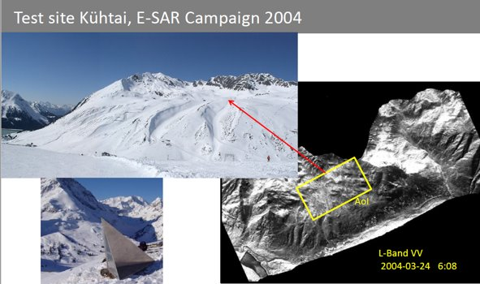
Datasets/database generated from ESA study – Snow cover
EXAMPLES

