Slide 1
CEOS-ARD Communications
Libby Rose (CEOS SEO)
Chris Barnes (KBR/USGS)
LSI-VC-13 2023, ESA/ESRIN
23rd - 24th March 2023

Slide 2
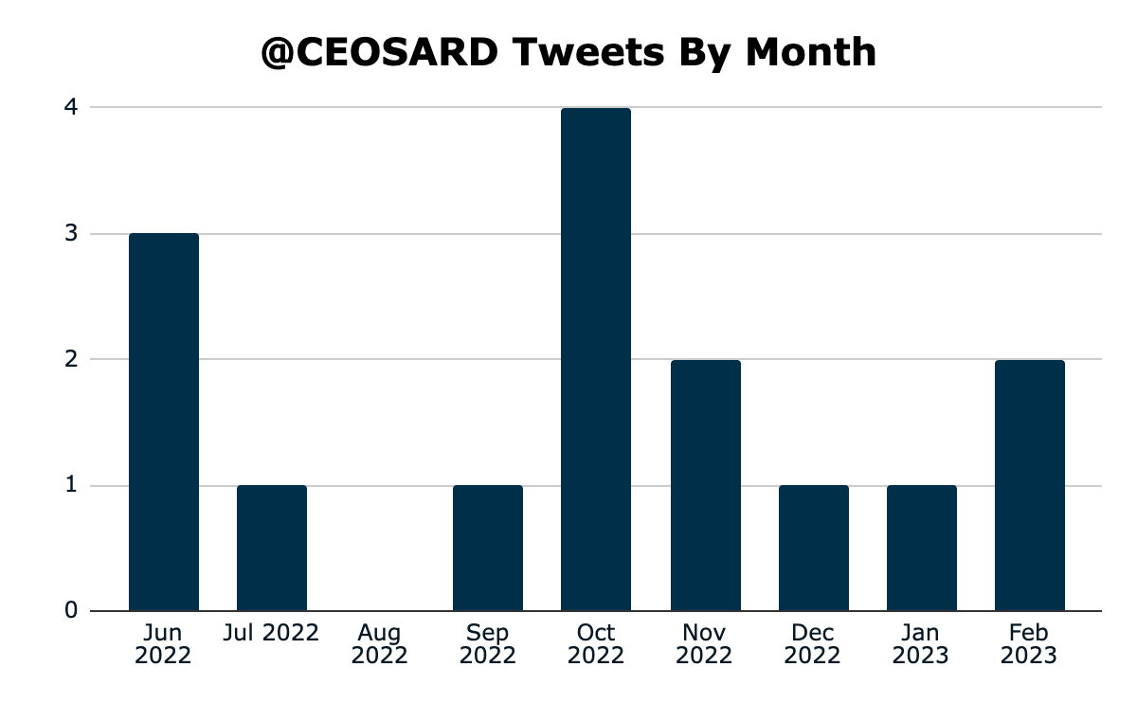
Twitter: @CEOSARD
Account opened in June 2022
55 followers: spread the word to grow our following!
Average 1.67 tweets per month
Averages
Impressions | 334.13
Engagements | 16.07
Engagement rate | 4.81%
Retweets | 2.27

Slide 3
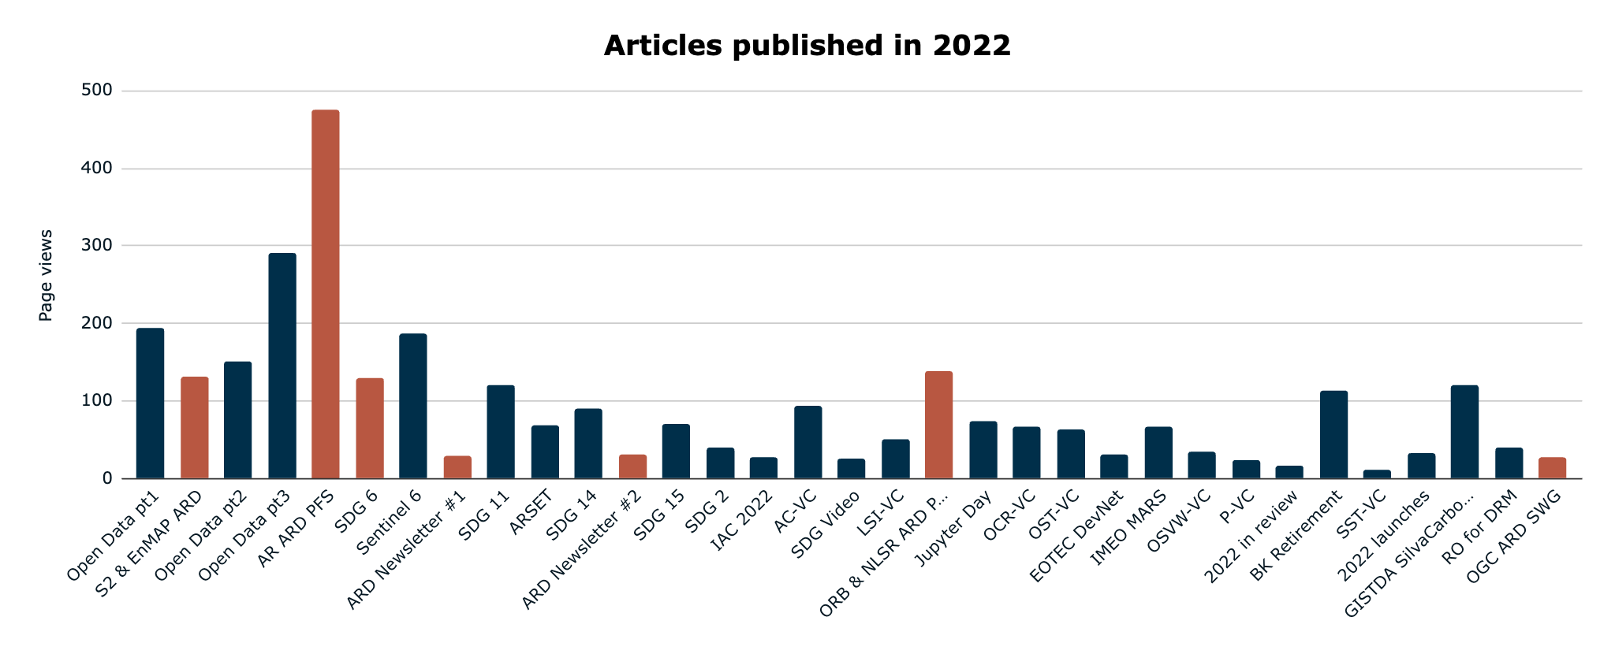
ceos.org/news: ARD Articles
ARD
ARD is one of the most popular topics!

Slide 4
ARD Newsletter
2 editions published in 2022
2nd was focused on CEOS-ARD @ LPS22
 | #1: 4 April 2022 | #2: 17 June 2022
Successful Deliveries | 265 | 316
Unique opens | 91 | 93
Total clicks | 55 | 80

Slide 5
ARD Newsletter: Future editions
April edition:
New products endorsed (ALOS-2)
Progress with OGC ARD SWG
Relevant outcomes of LSI-VC-13 (CEOS-industry workshop?)
August edition:
CEOS-ARD Session @ ARD23 workshop
CEOS-ARD @ IGARSS 2023
Two sessions to report on: CEOS session & OGC session
+ CEOS Booth

Slide 6
IGARSS 2023: CEOS Booth
Flyer
One flyer with highlights of CEOS Work, with links to websites etc
Print on glossy paper
Focus on people less familiar with EO
Analysis Ready Data
CEOS Analysis Ready Data (CEOS-ARD) are satellite data that have been processed to a minimum set of requirements and organized into a form that allows immediate analysis with a minimum of additional user effort and interoperability both through time and with other datasets.
Current Product Family Specifications
Surface Reflectance
Surface Temperature
Normalised Radar Backscatter
Polarimetric Radar
Aquatic Reflectance
Ocean Radar Backscatter
Nighttime Lights Surface Radiance
Outside
All CEOS Agency Logos
Training calendar & EOTEC DevNet
mission statement
ceos.org
Social media links
info@ceos.org
Inside
???
ARD
SDGs
@CEOSARD
Sign up for the CEOS-ARD Newsletter!
For more information, visit ceos.org/ard

Slide 7
Communication Materials
Create new page on ceos.org/ard
Host the CEOS-ARD logo in different formats and colours
This is where data providers can find the logo for their communications
Provide guidelines for use of the logo

Slide 8
Suggestions?
Always looking for content for the twitter page
Contact matthew@symbioscomms.com and libby@symbioscomms.com if you have anything ARD related to share
Other suggestions for IGARSS CEOS Booth?
Will also have a booth at GEO Week in November
News article topics for ceos.org/news are always welcome

