Slide 1
WGClimate-18 & CEOS-ARD
Matt Steventon
Agenda Item #8.2
LSI-VC-13, ESA/ESRIN
23rd - 24th March 2023

Slide 2
WGClimate-18
CEOS-ARD Sec joined the WGClimate-18 meeting (1 March).
WGClimate is considering a representative to the CEOS-ARD OG to explore opportunities.
Open question whether the CEOS-ARD concept applies to the climate domain. Needs to be end user driven.
WGClimate will consider a preliminary assessment of some datasets/CDRs in the ECV Inventory against the existing CEOS-ARD Product Family Specifications.
Also consider whether there is a need for new PFS for other climate related products.

Slide 3
LSI-VC-8 Follow-up on LST CDRs

Slide 4
SIT TW Side Meeting Outcome
In the ‘before times’, LSI-VC-8 & WGClimate joint session in Anchorage, Sept 2019. Minutes.
“6. The joint session with WGClimate resulted in the LSI-VC agreeing to undertake two actions from the WGClimate Coordinated Action Plan (around LST Climate Data Records and continuity). This is a positive step forward on the LSI-VC requirements and gap analysis thread, and a new CEOS Work Plan Task will be suggested in response.”
Way forward on the following or similar updated priorities?

Slide 5
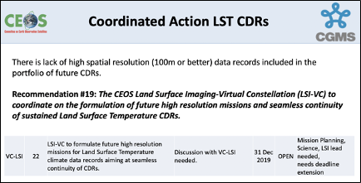
The goal here is to do a deeper analysis looking at the availability of LST datasets.
Datasets may also exist, but they may not necessarily be processed into a CDR.
Need to meet the 2004 CDR definition from NOAA. Derived geophysical records would also comply.
LSI-VC to begin by summarising the plans and projections of the way forward for USGS on Landsat TIRS, expanding to cover other missions and agencies in time.
Studying and understanding the future continuity of LST measurements is a valuable action for LSI-VC, as well as space agencies, outside of the WGClimate need.
The question of whether these measurements are supporting a CDR would also need to be addressed in a study, including whether there is a processing plan in place. This would necessarily involve both LSI-VC and WGClimate expertise on scientific assessment.

Slide 6
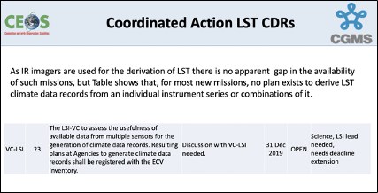

Slide 7
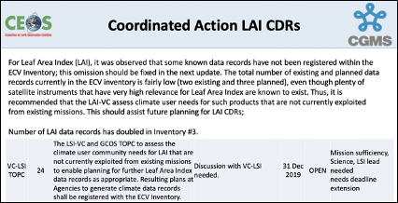
The suggestion at LSI-VC-8 was that activity and discussion on this LAI action be postponed until there is an outcome from an ongoing assessment within WGClimate?

Slide 8
Update 23 March - LST
Jeff, Joerg, and Wenying have not had the opportunity to discuss this further.
Most of the points discussed at Anchorage in 2019 are still relevant.
A thorough analysis of the LST in the ECV Inventory is a good starting point.
  Currently contains 17 current CDRs and 22 planned CDRs.
  We will have a better understanding of the current and future provision of LST by analyzing these records:
    Will there be a gap in LST records?
    Will these records provide the temporal/spatial resolution to meet user needs, especially high spatial resolution data?
    Are LST data records from multiple sensors consistently processed and harmonized to constitute a climate data record?

Slide 9
Update 23 March – GCOS IP
One of the main tasks for WGClimate in 2023 is to draft a space agency response to GCOS IP. Below are some actions that we would like to work with LSI-VC in our response:
  C5: ECV-specific satellite data processing method improvements
    Generate timely permafrost, land cover change, burnt area, and fire severity/burning efficiency products from high resolution satellite observations (e.g. Sentinel-1 /-2 and LandSat).
    Produce harmonized and validated AGB and change datasets from different satellite data streams, for enhancing AGB estimation at global and sub-national level.
    Ensure that the Bidirectional Reflectance Distribution Function (BRDF) parameters are provided together with surface albedo.
    Improve consistency of the inter-dependent land products.
F1: Responding to user needs for higher resolution, near real time data: Improve biomass, land cover, land surface temperature, and fire data with sub-annual observations and improved local detail and quality.
F2: Improved ECV satellite observations in polar regions, Surface temperatures of all surfaces (sea, ice, land)
Analysis of the current and planned LST records may help us address some of the actions listed above. If you could identify a POC for each of these actions during your meeting next week, that would be greatly appreciated. We will work with the POCs to draft the response.

Slide 10
Questions & Updates
Work we might have to wait for before we can re-open this discussion?
Saw from the CEOS SEC report that there's no capacity for WGClimate to join the CEOS-ARD Oversight Group?
  How about for the preliminary CEOS-ARD assessment of some LST CDRs / datasets from the ECV Inventory?
Lastly, towards the end of the session I was involved in there was discussion about reaching out to the VCs regarding refinement of the ECV Inventory records?

Slide 11
Notes
WGClimate asked me to present because they are considering how to engage with the CEOS-ARD Oversight Group.
Noted this point from WGClimate in particular: "A Thematic CDR (TCDR) is a consistently-processed time series of uncertainty-quantified values of a geophysical variable or related indicator, located in time and space, of sufficient length and quality to be useful for climate time-scale uses.”
This sounds a bit like CEOS-ARD?
They asked whether CEOS-ARD follows the FAIR principles.
We discussed where WGClimate might begin to engage with the CEOS-ARD framework - suggested that perhaps someone from WGClimate could look at how aligned the Surface Temperature PFS is with the LST CDR and datasets detailed in the ECV Inventory.
Whether the PFS applies to a composite CDR is to be seen
Whether additional PFS for different types of products are needed is up to WGClimate and their understanding of the target user community. I noted that we are targeting non-expert users typically, seeking to make additional sources of data more accessible to new users. This may be a new perspective for WGClimate to consider - typically their focus is science climate products.
This is a topic we could explore through their engagement with the ARD Oversight Group and development of any PFS would be done in collaboration with the VCs
It was suggested that we look at WIGOS metadata standards and see whether we have overlaps / similarities with our metadata standards.
For the LSI team: I also took the opportunity to follow up the discussion from LSI-VC-8 about LSI supporting work on

