Slide 1
CEOS AFOLU Roadmap
Update & LSI-VC impact
S Ward for
Ben Poulter (Lead Author, NASA)
Osamu Ochiai (JAXA, Co-Lead)
Frank Martin Seifert (ESA, Co-Lead)
CEOS LSI VC Forest and Biomass SG
LSI-VC-13
ESA, ESRIN
23-24 March 2023

Slide 2
Contents
Reminder of heritage & objectives
Progress update
Emerging Grand Vision
Summary of AFOLU engagement (COP27, GISTDA WS)
Next steps & schedule
LSI-VC impact
Slide ‹#›

Slide 3
Heritage & objectives
2020 CEOS Plenary 34 agreed to a CEOS AFOLU Roadmap, as an initiative to support UNFCCC Global Stocktake Process
  Based on Discussion Paper prepared by LSI-VC Forest & Biomass Team following SIT 35
  Recognising need for an AFOLU equivalent to the CEOS GHG Roadmap (with CGMS)
    “...if Land Use, Land Use Change and Forestry targets involved in the initial NDCs were implemented in full, this would represent approximately a quarter of pledged mitigation efforts up to 2030“
  2021 CEOS Plenary 36, AFOLU Roadmap to be co-led by NASA, ESA, JAXA
2021 / 2022 accomplishments
  Assessment of latest AFOLU products (land cover, agriculture & biomass) that could be readied for 2021 COP-26
  Biomass Harmonisation Exercise on ESA/NASA MAAP
  Coordination with SIT Chair and GHG Team on new CEOS GST Portal – as a unified point of entry to explain & offer our data
  New engagement axis with national inventory users, building on our GFOI experience and in the spirit of the ambition cycle of the Paris Agreement to learn together and grow together
  Significant input to the synthesis report on “The Role of Systematic Earth Observations in the Global Stocktake” for UNFCCC
  Joint Workshop of CEOS AFOLU and GCOS Terrestrial Observation Panel for Climate at SIT-TW 2022
  Contributions to COP27 and Earth Information Day

Slide 4
CEOS-TOPC AFOLU Workshop
Brought together AFOLU Roadmap Team & Terrestrial Observation Panel for Climate (TOPC) of GCOS.
Objectives:
  make a start on defining how society’s needs for information related to AFOLU and its reporting for GST can be expected to evolve in the coming years
  consider the policy needs and assumed AFOLU information needs in the 2035 timeframe on the assumption that this foundation can inspire and drive the generation of the CEOS AFOLU Roadmap
Structured along the lines of existing AFOLU thematic expert teams:
  Forests & Biomass, Agriculture, OLU (mangroves, wetlands..)
  And the dimensions of: global assessments and syntheses; national climate policy and actions; GHG inventories
Key outcome
  Identified a workflow for integrating the GHG and AFOLU roadmaps and activities of CEOS, IPCC and WMO for an operational GHG monitoring, reporting and verification (MRV) system

Slide 5
Vision for Roadmap
Focus in 2023 is the development of a CEOS AFOLU Roadmap document
Objectives:
Provide a framework for long-term (~ 15+ years) coordination of CEOS agency observing programmes in support of the needs of society for AFOLU-related information, with a focus on the needs and ambition cycle of the Global Stocktake of the Paris Climate Agreement.
A guiding vision for long-term space agency coordination around AFOLU. Characterises the needs, the services and applications required, the products and observing systems that can support. Explain the need to plan for ground segment, space segment and services.
An effective means for communicating our intentions to society, UNFCCC, national inventory community etc
Addresses basic observation continuity and the necessary agency coordination

Slide 6
Vision for Roadmap
Approach:
Define the 2035 observing system required to address the AFOLU information needs of society
Consider the technologies and systems needed to realise this observing system
Identify the stakeholders required at different stages of the value chain to ensure it can be sustained in the long-term (i.e. users- service providers, - data product producers-observation providers)
The technology development programmes and investments needed by space agencies to achieve them
The programmatic commitments that will be needed to get there
Addressing three different dimensions of GHG emissions and removals accounting:
Global assessments and syntheses
National climate policy and actions
GHG inventories

Slide 7
Contents and lead authors
Key Messages & Introduction (Ben, Steve Briggs + )
Remote Sensing contribution
  Activity Data (Martin Herold+)
  Emissions & Removal Factors (Laura Duncanson+)
Combining activity data and emission factors to estimate emissions and removals (Ben, Joana +)
  National GHG inventories/IPCC approach // IPCC AR6 approaches // Hybrid approaches
Perspective on GHG roadmap (Ben+)
Capacity Building & Engagement (Sylvia, Joana)
Forward looking (Ben, Osamu, Frank Martin)

Slide 8
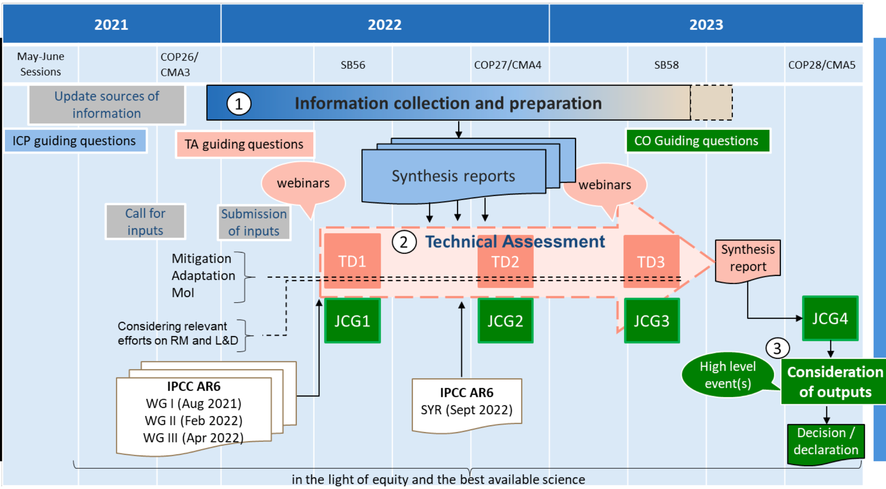

Heritage & objectives
Global Stocktake

Slide 9

CEOS and the GST
CEOS Strategy for the Global Stocktake (GST) 9 recommendations
Recommendation #6:
  It is recommended that to help in ensuring the take-up of satellite-based methods for AFOLU (and indeed in the context of MVS)
  CEOS should work with a few selected demonstrator countries to assist them in their national reporting under AFOLU (the model of GFOI can be compared).
  SilvaCarbon leading this effort

Slide 10
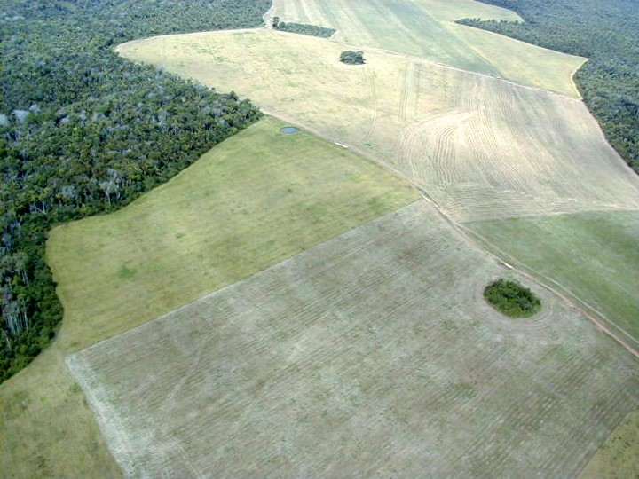

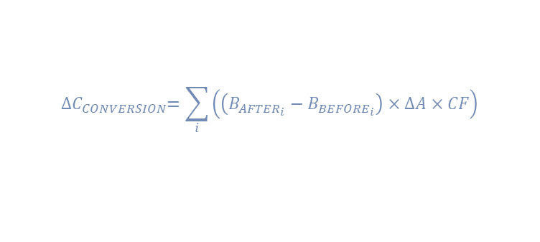
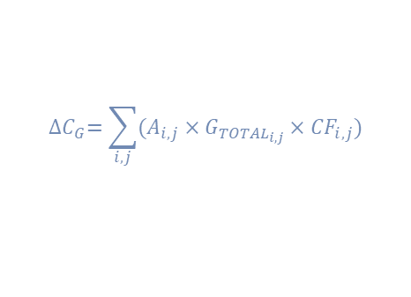
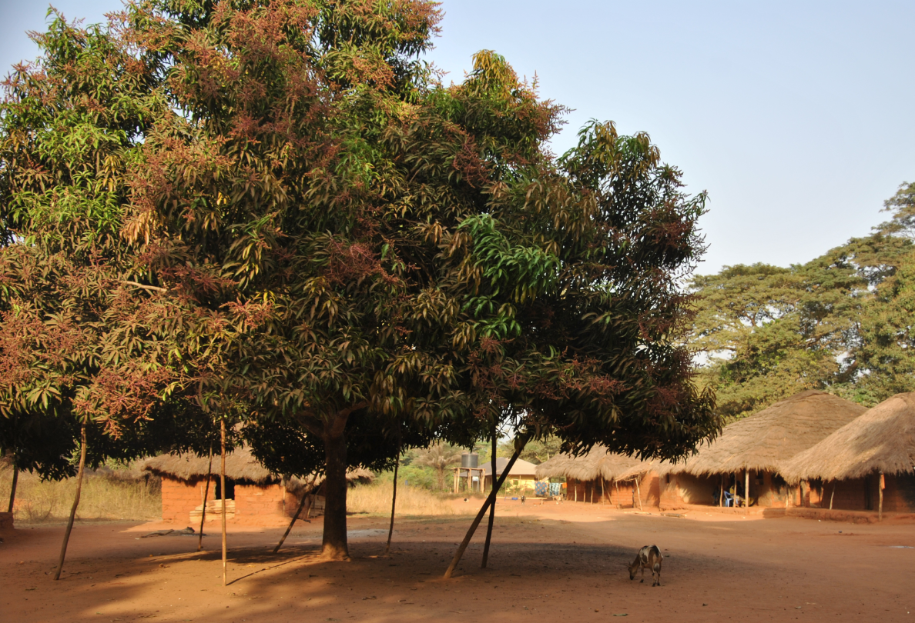
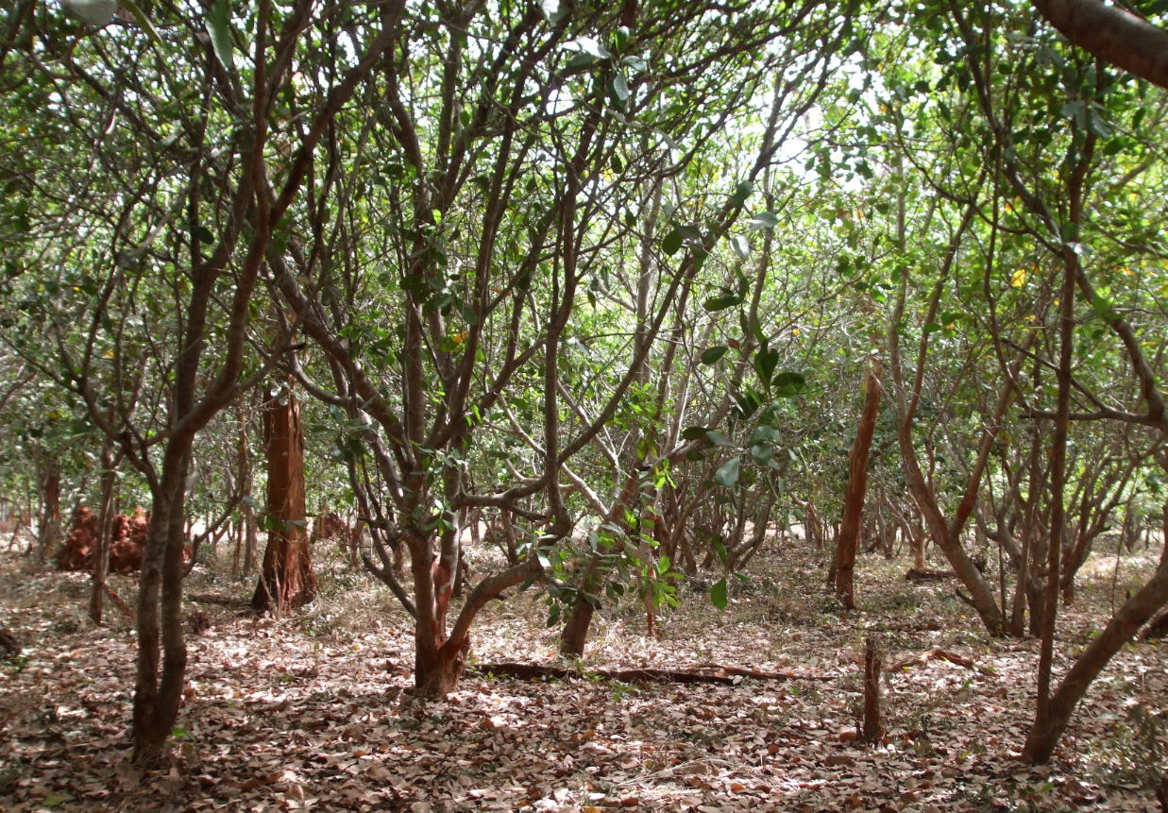
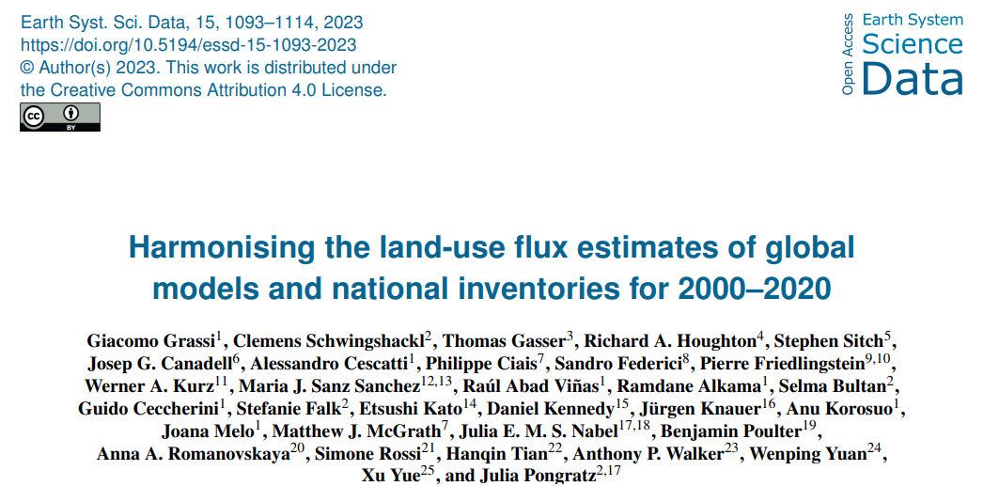
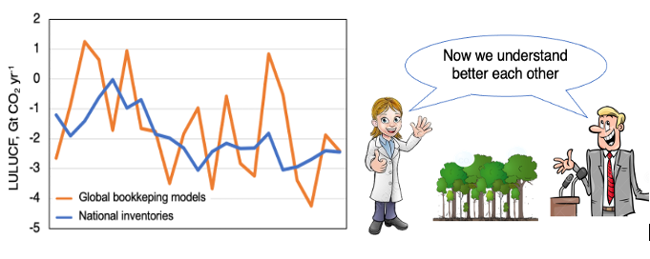
Why is the AFOLU roadmap important?
Contributing to the Global Stocktake requires adherence to the modalities and guidance of the UNFCCC
and explaining the differences in the estimates
Grassi et al 2023 Earth Syst. Sci. Data, 15, 1093–1114
@giac_grassi

Slide 11
Why is the AFOLU roadmap important?
Bringing together global land monitoring experts
Fostering collaboration with national land monitoring experts (familiar with GHG inventories and IPCC guidance)
Continuous capacity building both-ways
Setting and revisiting objectives, priorities, and clear actions
Short story to emphasise its importance

Slide 12
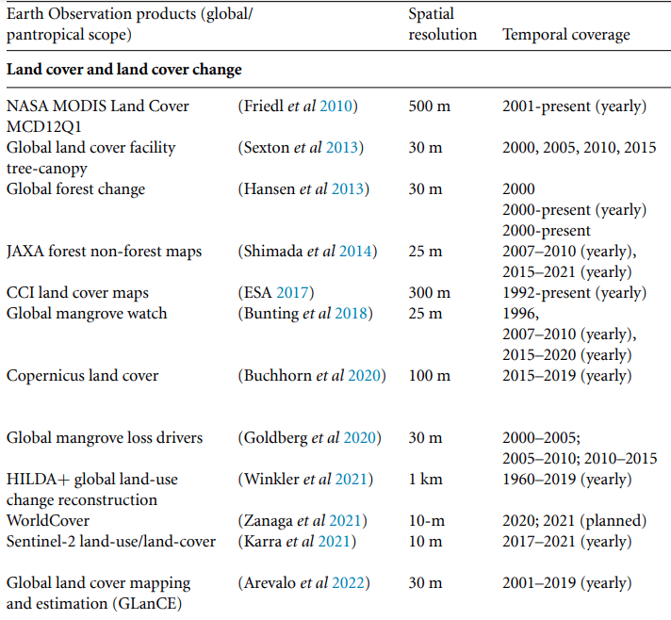
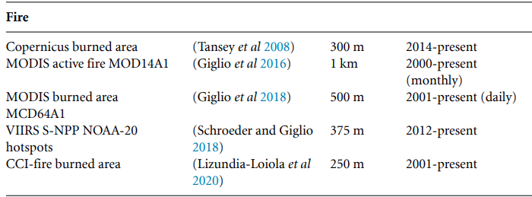
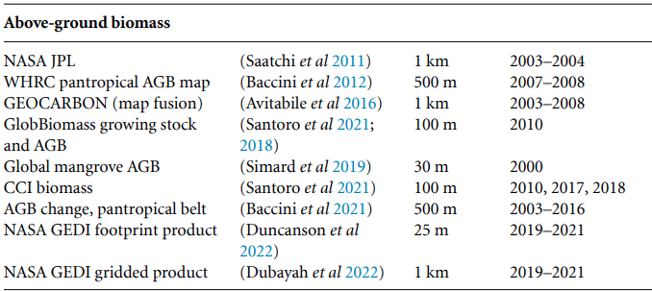
Why is the AFOLU roadmap important?
Earth Observation products/maps (global/pantropical scope) to estimate carbon fluxes from land

Slide 13
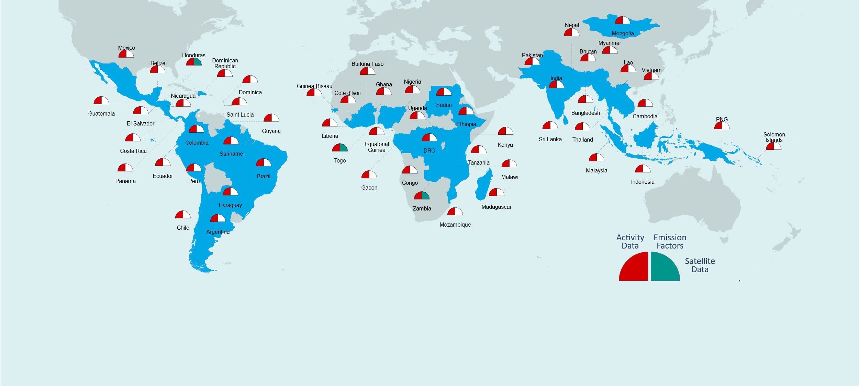
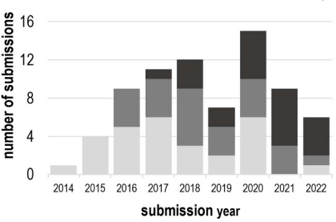

Why is the AFOLU roadmap important?
75 submissions to the UNFCCC
56 countries
80% tropical forests
Melo et al 2023 Environ. Res. Lett. 18 034021
Satellite data use in the current MRV framework
All countries use satellite data for Activity data
A few use satellite data to develop biomass maps as well
(not including airborne data)
Activity data method trend change in data source preference

Slide 14
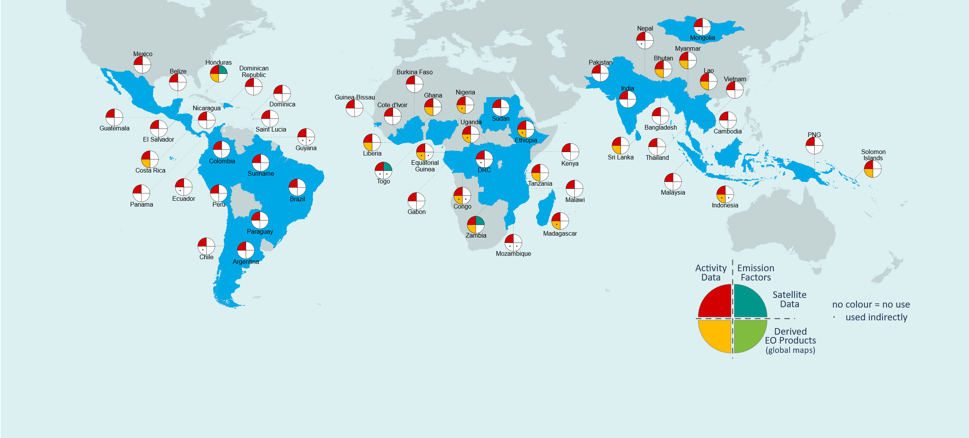
Why is the AFOLU roadmap important?
Use of satellite-based global maps?

Slide 15
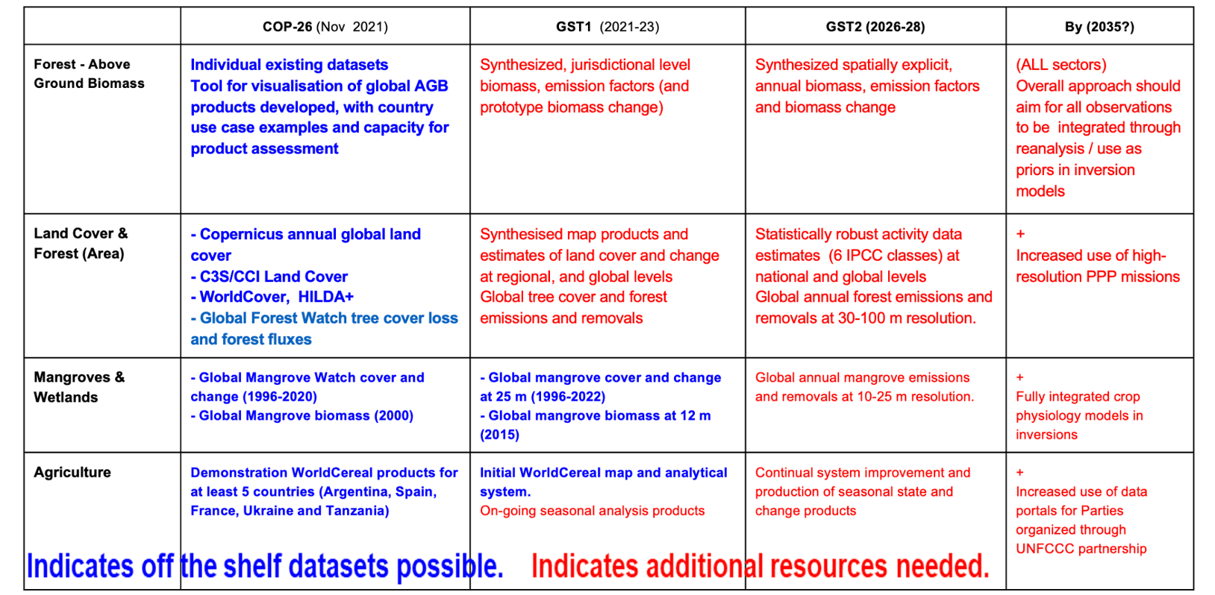
Progress update

Slide 16
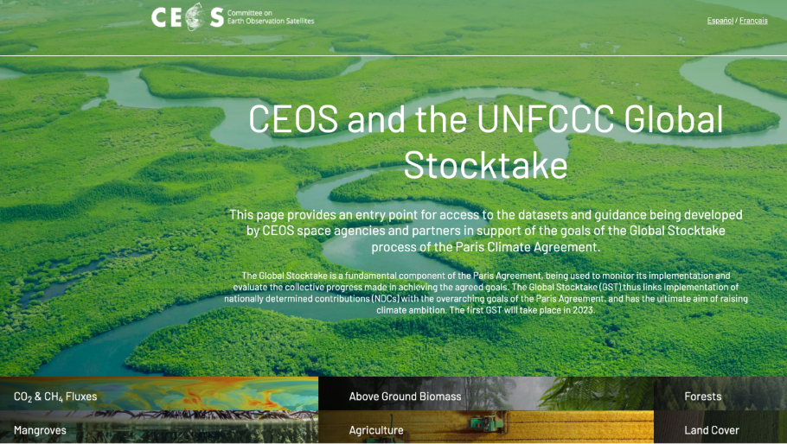
GST Portal
To promote communication of space-based GST inputs
Components/Products:
  CO2 & CH4 Fluxes
  Above Ground Biomass
  Forests
  Mangroves
  Agriculture
  Land Cover
Site link: ceos.org/gst
Slide ‹#›

Slide 17
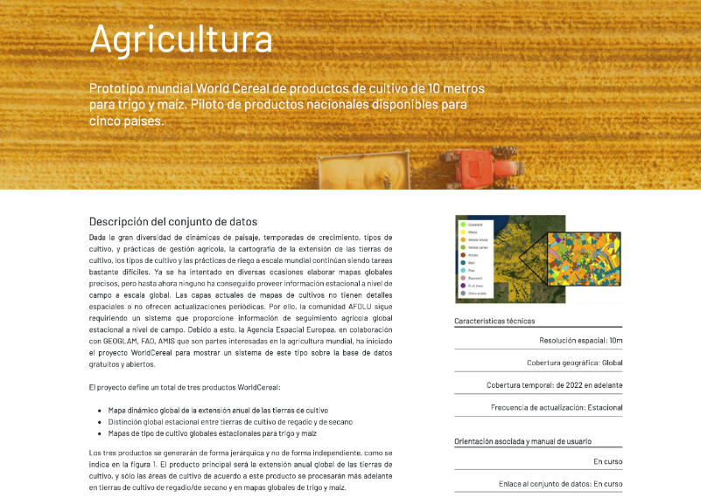
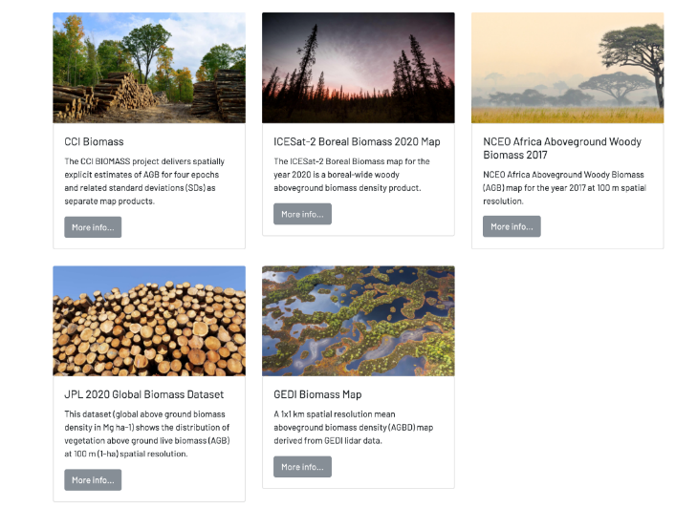

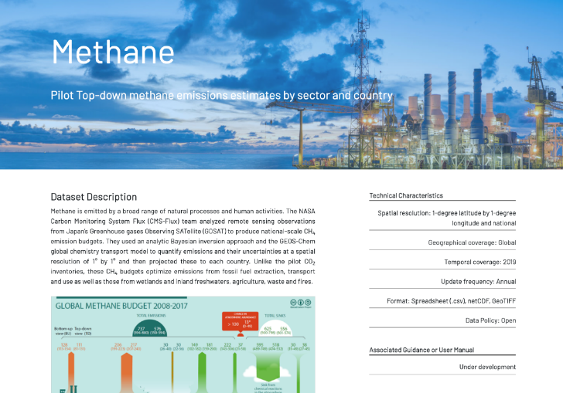
Dataset Descriptions
Dataset description
Pointers on usage
Methodology
Uncertainty & Accuracy
Sustainment
Associated Guidance
User Manual
Point of Contact for help
All in English, French and Spanish
Slide ‹#›

Slide 18
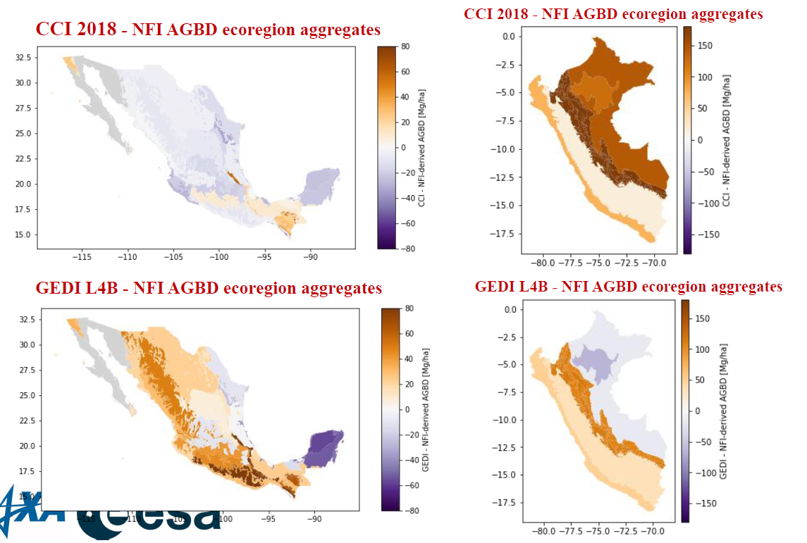

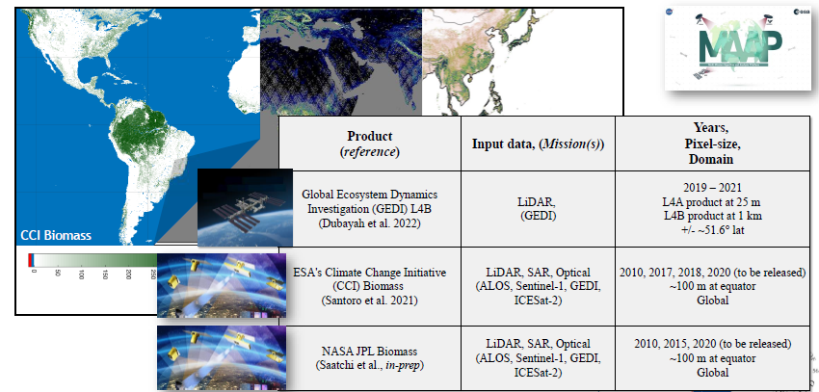
Progress update: biomass

Slide 19
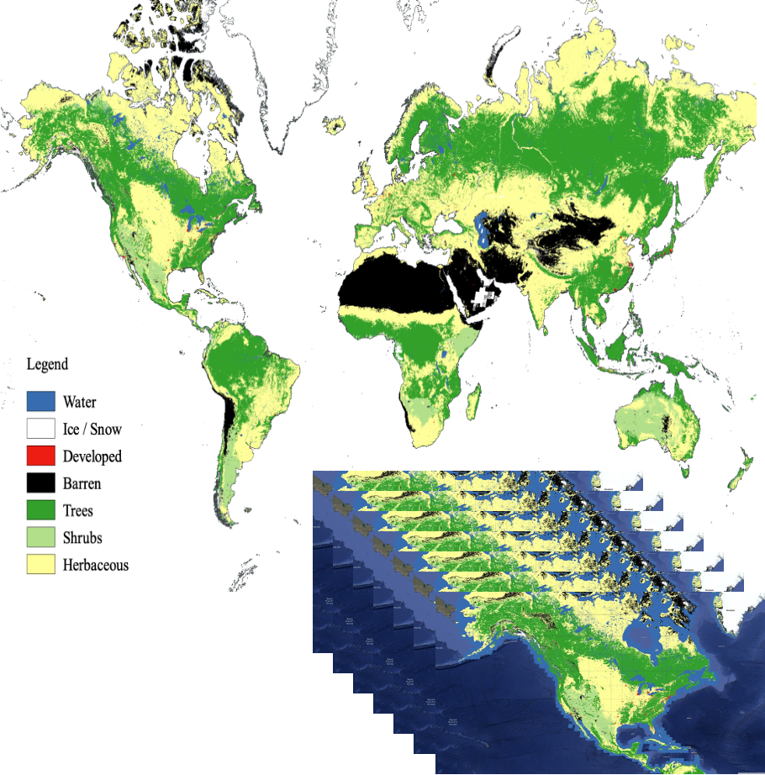
Progress update: land cover
Identifying forest, land cover and wetland cover and change essential for national GHG inventories as ‘activity’ data inputs for global AFOLU modeling and assessments
Copernicus Land Cover
NASA Global Land Cover Estimation (GLANCE)
ESA CCI and EC C3S
WorldCover 2020 and just released 2021
Hilda+
Dynamic World
Global Forest Watch forest gain/loss
Support national GHG inventories for activity data estimation by show-casing experiences of countries using satellite derived activity data
Improved global land change data for AFOLU and modeling for harmonized global land cover change data and novel next generation global land cover/change products with higher spatial, thematic and temporal delta
Enhance consistency and comparability of national GHG inventories and global GHG estimates

Slide 20
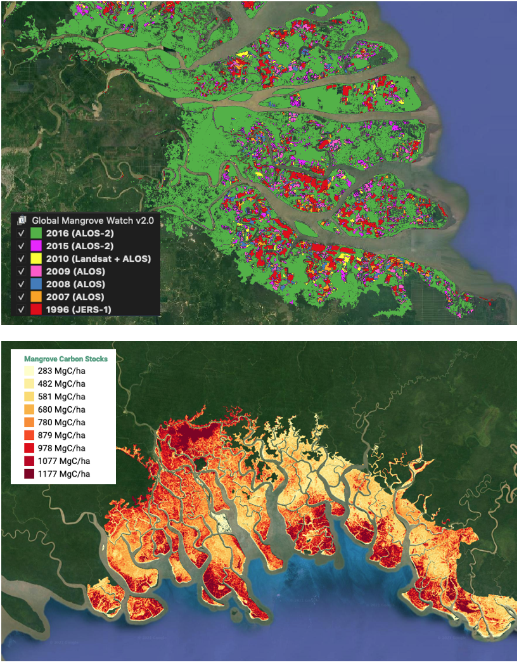
Progress update: Mangroves
Activity Data (AD) – Global Mangrove Watch (JAXA K&C)
Global maps of mangrove area and annual changes at 25 m derived from L-band SAR and optical data.
GMW v4 (release mid-2023)
– 10 m extent 2020 baseline extent
– Extended time-series 1992–2022
Official UNEP mangrove dataset for reporting on SDG 6.6.1
Open access in public domain (GMW.org, JAXA EORC, UNEP-WCMC)
Emission Factors (EF) – LCLUC Global Mangrove Mapping (NASA JPL/GSFC)
Global maps of mangrove Height, AGB and Total Biomass at 30 m.
Baseline year 2000 derived from SRTM DEM.
New 2015 baseline at 12 m from TanDEM-X DEM under development
Open access in public domain
(Bunting et al. 2022)
(Simard et al. 2018)

Slide 21
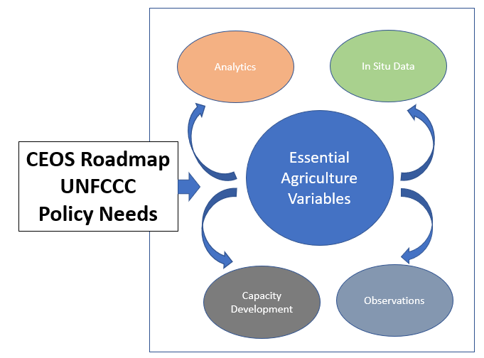
Progress update: Agriculture
Building on the WorldCereal efforts GEOGLAM has identified the Essential Agricultural Variables required to support AFOLU
  A gaps assessment is being conducted to better understand the requirements to meet long term needs for UNFCCC reporting (GST and NDC’s)
  Gaps pilotted for CROP TYPE EAV in parallel with Roadmap development
  The gaps assessment will address:
    Technical Needs:
      Observation Requirements
      Product Specifications
      Research Gaps, i.e.:
        Change monitoring
        Harmonization with other land sectors
    Institutional:
      Operational Analytics/Tools
      Long Term Service Requirements
      Capacity Development

Slide 22
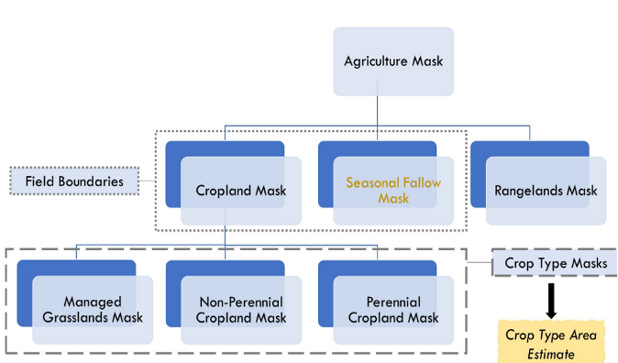
Example Progress update: Agriculture
GEOGLAM articulated cross-cutting Essential Agriculture Variables for multiple policy drivers
  Internal concept discussions around the CEOS Roadmap to the GST identified EAVs that overlap:
    Management
      Irrigation
      Cover Crop
      Tillage intensity
    Biomass and carbon
      Perennial Crop Biomass
      Temporary Crop Biomass
      Grasland/Rangeland Biomass
      Cover Crop Biomass
      Soil organic carbon
      (via ML or process-based model)
    LCLU+C →

Slide 23
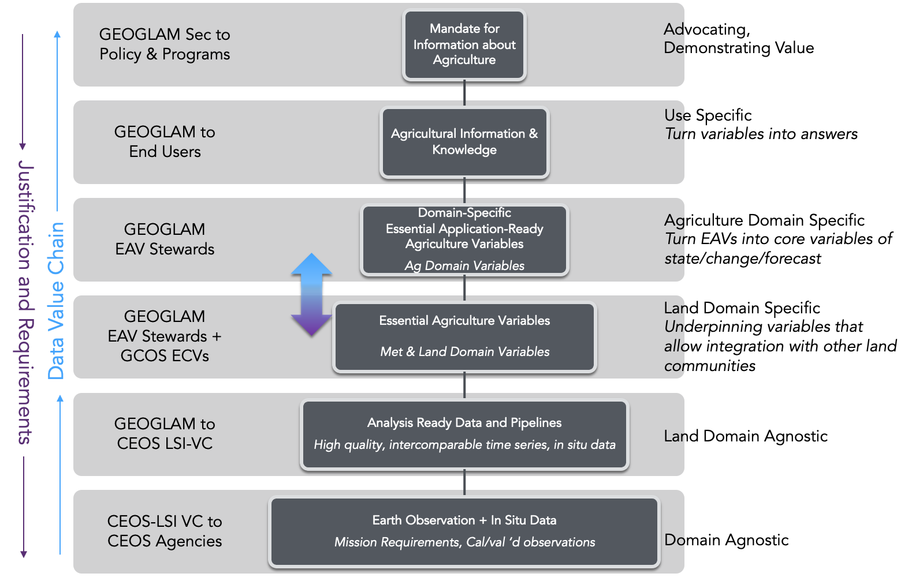
Progress update: Agriculture
A potential EAV that has been identified as cutting across our core priorities and AFOLU = CROP TYPE MASK
We will use the “Gap Analysis Framework” that focuses on identifying - per user case - the path (and the things blocking the path) to operational use of EO
We are using the CEOS AFOLU GST need for land cover as the user need for GLOBAL, HARMONIZED, TRANS-SCALAR CROP TYPE (“A”)
The Gap Analysis will elucidate
  Technical Needs:
    Observation Requirements
    Product Specifications
    Research Gaps
  Institutional:
    Operational Analytics/Tools
    Long Term Service Requirements
    Capacity Development

Slide 24
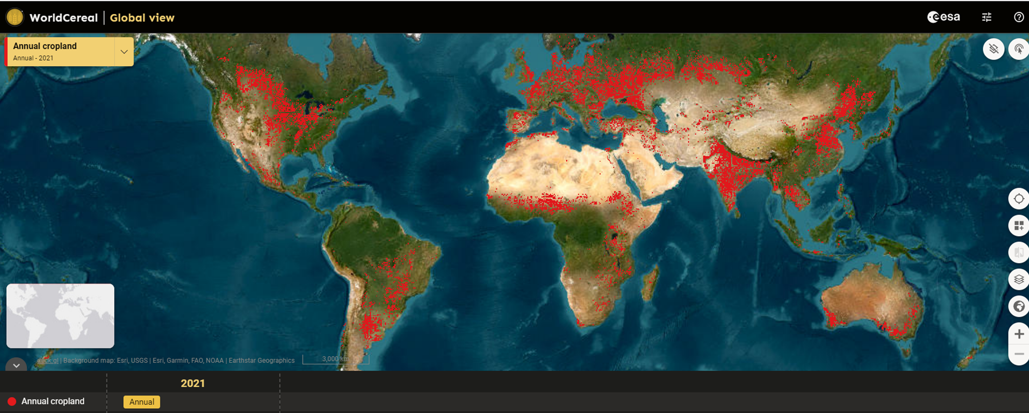
Progress update: Agriculture
Within GEOGLAM, a coordinated global effort, encompassing major producers and food insecure Least Developed Countries (LDCs)
● Existing agricultural products are not suitable for assessments under the Global Stocktake, or NDC’s in LDCs
● Open science is transforming the monitoring landscape and enabling new solutions. The WorldCereal initiative capitalizes on this
ESA WorldCereal project - A Major Step Forward
● WorldCereal, funded by ESA, has been a consortium effort led by VITO and
supported by the GEOGLAM community
● Most important, it is building a system, not just one-off products
● Produced Global cropland maps at 10 m resolution,
accuracies 80% +, on a seasonal basis (2021), focus on maize and cereals
● Developed a harmonized global in situ reference dataset
for agriculture
● Developed and tested state-of-the-art classification algorithms
WorldCereal, A two year project: A major step forward but just a first step…

Slide 25

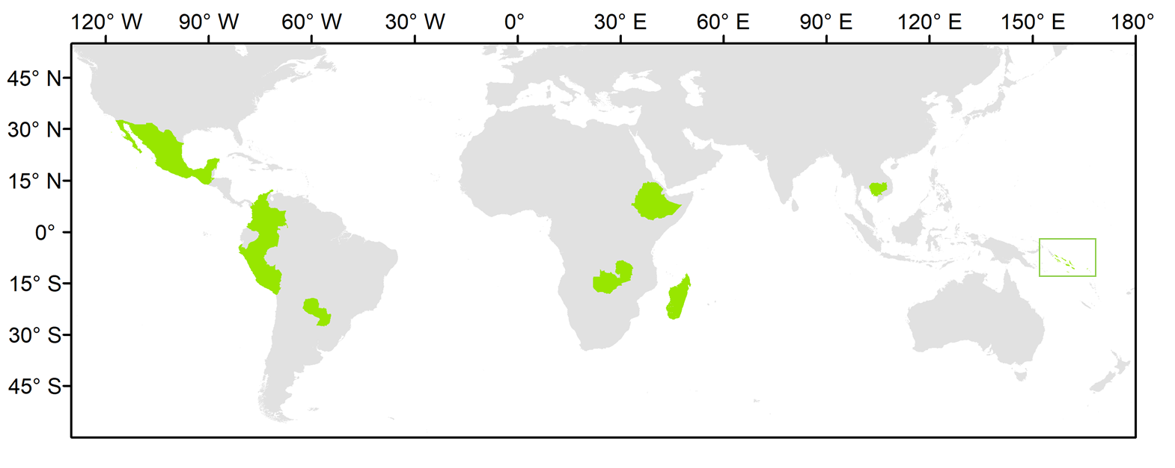
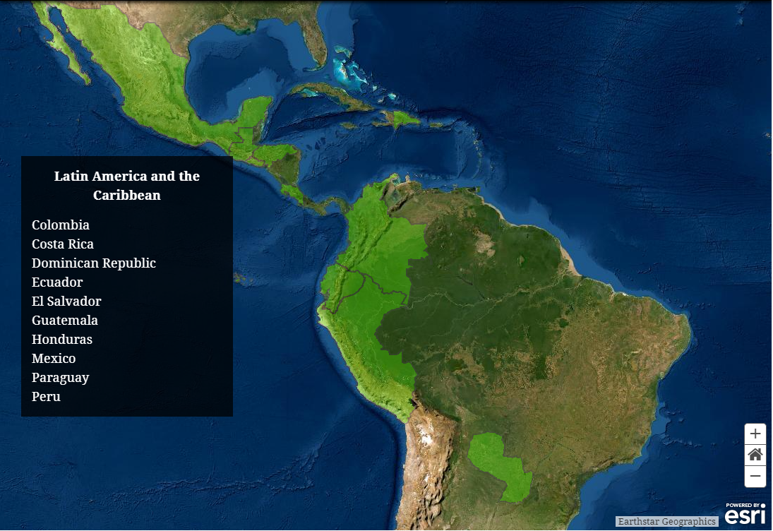
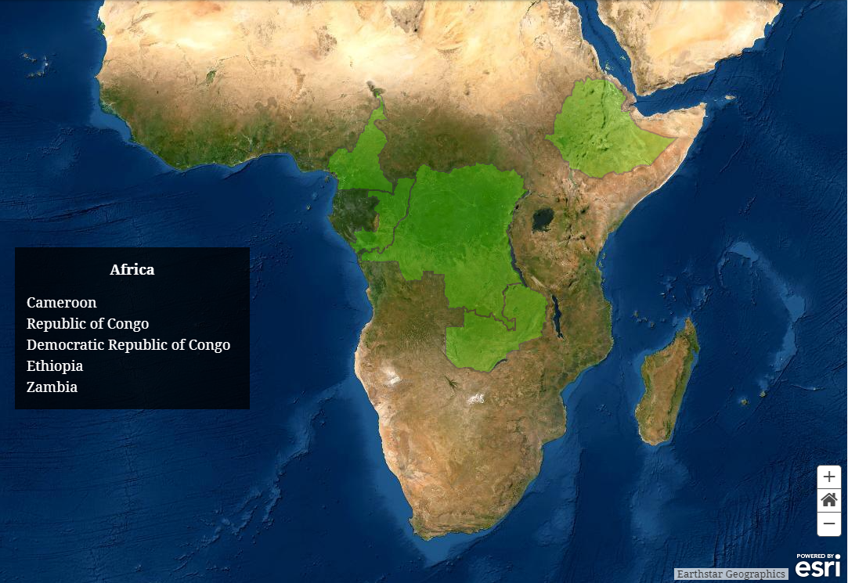
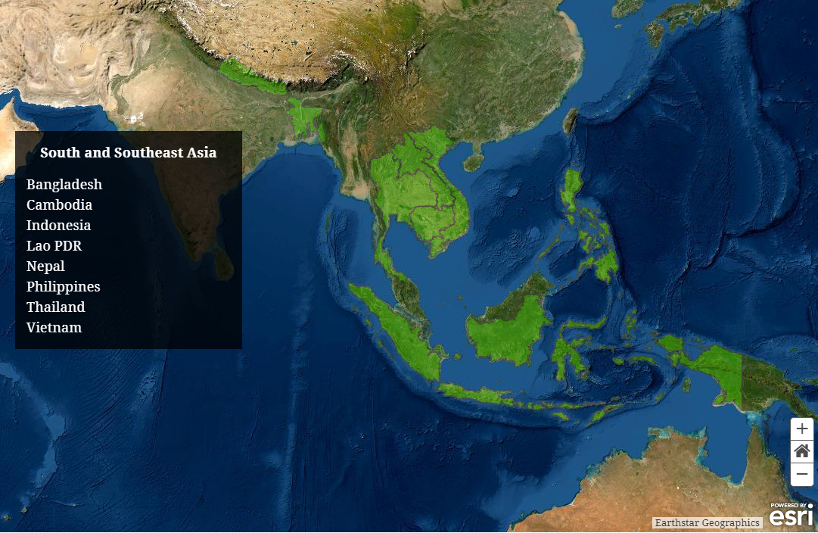
National User Engagement
Demonstration of uptake of satellite-based data and derived products in country reporting to the UNFCCC
 |  |  | indicators of MRV capacity
Country | Region | Status | FREL | BUR REDD+ Annex | BUR | NIR | NFI
Cambodia | Asia | LDC | 2017; 2021 | 2020 | 2020 | 2020 | No
Colombia | Latin American | n.a. | 2015; 2020 | 2016, 2019 | 2015, 2018 | 2019 | Yes
Ethiopia | Africa | n.a. | 2016 | n.a. | n.a. | n.a. | ?
Guatemala | Latin American | n.a. | n.a. | n.a. | n.a. | n.a. | Yes
Madagascar | Africa | LDC | 2017; 2018 | n.a. | n.a. | n.a. | Yes
Mexico | Latin America | n.a. | 2015; 2020 | n.a. | 2015, 2019 | 2019 | Yes
Paraguay | Latin America | n.a. | 2016 | 2019 | 2015, 2018 | n.a. | Yes
Peru | Latin America | n.a. | 2016; 2021 | n.a. | 2014, 2019 | 2019 | Yes
Solomon Islands | Asia | LDC | 2019 | n.a. | n.a. | n.a. | No
Zambia | Africa | LDC | 2016; 2021 | n.a. | 2020 | n.a. | Yes
validation of the harmonized biomass map (additional NFI data)
Solomon Islands

Slide 26
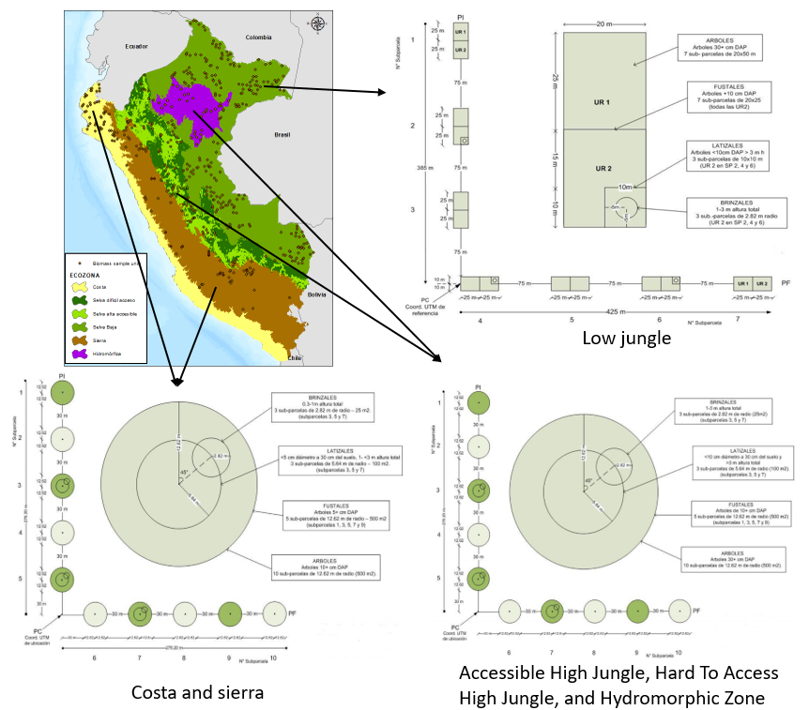
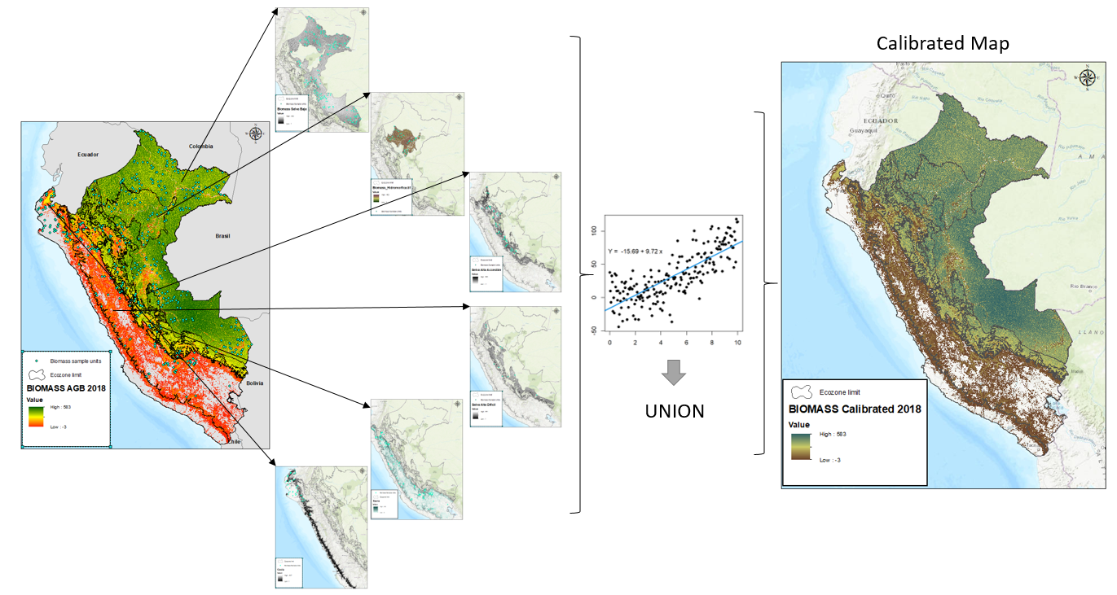
Biomass – Calibration of Global CCI Biomass Map in Peru
Current work:
1. Peru is using the CCI biomass map (AGB) to update ecozone emission factors in the Peruvian Amazon.
2. calibrating these maps using parcel field data to obtain a spatially explicit biomass map for all ecozones in Peru.
The carbon stored in the forests of Peru is measured from NFI Data by ecozones:
Coast,
Highlands
Accessible High Forest
High Forest of Difficult Access
Low Forest

Slide 27
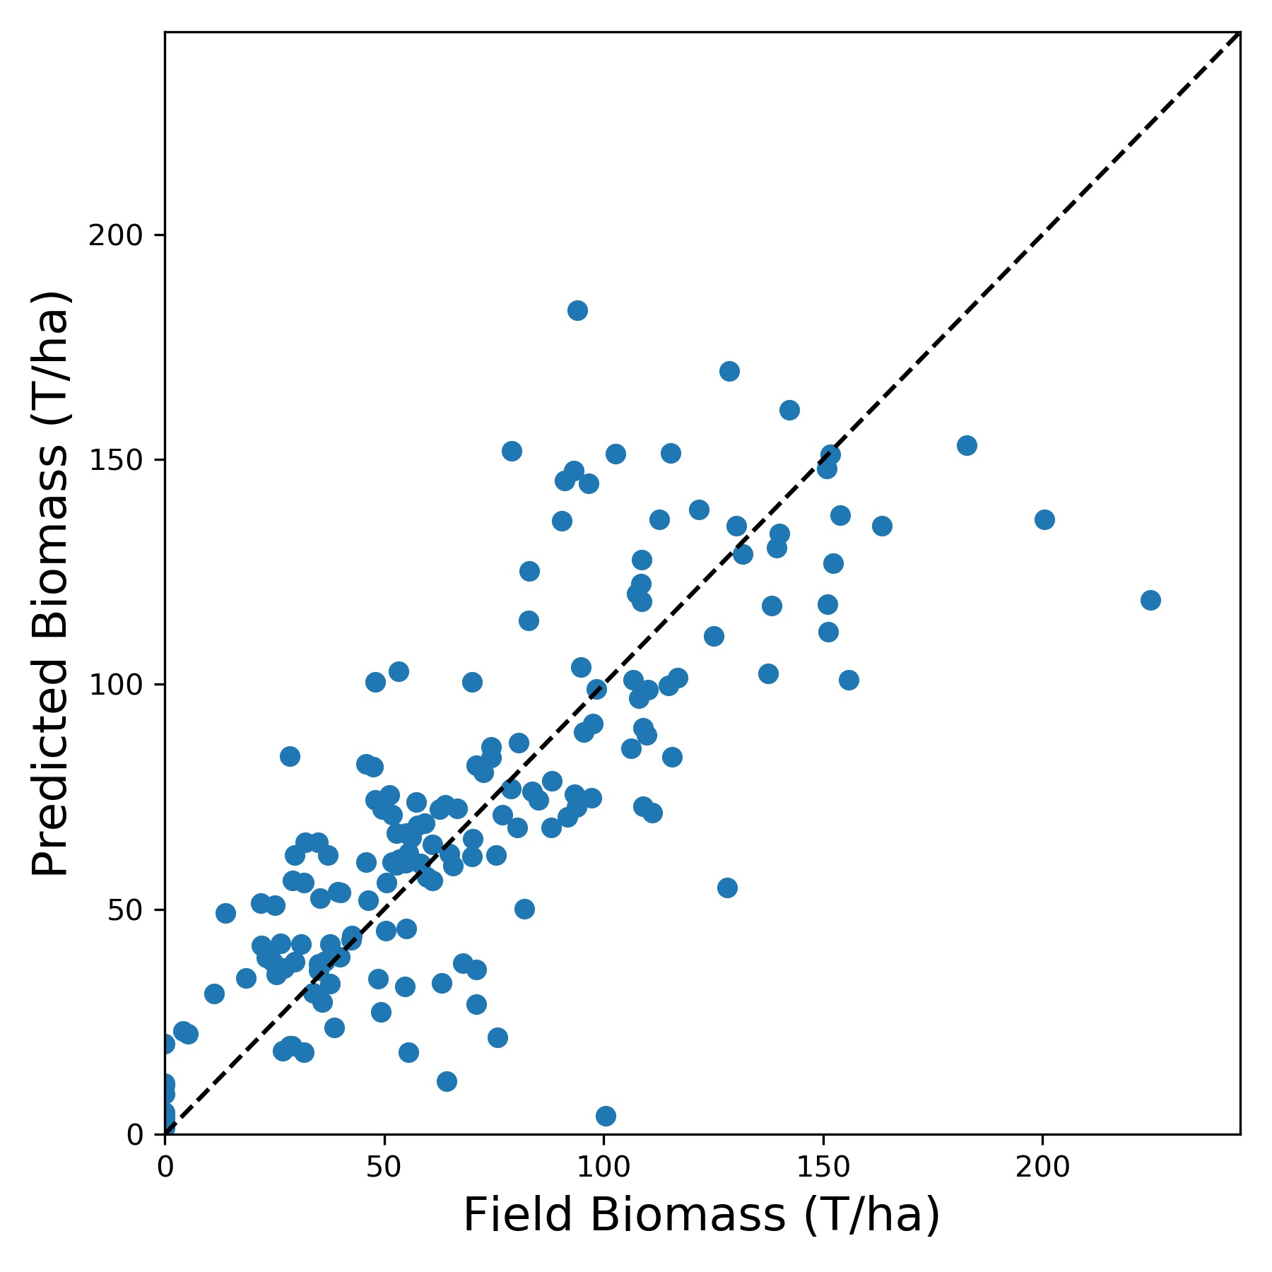
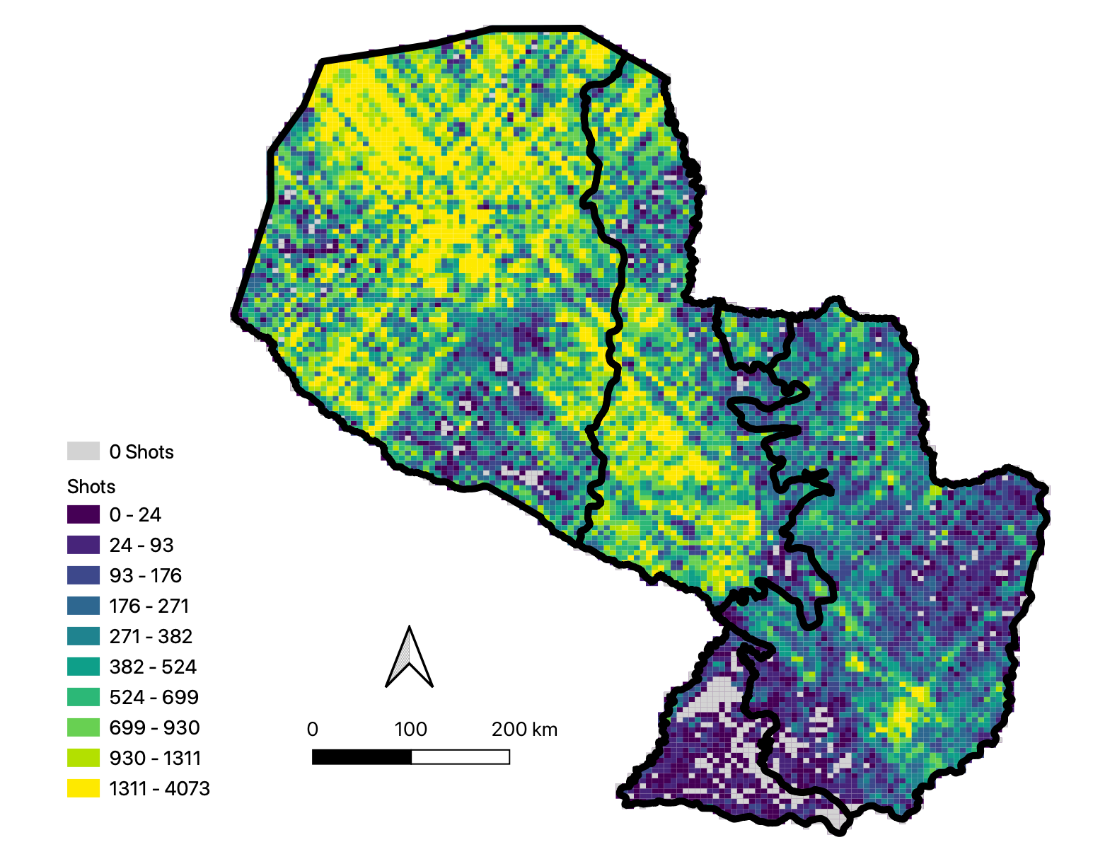
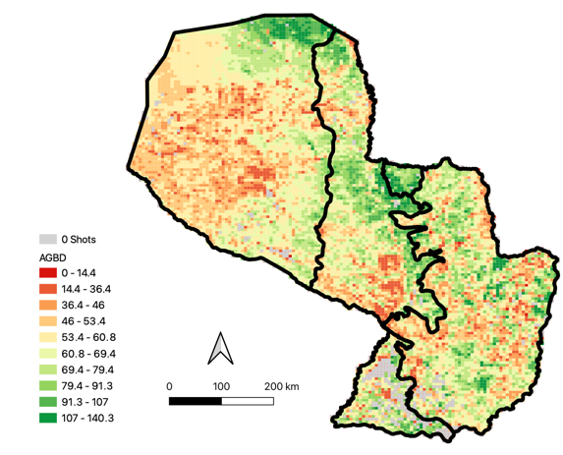
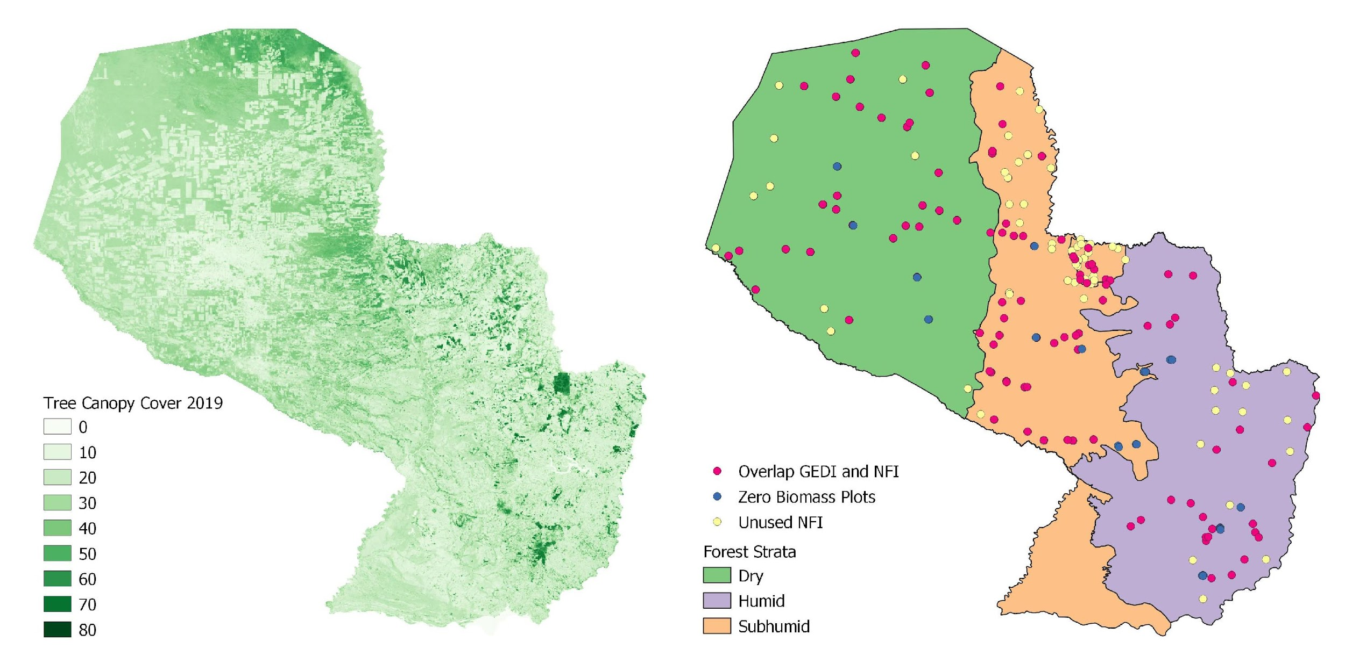
Model Overview
Paraguay GEDI inclusion on
Emission Factors
Two primary outputs:
  Map of biomass at 6 km pixel resolution
  Statistical estimate of mean biomass and margin of error
Updates biomass estimates from inventory to 2020
Estimate can be made at national, regional, local, or forest scale
Applicable in remote and inaccessible forests and in countries without a well-established forest inventory
Statistical estimation of mean biomass and margin of error
Remote sensing datasets calibrated with forest inventory data
Inputs: Field measurements of biomass, GEDI data, canopy cover, and forest strata
Predicted Versus Observed Biomass
GEDI
Tree Canopy Cover
Forest Strata and Field Plots
Notes:
We are piloting a methodology in Paraguay that integrates remote sensing and forest inventory data into a model to estimate aboveground forest biomass.
The model uses LiDAR measurements from the GEDI mission, a Landsat tree canopy cover dataset, and forest type information to predict biomass at our field plots. These datasets are spatially explicit and therefore cover the entirety of Paraguay’s vast and often inaccessible forests.

Slide 28
Moving Ahead….
Request of NFI or ground based data for calibration and validation of pantropical and global biomass datasets (ABG) – 27 countries
Include case studies of Biomass in NASA Biomass Dashboard
Validation of other CEOS datasets (World Cover, Hilda+ and Copernicus)
Engagement with other partners (GFOI and FAO)

Slide 29
Emerging Grand Vision for Roadmap
Affirmed that an AFOLU Roadmap is a generational challenge that CEOS and public EO programmes must rise to!
Provide a framework for long-term (~ 15+ years) coordination of CEOS agency observing programmes in support of the needs of society for AFOLU-related information, with a focus on (but not limited to) the needs and ambition cycle of the Global Stocktake of the Paris Agreement.
A guiding vision for long term space agency coordination around AFOLU. Characterises the needs, the services and applications required, the products and observing systems that can support. Explain the need to plan for ground segment, space segment and services.
Confirmed horizon of 2035 and interim milestones of GST1, GST2 and GST3.
Seeking to re-engage the key agencies and individuals using increased intensity process and individual assignments - ideally under a lead author.

Slide 30
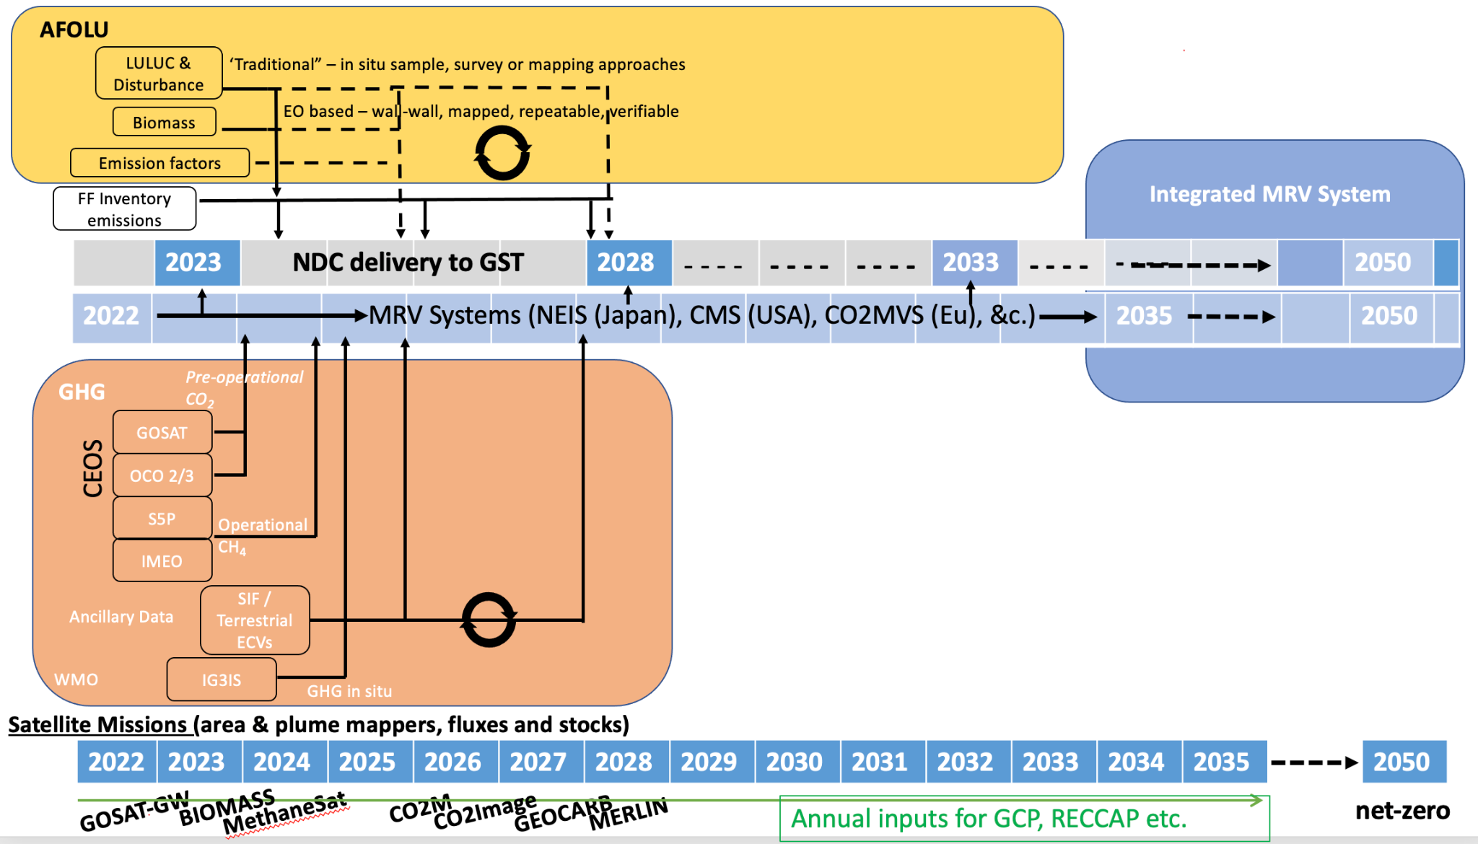
Emerging Grand Vision
Integration of existing and planned satellite missions
Synergies with ground-based and space-based networks
Informing UNFCCC/IPCC reporting guidelines
Inclusion on climate-carbon feedbacks

Slide 31
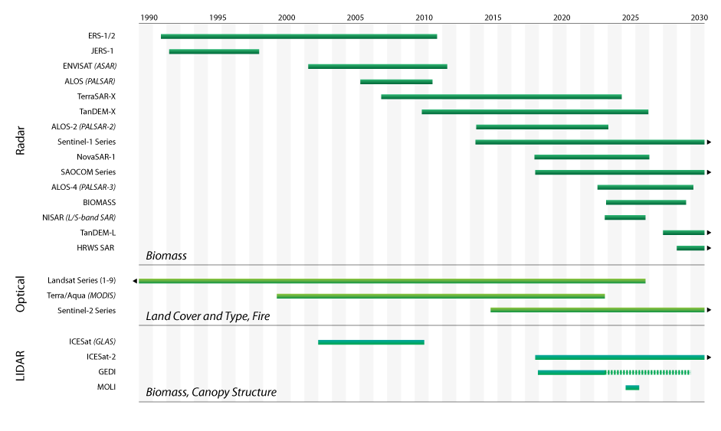
Define EO missions beyond 2035
2035
Observing
System

Slide 32
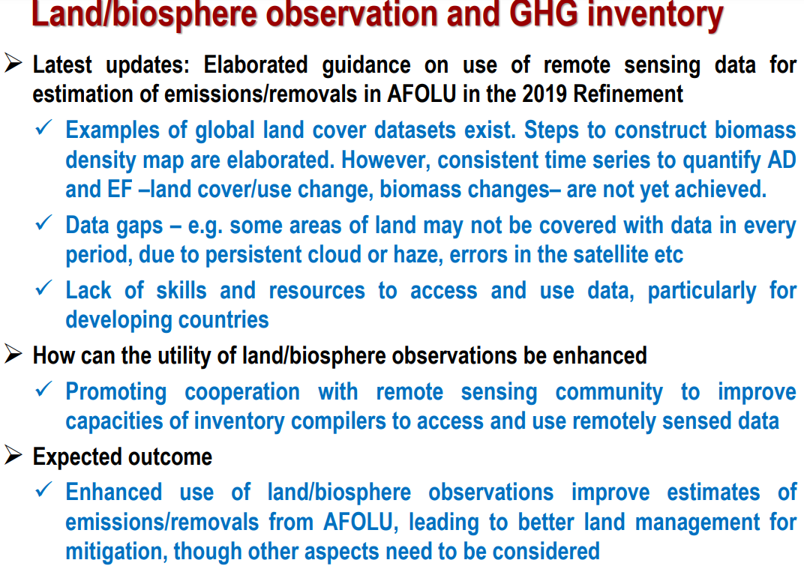
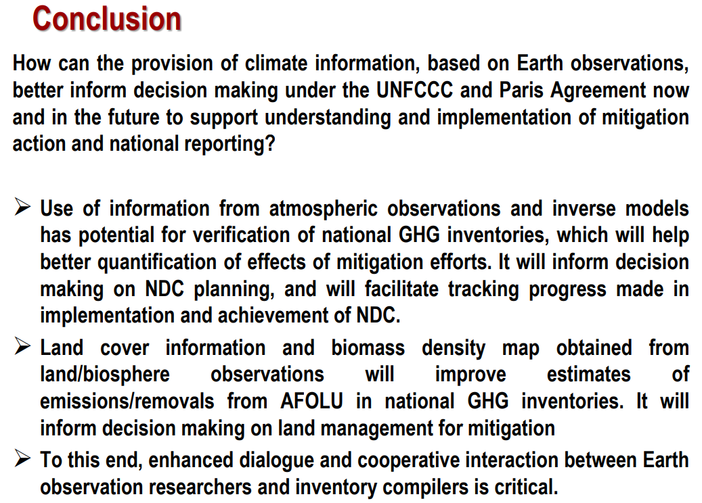
COP-27 Summary of AFOLU engagement
Earth Information Day (Nov 9, 2022)
    AFOLU roadmap reported in the CEOS/CGMS WGClimate Poster
    IPCC TFI Eduardo Calvo Buendia presented and well noted as below

Slide 33
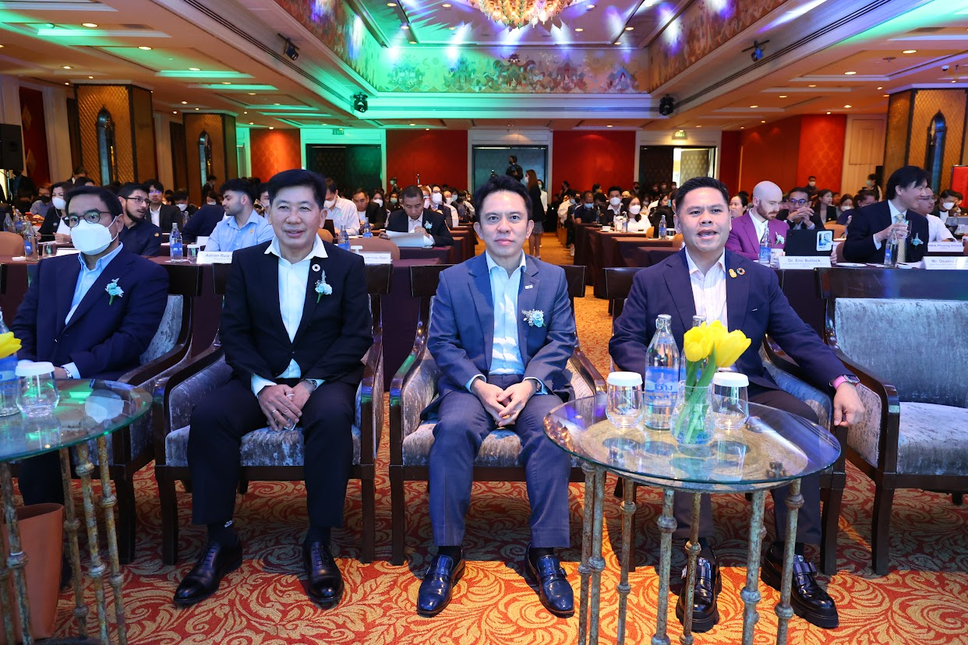

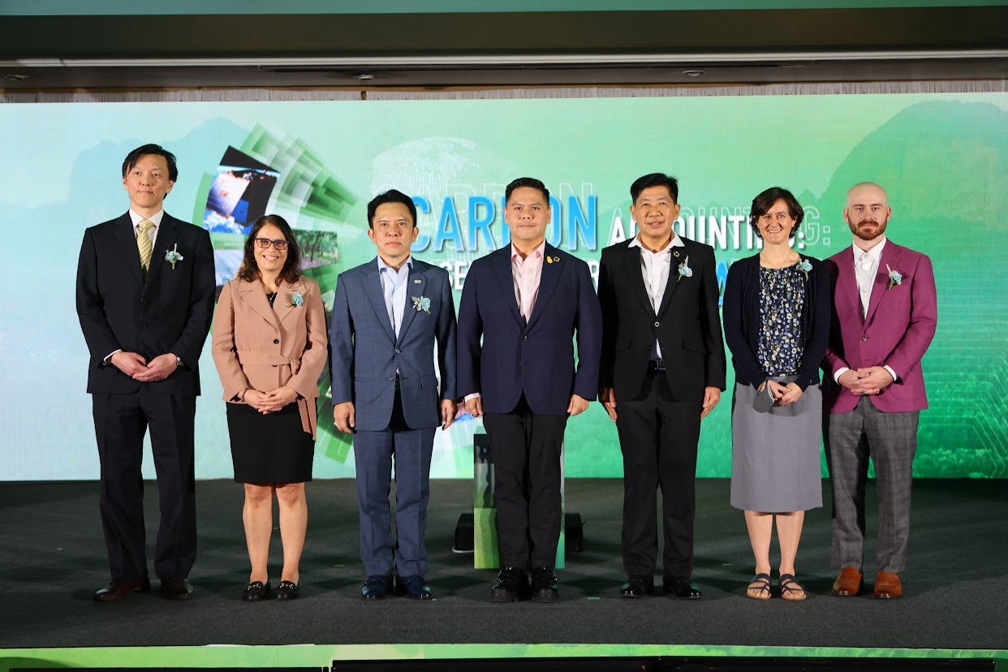
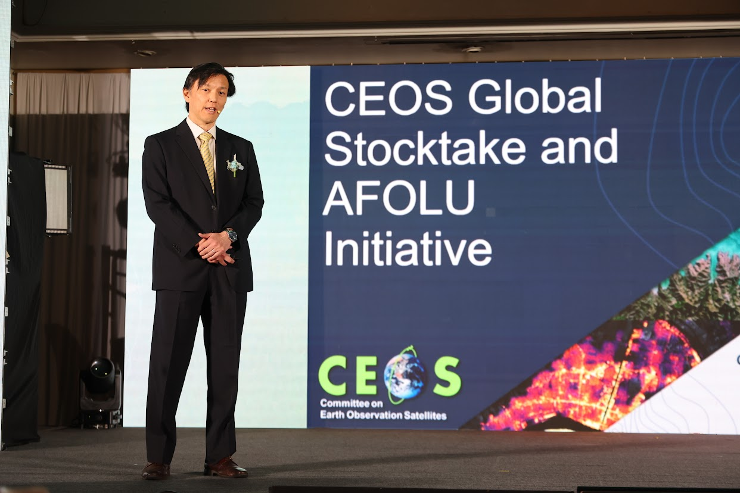
GISTDA-SilvaCarbon Workshop Day 1
GISTDA - SilvaCarbon CEOS Workshop on Uptaking Global AFOLU Datasets (2023 CEOS Chair Priority)
Day1@Bangkok

Slide 34
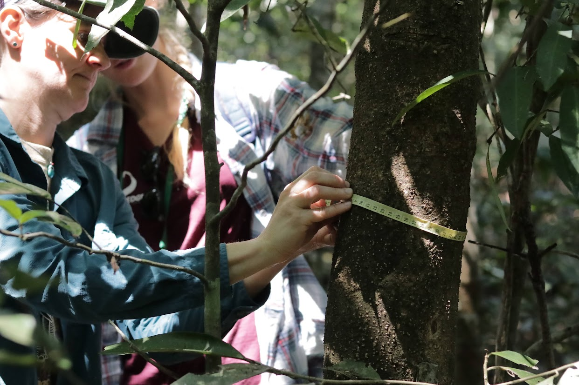
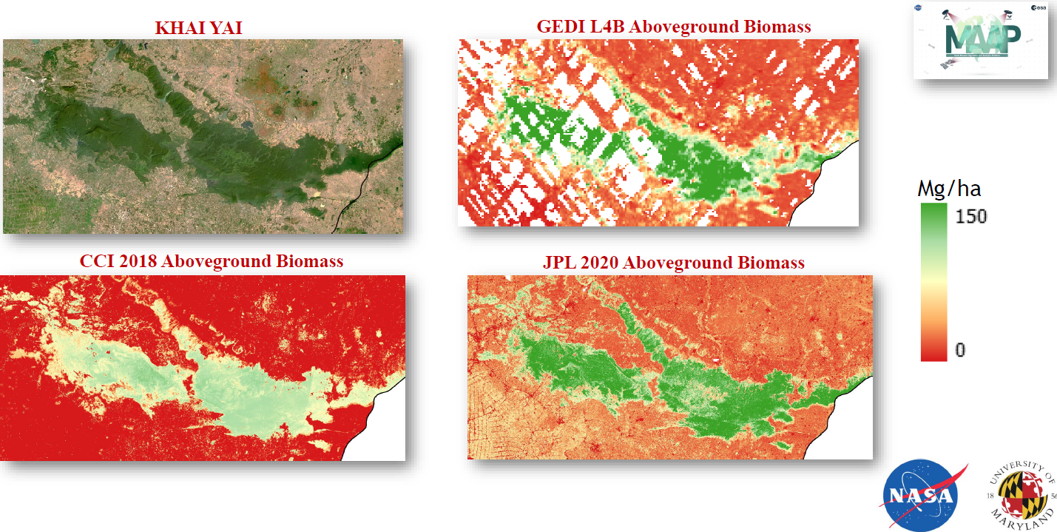

GISTDA-SilvaCarbon Workshop Day 2-4
Biomass estimation – WS and Field Work

Slide 35
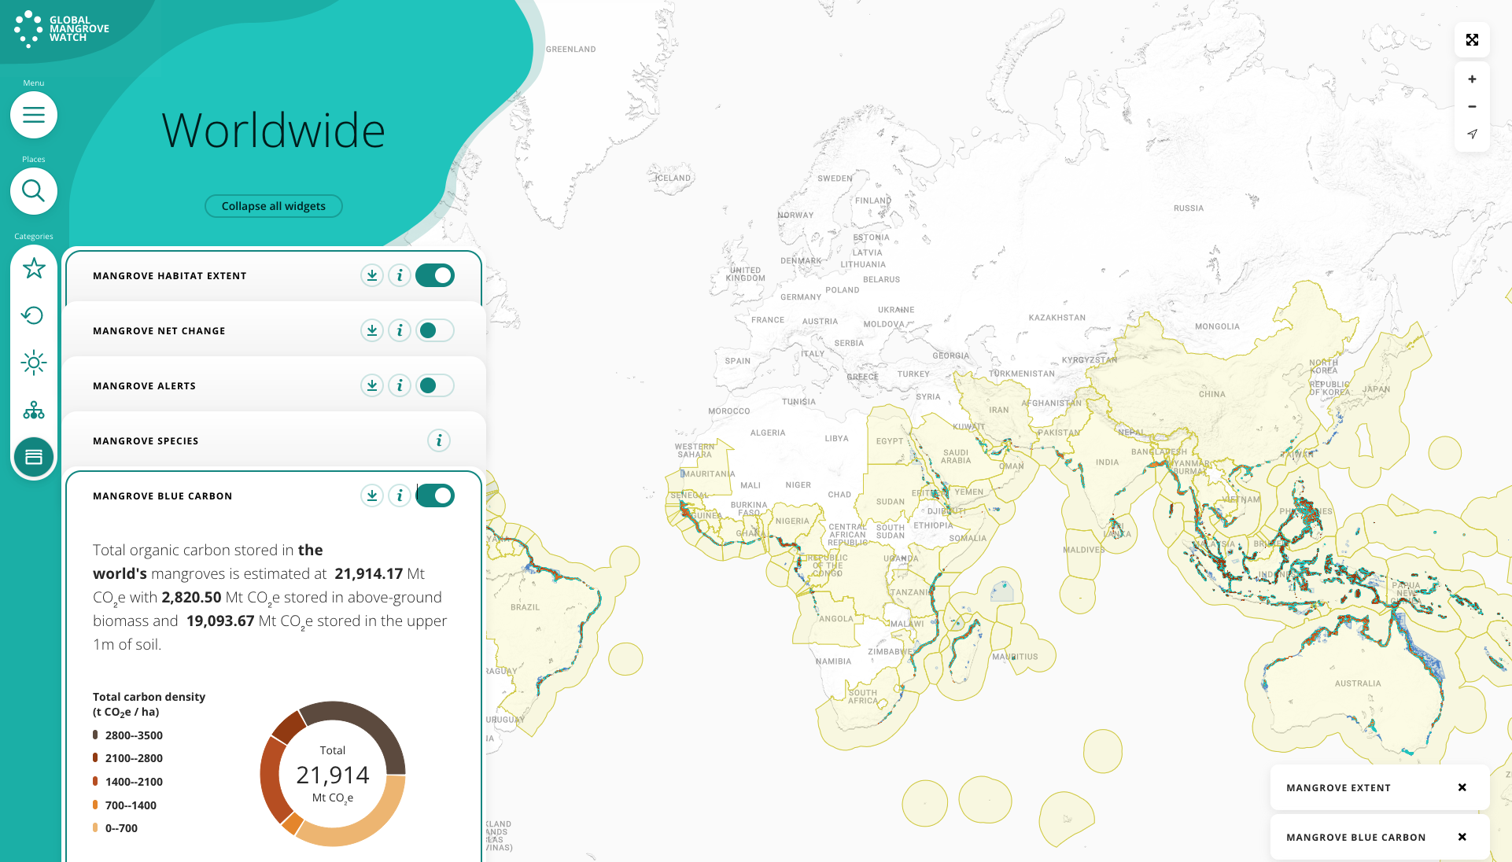
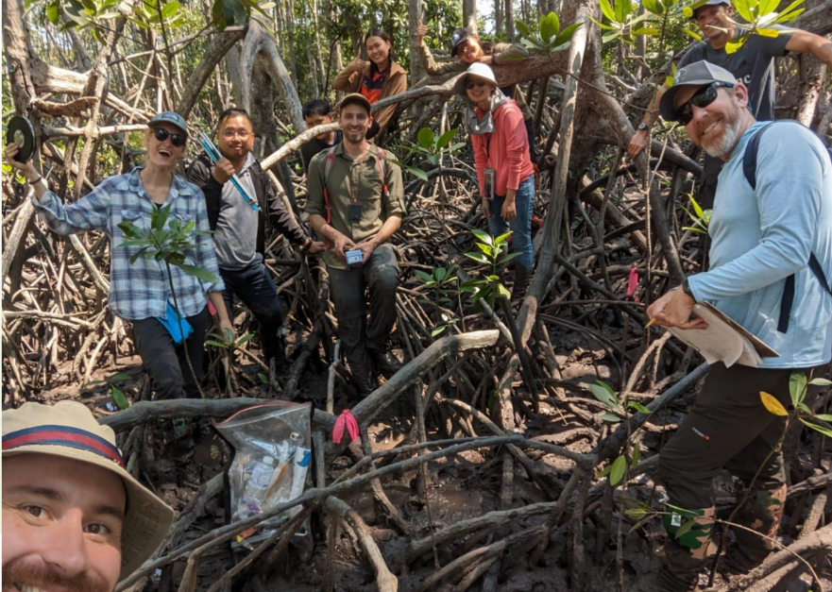
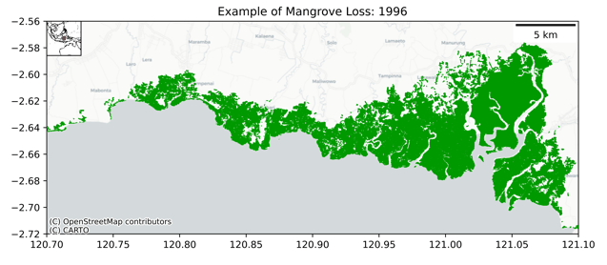
GISTDA-SilvaCarbon Workshop Day 5-7
Mangroves – WS and Field Work
globalmangrovewatch.org
Global Mangrove Watch
(Bunting et al. 2022)

Slide 36
Recommendations - bottom up so far
Recommendations (in development, and comments welcome)
Demonstrate and engage with IPCC Taskforce on Inventories on application of disaggregated geospatial data to provide activity and emission factor estimates
  On-going synthesis products development of 4 thematic products (AGB, LULC, Wetlands, Agriculture)
  Use of the Global Mangrove Watch (GMW) and other thematic datasets
  Continue international inventory training partnerships led by SilvaCarbon
  Support the CEOS GST Strategy for AFOLU field campaign
Consider the opportunities provided by the FAO LCCS taxonomy for consistent information from Earth observation data as input to IPCC reporting on land cover (translating to land use) and land cover change.
Explore opportunities for remote sensing applications to inventorying of non-forest systems, i.e., settlements, and also ‘trees outside forests’, using commercial-public partnerships

Slide 37
Recommendations - bottom up so far
Recommendations (in development, and comments welcome)
Expand the role of remote sensing to provide activity and emission factor data for nitrous oxide emissions (N2O)
Develop and mature a workflow for AFOLU integration within Monitoring, Reporting and Verification frameworks, e.g., WMO Greenhouse Gas Monitoring Infrastructure
Maintain synergies between CEOS AC-VC and LSI-VC via the GHG and AFOLU Roadmap actions
Support AFOLU-related ECVs with WGClimate
Inform the program of record for space-based missions that can inform AFOLU activity data and emission factor retrievals

Slide 38
Next steps & schedule
Thematic teams are already doing important relevant work (eg GEOGLAM for Ag) that we must harness for efficiency
Timing of Roadmap delivery by June 2023 to meet 2023 (GST1)
Primarily an internal document but also communicates our intent for public EO to serve society and these policy processes

Slide 39
LSI-VC role
Implementation of the AFOLU Roadmap recommendations will be THE land surface observations momentum wheel in CEOS for the next decade or more
An effective framework for progressing these actions is vital if EO is to realise its role and if public EO programmes, coordinated by CEOS, are to be credible and relevant
From experience this needs motivated champions in CEOS who are energised to pursue progress meeting to meeting and hustle individuals and agencies to deliver
The main agencies are represented in LSI-VC but not necessarily yet for this reason
LSI-VC is the logical home for this topic and it is a classic role for a CEOS VC
Can we reflect on the membership and agenda implications for LSI-VC to be confirmed as the vehicle for implementation of the CEOS AFOLU Roadmap
  Significant implications
  But impossible to refuse?

Slide 40
LSI-VC role
Confirming that LSI-VC is the home for this activity
Considering membership and champions needed for it to thrive
  May be different people on top of current LSI focus

Slide 41
Thanks..
Thanks to the many experts across CEOS structure and agencies who are supporting

