Slide 1
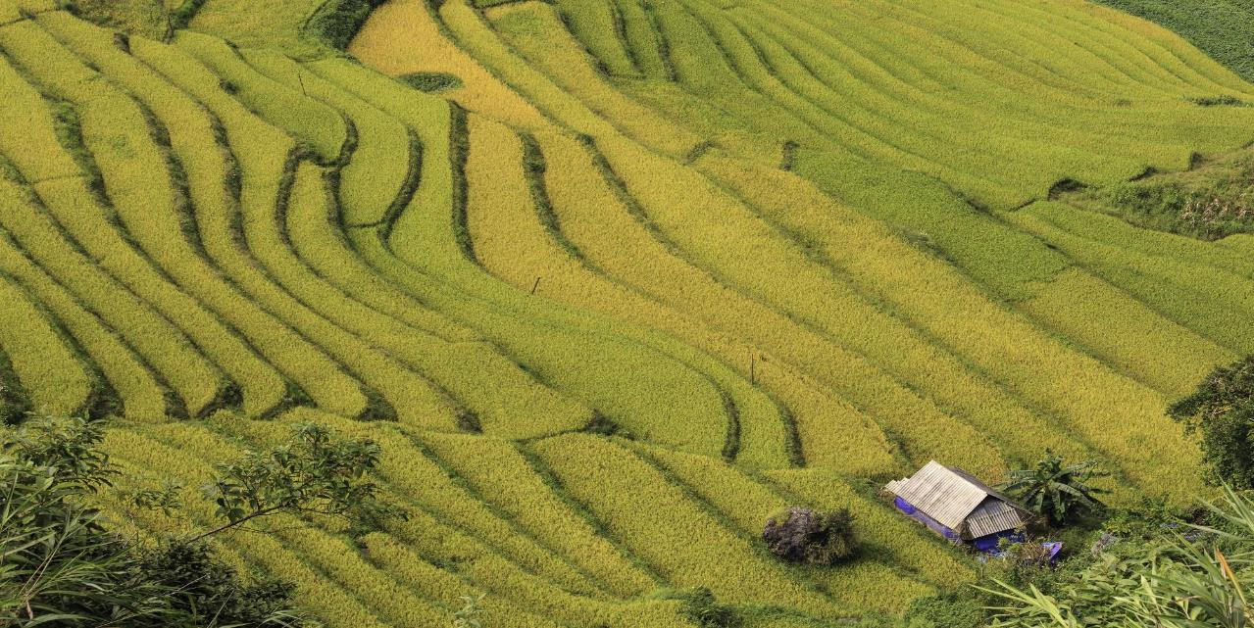
GEOGLAM Secretariat Update to CEOS LSI-VC
LSI-VC 23
Frascati, Italy
Alyssa Whitcraft & Sven Gilliams
On behalf of GEOGLAM Executive Committee

Slide 2
Getting the band back together: GEOGLAM ExCom | 21-23 March 2023
First ExCom since 2019
First ExCom as “main event”… ever?
Notes:
GEOGLAM in situ data WG update
Availability of good global reference and training data for AI/ML.
WGCV LPV connection?
CEOS response to updated GEOGLAM requirements;
AFOLU Roadmap Connection

Slide 3
GEOGLAM Secretariat
With thanks to Ian Jarvis!
Exemplary leadership at Agriculture & Agrifood Canada, JECAM, and for the last 5 years as GEOGLAM Executive Director
Retiring in April 2023
Search recently closed for new Director
High volume of applications
Search committee being assembled
Investigating transition options

Slide 4
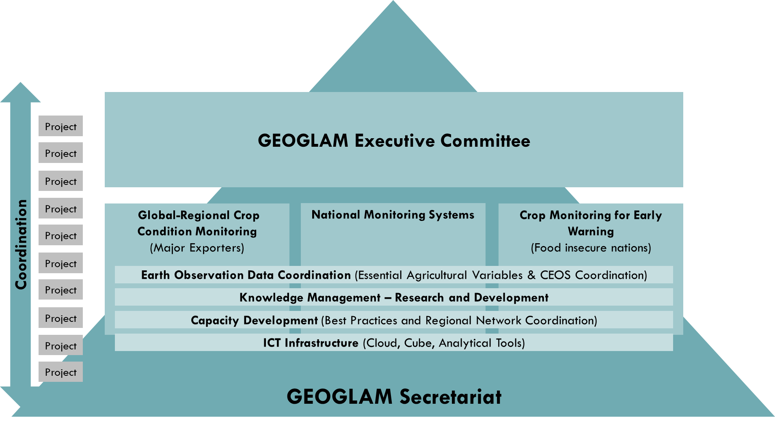
GEOGLAM Support
Aiming to diversify sources of support
GEOGLAM Secretariat supported currently by 4 countries
Canada, Germany, U.K. via cash
U.S. via secondment
GEOGLAM remains ”best-efforts” organization – tons of projects and programs that support the core work of GEOGLAM
Reminder that the co-leads of this group liaise with CEOS, usually via LSI-VC

Slide 5
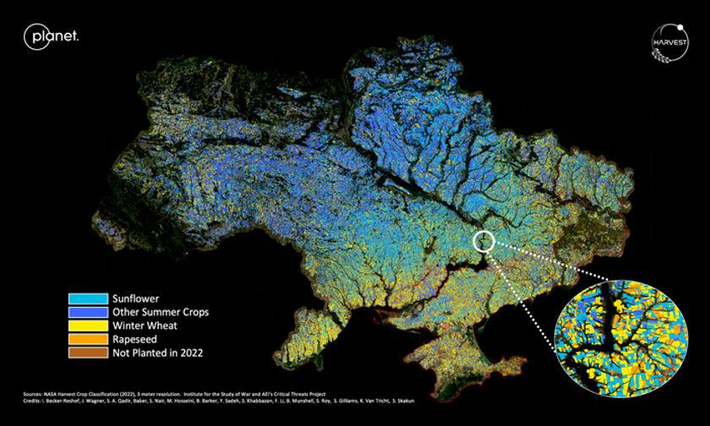
Some Priorities for GEOGLAM
Rapid Response Facility
NASA Harvest Rapid Agriculture Assessment for Policy Support (RAAPS) as model – seeking broader GEOGLAM engagement
Enable availability of private sector data for public science & societal benefit
Broaden the Community of Practice with steady engagement
Regional workshops, meeting where people are
Side meetings at common regional conferences
Better utilization of community knowledge products (e.g. ”GEOGLAM Guidelines for Good Practices in Capacity Development” – published April 2023!)

Slide 6
CEOS-Relevant Priorities for GEOGLAM
Harmonized global products
EAVs as guiding light
Launch new initiative on Community Agriculture Product Quality
Validation guidelines
Beginning with Joint Workshop (more later)
Strengthen relationship with CEOS + agencies, preparation for new missions and policy drivers
Moving from mission-focused science teams to domain-focused science teams
Domain-focus can be driven by GEOGLAM EAVs
WGCV LPV, WGISS overlaps
Notes:
Steve Covington’s comment about where processing takes place --> if you have to combine multiple streams of data, where does that actually take place in a paradigm about bringing users to the data?

Slide 7
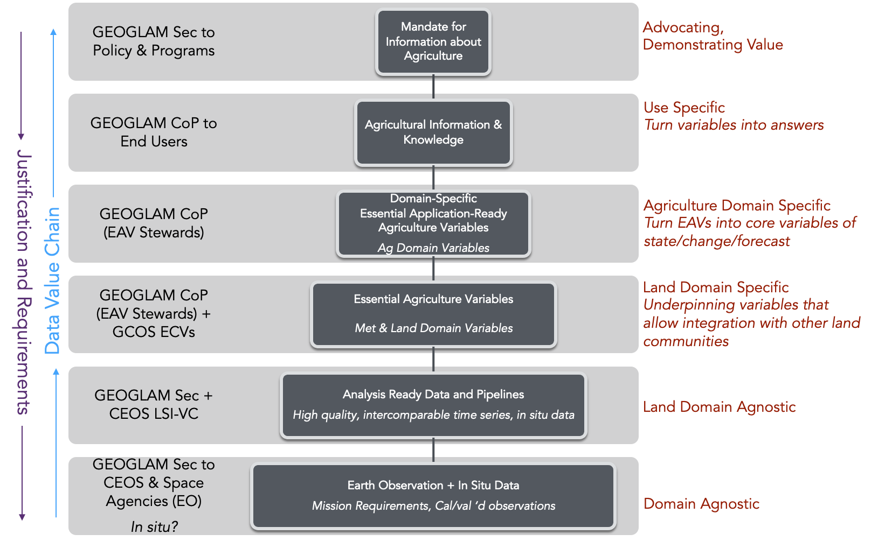
Essential Agricultural Variables for GEOGLAM Co-leads: Whitcraft (UMD/NASA Harvest) & Gilliams (VITO)
Essential: key ‘building blocks’ to produce relevant and timely information products
Agriculture: related to agricultural productivity and land use
Variables: they can be measured or inferred, and change over space and time
For GEOGLAM:
Using satellite Earth observations
Driven by our policy mandates
As a community!

Slide 8
Data Value Chain in GEOGLAM
GEOGLAM Sec to Policy & Programs
Mandate for Information about Agriculture
Advocating, Demonstrating Value
GEOGLAM CoP to End Users
Agricultural Information & Knowledge
Use Specific
Turn variables into answers
GEOGLAM CoP (EAV Stewards)
Domain-Specific Essential Application-Ready Agriculture Variables
Ag Domain Variables
Agriculture Domain Specific
Turn EAVs into core variables of state/change/forecast
Greater Domain Specificity
Justification and Requirements
Land Domain Specific
Underpinning variables that allow integration with other land communities
GEOGLAM CoP (EAV Stewards) + GCOS ECVs
Essential Agriculture Variables
Met & Land Domain Variables
GEOGLAM Sec + CEOS LSI-VC
Analysis Ready Data and Pipelines
High quality, intercomparable time series, in situ data
Land Domain Agnostic
GEOGLAM Sec to CEOS & Space Agencies (EO)
In situ?
Earth Observation + In Situ Data
Mission Requirements, Cal/val ‘d observations
Domain Agnostic

Slide 9
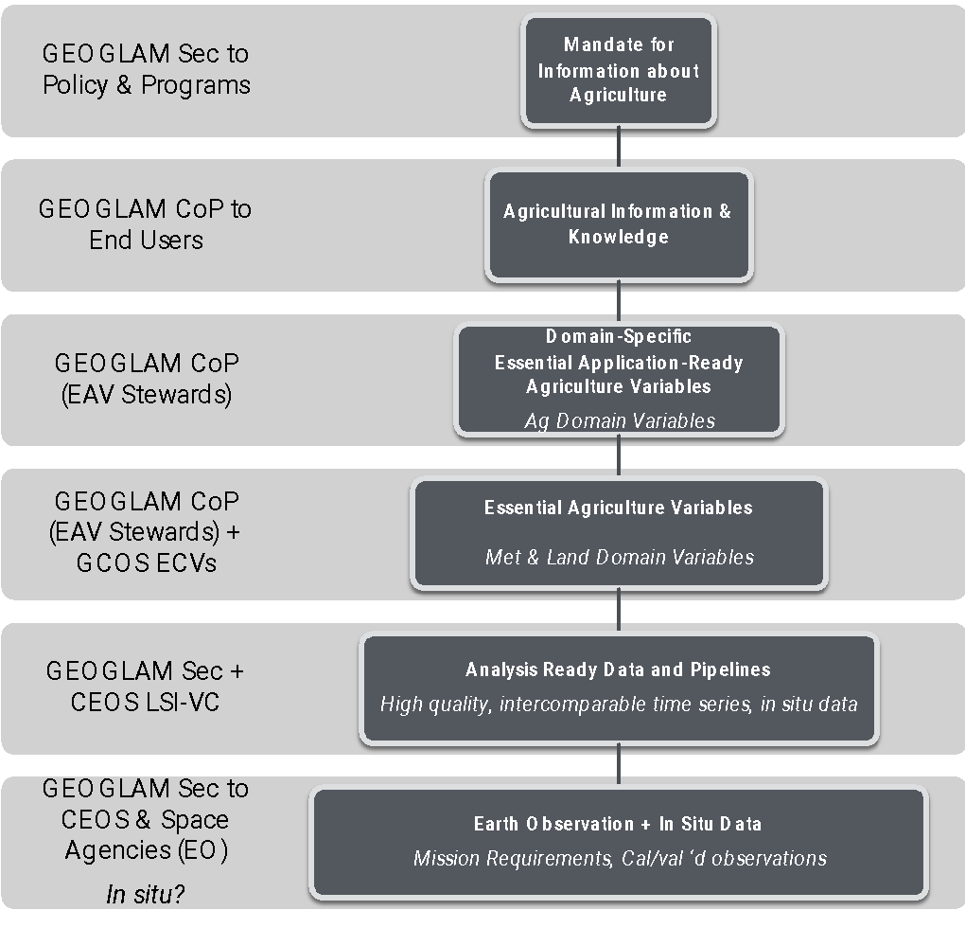
Who is involved in EAV production and availability?
Observations into ARD
Data Collection and Initial Processing
Observations – CEOS agencies (use-agnostic)
Search & Discovery of L0-L1
In situ data – vision from WorldCereal for crop type mapping, who advises on statistical sampling design is unclear; whether we can build a framework that cuts across EAVs is an area of research.
Data processing and L2 – (some) L4 product development
Science teams (creating variables as products)
Past: mission-specific science teams
Source-specific
Future: domain-specific science teams
Source-agnostic
Analytical platforms or toolkits (creating pipelines for variable-to-product)
e.g. domain-agnostic 🡪 SNAP, ODC, Copernicus GlobalLand, CSDE
e.g. domain-specific 🡪 GLAM, Sen2Agri, ASAP, CropWatch
*Domain-agnostic here still means land applications

Slide 10
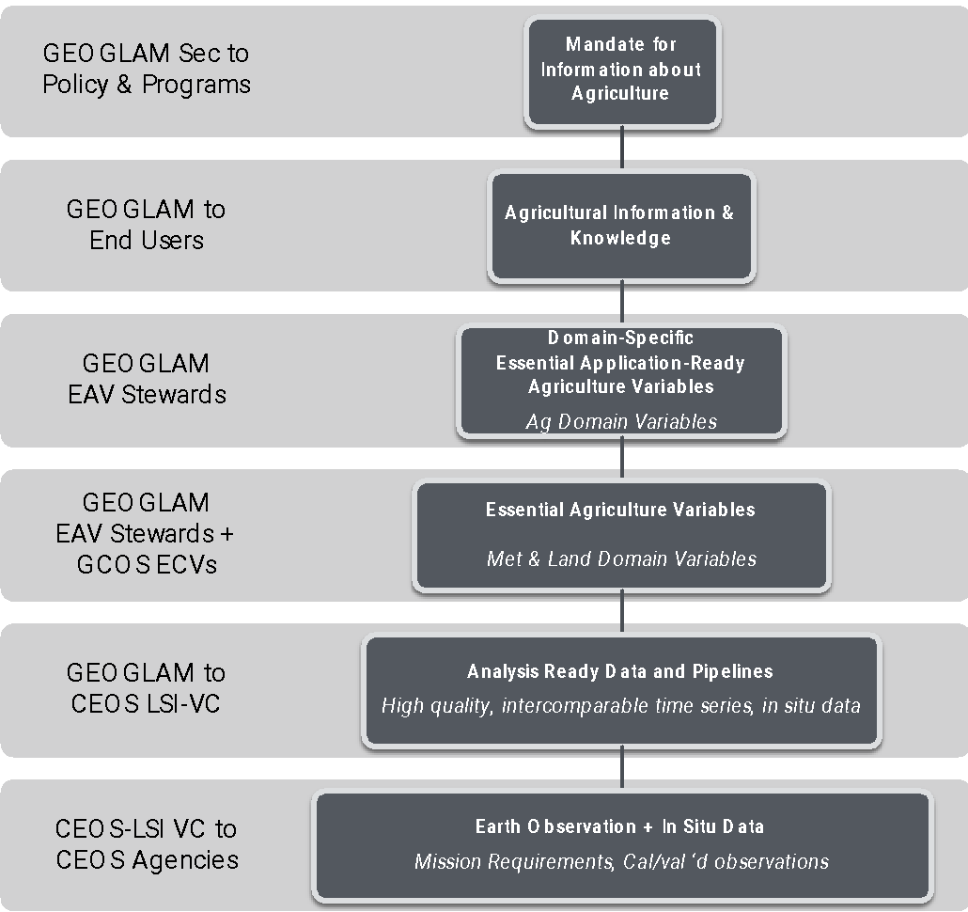
Who is involved in EAV production and availability?
Producing, Accessing, and Using EAV Products
(how does a person know which products to use, or where to get them)
Where to “discover” products & their documentation:
Central domain-specific ”list” (EAV website)
Per-product open access publications (e.g. Earth System Science Data) or websites that describe products (e.g. WorldCover “Delivery Mechanisms” - https://esa-worldcover.org/en/data-access )
Discovery and access of products
e.g. ESA World Cover, Zenodo (product-specific, associated with a publication or effort)
e.g. GEO Knowledge Hub (domain-specific)
e.g. DAAC-model (domain-agnostic)
*Domain-agnostic here still means land applications

Slide 11
Met & Land Domain EAVs
Land surface temp (ECV)
Air temperature (ECV)
Surface Soil Moisture (ECV)
Root Zone Soil Moisture (ECV)
Incoming radiation
Wind Speed (ECV)
Relative humidity
Precipitation (ECV)
Reference Evapotranspiration
Actual Evapotranspiration
Seasonal Dynamics of Surface Water Availability
LAI (ECV)
Aboveground Agricultural Biomass
fAPAR (ECV)
Fractional Cover
Soil Carbon
Runoff
Residue Cover
Surface roughness
Ag Domain EAVs
Water Productivity
Irrigated Cropland Map
Reference Crop Calendars
Current Crop Stage
GDD
Crop condition assessment
Crop yield forecast
Crop Yield estimation
Rangeland Condition assessment
Land Management Calendar
Agriculture Mask
Cropland Mask
Rangeland Mask
Seasonal Fallow mask
Seasonal Cover Crop Mask
Non-Perennial Cropland Mask
Perennial Cropland Mask
Managed Grasslands Mask
Crop Type Masks
Field Boundaries
Crop Type Area Estimation
Agricultural Burned-Area Map
+base multispectral data and simple Indices
Missing in EAV v.1

Slide 12
What we did at the GEOGLAM ExCom Mini-workshop on EAV Gap Analysis
Agreed on a framework for gap analysis
Why a gap analysis: identifying - per user case - the path (and the things blocking the path) to operational use of EO
Discussed proposed use cases
Set objectives
Short-, medium-, long-term-, & ongoing
Set a roadmap for undertaking framework for select variables
Including sources of info on gaps and rough level of effort per component of framework

Slide 13
Approach: Proposed Use Cases to Investigate
Management
Irrigation
Cover crop
Tillage intensity
Prior state & change
AFOLU
Global and National (i.e. NDCs)?
Production Statistics
National production forecast
Global production forecast
Crop condition monitoring
Early Warning
AMIS
Biomass & Carbon
Perennial crop biomass (including trees and agroforestry)
Temporary crop biomass
Grasslands/rangeland biomass
Cover crop biomass
Soil carbon (concentration?)
Current season or post-harvest
LCLU + C
Current season

Slide 14
For a specified USER CASE…
Conditions for EO adoption in producing Agriculture Information and Knowledge
Conditions for Production of Ag Domain Variables
Conditions for Production of Met & Land Variables
Notes:
Use Case
For each underpinning variable
EO data source 🡪 collected, accessible
In situ source 🡪 collected, accessible
Method status 🡪 open or closed; scalable/transferable Y/N; validated Y/N; performance quality
Is there a standard product for this variable broadly accessible?
For the use case – is the information needed being developed continuously and operationally?
Organizational conditions --> has the organization mandated someone to create EO-based information, and supporting them with sufficient resources?
Are the standard products for underpinning variables in place?
Technical capacity of individuals in organization
If not, are there resources to do the training/tech transfer/ongoing support?
Is there sufficient public documentation of related variables and tools (i.e. “Knowledge management”)

Slide 15
For a specified USER CASE…
Policy Conditions
Organizational Conditions
Summarized Variable Conditions
Integrated Analysis System
Conditions for EO adoption in producing Agriculture Information and Knowledge
Technical capacity to use analysis system(s)
Ag Variable 1
Ag Variable 2
Ag Variable n
Conditions for Production of Ag Domain Variables
M&L Variable 1
M&L Variable 2
M & L Variable n
Conditions for Production of Met & Land Variables
Notes:
Use Case
For each underpinning variable
EO data source 🡪 collected, accessible
In situ source 🡪 collected, accessible
Method status 🡪 open or closed; scalable/transferable Y/N; validated Y/N; performance quality
Is there a standard product for this variable broadly accessible?
For the use case – is the information needed being developed continuously and operationally?
Organizational conditions --> has the organization mandated someone to create EO-based information, and supporting them with sufficient resources?
Are the standard products for underpinning variables in place?
Technical capacity of individuals in organization
If not, are there resources to do the training/tech transfer/ongoing support?
Is there sufficient public documentation of related variables and tools (i.e. “Knowledge management”)

Slide 16
For a specified USER CASE…
Policy Conditions (Secretariat Summarizes all information and does engagement/advocacy around EO uses and pathways there)
Organizational Conditions
Current status of EO usage
Mandate
Funding
Summarized Variable Conditions
EO data source
in situ data source
method source
operational product provision
Integrated Analysis System
Method for integrating EO data/products
Compute/IT
Conditions for EO adoption in producing Agriculture Information and Knowledge
Technical capacity to use analysis system(s)
Operational transition
Ownership of initial system
Capability to manage changes (in variables, IT, sensors, new methods)
Ag Variable 1
Ag Variable 2
Ag Variable n
Summary of M&L variables
In situ source (specific to this variable) -> collected, accessible
Method status -> open or closed; scalable/transferable Y/N; validated Y/N; performance quality
In which regions/systems do we have good methods, in which regions/systems do we not?
Is there a standard product for this variable broadly accessible?
Conditions for Production of Ag Domain Variables
M&L Variable 1
M&L Variable 2
M & L Variable n
EO data source -> collected, accessible
In situ source -> collected, accessible
Method status -> open or closed; scalable/transferable Y/N; validated Y/N; performance quality
In which regions/systems do we have good methods, in which regions/systems do we not?
Is there a standard product for this variable broadly accessible?
Conditions for Production of Met & Land Variables
Notes:
Use Case
For each underpinning variable
EO data source 🡪 collected, accessible
In situ source 🡪 collected, accessible
Method status 🡪 open or closed; scalable/transferable Y/N; validated Y/N; performance quality
Is there a standard product for this variable broadly accessible?
For the use case – is the information needed being developed continuously and operationally?
Organizational conditions --> has the organization mandated someone to create EO-based information, and supporting them with sufficient resources?
Are the standard products for underpinning variables in place?
Technical capacity of individuals in organization
If not, are there resources to do the training/tech transfer/ongoing support?
Is there sufficient public documentation of related variables and tools (i.e. “Knowledge management”)

Slide 17
THE WAY FORWARD: Short-Term, Medium-Term, Long-Term, Ongoing tasks
Short-term
Selecting use-cases
We are using the CEOS GST AFOLU need for land cover as the for GLOBAL, HARMONIZED, TRANS-SCALAR CROP TYPE (“A”)
Sven will be your PoC for the CEOS GST AFOLU
Looking also at core G20 mandates (e.g. Global Crop Monitor)
Fundraising for broader Gap Analysis
Full EAV spectrum, full framework
Medium-term
Undertake gap analysis for CEOS GST AFOLU user need focused on:
Long-term
For each agreed-upon use:
Answering (filling in) Conditions for Met & Land EAVs
Answering (filling in) Conditions for Ag Domain EAVs
Answering (filling in) Conditions for EO adoption in producing Agriculture Information and Knowledge
Ongoing
Distilling observation information to CEOS and directly to agencies
Policy outreach and GEOGLAM business
Using EAV framework
Securing funding for addressing gaps identified in our use-specific cases
Summarized Variable Conditions
EO data sources
in situ data sources
Methods and harmonization
operational product provision
Integrated Analysis System
Method for integrating EO data/products Computational system + IT

Slide 18
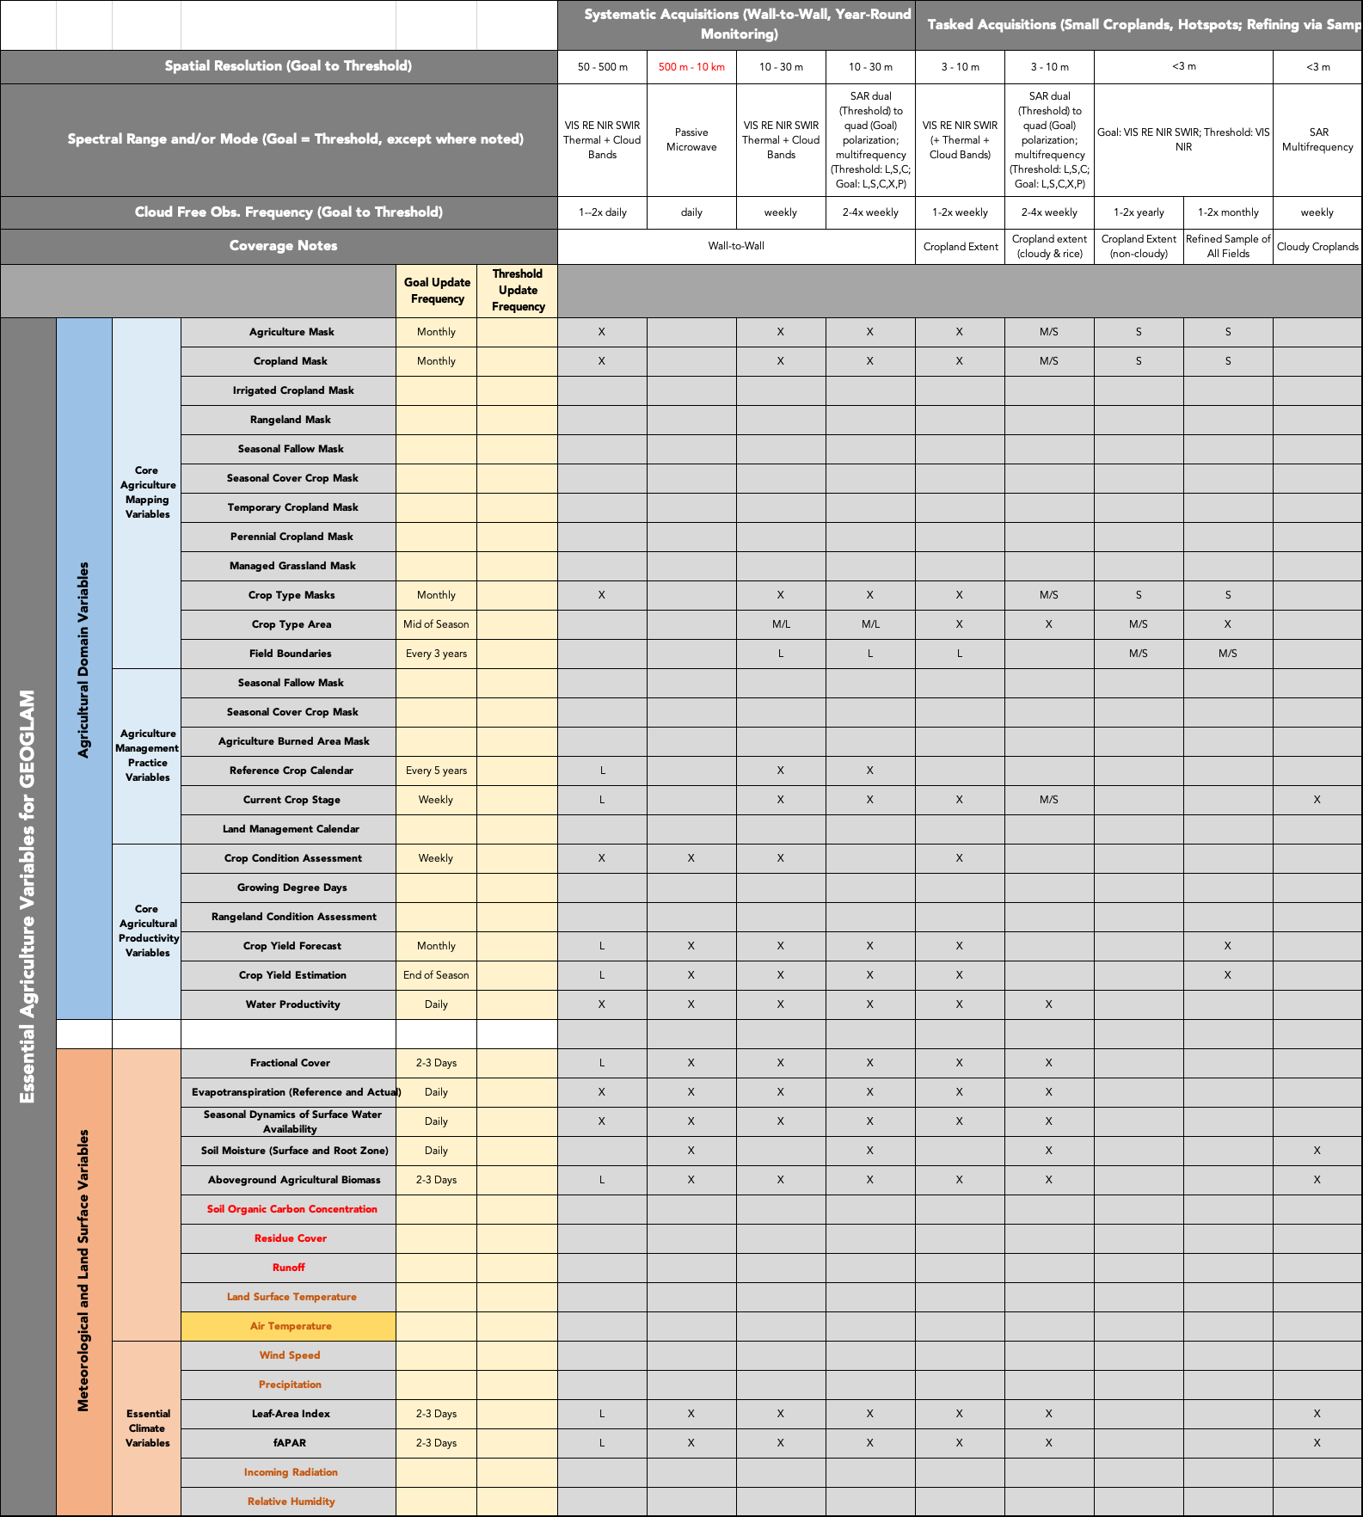
Source of the Variable Conditions
except in situ

Slide 19
Preview of EO Req Table Changes & Additions
We’ve moved away from “data scarcity” – thank you CEOS!
Imagery grouped in two ways:
“always on” – wall-to-wall [CEOS agencies]
“tasked acquisitions” – sampled [space companies]
Community Consensus EAVs for GEOGLAM replace broad product areas
We adopt GCOS ECV and CEOS CARD4L “goal to threshold” language

Slide 20
Joint Workshop: Community-led good-practices for cropland and crop type validation
12-14 September 2023 | USDA National Agricultural Library Beltsville, MD
Part of the new initiative on
Supports CEOS AFOLU Stocktake
Jointly organized by GEOGLAM & CEOS:
LPV Leadership: Sophie Bontemps (UCL) & Sasha Tyukavina (UMD)
EAV Leadership: Sven Gilliams (VITO) & Alyssa Whitcraft (UMD)
Supported by:
NASA Land Cover & Land Use Change Program
NASA Applied Sciences Agriculture Program

Slide 21
GEOGLAM and In Situ Data
A decade ago the major constraint to operational monitoring was access to free and open EO data, then the major hurdle became the cost and availability of big data analytics; the next constraint was access to mature, reproducible analytical tools. Great progress has been in all these areas…
One of the last major constraints to progress:
Open access to high quality, well managed in situ data for training and validation
Current in situ data access is insufficient for the development of systematic operational monitoring capacities required to address our policy priorities
Some incremental coordination leveraging our existing activities could have a major impact at relatively low cost
“the whole can be greater than the sum of the parts”
Notes:
As we look forward some concluding thoughts…

Slide 22
In Situ Data Progress
GEOGLAM initiated a working group on in situ data in 2021
Early 2022 an initial workplan and guidance document was developed by the WkGrp
GEOGLAM was able to leverage significant effort by WorldCereal to create a global reference data set for crop mapping
November 2022 GEOGLAM convened a workshop in Geneva to review and refine the workplan towards the development of a detailed action plan (currently in draft)
Key actions were developed, some in development, within existing resources and capacities, some require incremental support (i.e. funding, staff time, technical resources)
Notes:
Over 20 institutions were represented at the workshop and consensus was developed around the approach, and an action plan is now being refined from the discussion

Slide 23
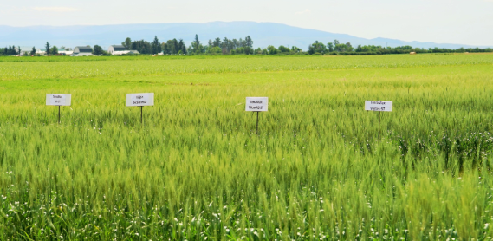
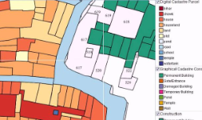
Reference data modular framework
Need for a global, extensive, open reference data repository with recent data on crop types and land cover
No current solution of sufficient, high quality (open) reference data so started a journey...
Notes:
Over 20 institutions were represented at the workshop and consensus was developed around the approach, and an action plan is now being refined from the discussion

Slide 24
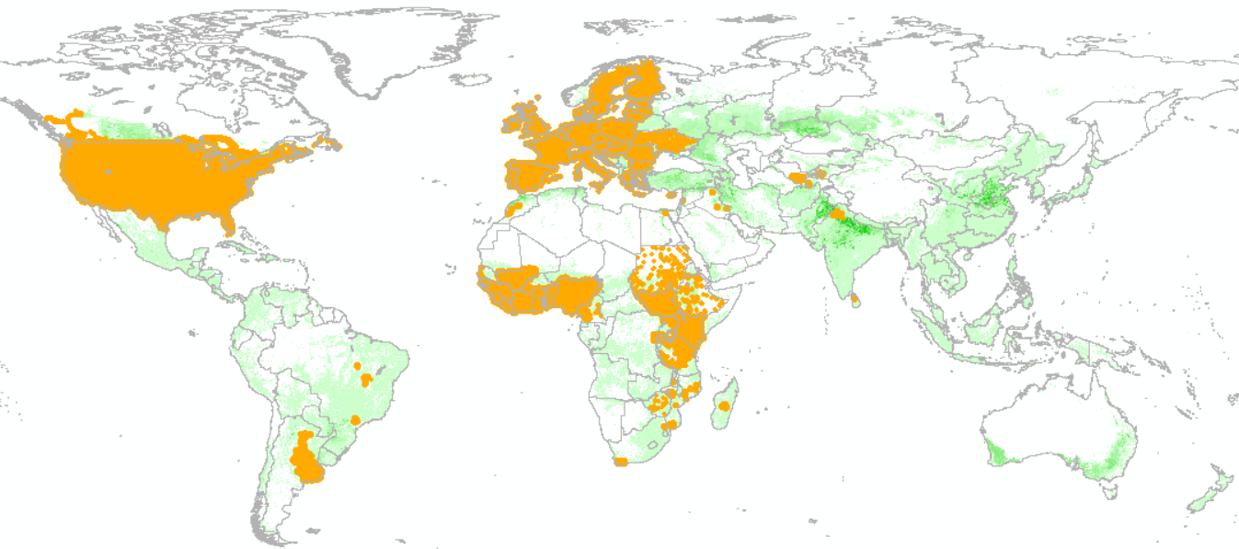
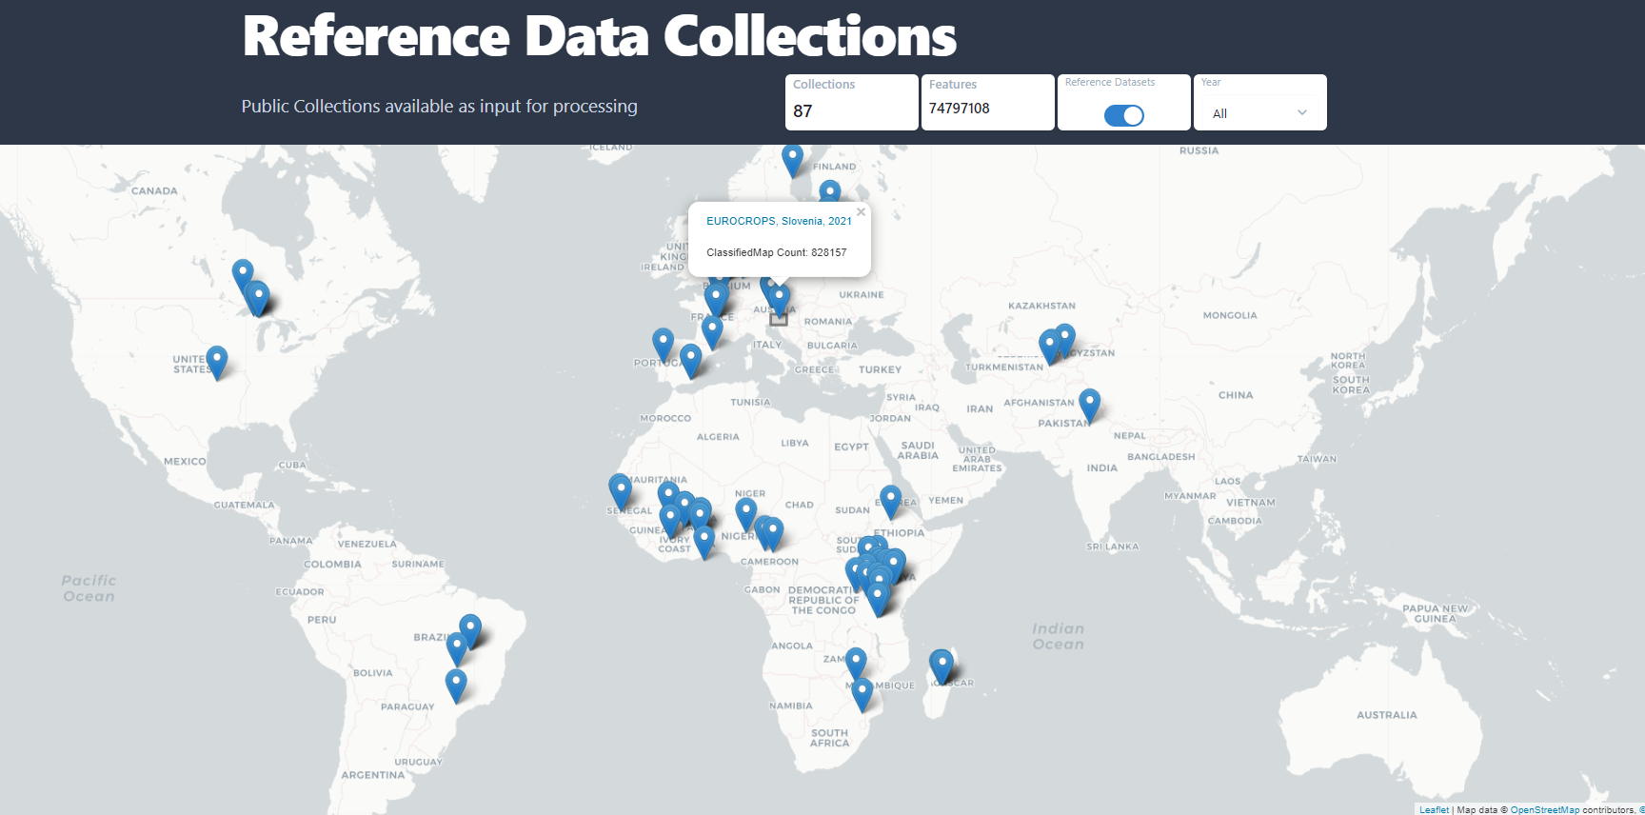
RDM status nov 2022
All data in the Reference Data Module (RDM)
https://esa-worldcereal.org/en/about/data-collection
Notes:
Over 20 institutions were represented at the workshop and consensus was developed around the approach, and an action plan is now being refined from the discussion

Slide 25
Next Steps
Gaps assessment for EAVs implementation, including in situ data needs
Institutionalize, sustain, and update the WorldCereal reference data repository and Encourage and Enable the community to share data following the open science and open data principles
Explore business models to strengthen and sustain harmonization hubs (data holdings)
Implement a demo distributed architecture with hosting capability using the open source CKAN solution under the neutral GEO/GEOGLAM umbrella, with an implementation of STAC, and common API to query the data
Notes:
Over 20 institutions were represented at the workshop and consensus was developed around the approach, and an action plan is now being refined from the discussion

Slide 26
Summary of CEOS-relevant efforts/actions (1) ch-ch-ch-ch-changes
Brad Doorn (NASA) has been LSI-VC GEOGLAM subgroup lead for years
It is time for him to have (at least) active co-leadership if not to pass leadership to another agency
Next GEOGLAM Executive Director will be evaluating the GEOGLAM governance and working structure to meet GEOGLAM ExCom priorities
Alyssa has been awarded NASA’s US-focused agriculture program (”NASA Acres”) and will step back from many GEOGLAM activities
Will remain EO Data Coordination WG (co-lead) and EAV WG (co-lead), with NASA Harvest support
Sven Gilliams stepping up to co-lead EO Data Coordination WG
Means more liaising with LSI-VC, including leading the CEOS GST AFOLU crop type map gap analysis

Slide 27
Summary of CEOS-relevant efforts/actions (2) strengthening our relationship
EO data requirements being updated in line with the EAVs
The substance of the GEOGLAM requirements – but what about the below, too?
Acquisition and preprocessing support for the Rapid Response Facility
A similar mechanism to Disasters Charter???
Support on the EAV gap assessment from CEOS would be welcome on EO data component (SEO? Agency designee? LSI-VC personnel?)
Cross referencing requirements table with MIMS
Data systems and IT components (what is, what could be)
GEOGLAM itself has growing working areas with WGCV LPV
Joint Workshop
In situ data coordination potential
LSI-VC/WGISS intersection around use-oriented data compute question
Feedback on the domain-oriented science team concept
*throws grenade for future discussion* 🡪 would CEOS be interested in broader agriculture applications than GEOGLAM (e.g. on-farm support, SOC/sustainability metrics)

Slide 28
GEOGLAM Sec to Policy & Programs
Mandate for Information about Agriculture
Agricultural Information & Knowledge
GEOGLAM to End Users
Use Specific
Turn variables into answers
GEOGLAM (EAV Stewards)
Domain-Specific Essential Application-Ready Agriculture Variables
Ag Domain Variables
Agriculture Domain Specific
Turn EAVs into core variables of state/change/forecast
Data Value Chain
Justification and Requirements
GEOGLAM (EAV Stewards) + GCOS ECVs
Land Domain Specific
Underpinning variables that allow integration with other land communities
Essential Agriculture Variables
Met & Land Domain Variables
GEOGLAM + CEOS LSI-VC
Analysis Ready Data and Pipelines
High quality, intercomparable time series, in situ data
Land Domain Agnostic
GEOGLAM to CEOS & Space Agencies (EO)
In situ?
Earth Observation + In Situ Data
Mission Requirements, Cal/val ‘d observations
Domain Agnostic

Slide 29
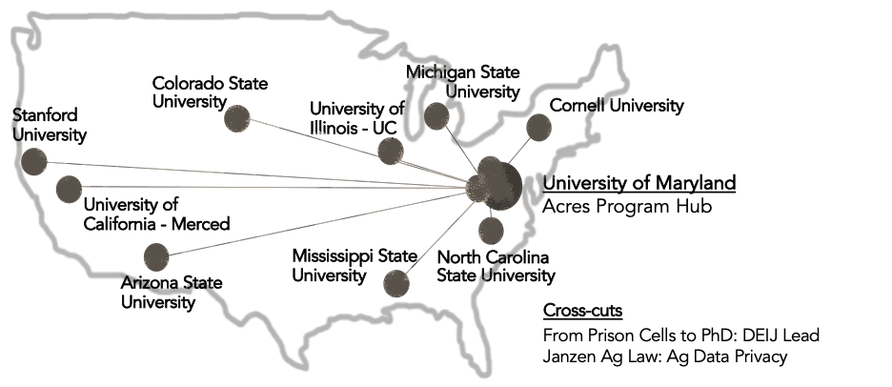
NASA
NASA’s US-focused Agriculture Program
launched March 2023
led by University of Maryland
sister program to NASA Harvest (Global)
Activities
Methods to Maps:
EAVs for US agriculture; products & pipelines
Maps to Information:
Metrics of US land use, productivity, and sustainability
Information to Knowledge:
Interplay between practices, sociology, economics
Knowledge to Action:
Integration-ready on-farm decision support tools
Policy-ready info on emissions, water quality, trade…
25 initial projects - 12 institutions across CONUS + Hawaii
Commodity row crops to rangelands to specialty crops
Large farms for global trade to smallholders for local food systems

