Slide 1
National Inventory User Engagement
Sylvia Wilson
National Land Imaging Program
US. Geological Survey

Slide 2


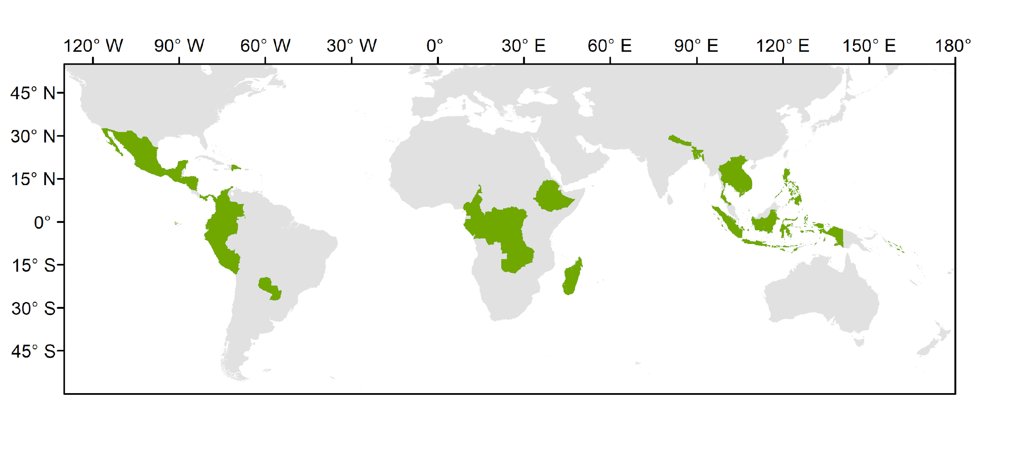
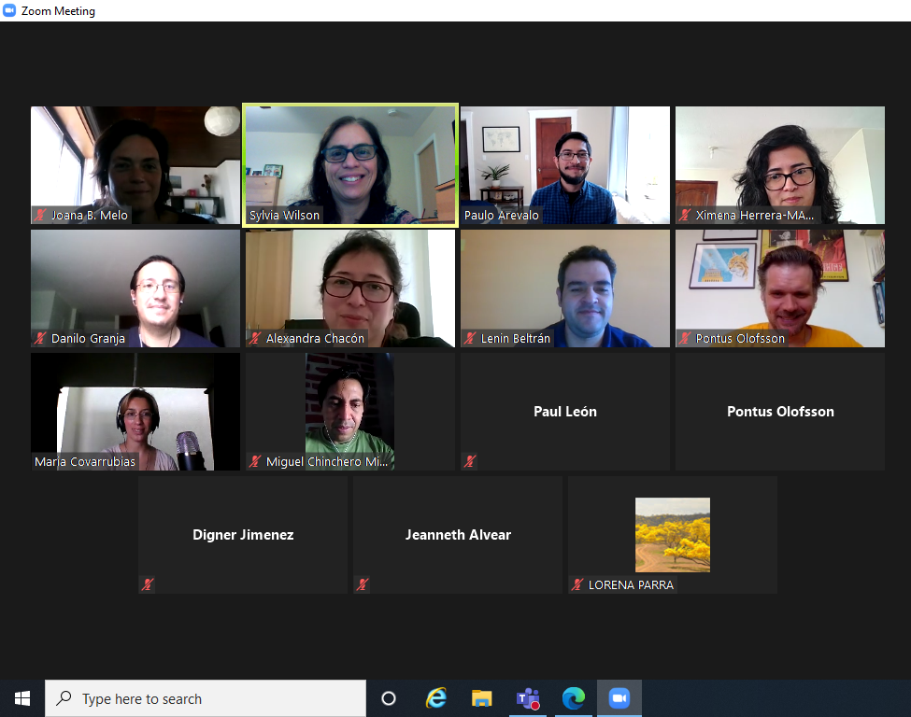
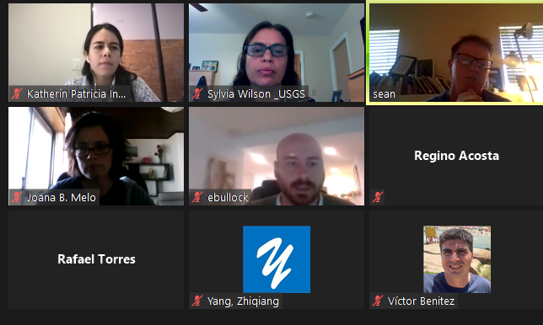
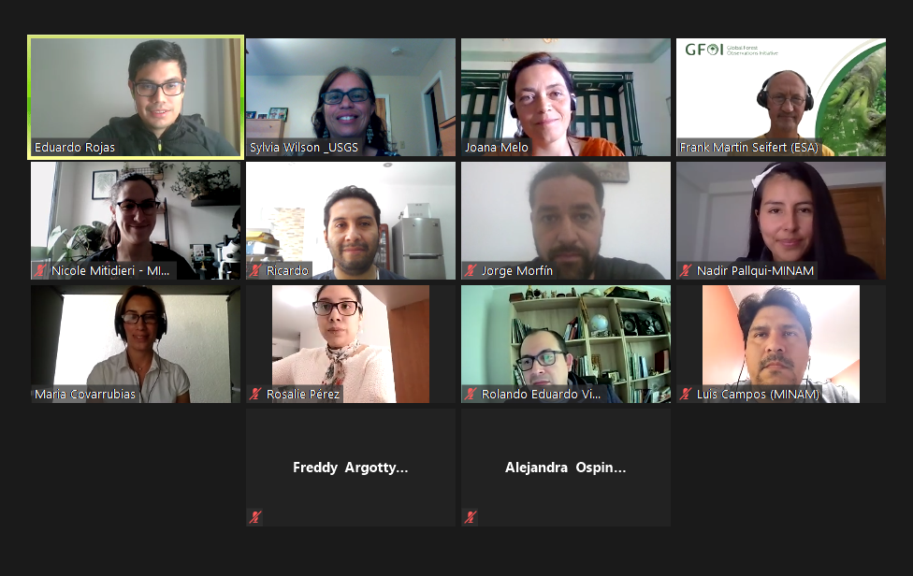
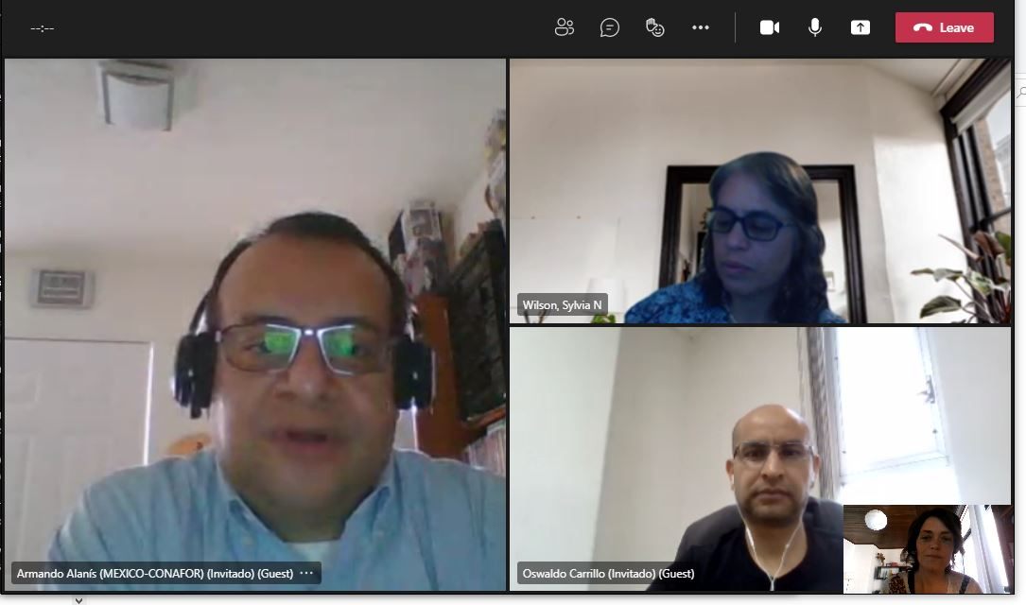
National Inventory User Engagement
Congo DRC Cameroon Ethiopia Gabon Madagascar Zambia
Colombia Costa Rica Dominican Republic Ecuador El Salvador Guatemala Honduras Mexico Nicaragua Panama Paraguay Peru
Bangladesh Cambodia Indonesia Lao PDR Nepal Philippines Solomon Islands Thailand Viet Nam

Slide 3
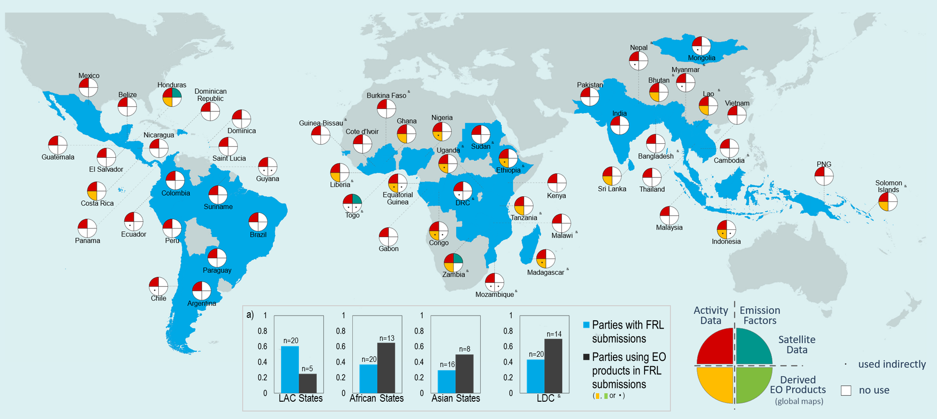
National Inventory User Engagement
2023 update
Baseline to measure progress on the uptake of satellite-based global maps in the next cycle of the GST
  (developing countries covering 80% of tropical forests)
Joana Melo et al 2023 Environ. Res. Lett.

Slide 4
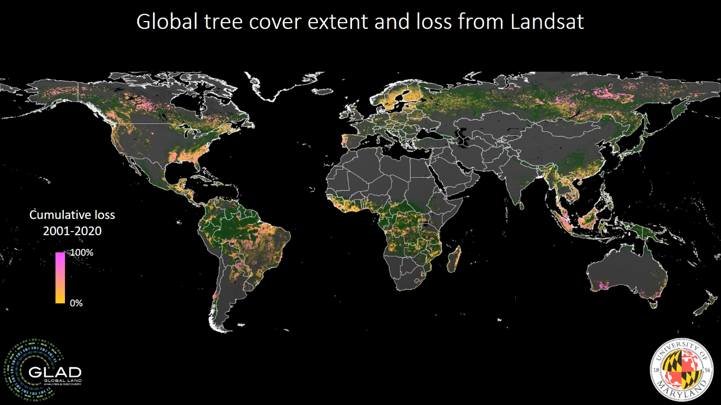
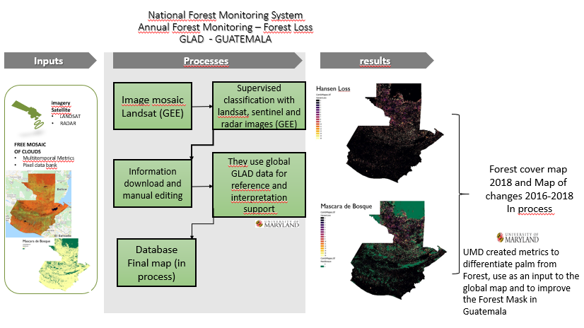
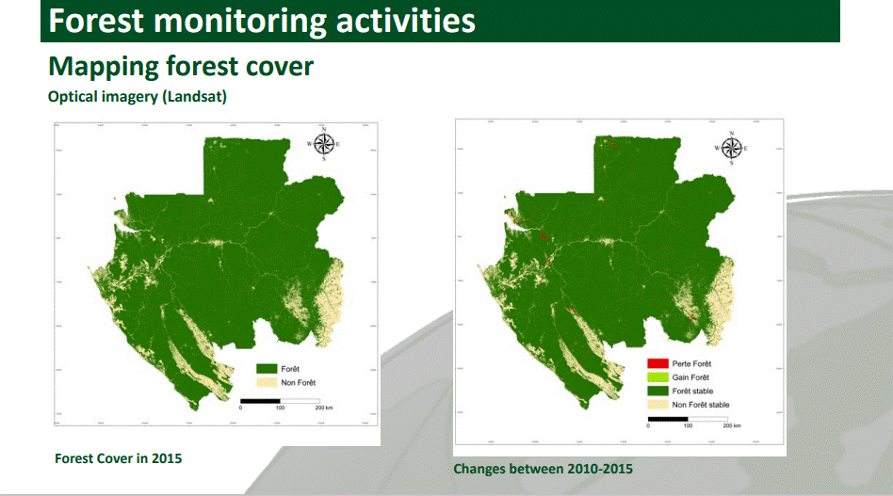
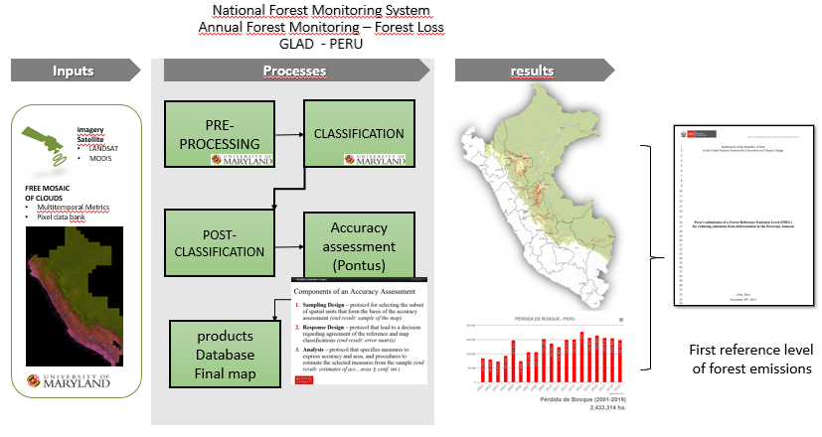
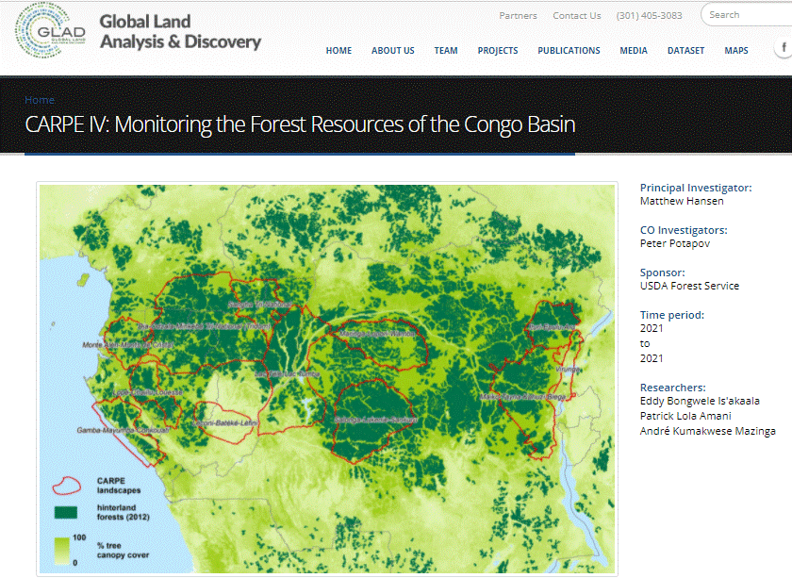
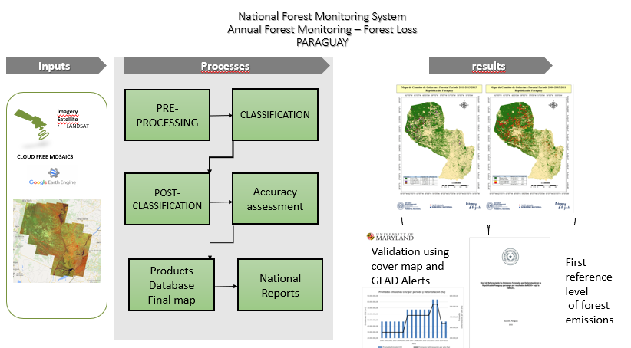

Slide 5

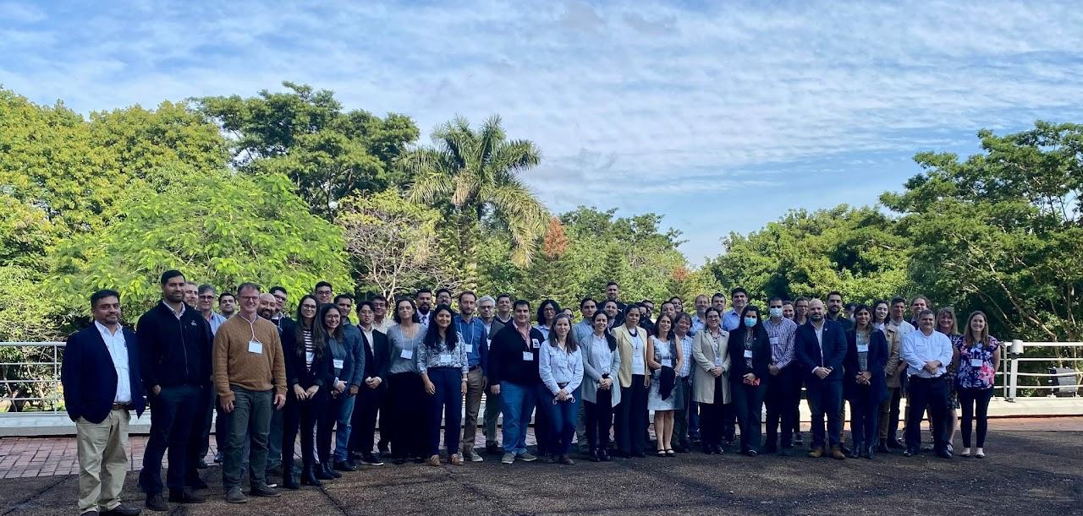



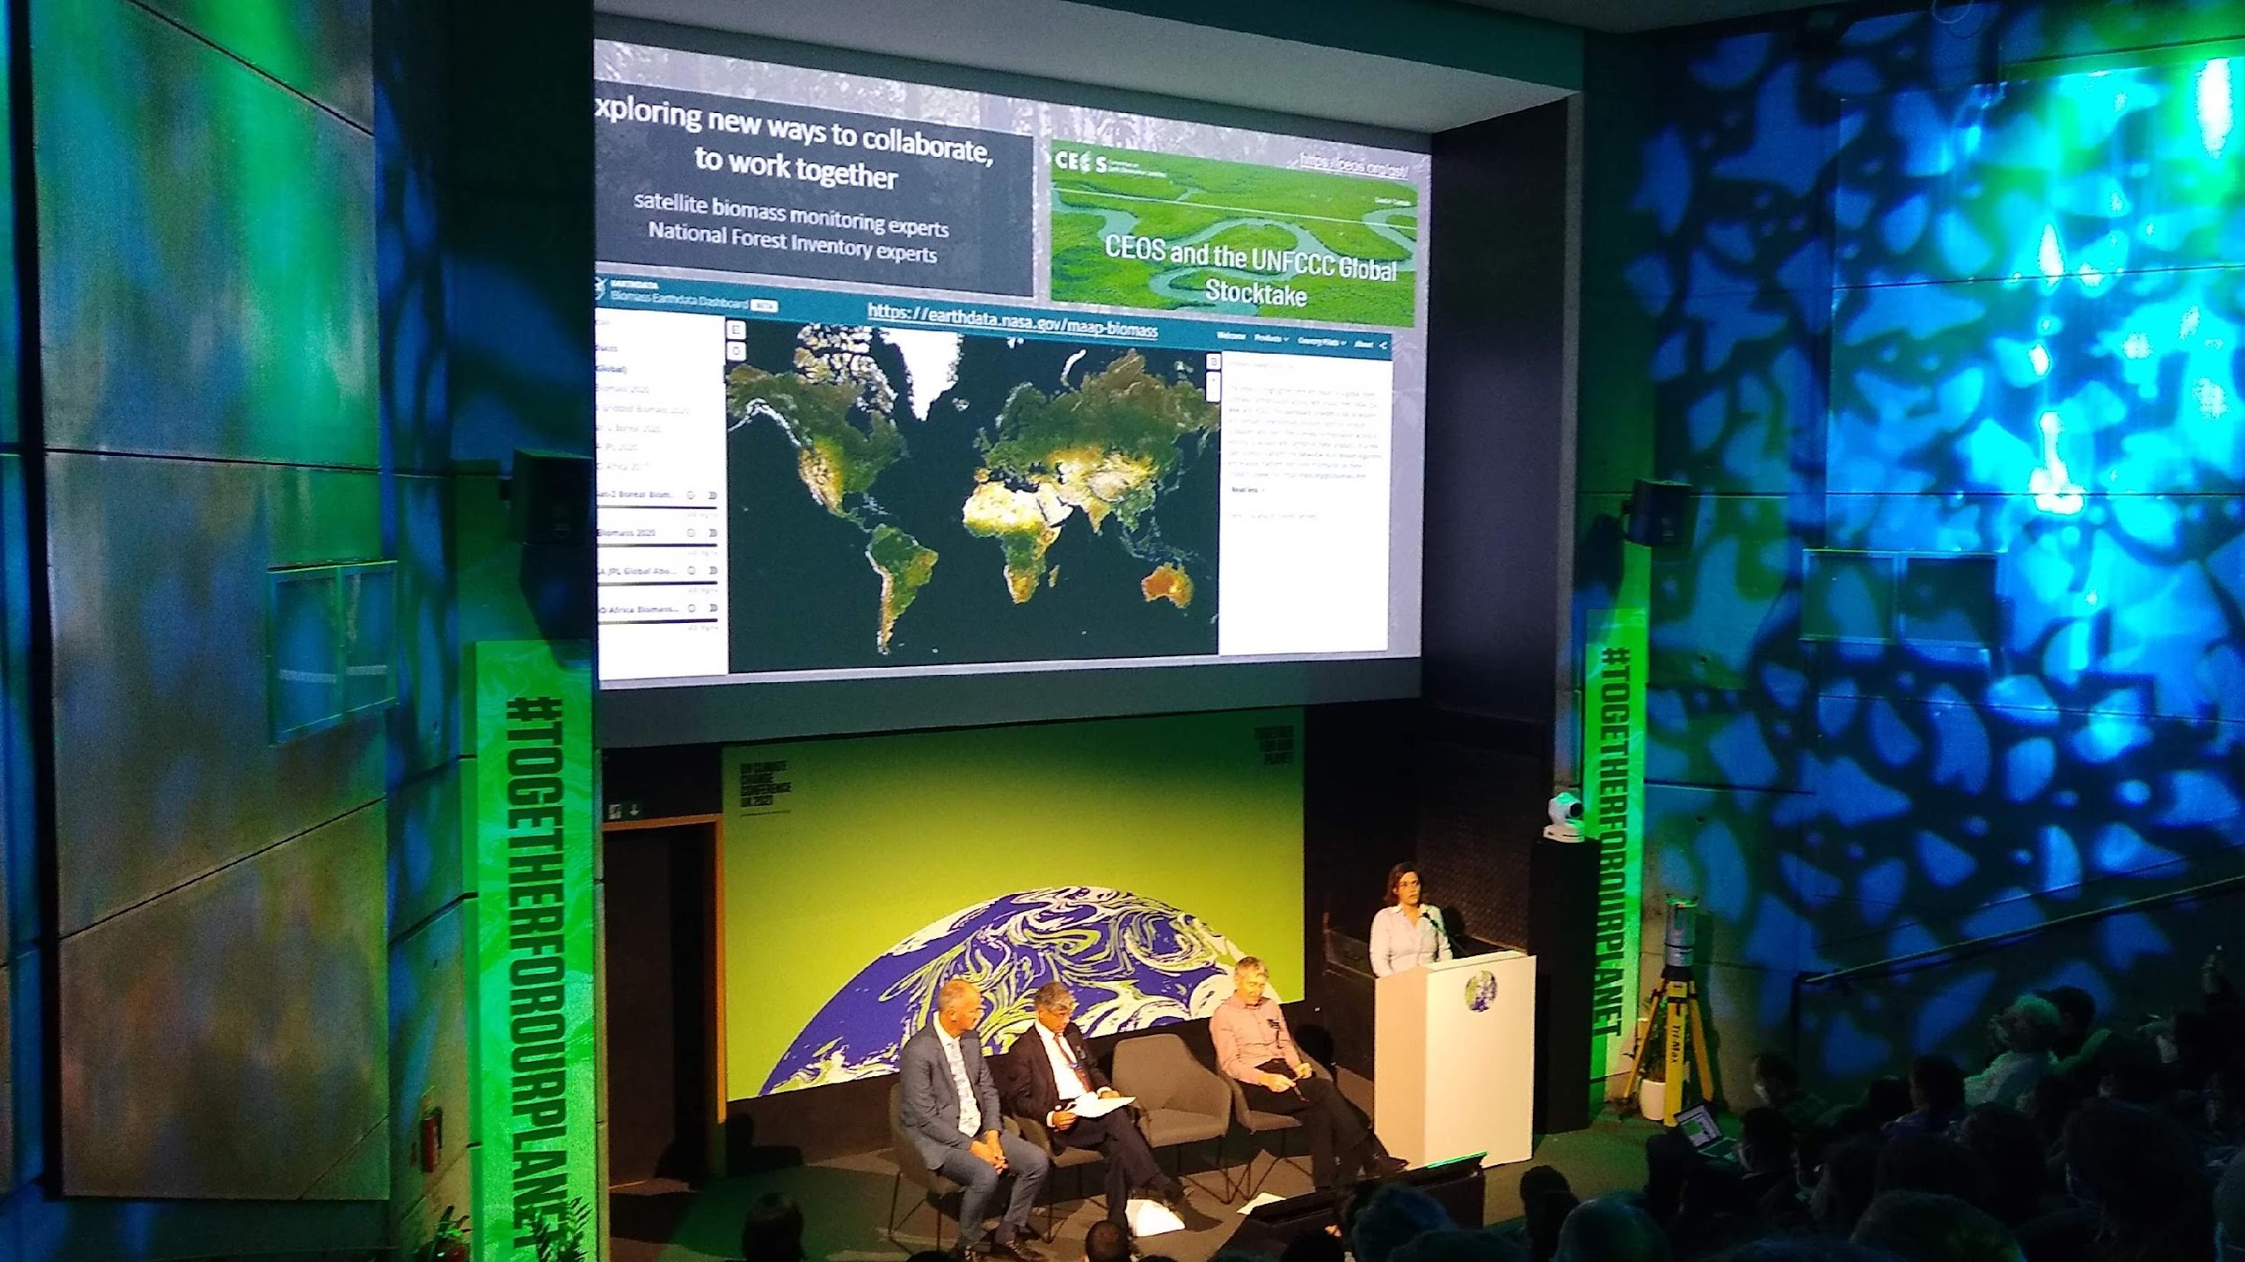
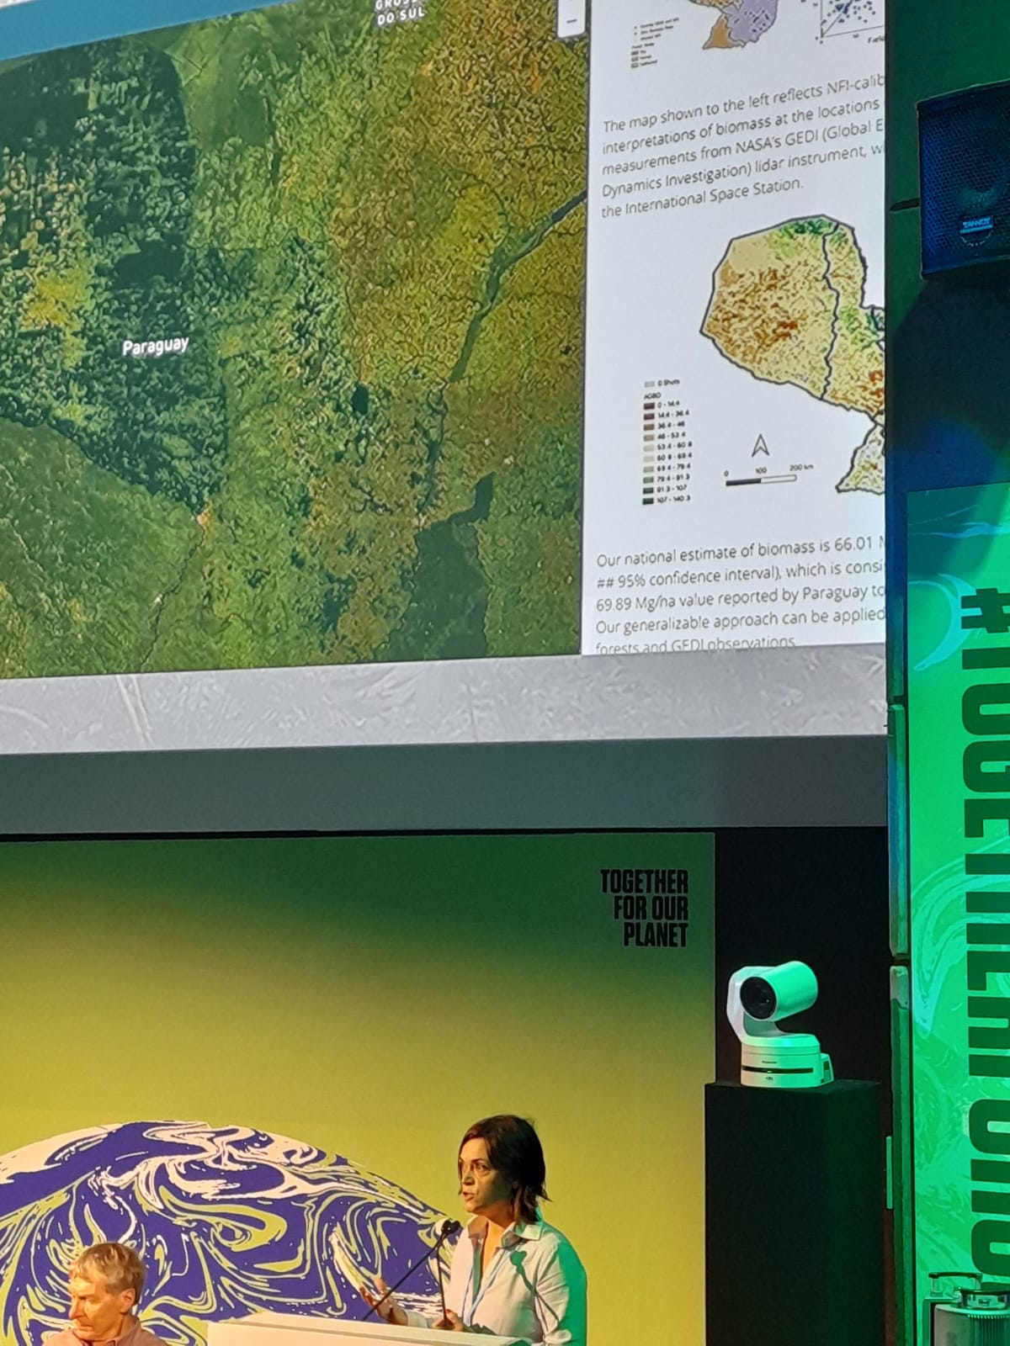
National Inventory User Engagement
Collaboratively develop demonstrations of Earth Observations uptake
Bilateral engagement: CEOS group or agency with a Country
Using GEDI and Landsat to Evaluate and Improve Annex-1 Countries’ National Forest Inventory for Estimating Forest Carbon Stocks
COP2 Forests and Carbon from Space Event, 6 Nov, 2021, Green Zone

Slide 6


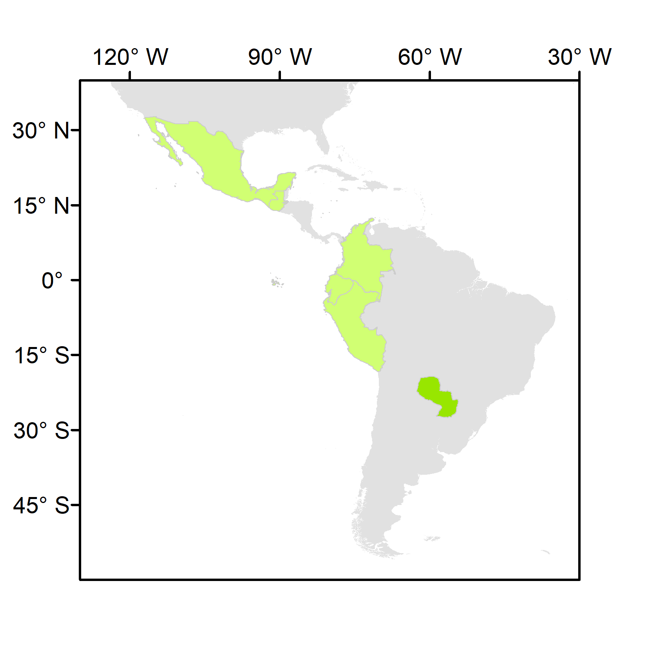
National Inventory User Engagement
1st SilvaCarbon/CEOS Regional Workshop – Biomass measurements
Paraguay, June 2022
 | Country | REDD+ FRL latest submission | REDD+ FRL previous submissions | BUR REDD+ Annex | BUR | NIR | NFI
Latin America and the Caribbean | Colombia | 2020 | 2015 | 2016, 2019 | 2015, 2018, 2022 | 2019 | Yes
 | Ecuador | 2020 | 2015 | 2016 | 2016 | 2017 | Yes
 | Guatemala | 2022 | n.a. | n.a. | n.a. | n.a. | partial
 | Mexico | 2020 | 2015 | n.a. | 2015, 2019 | 2019 | Yes
 | Paraguay | 2022 | 2016 | 2019 | 2015, 2018, 2021 | n.a. | Yes
 | Peru | 2021 | 2016 | n.a. | 2014, 2019 | 2019 | Yes
National teams to present their NFIs, and the data and methods currently used in reporting and domestic MRV
JAXA, ESA, NASA to present:
  the available datasets and methodologies to measure land use GHG fluxes
  demonstrations of opportunities for their uptake
  a clear plan for sharing of NFI data and collaborating in the calibration/validation of products
LULUCF experts in IPCC guidance (nominated in the UNFCCC roster by their Governments or contributors to the 2019 refinement of the IPCC guidelines)
Colombia Ecuador Guatemala Mexico Paraguay Peru

Slide 7
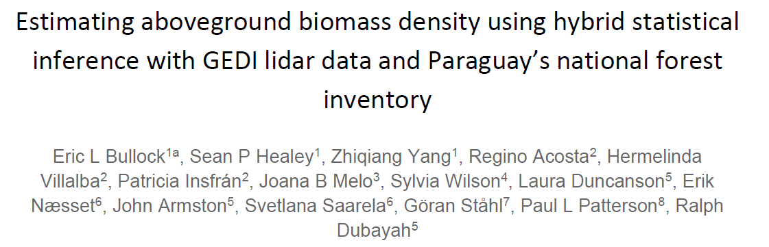

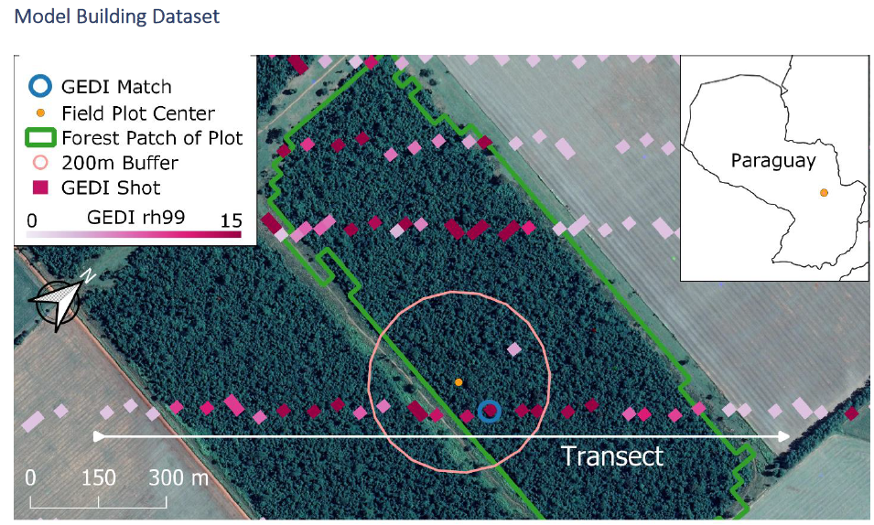
National Inventory User Engagement
2023 update
1st SilvaCarbon/CEOS Regional Workshop – Biomass
measurements; Paraguay, June 2022

Slide 8
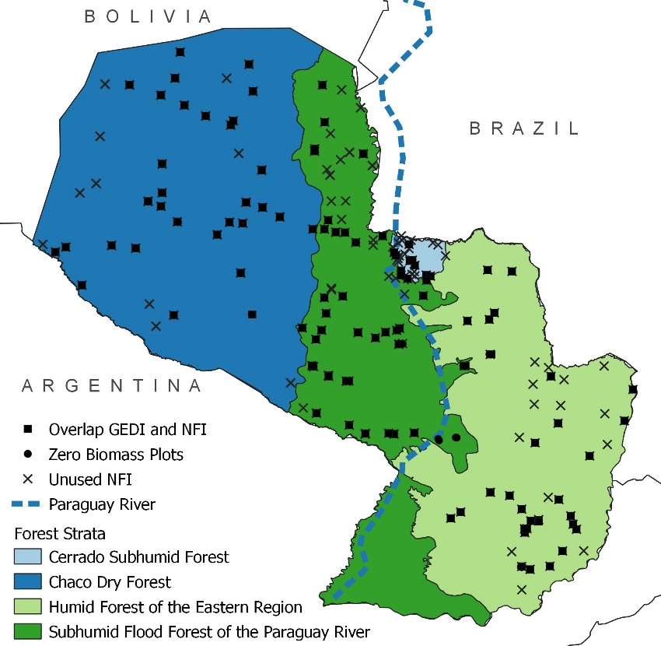
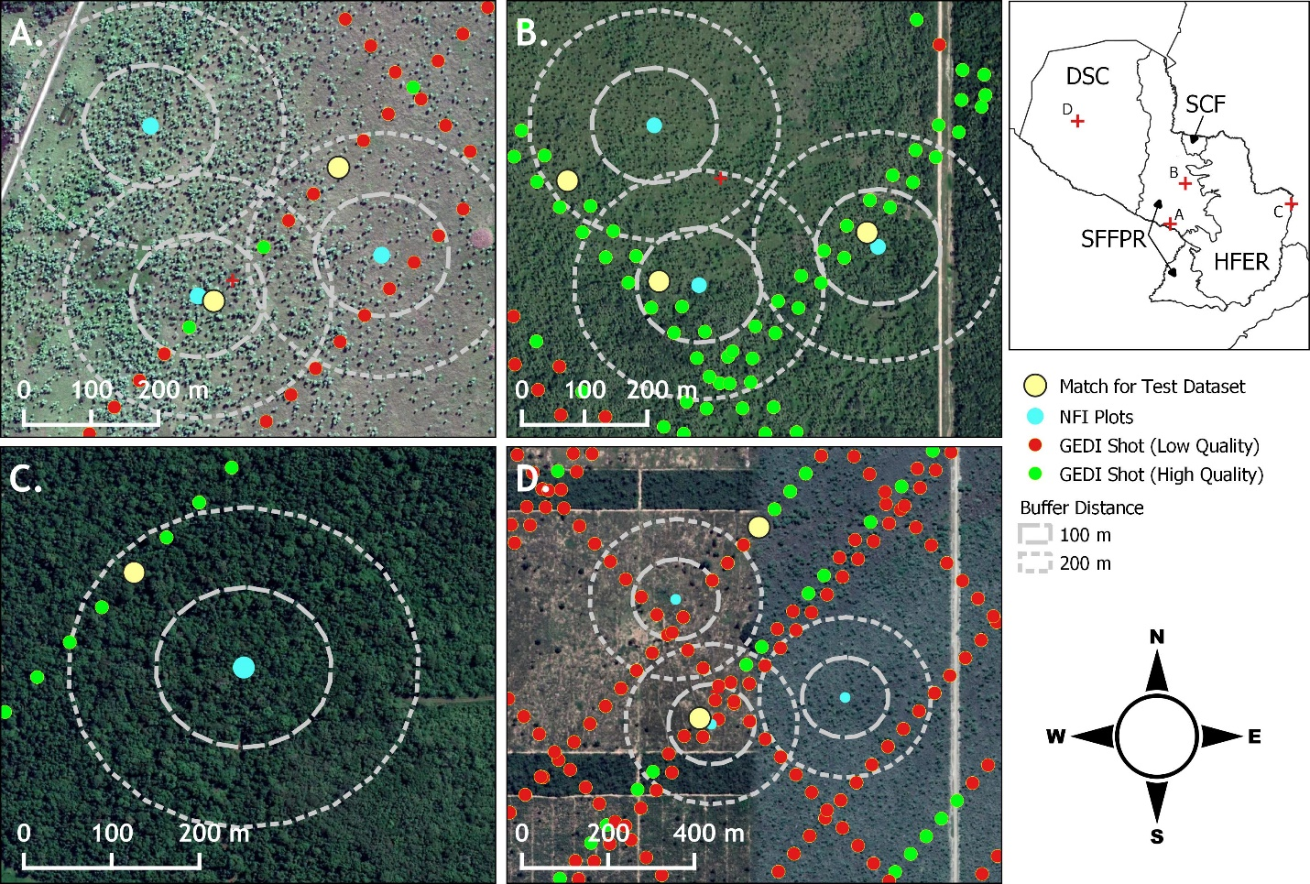
National Inventory User Engagement
There are many plots in Paraguay’s NFI within 200 meters of GEDI shots
Project: Use of GEDI measurements to support carbon accounting in Paraguay. Lead by Dr. Sean Healey– Biomass Harmonization Initiative

Slide 9
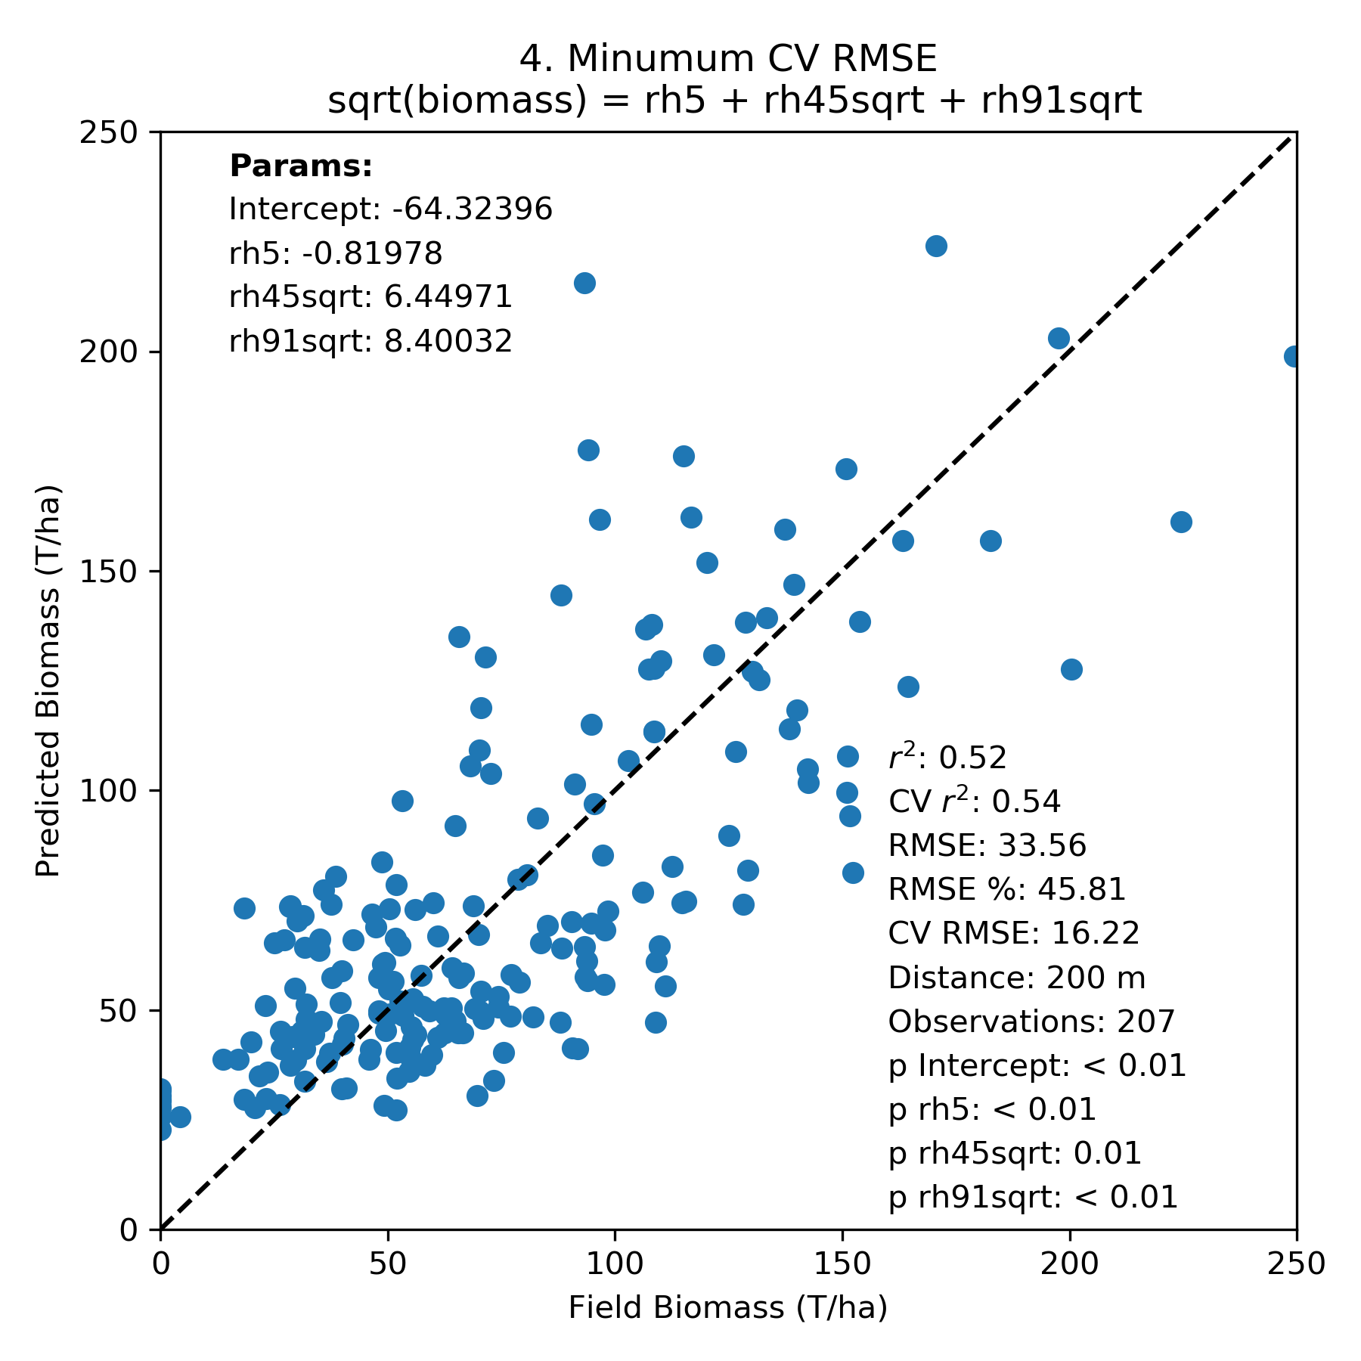
National Inventory User Engagement
Within the CEOS Biomass Harmonization initiative Paraguay was the first country to have the biomass model of GEDI calibrated in country.
USGS SilvaCarbon Program and USFS combine efforts to demonstrate the methodology in a regional workshop.

Slide 10
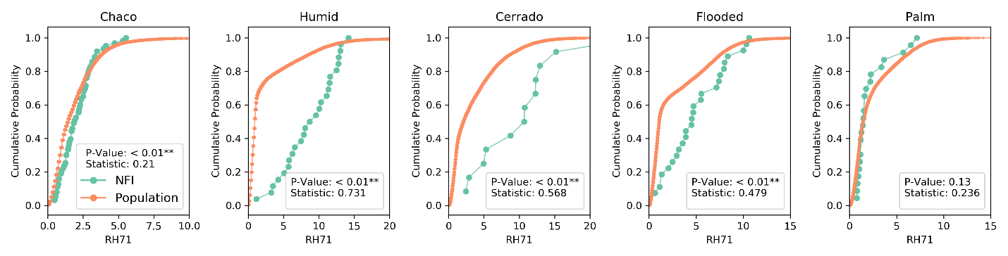
National Inventory User Engagement
Strata | NFI |  | GEDI
 | Mean (Mg/Ha) | 95% CI (Mg/Ha) | Mean (Mg/Ha) | 95% CI (Mg/Ha)
Chaco | 59.26 | 10.69 | 62.76 | 6.40
Humid | 111.49 | 14.25 | 65.70 | 2.49
Cerrado | 109.16 | 14.35 | 97.19 | 2.16
Subhumid Flood | 108.78 | 15.84 | 83.91 | 2.58
Palm | 34.29 | 15.93 | 40.20 | 1.32
Comparison: National Forest Inventory and the Statistic Estimate of GEDI

Slide 11

Paraguay User Engagement
Conclusions:
The results showed that the model underestimated biomass. Still, the level of uncertainty was low enough that this methodology could benefit Paraguay if used in inaccessible areas or to augment the NFI.
INFONA has an excellent National Forest Inventory, and they have contributed data to calibrate this biomass model that contributes to carbon accounting and improves the NFI.
There is a capacity-building component that will take place in the longer term with the support of the SilvaCarbon program.
CEOS, through the SilvaCarbon program, engaged with Thailand in mangrove extent and carbon accounting monitoring using global products. A regional workshop took place in support of CEOS during the week of Feb 21.

Slide 12

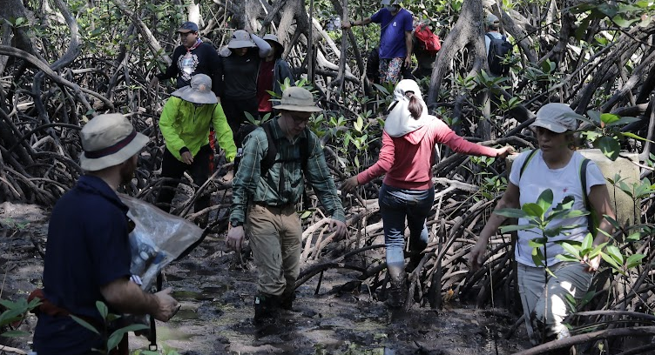
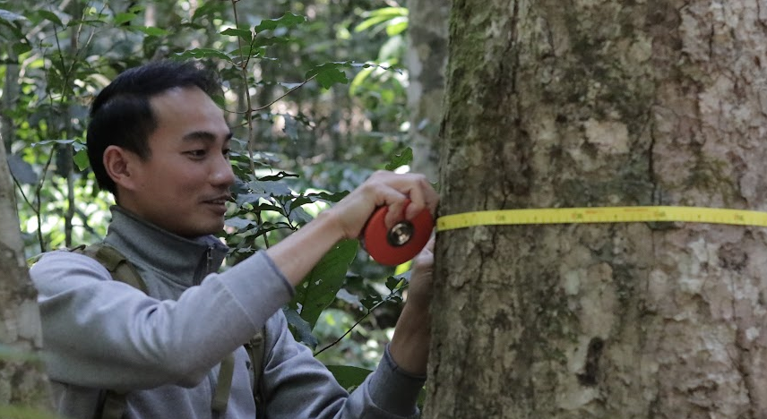
CEOS workshop: GISTDA and SilvaCarbon
CEOS Workshop:
Validating and Calibrating Global Space Datasets with ground-based data in support AFOLU reporting
22 February to 02 March, 2023
Chanthaburi Province and Khao Yai National Park - Thailand

Slide 13

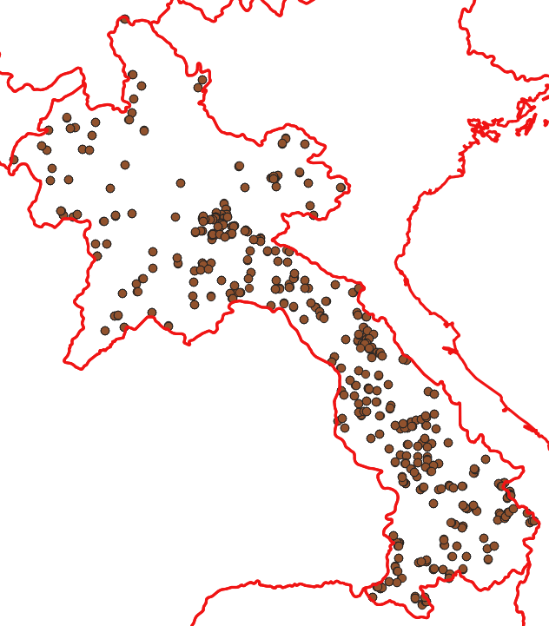
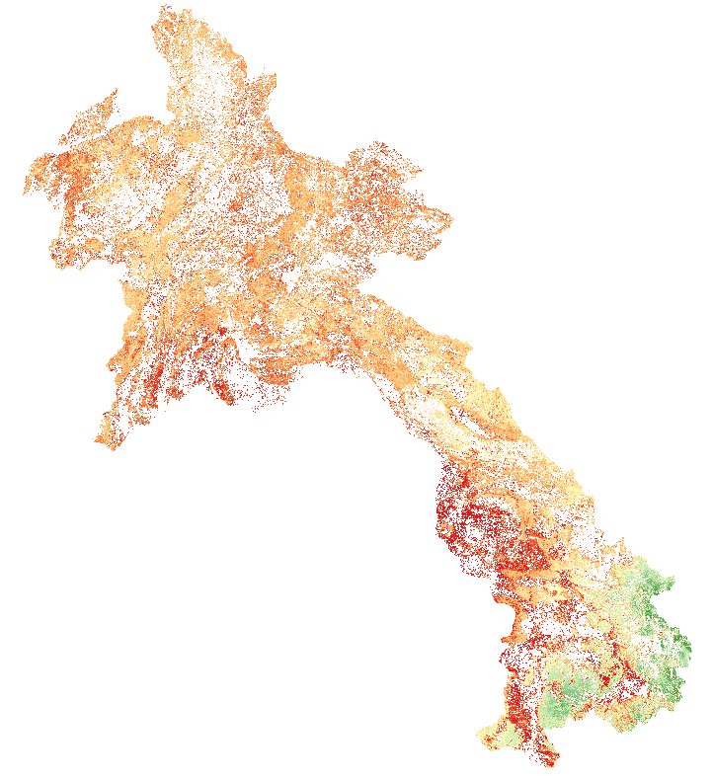
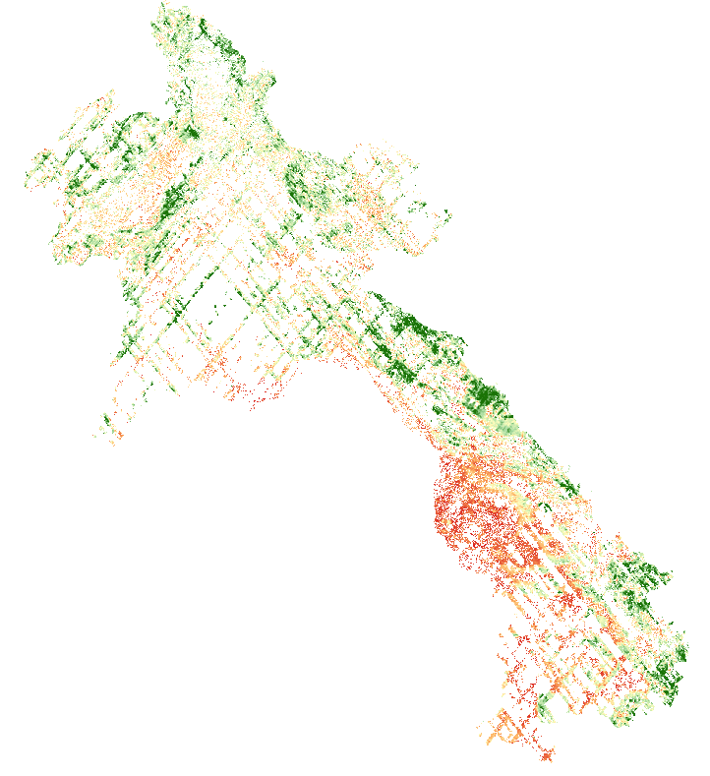
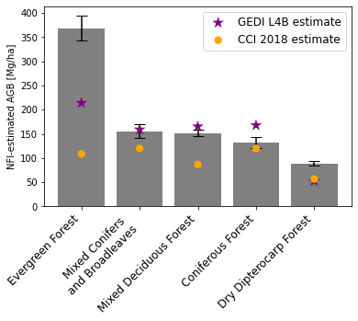
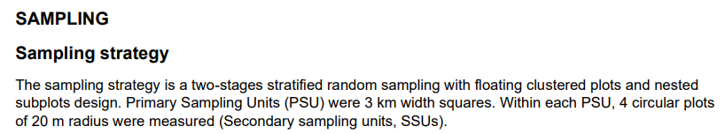
Comparison of space-based AGB map products to NFI data
Laos
1478 NFI plots (collected in 2019)
CCI 2018 AGB (100 m x 100 m)
GEDI L4B AGB (1 km x 1 km)
Slide courtesy of: Neha Hunka (UMD)

Slide 14
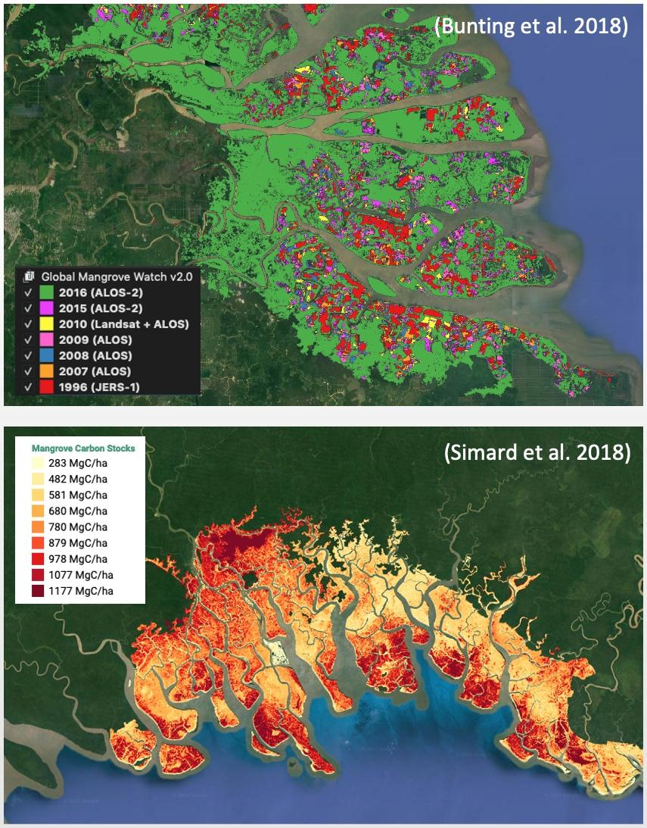
Mangrove Mapping and Monitoring
Mangroves (Forest / OLU-Wetlands)
Activity Data – Global Mangrove Watch (JAXA K&C)
Global maps of mangrove area and annual changes at 25 m derived from L-band SAR and optical data. Open access in public domain.
1996–2018 available on 2021. 2019-2021 for GST1.
Official UNEP SDG 6.6.1 mangrove dataset.
Emission Factors - LCLUC Global Mangrove Mapping (NASA JPL/GSFC)
Global maps of Height, AGB and Total Biomass at 30 m. Open access in public domain.
Baseline year 2000 derived from SRTM DEM.
New 2015 baseline at 12 m from TanDEM-X DEM available for GST1.

Slide 15
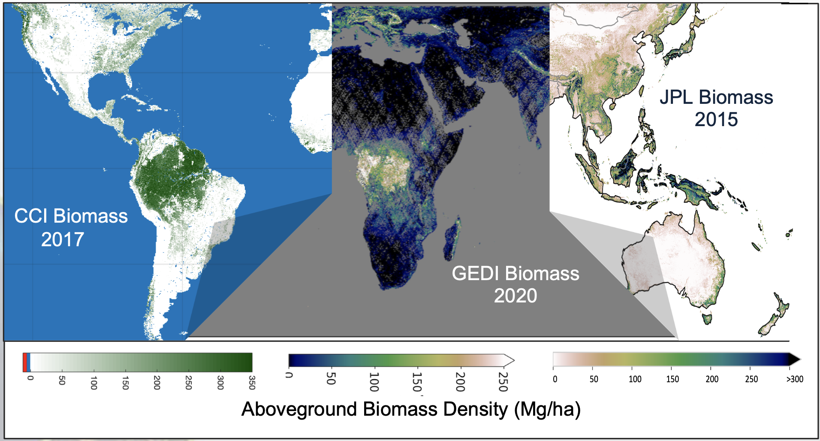
Recommendations from testing biomass global
maps
Calibration (limited amount of NFI pantropical data)
Different estimates of biomass volume by different maps
Uncertainty calculated at global scale
Some of the maps don’t fit the requirements for reporting
Harmonization is no longer possible
Lifetime of the satellite information is uncertain

Slide 16
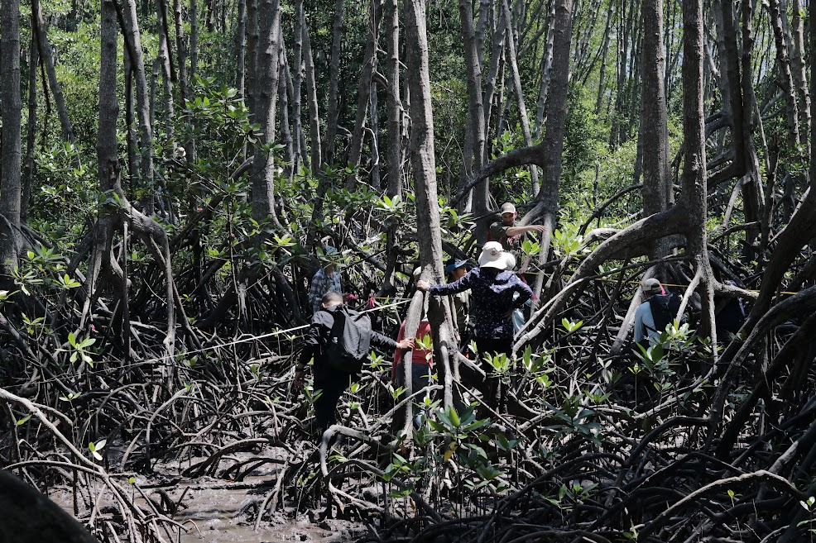
Recommendations from testing mangroves
maps
Calibration (limited amount of NFI pantropical data)
For AFOLU only cover tier 1
Difficult to apply methods for combining AD and EF
Ambiguity on where mangroves are reported (BUR vs REDD+ annex)
Need to link with databases of EF data (e.g. SWAMP carbon database)

Slide 17
In conclusion and moving Ahead….
Case studies for Land Cover Mapping
Latin America – Paraguay, Guatemala, Peru, Colombia
Central Africa – Gabon, ROC, DRC, Camer0on
Pacific Islands – Papua New Guinea
Southeast Asia – Thailand, Cambodia, Vietnam
Regional workshops are scheduled for 2023:
Mangroves datasets (Gabon and Peru)
Possible engagement with other partners (GIZ in Solomon Islands)
Bilateral country engagement biomass estimation
Include more case studies of Biomass in NASA Biomass Dashboard – New NASA CMS grant to UMD (Mexico, Ecuador, Senegal and Ghana)
Solomon Islands, Vanuatu and PNG case study with US Forest Service

Slide 18
In conclusion and moving Ahead….
Bilateral country engagement mangrove mapping and monitoring
Engagement with other partners (in Solomon Islands)
Regional workshop in Gabon for Central African Countries – September 25 – 30, 2023
Regional workshop in Peru for Latin America and Caribbean countries – November 2023
Thanks!
Sylvia Wilson snwilson@usgs.gov

