Slide 1


Slide 2

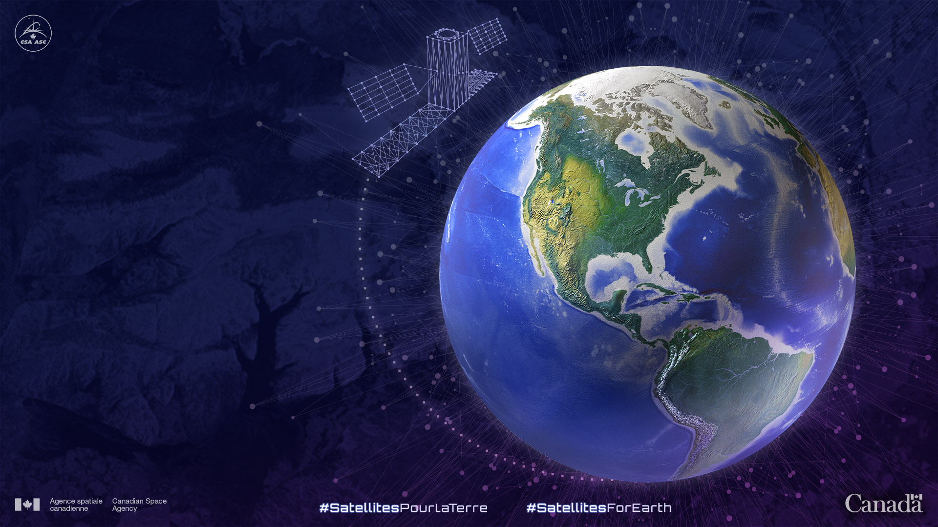


Canadian Space Agency Update on Missions and
Data Contribution
Favoriser une utilisation intelligente des données satellitaires pour développer des solutions aux principaux défis sur Terre et dans notre vie de tous les jours.
Fostering a smart use of satellite data to develop solutions to key challenges on Earth and in our everyday lives
Janin Huard – Director
Guy Aubé
Justin Beauregard
Stéphane Chalifoux
Julie Claveau
Christobal Colon
Yves Crevier
Robin Dubé
Laurent Giugni
Michael Kirby
Pierre Nadeau
utiliTerre smartEarth
ACCELERATOR
Accelerating innovation
ACCELERATEUR
Accélérer l`innovation
INTEGRATOR
Stimulating uptake of Space Capacities
INTEGRATEUR
Stimulating uptake of Space Capacities
ENABLER
Developing Capacities
FACILITATEUR
Developing Capacities
Notes:
smartEarth is the Canadian Space Agency's renewed funding initiative fostering a smart use of satellite data to develop solutions to key challenges on Earth and in our everyday lives.
utiliTerre est l'initiative de financement renouvelée de l'Agence spatiale canadienne qui favorise une utilisation intelligente des données satellitaires pour développer des solutions aux principaux défis sur Terre et dans notre vie de tous les jours.

Slide 3
 | RADARSAT-1 (1995-2013) | RADARSAT-2 (2007 - ) | RCM (2018)
# of satellite | 1 | 1 | 3
Mass | 2750 kg | 2300 kg | 1430 kg
Exact revisit | 24 day | 24 day | 4 day (12 / sat)
SAR time / orbit | 28 min | 28 min | 15 min / sat
Antenna size | 15 m | 15 m | 6.75 m
Polarization | HH | HH, VV, HV, VH | HH, VV, HV, VH, Compact Pol.
Look direction | Right | Right or Left | Right

Slide 4
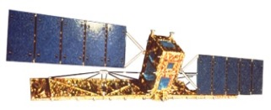
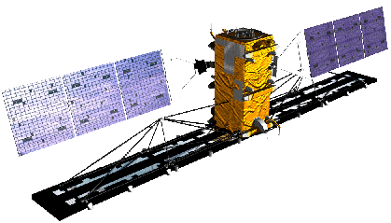

RADARSAT Business Model Evolution
RADARSAT-1
SAR EO is experimental
R-1 is first operational SAR satellite worldwide
Data available for GoC at the cost of processing
Exclusive right to commercially distribute data to RSI (now MDA-GSI)
Bring substantial royalties to GoC
RADARSAT-2
Privately-owned and operated by MDA
Data sold and distributed by MDA-GSI
MDA has a world-wide network of data resellers
GoC has access to $450M pre-paid data credit and pays processing costs
RCM
Government-owned and operated with contractual support from industry
Designed to serve Canadian interests first
Commercial component being defined
Comply with the Directive on Open Gov’t (subject to exceptions)
Notes:
Government users are unsatisfied with sharing restrictions under R-2 regime

Slide 5
Update on Missions Data availability
RADARSAT 1 (1995 – 2013)
  Decommissioned in 2013
  Archive is distributed over 43 foreign receiving stations
  RADARSAT 1 open data project to repatriate all Radarsat-1 data stored in foreign stations back into the GoC Archive by 2028 and make them available for science and R&D
RADARSAT 2 (2007 - )
  MDA owned and operated
  Commercial access to new data tasking for operations
  Ad hoc agreement on the use of the archive for science and R&D (Polar datasets, circum-tropical rain forest, volcano demonstrator, etc.)
  Long-term coherent archive of high res data for tropical forest
RCM (2018 - )
  Government of Canada focused mission
  Free data with open and limited access to vetted users
  Standard coverage operations
  General public’s access will be expanded to include complex products in addition to detected products (Spring 2023)
  Access to 16-m resolution or coarser image products is also expanded to include international land

Slide 6
RADARSAT C-Band data archive for monitoring and R&D
Advantages
  All-weather imaging instruments – ideal for monitoring in regions of inclement weather;
  Rich continuous archive over almost 3 decades 27 years of C-band data
  Improved temporal resolution with RCM
  Good examples – sea ice monitoring, polar ice sheets, crop and agriculture variables, disaster response/mitigation, etc.
Limitations
  Data coherence – requires dedicated acquisition strategies
  Limited penetration for the monitoring of dense vegetation areas
  Requires standardization of the integrated method – from acquisition to analysis to ensure comparability and reproducibility of results
  Need for validation
  Business models with varied access to data
We would like to capitalize on the LSI-VC AFOLU coordinated work to better understand
the capabilities of the RADARSAT archive for specific challenges

Slide 7
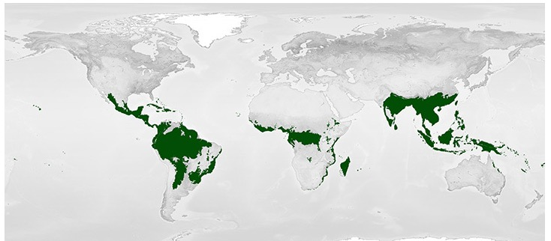
Terrestrial Applications and R&D Challenges
Interest to assess and better understand the usefulness of the RADARSAT archive for specific challenges related to forest, ecosystem and biodiversity applications
Approach to be articulated in the form of challenges with specific science questions addressing key science priorities
Capitalize on the LSI-VC framework:
  R&D priorities,
  ARD, data access, interoperability
  Methods and guidance
Development of a National platform
NASA Tropical Rain Forest Mask – Earth Observatory Biomes

Slide 8
Additional slides

Slide 9
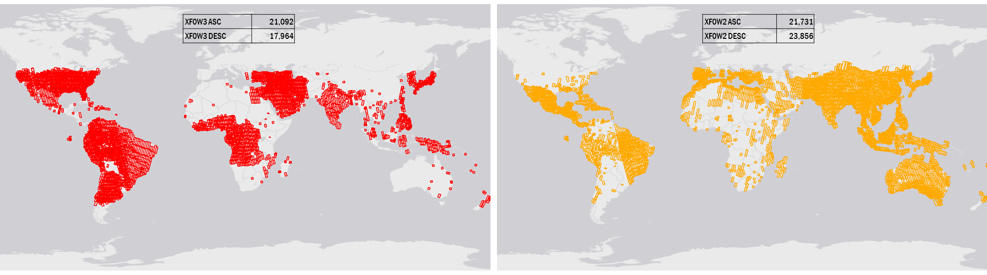
RADARSAT 2 Archive (Extra-Fine 2 and 3) Between 2012 to 2022
The Extra-Fine Resolution Beam Mode nominally provides swath width of 125km at 5m res.
Incidence angle range from 22 to 49 degrees
SLC products
Single polarization which can be either a linear co-polarization (HH or VV) or a linear cross-polarization (HV or VH)

Slide 10
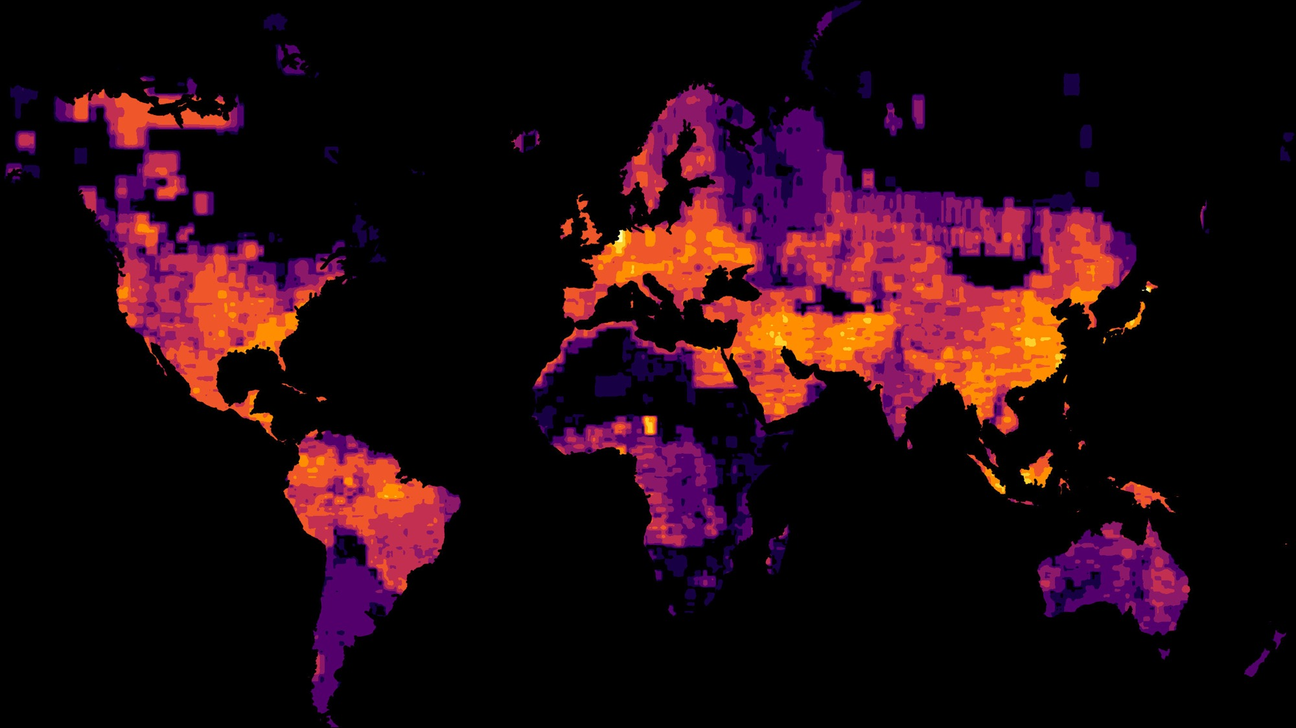
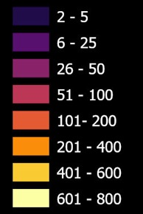

Slide 11
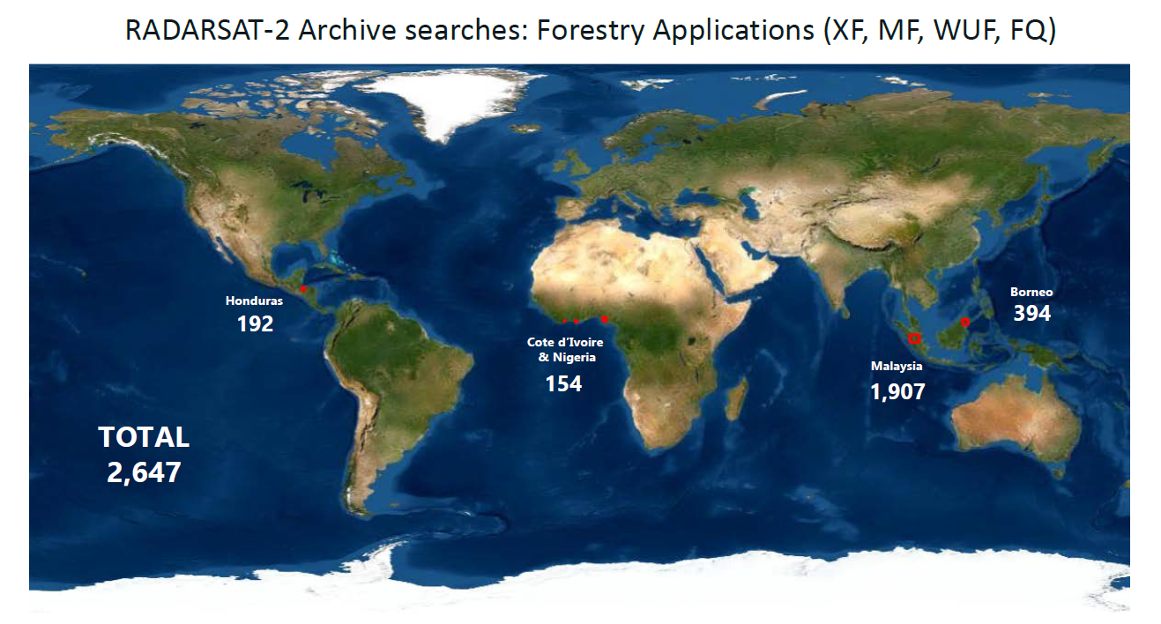

Slide 12
R&D Challenges
What is the spatial and temporal variability of forest structure and biomass in the circumtropical rainforest, and how is it affected by climate and other environmental factors?
How has the extent and distribution of forest cover in the circumtropical rainforest changed over time, and what are the drivers of these changes?
What are the patterns and drivers of forest disturbance in the circumtropical rainforest, including deforestation, degradation, and recovery?
What is the relationship between biodiversity and forest structure and biomass in the circumtropical rainforest, and how does this vary across different regions and forest types?
How do changes in forest structure and biomass affect carbon storage and fluxes in the circumtropical rainforest, and what are the implications for global climate change?
What are the impacts of land use change, including agricultural expansion and infrastructure development, on forest cover, structure, and biomass in the circumtropical rainforest?
How can SAR data be integrated with other remote sensing and in situ data sources to improve our understanding of forest dynamics in the circumtropical rainforest?

Slide 13
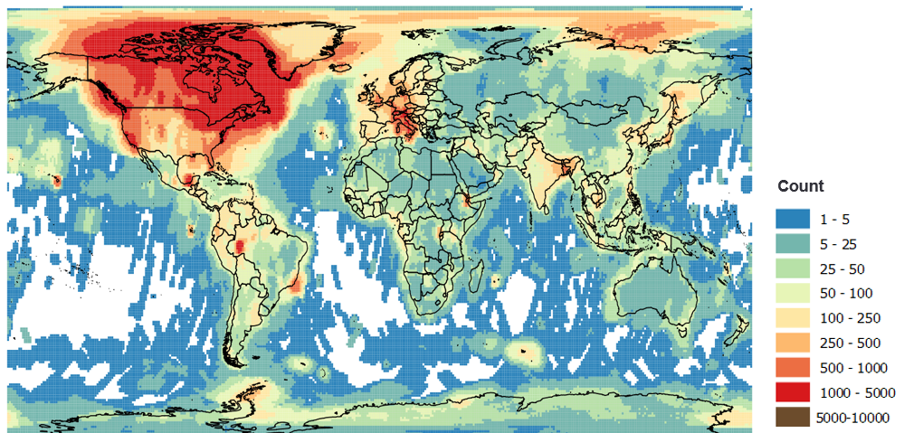
Unprocessed (raw) RADARSAT-1 data
in the Canadian Archives in 2019
This data is approximately 48% of the total scenes acquired by RADARSAT-1.

Slide 14
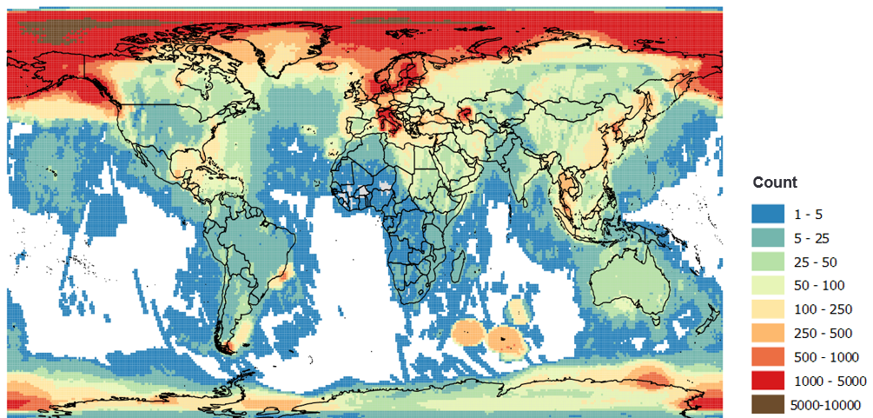
Unprocessed (raw) RADARSAT-1 data
at Foreign Stations in 2019
This data is approximately 50% of the total scenes acquired by RADARSAT-1.

Slide 15
RCM Data Access to General Public

Slide 16
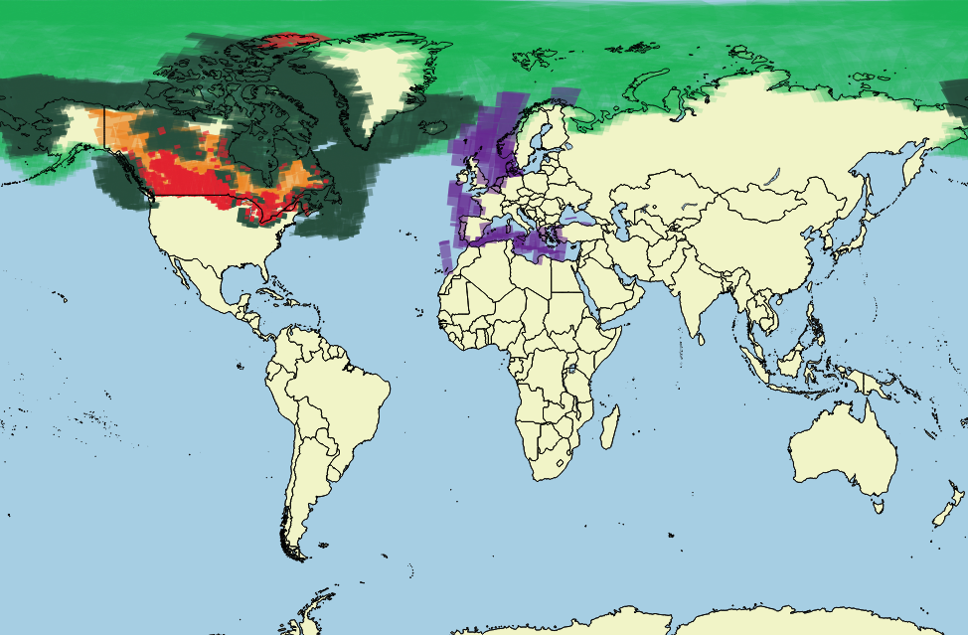
Image Products resulting from Standard Coverages
Overview Map
12 day acquisition cycle shown
Med. Res. 50m - GRD
Avg. Daily
Med. Res. 50m - GRD Every 3 day
Med. Res. 50m* - SLC Monthly
Med. Res. 16m/30m* - SLC Weekly to Monthly
Ship Detection Mode - GRD
Weekly
Acquisitions may be changed without notice to meet requirements of the Government of Canada
Notes:
This graphic represents the expected coverage from RCM at the start of the Routine Operations mission phase in Q3 2019.
Coverage for High and Very High resolution beam modes are not shown. These are expected to be acquired mostly in an ad-hoc fashion over small areas of interest over Canada and internationally.
Domestic and global coverages that are exclusively for defence and security are not shown.

Slide 17
Canadian Contributions to CARD-SAR Definitions
F. Charbonneau, Canada Centre for Remote Sensing, NRCan
Active contribution to NRB and POL updates
  Published 13 May 2022
  Distribution of sample RCM CARD-POL products
Active contribution to the OCEAN CARD
  Published 21 September 2022
  Product Specifications Format (PFS): Co-author
  Metadata template: Co-leader
  Distribution of sample RCM CARD-OCEAN product
  Recent new member: B. Deschamps, Canadian Ice Services
In progress: Development of a unique “Harmonized CARD”
  A unique PFS document and its corresponding metadata template defining jointly NRB, POL, OCEAN and GSLC
  Objective: Reduce confusion between different PFS
  Distribution of sample RCM CARD-Harmonized prototype products
  Lead: F. Charbonneau, NRCAN/CCRS

Slide 18
RADARSAT and CARD Status
Activities at CCRS/NRCan
  Radarsat-1
    Evaluation not yet initiated
    Definitely, the geolocation accuracy will be an issue
  Radarsat-2 and RCM
    Due to Radarsat polarimetric capacity, CARD-POL format is privileged, will migrate to CARD-Harmonized if PFS approved
    Internal production of regional CARD cubes (2008 to now)
    Multi-resolution – Muti-angle integration analysis
    Temporal change detection and monitoring performance analysis
    Initial discussion on RCM CARD operational production have begun
CARD compliance
  Prototype products generated from Radarsat-2 and RCM meet 100% “THRESHOLD” requirements for NRB, POL and OCEAN CARD PFS
  “TARGET” compliance level not assessed yet
Other initiative
  Polar TEP platform: Early development phase of RCM ScanSAR CARD operational production

Slide 19
RADARSAT-2 and RCM CARD Sample Products
  NRB, POL, OCEAN, and Harmonized CARD sample products available
    SFTP host: scatterhome.hopto.org
    user: SFTPfriends
    password: CARD2022;-)
    port: 577

