Slide 1
CEOS-ARD Capacity Development Activities
Chris Barnes, KBR/USGS
Agenda Item 6.7
LSI-VC-13 2023, ESA/ESRIN
23rd - 24th March 2023

Slide 2
Agenda
Transform to Open Science (TOPS) Mission
USGS-NASA TOPS CEOS Work Plan Deliverable 2023
Working Group on Capacity Development and Data Democracy (WGCapD-12) Annual Meeting Summary
  Next Steps

Slide 3

Transform to Open Science (TOPS) Mission
TOPS is part of NASA’s Open-Source Science Initiative
  Involves 10 other R&D federal agencies and 88 Academic institutions
  e.g., USGS, NOAA, USDA, NSF, DoE
Designed to rapidly transform agencies, organizations,
and communities to an inclusive culture of open science
USGS will hold a Community for Data Integration Workshop focused on the theme of Open Data for Open Science from 2-5 May 2023
  Registration deadlines: 31 March 2023 (in person, WV), 30 April (virtual)

Slide 4
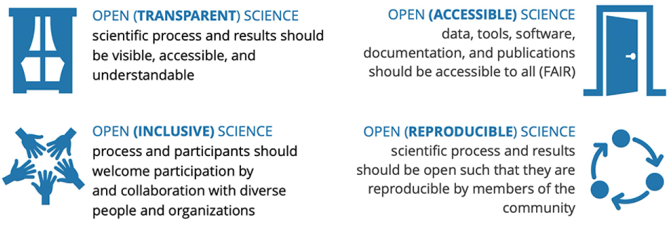
Transform to Open Science (TOPS) Mission
Open-source science is a commitment to the open sharing of
software, data, and knowledge (algorithms, papers, documents, ancillary information) as early as possible in the scientific process

Slide 5
Transform to Open Science (TOPS) Mission
Over the next 5 years TOPS aims to:
  Accelerate major scientific discoveries
  Broaden participation by historically excluded communities
  Increase understanding and adoption of open science principles and techniques
Open Science will broaden participation, increase accessibility to knowledge, and embrace new technologies that can respond to these changes at scale

Slide 6



USGS-NASA TOPS Deliverable
USGS & NASA have committed to a joint CEOS Work Plan deliverable for 2023 through the Working Group on Capacity Development & Data Democracy (WGCapD) in support of TOPS
Deliverable strategy is to highlight international and underserved nations with access to “open-sourced data” via a communications and outreach plan (e.g., promotion of webinars, eLearning, hackathons…)

Slide 7
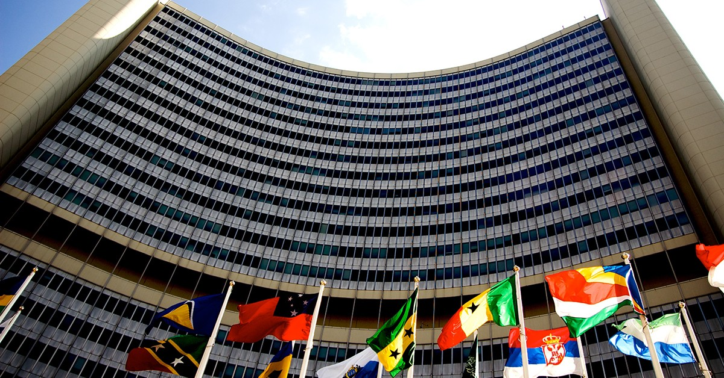
WGCapD-12 Annual Meeting Summary
Joint WGCapD-12/UN-Space meeting took place at UN HQ, Vienna, Austria
  1-3 March 2023
  187 participants from >160 entities
  18 CEOS agencies
  24 UN-Space entities
  4 CEOS Working Groups
    WGDisasters
    WGISS
    WGB
    WGSDG

Slide 8
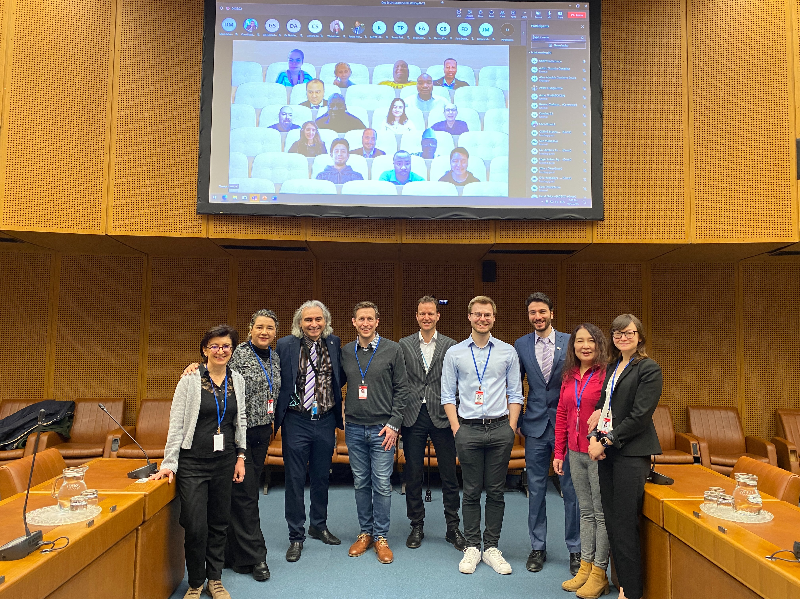
WGCapD-12 Annual Meeting Summary
Agenda involved:
  Education/Training
  User EO Uptake
  EO Data Access
  EO Software Tools
  Infrastructure
Day 1 – Regional Capacity Development
  Africa, Americas, Asia-Oceania, Europe
Day 2 – UN-Space & CEOS Working Groups
Day 3 – WGCapD Member Space Agency Updates

Slide 9
Day 1 – Regional Capacity Development
Key Takeaways
Africa
  More information about open software, open-source algorithms and real-time applications. Education and training on floods, drought, landslides, wildfires, water extent, crop monitoring and early warning systems. Facilitate better EO data access
Americas
  Indigenous co-development of EO activities/training. Disaster risk reduction training at city and county-levels
Asia-Oceania
  Open-source techniques and tools for EO data processing. Disaster risk reduction training including increased awareness/knowledge of existing/future EO data/products
Europe
  Training for young professionals. Need for open, standardized access to learning resources. Access to free or low-cost cloud processing platforms

Slide 10
Day 2 – UN-Space & CEOS Working Groups
Key Takeaways
EO data is already used widely across the UN for different purposes, although in some cases there is a willingness to explore other EO data/products and tools to improve current applications
A plethora of UN-Space entities such as UN Office on Drugs and Crime, UN-Habitat, World Food Programme and the UN International Children’s Emergency Fund expressed an interest in learning more about where/how to access data capacity building materials and “more ARD” to facilitate their respective and unique mission objectives

Slide 11
Day 3 – WGCapD Member Updates
Key Takeaways
A wealth of capacity building resources are available. Some are already answering the needs expressed by the users; however, further coordination in response to specific user needs expressed by WGCapD participants/members is needed
  Funding for access to higher resolution data, “more ARD” and cloud computing
  Improved awareness of disaster response decision makers to current/future availability of EO data, products and tools

Slide 12
WGCapD-12 Next Steps
WGCapD Chair will reach out to those entities expressing capacity needs to support local applications so they can be addressed
  The phrase “more ARD” was used regularly, but when asked what specific “ARD” was lacking it was inconclusive.
  As this discussion took place among several CEOS agencies, there still could be some confusion on ARD/EO processing level terminology that might need to be addressed
WGCapD Chair to write a summary report of the meeting/captured action items
WGCapD Members review action items and discuss as potential future CEOS work plan collaborations

Slide 13
Christopher Barnes
barnes@contractor.usgs.gov

