Slide 1
CEOS-ARD in the Cloud
Discussion Starters
Presenter, Organization
Agenda Item #: 6.6
LSI-VC-13 2023, ESA/ESRIN
23rd - 24th March 2023

Slide 2
CEOS Work Plan – CEOS-ARD in the Cloud
"A core driver of CEOS-ARD is the provision of data that allows immediate analysis with a minimum of additional user effort. Cloud computing is central to achieving this ambition. This task encompasses the work that must be done across the CEOS-ARD Oversight Group, WGISS, and the VCs to ensure effective availability and use of CEOS-ARD in the cloud.
Topics include:
Taking stock of CEOS-ARD availability in the cloud
Exploring how CEOS-ARD can better support cloud platforms, data providers and users
Better represented in the cloud (e.g., branding, logo);
Discussions around data formats and STAC / metadata catalogues,
Cross-cloud data access and use
Authoritative data / provenance, etc.
Connecting CEOS with OGC's Earth Observation Exploitation Platform DWG could be beneficial and should be explored."

Slide 3
Goals
Get as much CEOS-ARD in the cloud as possible
  Commercial cloud, CDSE, other
  LSI and other data types
Make it easy to find, access and use
  Cross-cloud mechanisms
  STAC, COG
  Authoritative data / provenance
  Facilitate automation, AI/ML-enabling
Make it as interoperable as possible
  CEOS Interoperability Framework

Slide 4
Pecora 22 – ARD feedback
Agencies should pursue a common, analysis-ready, freely/easily accessible international data layer for land imaging that is highly accessible, usable, and traceable to the authoritative source data
Agencies should develop distributed complementary approaches to cloud service providers which avoid the “vendor capture” dilemma. These approaches would result in improved innovation, data security, reliability, and traceability for users
NASA should capture lessons learned from its recent with the three big cloud service providers (Google, Amazon, and Microsoft) – what are the advantages and disadvantages for using each one - and share them with other public EO agencies
There would be great benefit from creating a standard data catalog such as the proposed Geospatial Digital Object Identifier (GDOI) (e.g., subset of the Spatio-Temporal Access Catalog (STAC) record and the Digital Object Identifier (DOI)) containing the basic metadata for a given observation
Cloud-optimized data formats are optimized for provision but not yet conducive to long term data curation
Agencies and cloud service providers should ensure the commercially hosted data is the authoritative data
Space agencies should try to retain control of their data (e.g., authoritative data sources)

Slide 5
GEOGLAM Cloud feedback
Data in AWS should ideally be “cloud optimized GeoTIFF”. HDFs have very high value to science (and roles in existing workflows) but our survey work show GEOGLAM application developers largely prefer GeoTIFF, as well.
Interoperable, analysis-ready moderate resolution data products are of high priority across the satellite-based agricultural monitoring community, which is growing by leaps and bounds each year in both the public and private sectors. The provision of fully interoperable, intercomparable data to construct coherent time series will be critical to realizing the agricultural transformation necessary to feed the world sustainably and fight climate change (in line with 2030 Agenda for Sustainable Development, G20 Action Plan on Food Price Volatility and Markets, and UNFCCC COP21).

Slide 6
OGC EO Exploitation Platform DWG
Defines the role for OGC activities within the Earth Observation Data Exploitation platform domain
Provides an open forum for the discussion and presentation of interoperability requirements, use cases, pilots, and implementations of OGC standards in this domain.
Foster interoperability among Exploitation Platforms and their components
Will act as an open form for discussion and documentation of interoperability requirements for the domain in order to drive OGC standards evolution

Slide 7
Discoverability and Accessibility
Matt Steventon

Slide 8
Goals
Get as much CEOS-ARD in the cloud as possible
  Commercial cloud, CDSE, other
  LSI and other data types
Make it easy to find, access and use
  Cross-cloud mechanisms
  STAC, COG
  Authoritative data / provenance
  Facilitate automation, AI/ML-enabling
Make it as interoperable as possible
  CEOS Interoperability Framework

Slide 9
A couple of entry points:
“Top down” via ceos.org/ard
“Bottom up” via various providers
The former is easier for us to progress, so let’s start there

Slide 10
Top down..
Perspective:
The non-expert user
I hear CEOS-ARD is a good starting point, and look to ceos.org/ard
Ok, looks promising, some datasets, now what..

Slide 11
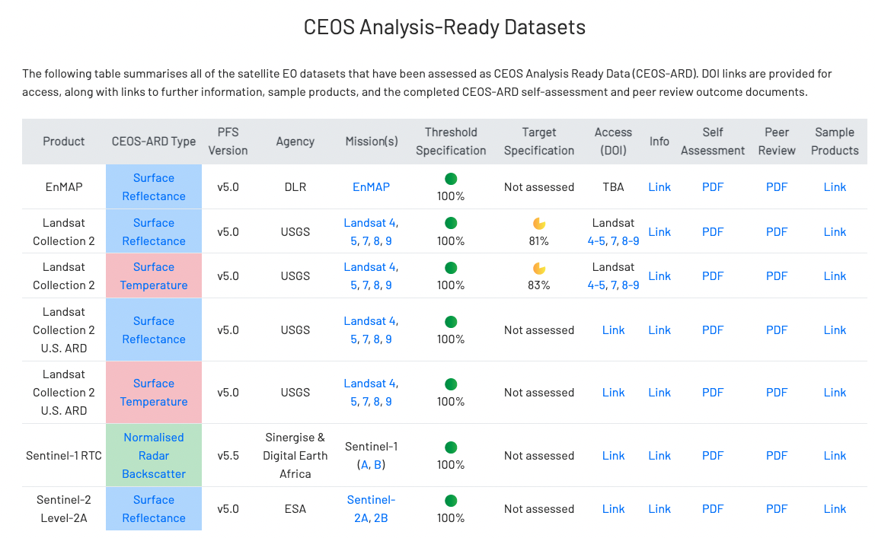
This is what users are after? <10% of screen space
Access links:
Inconsistent
Not direct - go to various websites
Requires further digging
No sense of cloud repository availability
Confusing naming conventions
  Levels, inconsistent labelling
  Tiles, scenes, etc.
Same datasets from multiple providers and mirrors?
Variants
Sample products likewise difficult to find?
Sample metadata not clear
Data access needs to be clearer and consistent?
Can we put different cloud service links on here?
Lack of emphasis on data access and “What do I do next?”

Slide 12
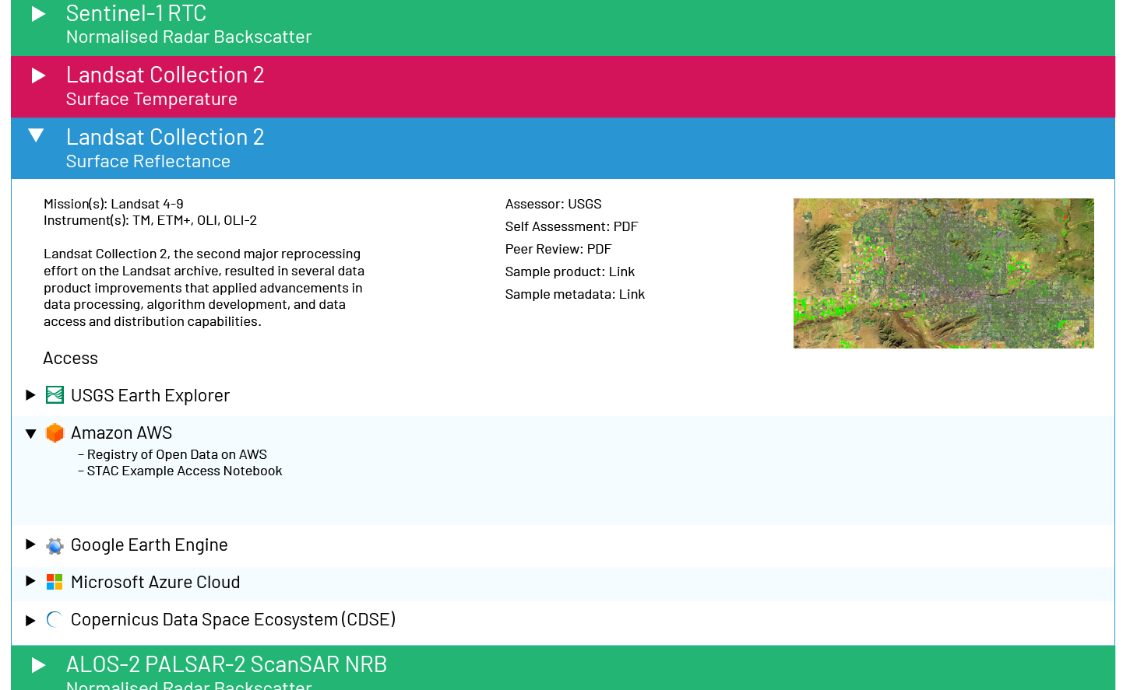
Proposal for discussion
Needs a more robust database, easier way to admin tables
Questions:
Will the inclusion of commercial access info be a problem?
STAC Example access notebooks – SEO support?
ODC Sandbox linkages?
Other tutorial like information on how to access data?
What other info do we include? Formats etc.?
Data location?
Geographic extents for things like DEAfrica datasets?
Data provenance, derived datasets, … ?
Multiple product types, e.g. JAXA ALOS-2 NRB, dataset details, resolutions, etc.
Filters?
Identification of specific metadata files
Much bigger focus on data access and resources to help users (e.g., STAC access example notebooks)

Slide 13
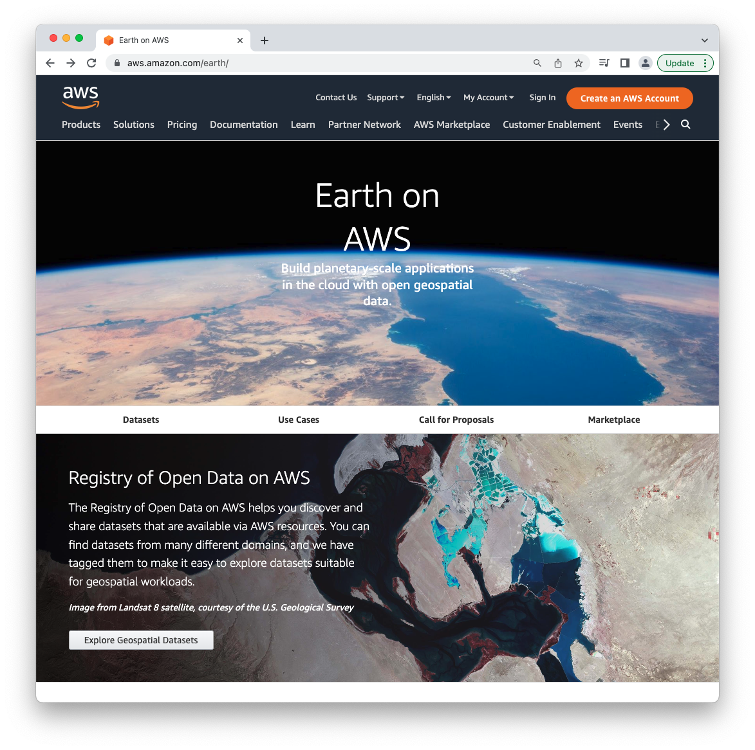
And what about the other direction?
Example: https://aws.amazon.com/earth/

Slide 14
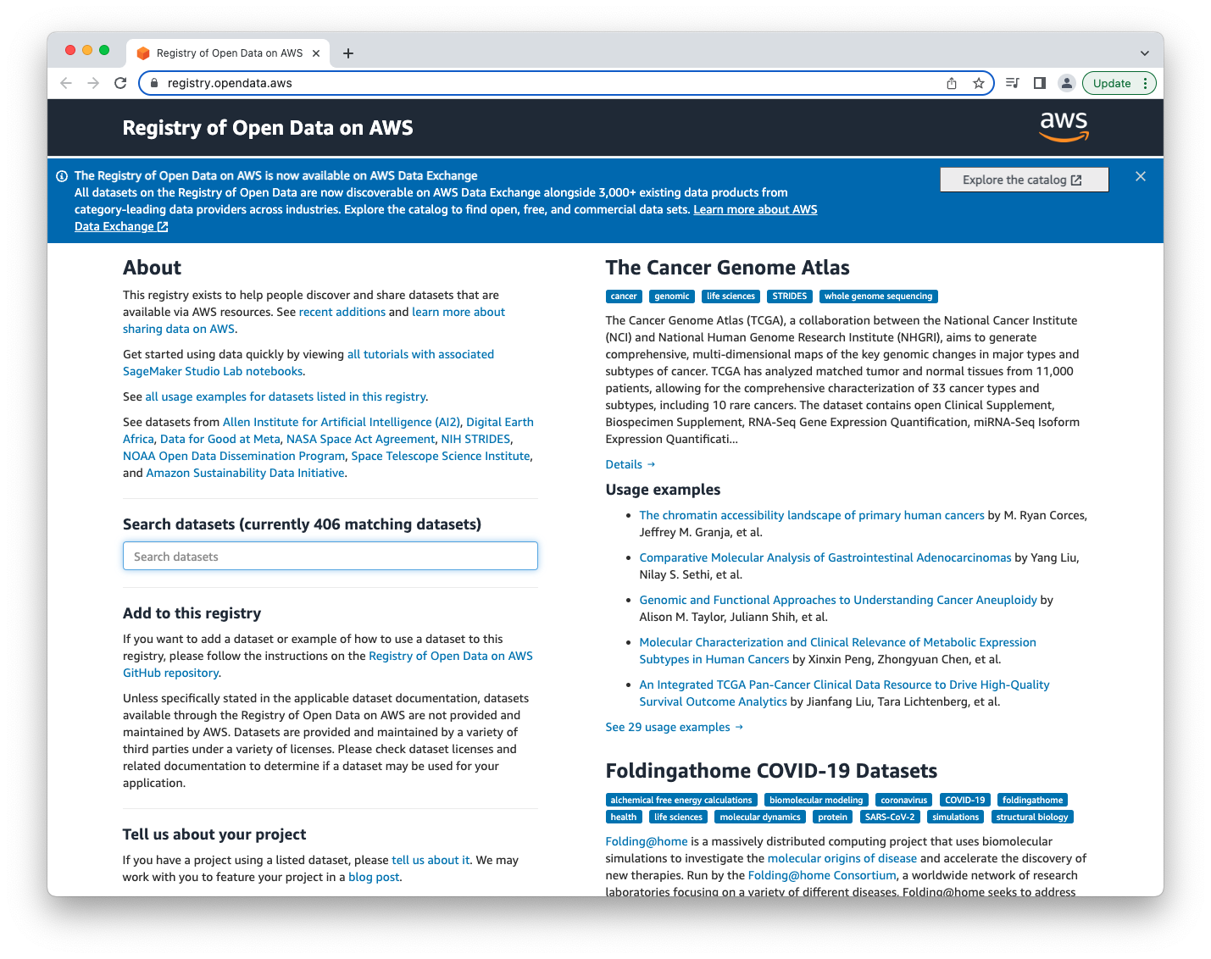
And what about the other direction?
Example: https://registry.opendata.aws/

Slide 15
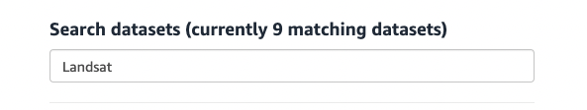
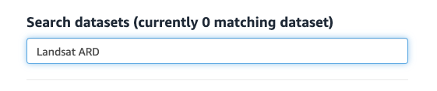
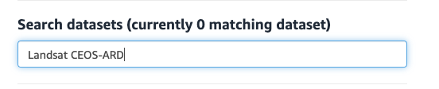
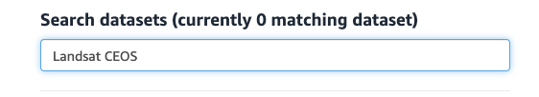
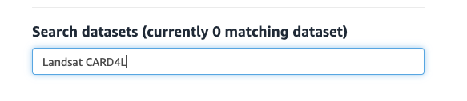
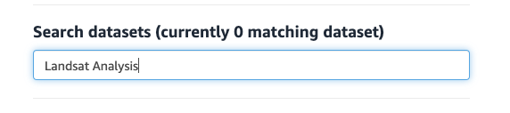
And what about the other direction?
https://registry.opendata.aws/

Slide 16
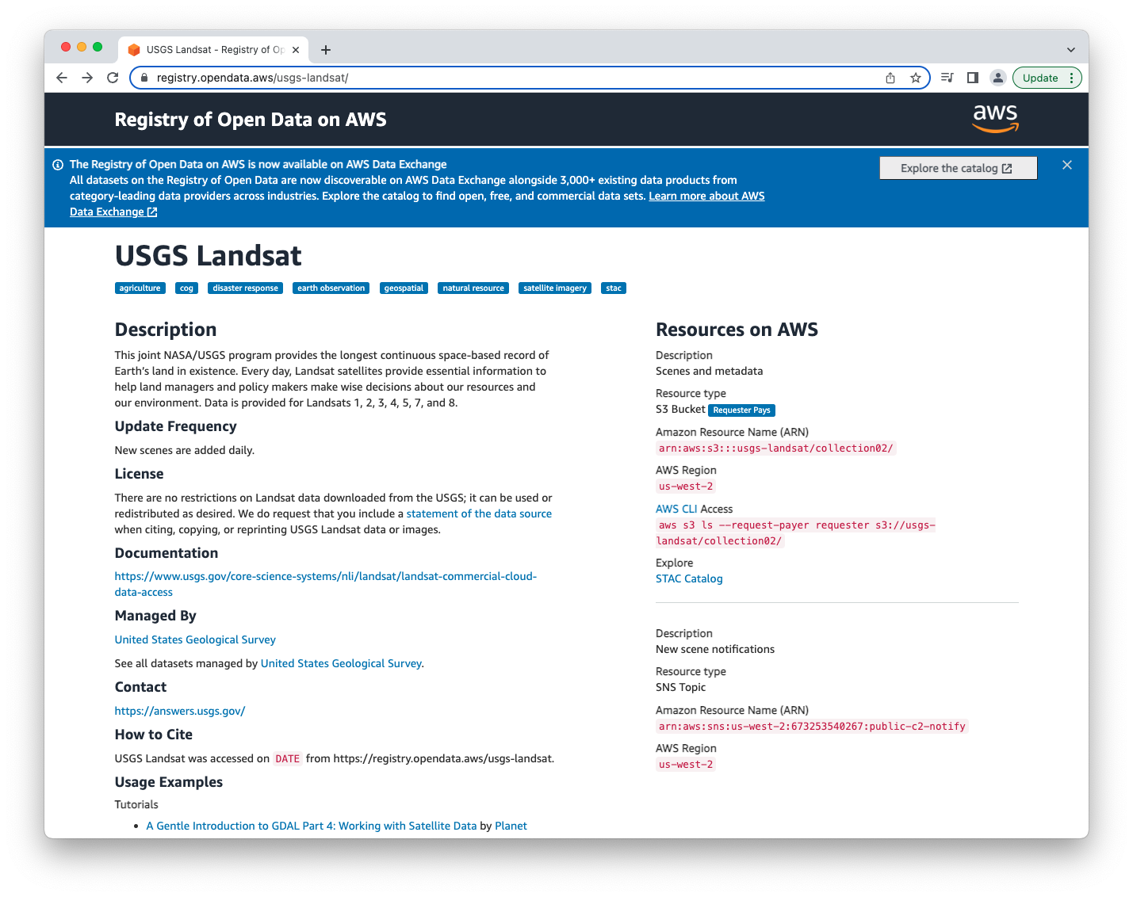

Slide 17
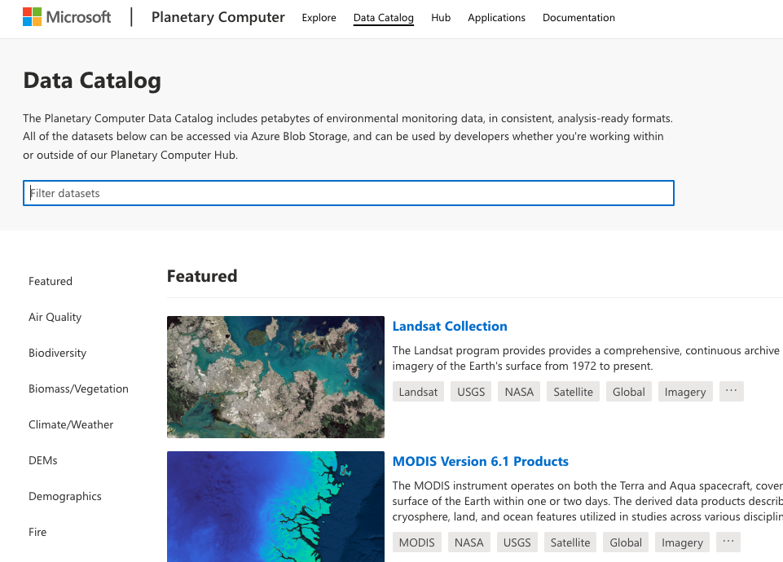

Slide 18
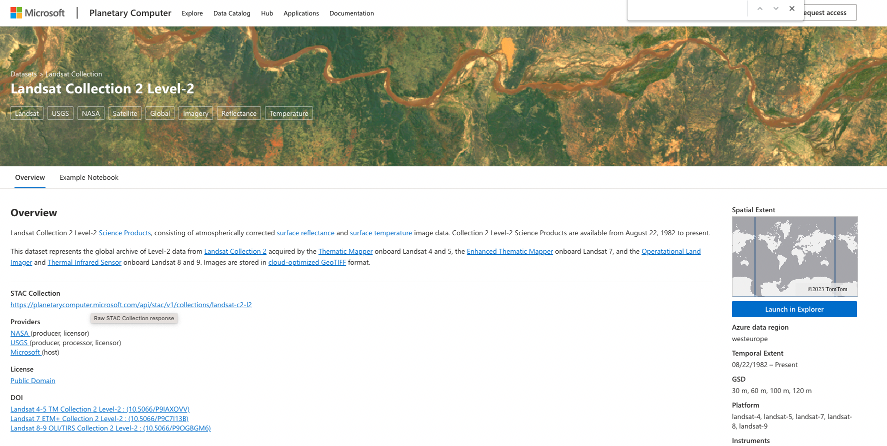

Slide 19
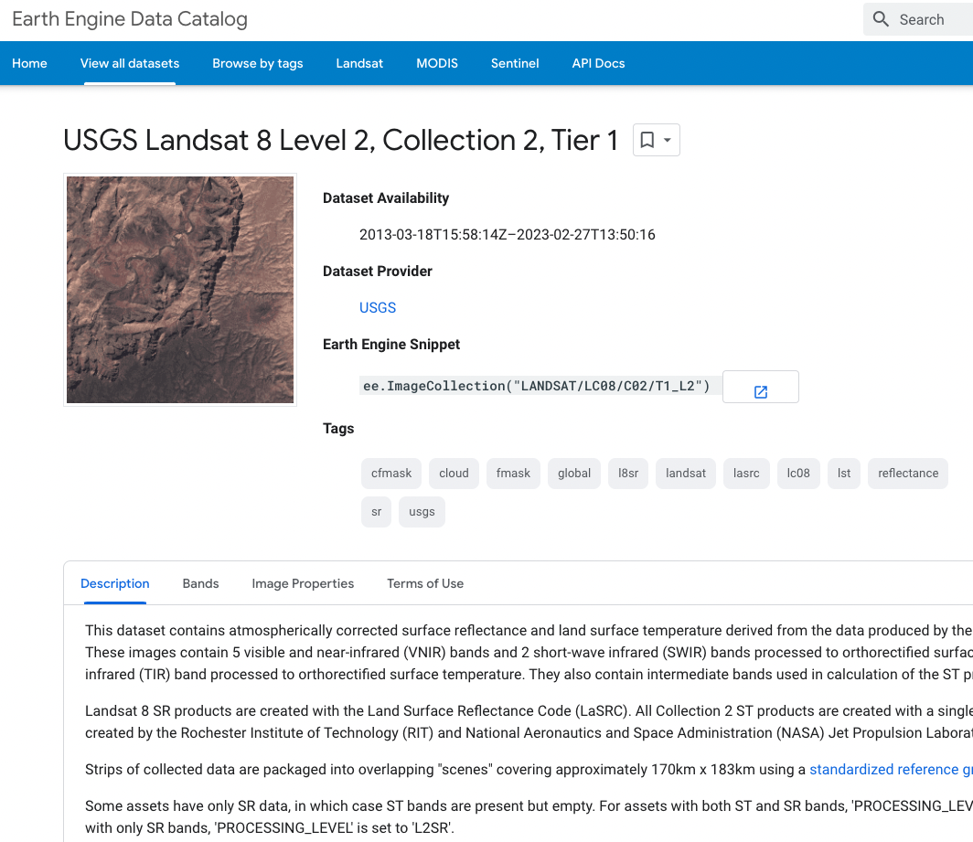

Slide 20

What can we do to better represent CEOS-ARD in the cloud?
Guidelines for CEOS Agencies publishing dataset to cloud providers? Action?
Need branding e.g. logo on these platforms?
Seek to have CEOS-ARD highlighted, e.g. on https://aws.amazon.com/earth/
Collaboration on comms
CEOS-ARD, ARD tags for data repositories would be an easy win?
Different copies of datasets - are they all processed the same, are they exact mirrors?
  CEOS-ARD stamp for provenance?
  Need to note this type of info in our own ceos.org/ard tables
  Very hard to keep track of
Not just commercials - what about CDSE now – good opportunity to have CEOS-ARD closely connected and represented
We need to establish relationships with theses big data providers
Action to get our position and desired scenario in line for discussion with them at an industry workshop day later in 2023 before LSI-VC-14?
Connections with other systems?
  WGISS: IDN, CDA, CWIC, FedEO, OpenSearch
  MIM DB - done
  EOPortal
  others

Slide 21
GA-USGS Cloud Enabling Collaboration Activities
Andreia Siqueira, GA
Steve Labahn, USGS

Slide 22
Overview
Collection Management Principles & Guidelines
Metrics & Reporting
Provenance, Authoritative Data, Replica Copies, Derived Datasets & Inherited CEOS-ARD Compliance (Future Topic)
  LSI-VC-13 Discussion: Methods (TBD) whereby replica copies are also identified as meeting CEOS-ARD compliance?

Slide 23
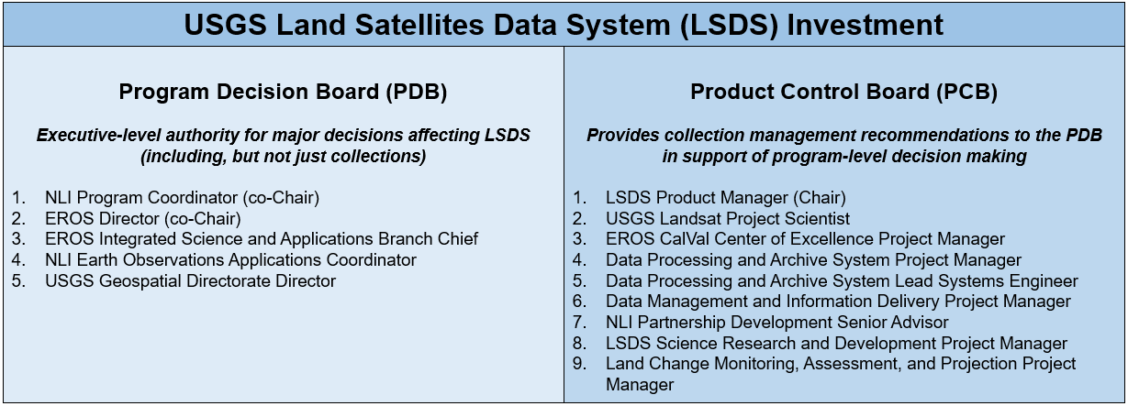
Collection Management Principles & Guidelines
Customer focused, predictable, understood, communicated, and reliable approach is key (automation, AI/ML-enabling)

Slide 24
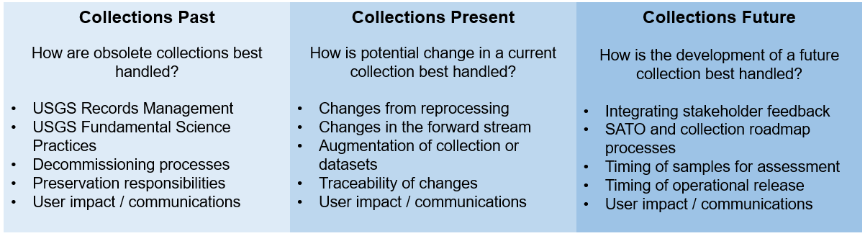
Collection Management Principles & Guidelines - Early Stages
PCB established 3 sub-groups, considering USGS policies, broad data management principles and prior art, and lessons learned

Slide 25
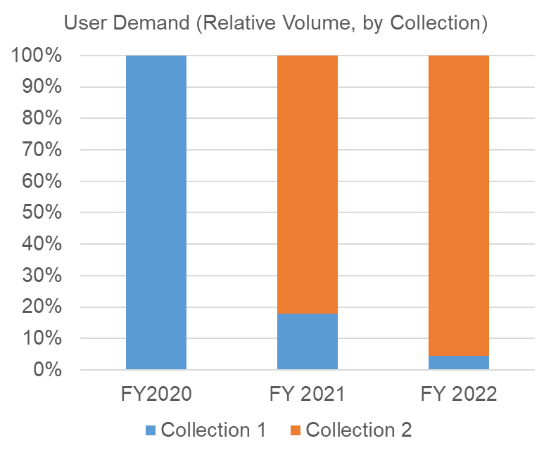
Metrics & Reporting
USGS - Landsat Collection 1 to Collection 2 Transition
Collection 1
  Only Level-1 products
  Only stored on-premises
  Only bundle access
  Forward processing ended Dec. 2021
  Decommissioned Dec. 2022
Collection 2
  Added Level-2 (CEOS-ARD compliant) products
  Products released Dec. 2020
    Recent products stored on-prem
    All products stored in cloud
  Bundle, band, or pieces and parts access
  Cloud direct access began in May 2021
  Forward processing ongoing

Slide 26
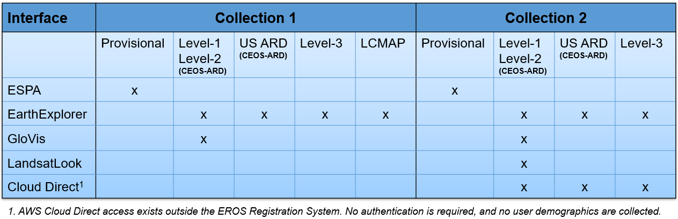
Metrics & Reporting
USGS - Interfaces

Slide 27
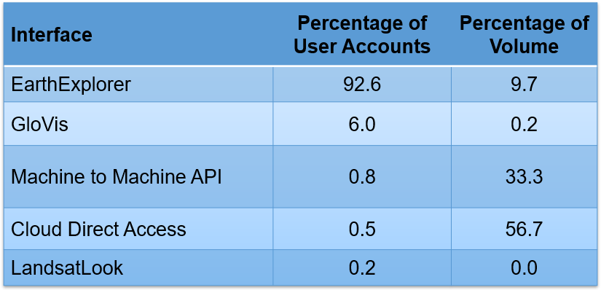
Metrics & Reporting
USGS - Collection 2 Demand by Interface

Slide 28
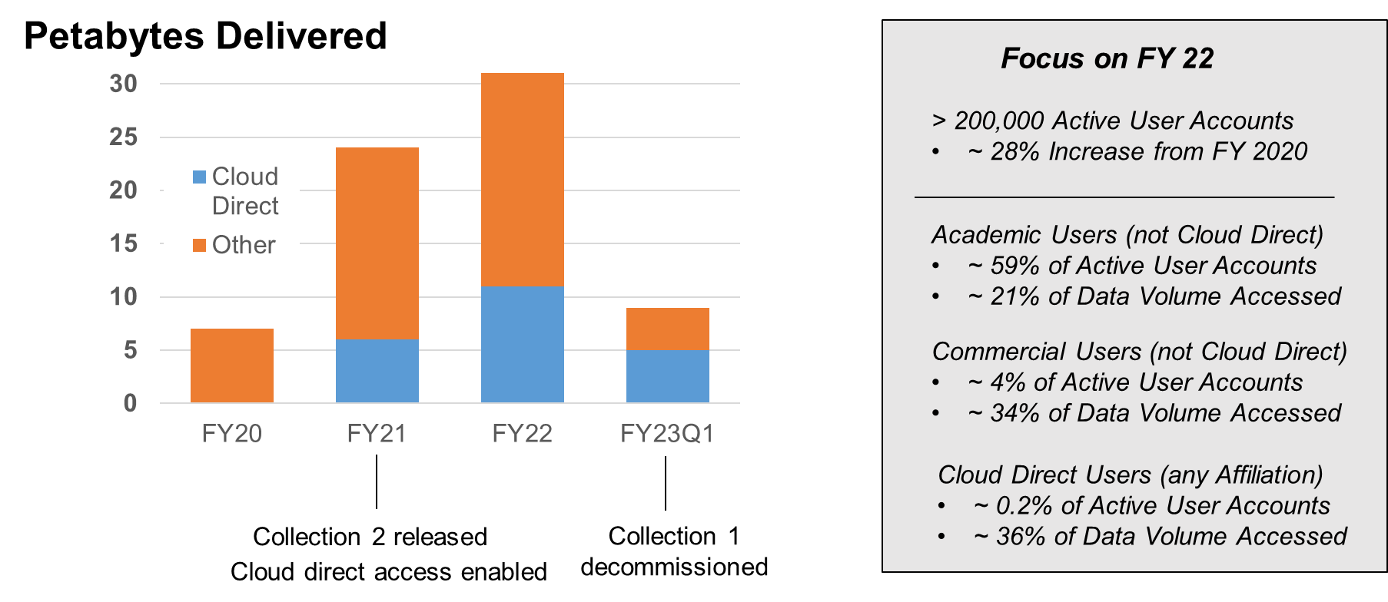
Metrics & Reporting
USGS - Recent Landsat Product Demand & Access Trends

Slide 29
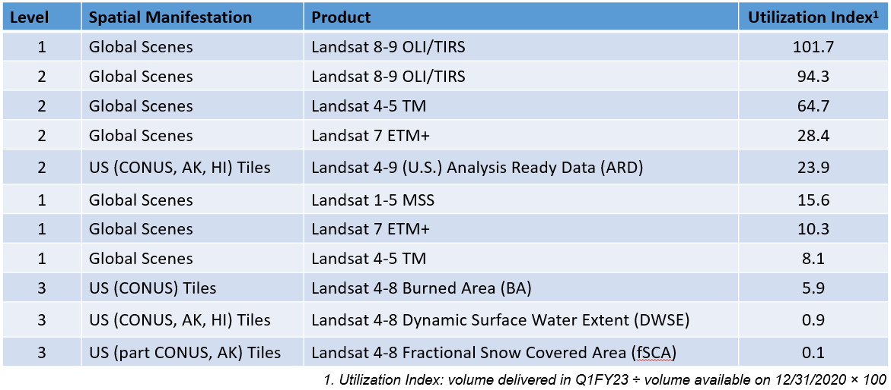
Metrics & Reporting
USGS - Landsat Collection 2 Demand & Utilization

Slide 30
Metrics & Reporting
GA-USGS Collaboration
USGS exploring user metrics to highlight issues around traditional approaches versus Cloud access modes
Aspects of architecture / metrics / interfaces / dashboards / ETL reuse could all be explored but initially focusing on metrics / KPI
GA working on development of Enterprise Data Model in Microsoft PowerBI to enable interfacing with complex AWS metrics
GA-USGS teams prepared a requirements spreadsheet outlining existing and potential reporting measures - now working to identify areas to collaborate (e.g., usage volume by Identity and Access Management (IAM) role, IP address, age of data, unique users by interface, volume by interface, volume by country, and daily egress volume)

Slide 31
SpatioTemporal Asset Catalog (STAC)

Slide 32
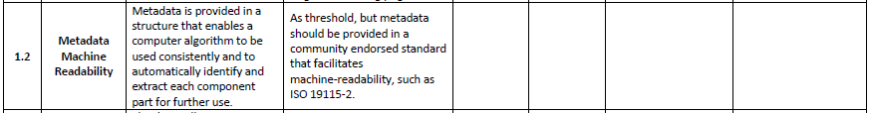
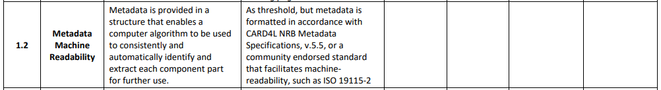
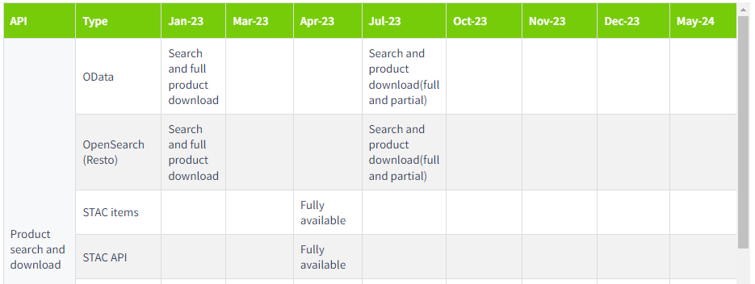
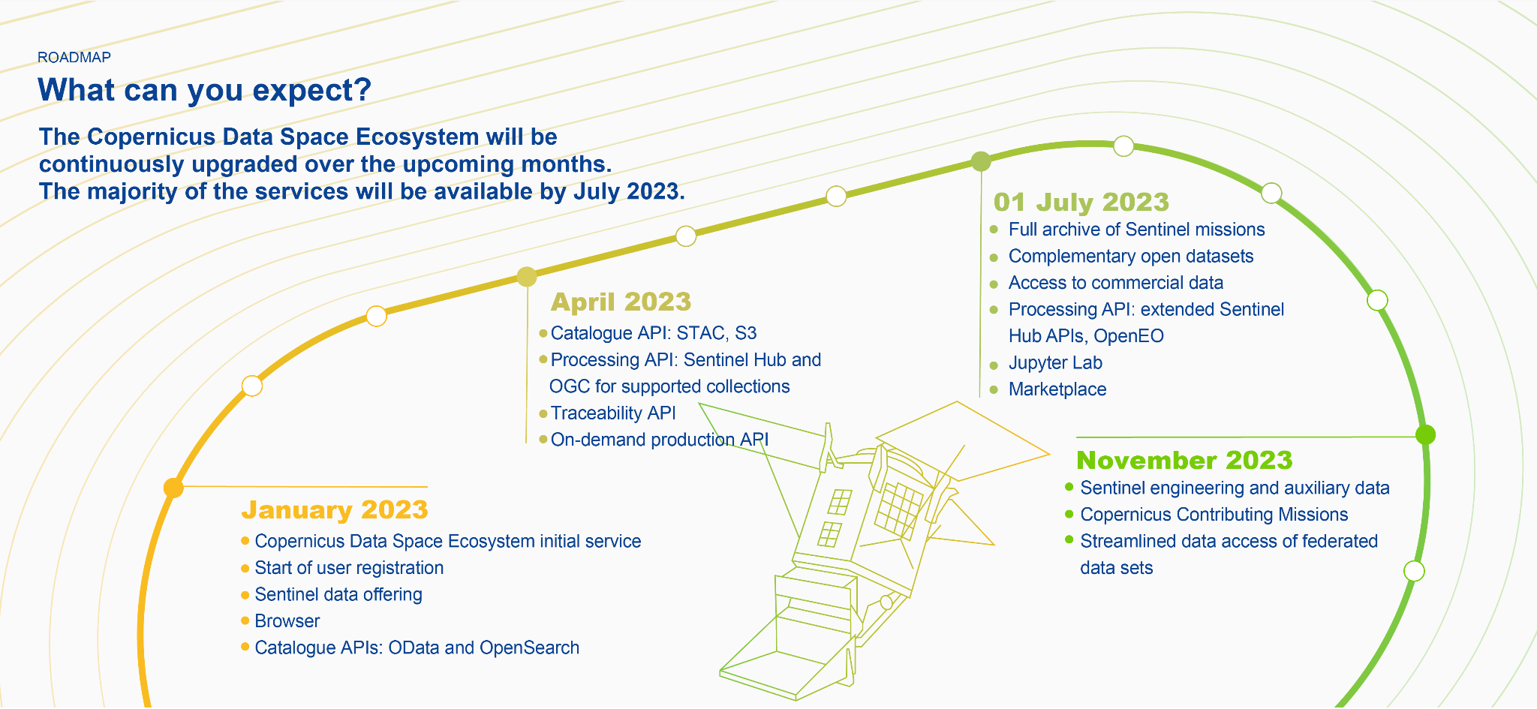
Current State
STAC not required in PFSs, but strongly encouraged as a Cloud-enabling format
USGS Landsat Collection 2 incorporated STAC spec 1.0
ESA Copernicus Data Space Ecosystem (CDSE) to incorporate STAC (APIs (copernicus.eu))

Slide 33
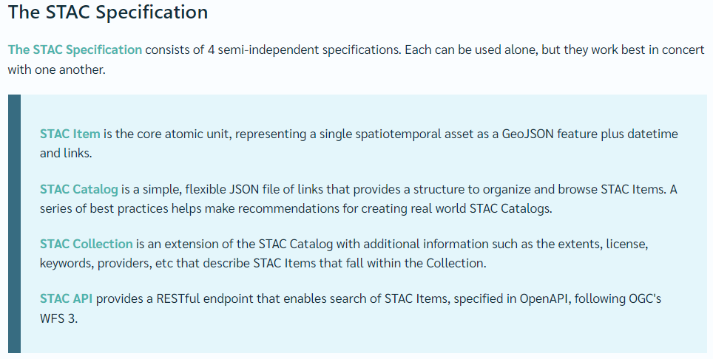
Current State

Slide 34
Current State
CARD4L (Optical and SAR) STAC Extension v0.1 created (STAC Item)
  CARD4L - Optical (aligned with SR/ST PFS v5.0)
  CARD4L - SAR (aligned with NRB PFS v5.5 / POL PFS v3.5)
  Maturity Classification: Proposal (Optical) / Pilot (SAR)
    Proposal -> Pilot -> Candidate -> Stable -> Deprecated
  Disclaimer: The extensions are not officially approved by CEOS, but there's a desire to get CEOS approval. Nevertheless, the extensions have been discussed with CEOS. The STAC extensions don't allow to fulfill 100% target compliance (but most of it), but they surely allow to be 100% threshold compliant.
Conducted March 2021 STAC Workshop to mature/finalize CARD4L STAC Extension
  Several issues remained unresolved and no significant progress since then

Slide 35
Items for Consideration
Interest in defining STAC Items at level lower than CEOS-ARD (Level-2)
  Rationale: Much of the metadata comes from Level-1 processing and is inherited into Level-2 products
Much of the metadata could be or is already part of the Core STAC Spec
  Rationale: A mapping of CEOS-ARD metadata to the Core STAC Spec may be a more efficient (and less redundant) approach
Interest in generating an automated validation check (for CEOS-ARD/CARD4L compliance)
  Rationale: An automated validation check ‘tool’ would provide a more efficient data provider self-assessment and less burdensome than current CEOS WGCV manual validation
Matt Hanson has ideas on how to recognize CEOS-ARD compliance of replica archives using STAC
Proposed CEOS Interoperability Framework includes STAC under Data Accessibility (WGISS Lead)
Potential pre-ARD23 Workshop (Monday prior) meeting to address STAC forward plan

Slide 36
STAC Questions
Should STAC be a more central feature of CEOS-ARD? Clearly STAC is the way things are going? ARD needs to be discoverable and accessible, so to what extent does CEOS try to encourage its use. What are the alternatives if not?
How is STAC currently being used by CEOS agencies and how is this expected to evolve in future with CDSE, etc.
What do we do about the numerous STAC extensions, how do we help consolidate these, and avoid having a STAC extension for every dataset (I understand there are multiple S2 extensions developed by different groups?)
How do we best align STAC with the CEOS-ARD PFS Template and metadata specifications and who can help us do so
Identifying STAC expertise for the ISO/OGC ARD Standards Working Group. We have discussed the ISO/OGC ARD standard perhaps best being a combination of CEOS-ARD + STAC.
Plan for the WGISS STAC Best Practices document and how this fits with the CEOS Interoperability Framework. I'd like to know the target audience and the unique value the best practices document will bring.
  What sort of guidance should we give to data providers to ensure data is searchable.
  Note JAXA ALOS GEE data issue (zip).
Overall we need to understand and chart the best next steps for CEOS-ARD + STAC.

Slide 37
Closing

Slide 38
Goals
Get as much CEOS-ARD in the cloud as possible
  Commercial cloud, CDSE, other
  LSI and other data types
Make it easy to find, access and use
  Cross-cloud mechanisms
  STAC, COG
  Authoritative data / provenance
  Facilitate automation, AI/ML-enabling
Make it as interoperable as possible
  CEOS Interoperability Framework

Slide 39
Closing
Decision: Matters to raise for WGISS attention and eventual elevation to CEOS Principals (e.g., encourage STAC for all CEOS datasets, COG, etc.?)
Recap of actions that agencies could be doing together to improve CEOS-ARD access and interoperability in the cloud

