Slide 1

Cross-Cloud Data Access and Discovery
Brian Killough
CEOS Systems Engineering Office (SEO)
LSI-VC Meeting – Frascati, Italy
March 24, 2023

Slide 2
An LSI-VC Objective for ARD
  Getting CEOS-ARD into the cloud, and making it accessible and interoperable across major cloud platforms needs to be a priority for CEOS agencies.
  We aim to get a better understanding of agencies’ relationships with cloud platforms, agency plans for EO data distribution and access, strategies for data discoverability, any proprietary data platforms and tools, etc.
  Aim to identify actions that CEOS Agencies might take (together and individually) to increase the availability, discoverability, accessibility and interoperability of their data – CEOS-ARD in particular.

Slide 3
Motivation for a Cross-Cloud Study
  Pecora 22 Workshop - Session 2A - Implementing ARD – Common Approaches, Predictability, and Improving EO Data Interoperability
    Key Finding #1 - NASA should capture lessons learned from its recent with the three big cloud service providers (Google, Amazon, and Microsoft) – what are the advantages and disadvantages for using each one - and share them with other public EO agencies
  Request from GEO to CEOS SEO to inform the evolution of the GEO Common Infrastructure (GCI).
    Existing Data Cubes are connected to the GCI via Open Earth Alliance (GEO Community Activity to promote Data Cubes).
    Existing cloud providers are connected to the GCI through CEOS ARD.
  Improving the User Experience
    Understand qualitative and quantitative differences in cloud providers
    Leverage knowledge to improve community experiences through ODC
    Develop plans for future benchmarking and optimizations

Slide 4
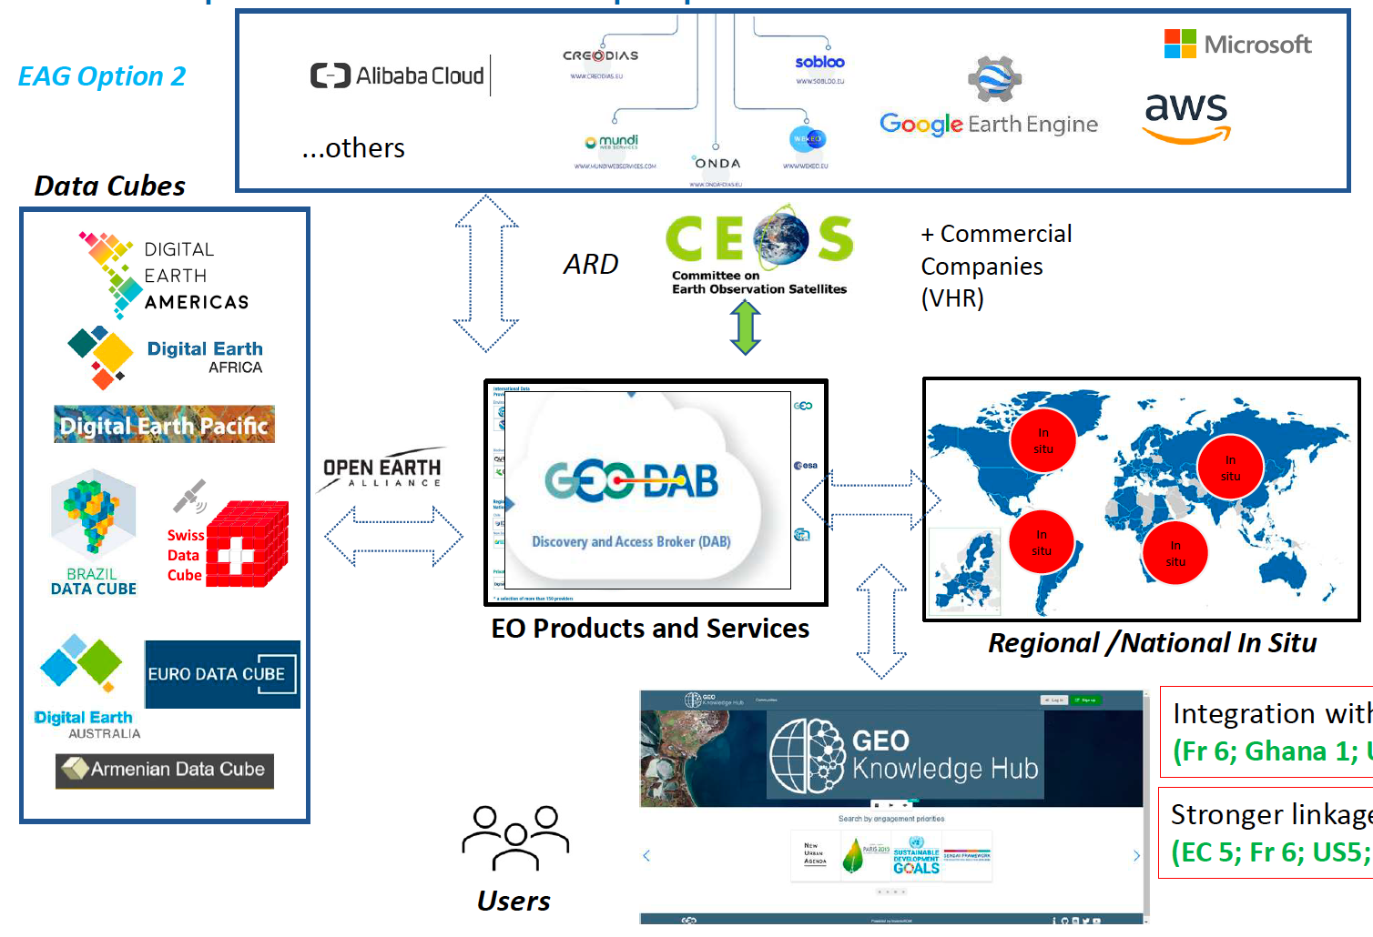
GEO Common Infrastructure (GCI)
Cloud
Providers
Data
Cubes
GCI

Slide 5
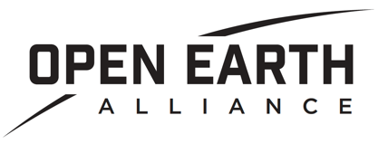
Open Earth Alliance (OEA)
Vision & Mission: Support global sustainability (SDGs) and understanding through the use of open solutions (technology, data, and algorithms).
Impact society through the development and use of Open Source EO technology, algorithms, and data (e.g, the Open Data Cube)
Promote Leadership & Partnership in the EO Community
Grow Industry
Goals:
Support community unification – conceptually and technically.
Support evolution of broader community resources (Documentation, examples, code sharing, implementations, etc.).
Define roadmap based on community feedback for improved adoption, contribution, service, and maintenance.
Be a voice between ODC projects to grow the projects and community.
Support opportunities for funding mechanisms to grow affiliate cub projects and associated activities.
Support alignment technical and non-technical standards among major community member/contributors.

Slide 6
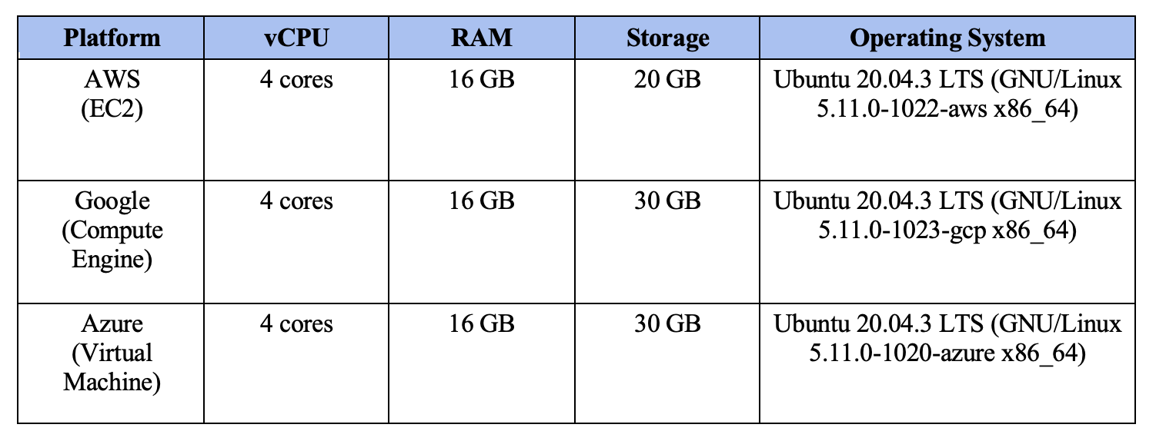
Software Instances
  Software installations … We are using virtual private server machines. Docker Engine and docker-compose were installed in the instances. Docker container with JupyterHub and Postgres with PostGIS extensions was used for the analysis.

Slide 7
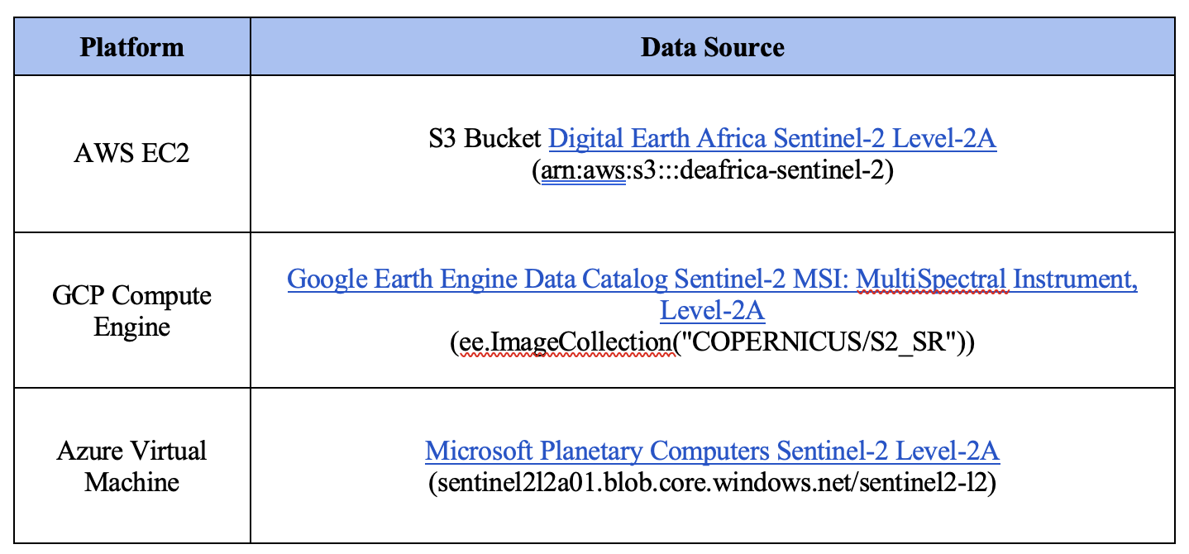
Data Source: Sentinel-2
AWS = Amazon Web Services
GCP = Google Cloud Platform
  Early findings …
  Definitive differences in performance based on testing of standard options.
  This is a simple benchmark intended to fortify future refined benchmark methodologies.
  Requires larger statistical experiments over time to truly determine accuracy of benchmarks
  (daily service volume can vary, new systems can come online, etc.)

Slide 8
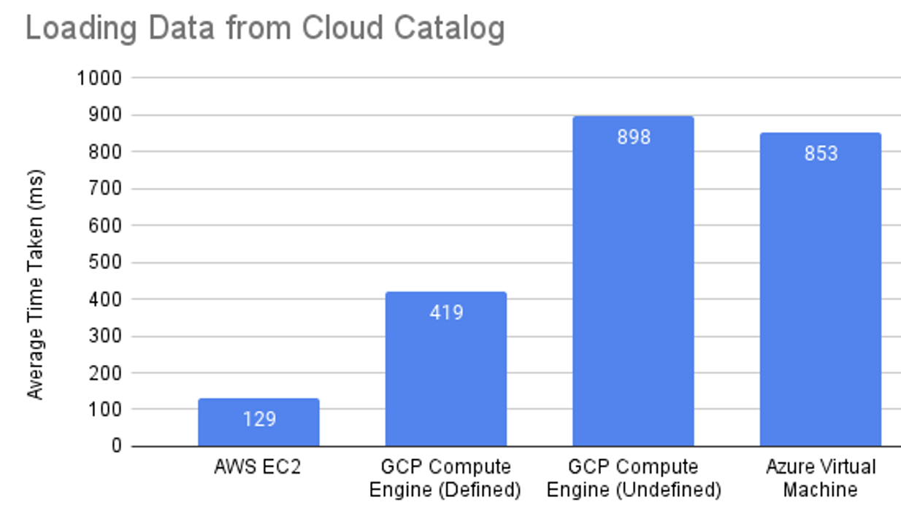
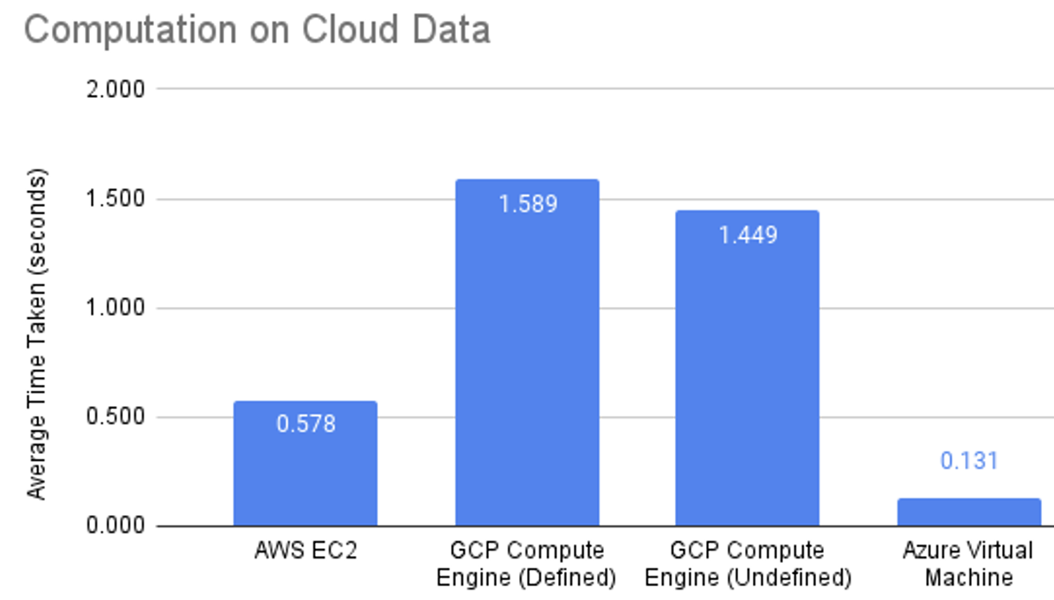
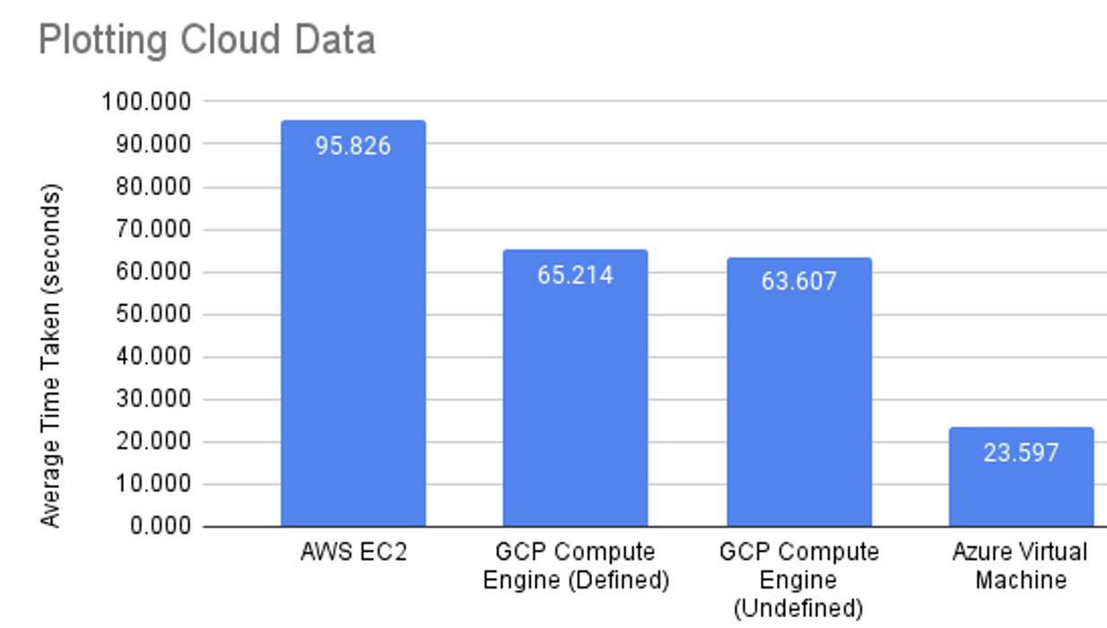
Benchmarking with Jupyter Notebooks
  The following operations were tested for each cloud provider: data loading in an xarray, calculation of spectral indices (NDVI, NDWI, MNDWI), and plotting.

Slide 9
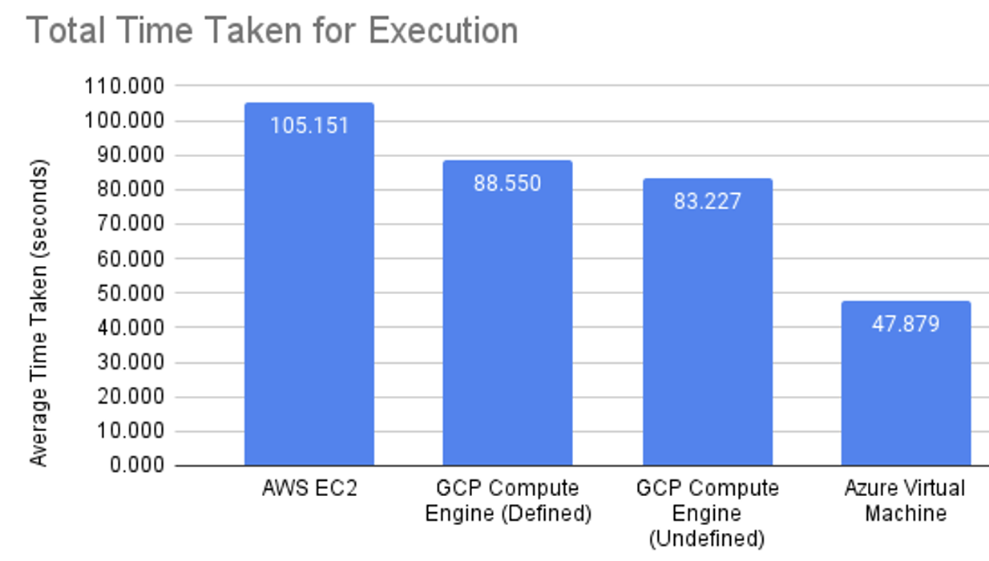
Benchmarking with Jupyter Notebooks
  Conclusions
  AWS 6x faster data loading than GCP and Azure
  Azure computation 4x faster than AWS and 10x faster than GCP
  Azure plotting 3x faster than GCP and 4x faster than AWS
  Total execution … Azure wins. 2x faster than GCP and AWS.
Disclaimer … this is the first known test of all 3 major
U.S. cloud services!

Slide 10
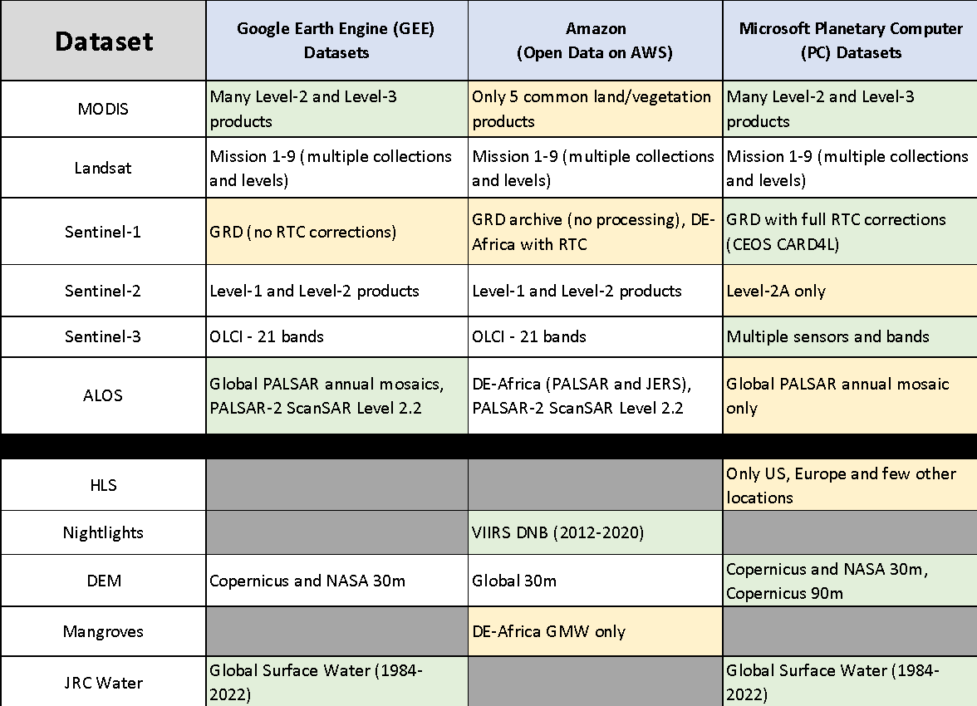
Satellite Dataset Summary
  Text
  Text
  Text
  Summary
  Major CEOS datasets available on all major cloud platforms.
  Sentinel-1 radar with RTC … only on Microsoft PC
  ALOS mosaics and ScanSAR only on GEE
  Partial HLS only on Microsoft PC
  Global JRC water dataset not on AWS
  Nightlights (VIIRS DNB) only on AWS
  DE-Africa holds many datasets (S1 RTC, Fractional Cover, WOFS Water, GEOMAD, Chirps Rainfall, GMW, Coastlines )

Slide 11
Cloud Providers: Market Share and Datasets
Rank | Cloud Provider | Market Share | Well-Known Satellite Data Hosted
1 | Amazon Web Services (AWS) | 32% | Landsat, Sentinel, MODIS, ASTER, etc.
2 | Microsoft Azure | 20% | Landsat, Sentinel, MODIS, NAIP, CBERS, DigitalGlobe, etc.
3 | Google Cloud Platform (GCP) | 10% | Landsat, Sentinel, MODIS, ASTER, etc.
4 | Alibaba Cloud | 6%
5 | IBM Cloud | 4%
6 | Tencent Cloud | 3%
7 | Oracle Cloud | 3%
8 | Salesforce | 3%
9 | Baidu Cloud | 2%
NA | CREODIAS Cloud | <1% | Sentinel, Envisat, ERS, Radarsat-2, SMOS, CryoSat-2, Swarm
NA | DigitalGlobe (Maxar Tech) | <1% | WorldView, GeoEye, QuickBird, IKONOS
NA | Airbus OneAtlas | <1% | Pleiades, SPOT, TerraSAR-X
NA | Planet | <1% | PlanetScope, RapidEye, SkySat
NA | Orbital Insight | <1% | Sentinel, PlanetScope, SkySat
NA | Spire | <1% | ADS-B, AIS, GNSS-RO
NA | Descartes Labs | <1% | Landsat, Sentinel, MODIS
NA | SpaceKnow | <1% | Landsat, Sentinel, PlanetScope, SkySat
NA | BlackSky | <1% | SkySat, PlanetScope
NA: Not Available
Reference: Satellite Data Services. www.grandviewresearch.com/industry-analysis/satellite-data-services-market

Slide 12
Conclusions and Thoughts
  Text
  Text
  Text
  What differences did we find? … ease of setup (Microsoft), most common use (Amazon), most diverse set of cloud services (Amazon), fastest execution (Microsoft), most satellite datasets (Microsoft), best ML/AI resources (Microsoft). Our suggestion to users … go where the data is located. There are computational and cost efficiencies gained by this approach.
  GEO connections … The SEO needs to formulate a more detailed plan for how to support the future GCI (GEO Common Infrastructure). The Open Earth Alliance (OEA) is a GEO Community Activity that can help connect the many regional and national data cubes and promote sharing of data and applications. The connection to cloud providers is managed by CEOS through the LSI-VC (ARD topics) and the SEO (implementation testing). How we move forward to improve these connections and add value to the global user community is uncertain but worth further discussion.
  Can we develop a list of CEOS “desires” that will improve access and use of our datasets from these regional data cubes and cloud providers? For example, we desire a unified metadata API (e.g., STAC) that has flexibility for different data types and sources (e.g., China). We desire notifications of latest dataset releases or reprocessed dataset releases. Are there other desires?

Slide 13
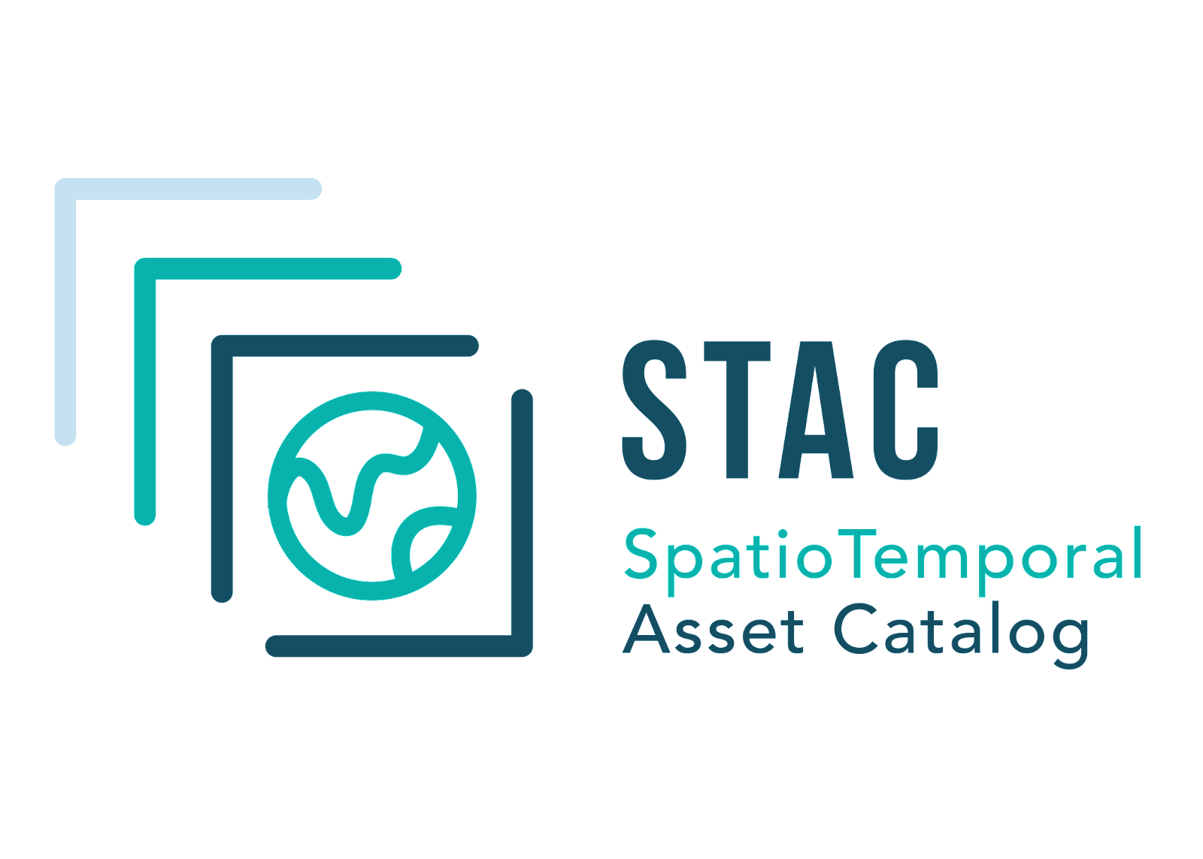
EO Data Standardization
  Standardizing EO dataset metadata is important for cross-utilization and shareability of example analyses.
  Community should implement standards as much as possible and work with the community to formalize the use of such standards.
  One prominent example is the use of the Spatio-Temporal Asset Catalog (STAC) as an important tool for standardizing the metadata of a given EO dataset. Helps to unify access to the data.
    Previous to adoption of STAC, metadata could vary based on who implemented the data.

Slide 14
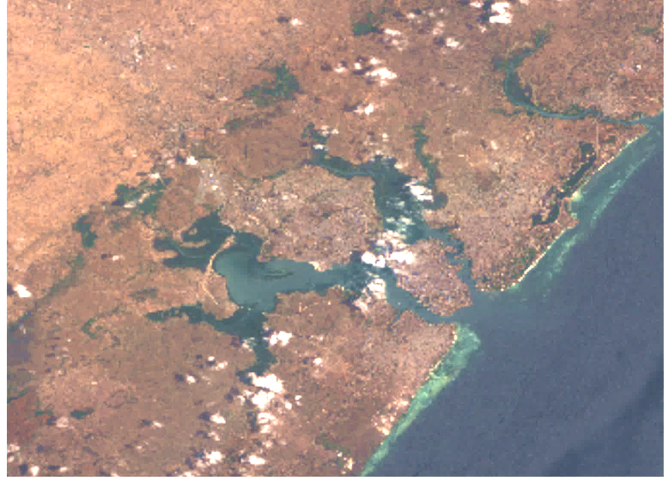
Cloud Project with Sinergise
  Text
  Text
  Text
Integration of Sentinel Hub (SH) and the Open Data Cube (ODC)
  We tested the SH-ODC environment on CreoDIAS, a cloud-based platform funded by the European Commission that provides access to EO data from the Copernicus program.
  We tested a demo that confirmed our ability to use ODC on CreoDIAS and utilize the Sentinel Hub-Open Data Cube (SH-ODC) environment for importing Sentinel Hub datasets to be used in ODC applications.
Sentinel-2 image over Mombasa, Kenya
Produced by an SH-ODC demo notebook using
SENTINEL2_L1C data from Sentinel Hub

Slide 15
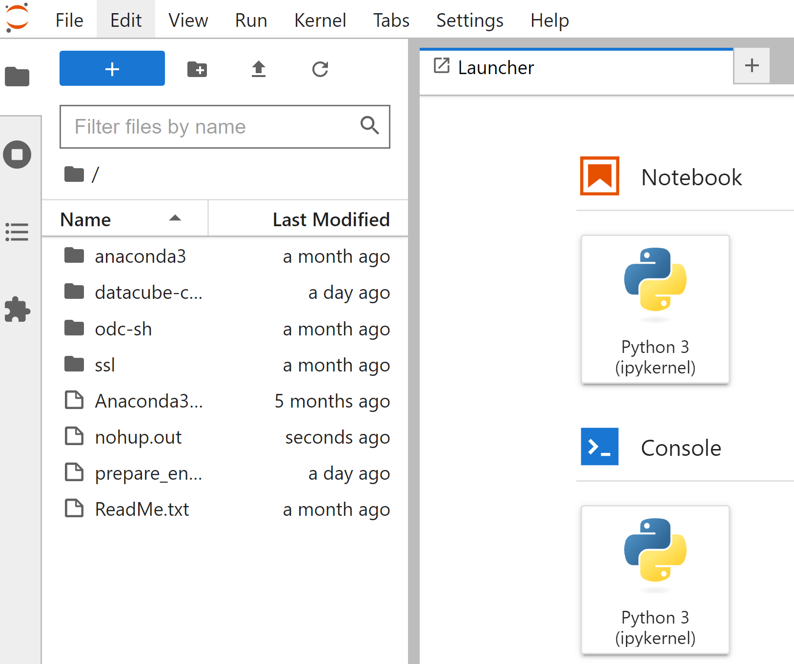
How SH-ODC Works …
  CreoDIAS made an ODC "image" that spawns some ODC Jupyter notebooks and uses data from Sentinel Hub.
  An account was created in the CreoDIAS cloud environment and testing credits were added to the account.
  The cloud service with the account was configured to use the ODC VM image.
  JupyterLab was installed and configured to access the SH-ODC.
  JupiterLab to access the SH-ODC environment

Slide 16
SH-ODC > Advantages and Issues
  Text
  Text
  Text
  Advantages
  CreoDIAS users have access to pre-configured environments for processing Sentinel data, such as this new environment that has been created for ODC.
  SH-ODC offers excellent documentation and resources for users to easily get started with the platform and troubleshoot any issues that may arise.
  During testing, the compute instance was set to eo1.large with 4 vCPUs. The user experience of running the analysis on JupyterLab was very smooth.
  Issues
  Data Type: The dc.load function returns a dataARRAY with bands as a dimension, as opposed to a dataSET. This will cause issues with existing ODC applications but fixes are possible to make them compatible.
  Security Risk: It would be easy for anyone with JupiterLab notebook access to get the "secret key SH_CLIENT_ID and SH_CLIENT_SECRET.
  Cloud Administrators may have limited control over the underlying infrastructure in CreoDIAS as compared to AWS/Azure.

Slide 17
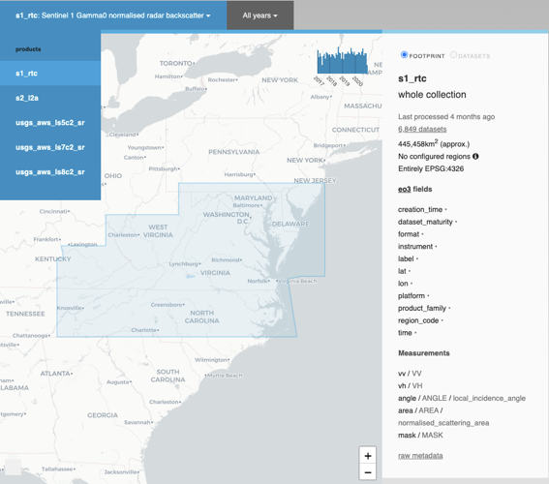

Earth Analytics Interoperability Lab (EAIL)
Initiated in April 2020 as a CEOS WGISS initiative, EAIL is a data and analytics platform that uses AWS Cloud and Open Data Cube. Its advantages are Jupyter Hub, Dask scaling, customized ARD pipelines and GPU processing. There are 59 registered users!
Jonathan Hodge (CSIRO-Chile) is the primary EAIL lead and architect. The SEO is working with CSIRO in 2023 to become trained on EAIL operations to support users.
EAIL currently supports one active CEOS project > COAST (Chesapeake Bay study). Other projects interested in using EAIL include: WGCV (DEMIX Cal-Val campaigns), DE-Americas (Caribbean Pilot project), and CEOS Ecosystem Extent Pilot Project.
Datasets include: Landsat, Sentinel-2, MODIS, Sentinel-3, Sentinel-1 (CARD4L with RTC), Copernicus DEM, and NASA DEM.

Slide 18
Future SEO plans related to ARD
  Text
  Text
  Text
  The SEO plans to test (via Jupyter notebooks) specific ARD datasets > NASA Black Marble Nightlights on AWS (when available) and ALOS ScanSAR on Google Earth Engine. These tests will demonstrate ease of access and use of CEOS datasets in the cloud.
  The SEO plans to advance its testing of the MS Planetary Computer to understand how the integrated ODC tools (e.g., STAC, ODC loading) operate and how more general ODC utilities could be used in their environment. This is the baseline cloud environment used by the Digital Earth Pacific program.
  The SEO plans to complete an ARD study for the NASA Black Marble (BM) dataset to address terrain occlusion issues (ACTION: LSI-VC-12-02). This analysis will use the Copernicus DEM and the Black Marble pixel size (750-meters) and viewing geometry to develop a global mask where terrain occlusion is an issue (e.g., mountains, cities) and assess its significance for data applications.

