Slide 1
GISTDA Report
Prayot Puangjaktha
GISTDA
Agenda Item # 3.5
LSI-VC-13 2023, ESA/ESRIN
23rd - 24th March 2023

Slide 2
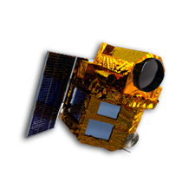
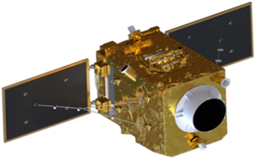
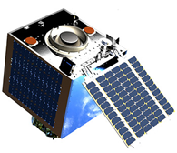
The Status of THEOS Satellites
Thailand Earth Observation System
Satellite | THEOS (THAICHOTE) | THEOS-2 Main VHR | THEOS-2A (Small Sat)
Manufacturer | AIRBUS DS | AIRBUS DS | SSTL
Launch Date | October 1st 2008 | Mid - Late 2022 | Mid - Late 2022
Launch Vehicle | DNEPR | VEGA | PSLV
Norad ID | SC33396 | TBD | TBD
Design Life | 5 Yrs | 10 Yrs | 3 Yrs
Platform | Astrobus 500 | Astrobus 250 | Carbonite 2+
Mass | 720 kg | 420 kg | 105 kg
Orbit | 822 km SSO | 621km SSO | 520km SSO @BOL
Orbit Cycle | 26 days | 26 days | Vary (No propulsion)
Revisit | 2 days at 45°Roll | 4 days at 45°Roll (WC) | 2 days at 45°Roll
Payload | Optical Imager Cassegrain 600mm AP | Optical Imager TMA 500mm AP | 1st : Optical Imager 250mm AP 2nd :AIS/ADS-B Reciever 3rd :Experimental Payload (Raspberry-Pi, 2 cameras, Sun Sensors, GPS)
Spatial Resolution | 2m (PAN)/ 15m (MS) | 0.5m (PAN)/ 2m (MS) | 1.11m MS @520km
Spectral Resolution | PAN + MS (RGB-NIR) | PAN + MS (RGB-NIR) | Primary: RGB (Beyer)
Radiometric Resolution | 8 BPP | 12 BPP | 10 BPP
Swath Width/ Scene | 22km / 90km | 10.3km | 5.7km x 5.7km
Geolocation accuracy | 300 m @ 1 sigma | 25 m | 250m (CE90)
SSR Memory | 512Gbits (redounded) | 1TBits (redounded) | 512Gbytes
THEOS-1
In-orbit
THEOS-2
Set to launch in 2023
THEOS-2A
Set to launch in 2023

Slide 3
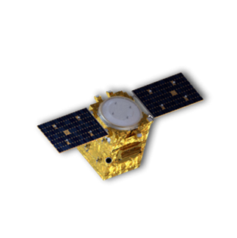
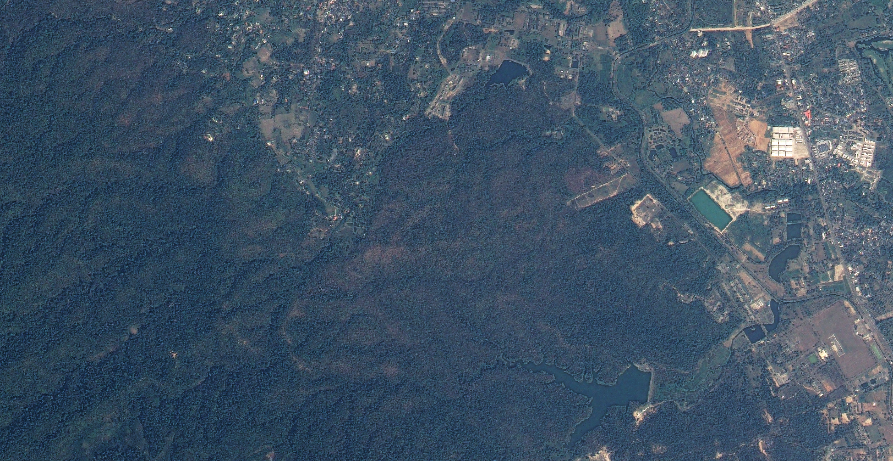
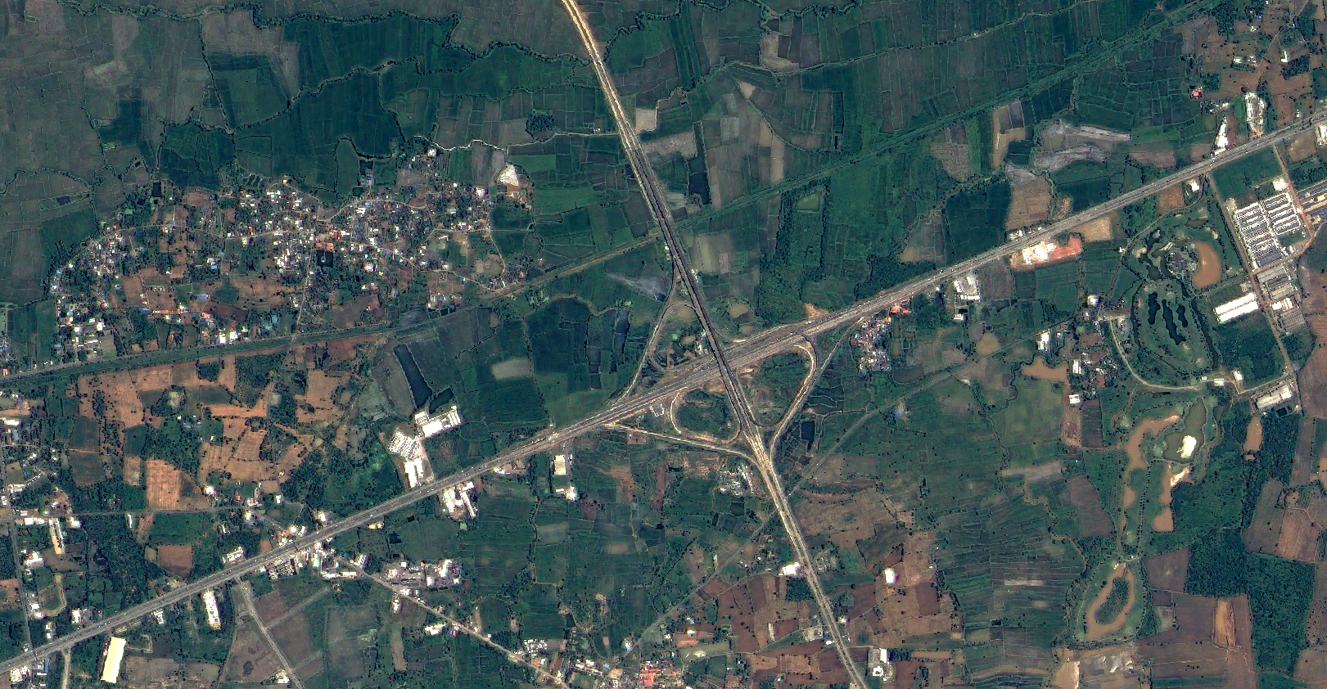
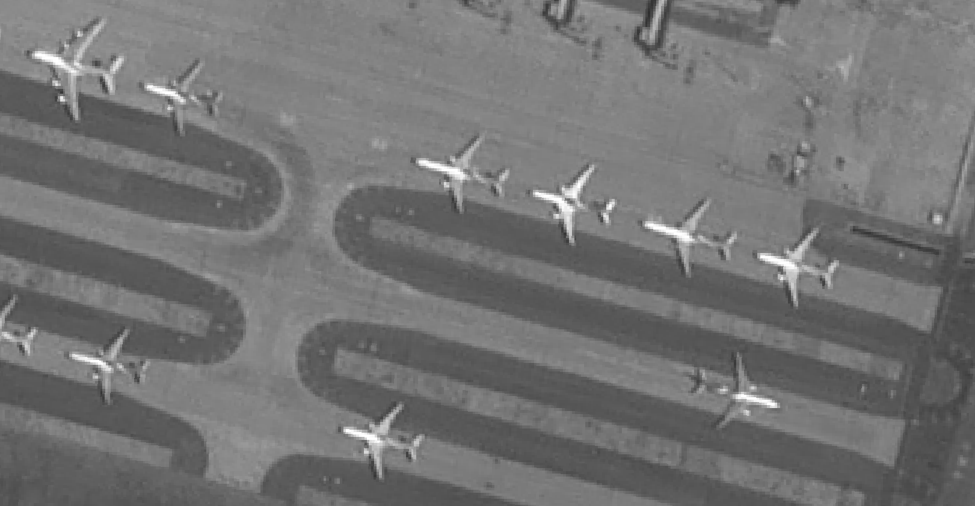
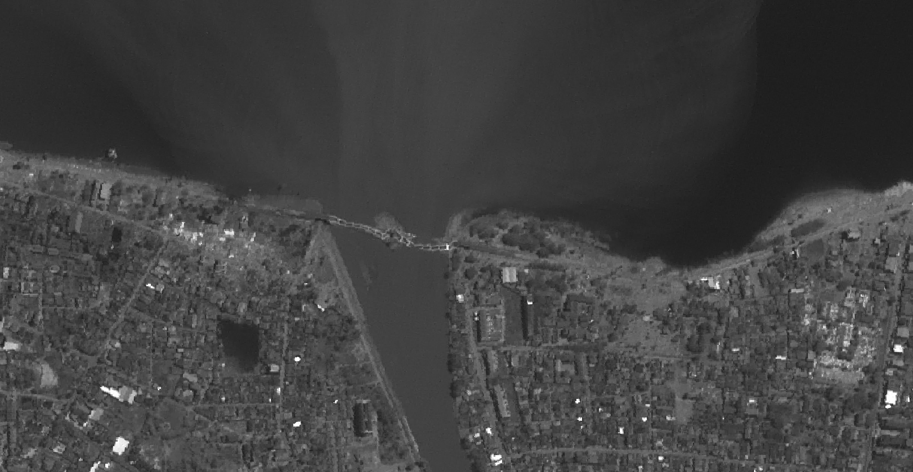
GISTDA Land Imaging Programs
Continuous Land Observations by THOES Series Missions
2020 | 2021 | 2022 | 2023 | 2024 | 2025 | 2026 | 2027 | 2028 | 2029 | 2030 | 2031 | 2032 | 2033 | 2034 | 2035
THEOS-1 (Optical)
Operated since Oct 1, 2008
> 14 years In-orbit
THEOS-2 (Optical)
Ready to launch
Mission Operation (10 years)
THEOS-2A (Optical)
Mission Operation (3 years)
Ready to launch
*The THEOS-3 project is currently under discussion.
Agriculture
Natural Resources
Land & Urban Planning
National Security
Disaster Monitoring

Slide 4
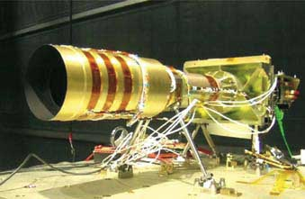
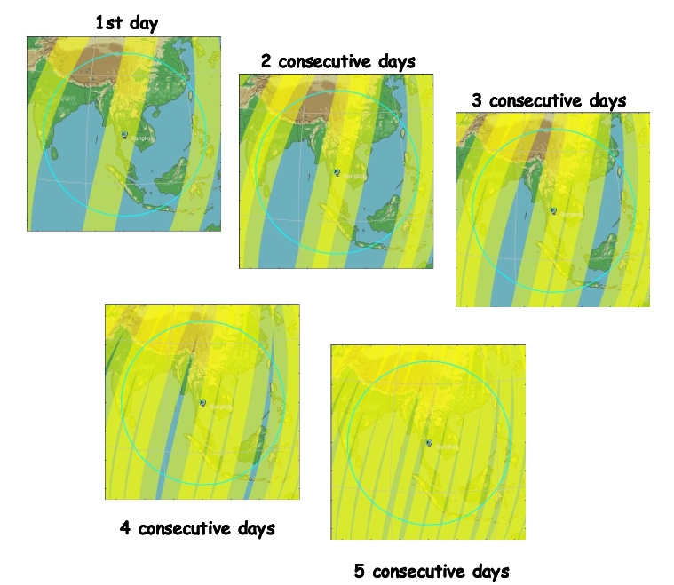
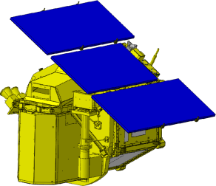
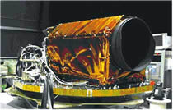
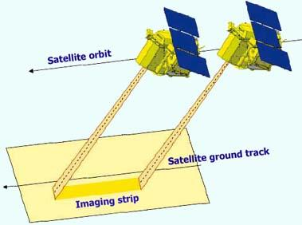
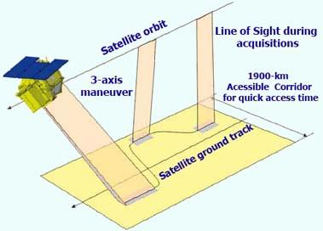
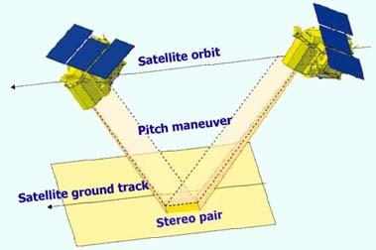
THEOS-1 Satellite
Thailand Earth Observation System (THEOS-1)
MS Camera
Satellite
orbit
THEOS-1
In-orbit
1900-km Accessible Corridor
PAN Camera
for quick access time
Acronym | THEOS-1
Imager Instruments | Blue (0.45 - 0.52 µm) 15 m Green (0.53 - 0.60 µm) 15 m Red (0.62 - 0.69 µm) 15 m Near-Infrared (0.77 - 0.90 µm) 15 m Panchromatic (0.45 - 0.90 µm) 2 m
Status | Operational (EOL ≥ 2025)
90-km MS swath
22-km PAN swath
Satellite Ground Track
Revisit time: 26 days (Nadir)
Accessible Corridor Covered in 5 Days (with 30° tilting angle)

Slide 5
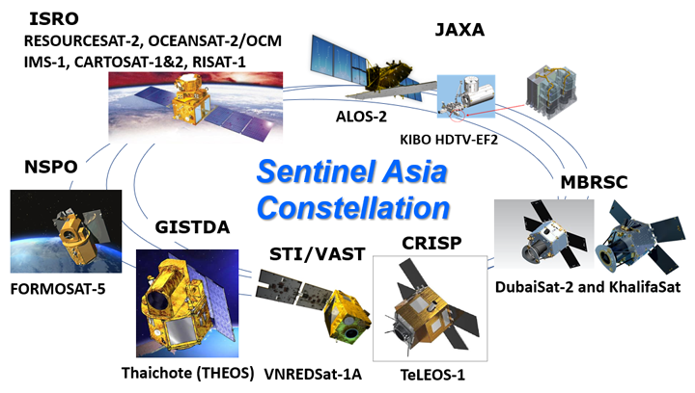
GISTDA Efforts in EO dataset interoperability
GISTDA is committed to contributing to the CEOS and promoting EO data sharing globally.
GISTDA currently belongs to the Sentinel Asia organization and has been offering Earth observation (EO) data to aid in disaster monitoring and response efforts across the Asia-Pacific region.
GISTDA is actively searching for other EO constellation partners to increase its contributions to the sharing of EO data.
GISTDA's focus on promoting the standardization of EO data formats and metadata to facilitate data sharing and interoperability among different platforms.
https://earth.jaxa.jp/en/application/disaster/sentinel-asia/index.html

Slide 6
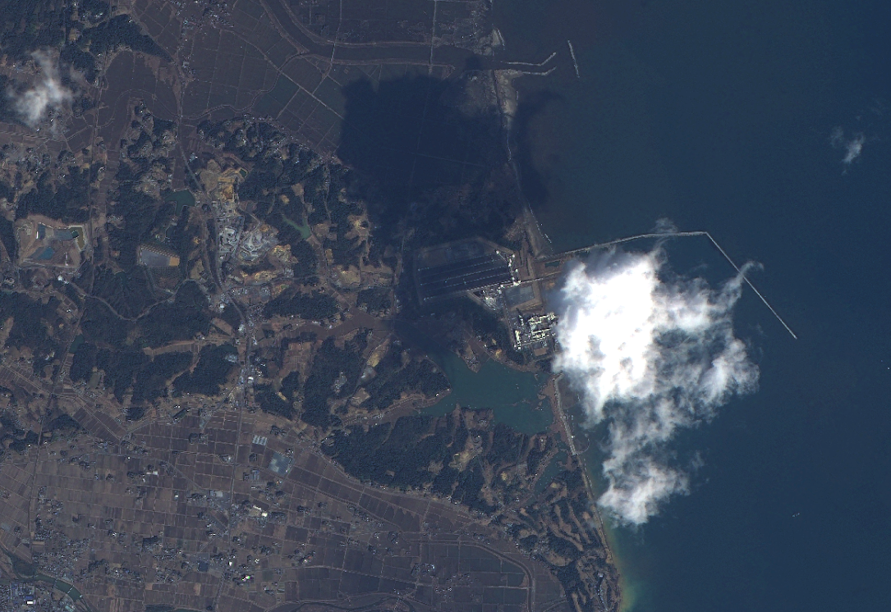
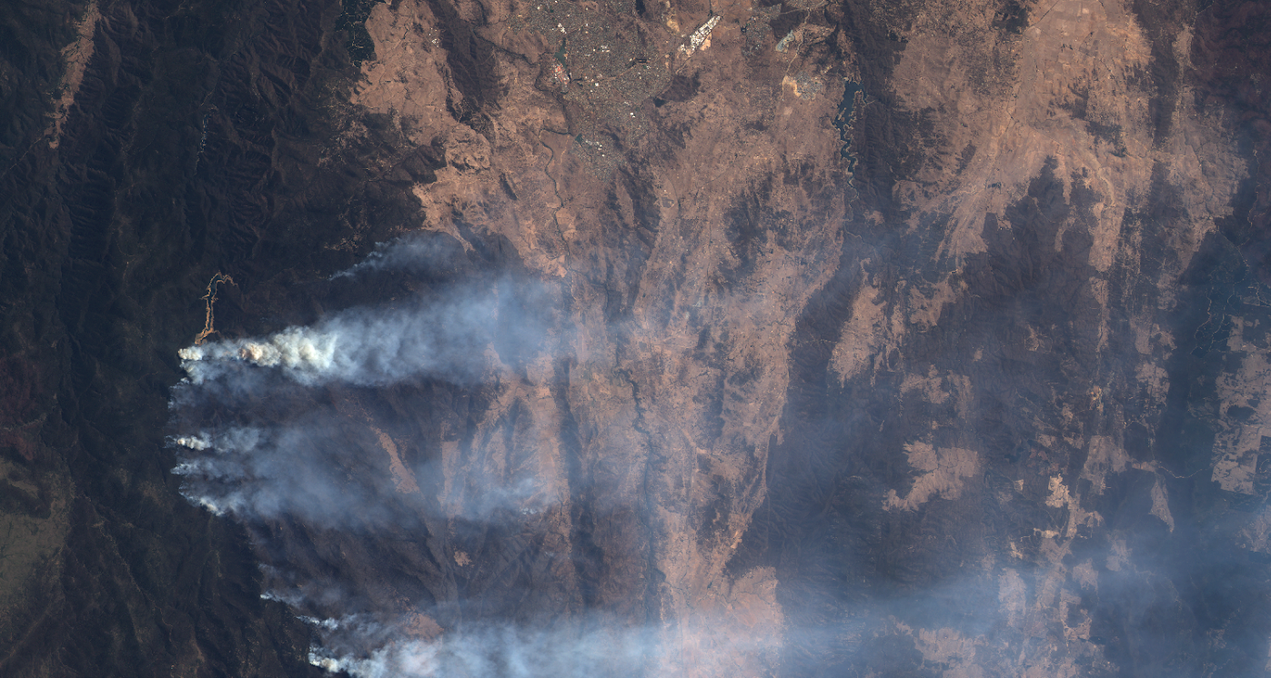
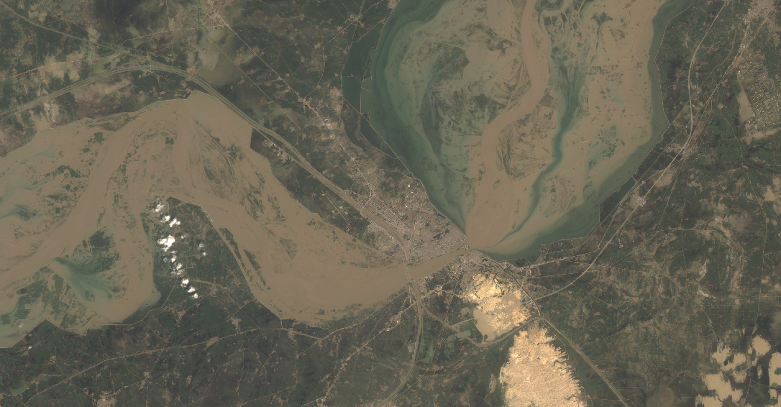
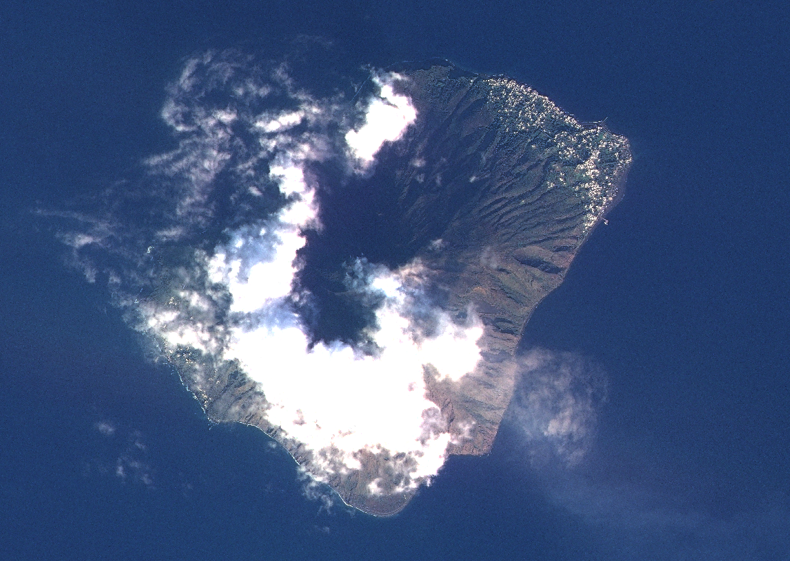
Disaster Monitoring by THEOS-1 Satellite
2011 Tohoku Earthquake and Tsunami (2011.03.12)
Fukushima, Japan
Wildfire in Namaji National Park (2020.02.02)
Canberra, Australia
2022 Monsoon Flood around Indus River (2022.08.29)
Sukkur, Pakistan
Stromboli Volcano Eruption (2022.12.25)
Stromboli, Italy
Sea Ice Cracking (2022.11.23)
Antarctica

Slide 7
GISTDA's Cloud Utilization Plan
Objective: Improve satellite data storage, management, and analysis.
Increased efficiency, productivity, and collaboration.
Four areas of focus:
Data storage: Securely store large volumes of satellite imagery and data for easy access anywhere, anytime
Data processing: Leverage cloud-based computing power to process massive amounts of satellite data and imagery quickly and efficiently.
Collaboration: Use cloud-based tools to share data and insights with partners and users around the world, allowing for greater collaboration and improved decision-making.
Application development: Utilize cloud infrastructure to develop and deploy new applications and services that can enhance operational capabilities and provide value-added products and services to users.
www.sphere.gistda.or.th

Slide 8
GISTDA Self Assessment
In the initial phase, GISTDA plans to develop THEOS Analysis Ready Data (ARD) using CARD4L-SR v5.0 at the THRESHOLD as a primary goal.
GISTDA has already assessed the Analysis Ready Data (ARD) self-assessment for THEOS-1 satellite standard product.
 | Threshold | Target
1. General Metadata
1.1 Traceability | Not required
1.2 Metadata Machine Readability | Yes
1.3 Data Collection Time | Yes
1.4 Geographical Area | Yes
1.5 Coordinate Reference System | Yes
1.6 Map Projection | Yes
1.7 Geometric Correction Methods | Not required
1.8 Geometric Accuracy of the Data | Not required
1.9 Instrument | No
1.10 Spectral Bands | No
1.11 Sensor Calibration | Not required
1.12 Radiometric Accuracy | Not required
1.13 Algorithms | No
1.14 Auxiliary Data | No
1.15 Processing Chain Provenance | No
1.16 Data Access | No
1.17 Overall Data Quality | No
2. Per-Pixel Metadata
2.1 Metadata Machine Readability | Yes
2.2 No Data | Yes
2.3 Incomplete Testing | Yes
2.4 Saturation | Yes
2.5 Cloud | No
2.6 Cloud Shadow | No
2.7 Land/Water Mask | Not required
2.8 Snow/Ice Mask | Not required
2.9 Terrain Shadow Mask | Not required
2.10 Terrain Occlusion | Not required
2.11 Solar and Viewing Geometry | Yes
2.12 Terrain Illumination Correction | Not required
2.13 Aerosol Optical Depth Parameters | Not required
3. Radiometric and Atmospheric Corrections
3.1 Measurement | No
3.2 Measurement Uncertainty | Not required
3.3 Measurement Normalisation | Not required
3.4 Directional Atmospheric Scattering | No
3.5 Water Vapour Corrections | No
3.6 Ozone Corrections | Not required
4. Geometric Corrections
4.1 Geometric Correction | No
General Metadata: | Pass some of the threshold requirements
Per-pixel Metadata: | Pass some of the threshold requirements
Radiometric and Atmospheric Corrections: | Improvements are required
Geometric Corrections: | Improvements are required
GISTDA is currently developing Analysis Ready Data (ARD) for THEOS-1 satellite and plans to make it available to users worldwide in 2024.
THEOS-1 Self Assessment, Updated Mar 17, 2023

Slide 9
THEOS-1 ARD SAMPLE
Barcelona, Spain (Scale 1 : 50000)
Lat 41.343, Lon 2.094
THEOS-1 MS Image (15 m/pixel)
THEOS-1 MS images before ARD processing.
THEOS-1 MS images after ARD processing.

Slide 10
Requesting CEOS Collaboration for THEOS-1 ARD Development
GISTDA’s request for technical support and collaboration from CEOS to enhance THEOS-1 ARD development
Algorithm development: GISTDA seeks technical assistance and expertise from CEOS to develop and implement ARD algorithms and processing techniques that meet international standards and ensure compatibility with a wide range of applications.
Quality control: GISTDA requires best practices and guidelines from CEOS for quality control in the development of ARD to ensure that the data products meet international standards and are of high quality.
Capacity building: GISTDA needs CEOS to provide training and workshops to enhance the knowledge and skills of its staff and other stakeholders in developing ARD and using the data products for various applications.
Collaborative research: GISTDA looks forward to collaborating with CEOS on research and development projects that aim to improve ARD algorithms and processing techniques for THEOS-1 satellite data.

Slide 11
THANK YOU
PRAYOT PUANGJAKTHA
Calibration and Validation Officer
GISTDA
prayot@gistda.or.th

