Slide 1
ESA Update on CEOS-ARD
Ferran Gascon
as ESA representative at CEOS LSI-VC
CEOS LSI-VC#13
23 March 2023

Slide 2
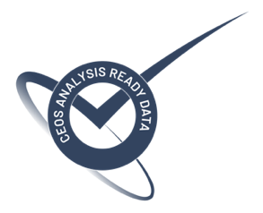
Status of ESA CEOS-ARD Products
Mission | Product | PFS | Status | Availability Date
Sentinel-2 | L2A | SR | ✅ | January 2022
PROBA-V | Collection 2 | SR | ✅ | March 2023
Sentinel-2 | L2H | SR | Under Development | 2023
Sentinel-2 | L2F | SR | Under Development | 2023
Sentinel-2 | L2A | AR | Under Development | TBD
Sentinel-1 | NRB | NRB | Under Development | TBD
Sentinel-3 | SYN | SR | Under Development | TBD
ERS SAR | TBC | NRB | Under Development | 2023
ERS ATSR | TBC | LST | Under Development | 2023
Envisat ASAR | TBC | NRB | Under Development | 2023
Envisat MERIS | TBC | SR | Under Development | 2023
CHIME | L2A | SR | Under Development | 2028
CHIME | L2H/L2F | SR | Under Development | TBD
LSTM | L2A | ST, SR | Under Development | 2028
LSTM | L2H/L2F | ST, SR | Under Development | TBD
ROSE-L | TBD | NRB…TBC | Under Development | TBD

Slide 3
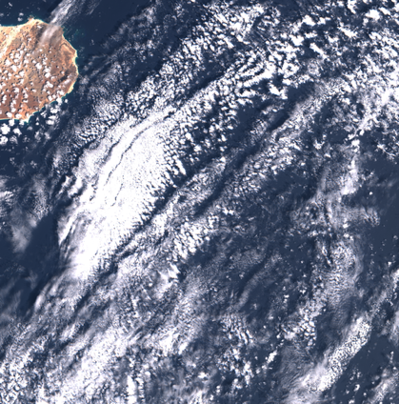
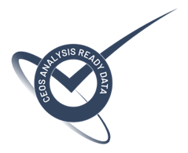
Sentinel-2 Collection-1
Collection-1 being generated by reprocessing full S2 archive for all user products (Level-1B, Level-1C and Level-2A).
Products will use the latest Processing Baseline (05.XX) which includes Copernicus DEM 30m, geometric refinement with S2 GRI (Global Reference Image), etc.
Reprocessing campaign on-going, first products published on 24 January 2023 on DIAS platforms (CREODIAS, Mundi and ONDA).
Collection-1 will be CEOS-ARD compliant: http://ceos.org/ard
More information at: https://sentinels.copernicus.eu/ca/web/sentinel/technical-guides/sentinel-2-msi/copernicus-sentinel-2-collection-1-availability-status
Cabo Verde 04 April 2019

Slide 4
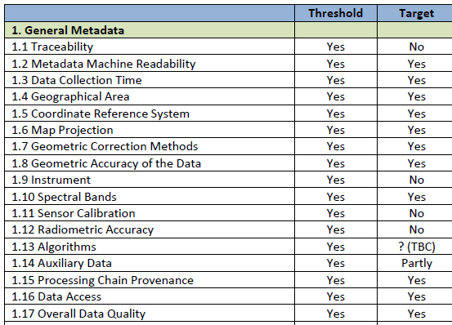
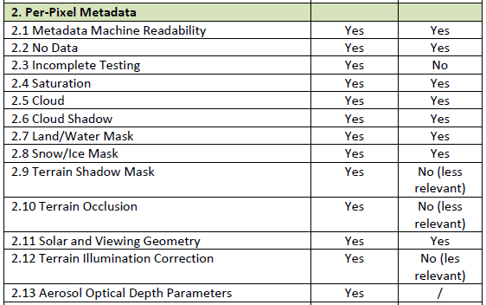
PROBA-V CEOS-ARD – Self-assessment

Slide 5
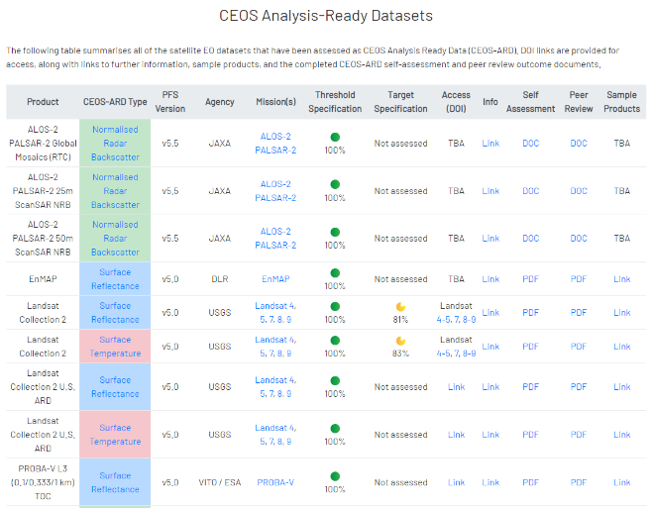
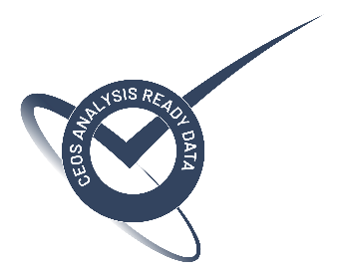
CEOS-ARD approved!
On 21/03/2023:
Declaration on CEOS-ARD compliancy for surface reflectance products (at threshold level):
S1-100m-TOC
S5-100m-TOC
S1-333m-TOC
S10-333m-TOC
S1-1km-TOC
S10-1km-TOC

Slide 6
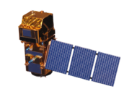
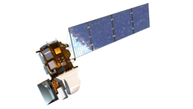
S2-Landsat Harmonised/Fused Products
Harmonisation (Level-2H product) includes consistent atmospheric corrections (same Atmospheric Correction algorithm), spectral adjustments, BRDF adjustments and re-gridding.
Fusion (Level-2F product) brings L8 resolution to S2 one.
L2F
S10
L10
S2 L1C
Archive
Stitching
Geometric Processing
Atmospheric Correction
BRDF Adjustment
Fusion
L2H
S10
L30
L8 L1T Archive
Stitching
Geometric Processing
Atmospheric Correction
BRDF Adjustment
Spectral
Adjustment
Processor (Sen2Like) available on GitHub: https://github.com/senbox-org/sen2like

Slide 7
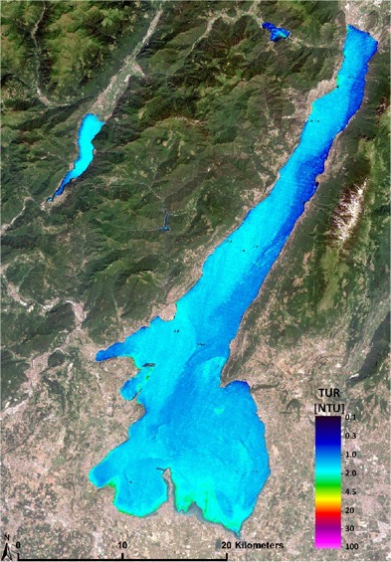
Sentinel-2 Aquatic Reflectance
Worldwide coverage: inland + coastal + open waters
To provide Aquatic Reflectance.
To provide the output as additional layer within Level-2A product.
Output product compliant with CEOS-ARD Aquatic Reflectance PFS.
Output spatial resolution: 60m.
Based on open-source algorithms.
Algorithm | Used by | Licence | Pros
C2RCC (C2X) | CMEMS | GPL/MIT Open source | Better results on Clear waters
ACOLITE-DFS | CMEMS | GPL Open source | Good results for Turbid waters
POLYMER | CLMS | Open Source but fee requested if HYGEOS | Provides greater retrieval power in most difficult conditions (sunglint, highly absorbing waters) by imposing a solution for RRS
iCOR | CMEMS (fallback) | Open source | Good results over Turbid waters
First Water Quality product with S2 in 2015 (EOMAP). Lago di Garda, Italy.

Slide 8
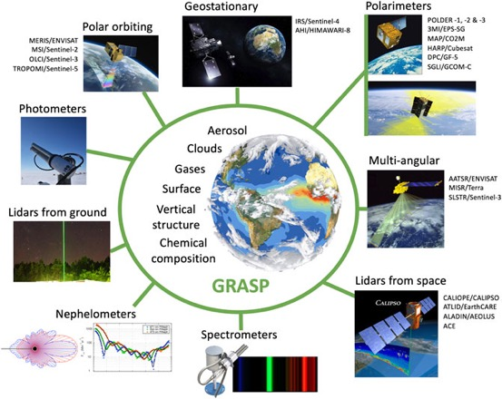
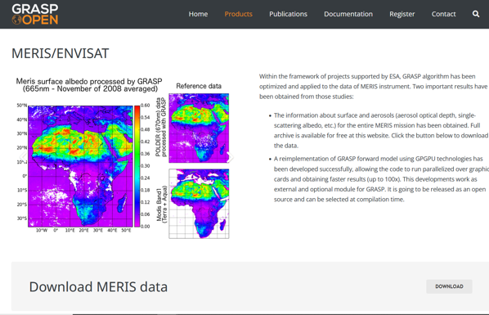
CEOS-ARD SR for Envisat - MERIS
CAWA-2 project completed in Dec 22: L2/L3 MERIS products available at https://www.grasp-open.com/products/
The GRASP (Generalized Retrieval of Atmosphere and Surface Properties) atmospheric correction algorithm was successfully tested on MERIS Full Resolution data and is a good candidate for piloting the generation of ESA CEOS ARD Surface Reflectance products.
Further cloud mask and cloud shadow mask refinement activities need to be implemented before submitting the dataset as ESA CEOS-ARD product. A dedicated improvement project will start in Q1 2023.

Slide 9
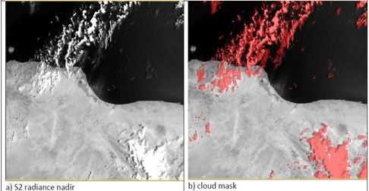
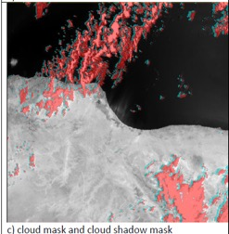
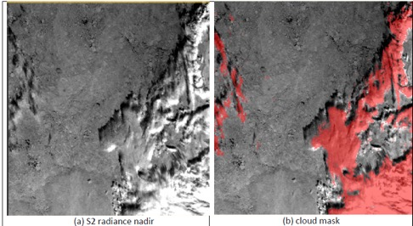
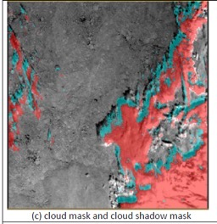
CEOS-ARD ST for ERS/Envisat - (A)ATSR
Activities ongoing for the definition of the best cloud shadow algorithm to be applied to (A)ATSR data.
Mediterranean Sea (31°N, 15°E) – 20020810T083508
The retrieval of cloud top height is not completely solved yet.
Cloud Top Height is fixed at 6km.
The conversion of brightness temperature into cloud top height is a complex task.
Cloud shadow is computed only over land.
Far North (81°N, 122°E) – 20020810T083508

Slide 10
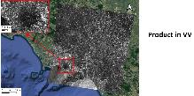
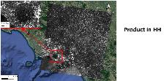
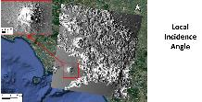
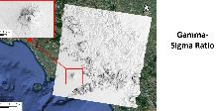
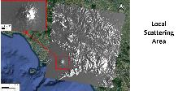
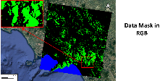
CEOS-ARD NRB for ERS/Envisat for SAR/ASAR
Started project to align CEOS-ARD specs for ERS/Envisat (A)SAR data to those of an under development enhanced Sentinel-1 product.
A subset of SAR and ASAR data will be processed with corresponding and adapted algorithms to those under development in the enhanced Sentinel-1 product (including the usage of the Copernicus 30m DEM and the Cloud Optimized GeoTIFF format to facilitate compliance between the two products).
First results identified the major corrections impacting data geolocation quality and the potential improvements which can be attained.
Project will deliver in Q2 2023 the first subset of ERS and Envisat SAR NRB (Normalized Radar Backscatter) ARD products aligned at best to Sentinel-1 corresponding products.

Slide 11
Sentinel-3 Synergy Surface Reflectance
CARD4L-SR Status and prospective
Steffen Dransfeld¹, Silvia Scifoni²
ESA ESRIN ESA S3 Optical Data Quality Manager
Serco Italia Spa, S3 Data quality management support

Slide 12
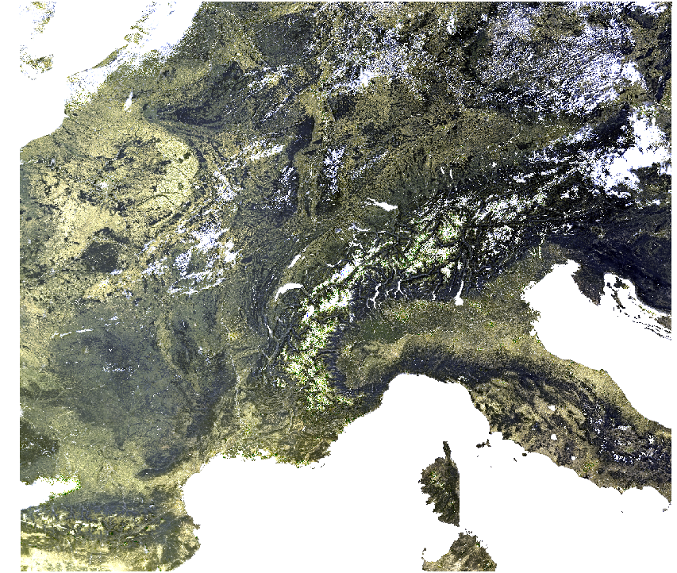
Sentinel-3 SY_2_SYN product overview
SYN Level-2 processing aims to combine information from the OLCI and SLSTR instruments to provide improved data for land surface analysis.
SY_2_SYN: atmospherically corrected surface directional reflectance (SDR) from 16 OLCI and 5 Nadir and Oblique SLSTR bands, and aerosol parameters over land.
Coverage: corresponds to the common part of the OLCI and SLSTR nadir view swaths for the daylight part of the SENTINEL-3 orbit.
Revisit time: it is based on the longest revisit time of the two instruments, OLCI and SLSTR. It is less than 2 days at the equator with two operational satellites.
Spatial resolution: ~300 m on the OLCI L1B image grid.
Data access: https://scihub.copernicus.eu/dhus/#/home
Data availability: since October 2018.
S3A_SY_2_SYN____20210814T094700_20210814T095000_20210816T134840_0179_075_136_2160_LN2_O_NT_002.SEN3

Slide 13
SY_2_SYN CARD4L SR Self-Assessment Status overview
CARD4L-SR Threshold requirements
CARD4L-SR Target requirements

Slide 14
SY_2_SYN CARD4L SR Threshold requirements self-assessment
General Metadata
Traceability
Metadata Machine Readability
Data Collection time
Geographical Area
Coordinate Reference System
Map Projection
Geometric Correction methods
Geometric Accuracy of the data
Compliant
Instrument
Spectral bands
Sensor calibration
Radiometric accuracy
Algorithms
Auxiliary data
Processing Chain provenance
Data Access
Overall data quality
General Metadata
(2/2)
Not compliant
Not applicable
Coordinate reference system and Map projection: the SYN product is georeferenced but not projected on a regular tiling grid or map projection. The metadata do not specify a CRS or map projection accordingly.
Recent evolution: the DOI landing page was created containing information on Algorithms, Instrument, Data Access, etc:
https://sentinels.copernicus.eu/web/sentinel/user-guides/sentinel-3-synergy/processing-levels/level-2
The DOI landing page is included in the product, and it will be available to users from the next PB deployment (very soon).

Slide 15
SY_2_SYN CARD4L SR Threshold requirements self-assessment
Per-pixel metadata
Metadata Machine Readability
No data
Incomplete testing
Saturation
Cloud
Land/water mask
Cloud shadow
Snow/Ice mask
Terrain shadow mask
Terrain Occlusion
Solar and Viewing Geometry
Terrain Illumination Correction
Aerosol Optical Depth Parameter
General Metadata
(2/2)
Compliant
Not compliant
Not applicable
Incomplete testing and cloud shadow: SYN product is not compliant because cloud shadow test is still missing, but it is under development and will probably be included in the next delivery (late Spring 2023).

Slide 16
SY_2_SYN CARD4L SR Threshold requirements self-assessment
Compliant
Not compliant
Radiometric – Atmospheric- Geometric corrections
Measurement
Measurement Uncertainty
Measurement Normalisation
Directional Atmospheric Scattering
Water Vapour Corrections
Ozone corrections
Geometric corrections
Not applicable
Geometric corrections: the sub-pixel accuracy has been accessed for OLCI and SLSTR individually, but not for SYN.

Slide 17
SY_2_SYN CARD4L SR Target requirements self-assessment
General Metadata
Traceability
Metadata Machine Readability
Data Collection time
Geographical Area
Coordinate Reference System
Map Projection
Geometric Correction methods
Geometric Accuracy of the data
Compliant
Not compliant
Coordinate reference system and Map projection: same comment of threshold.
Geometric correction methods: it is part of the OLCI and SLSTR L0 to L1 processing. However, there is no information part of the SYN metadata.

Slide 18
SY_2_SYN CARD4L SR Target requirements self-assessment
General Metadata
Instrument
Spectral bands
Sensor calibration
Radiometric accuracy
Algorithms
Auxiliary data
Processing chain provenance
Data Access
Overall data quality
Compliant
Not compliant
Radiometric accuracy: we have an empty parameter for radiometric uncertainty.
Algorithms: ATBD are not all published in peer-review journals.
Auxiliary data: information on auxiliary data will be available in the metadata as a single DOI landing page, but these are not publicly available for downloading.

Slide 19
SY_2_SYN CARD4L SR Target requirements self-assessment
Per-pixel metadata
Metadata Machine Readability
No data
Incomplete testing
Saturation
Cloud
Cloud shadow
Land/water mask
Compliant
Snow/Ice mask
Terrain shadow mask
Terrain Occlusion
Solar and Viewing Geometry
Terrain Illumination Correction
Aerosol Optical Depth Parameter
General Metadata
(2/2)
Not compliant
Incomplete testing: same comment of threshold
Saturation: there is a summary saturation flag but it is not for each spectral band.
Cloud shadow: cloud shadow is under development.
Terrain shadow mask: it is available for OLCI in IdePix. This could be adapted to SLSTR and then for SYN.
Terrain occlusion: not available.
Terrain illumination correction: terrain correction is not included in SYN processing.

Slide 20
SY_2_SYN CARD4L SR Target requirements self-assessment
Compliant
Radiometric – Atmospheric- Geometric corrections
Measurement
Measurement Uncertainty
Measurement Normalisation
Directional Atmospheric Scattering
Water Vapour Corrections
Ozone corrections
Geometric corrections
Not compliant
Measurement normalisation: values are not normalised. It could however be useful for users to have a BRDF correction as for e.g. MODIS does it.
Geometric corrections: as already mentioned in Threshold requirement, the sub-pixel accuracy has been accessed for OLCI and SLSTR individually, but not for SYN.

Slide 21
Conclusion
The recent SYN_SDR product evolution (DOI inclusion) allows to reach the threshold requirements for Instrument, data access, Algorithms. Cloud shadow will be probably delivered in late Spring 2023.
Few steps are still necessary to reach the ARD compliance at Threshold level:
Coordinate System – Map Projection: ongoing discussion about how the best tiling approach could be
adopted, if to follow or not MODIS grid, or the most recent DGGS (Discrete Global Grid System). Could DGGS also considered as the answer to the CEOS ARD requirement concerning the Coordinate System and Map projection?
Geometric correction: ongoing discussion on how to fulfil this requirement. SYN SDR are provided as georeferenced pixels based on two separate geometrically calibrated and then co-registered instruments.

Slide 22
Thank You

