Slide 1
NovaSAR-1 ARD Application Examples
- Burn Area Mapping in Fraser Island, QLD in Oct-Dec 2020
(Ticehurst et al, 2021)

Slide 2
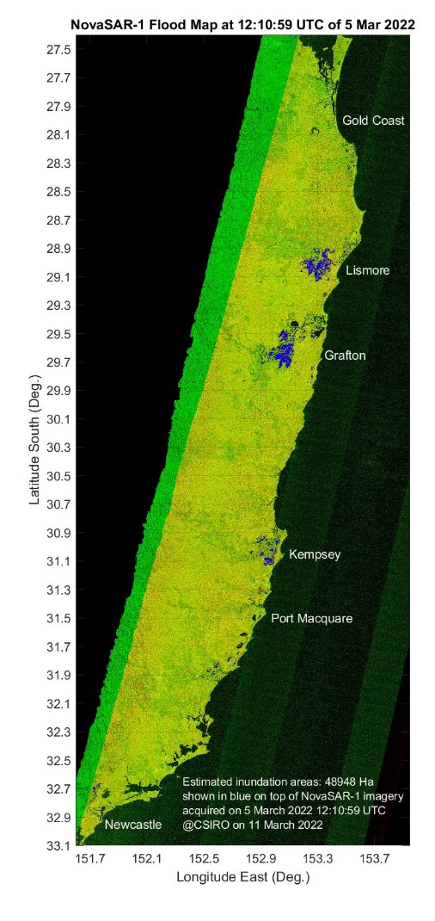
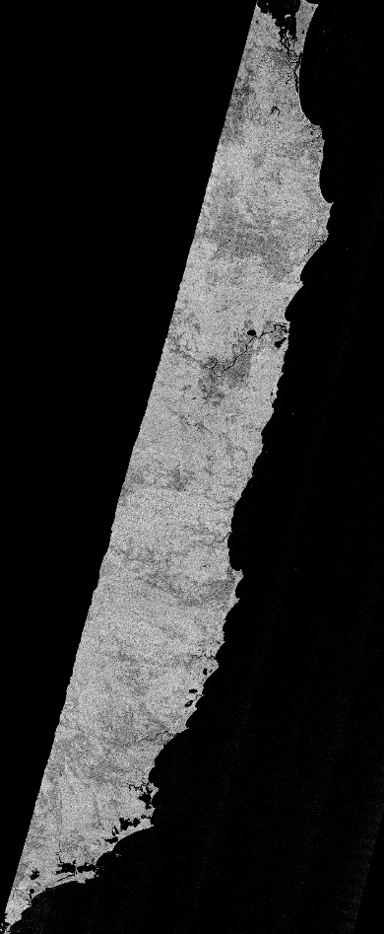
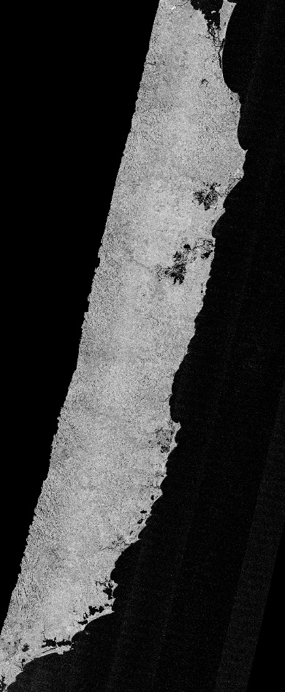
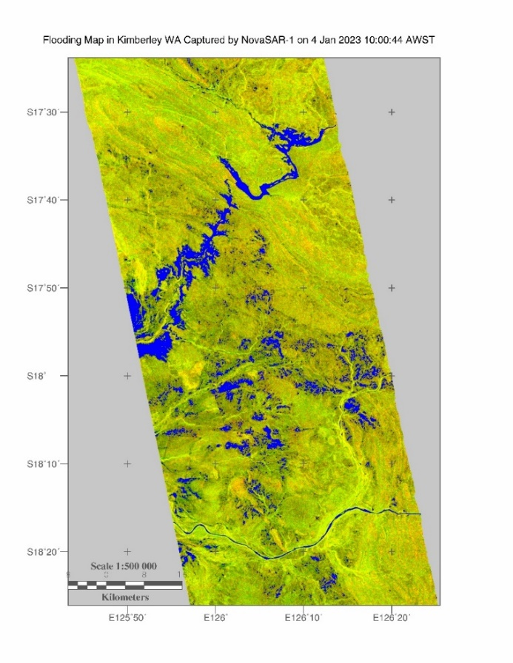
NovaSAR-1 ARD Application Examples
- Flood maps in Kimberley WA on 4 Jan 2023 (left) and in East Coast on 5 Mar 2022 (right)
13 Feb 2021
5 Mar 2022

