Slide 1
Open Geospatial Consortium Analysis Ready Data (ARD) Standards Working Group (SWG) Update
OGC
®
P. Strobl, EC-JRC
Agenda Item #: 2.5
LSI-VC-13 2023, ESA/ESRIN
23rd - 24th March 2023

Slide 2
Why an ARD standard?
Significant activity and discussion in the broader EO community around ‘Analysis Ready Data’
Term ‘ARD’ is inherently subjective
CEOS, with its long heritage, experience, and expertise has a key role to play in defining ARD for the community (Incl. ‘New Space’)
Feedback from industry (VH-RODA, JACIE, LPS, ARD2x) that formal standards are needed for ‘ARD’
Government and commercial sectors will likely not reference documents and commit funds unless they have gone through an open standard process (formal peer review, etc.)
Standards built on the foundation of CEOS-ARD would be helpful
Increase reach of the concepts of CEOS-ARD

Slide 3
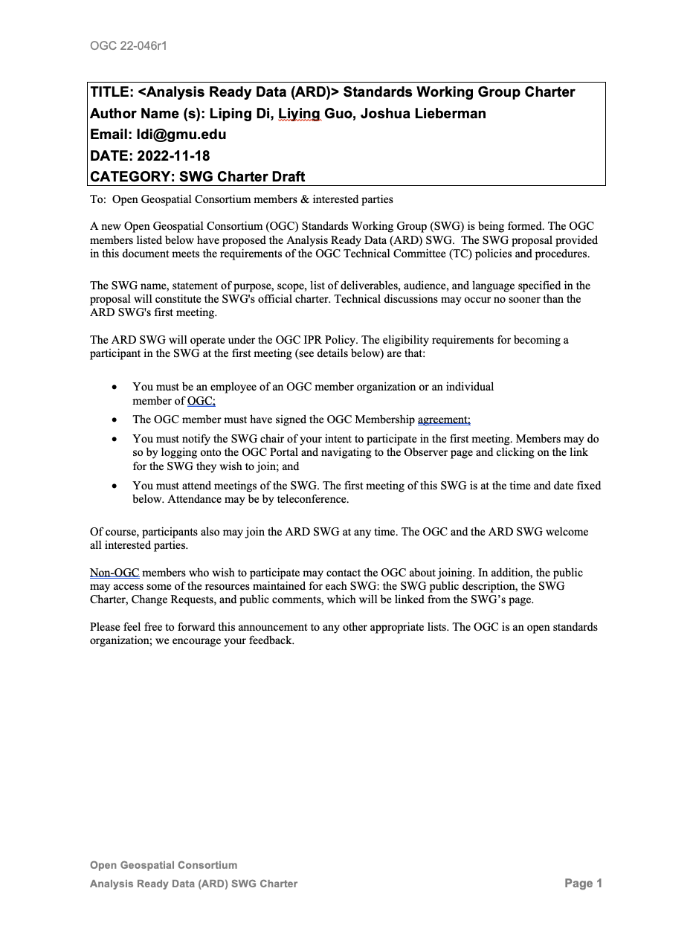
SWG charter
Out for public comment in Dec 2022
Few comments received
Presentation and release for vote at OGC TC in Frascati 02/2033
Charter Members
Name | Organization
Liping Di | George Mason University
Steven T Labahn | U.S. Geological Survey
Ferran Gascon | European Space Agency
David E. Borges | NASA
Rich Frazier | Federal Geographic Data Committee
Liying Guo | George Mason University
Yuqi Bai | Tsinghua University
Joshua Lieberman | Open Geospatial Consortium
Matthew Steventon | For GA, ESA, and USGS
Peter Strobl | EC-JRC
Sumit Sen | IIT Bombay
ADRIAN GUZMAN | Mexican Space Agency
Anna Wendleder | German Aerospace Center, DLR
HariPriya S | NRSC, ISRO
Radhika T | NRSC, ISRO
Christopher Barnes | KBR contractor to the U.S. Geological Survey
Andreia Siqueira | Geoscience Australia
David Moffat | Plymouth Marine Laboratory, UK
Peter Baumann | rasdaman GmbH Bremen

Slide 4
Related OGC standards
WCS: OGC Web Coverage Service can provide on-demand ARD data services for coverage data.
WFS: OGC Web Feature Service can provide on-demand ARD data services for feature data.
OGC API – Features can provide on-demand ARD data services for feature data.
CSW: OGC Catalog Service for Web can provide federated discovery of ARD products from multiple data providers
GML: GML is a comprehensive encoding of features, geometry, and topology in XML. GML can be used to encode the feature ARD.
GeoTIFF, NetCDF, and HDF5: These OGC standards are useful for encoding and packing coverage ARD.
WKT CRS: The Well-Known Text representation of Coordinate Reference Systems offers a standardized way to describe CRSs for reference by any spatial data set fully.
OMS Observations and Measurements: this standard defines XML schemas for observations, and for features involved in sampling when making observations. These provide document models for the exchange of information describing observation acts and their results, both within and between different scientific and technical communities.
DGGS Discrete Global Grid Systems Abstract Specification: The goal of DGGS is to enable rapid assembly of spatial data without the difficulties of working with projected coordinate reference systems. DGGSs represent the Earth as hierarchical sequences of equal area tessellations, each with global coverage and with progressively finer spatial resolution.
Several evolving OGC Standards are also relevant: OGC API – Tiles, OGC API – Maps, OGC API – Records, OGC API-EDR, and Cloud Optimized GeoTIFF.
Domain Working Groups (DWGs): GeoDataCube (GDC), Earth Observation Exploitation Platforms (EOXP)
… and what about STAC???

Slide 5
SWG charter vote
Charter is at: https://portal.ogc.org/files/?artifact_id=103013&version=1
Voting period 02 March to 16 April 2023
State as of today 23/03/2023: 3 more votes needed!
After vote ca. 2 weeks to EPC to finalize approval
If you are an OGC member VOTE!
… if not consider joining

Slide 6
Pertinent questions:
“My favourite slide of the entire week” Scott Simmons, Chief Standards Officer OGC
https://portal.ogc.org/files/?artifact_id=104110
ANALYSIS
What kind? visual interpretation, simple algebra, machine learning, physical modelling, AI, with same sensor, sensor fusion, data assimilation …
READY
For whom? EO experts, EO users, analysts, decision makers, general public …
DATA
Which types? “Remote Sensing”, “in-situ”, “Earth Observation”, “gridded”, “localised”, “orthorectified”, “spatiotemporal” …

Slide 7
Thank you!
peter.strobl@ec.europa.eu

