Slide 1
PFS: Geometric Uncertainty and Absolute / Relative Accuracy
Medhavy Thankappan
Geoscience Australia
Agenda Item #:2.4
LSI-VC 13
23-24 March 2023

Slide 2
Action Item LSI-VC 12-08
LSI-VC Leads to consider how to re-open the discussion regarding how the PFS address geometric uncertainty and absolute/relative accuracy (note parameters 1.8, 1.7, and 4.1 in the SR PFS). WGCV support (incl. TMSG) will be needed.
This should be considered in the frame of the CEOS Interoperability Framework.

Slide 3
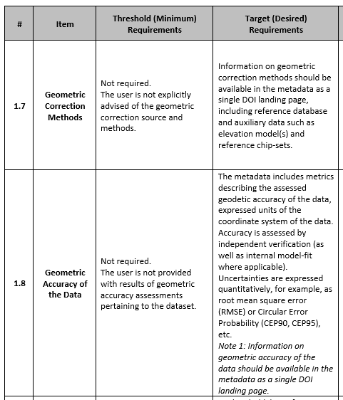
PFS Elements in General Metadata

Slide 4
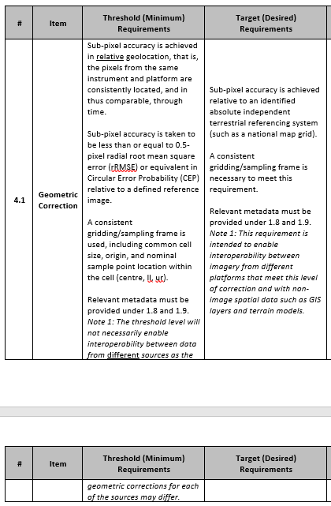
PFS Elements in Per-pixel Metadata

Slide 5
Discussion

Slide 6
Thank you
medhavy.thankappan@ga.gov.au

