Slide 1
JAXA
JAXA mission
and
CEOS-ARD product development update
Takeo Tadono, JAXA EORC
Ake Rosenqvist, soloEO/JAXA

Slide 2
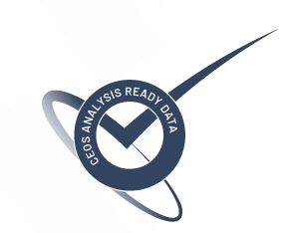
CEOS-ARD SAR – ALOS-2 PALSAR-2
Aug. 2022: Self-assessment submitted for NRB v5.5 THRESHOLD compliance
Three ALOS-2 PALSAR-2 products:
25m Fine Beam Global Mosaics
25m ScanSAR scene-based products
50m ScanSAR tile products
March 2023: Review completed. “All three products evaluated as CEOS-ARD compliant at the Threshold level.
Near-future plans: Re-processed JERS-1 SAR and ALOS PALSAR products to feature the same NRB-compliant format, and ALOS AVNIR-2 Surface Reflectance product.
2

Slide 3
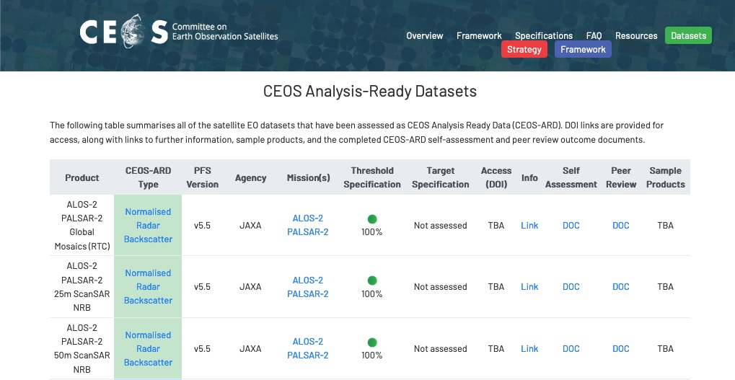
CEOS-ARD SAR – ALOS-2 PALSAR-2
Public access @JAXA EORC www
Public access @ GEE, AWS, [DE-Africa]
Africa (online); South America (proc by late April)
Rest of ScanSAR coverage: TBC
Access through JAXA RA (K&C) programme
3

Slide 4
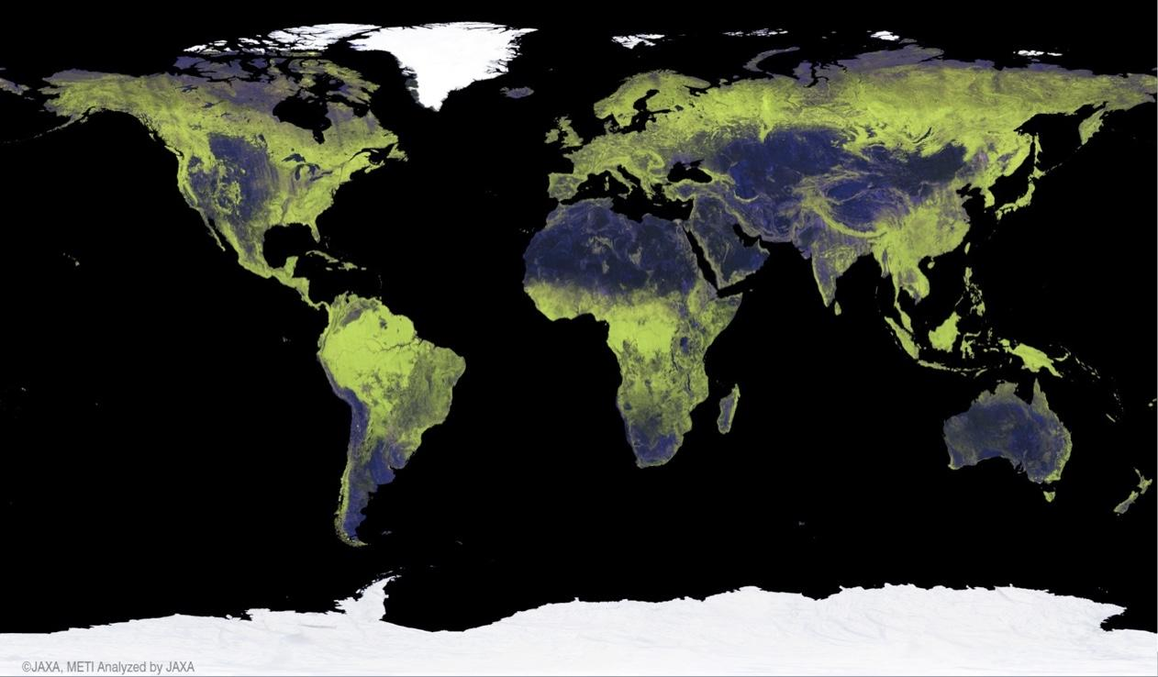
JAXA Annual Global 25 m Mosaics
Global Mosaic revisions
Modifications to the Sigma-SAR processor and EORC mosaicking software undertaken during 2021/2022.
Processing/Re-processing schedule
ALOS-2 2015–2021 [COMPLETED]
JERS-1 (tiles): 1993-1998 [COMPLETED]
ALOS-2 2022 [New]: April 2023
ALOS: 2007 & 2010: May 2023
ALOS: 2008 & 2009: July 2023
New mosaic features:
Improved geometric accuracy
Single-year data only (i.e. no gap-filling from other years in case of missing data)
Cloud Optimized GeoTiff (COG) format
Compliance with CARD4L NRB v5.5
Public download www:
https://www.eorc.jaxa.jp/ALOS/en/dataset/fnf_e.htm
4

Slide 5
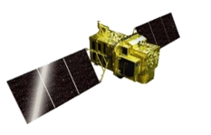
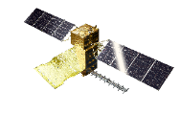
Continuous Observations by ALOS Series Missions
Providing continuous L-band SAR observations since 2014, successor to “DAICHI” (ALOS PALSAR, PRISM and AVNIR-2) 2006-2011 and JERS-1 (SAR and VNIR) 1992-1998
ALOS-2 PALSAR-2 - operations ongoing
ALOS-3 optical – Launch failure on March 7, 2023
ALOS-4 PALSAR-3 – FY2023 as schedule
JFY 2014 | 2015 | 2016 | 2017 | 2018 | 2019 | 2020 | 2021 | 2022 | 2023 | 2024 | 2025 | 2026 | 2027 | 2028 | 2029 | 2030
ALOS-2 (L-band SAR)
Post Operation Review Meeting
Launch
Mission Operation
(5 years)
Post-Operation #1
(2 years)
Post Operation #2
(X years)
ALOS-3 (Optical)
March 7
Development
Mission Operation (7 years)
ALOS-3 Follow-on
(Under discussion)
Feasibility Study
Development
ALOS-4 (L-band SAR)
TBC
Development
Mission Operation (7 years)
ALOS-4 Follow-on
(Under discussion)
Feasibility Study
Development

Slide 6
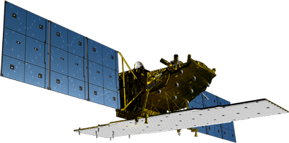
ALOS-2 PALSAR-2
On-board internal calibration is performed every 3 months.
Product quality of key observation modes is evaluated regularly using SAR data over calibration sites.
Launched 2014, ALOS-2 currently in its 2nd Post-operations phase
PALSAR-2 remains in good condition and performance.
PALSAR-2 calibration summary (using PALSAR-2 acquired 07/2014 – 09/2022)
Items | Results
Geometry (RMSE) | [Stripmap and Spotlight] 5.39 m (L1.1) / 6.73 m (L2.1) [ScanSAR] 60.77 m (L1.1) / 29.33 m (L2.1)
Radiometry | RCS accuracy (1σ) | 0.522 dB (corner reflectors) 0.41 dB (Amazonian forests)
Polarimetry | VV-HH amplitude ratio | 1.003 (σ=0.012)
 | VV-HH phase difference | -0.362 deg (σ=1.404)
 | Cross talk | [HV/HH] -42.970 dB (σ=6.609) [VH/VV] -42.889 dB (σ=5.590)
* https://www.eorc.jaxa.jp/ALOS/a/en/alos-2/a2_calval_e.htm

Slide 7
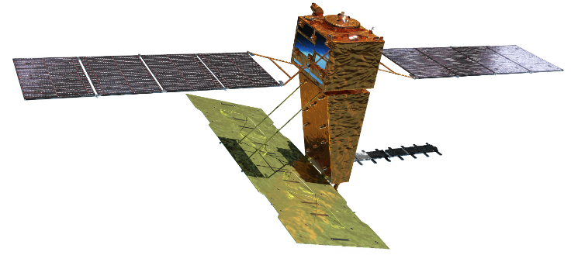
ALOS-4 PALSAR-3
Phase D
Launch | FY2023 by H3 Test Flight 2
Orbit | Same orbit as ALOS-2 Sun-synchronous sub-recurrent orbit Altitude: 628 km Inclination angle: 97.9 degree Local sun time at descending: 12:00 ± 15 min. Revisit time: 14 days (14+11/14 rev/day)
Lifetime | 7 years
Size | X 10.0 m x Y 20.0 m x Z 6.4 m
Satellite Mass | ~2,990 kg
Downlink | 1.8 / 3.6 Gbps (Ka-band)
Mission Instruments | PALSAR-3 (Phased Array type L-band Synthetic Aperture Radar-3) SPAISE3 (SPace based AIS Experiment 3)
Y
X
Z
SPAISE3 (AIS)
PALSAR-3
Ka-band DT antenna
In-orbit configuration

