Slide 1
SAR & LiDAR
PFS Progress update
AR – on behalf of the CEOS-ARD SAR Team
A. Rosenqvist &
T. Tadono (JAXA)
Agenda Item 2.2
LSI-VC-13, ESA/ESRIN
23rd - 24th March 2023

Slide 2

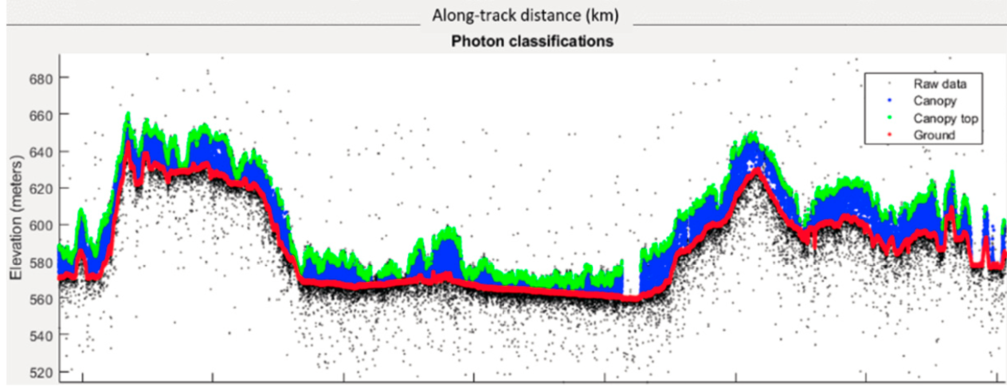
CEOS-ARD for (Spaceborne) Lidar
PFS: Lidar Terrain & Canopy Height
Footprint (1D single-source) product
Gridded (2D multi-source) product – under discussion
Prime focus on spaceborne Lidar
Accommodating full waveform and photon counting systems
Current ARD-Lidar team members
Lidar mission teams:
  GEDI, MOLI, ICESat-2
Data Providers:
  NASA LP-DAAC; USGS (TBD), NSDIC (TBC); ...
Science community
Schedule (easy does it...)
First PSF draft: Q3/2023
V1.0: ~2024
Lidar Terrain & Canopy Top Height PFS draft (based on new CEOS-ARD PFS template)
Terrain & canopy top height from ICESat-2
(Neuenschwander et al, 2019)

Slide 3
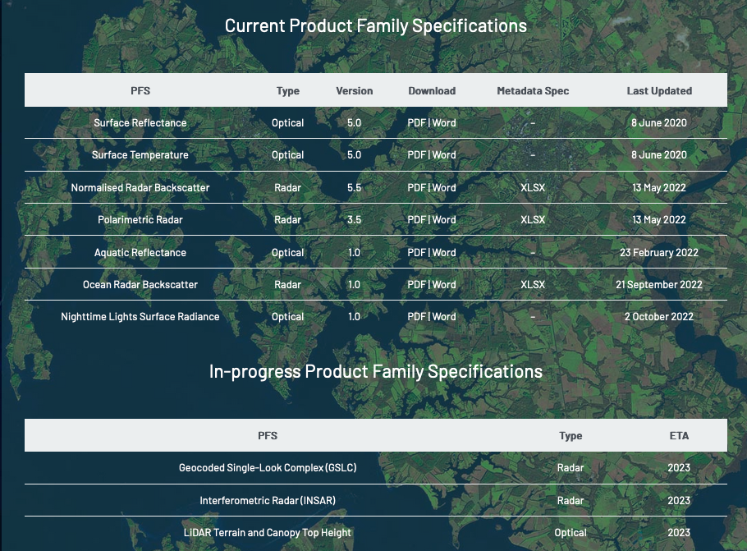
CEOS-ARD for Synthetic Aperture Radar
Endorsed:
Normalised Radar Backscatter (NRB v5.5)
Polarimetric Radar (POL v3.5)
Ocean Radar Backscatter (ORB v1.0)
In the pipeline:
Geocoded SLC (GSLC)
On the back burner:
Interferometric Radar (INSAR)
Community uptake:
Approved NRB compliant:
  DE-Africa/Sinergise (Sentinel-1)
  JAXA (ALOS-2 PALSAR-2)
Ongoing NRB self-assessments or preps
  CSIRO (NovaSAR) , ESA (S-1), DLR (S-1), CONAE (SAOCOM), ISRO (EOS-04/RISAT-1A), ...

Slide 4
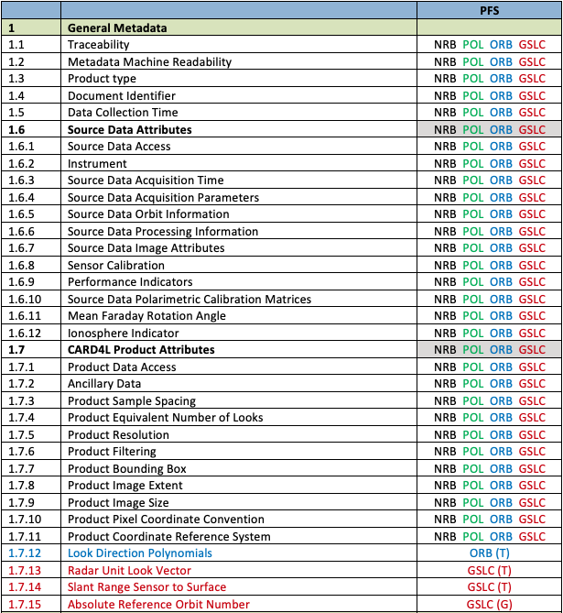
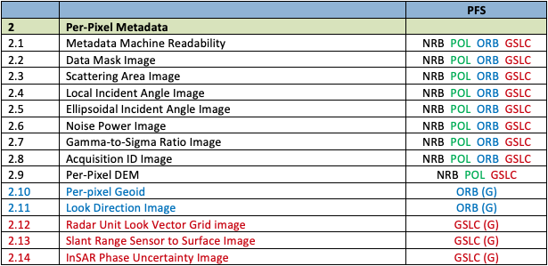
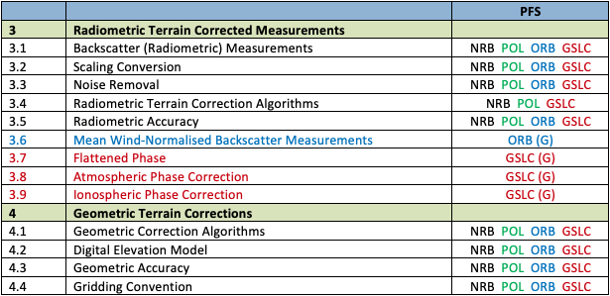
CEOS-ARD for Synthetic Aperture Radar
Large number of SAR PFSs (NRB, POL, ORB, GSLC) – and more to come
  Challenge for users and data providers
75% commonality of parameters
  Common parameters must match
  Revisions to one affect all
  Challenge to keep track & risk for inconsistencies
An opportunity for harmonisation?
44 of 59 parameters common across the SAR PFSs

Slide 5


Harmonised SAR – One PFS to Rule Them All
Single PFS for all CEOS-ARD SAR products:
  NRB, POL, ORB, GLSC
Goals:
  Ensure consistent parameter names and specifications across all SAR PFSs
  Simplify revisions and change tracking
  Maintain PFS clarity and readability while describing multiple products
  No changes to (Threshold) specifications for endorsed PFSs
NRB 5.5, POL 3.5, ORB 1.0) remain valid
First Harmonised SAR PFS draft under development:
  Google doc available for viewing 🡪
  Comments welcome!
Harmonised SAR PFS
Harmonised PFS Draft HERE

Slide 6
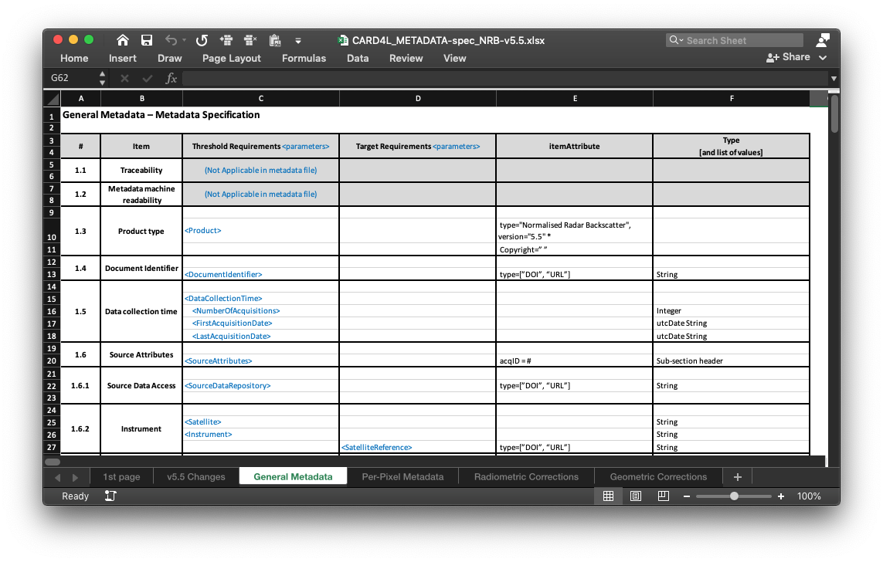
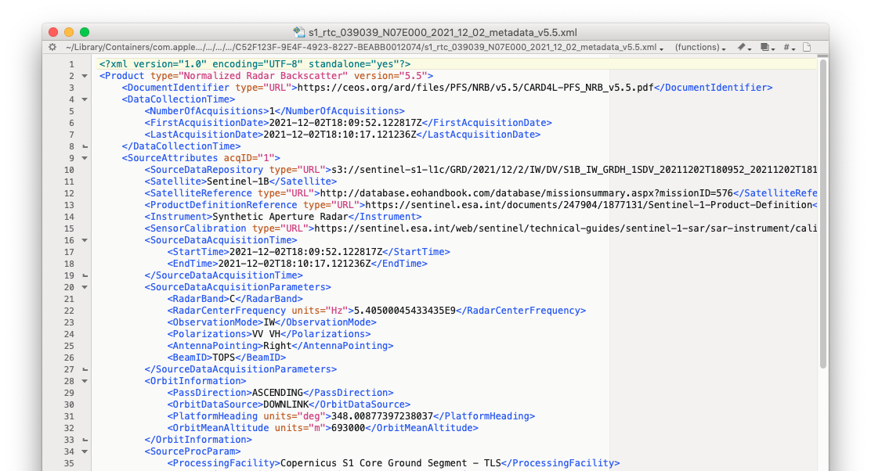
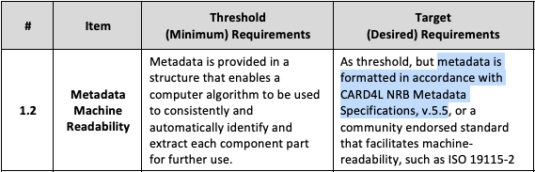
Harmonised SAR – One PFS to Rule Them All
Metadata specifications
Accompanying metadata specification under development
Consistent mapping of parameter names between PFS and metadata
Specs for XML format but data provider may select other metadata formats
Non-mandatory (Target req.)

Slide 7
CEOS-ARD for SAR and LiDAR
PFS Cross-cutting issues
Improving interoperability across existing (optical & SAR) PFS. Common terminology
Explicit requirements (Threshold) or recommendations (Target/Goal) in PFSs for data formats that can be ingested directly in common GIS SW (e.g. GeoTiff/COG).
Accompanying metadata specifications
  Target/Goal also beyond SAR and Lidar PFSs?
  Additional format specs beyond XML? (e.g. .json/geojson)
Cloud interoperability and STAC – how to reflect in the PFSs
New CEOS Interoperability Framework Coordination to address some of the above

