Slide 1
CEOS-ARD Assessments
Medhavy Thankappan
& Peter Harrison
Geoscience Australia
Agenda Item#:2.1
LSI-VC 13
23-24 March 2023

Slide 2
CEOS-ARD Review Process
CEOS-ARD Review Panels are only used for ‘Target’ level submissions (agreed at WGCV-49)
CEOS-ARD peer review guidelines: suggested total of five members on the Review Panel
  One WGCV member
  Three members who are either WGCV members or sub-group members nominated by their Chairs
  Not more than one member from a given sub-group
  Two-year terms for all members
Threshold level CEOS-ARD submissions evaluated through one-on-one interactions between data provider and PoCs for WGCV and LSI-VC
Need a Review Panel to cover the SAR domain (seeking self-nominations)
Landsat CEOS-ARD Review Panel
Sentinel-2 CEOS-ARD Review Panel
Hyperspectral CEOS-ARDReview Panel
Nigel Fox
Valentina Boccia
Darren Ghent
Jeffrey Czapla-Myers
Medhavy Thankappan
Nigel Fox
Cody Anderson
Darren Ghent
Fernando Camacho
Medhavy Thankappan
Nigel Fox
Kurt Thome
Cindy Ong
Hirokuza Yamamoto
Medhavy Thankappan

Slide 3
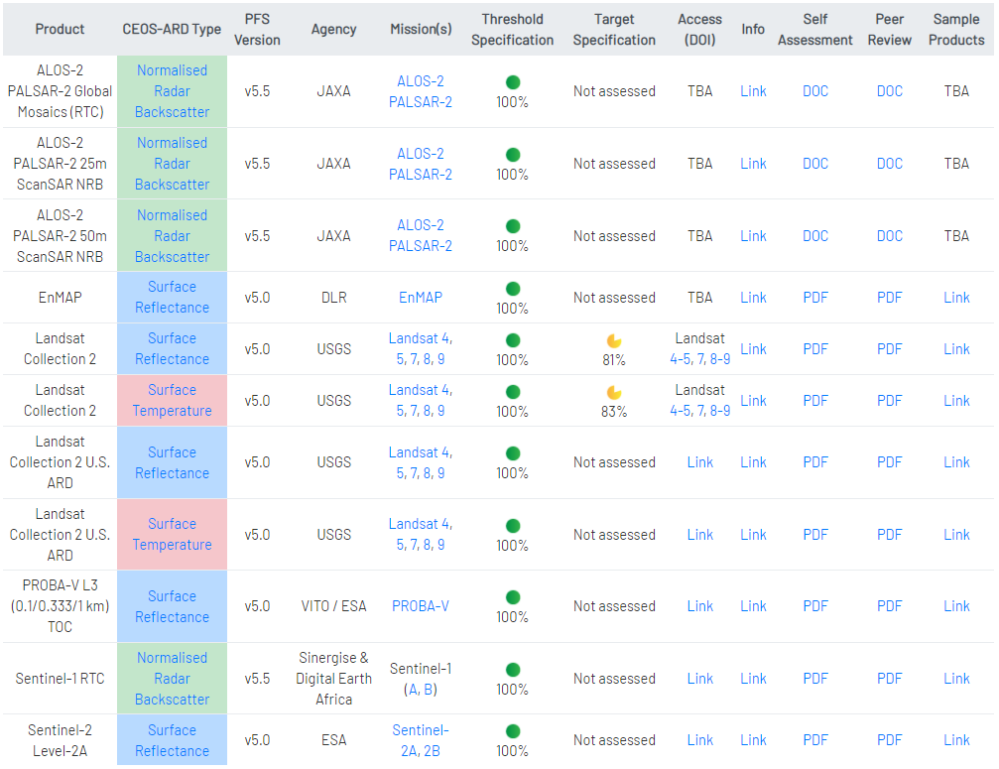

CEOS-ARD Assessments (Complete)

Slide 4
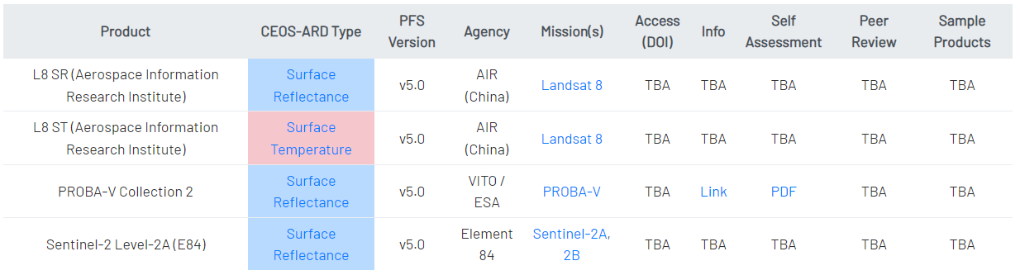
CEOS-ARD Assessments (In Progress)
Recently submitted for review
Review pending clarification from data provider
Replica datasets under review as already meeting CEOS-ARD Compliance

Slide 5
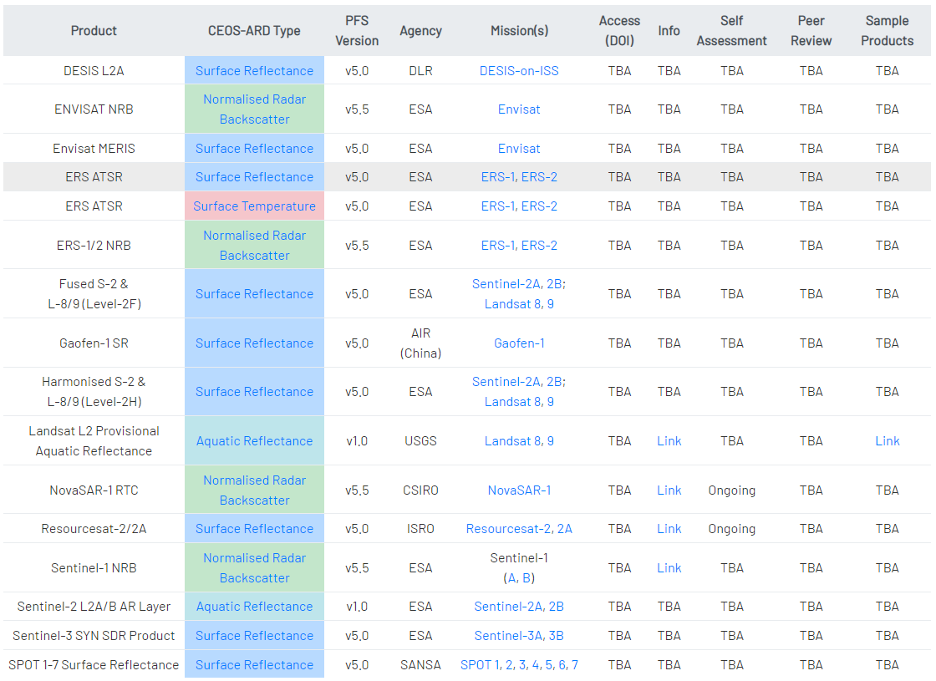
CEOS-ARD Assessments (Outlook)

Slide 6
For Noting / Discussion
‘CARD4L’ replaced by ‘CEOS-ARD’ to reflect use in other domains (e.g. aquatic)
Peter Harrison is supporting CEOS-ARD evaluation at GA
Feedback on self assessment submitted for CEOS-ARD products
A simple LSI-VC gating process to verify submission would be helpful
Clear evidence for metadata items in submission (for quick verification)
Information overload – provide only material relevant for evaluation
Identifying non-PFS elements included in the product package (e.g. derivatives)
Redundancy / back-up to be identified for WGCV PoC

Slide 7
Thank you
medhavy.thankappan@ga.gov.au
peter.harrison@ga.gov.au

