Slide 1
GEOGLAM Updates for LSI-VC 12
Alyssa Whitcraft & Ian Jarvis
On behalf of the GEOGLAM Executive Committee
akwhitcraft@geoglam.org | ijarvis@geosec.org
ESA-ESRIN | Frascati, Italy | 9 September 2022

Slide 2
Topics
Capacity Development Team Guidance Document
Essential Agriculture Variables for GEOGLAM & CEOS Intersection:
Joint Crop Mapping Validation Workshop CEOS WGCV LPV
AFOLU (Preview!)
Updating observation requirements – LSI-VC
In Situ Data Coordination & Executive Director Updates
Summary Actions for CEOS Related to GEOGLAM

Slide 3
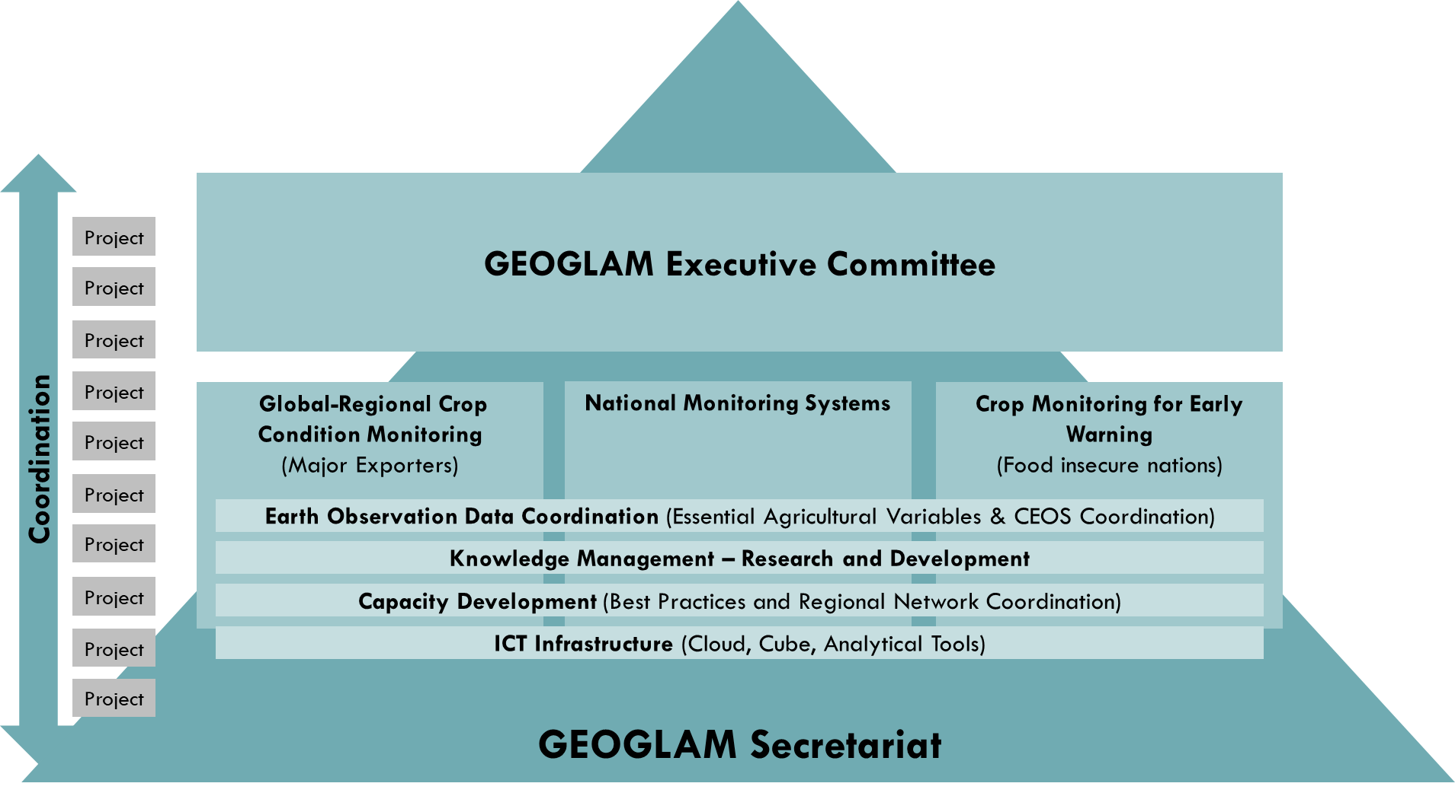
GEOGLAM Today
~100 organizations (best efforts) in 46 countries
2 regional networks (Asia-RiCE, AMA)
Crop Monitors
Community Reports
Interaction with GEO
Interaction with CEOS
Interactions with Policy
In Situ Data Working Group
Notes:
And with so much going on, we’re in need of reducing duplication of effort

Slide 4
Capacity Development Team
Team Co-Leads: Andy Nelson (ITC – U. Twente) & Alyssa Whitcraft (GEOGLAM etc.)
Team Roles & Responsibilities:
Develop a strategic vision for capacity development for GEOGLAM
Cyclical, iterative: e.g. operationalizing our R&D (JECAM, In Situ); but also driving priorities!
Help organize materials and resources for future reuse by actors across GEOGLAM
Preserving and multiplying lessons learned
Engage with other CapDev organizations – GEOGLAM as a community resource
CapDev Guidance Document: A resource of community knowledge and practice
A blend of theory, practice, and narratives of successful engagement from GEOGLAM partners and stakeholders
Collect and share evidence-based “good practices” around capacity development
Across the full CapDev “life-cycle” – i.e. it should all start at project conceptualization
Emphasis on “co-development” “co-design” ”co-production”
Serve as a resource for organizations seeking to “support GEOGLAM”
“What does it mean to support GEOGLAM where tech transfer/capacity development is implicated?”
Now we have an answer!
Notes:
It is aimed at GEOGLAM partners and also the organisations that GEOGLAM interacts with, including govn. agencies, CEOS, policy bodies
It is a resource for ambitions to scale up agricultural monitoring activities and associated capacity development activities
It will be a blend of theory, practice and narratives from GEOGLAM members and stakeholders with examples of successful engagement

Slide 5
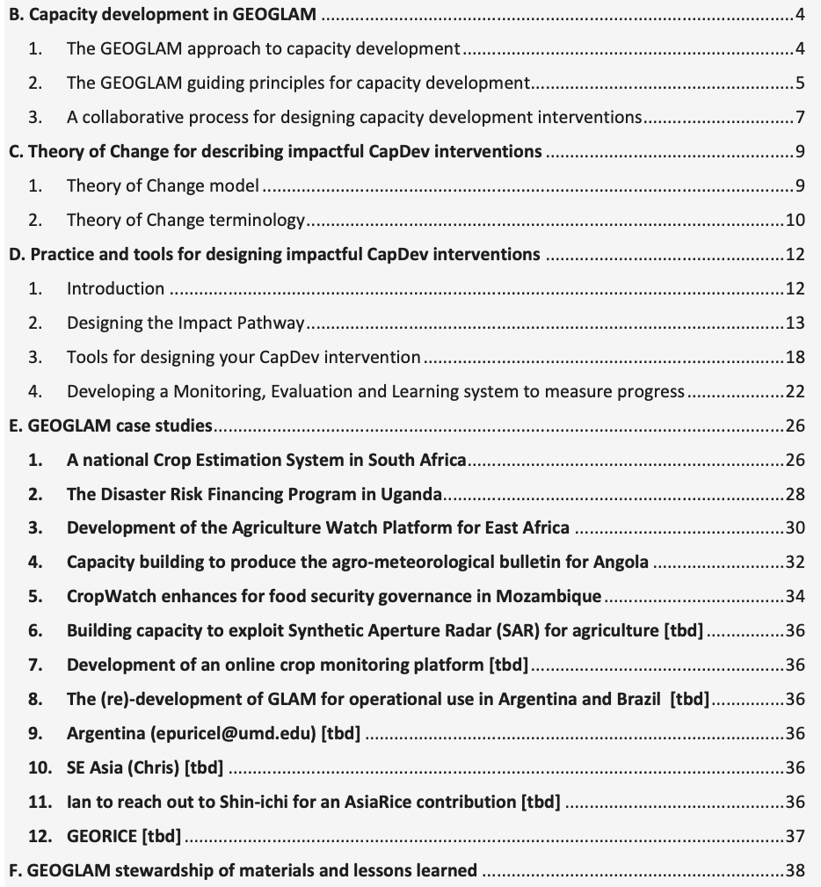
CapDev Document
Next Steps:
- Review by ExCom
- Endorsement by CEOS
- Endorsement by GEO and reuse by other GEO communities
Why CEOS Endorsement?
- CEOS agencies should know it is a thing they can use and implement, esp. when aiming to support GEOGLAM (in their own projects; in crafting tenders and selecting proposals)
- We all want to get more EO use; here’s what we have found works
Editors: Andy Nelson, Joost Teuben, Alyssa Whitcraft, Sophie Bontemps, and Ian Jarvis
Notes:
--> restating: "The whole purpose of the doc is basically to prevent the sort of top-down approaches to capacity development that are often funded by space agencies, because we have found them to be ineffective, and to instead provide funding agencies (space or not) with a proposed alternative for how to create the most impact in the uptake of EO by new users."
--> there is also the important purpose of providing practitioners in the CEOS and broader EO community with very practical guidelines and tools for successful capdev relationships/interventions. The recommendations are largely generalizable, so the document is a service to our whole applications community. We have had a lot of success; this is a community document distilling those lessons and providing case studies to illustrate.
--> We actually want CEOS agencies to know it is a thing they can use and implement, especially if they are aiming to support GEOGLAM, both in the projects themselves and in the crafting solicitations/tenders and selection of proposals. I am thinking that "Endorsement" is a way to get it formally in the CEOS record, and to get real space agency attention and awareness.

Slide 6
Essential Agriculture Variables for GEOGLAM
Nested under EO Data Coordination
EAV Co-Leads: Alyssa Whitcraft & Sven Gilliams (VITO)
Notes:
15 minutes total – aim for 12 minutes

Slide 7
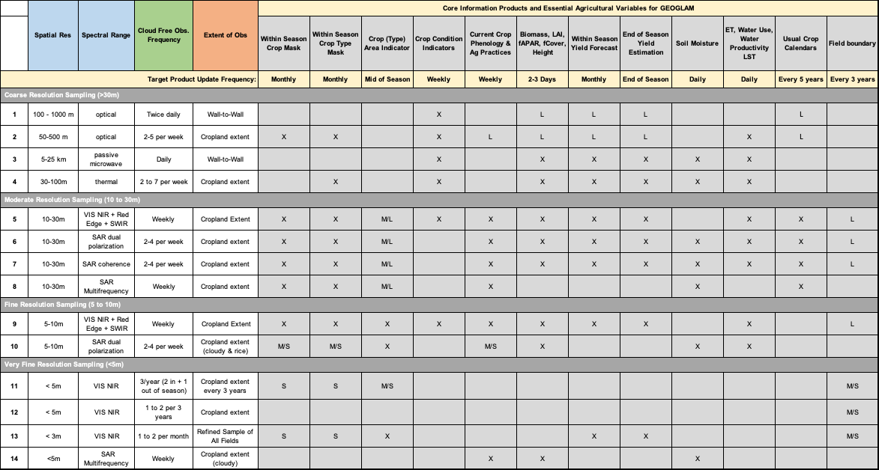
GEOGLAM Earth Observation Data Requirements Table (2019)

Slide 8
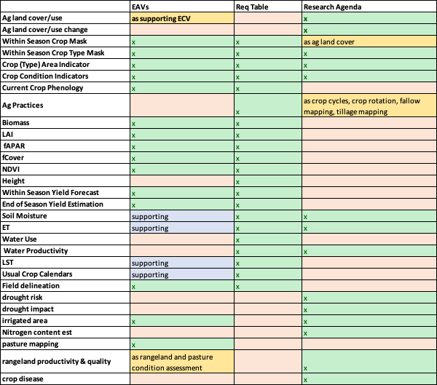
Challenges:
Requirements Table lacked product information or prioritization
Even within GEOGLAM, we had inconsistent prioritization of variables
Proliferating policies and demands on GEOGLAM
Need to limit scope WHILE leveraging our expertise and tools for impact
Need to directly link our variables to policy and use
CEOS has always needed this!
Grounded not in what instruments we have available, but in “decision units”

Slide 9
For a complex policy and operations environment, we need an integrator
GEOGLAM provides a bridge between EO and impact.
Variable specification & priorities
Telling space agencies, funding agencies, and R&D community what is needed – how to support GEOGLAM
Methods improvement
Complemented by cal/val, in situ data
Product generation
Standard products for multiple uses
Capacity Development
Operational transition of methods, tools, and products
Decisions Driving Needs Data Feeding Decisions
Policy/decision support drive the data requirements
Space agencies need traceability to justify missions & science teams
But, data needs to be transformed into information to be useful for policy
We need to reduce complexity
We need to harmonize and prioritize needs

Slide 10
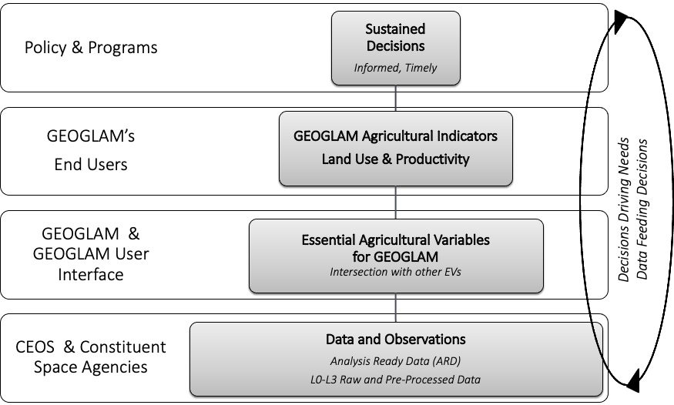
EAVs as Integrators
Information produced by the GEOGLAM community can help support a multitude of policy targets
Building upon other EVs allows inter-policy relevance
Policy targets require information integrated from multiple science communities
“once the geospatial data are created, they can be used many times to support a multiplicity of applications” – UN
EAVs also integrate the data-to-decisions cycle
Notes:
I call this the “data-to-decisions” chain or the “GEOGLAM data value chain” - where we are bringing data to communities through a series of activities which add value and relevance, while reducing unnecessary complexity. And, although not perfectly designed (I’m not a graphic designer, believe it or not) – you can see that decisions are driving needs all the way through (info, product, data)
What we realized is that defining high-value EO-based products which are applicable across multiple decisions and policy spheres both demystifies the value of EO for policymakers and provides clear evidence to the world’s space agencies of the traceability of their observations into decisions and policy.

Slide 11
How it Started…
October 2019, Louvain

Slide 12
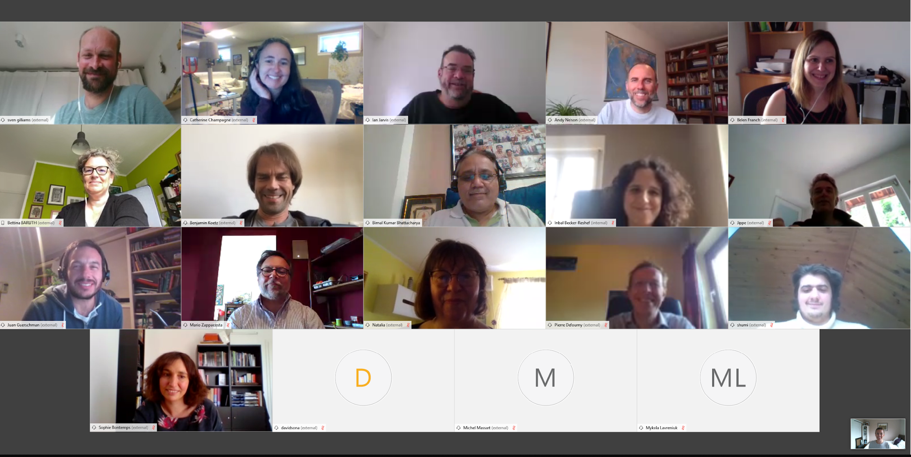
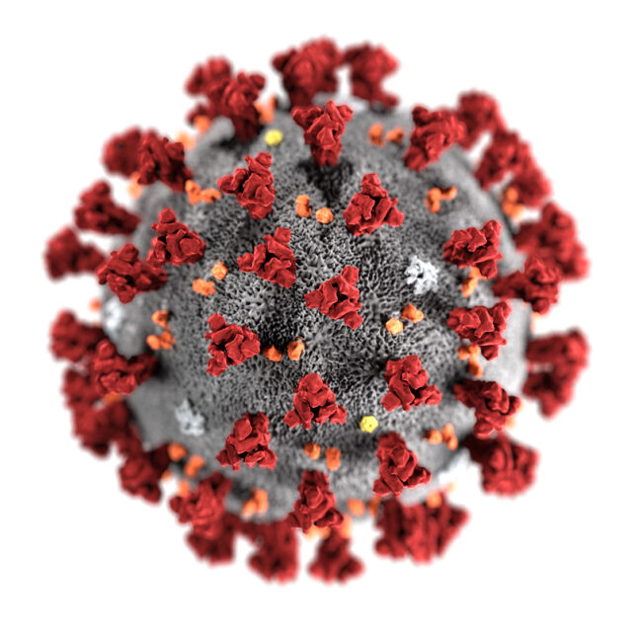
How it Went…
June 2020, Virtual
Coronavirus

Slide 13
How it’s Going
Sad I can’t be there ☹

Slide 14
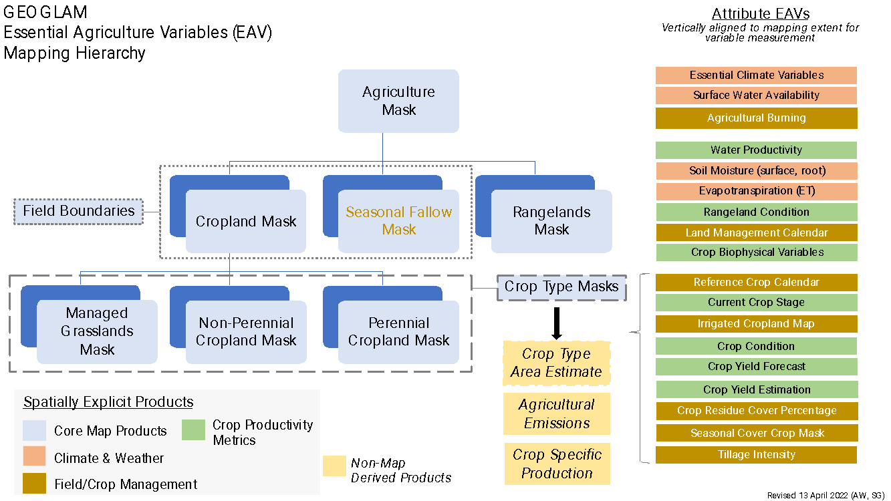
How it’s Going…

Slide 15
EAV Website
AgVariables.org

Slide 17
EAV Next Steps (1/3)
EAV | Land Use & Cover | Mgmt | Biomass & Emissions
Core Map Products (previous slide) | x
Crop Calendar | x | x
Land Management Calendar |  | x
Seasonal Cover Crop Map |  | x
Irrigated Cropland Map | x | x
Tillage Intensity |  | x
Crop Rotation Sequence |  | x
Seasonal Fallow Mask | x | x
Agricultural Burning |  | x
Crop Yield Estimation |  |  | x
Aboveground Agricultural Biomass |  |  | x
Crop Residue Cover Percentage |  |  | x
Soil Moisture |  |  | x
ET (reference and actual) |  |  | x
Fractional Cover |  |  | x
Agromet Variables (ECVs) |  |  | x
“A Joint Workshop to Develop Community Good Practices & Product Accuracy Protocols for Cropland and Crop Type Products”
Tyukavina (UMD), Bontemps (UCL), Nickeson (NASA GSFC) 🡪 CEOS LPV Co-leads & Coordinator
Whitcraft (UMD), Gilliams (VITO), Justice (UMD) 🡪 GEOGLAM EAV co-leads + GEOGLAM co-chair
NASA-funded (Applied Sciences + R&A)
Q1 2023
AFOLU (more Monday from Ian)
Crosswalk between EAVs and AFOLU, in progress 🡪

Slide 18
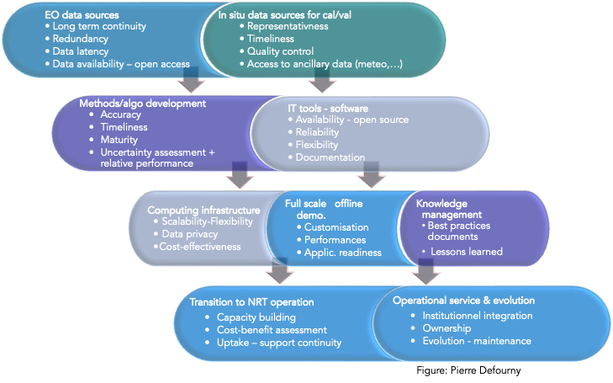
EAV Next Steps (2/3)
Gap Analysis
LOE beyond current funding
Transparent Product “Certification” Process
Learning from CEOS ARD/PFS
must meet the definition for the specified EAV, including any stated minimum accuracy requirement, “product generation notes”
must be generated at a minimum of national-scale
must undertake error assessment
must be freely and publicly available
must have documentation in the form of a peer-reviewed paper (journal not req’d)

Slide 19
EAV Next Steps (3/3)
Harmonizing/Updating GEOGLAM Requirements
More than 40 EAVs (including several ECVs and many that tightly overlap)
- Only 12 groupings
- No coverage of grasslands, rangelands
- Phenology and practices grouped
etc.
We should link satellite data requirements concretely to variable/observable to use
Expect an updated “GEOGLAM Requirements” in 2023
There will then need to be a CEOS Strategic Response
Last iteration was 2019

Slide 20
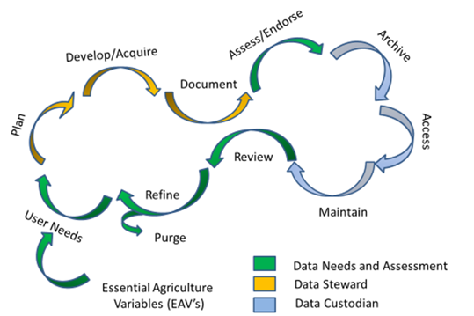
In Situ Data Coordination:
Data Lifecycle Management
Harmonized datasets, EAV driven
Leveraging ESA-WorldCereals
Working with GEO Data Wkgrp
November Workshop
Review progress
Mobilize community support
Identify remaining gaps
Create implementation plan
Notes:
We have also been working on enhanced in situ data coordination…perhaps the most daunting task before us
We have just completed a guidance and workplan document that will chart our course forward
Upcoming workshop in November. Save the date is out, happy to share with any LSI VC members with an interest

Slide 21
Pulling it all Together:
Open Science
Data and Tools
R&D
Operations
Essential
Agriculture
Variables
In Situ
Data
Coordination
Information
Products
Addressing Policy Challenges
Needs
Capacity (co) Development Guidance
(National and International)
Adaptation
National Adaptation Plans (NAP)
UNFCCC Supplemental
NAP Guidance
Mitigation
AFOLU Roadmap
Global Stocktake (GST)
Nationally Determined Contributions (NDCs)
Climate
Response
Early Warning & Food Security
Crop monitor for early warning
Seasonal Forecasts
Special Reports
Market Information
Agricultural Markets Information System (AMIS)
Commodity Crop Conditions
Seasonal Forecasts
Food
Security & Markets

Slide 22
GEOGLAM Looking Forward
Factors influencing food insecurity can be expected to increase
Climate Extremes
Pest and disease
Conflict
Earth Observation will need to play an ever increasing role to inform policies and programs
Key actions to rise to the challenge
Need for sustained solutions with long term continuity
Scale up co-development efforts to less developed nations
Better integration across sectors and science domains
Notes:
As we look forward some concluding thoughts…

Slide 23
Summary of CEOS “Actions” for GEOGLAM
Endorsement of CapDev Document 🡪 CEOS Plenary 2022
What does CEOS need/want to do about the EAVs?
Endorsement, or wait for the requirements + CEOS response?
There will likely be more CEOS LPV – EAV interactions
Mutually find a way together on the “A” in AFOLU (Monday)

Slide 24
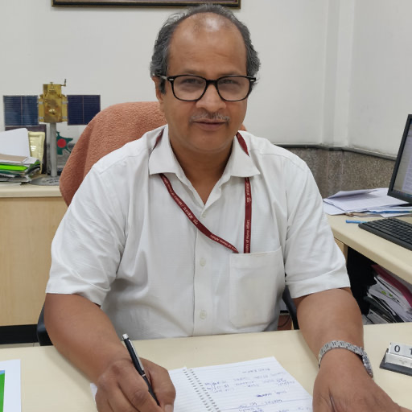
In Memoriam, Dr. Shibendu S. Ray
A pioneer in agriculture monitoring
Founding Director of the Mahalanobis National Crop Forecasting Center
ISRO scientist
An adored mentor and collaborator
Lost to COVID-19 on 4 May 2021

