Slide 1


AFOLU Information Needs and Observing Capabilities in 2035
Joint Workshop of CEOS AFOLU Roadmap Team &
GCOS Terrestrial Observation Panel for Climate
12 September 2022
Committee on Earth Observation Satellites
Notes:
Osamu to speak < 10 mins

Slide 2
Meeting Objectives & Context
AFOLU Co-Leads (15 mins)
12 September 2022
Committee on Earth Observation Satellites
Notes:
Osamu to speak < 10 mins

Slide 3
Heritage
2020 CEOS Plenary agreed to a CEOS AFOLU Roadmap, as an initiative in support of the UNFCCC Global Stocktake Process
  Discussion Paper prepared by LSI-VC Forest & Biomass Team
  Recognising need for an AFOLU equivalent to the CEOS GHG Roadmap (with CGMS)
  “...if Land Use, Land Use Change and Forestry targets involved in the initial NDCs were implemented in full, this would represent approximately a quarter of pledged mitigation efforts up to 2030“
2021 accomplishments
  Assessment of latest AFOLU products that could be readied for COP-26
  Coordination with SIT Chair Team and GHG Team on the new CEOS GST Portal – as a unified point of entry to explain and offer our data
  New engagement axis with national inventory users, building on our GFOI experience and in the spirit of the ambition cycle of the Paris Agreement to learn together and grow together
  Significant input to SO GST on Mitigation, Adaptation and Means of Implementation.

Slide 4
CEOS AFOLU Roadmap
Focus in 2022 & 2023 is the development of a CEOS AFOLU Roadmap document
Objectives:
Provide a framework for long-term (~ 15+ years) coordination of CEOS agency observing programmes in support of the needs of society for AFOLU-related information, with a focus on the needs and ambition cycle of the Global Stocktake of the Paris Climate Agreement.
A guiding vision for long term space agency coordination around AFOLU. Characterises the needs, the services and applications required, the products and observing systems that can support. Explain the need to plan for ground segment, space segment and services.
An effective means for communicating our intentions to society, UNFCCC, national inventory community etc
Addresses basic observation continuity and the necessary agency coordination to achieve it

Slide 5
CEOS AFOLU Roadmap
And expected contents:
define the 2035 observing system required to address the AFOLU information needs of society
consider the technologies and systems needed to realise this observing system
identify the stakeholders required at different stages of the value chain to ensure it can be sustained in the long-term (i.e. users- service providers, - data product producers-observation providers)
the technology development programmes and investments needed by space agencies to achieve them
the programmatic commitments that will be needed to get there
Addressing three different dimensions:
global assessments and syntheses
national climate policy and actions
GHG inventories

Slide 6
Today’s Workshop
CEOS SIT Chair Team host
Brings together the AFOLU Roadmap Team and the Terrestrial Observation Panel for Climate (TOPC) of GCOS.
Objectives:
  make a start on defining how society’s needs for information related to AFOLU and its reporting can be expected to evolve in the coming years
  consider the policy needs and assumed AFOLU information needs in the 2035 timeframe on the assumption that this foundation can inspire and drive the generation of the CEOS AFOLU Roadmap
Structured along the lines of our AFOLU thematic expert teams:
  Forests & biomass, Agriculture, OLU (mangroves, wetlands..)
  And the dimensions of: global assessments and syntheses; national climate policy and actions; GHG inventories
We aim to reboot the Roadmap progress. We will still need expert champions to volunteer to get this done in the year ahead!

Slide 7
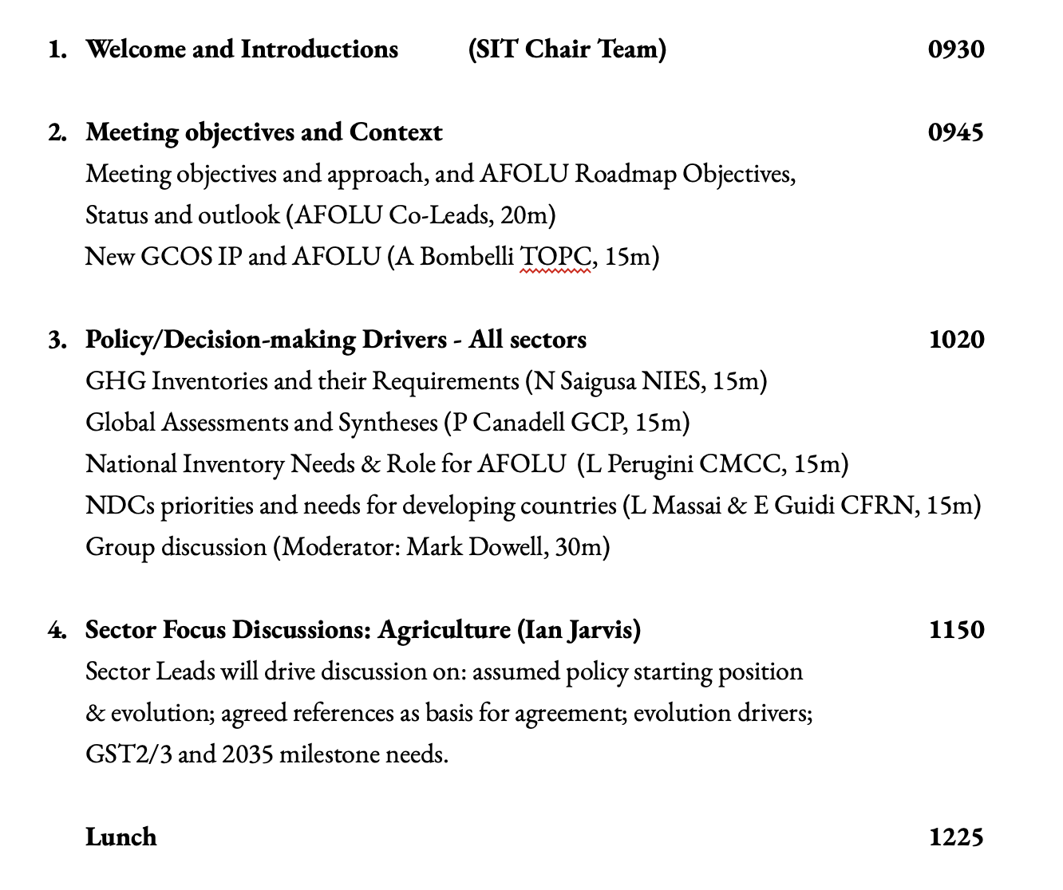
Agenda - am

Slide 8
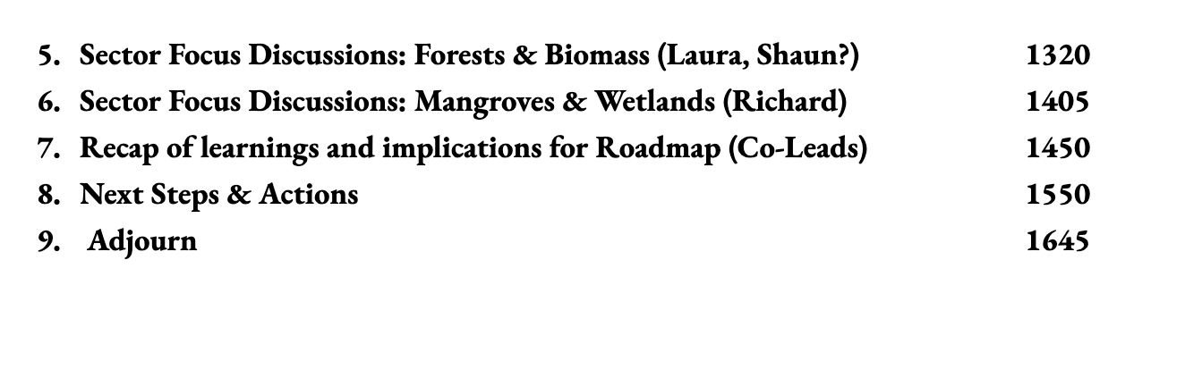
Agenda - pm

Slide 9
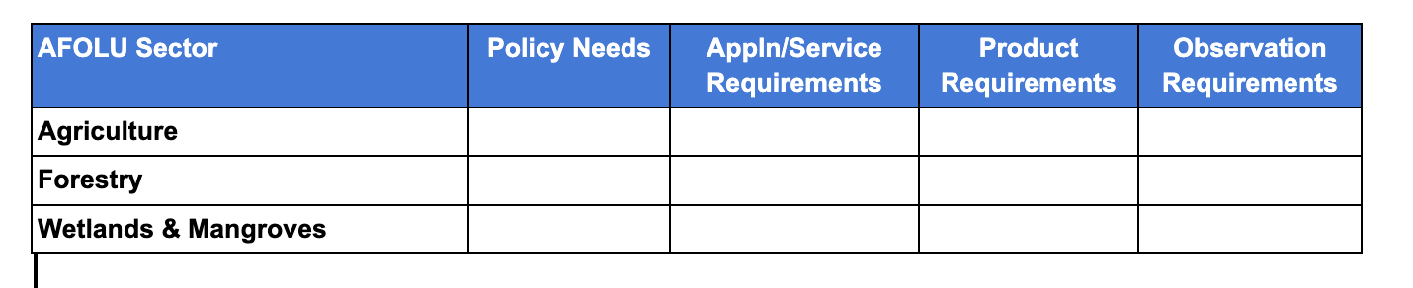
Thematic presentations
Thematic teams asked to come with a start on the requirements for discussion - a start on the template for each of the 3 dimensions, each addressing the 2035 time horizon and interim milestones of GST1 (2026) and GST2 (2031)
45 mins each is not much time! At best we can agree approach, scope, depth and learn from each team.

Slide 10
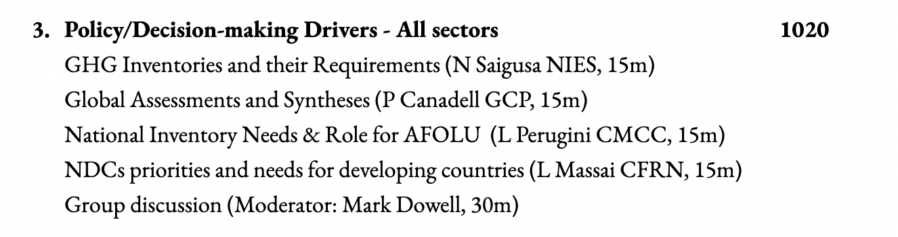
Policy & Drivers presentations
1.5 hours of context to inform and advise our discussions

