Slide 1
Suggestion for a CEOS Interoperability Framework
Peter Strobl, EC
Agenda Item #5.1
SIT TW 2022, ESA/ESRIN
13th - 15th September 2022

Slide 2
Background
Discussion Paper
CEOS Analysis-Ready Data (CEOS-ARD) framework is a first step towards increasing the interoperability of Earth observation datasets.
CEOS-ARD is a first step on the interoperability spectrum :
From WGISS & LSI developed CEOS Interoperability Terminology Report (2020)

Slide 3
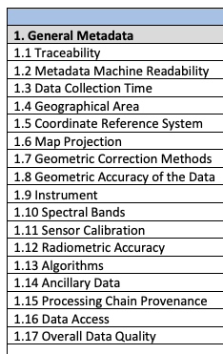
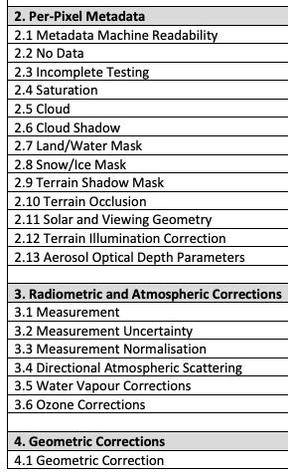
Background
The CEOS-ARD Product Family Specifications (PFS) define parameters which facilitate interoperability
Only a subset of what needs to be considered when trying to achieve full interoperability of datasets

Slide 4
Background
Addressing the full scope of interoperability requires a framework that captures all aspects of the problem.
The following (non-exhaustive list) are all important factors to consider, and each have a number of component pieces:
Structural / Data Architecture
Accessibility / System / Data Presentation
Formats / Syntactic / Data Language
Terminology / Semantics / Data Context
Factors and components are distributed across many CEOS groups (e.g., LSI-VC, WGISS, WGCV, etc.), and therefore a robust framework and coordination mechanisms are needed to address all of the necessary pieces.

Slide 5
CEOS (LSI) ‘Interoperability Spectrum’, thus far:
CEOS LSI-VC Vision:
Sensor Agnostic Land Surface Data from all Missions
Total Interoperability, straight from data providers – increased transparency and openness vs downstream efforts (e.g., GEE, Sinergise), for all users, and taking advantage of broad range of CEOS missions
Enable the use of complementary sensors to achieve a coherent single data stream to enable characterization of change on the Earth’s surface through time.
Harmonisation vs homogenisation?
Structural / Data Architecture
CEOS-ARD
Minimum Data Processing Level + Documented
Uncertainty measures
Consistent / Interoperable Metadata
MRI Framework and PFS parameters?
LSI-VC / CEOS-ARD OG
Interoperability Blocks / Activity Areas
Common References: Grids, DEM, GCP(?)
Discrete Global Grid System (DGGS)
Strobl / WGCV
Terminology / Semantics / Data Context
Strobl / Molch / Woolliams / WGCV
Formats / Syntactic / Data Language
COG / Cloud-enabling
WGISS
Accessibility / System / Data Presentation
STAC
Hanson / USGS
WGISS

Slide 6
Various (non-EO-specific) frameworks exist…

Slide 7
Interoperability Layers
Example from knowledge organisation (KO), https://www.isko.org/cyclo/interoperability

Slide 8
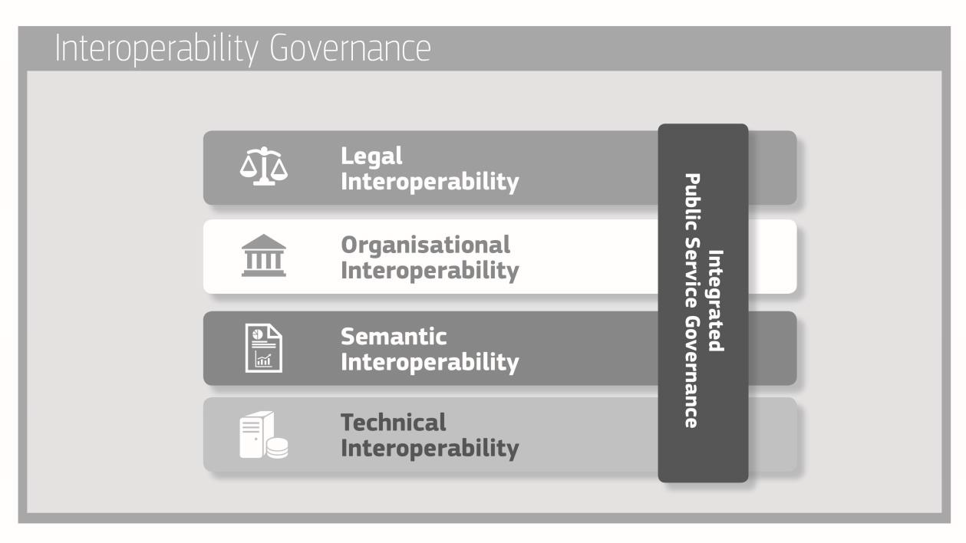
European Interoperability Framework
https://eur-lex.europa.eu/resource.html?uri=cellar:2c2f2554-0faf-11e7-8a35-01aa75ed71a1.0017.02/DOC_3&format=PDF

Slide 9
European Open Science Cloud - Interoperability Framework
Legal interoperability* is about ensuring that organisations operating under different legal frameworks, policies and strategies are able to work together. This might require that legislation does not block the establishment of European public services within and between Member States and that there are clear agreements about how to deal with differences in legislation across borders, including the option of putting in place new legislation.
Organisational interoperability refers to the way in which organisations align their business processes, responsibilities and expectations to achieve commonly agreed and mutually beneficial goals (source: European Interoperability Framework).
Semantic Interoperability. It ensures that the precise format and meaning of exchanged data and information is preserved and understood throughout exchanges between parties, in other words ‘what is sent is what is understood’.*
Syntactic interoperability. If two or more systems use common data formats and communication protocols and are capable of communicating with each other using open standards (source: Interoperability - Wikipedia)
Technical interoperability. A characteristic of an Information Technology (IT) system, whose interfaces are completely understood, to work with other IT systems, at present or in the future, in either implementation or access, without any restrictions or with a controlled access (source: Interoperability - Wikipedia).
https://op.europa.eu/en/publication-detail/-/publication/d787ea54-6a87-11eb-aeb5-01aa75ed71a1/language-en
*https://joinup.ec.europa.eu/collection/nifo-national-interoperability-framework-observatory/glossary

Slide 10
Proposal
CEOS effort should be built upon and derived from one of these existing, broad, well considered, and well defined frameworks.
Once an appropriate framework has been agreed:
apply it to the specific problem of Earth observation dataset interoperability
structure future work and define responsibilities across the CEOS organisation.

Slide 11
LSI-VC-12 Discussion
Do we need a CEOS Interoperability Framework (CEOS-IF)?
Should it focus on LSI or should it encompass all CEOS work?
Do you know of some particularly well-suited frameworks for our purpose?
Which one is, or could be, suitable for your agency?
How many and which components should a CEOS-IF have?
Which of the shown examples would you follow?
What should be adapted?
Where do you see your own expertise best represented?
Which components would LSI-VC lead?
Where could you lead or contribute?
Which components would LSI-VC contribute to?
In which of these areas are you already active and in which frame (agency / national / international)?
Which layers are you interested in and willing to discuss?
Who should deal with the other components?
Which topics should be addressed within CEOS and by whom?
What is out of scope for CEOS and do you have suggestions whom we might need to cooperate with?
Decision: Agree recommendation from the LSI-VC perspective to CEOS as input for the presentation at the 2022 SIT Technical Workshop.

Slide 12
SIT TW Presentation
Hope to have WGISS participation in that LSI-VC-12 discussion
LSI-VC-12 Agenda item (currently 10:20 CEST, Sept. 9)
Register here
ESA ESRIN location
Virtual connection details will be shared with registered participants soon
Please share with WGISS team
Feedback also welcome in the Discussion Paper (comments) or via email to matthew@symbioscomms.com and Peter.STROBL@ec.europa.eu

Slide 13
SIT TW Presentation
Peter will report on the Interoperability Framework proposal following the discussion at LSI-VC-12
Possibly propose a CEOS Plenary action for LSI-VC to flesh out the concept with other interested parties, and to come back with a concrete proposal for SIT-38 consideration?
Would WGISS be interested in participating in / support such an action ?

