Slide 1
LSI-VC Vision

Slide 2
CEOS Work Plan
    Will need to update later this year
    Sense tasks are: routine and/or unorganised
Mostly in service to the CEOS-ARD Strategy
Under-representation of forwarding-looking specific actions in other areas like interoperability, requirements ?
Broaden representation of team and their own priorities

Slide 3
LSI-VC Terms of Reference
LSI-VC Terms of Reference (20 December 2019)
A lot has changed!
Great progress on CEOS-ARD

Slide 4
Key Points – Current Terms
Opportunities and Challenges:
Optimize use of LSI assets, maximize global coverage, minimize data gaps
Simplify user interaction with vast amounts of data
Support downstream user uptake of data

Slide 5
Key Points – Current Terms
Mission Statement:
Maximize value derived from CEOS Agency LSI assets
Facilitate coordinated and optimized LSI contributions from CEOS Agencies in support of adopted CEOS priorities
High level opportunities, challenges, and mission remain relevant
Activities differ from practice
Outcomes perhaps… unrealistic?
Harmonization of future and existing mission acquisition plans across major international land surface imaging programs based on a reliable understanding of domain-specific requirements

Slide 6
Proposing a new Vision and more specific Objectives to help us:
Clarify and organise our goals
Broaden the ‘umbrella’ of LSI-VC activities
Increase representation of all team members and their own priorities
Define our next CEOS Work Plan inputs
Better understanding of Progress / Status, Lead(s), Contributor(s), Partners & Connections, etc.

Slide 7
LSI-VC Vision Proposal
Sensor agnostic land surface data from all missions, achieving a coherent single data stream that enables characterisation of change on the Earth’s surface through time.

Slide 8
Objective #1
Promote uptake and ease the use of land surface imaging datasets via an efficient CEOS-ARD for Land process

Slide 9
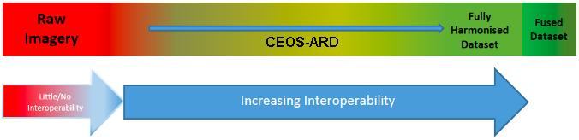
Objective #2
Move CEOS agency and other data providers' land surface imaging datasets along the interoperability spectrum, with a view to a future of sensor agnostic land surface data from all missions.

Slide 10
Objective #3
Respond to CEOS land surface imaging priority needs, including on observation and mission continuity, gaps and requirements, observing strategies, and other technical topics.

Slide 11
Now define our work to achieve these objectives…
Keeping in mind inputs like AFOLU Roadmap, GEOGLAM EAVs, CEOS-ARD Strategy, Interoperability Framework, etc.
Work Package 1: Responding to AFOLU Roadmap & GEOGLAM EAV Requirements
Work Package 2: CEOS-ARD for Land (CARD4L)
Work Package 3: Improving LSI Interoperability

Slide 12
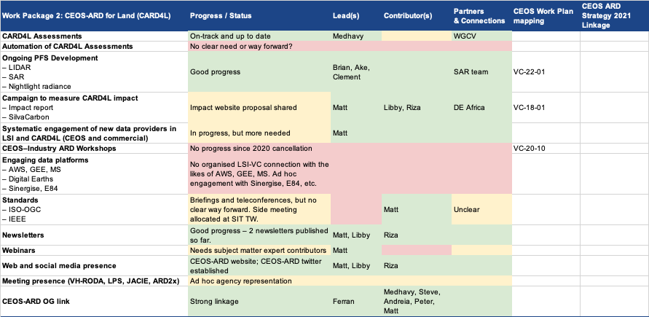

Slide 13
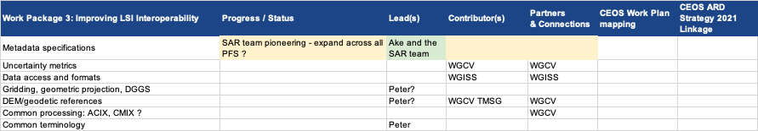
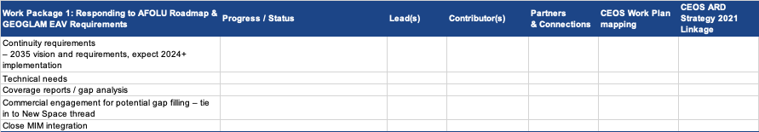

Slide 14
Questions and Discussion
Decision: Proposed Vision and Objectives make sense?
Decision: Work packages appropriate?
Hear from LSI-VC team on their own priorities and objectives
Action? Update our Terms of Reference Activity and Outcomes sections
Action? LSI-VC team to help define work packages that align with own priorities

