Slide 1

CEOS Analysis Ready Data For Land-CARD4L for SAR – ISRO’s Perspective
LSI-VC-12- September 2022
Hari Priya Sakethapuram
Scientist ‘SE’
Microwave Data Processing Group
National Remote Sensing Centre
Indian Space Research Organization

Slide 2
Presentation Overview
Introduction to CEOS-ARD
SAR CARD4L Specifications and PFS
NRSC/ISRO-An Overview
In-House ARD Generation for Current SAR missions-NRB and PolSAR
Proposals for Upcoming SAR missions
Futuristic -Deep Learning Open SAR datasets Creation
SAR Data Cube Structuring

Slide 3
CEOS-ARD
CEOS Analysis Ready Data for Land (CARD4L) has been proposed to support the objective of simplified EO data handling for the user.
CEOS-ARD reflects the attributes of fundamental measurement products for the majority of global remote sensing users with land imaging applications, and are the minimum level required to support time series analysis and data interoperability
CARD4L for Optical/SAR/LIDAR data are processed to a minimum set of user based requirements .
Data providers to take the responsibility of fundamental data correction and processing tasks, so the users can take up spatial-temporal analysis and research of remote sensing data in a time-bound sense.
This involves data suppliers removing many of the fundamental data correction and processing tasks in order to increase the user-base .

Slide 4
CARD-Product Family Specifications- SAR
The general guidance document for data providers specifies the minimum set of requirements corresponding to geometric and radiometric data corrections, ancillary meta data information and the per pixel meta data corresponding to the image.
CARD4L Product Family Specifications (PFS) for SAR comprises the primary concepts pertaining to SAR:
1.The Normalized Radar Backscatter (NRB -For Land) and (ORB- Ocean Radar Backscatter )
2.Polarimetric SAR
3.Geo-coded Single Look Complex
4.SAR Interferometric Products
The SAR product is declared to be CARD4L compliant once all the thresholding requirements are incorporated.

Slide 5
CARD4L –PFS FOR SAR
POL
Any one Polarimetric Decomposition (As per the discretion of the data provider)
Polarimetric Covariance Matrix
(C-Matrix)
NRB
Radar Measurements
with RTC
Pixel-wise Meta Data
(Incidence Angle map
Layover/Shadow Mask)
General Meta Data
(Can be modified as per the requirements)

Slide 6
NRSC-IMGEOS –An Overview
National Remote Sensing Centre-NRSC is an arm of Indian Space Research Organization –ISRO and is equipped with Integrated Multi-Mission Ground Segment for Earth Observation Satellites –(IMGEOS) framework.
IMGEOS is set for acquisition, processing and dissemination of data on a 24x7 basis from Indian and Global remote sensing satellite missions.
NRSC is a Satellite/Ariel Remote Sensing Data Producer and Data Distributor.
The acquired SAR data corresponding to every data dump is pre-processed for extracting the Level-0 raw files which are then processed for generating the higher levels of data.
The processed data is archived in the centralized Storage Area Networks .
Based on online user requests, they are either re-processed or fetched from the archives for dissemination.

Slide 7


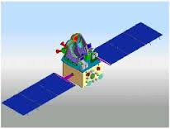

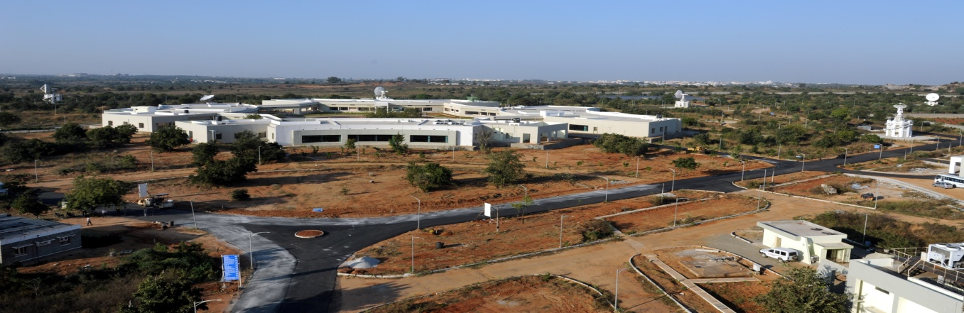
IMGEOS -NRSC

Slide 8
RISAT-1 - C Band SAR
RISAT-1 is C –Band SAR (5.35 GHz) developed and launched by ISRO in 2012.
The primary imaging modes are Fine Resolution Stripmap (FRS1) at 3m,Medium/Coarse Resolution ScanSAR MRS/CRS with 24 m to 48m ground resolution and High Resolution Spotlight with 1m resolution.
The TX/RX polarizations are Single (HH/VV), Dual (HH+HV/VV+VH) .
The standard Data provided is Level-2 Enhanced ,which is Terrain Geo-Referenced with per-pixel local incidence angle map (LIA) and the Mask Layers .
Level-1 Single Look Complex Data is available to the users based on the requirements.
It also features a unique Hybrid Polarimetric mode ,the circular FRS-1 mode is realized in the Circular Transmit Linear Receive (CTLR) configuration wherein, the transmission is Right Circular with linear receive giving rise to RH and RV channels.

Slide 9
RISAT-1 - Radar Backscatter and
Polarimetric Products realization
The CFRS-1 Single Look Complex data is in CEOS format comprising of the real and imaginary components of the processed signal.
In –house software has been developed for polarimetric processing and derivation of the Stokes vector . Hybrid polarimetric parameters like Degree of Polarization-m, relative phase(delta) , axial ratio(AR),circular polarization ratio(CPR) from the data channels .
These parameters are in turn used to generate the channels corresponding to Surface, Double and Volume Bounce scattering of the target area.
Based on the scattering mechanism, hybrid polarimetric decomposition techniques m-delta and m-chi are implemented and provided for Application based studies.
Software Tool has been developed in-house for ingesting and analyzing datasets from contemporary SAR sensors- Radarsat-2 ,Sentinel-1A /1B, RISAT-1 /1A, L&S Airborne SAR, Novasar, Chandrayaan-SAR (Sigma Naught /Gamma Naught Generation, Polarimetric Processing, Textural Features Generation etc..)

Slide 10
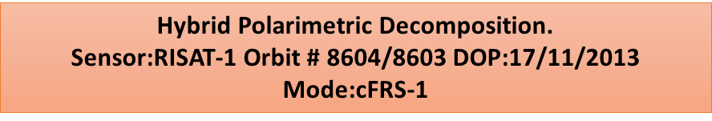
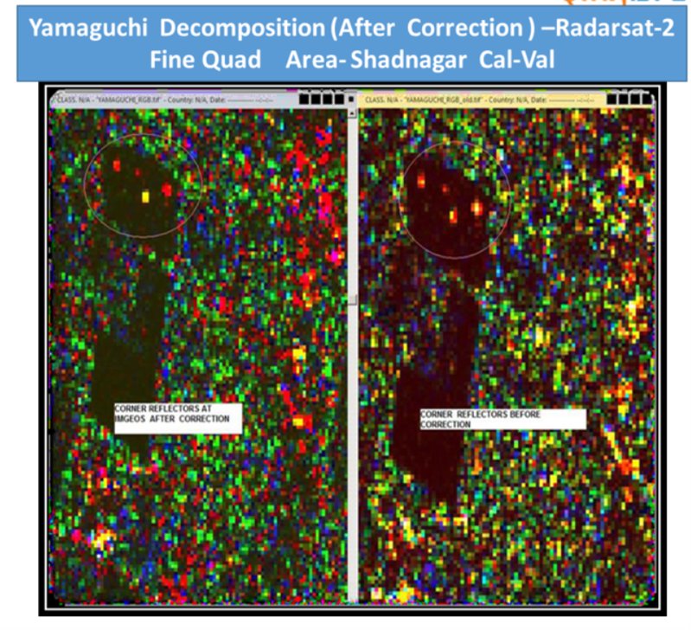
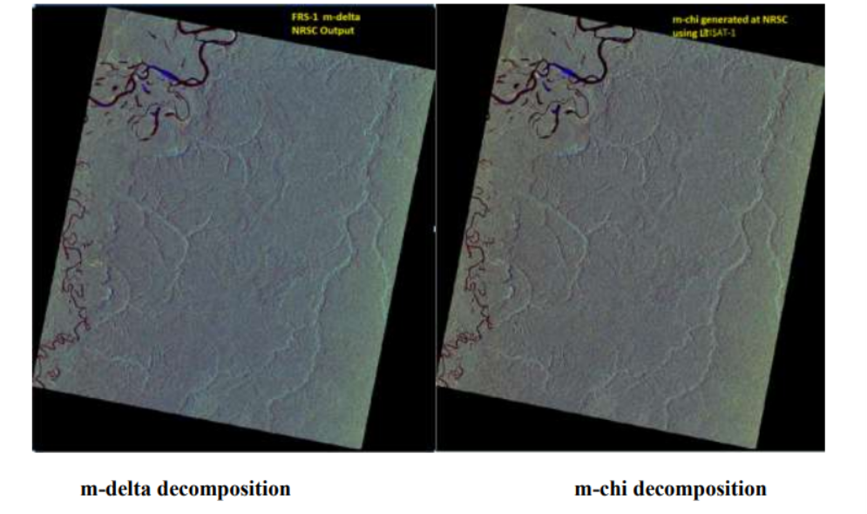
Polarimetric Products –RISAT1 (Circular Hybrid ) and Radarsat2(Full Quad )

Slide 11
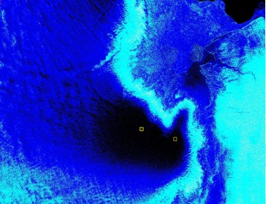
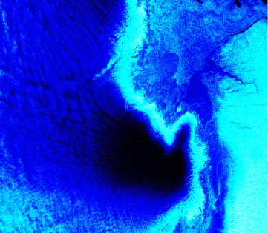
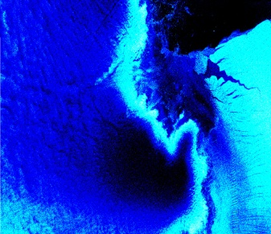
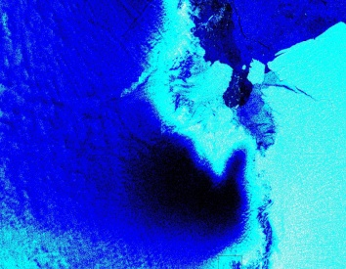
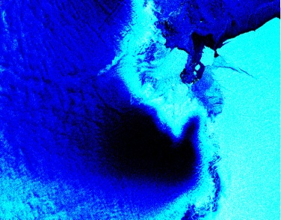
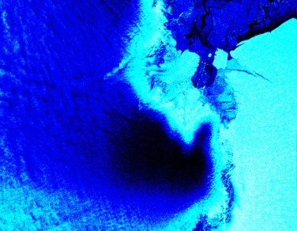
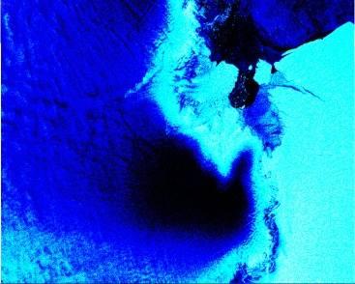

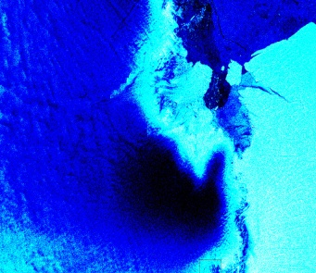
Variation of backscatter Signatures across the austral season- Sentinel SAR(Region-Antarctica) )
6th JAN -2019 18th JAN--2019 17th FEB- -2019
13th MARCH -2019 31st MARCH -2019 18th APRIL -2019
12th MAY-2019 30th MAY 2019 29th JUNE -2019

Slide 12
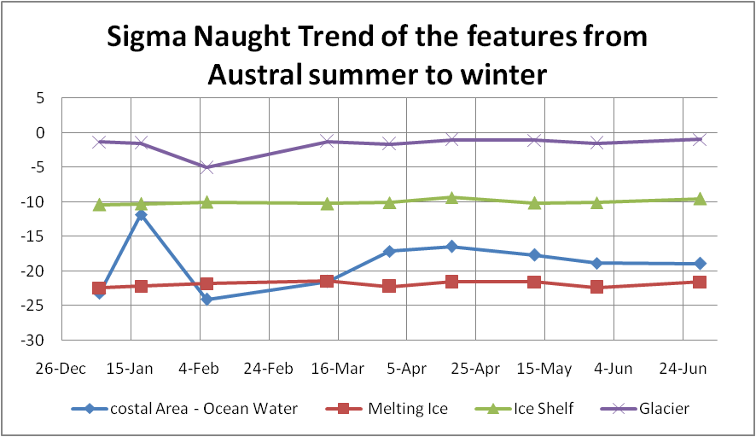
Sentinel-1 –Observations( Polar Antarctic)

Slide 13
Novasar-1 – Data Analysis for CEOS -ARD
NovaSAR (S Band-3.1-3,5GHz) is a joint technology demonstration initiative of SSTL (Surrey Satellite Technology Ltd.), UKSA, and Airbus DS. It was launched by ISRO in 2018.
The primary imaging modes are Stripmap at 6m and ScanSAR with 25 m to 45 m ground resolution. The TX/RX polarizations are Single (HH/VV), Dual (HH+HV/VV+VH) and Tripol (HH,VV,HV) .
The Level-1 NovaSAR products generated by the SSTL IFP (Image Formation Processor) comprise Single Look Complex (SLC) and Ground Range data for Stripmap mode and Mutilook Detected data for ScanSAR mode in various polarization combinations. The Level-1 Products are geocoded and ellipsoid corrected.
Terrain Correction for realising
NovaSAR-GTC Mode:6m-Stripmap
Date of imaging: 4/8/2021;
Scene No.:15
Area: Near Uttar Pradesh, India

Slide 14
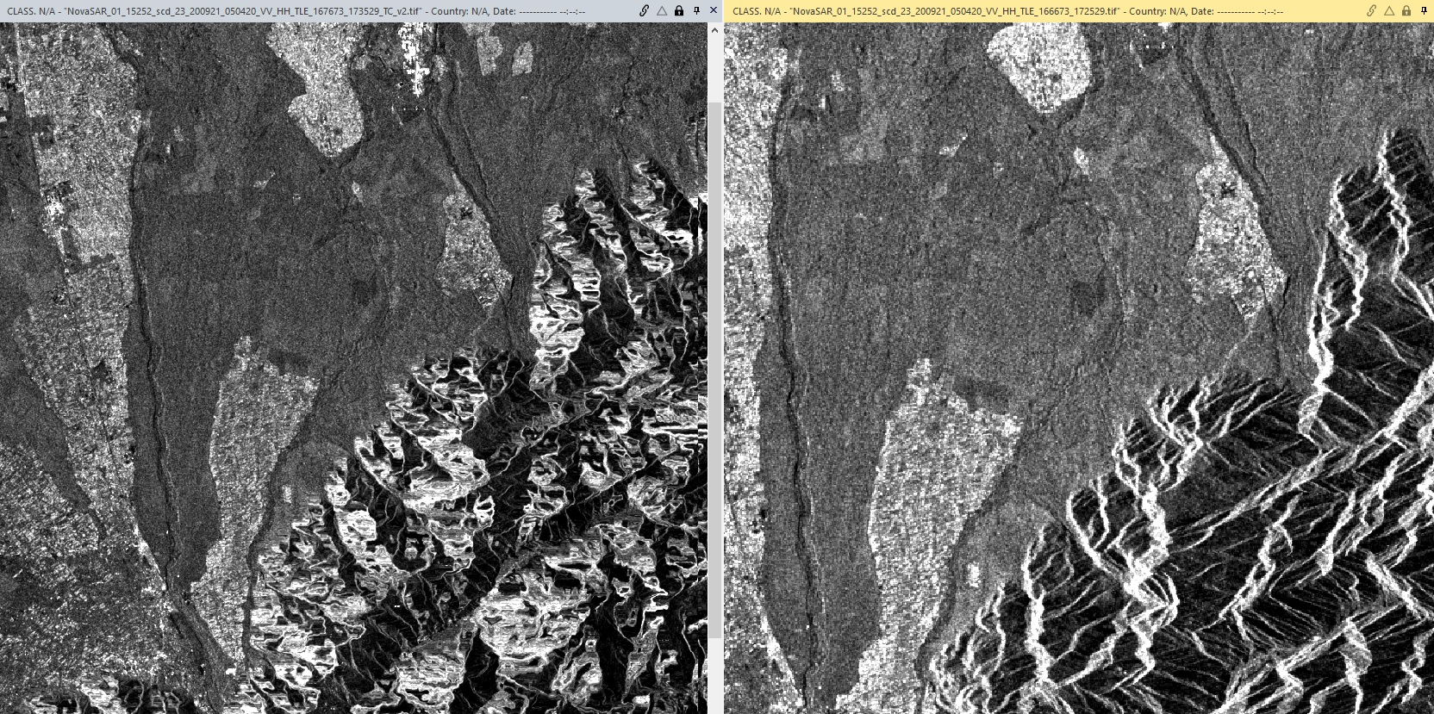
Improved Geocoding and Terrain Correction -NovaSAR
Producer’s Accuracy – Better than 20m for GPS based Orbit and better than 80 m(worst case ) for TLE based Orbit

Slide 15
Novasar -Data Analysis CEOS –ARD
Geometric Accuracy validation is carried out at regular intervals using corner reflectors (Point Targets ) deployed in IMGEOS Cal-Val site .
The implementation methodology for Geometric and Radiometric Corrections is being modified for improving the accuracies.

Slide 16
Novasar- Sigma Naught Backscatter

Slide 17
NovaSAR- Data Products
Software is developed for generation of Scene-based Data products based on the Imaging mode and archived as Level-1 Data .
Based on the User Requests, Level-2 Bundled Products are generated in an automated fashion in the IMGEOS data production chain.
Level-2 Bundle Product contains SAR Imagery Files , Backscatter Files for the respective polarizations along with Surface Water Layer Products.

Slide 18
CEOS –ARD -Compliance and Challenges
CEOS- ARD compliance :
The Realization of CEOS ARD products are to be implemented in the Automated IMGEOS Chain .
Additional Software Tools are also under development and validation for generating ARD as per User Requirements.
New software Plug-Ins are proposed and devised for the existing In-house Tool for generating CARD using Polarimetric and Interferometric Processing for the future SAR Missions
Challenges: With the provided Satellite Ephemeris and External DEM sources, Geometric and Radiometric Terrain Correction methodologies are implemented for the Sensor Specific SAR data formats.
The Process is revived and modified for obtaining better Geometric and Radiometric accuracies .(Threshold)
The resulting Normalised Radar Backscatter –NRB layers can be provided in the automated chain.
For PolSAR, the CARD4L PFS requirements have been developed and analyzed.

Slide 19
EOS-04 SAR
EOS04 : Launched In February 2022
The Data Processing is carried out at various levels :
Level-2 Standard Geo-referenced Products (With Per Pixel Meta Data) – Threshold re
Level-1 Single Look Complex and Ground Range Products
Level1C comprising Covariance Matrix and Stokes component layers
Level3A Comprising Polarimetric Decomposition Channels
NISAR :NASA-ISRO SAR is designed to provide Polarimetric, Interferometric Products which have to be Analysis Ready evaluated for the required quality metrics at various Levels of Processing.

Slide 20
Futuristic -Deep Learning ARD Creation for
SAR
In the recent times, several Deep Learning Models have been successfully implemented for SAR data. Analysis using Fully Convolutional Neural Networks.
Training of such neural networks also requires densely annotated training data which can serve as ARD for :
Image classification
Scene classification:
Semantic segmentation
Object detection
Registration/matching
Annotated ARD at different frequency bands can be realised for the specific study regions and for the corresponding Land-Use Land Cover / Applications scenario with appropriate product specifications.

Slide 21
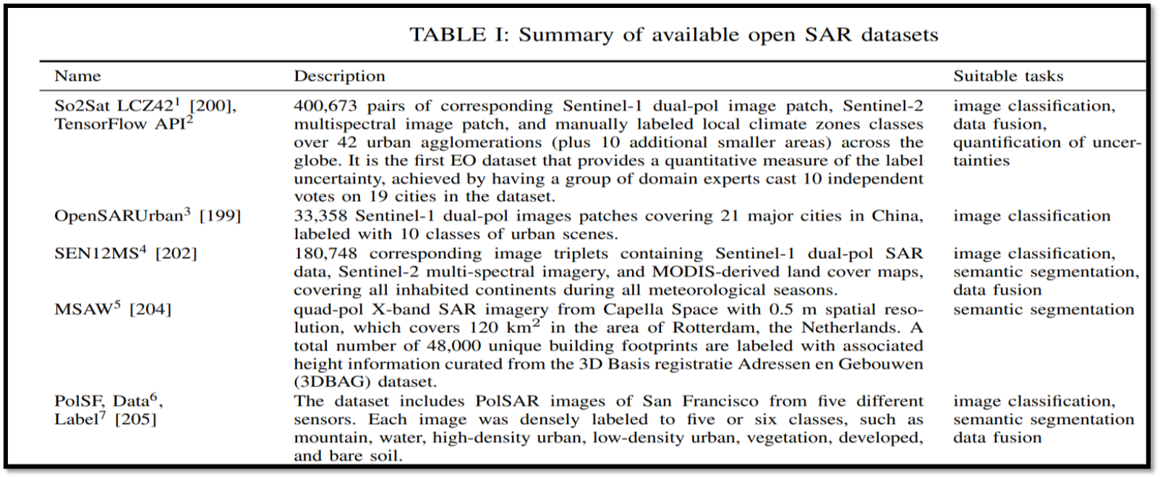
Open SAR datasets- For DL Implementation[8]

Slide 22
SAR Data Cube – Structured Time Series Stack
Design and Development of Time Series SAR Data Cube for enhancing SAR data utilization, visualization.
Design, development and implementation of co-registered and temporally arranged Data Cube for Level-1 and Level-2 data products using Dual, Hybrid and Full Polarimetric SAR .
Level-1 data cube shall comprise structured layers of corresponding Polarimetric parameters and relevant Hybrid and full polarimetric decomposition layers, as applicable.
The Level-2 Data Cube shall comprise structured layers of the Sigma Naught backscatter, Surface Water information, Textural Homogeneity, Entropy and Correlation layers.
Develop an insightful change detection/time series stack for SAR applications.

Slide 23
References
[1] https://ceos.org/ard/
[2] ISRO NovaSAR Ground Segment ICD- NV K V - #0324588
[3] Scene-based Level-1 and Level-2 Products Generation for NovaSAR-NRSC-DPA-MDPGSAR-DPD-Dec2020-TR-0001740-V1.0
[4] Concept of operations of NovaSAR in IMGEOS-Dec 2019.
[5] Synthetic Aperture Radar –Radiometric Calibration-David Small Erich Meler-Department of Geography-University of Zuich- www.geo.uzh.ch
[6]J.-C. Souyris, P. Imbo, R. Fjrtoft, S. Mingot, and J.-S. Lee, “Compact polarimetry based on symmetry properties of geophysical media:Then π/4 mode,” IEEE Trans. Geosci. Remote Sens., vol. 43, no. 3, pp. 634–646, Mar. 2005.
[7] M. Nord, T. Ainsworth, J.-S. Lee, and N. Stacy, “Comparison of compact polarimetric synthetic aperture radar modes,” IEEE Trans. Geosci. Remote Sens., vol. 47, no. 1, pp. 174–188
[8] Deep Learning Methods for Synthetic Aperture Radar Image Despeckling :An Overview of Trends and Perspectives-Giulia Fracastoro, Enrico Magli et al –arXiv:.05508v2(eess.IV) 2 may 2021
[9] Data Format and Product Specifications Document –RISAT-1/1A –Space Applications Centre SAC/ISRO

Slide 24

Thank You
Thank You

