Slide 1

ESA Update on
Land Surface Imaging and ARD
Ferran Gascon
as ESA representative at CEOS LSI-VC
CEOS LSI-VC#12
08 September 2022

Slide 2
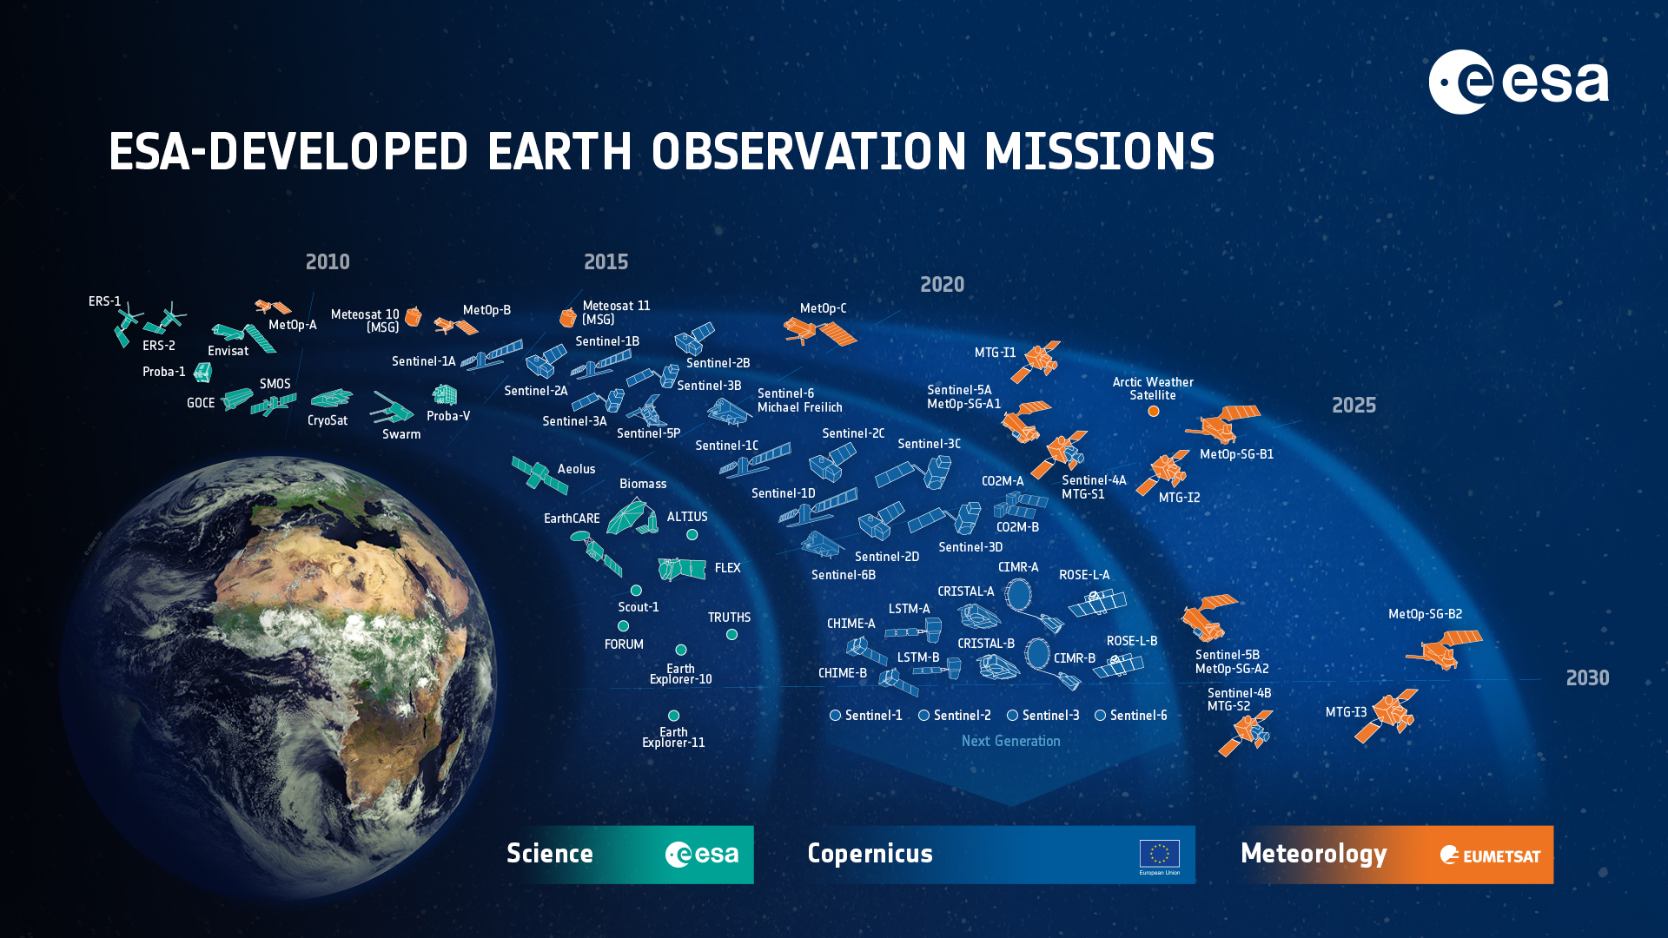





















ESA UNCLASSIFIED – For Official Use
European Space Agency
Notes:
D/EOP has three main lines of activities: Earth Science, Copernicus and Meteorology

Slide 3







Copernicus Sentinels Status
S-1
S-2
S-3
S-4
S-5P
S-5
S-6
Radar
High Res. Optical
Medium Res. Optical & Altimetry
Atmospheric Chemistry (GEO)
Atmospheric Chemistry (LEO)
Atmospheric Chemistry (LEO)
Altimetry
A
3 Apr 2014
A
23 Jun 2015
A
16 Feb 2016
A
>2024
A
13 Oct 2017
A
2023
A
21 Nov 2020
B
25 Apr 2016
B
6 Mar 2017
B
25 Apr 2018
B
2032
B
2030
B
2025
C
2023
C
>2024
C
>2025
C
> 2030
D
> 2025
D
> 2026
D
> 2027
Notes:
Green = launched
Blue = under development / to be developed

Slide 4

Sentinel-1A
fully operational
Catastrophic floods
in Pakistan
Heavy monsoon rainfall – ten times heavier than usual – since mid-June 2022, has led to a large part of the country being underwater
Flood map based on Sentinel-1A data acquired on 30 August 2022
https://www.esa.int/ESA_Multimedia/Images/2022/09/Pakistan_inundated
Copyright: Contains Copernicus Sentinel data (2022) / processed by ESA

Slide 5

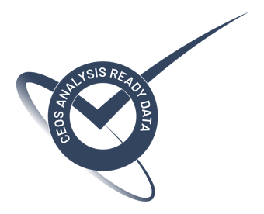
Main Recent Achievements
2021 August: Worldwide deployment of the geometry-refined production.
2021 December: Generation Level-2H and Level-2F pilot production over Belgium, for evaluation.
2022 January: Upgrade of Level-1C and Level-2A products (baseline for coming Collection 1).
2022 January: Level-2A product compliant to CEOS-ARD (Analysis Ready Data) specifications.
2022 January: Release of new Sen2Cor Level-2A stand-alone processor (version 2.10).
2022 June 06: Start of operations with new observation scenario (cf. HLOP 3.1).

Slide 6
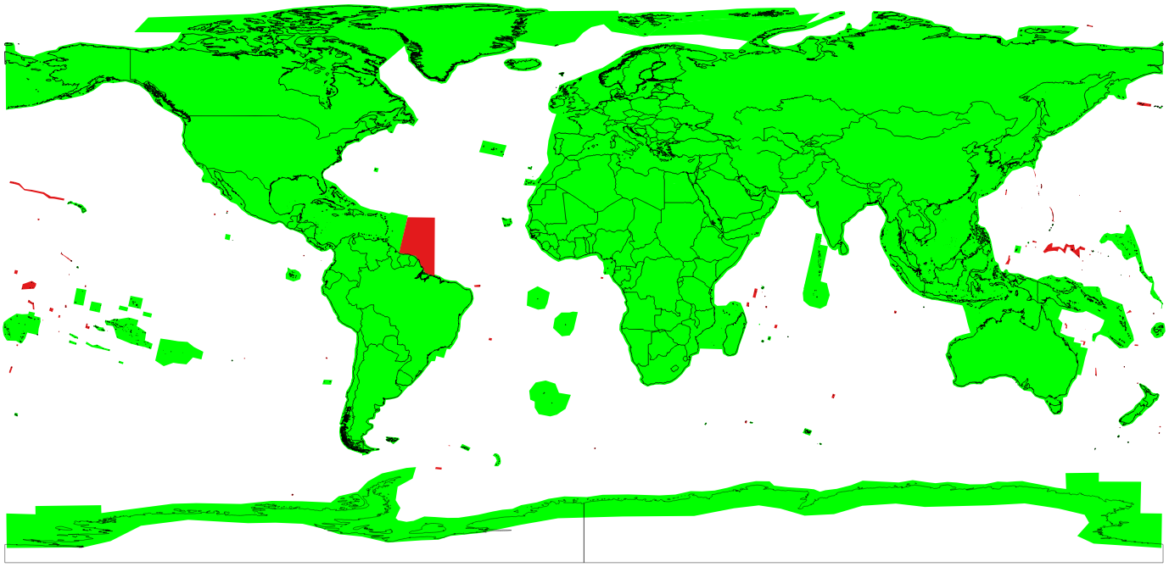
New Observation Scenario

Slide 7
Mission Outlook
Sentinel-2 archive reprocessing to generate Collection-1.
Distribution of Sentinel-2 GRI (Global Reference Image) as a free & open product.
Assessment of S2-Landsat harmonised and fused products pilot production over Belgium.
Development of new Aquatic Reflectance layer within Level-2A product.
Explore feasibility of using DGGS (Digital Global Grid System).
New product format evolutions (STAC metadata, Zarr, JSON metadata, etc.)
New data access service (for all Sentinels and CCMs).

Slide 8
Towards Sentinel-2 Collection 1
Collection 1 generated by reprocessing full S2 archive for both Level-1C and Level-2A products.
Reprocessing campaign started in Q2 2022, and data will be progressively published on DIAS platforms (CREODIAS, Mundi and ONDA) starting from Q4 2022 and completed by Q1 2023 (TBC).
Using latest processing baselines for Level-1C and Level-2A products.
Collection 1 will be CEOS-ARD compliant [http://ceos.org/ard].

Slide 9


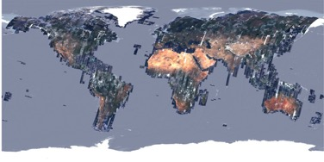
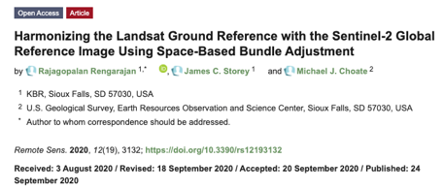
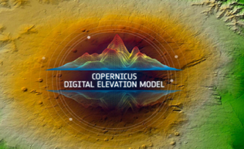
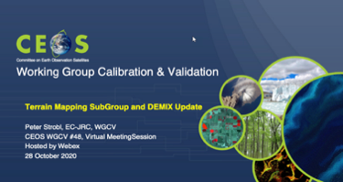
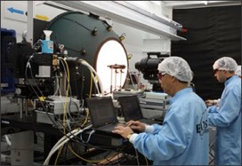
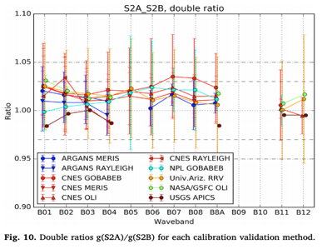
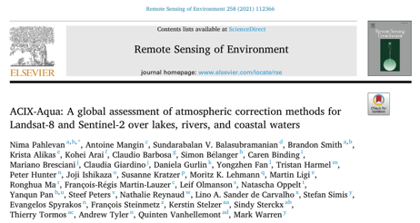
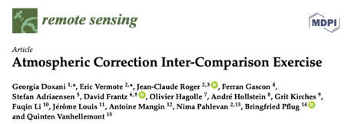
Interoperability with Landsat
Geometry :
  S2 GRI (Global Reference Image)
  Copernicus DEM (Digital Elevation Model)
  CEOS DEMIX (DEMs Intercomparison eXercise)
  DGGS (Discrete Global Grid System)
Level-1 Radiometry :
  Pre-flight sensor comparison using an integrating sphere
  S2 spectral responses close to Landsat-8/9
  Absolute radiometry inter-comparison
Level-2A Radiometry and Cloud Mask:
  CEOS ACIX (Atmospheric Correction Intercomparison eXercise)
  CEOS CMIX (Cloud Mask Intercomparison eXercise)
  CARD4L [ http://ceos.org/ard ]
Level-2H and Level-2F
  Sen2Like

Slide 10
Status of ESA CEOS-ARD Products
Mission | Product | PFS | Status | Availability Date
Sentinel-2 | L2A | SR | ✅ | January 2022
PROBA-V | Collection 2 | SR | Under Review | Q4 2022
Sentinel-2 | L2H | SR | Under Development | TBD
Sentinel-2 | L2F | SR | Under Development | TBD
Sentinel-1 | NRB | NRB | Under Development | TBD
ERS SAR | TBC | NRB | Under Definition/Development | 2023
ERS ATSR | TBC | LST | Under Definition/Development | 2023
Envisat ASAR | TBC | NRB | Under Definition/Development | 2023
Envisat MERIS | TBC | SR | Under Definition/Development | 2023
CHIME | L2A | SR | Under Development | 2028
CHIME | L2H/L2F | SR | Under Development | TBD
LSTM | L2A | ST, SR | Under Development | 2028
LSTM | L2H/L2F | ST, SR | Under Development | TBD
ROSE-L | TBD | NRB…TBC | Under Development | TBD
Sentinel-2 | L2A | AR | Under Definition/Development | TBD

Slide 11
VH-RODA 2022 Workshop
https://earth.esa.int/eogateway/events/vh-roda

Slide 12
Notes:
Columbia Glacier in Alaska
Sentinel-2 image acquired in August 2019. On top of the image we have annotated historical glacier calving front lines from 1986 using data from Landsat and Sentinel-2.
Main result : The glacier has been retreating of about 20 km in 33 years (1986-2019)

